Slide 1
Demonstration for Homework Problems

Slide 2
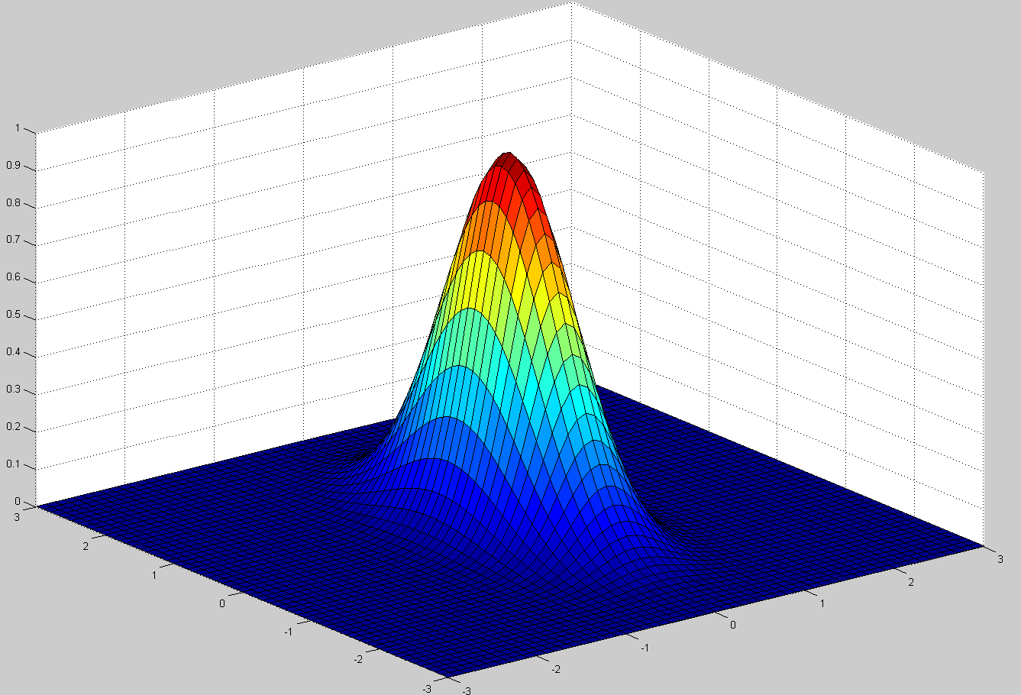
Problem 2.21 a
h(x,y)
clear all
x=-3:0.1:3;
y=-3:0.1:3;
l=length(y);
for i=1:l
h(i,:)=exp(-pi*(x.^2+ (y(i).^2)/4));
end
surf(x,y,h)
y
x

Slide 3
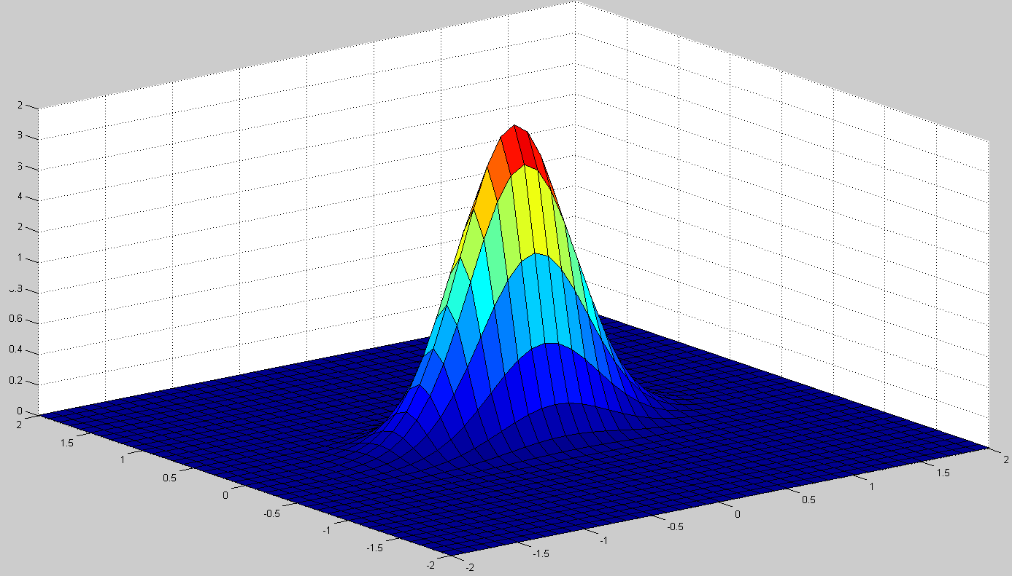
Problem 2.21 b
H(u,v)
clear all
u = -2:0.1:2;
v = -2:0.1:2;
l=length(v);
for i=1:l
H(i,:)=2*exp(-pi*(u.^2+(4*(v(i).^2))));
end
surf(u,v,H)
v
u

Slide 4
Problem 2.22
l(x)
f(x)
$$w=\frac{π}{α}$$
f(x)
$$w=\frac{π}{2α}$$
$$\frac{−w}{2}$$
$$\frac{w}{2}$$
x
x
x
$$\frac{−π}{2α}$$
$$\frac{π}{2α}$$
$$\frac{−π}{2α}$$
$$\frac{π}{2α}$$
$$\frac{3π}{2α}$$
$$\frac{−π}{4α}$$
$$\frac{π}{4α}$$
$$\frac{−w}{2}$$
$$\frac{w}{2}$$
$$\frac{3w}{2}$$
$$g\left(x\right)=f\left(x\right)∗l\left(x\right)= \int_{−∞}^{∞}{f\left(x−ξ\right)l\left(ξ\right)dξ}$$
f(-ξ)
f(w-ξ)
$$\frac{π}{2α}$$
$$\frac{π}{2α}$$
ξ
$$\frac{−π}{2α}$$
$$\frac{π}{2α}$$
ξ
$$\frac{−3w}{2}$$
$$\frac{−w}{2}$$
$$\frac{w}{2}$$
$$w$$
$$\frac{3w}{2}$$
$$w$$
$$\frac{3w}{2}$$
$$\frac{−w}{2}$$
$$\frac{w}{2}$$

Slide 5
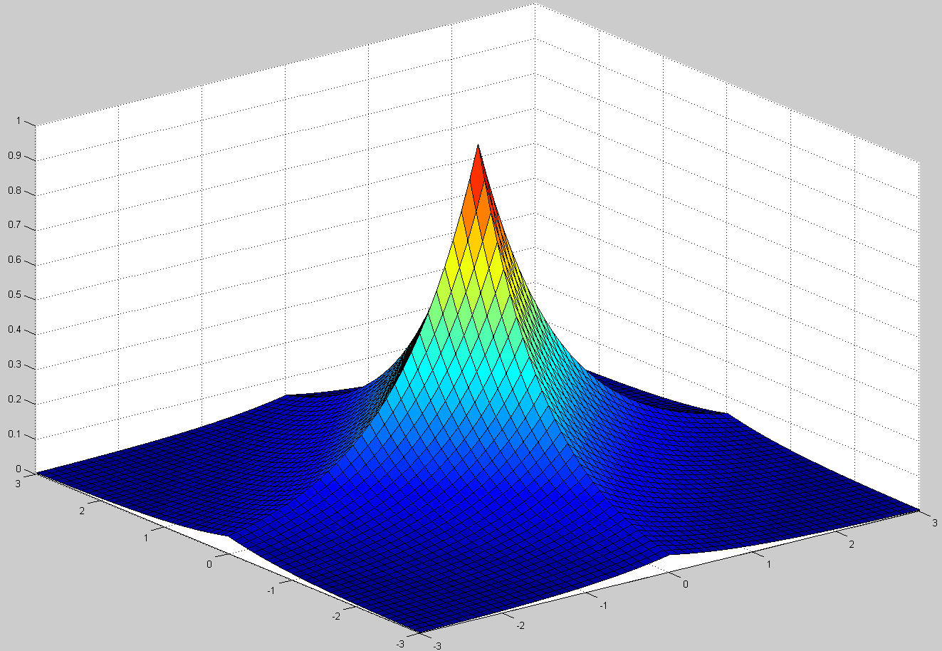
Problem 2.23b
$$h\left(x,y\right)=e^{−\left(\left|x\right|+|y|\right)}$$
clear all
x=-3:0.1:3;
y=-3:0.1:3;
l=length(y);
for i=1:l
h(i,:)=exp(-(abs(x) + abs(y(i))));
end
surf(x,y,h)
$$h\left(x,y\right)$$
y
x

Slide 6
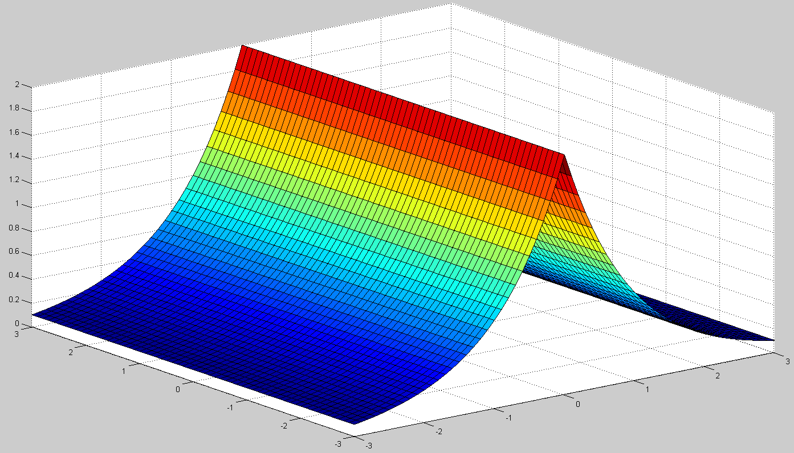
Problem 2.23c
$$h\left(x,y\right)=e^{−\left(\left|x\right|+|y|\right)}$$
$$f\left(x,y\right)=δ(x)$$
$$g\left(x,y\right)$$
clear all
x=-3:0.1:3;
y=-3:0.1:3;
l=length(y);
for i=1:l
h(i,:)= 2*exp(-abs(x)) ;
end
surf(x,y,h)
$$f\left(x,y\right)$$
y
x

Slide 7
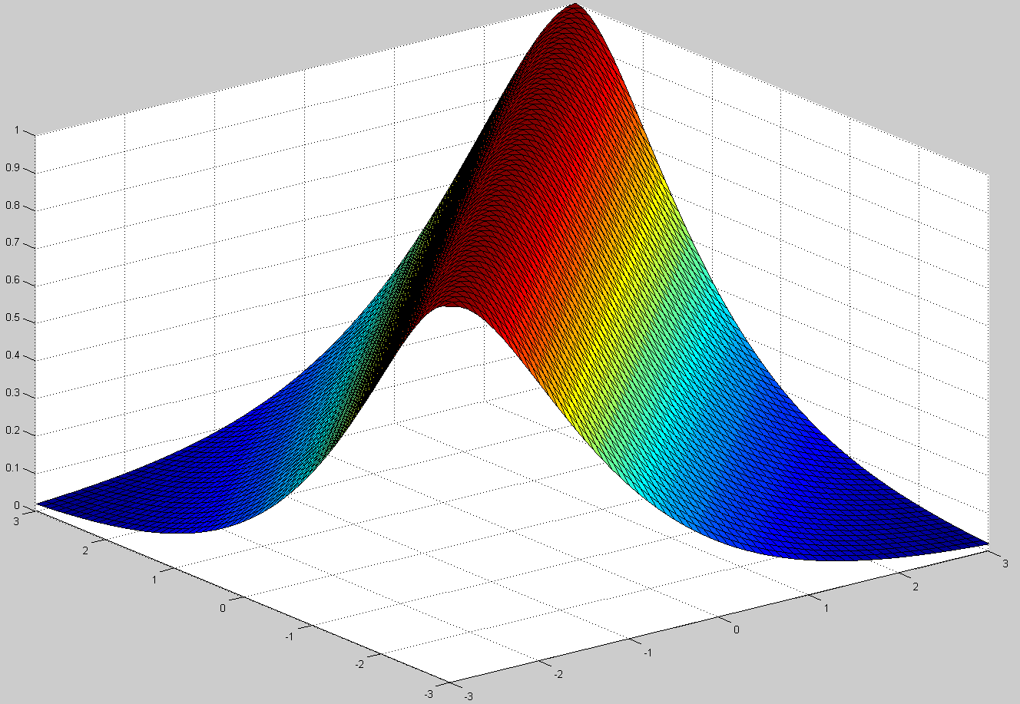
Problem 2.23d
$$h\left(x,y\right)=e^{−\left(\left|x\right|+|y|\right)}$$
$$f\left(x,y\right)=δ(x−y)$$
clear all
x=-3:0.1:3;
y=-3:0.1:3;
l=length(y);
for i=1:l
h(i,:)=(1+ abs(x-y(i))).*exp(-(abs(x-y(i)))) ;
end
surf(x,y,h)
$$g\left(x,y\right)$$
$$f\left(x,y\right)$$
y
x

