Slide 1
Physics of Magnetic Resonance
Chapter 12
Biomedical Engineering
Dr. Mohamed Bingabr
University of Central Oklahoma

Slide 2
Outline
Introduction
Microscopic Magnetization
Macroscopic Magnetization
Precession and Larmor Frequency
Transverse and Longitudinal Magnetization
RF Excitation
Relaxation
The Bloch Equation
Spin Echoes
Basic Contrast Mechanisms

Slide 3
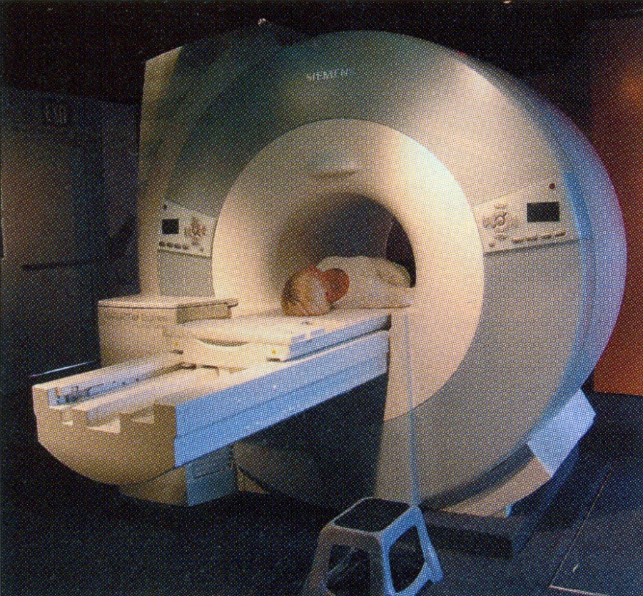
Magnetic Resonance Imaging
  A projection of the three-dimensional volume of the body onto a two-dimensional imaging surface.
  MRI is the imaging of hydrogen density in tissues.
  Advantage:
  1- High image quality
  2- risk-free imaging
  Disadvantage: high cost
  Uses: Assess Neurological effects of stroke, trauma or disease. Orthopedic scans for injuries and degeneration involving knees, shoulders, feet and ankles.

Slide 4
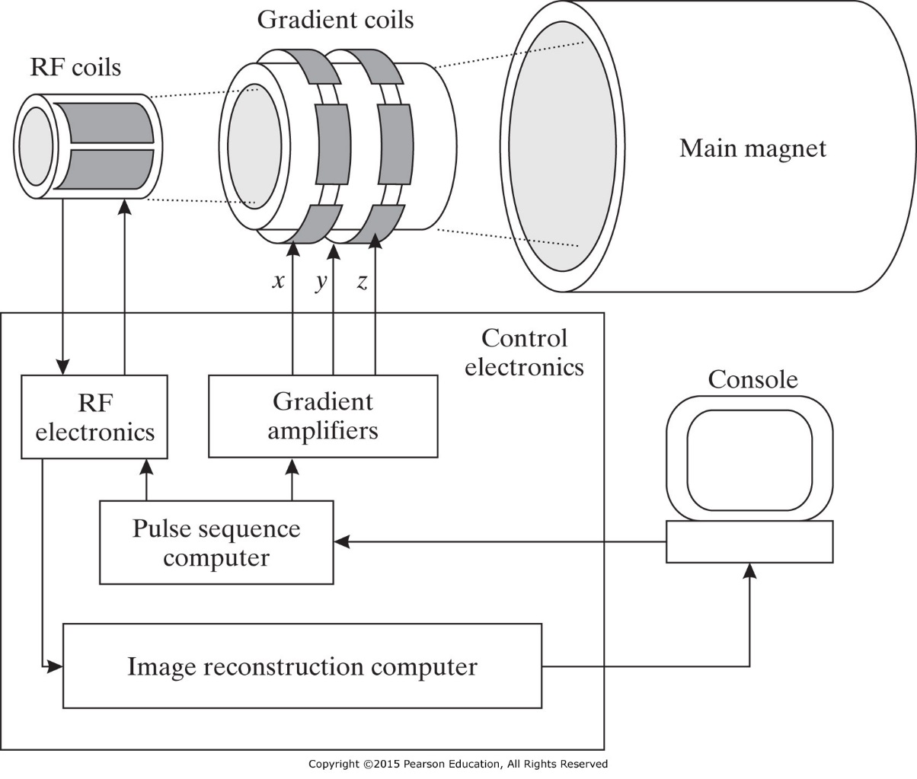
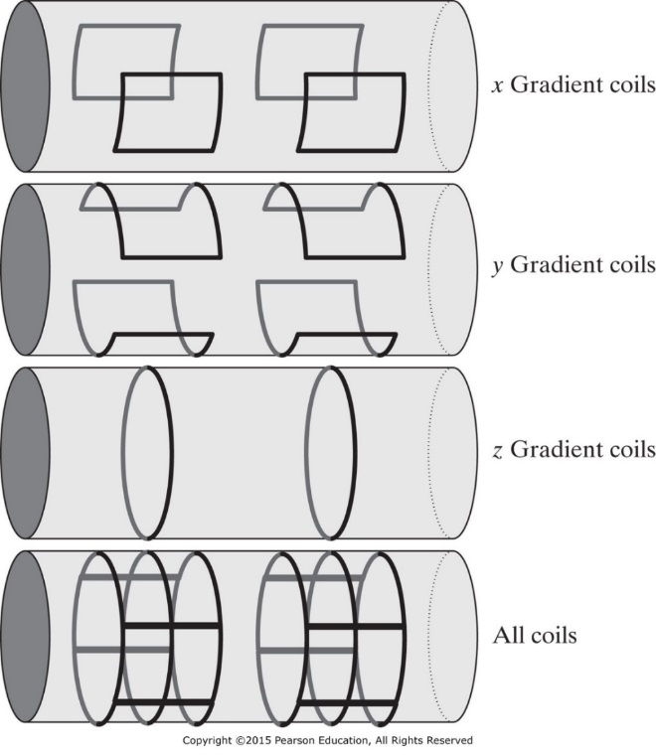
Magnetic Resonance Imaging
  Magnetic Field Strength
  Earth: 25 to 65 microTesla
  External Magnetic field B₀ = 0.5 to 7 Tesla
  Gradient Magnetic Coil = 10-60 mT/meter
  1 Tesla = 10,000 Gauss
y
x
z

Slide 5
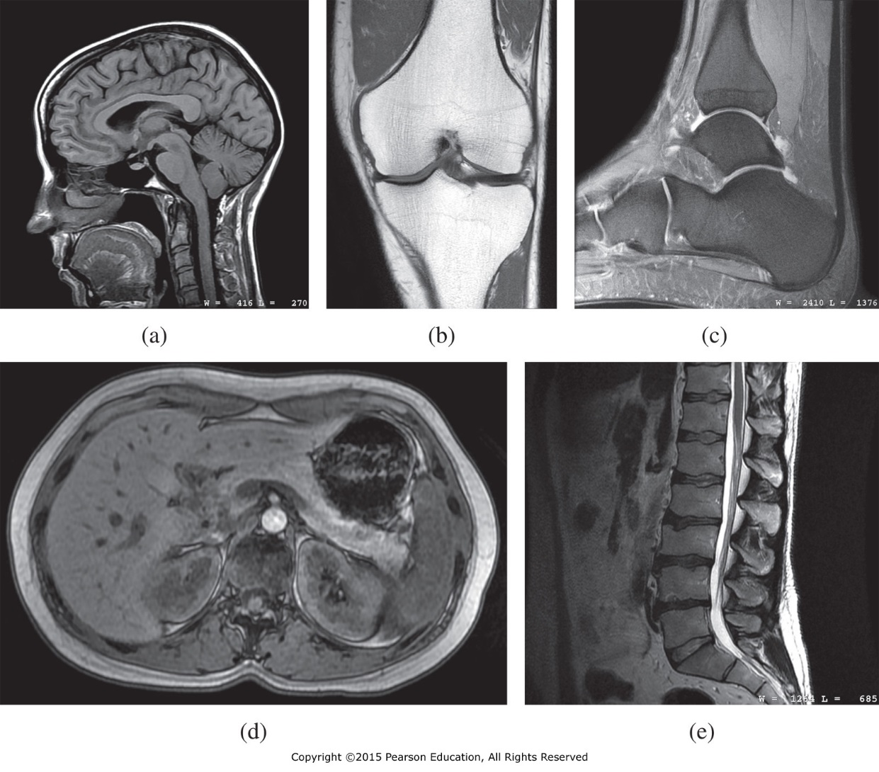
Microscopic Magnetization
MR images of (a) the head showing the brain, spinal column, tongue, and vocal tract; (b) the knee; (c) the ankle; (d) the liver; and (e) the lumbar spine.

Slide 6
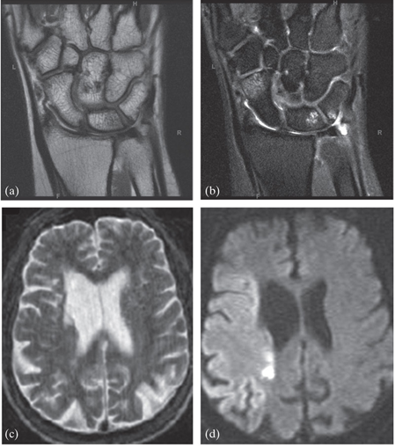
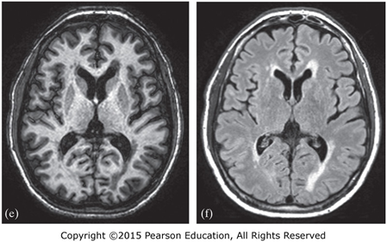
Microscopic Magnetization
a) and (b) show two images of a wrist fracture. (c) and (d) show two images of a stroke. (e) and (f) show two MR images of a multiple sclerosis patient.

Slide 7
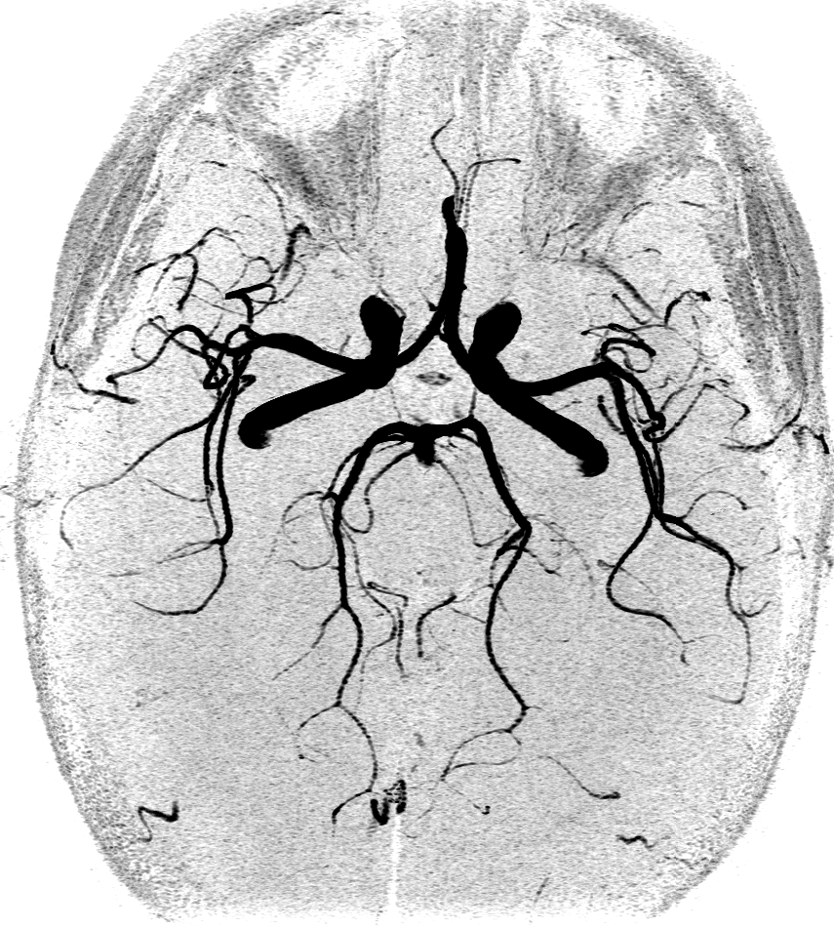
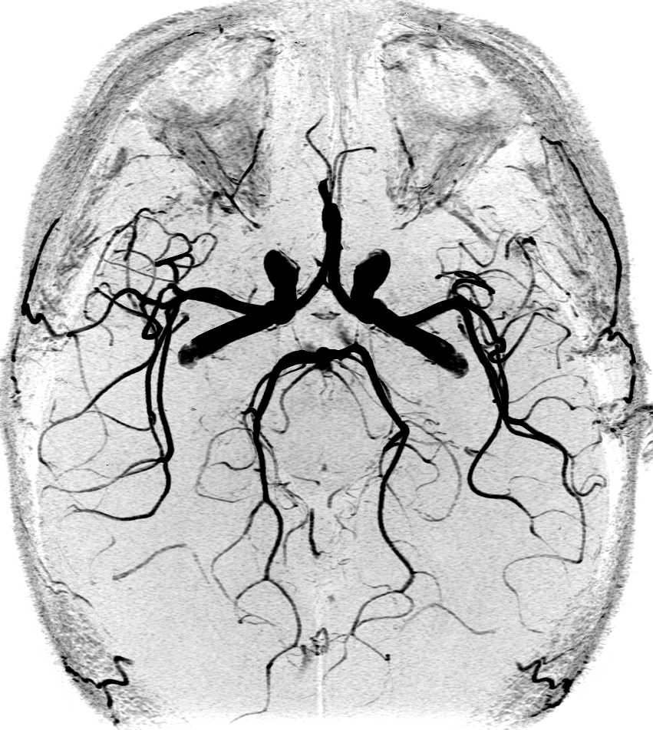
1.5 T vs. 3.0 T (3D MR Angiography)
1.5 T
3.0 T

Slide 8
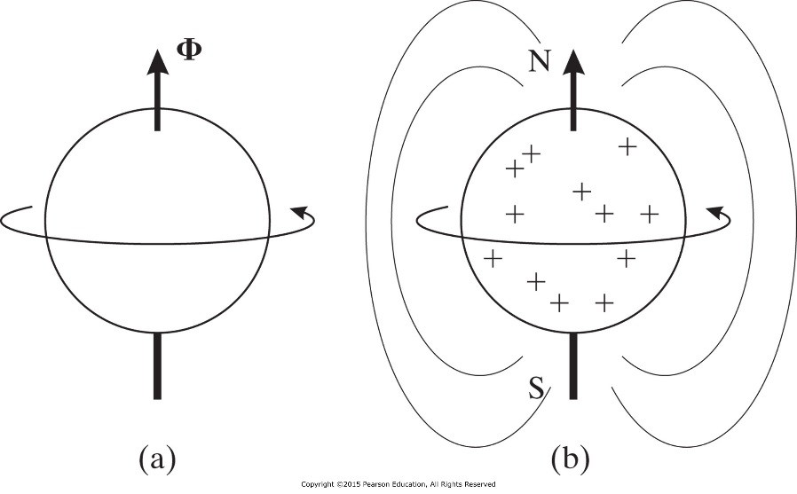
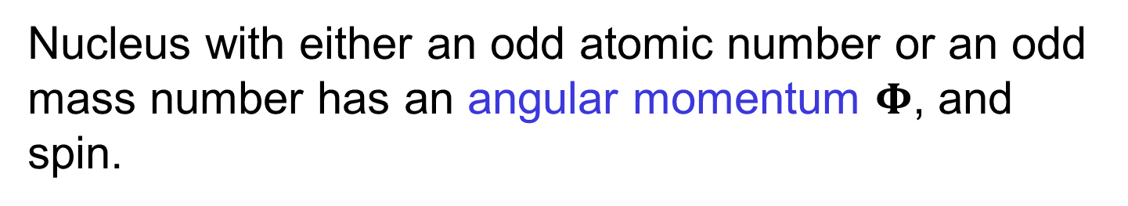


Microscopic Magnetization
Nucleus with either an odd atomic number or an odd mass number has an angular momentum $Φ$, and spin.
Microscopic magnetic field has a magnetic moment vector μ.
$$μ=γΦ$$
$γ$: gyromagnetic ratio with unit radian per second per tesla
$$γ=γ/2π$$
Hz/Tesla

Slide 9
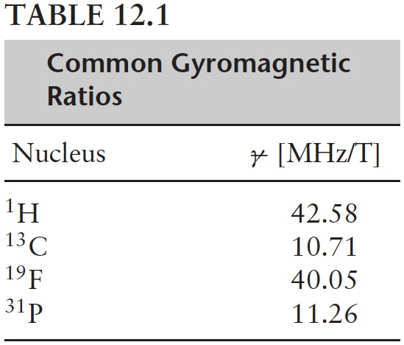
Microscopic Magnetization
No net magnetization in the absence of external magnetic source.

Slide 10
Nuclear Magnetization
Spin quantum number ½ system
Magnetic
Field (B₀)
54º
126º
Positive
Orientation
(Lower Energy)
Negative
Orientation
(Higher energy)

Slide 11
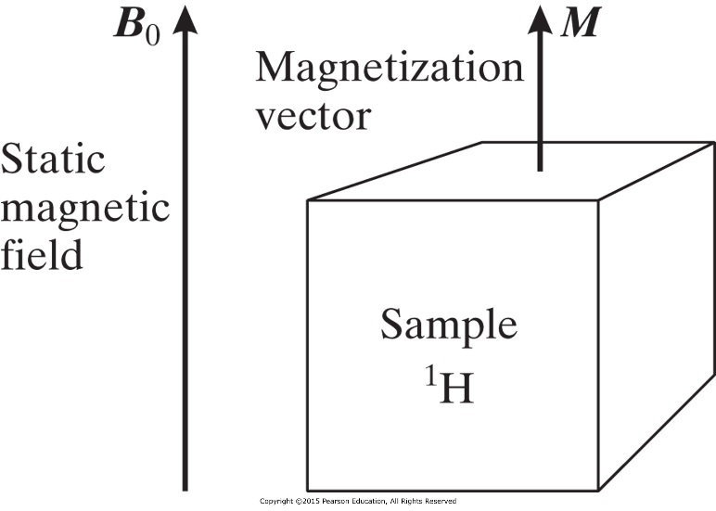
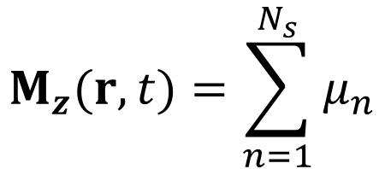

Macroscopic Magnetization
Net Magnetization
B₀
M
$$M_{z}(r,t)=\sum_{n=1}^{N_{s}}{μ_{n}}$$
$$M_{xy}(r,t)=0$$
r = (x, y, z)

Slide 12
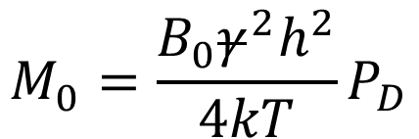
Macroscopic Magnetization
After a while M(r, t) will reach its equilibrium value M₀
$$M_{0}=\frac{B_{0}γ^{2}h^{2}}{4kT}P_{D}$$
P_{D} = proton density per unit volume
T: temperature from absolute value
h: Planck’s constant
k: Boltzmann’s constnt
Why can't we measure the Magnetic field M ?

Slide 13
MR Imaging
The value of an MR image at a given tissue voxel is determined by:
1- Tissue Property
a) Relaxation parameters T₁ and T₂
b) Proton density
2- Scanner imaging protocol to manipulate vector M
a) Pulse sequence
b) Magnetic gradient

Slide 14
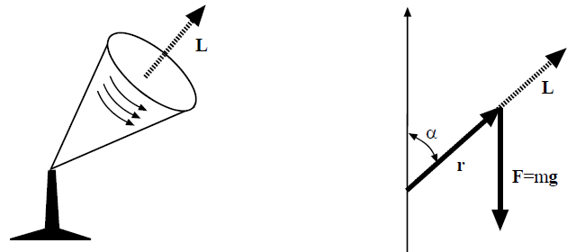
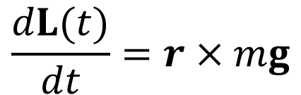
Motion of Gyroscope
Equation that describes the motion of a gyroscope is
where L(t) is the gyroscope’s angular momentum, r the radius from the fixed point of rotation, m the mass, and g earth gravity.
$$\frac{dL(t)}{dt}=r×mg$$

Slide 15
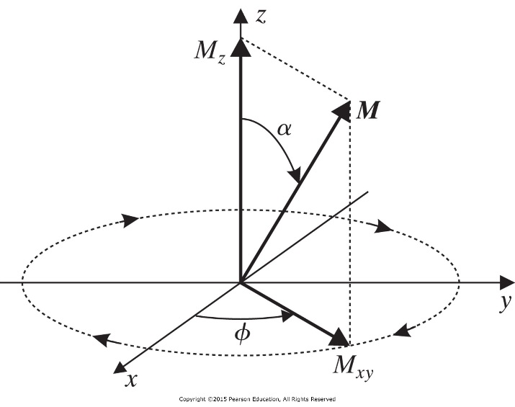

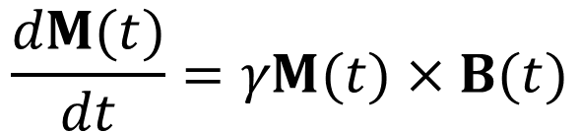
Precession and Larmor Frequency
M(t) is a magnetic moment and it experiences a torque at the presence of a time-varying magnetic field B(t).
$$\frac{dM(t)}{dt}=γM(t)×B(t)$$
If B(t) is a static magnetic field equal B₀ at the z direction and the initial magnetization M(0) equal M₀ and oriented at an angle α relative to the z axis then the solution is:
$$M_{z}\left(t\right)=M_{0} cos α$$
$$M_{x}\left(t\right)=M_{0} sin α cos \left(−γB_{0}t+φ\right)$$
$$M_{y}\left(t\right)=M_{0} sin α sin \left(−γB_{0}t+φ\right)$$

Slide 16



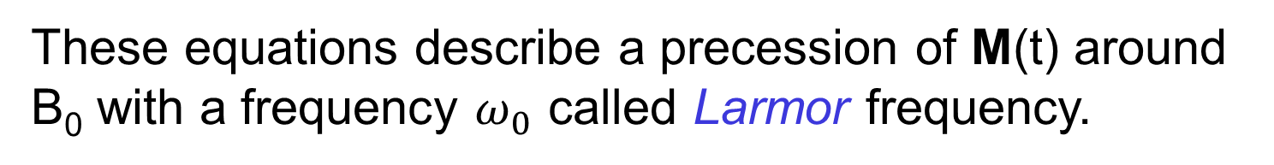

Precession and Larmor Frequency
$$M_{z}\left(t\right)=M_{0} cos α$$
$$M_{x}\left(t\right)=M_{0} sin α cos \left(−γB_{0}t+φ\right)$$
$$M_{y}\left(t\right)=M_{0} sin α sin \left(−γB_{0}t+φ\right)$$
These equations describe a precession of M(t) around B₀ with a frequency $ω_{0}$ called Larmor frequency.
$$ω_{0}=γB_{0}$$
$$v_{0}=γB_{0}$$
$$M_{x}\left(t\right)=M_{0} sin α cos \left(−2πv_{0}t+φ\right)$$
$$M_{y}\left(t\right)=M_{0} sin α sin \left(−2πv_{0}t+φ\right)$$
$$M_{z}\left(t\right)=M_{0} cos α$$

Slide 17
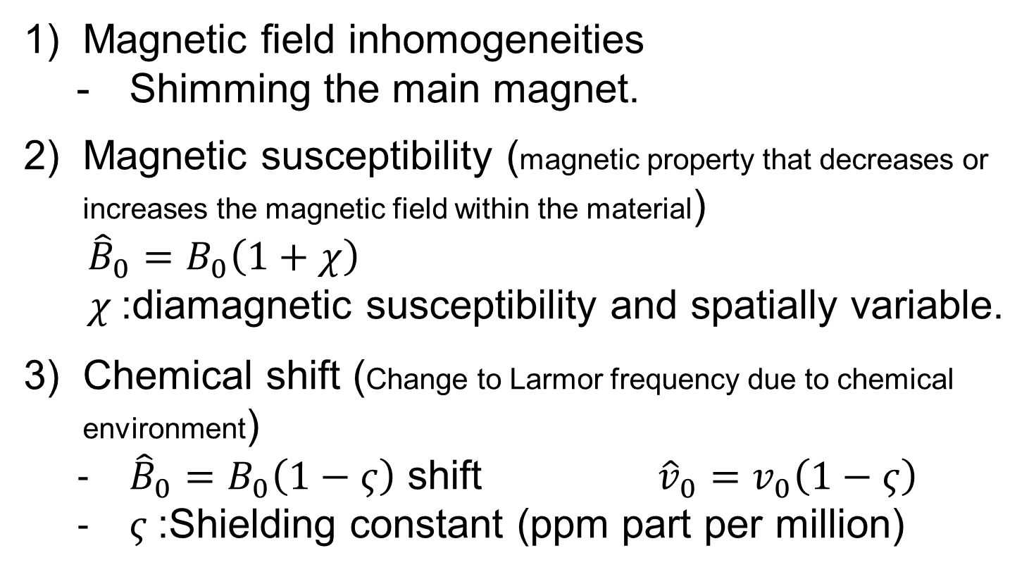

Is Larmor Frequency Constant?
$$ω_{0}=γB_{0}$$
Three sources for B₀ fluctuation:
Magnetic field inhomogeneities
  Shimming the main magnet.
Magnetic susceptibility (magnetic property that decreases or increases the magnetic field within the material)
  ${\hat{B}}_{0}=B_{0}\left(1+χ\right)$
  $χ$:diamagnetic susceptibility and spatially variable.
Chemical shift (Change to Larmor frequency due to chemical environment)
  ${\hat{B}}_{0}=B_{0}\left(1−ς\right)$ shift ${\hat{v}}_{0}=v_{0}\left(1−ς\right)$
  $ς$:Shielding constant (ppm part per million)

Slide 18



Longitudinal and Transverse Magnetization
Longitudinal Magnetization
$$M_{z}\left(t\right)=M_{0} cos α$$
Transverse Magnetization
$$M_{x}\left(t\right)=M_{0} sin α cos \left(−γB_{0}t+φ\right)$$
$$M_{y}\left(t\right)=M_{0} sin α sin \left(−γB_{0}t+φ\right)$$
$$M_{xy}\left(t\right)=M_{x}\left(t\right)+{j M}_{y}\left(t\right)$$
$$M_{xy}\left(t\right)=M_{0} sin α e^{−j\left(γB_{0}t−φ\right)}$$
M_{xy}(t) is the signal measured to form the MRI images

Slide 19
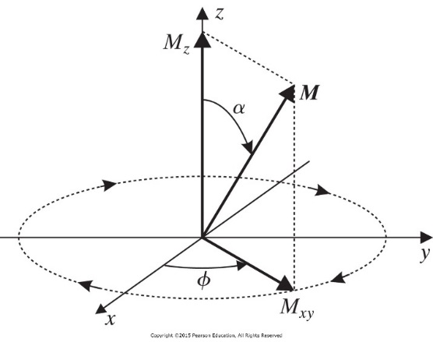
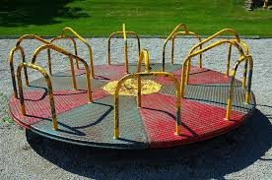





Rotating Frame
A reference frame (rotating frame) is a frame that rotates at the Larmor frequency v_{o}.
$$x^{′}=x cos \left(2πv_{0}t\right)−y sin \left(2πv_{0}t\right)$$
$$y^{′}=x sin \left(2πv_{0}t\right)+y cos \left(2πv_{0}t\right)$$
$$z^{′}=z$$
Merry Go Rounds
Viewing the transverse and longitudinal magnetization signals from the rotating frame.
$$M_{x^{′}y^{′}}\left(t\right)=M_{0} sin α e^{jφ}$$
$$M_{x^{′}}\left(t\right)=M_{0} sin α\cos{φ}$$
$$M_{z^{′}}\left(t\right)=M_{0} cos α$$
$$M_{y^{′}}\left(t\right)=M_{0} sin α\sin{φ}$$

Slide 20
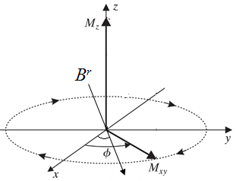



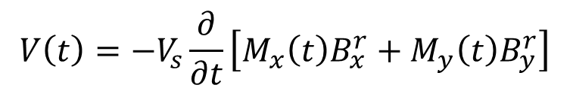
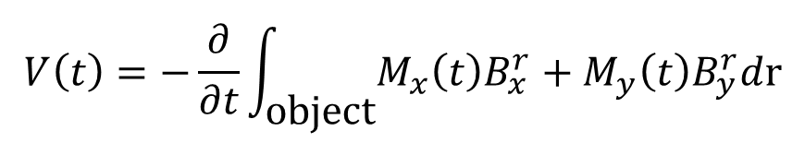
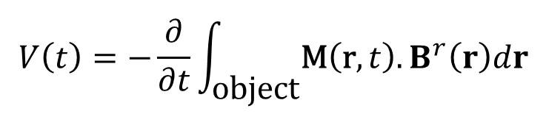
NMR Signals
A coil placed next to the area need to image will experience magnetic field radiated from the subject. This magnetic field will induce electric voltage in the coil proportional to the transverse magnetic field (Faraday’s Law).
$$Φ_{B}=\int{\vec{B}∙d\vec{A}}$$
$$V\left(t\right)=−\frac{∂}{∂t}\int_{\text{o}\text{bject}}{\text{M}\left(\text{r},t\right).B^{r}\left(r\right)dr}$$
$$v(t)=−\frac{dΦ_{B}}{dt}$$
B^{r} is the magnetic field produced by the transmitter (coil) to control the magnetization vector M. Assume object is homogeneous and coil produce uniform field B^{r}. M_{z} change slowly so dM_{z}/dt is zero.
$$V\left(t\right)=−\frac{∂}{∂t}\int_{\text{o}\text{bject}}{M_{x}\left(t\right)B_{x}^{r}}+M_{y}\left(t\right)B_{y}^{r}d\text{r}$$
$$V\left(t\right)=−V_{s}\frac{∂}{∂t}\left[M_{x}\left(t\right)B_{x}^{r}+M_{y}\left(t\right)B_{y}^{r}\right]$$
V_{s} is the volume of the sample
$$θ$$

Slide 21



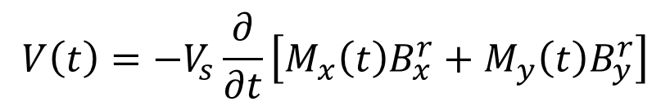

NMR Signals
$$V\left(t\right)=−V_{s}\frac{∂}{∂t}\left[M_{x}\left(t\right)B_{x}^{r}+M_{y}\left(t\right)B_{y}^{r}\right]$$
Remember
$$M_{x}\left(t\right)=M_{0} sin α cos \left(−2πv_{0}t+φ\right)$$
$$M_{y}\left(t\right)=M_{0} sin α sin \left(−2πv_{0}t+φ\right)$$
$$θ$$
The x-y components of the magnetic field B^{r} are
$$V\left(t\right)=−2πv_{0}V_{s}M_{0}\text{sin}α\left[B_{x}^{r}\text{sin}\left(−2πv_{0}t+φ\right)−B_{y}^{r}\text{cos}\left(−2πv_{0}t+φ\right)\right]$$
$$B_{x}^{r}=B^{r}\text{cos}θ_{r}$$
$$B_{y}^{r}=B^{r}\text{sin}θ_{r}$$
$$V\left(t\right)=−2πv_{0}V_{s}M_{0}\text{sin}αB^{r}\text{sin}\left(−2πv_{0}t+φ−θ_{r}\right)$$
The frequency v₀ of V(t) will determine the location of the voxel in the body from which the NMR is radiating, and the magnitude will determine the density of the H atoms in the voxel.

Slide 22
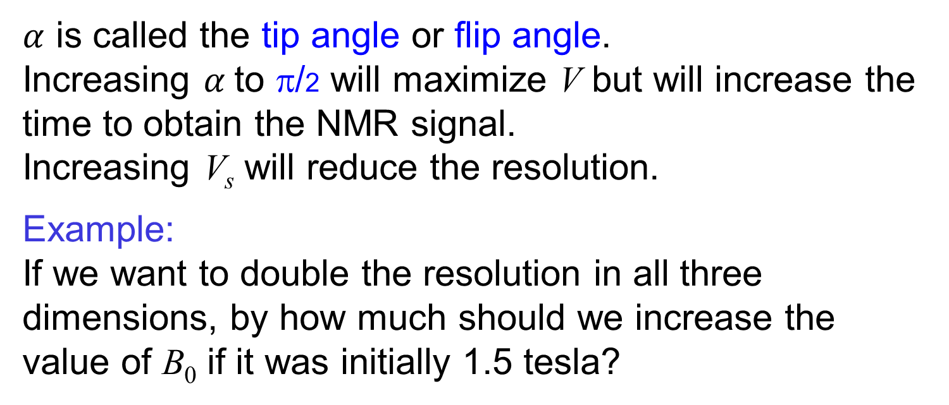

Maximizing the Magnitude of NMR Signals
The goal is to maximize the magnitude of the NMR signal:
$$\left|V\left(t\right)\right|=2πv_{0}V_{s}M_{0}B^{r}sinα$$
$α$ is called the tip angle or flip angle.
Increasing $α$to π/2 will maximize V but will increase the time to obtain the NMR signal.
Increasing V_{s} will reduce the resolution.
Example:
If we want to double the resolution in all three dimensions, by how much should we increase the value of B₀ if it was initially 1.5 tesla?

Slide 23
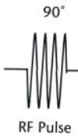
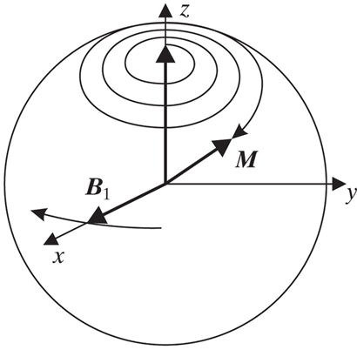
RF Excitation
When the magnetization vector M is aligned with the strong external vector B₀ it is very hard to detect M by the RF antenna. RF excitation is the tool to push M vector away from the B₀ in order to detect M.
RF excitation is established by a pulse of alternating current running through an antenna (coil) surrounding the sample.
The antenna will radiate circularly polarized magnetic field B₁(t) with Larmor frequency using quadrature RF coils.
When the frequencies of B₁(t) and M(t) are the same then M(t) will be pushed away from the external magnetic field B₀ by tip angle α.
The value of α depends proportionally on the strength of the pulse and the time duration.

Slide 24
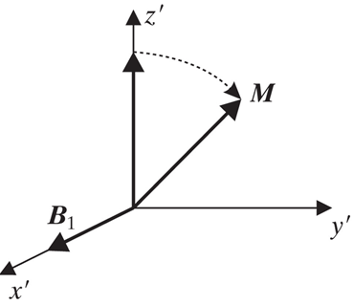


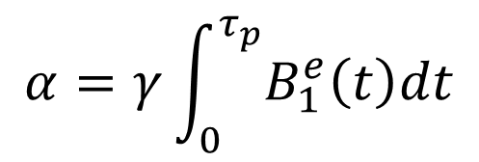
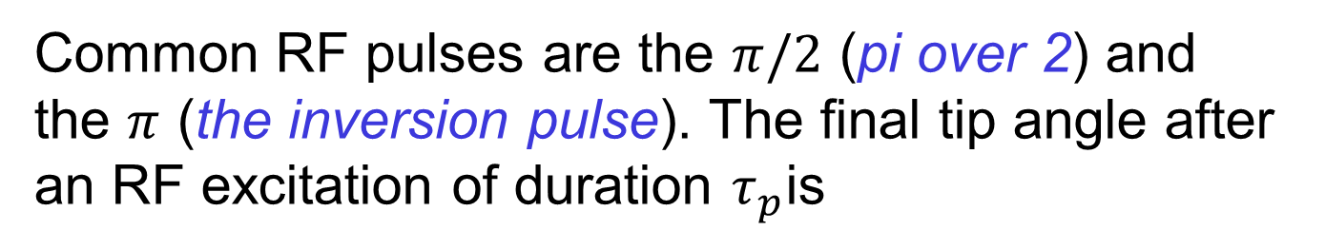
RF Excitation
The circularly RF excitation pulse B₁(t)
$$B_{1}\left(t\right)=B_{1}^{e}(t)e^{−j\left(2πv_{0}t−φ\right)}$$
$B_{1}^{e}(t)$ is the envelop of B₁(t) and $φ$ is the initial phase
Common RF pulses are the $π/2$ (pi over 2) and the $π$ (the inversion pulse). The final tip angle after an RF excitation of duration $τ_{p}$is
$$α=γ\int_{0}^{τ_{p}}{B_{1}^{e}\left(t\right)dt}$$
For rectangular pulse $α=γB_{1}τ_{p}$
Rotational plane

Slide 25

RF Excitation
Example
We apply an RF pulse to a sample of protons. The sample is in equilibrium with the B₀ field in the +Z direction. We need to tip the magnetization vector M into the x-y plane in 3 ms. What should the strength of RF excitation be?
$$α=γB_{1}τ_{p}$$

Slide 26
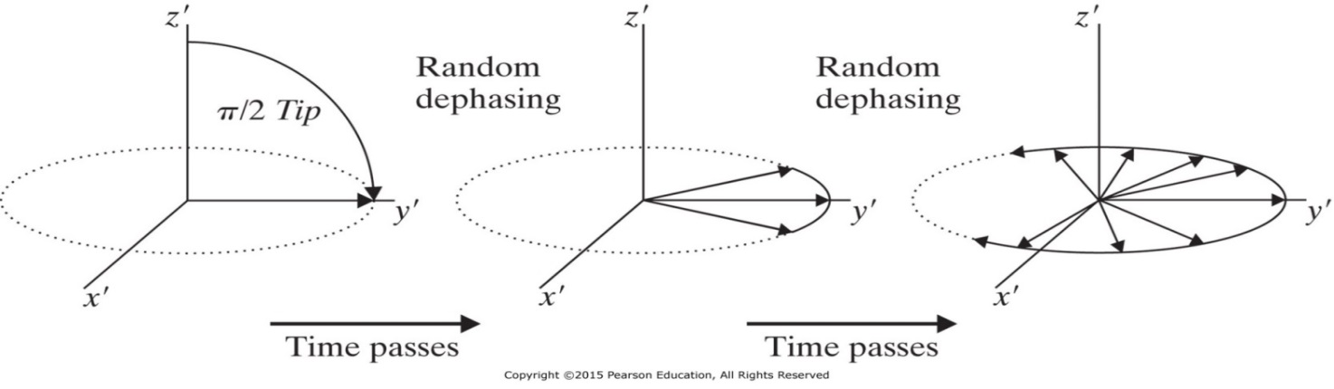
Relaxation after α Pulse Excitation
At the end of the α pulse, M will precess in response to the presence of the main magnetic field B₀. The received signal M_{xy}(t) will slowly decay due to transverse and longitudinal relaxations mechanisms.
Time Pass
Time Pass
Time Pass
M
M
M_{z}
M₀
M_{z}
M
M_{z}
M_{z}
M_{xy}
M_{xy}
M_{xy}
M_{xy}
Longitudinal relaxation
Transvers relaxation

Slide 27
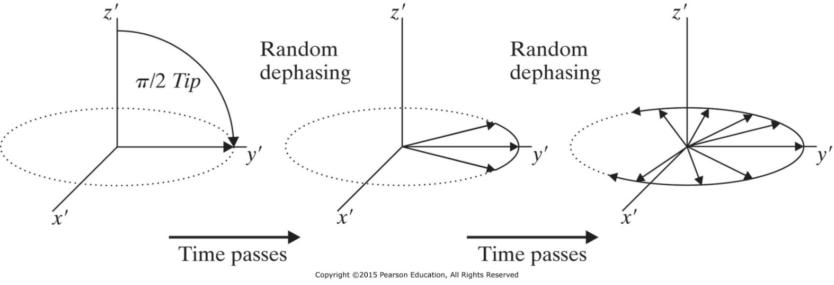
Transverse (Spin-Spin) Relaxation
Transverse Relaxation (spin-spin relaxation)
Perturbations in the magnetic field due to other spins that are nearby causes some protons to momentarily speed up or slow down, changing their phase. As a result M_{xy} exponentially decay to zero.

Slide 28
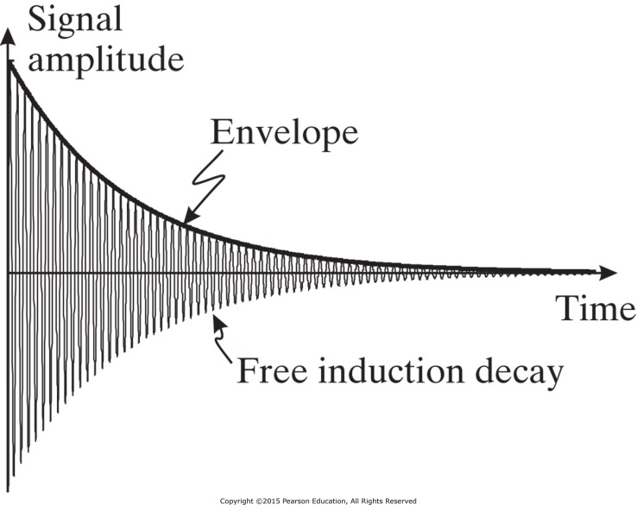
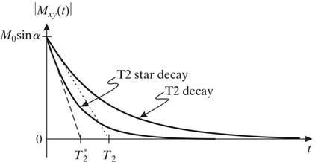
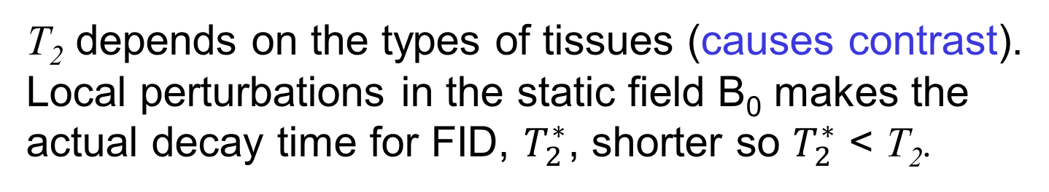
Transverse Relaxation
The decayed received signal in the antenna is called free induction decay (FID). The decay time constant is called transverse relaxation time T₂.
$$M_{xy}\left(t\right)=M_{0} sin α e^{−j\left(γB_{0}t−φ\right)}e^{−t/T_{2}}$$
T₂ depends on the types of tissues (causes contrast).
Local perturbations in the static field B₀ makes the actual decay time for FID, $T_{2}^{∗}$, shorter so $T_{2}^{∗}$ < T₂.

Slide 29
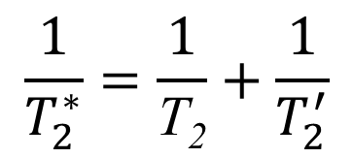
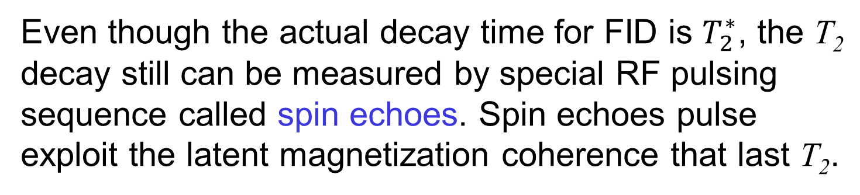
T₂ of Some Normal Tissue Types
Tissue | T₂ (ms)
gray matter | 100
white matter | 92
muscle | 47
fat | 85
kidney | 58
liver | 43
$$\frac{1}{T_{2}^{∗}}=\frac{1}{\text{T}\text{2}}+\frac{1}{T_{2}^{′}}$$
Even though the actual decay time for FID is $T_{2}^{∗}$, the T₂ decay still can be measured by special RF pulsing sequence called spin echoes. Spin echoes pulse exploit the latent magnetization coherence that last T₂.

Slide 30
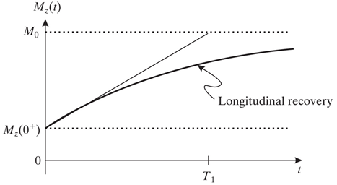
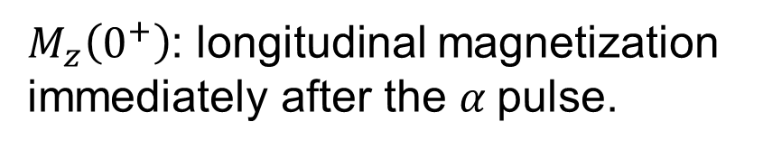

Longitudinal (spin-lattice) Relaxation
The longitudinal relaxation time (T₁) is the time it takes for the longitudinal magnetization M_{z}(t) to recovers back to its equilibrium value M₀. M_{z}(t) rises exponentially the rising time T₁ depends on the tissue property.
Time
M
M
M_{z}
M₀
M_{z}(0⁺)
M
α
M_{xy}
$$M_{z}\left(t\right)=M_{0} \left(1−e^{−t/T_{1}}\right)+M_{z}\left(0^{+}\right)e^{−t/T_{1}}$$
$$M_{z}\left(t\right)=M_{0}+\left(M_{z}\left(0^{+}\right)−M_{0}\right)e^{−t/T_{1}}$$
$M_{z}\left(0^{+}\right)$: longitudinal magnetization immediately after the $α$pulse.
$$M_{z}\left(0^{+}\right)=M_{0}\cos{α }$$

Slide 31
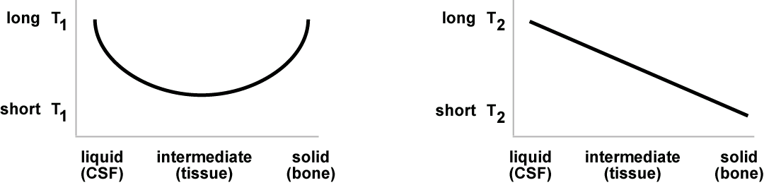
T₁ and T₂ for Different Tissues
250 ms < T₁< 2500 ms
25 ms < T₂ < 250 ms
5 T₂ < T₁ < 10 T₂

Slide 32
Examples
A sample is in equilibrium if there have been no external excitation for at least 3 times the largest T₁ in the sample.
Example:
Suppose a sample is in equilibrium, and a π/2 pulse is applied. What happens to the longitudinal magnetization of the sample?
Example:
Suppose a sample is in equilibrium, and an α pulse is applied. What are the transverse and longitudinal magnetizations of the sample, expressed in the rotating and non rotating frames?

Slide 33
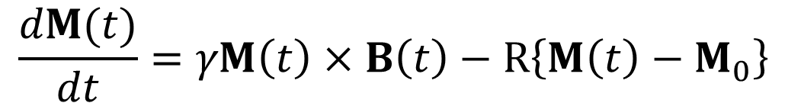
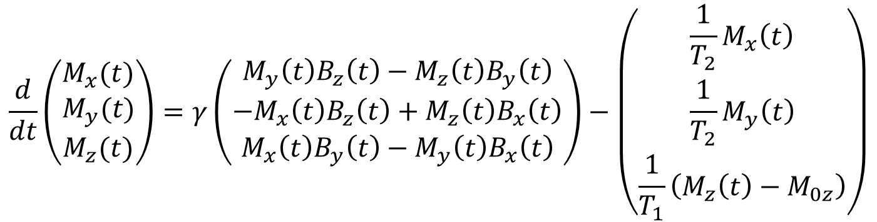
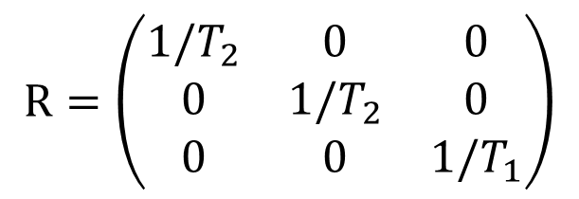

The Bloch Equations
Bloch equations describe the behavior of the magnetic spin at the presence of the forced magnetic fields and the relaxation behavior.
$$\frac{dM(t)}{dt}=γM\left(t\right)×B\left(t\right)−R\left\{M\left(t\right)−M_{0}\right\}$$
$$R=\left(\begin{matrix}1/T_{2} & 0 & 0 \\ 0 & 1/T_{2} & 0 \\ 0 & 0 & 1/T_{1}\end{matrix}\right)$$
$$B\left(t\right)=B_{0}+B_{1}(t)$$
$$\frac{d}{dt}\left(\begin{matrix}M_{x}(t) \\ M_{y}(t) \\ M_{z}(t)\end{matrix}\right)=γ\left(\begin{matrix}M_{y}\left(t\right)B_{z}\left(t\right)−M_{z}\left(t\right)B_{y}\left(t\right) \\ {−M}_{x}\left(t\right)B_{z}\left(t\right)+M_{z}\left(t\right)B_{x}\left(t\right) \\ M_{x}\left(t\right)B_{y}\left(t\right)−M_{y}\left(t\right)B_{x}\left(t\right)\end{matrix}\right)−\left(\begin{matrix}\frac{1}{T_{2}}M_{x}\left(t\right) \\ \frac{1}{T_{2}}M_{y}\left(t\right) \\ \frac{1}{T_{1}}\left(M_{z}\left(t\right)−M_{0z}\right)\end{matrix}\right)$$

Slide 34
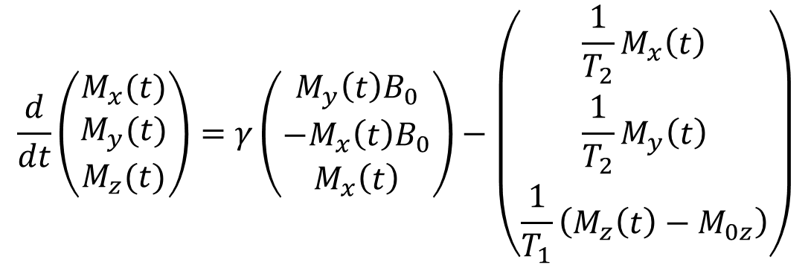
Solution of Bloch Equations
After α pulse, the RF field B₁ is shut down and only B₀ is nonzero. Therefore B_{x}(t) = B_{y}(t) = 0 and B_{z}(t) = B₀ ,
$$\frac{d}{dt}\left(\begin{matrix}M_{x}(t) \\ M_{y}(t) \\ M_{z}(t)\end{matrix}\right)=γ\left(\begin{matrix}M_{y}\left(t\right)B_{0} \\ {−M}_{x}\left(t\right)B_{0} \\ M_{x}\left(t\right)\end{matrix}\right)−\left(\begin{matrix}\frac{1}{T_{2}}M_{x}\left(t\right) \\ \frac{1}{T_{2}}M_{y}\left(t\right) \\ \frac{1}{T_{1}}\left(M_{z}\left(t\right)−M_{0z}\right)\end{matrix}\right)$$
$$M_{x}\left(t\right)=M_{0} sin α cos \left(−2πv_{0}t+φ\right)e^{−t/T_{2}}$$
$$M_{y}\left(t\right)=M_{0} sin α sin \left(−2πv_{0}t+φ\right)e^{−t/T_{2}}$$
$$M_{z}\left(t\right)=M_{0}\cos{α}\left(1−e^{−t/T_{1}}\right)+M_{z}\left(0^{+}\right)e^{−t/T_{1}}$$
Verify that the transverse and longitudinal relaxation solution satisfy Bloch equations.

Slide 35

Magnetization M for π/2 Pulse
Example:
The Bloch equations describe the behavior of M in the laboratory frame. Find the equations for the x, y, and z components of M after a π/2 pulse (in the x direction) satisfy the equations.
$$M_{x}\left(t\right)={−M}_{0} sin \left(2πv_{0}t\right)e^{−t/T_{2}}$$
$$M_{y}\left(t\right)={−M}_{0} cos \left(2πv_{0}t\right)e^{−t/T_{2}}$$
$$M_{z}\left(t\right)=M_{z}\left(0^{+}\right)e^{−t/T_{1}}$$

Slide 36
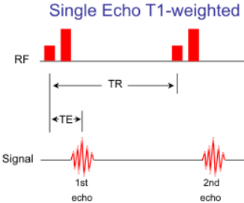
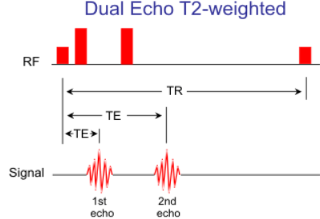

Spin Echoes to Measure T₂
Pure transverse relaxation, characterized by the time constant T₂, is a random phenomenon characterized by tissue properties. A π/2 RF pulse followed by π pulse elicit the spin echoes transverse signal M_{xy}(t).
T_{R} > 2000msec,
T_{E} > 80msec
Two mechanisms that causes spin echo amplitude to decrease:
1- Longitudinal relaxation T₁
2- Phase of the coherent echo is never perfectly aligned.
The problem is FID decay at the rate of $T_{2}^{∗}$, which is much smaller than T₂

Slide 37



Spin Echoes to Measure T₂
T_{E} is the echo time
T₂
$$T_{2}^{∗}$$
T_{R} > 2000msec, T_{E} > 80msec

Slide 38

Spin Echoes to Measure T₂

Slide 39
Example
Suppose two ¹H isochromats are in different locations in a 1.5 T magnet, and the fractional difference in field strength is 20 ppm (parts per million).
How long will it take before these isochromats are 180º out of phase?
What will be their phase difference at T_{E}/2 if the echo time is 4 ms?

Slide 40

T₁-Weighted Contrast Image
The image intensity is proportional to the time relaxation of the longitudinal component of magnetization.

Slide 41

Spin-Spin Pulse to Measure T₁
B₀
T_{r}
T₁
T_{R} < 1000msec, T_{E} < 30msec
$$M_{z}\left(t\right)=M_{0} \left(1−e^{−t/T_{1}}\right)+M_{0}\text{cos}α e^{−t/T_{1}}$$

Slide 42
Spin-Spin Pulse to Measure T₁
When the sample at equilibrium and excited by α pulse then
After T₁ which is larger than 3 times T₂, M_{xy} will be negligible but M_{z}(t) will have value
If at time T_{R}=T₁ the tissue is excited with another α pulse then the transverse magnetization
$$M_{xy}\left(t\right)=M_{0} sin α e^{−j\left(2πv_{0}t−φ\right)}e^{−t/T_{2}}$$
$$M_{z}\left(t\right)=M_{0} \left(1−e^{−t/T_{1}}\right)+M_{z}\left(0^{+}\right)e^{−t/T_{1}}$$
$$M_{xy}\left(t\right)=M_{z}\left(0^{−}\right)sin α e^{−j\left(2πv_{0}t−φ\right)}e^{−t/T_{2}}$$

Slide 43
Basic Contrast Mechanisms
The transverse magnetization M_{xy}(t) produces the measurable MR signal.
Tissue contrast in MRI determined by
Tissue properties P_{D}, T₂, and T₁.
Characteristic of the externally applied excitations:
  Tip angle α
  Echo time T_{E}
  Pulse repetition interval T_{R}

Slide 44

Weighted Images
Three images of the same slice through the skull. Contrast between the tissue types are classified as (a) P_{D}-weighted, (b) Τ₂-weighted, and (c) Τ₁-weighted.

Slide 45

Brain Tissue Parameters
Water 3000 3000
Liver 45 420
Fat 85 240

Slide 46

P_{D}-Weighted Contrast Image
The image intensity is proportional to the number of hydrogen nuclei in the sample.
Need to image the sample in equilibrium before the signal has a chance to decay from T₂ effects.
RF signal: Long T_{R} = 3500 ms, short T_{E} = 17 ms, and α = π/2.

Slide 47

T₂-Weighted Contrast Image
The image intensity is proportional to the transverse relaxation times of different tissues.
RF signal: Long T_{R} = 3500 ms, long T_{E} = T₂ of the tissues being imaged.
GM and WM has small contrast with respect to each other and large contrast with respect to CSF.
WM is slightly darker than GM because its NMR signal has decayed slightly faster.

Slide 48

T₁-Weighted Contrast Image
RF signal: Short T_{R} = 600 ms, short T_{E} = 17 ms and α = π/2.
T_{R} falls in between the T₁ values for GM and WM but is much smaller than that of CSF.
GM and WM will have recovered approximately two-thirds of their longitudinal magnetization, whereas CSF will have recovered relatively little.
CSF signal smaller than GM and WM signals.
GM and WM are relatively bright, while the CSF is dark in the image.

Slide 49



Brain Tissue Parameters
Weighted Image | T_{R} | T_{E} | α
P_{D} | Long 3500 ms | Short 17 ms | π/2
T₂ | Long 3500 ms | long T₂
T₁ | Short 600 ms | Short 17 ms | π/2
$$M_{xy}\left(t\right)=M_{0} sin α e^{−j\left(2πv_{0}t−φ\right)}e^{−t/T_{2}}$$
$$M_{z}\left(t\right)=M_{0} \left(1−e^{−t/T_{1}}\right)+M_{0}\text{cos}α e^{−t/T_{1}}$$
$$M_{xy}\left(t\right)=M_{z}\left(0^{−}\right)sin α e^{−j\left(2πv_{0}t−φ\right)}e^{−t/T_{2}}$$

Slide 50



Inversion Recovery
Inversion recovery uses a 180º RF pulse to establish T₁ contrast.
After 180º RF pulse
$$M\left(0^{+}\right)={−M}_{0}$$
$$M_{z}\left(t\right)=M_{0} \left(1−{2e}^{−t/T_{1}}\right)$$
Let t_{null} be the time when M_{z} = 0
t_{null} = T₁ ln 2
After π/2 pulse at t_{null} M_{z} = 0 and
$$M_{xy}\left(t_{\text{null}}^{+}\right)=M_{z} \left(t_{\text{null}}^{+}\right)\text{sin}α=0$$
Tissues of different T₁ will have M_{xy} values and will be imaged. Inversion recovery is used to suppress certain tissues

Slide 51
Animation and More Detail
MRI is taught as a one semester course. For more detail and animation visit the following website:
http://www.cis.rit.edu/htbooks/mri/inside.htm
https://www.youtube.com/watch?v=Ok9ILIYzmaY
https://www.youtube.com/watch?v=zf5oX01bRgk
Magnetic Resonance Laboratory at Rochester Institute of Technology.

Slide 52
Problem 12.6

Slide 53
Problem 12.11

Slide 54

Problem 12.14

