Slide 1
Basic Imaging Principles
Chapter 1
Biomedical Engineering
Dr. Mohamed Bingabr
University of Central Oklahoma

Slide 2
ENGR 4223: Biomedical Imaging ( Syllabus)
INSTRUCTOR: Mohamed Bingabr, Ph.D.
CONTACTS: Office: Howell 221D ; Phone: 974 5718; Email: mbingabr@uco.edu
OFFICE HOURS: MWF 10:00 – 10:50, MW 3:00 – 3:50, and by appointment
CLASS HOURS: MW 4:00 – 5:15 Howell Hall 112
TEXTBOOK: “Medical Imaging Signals and Systems”, 2nd edition by J. Prince and J. Links.
Reference: “Physics of Radiology”, by Anthony Wolbarst.
PREREQUISITE: ENGR 3323 Signals and Systems
COURSE WEBSITE: http://www.engineering.uco.edu/~mbingabr
GRADES:
Homework and Attendance 15 %
Attendance 10 %
Quizzes 20 %
2 Tests 30 %
Final Exam 25 %
A ≥ 90% 80% ≤ B < 90% 70% ≤ C < 80% 60%≤ D <70% F < 60%
Note: Dates of the 2 tests and the final exam will be announced during the semester. Quizzes will be given every Monday.

Slide 3
Subject | Reading
Introduction Physical Signals Imaging Modalities | Ch1
Signals and Systems Signals Systems The Fourier Transform Properties of Fourier Transform Transfer Function Circular Symmetry and the Hankel Transform Sampling | Ch2
Image Quality Contrast Resolution Noise Signal-to-Noise Ratio Nonrandom Effects Accuracy TEST 1 | Ch3
Physics of Radiography Ionization Forms of Ionizing radiation Nature and Properties of Ionizing Radiation Attenuation of Electromagnetic Radiation Radiation Dosimetry | Ch4 Notes
Projection Radiography Instrumentation Image Formation | Ch5
Computed Tomography CT Instrumentation Image Formation Image Quality in CT TEST 2 | Ch6 Notes
Physics of Magnetic Resonance Microscopic Magnetization Macroscopic Magnetization Precession and Larmor Frequency Transverse and Longitudinal Magnetization RF Excitation Relaxation The Bloch Equations Spin Echoes Contrast Mechanisms | Ch12
Magnetic Resonance Imaging Instrumentation MRI Data Acquisition Image Reconstruction Image Quality | Ch13
Final
It is expected that each student will actually spend a total of 6 to 8 hours per week on the course (not including lecture times). I don’t expect you to memorize formulas but I expect you to understand them. So, you will be allowed to bring to the exam one sheet of paper that contains any relative formulas you might need, but make sure you know how to use them conceptually and not just mechanically.

Slide 4
Basic Imaging Principles
What does the human body look like on the inside?
Invasive Techniques:
Operation
Endoscope
Noninvasive Techniques: Imaging Modality
Magnetic Resonance Imaging (MRI)
Ultrasound Imaging
x-ray
Computed Tomography (CT)
Nuclear Medicine
Functional Magnetic Resonance Imaging (fMRI)
Positron Emission Tomography (PET)

Slide 5
What do Images look like, and why?
Image depends on the measured parameters of the body’s tissues (signal) such as:
- Reflectivity in ultrasound imaging
- Linear attenuation coefficient in x-ray and CT scan
- Hydrogen proton density in MRI
- Metabolism or receptor binding in PET
Measured parameters must have important medical information about the tissue.
Image reconstruction: the process of creating an image from measurement of signals (parameters).
Image quality determined by: Accurate spatial distribution of the physical parameters. Resolution, Noise, Contrast, Geometric Distortion, Artifacts

Slide 6
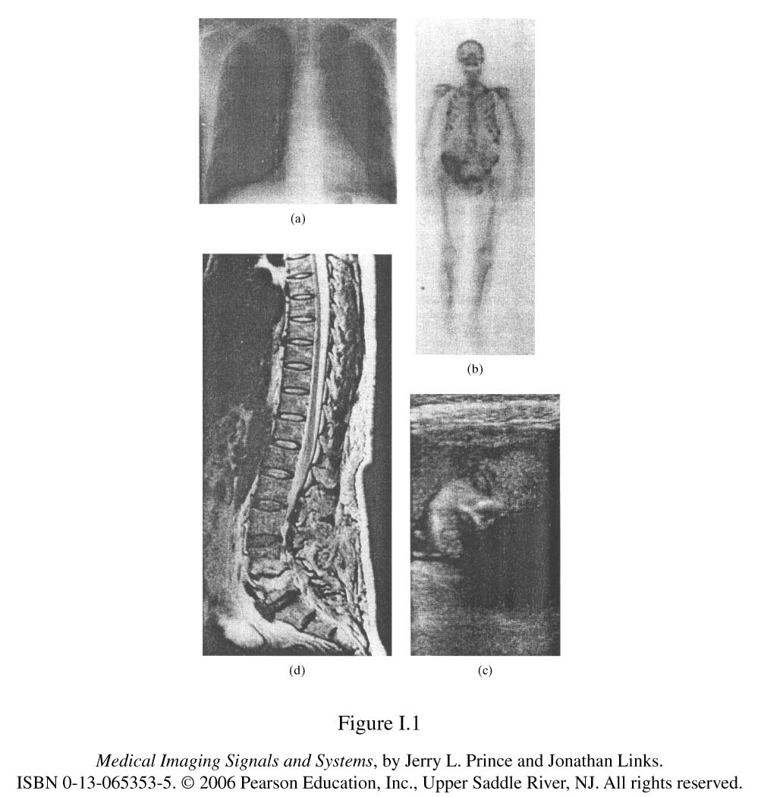
x-ray
Transmission through the body
Gamma ray emission from within the body
Nuclear magnetic resonance induction
Ultrasound echoes

Slide 7
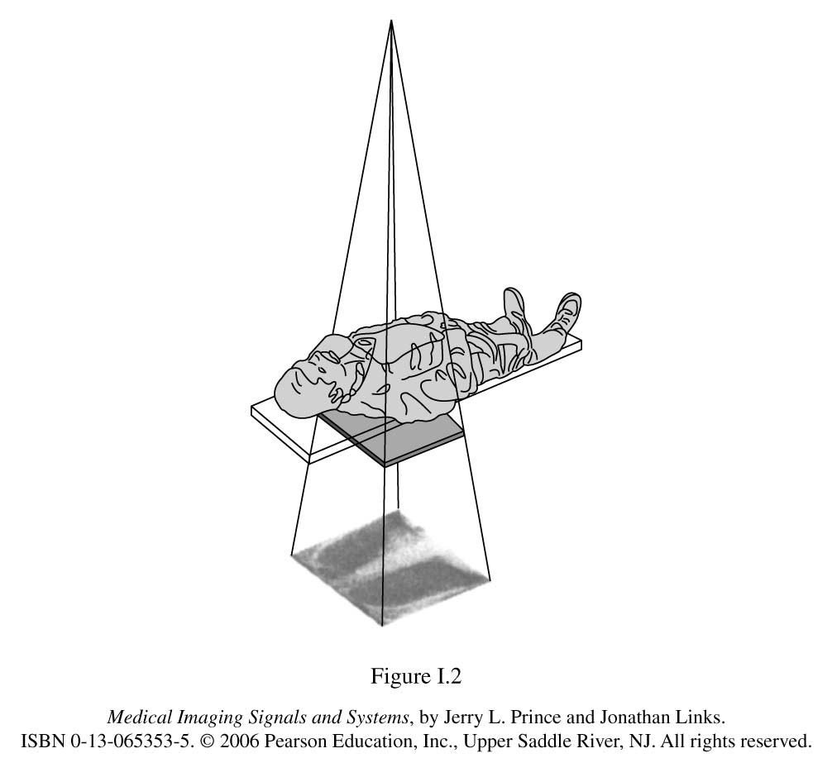
Projection Images
The creation of a two-dimensional image “shadow” of the three dimensional body. X-ray are transmitted through a patient, creating a radiograph.

Slide 8
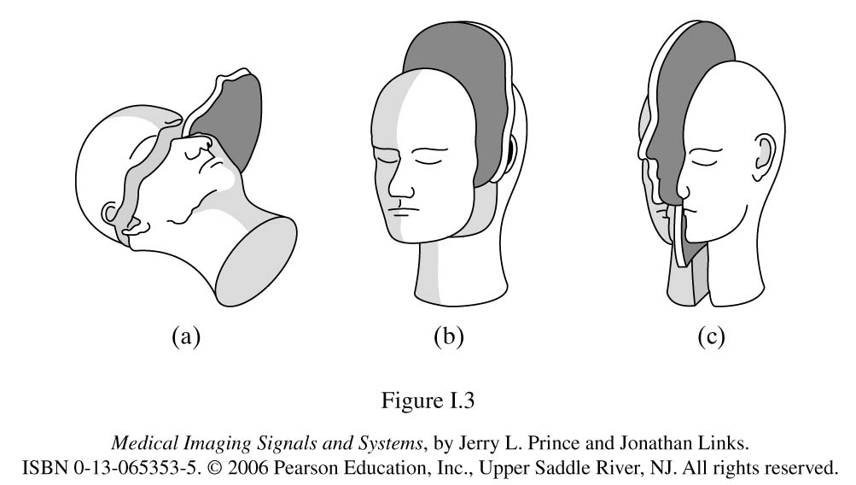
Tomography Images
The three standard orientations of slice (tomographic) images
Coronal
Frontal
Axial, Transaxial, Transverse
Sagittal
Oblique Slice: an orientation not corresponding to one of the Standard slice orientation, Fig. 1.1 d.

Slide 9
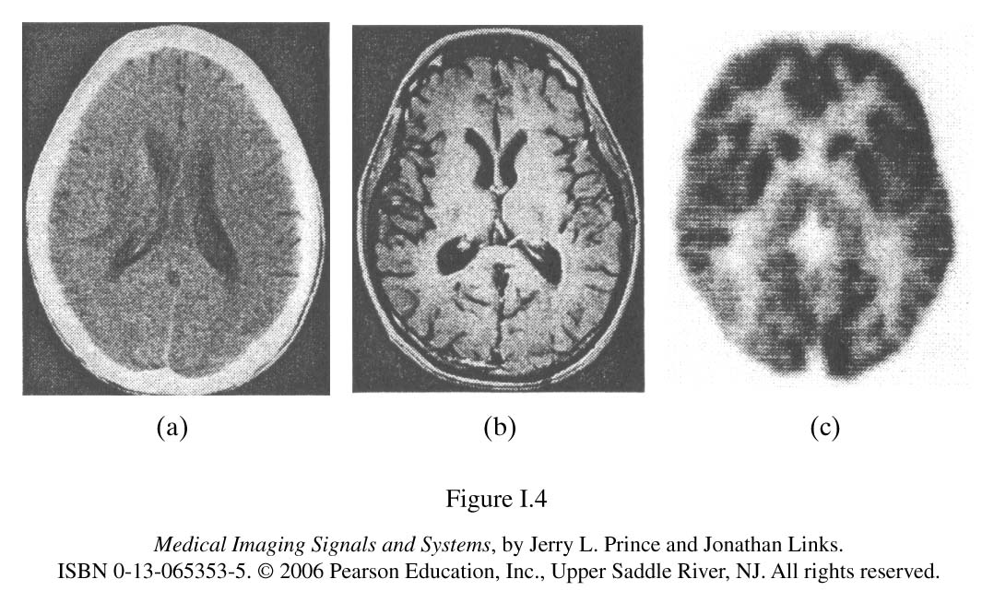
Three slice images of the brain obtained by different modalities. Images are different because signals measured by the modalities are different.
Computed Tomography
Magnetic Resonance Imaging
Positron Emission Tomography

Slide 10
Introduction
Chapter 1
Biomedical Engineering
Dr. Mohamed Bingabr
University of Central Oklahoma

Slide 11
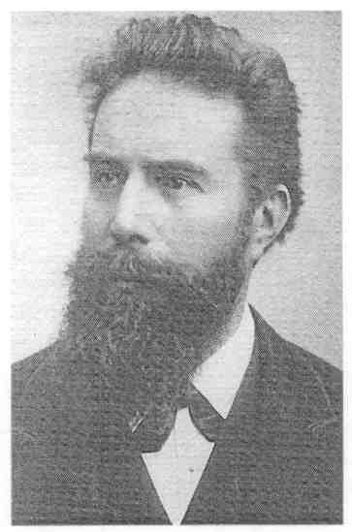
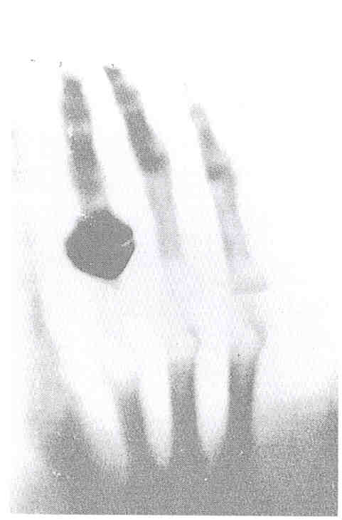
Introduction
Wilhelm Röntgen
Nov. 1895 – Announces X-ray discovery
1901 – Receives first Nobel Prize in Physics
– Given for discovery and use of X-rays.
Radiograph of the hand of Röntgen’s wife, 1895.

Slide 12
1940’s, 1950’s
Background laid for ultrasound and nuclear medicine
1960’s
Revolution in imaging – ultrasound and nuclear medicine
1972
CT (Computerized Tomography)
- true 3D imaging
- Allan Cormack and Hounsfield win Nobel Prize in 1979
1980’s
-In 1952 Felix Bloch and Edward Purcell received Nobel Prize in Physics for describing the phenomena of NMR
-In 1991 Richard Ernst received Nobel Prize in chemistry for a paper describing the use of MRI in medicine in 1973.
- In 2003 Paul Lauterbur and Peter Mansfield received Nobel Prize for developing Key method in MRI image construction.

Slide 13
Physical Signal
Detection of physical signals arising from the body and transform these signals to images.
Typical signals
- Transmission of x-ray through the body ( Projection radiography)
- Emission of gamma rays from radiotracer in the body (NM)
- Reflection of ultrasonic waves within the body (in ultrasound imaging)
- Precession of spin systems in a large magnetic field (MRI)
All signals above use Electromagnetic waves (EM) except the ultrasound imaging.
f ∝ 1/λ f ∝ Energy

Slide 14
Physical Signal
Characteristics of spectrum that are useful for medical imaging
For Electromagnetic Imaging
λ > 1 Angstrom (Aº) : Energy is highly attenuated by the body
< 0.01 Angstrom : Energy is too high and less contrast
Unit of energy for EM is electron volts (eV): 1 eV is the amount of energy an electron gains when accelerated across 1 volt potential.
Useful energy for medical imaging: 25 k eV – 500 k eV
For Ultrasound Imaging
In ultrasound, image resolution is poor for long wavelength, and attenuation is too high for short wavelength.
Ideal frequency range for ultrasound imaging is 1 to 20 MHz

Slide 15
Spectrum

Slide 16
Imaging modalities
Projection Radiology
  - Ionized radiation, transmission imaging
Computed Tomography
  - Ionized radiation, transmission imaging
Nuclear Medicine
  - Ionized radiation, emission imaging
Ultrasound Imaging
  - Reflection imaging
Magnetic Resonance Imaging

Slide 17
Projection Radiography
Projection of a 3-D object onto a 2-D image using x-rays pulse in uniform cone beam geometry.
Different Modalities
Routine diagnostic radiography: x-rays, fluoroscopy, motion tomography.
Digital radiography
Angiography
Neuroradiology
Mobile x-ray systems
Mammography
attenuated
x-rays
light
x-ray
tube
x-rays
Body
Scintillator
Film
Bones block x-rays more than soft tissues

Slide 18
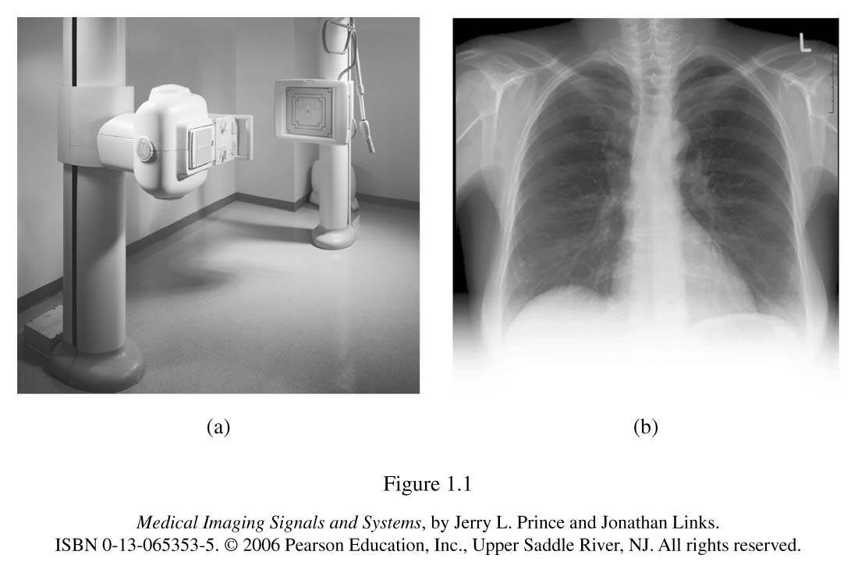
Projection Radiography

Slide 19
Computed Tomography (CT-scan)
The x-rays are collimated (restricted in their geometric spread) to travel within an approximate 2-D “Fan beam”
CT collects multiple projections of the same tissues from different orientations by moving the x-ray source around the body.
CT systems have rows of digital detectors whose signals are inputted to a computer. The computer reconstruct cross sections (slice) of the human body.

Slide 20
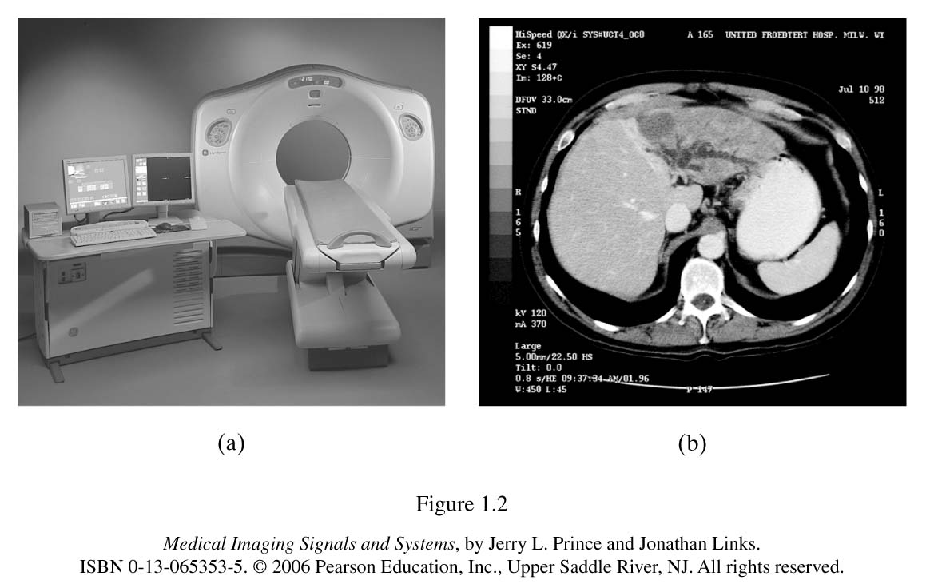
Computed Tomography (CT-scan)
Type of CT scan: single-slice CT, helical CT, multiple-row detector CT (MDCT).
Slice through the liver

Slide 21
Nuclear Medicine Imaging (NMI)
NMI is imaging methods of the tissue physiology.
Imaging of gamma rays emitted by radioactive substance introduced into the body. These radiotracers are bound to biological molecules that are naturally consumed by body tissues.
Nuclear medicine imaging reflects the local concentration of a radiotracer within the body. Since this concentration is tied to the physiological behavior of the carrier molecule within the body, nuclear medicine imaging is functional imaging methods.
Example radioactive iodine to study thyroid function.

Slide 22
Nuclear Medicine
Modalities of Nuclear Medicine:
Conventional radionuclide imaging or scintigraphy
Single-photon emission computed tomography (SPECT)
Positron emission tomography (PET)
In Conventional and SPECT: a radioactive atom’s decay produces a single gamma ray, which may intercept the Anger camera (scintillation detector).
In PET, a radionuclide decay produces a positron, which immediately annihilates (with an electron) to produce two gamma rays flying off in opposite directions.

Slide 23
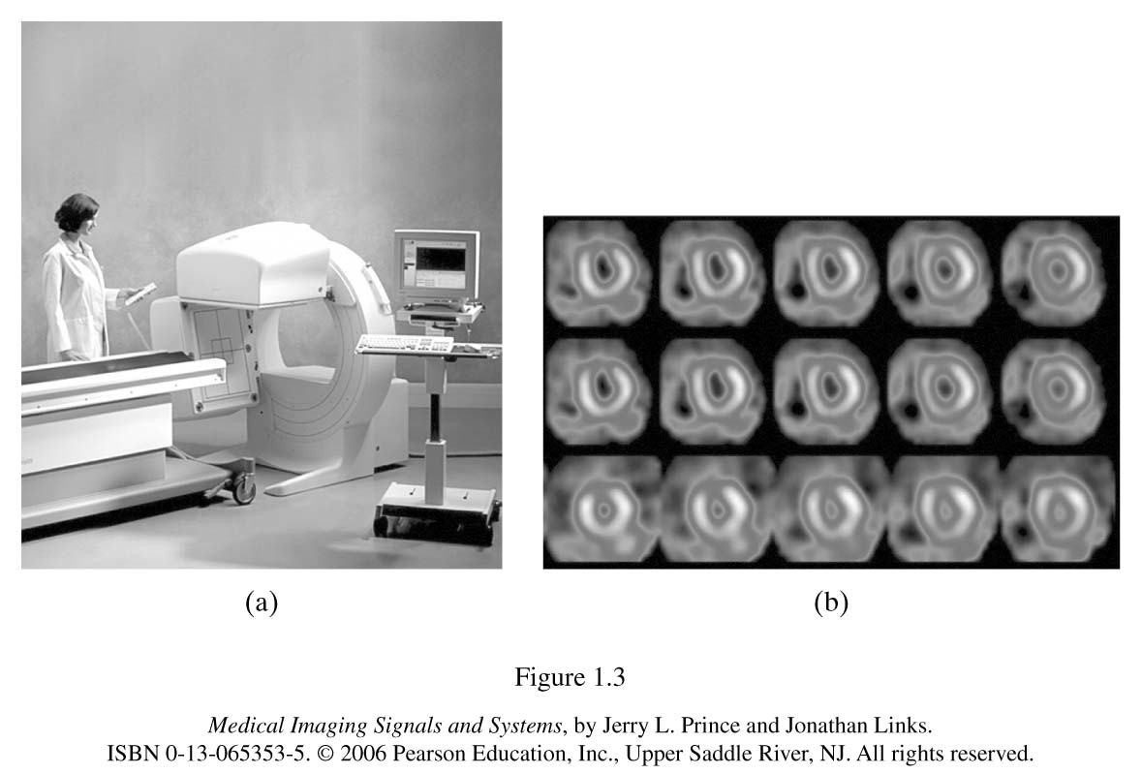
Nuclear Medicine

Slide 24
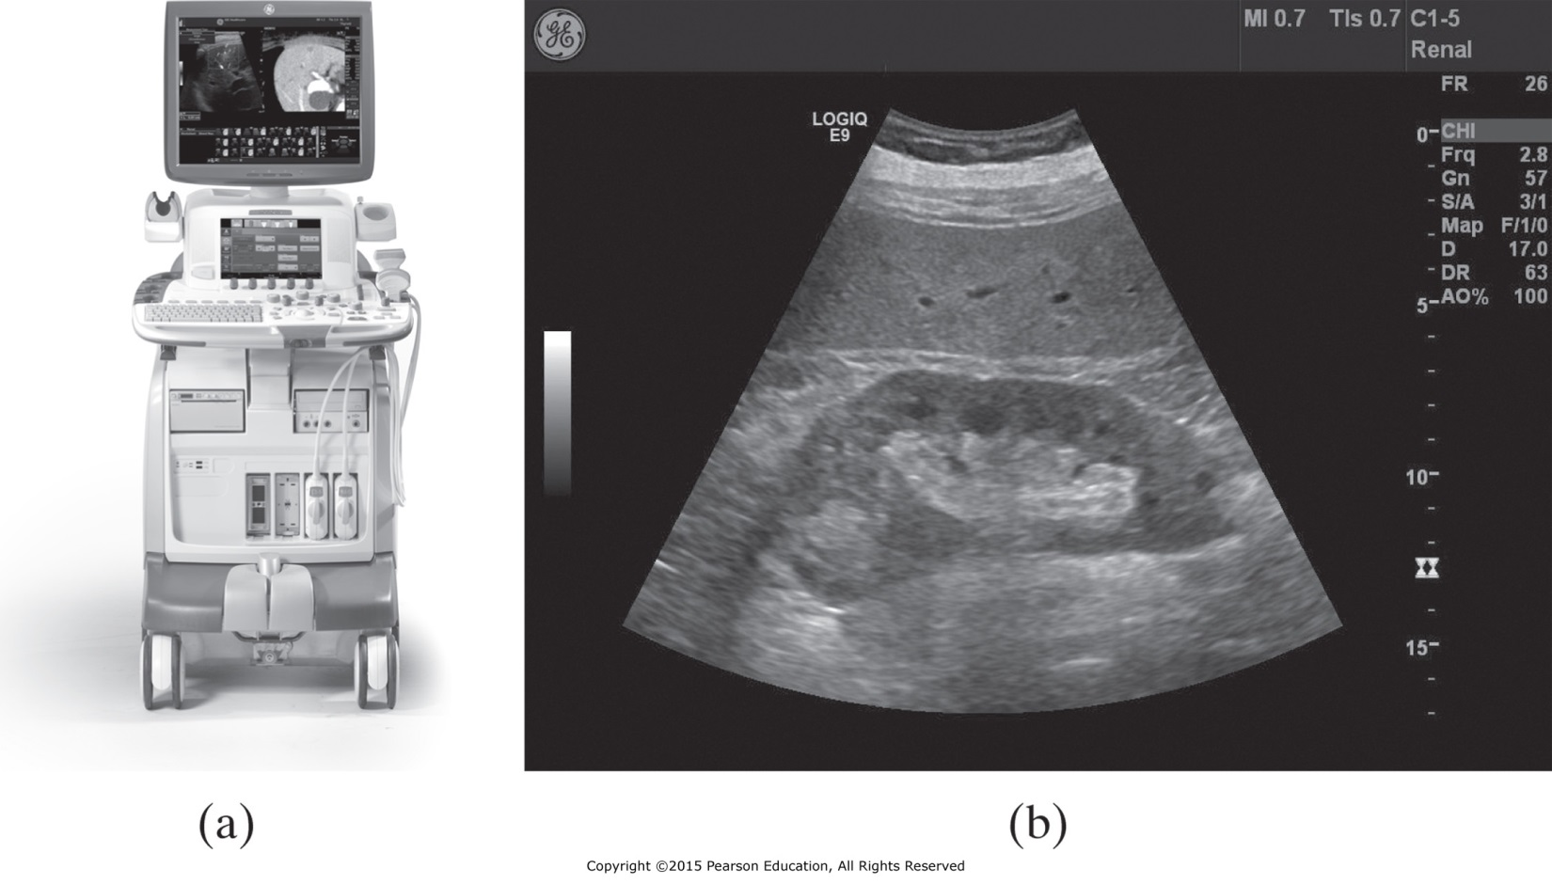
Ultrasound Imaging
Uses electric-to-acoustic transducers to generate repetitive bursts of high-frequency sound.
Time-of-return: give information about location
Intensity: give information about the strength of a reflector
Figure 1.4
An ultrasound scanner and
an ultrasound image of a kidney.

Slide 25
Modalities of Ultrasound
A-mode imaging: generate one-dimensional waveform. Does not produce image but provide detail information about rapid or subtle motion (heart valve).
B-mode imaging: cross-sectional anatomical imaging.
M-mode imaging: generate a succession of A-mode signals and displayed as image in computer screen. Used to measure time-varying displacement such as a heart valve.
Doppler imaging: uses the property of frequency and phase shift caused by moving objects. Phase shift is converted to sound that reveal information about motion such as blood flow.
Nonlinear imaging: higher resolution, greater depth, image different properties of tissues.

Slide 26
Magnetic Resonance Imaging (MRI)
MRI measure the hydrogen atoms density in tissues.
Hydrogen nucleus align itself with an external Magnetic field
Radio frequency pulse cause hydrogen atoms to tip a way from the direction of the external magnetic field.
When excitation pulse end, hydrogen nucleus realign itself with the magnetic field and release a radio-frequency.

Slide 27
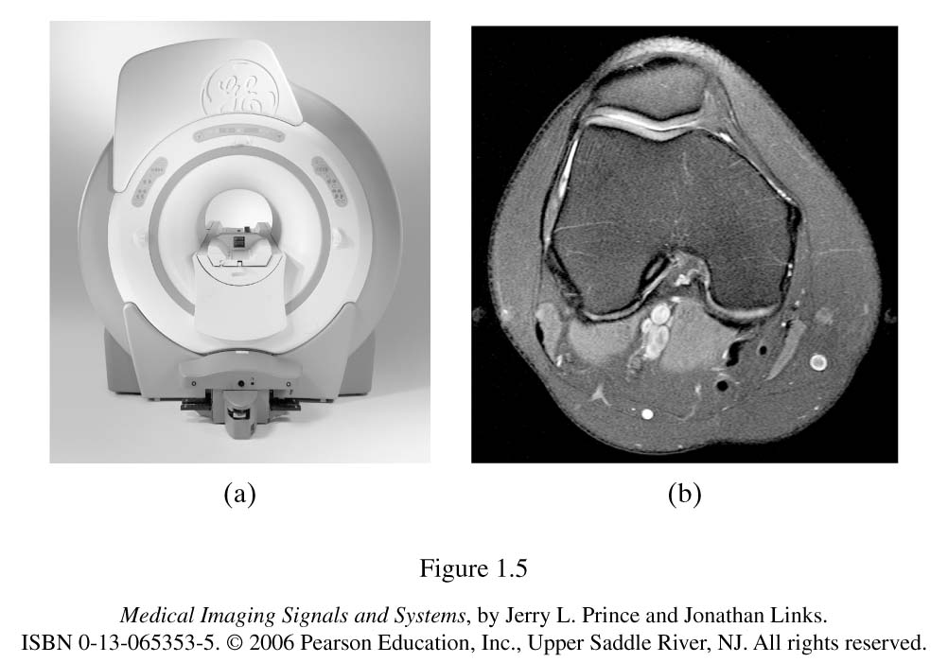
MRI Modalities
Standard MRI
Echo-planar imaging (EPI): generate images in real time.
Magnetic resonance spectroscopic imaging: image other nuclei besides the hydrogen atom.
Functional MRI (fMRI): uses oxygenation-sensitive pulse sequence to image blood oxygenation in the brain.
Figure 1.5
An MR scanner and
(b) an MR image of a human knee.

Slide 28
Multimodalities Imaging
Imaging system that consist of two different medical imaging modalities to reveal different properties of the human body.
CT → Bones anatomy
MRI → Tissue anatomy
PET → tissue physiology
PET/CT systems improve the construction of the PET images.

Slide 29
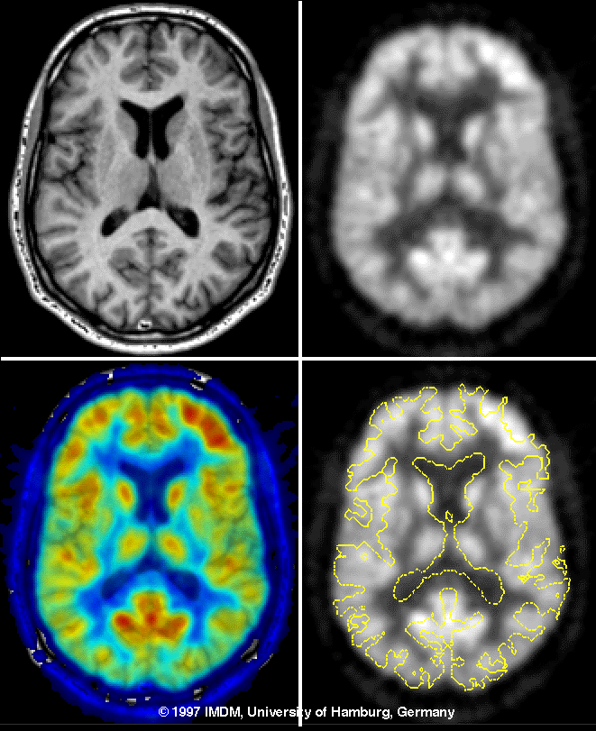
Multimodalities Imaging
PET/CT systems improve the construction of the PET images.

