Slide 1
Signals and Systems Chapter 2
Biomedical Engineering
Dr. Mohamed Bingabr
University of Central Oklahoma

Slide 2
Outline
Signals
Systems
The Fourier Transform
Properties of the Fourier Transform
Transfer Function
Circular Symmetry and the Hankel Transform

Slide 3
Introduction
Signal Type
Continuous Signal: x-ray attenuation
Discrete Signal: times of arrival of photons in a radioactive decay process in PET
Mixed signal: CT scan signal g(l,θ_{k})
System Type
Continuous-continuous system
Continuous input → Continuous output
Continuous-discrete system
Continuous input → Discrete output

Slide 4
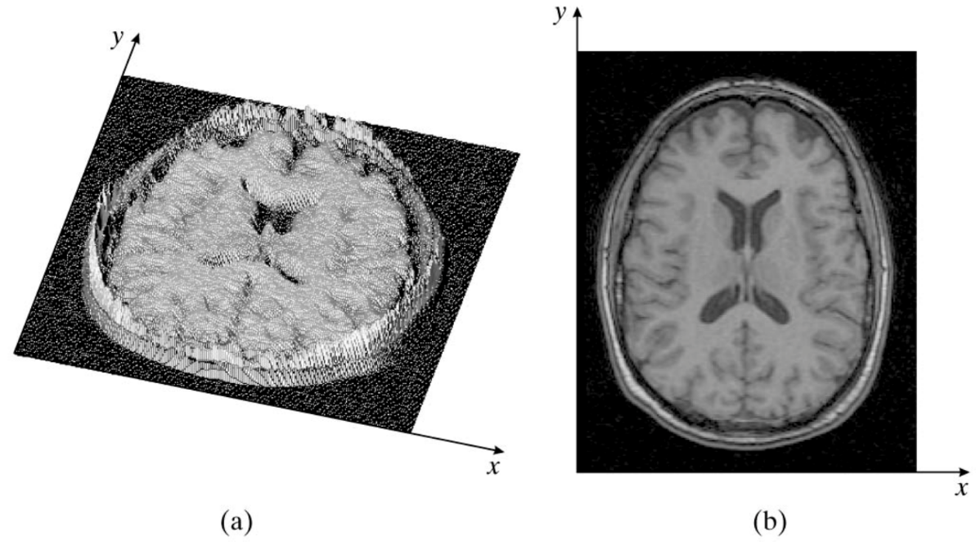
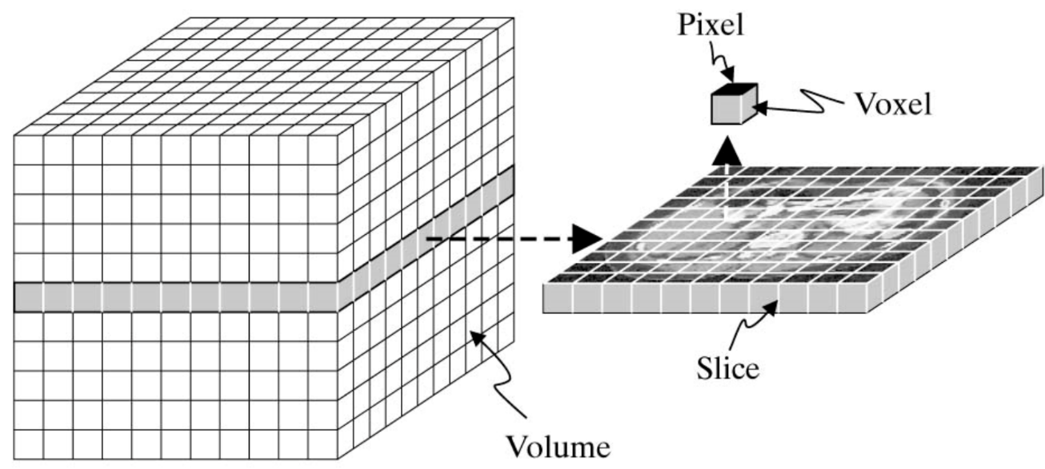
Signals
2-D continuous signal is defined as f(x,y)
(x,y) : is a pixel location
f : is pixel intensity
function
image

Slide 5
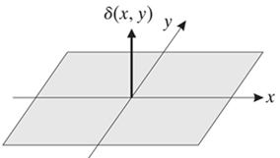
Point Impulse
1-D point impulse (delta, Dirac, impulse function)
$$δ\left(x\right)$$
$$δ\left(x\right)=0, x≠0,$$
$$\int_{−∞}^{∞}{f(x)}δ\left(x\right)dx=f\left(0\right).$$
$$x$$
2-D point impulse
$$δ\left(x,y\right)=0, (x,y)≠(0, 0)$$
$$\int_{−∞}^{∞}{\int_{−∞}^{∞}{f(x, y)}δ\left(x, y\right)dxdy}=f\left(0, 0\right).$$
Point impulse is used in the characterization of image resolution and sampling

Slide 6
Point Impulse Properties
1- Sifting property
$$\int_{−∞}^{∞}{\int_{−∞}^{∞}{f(x, y)}δ\left(x−ξ, y−η\right)dxdy}=f\left(ξ,η\right).$$
We can interpret the product of a function with a point impulse as another point impulse whose volume is equal to the value of the function at the location of the point impulse.
2- Scaling property
$$δ\left(ax, by\right)=\frac{1}{\left|ab\right|}δ(x, y)$$
2- Even function
$$δ\left(−x, −y\right)=δ(x, y)$$

Slide 7
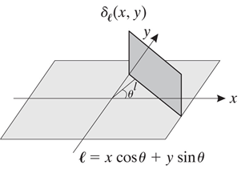
Line Impulse
Line also used to assist image resolution
$$L\left(l, θ\right)=\left\{\left(x,y\right)|xcosθ+ysinθ=l\right\}$$
This is a line whose unite normal is oriented at an angle θ relative to the x-axis and is at distance l from the origin in the direction of the unit normal.
The line impulse $δ_{l}\left(x, y\right)$ associated with line $L\left(l, θ\right)$
$$δ_{l}\left(x, y\right)=δ_{l}\left(xcosθ,+ysinθ−l\right)$$

Slide 8
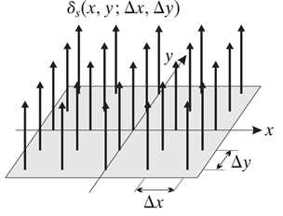
Comb and Sampling Functions
Used in medical imaging production (sampling CT image 1024 x 1024), manipulation, and storage.
$$comb(x)=\sum_{−∞}^{∞}{δ(x−n)}$$
2-D comb function
$$comb(x,y)=\sum_{m=−∞}^{∞}{\sum_{n=−∞}^{∞}{δ(x−m,y−n)}}$$
Sampling function
$$δ_{s}\left(x, y;∆x,∆y\right)=\sum_{m=−∞}^{∞}{\sum_{n=−∞}^{∞}{δ(x−m∆x,y−n∆y)}}$$

Slide 9
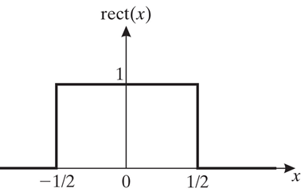
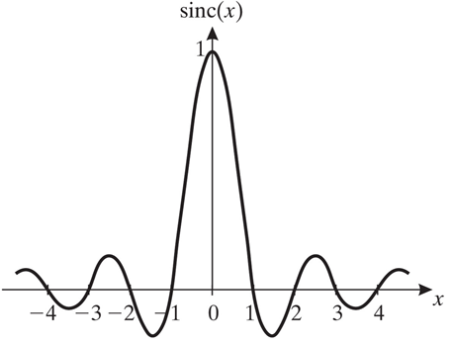
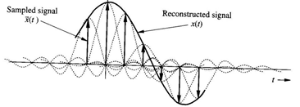
1-D Rect and Sinc Functions
Rect function is used in medical imaging for sectioning.
$$rect(x)=\left\{\begin{matrix}1, \text{for}\text{ |}x|<\frac{1}{2} \\ 0\text{, }\text{for}\text{ |}x|>\frac{1}{2}\end{matrix}\right.$$
Sinc function is used in medical imaging for reconstruction.
$$sinc\left(x\right)=\frac{sinπx}{πx}$$

Slide 10
2-D Rect and Sinc Functions
$$rect(x,y)=rect(x)rect(y)$$
$$rect(x,y)=\left\{\begin{matrix}1, \text{for}\text{ |}x|<\frac{1}{2} \text{and} |y|<\frac{1}{2} \\ 0\text{, }\text{for}\text{ |}x|>\frac{1}{2} \text{and} \left|y\right|>\frac{1}{2}\end{matrix}\right.$$
$$sinc\left(x,y\right)=sinc\left(x\right)sinc(y)$$
$$sinc(x,y)=\left\{\begin{matrix}1, \text{for} x=y=0 \\ \frac{\sin\left(πx\right)sin⁡(πy)}{π^{2}xy}\text{, }\text{otherwise}.\end{matrix}\right.$$

Slide 11
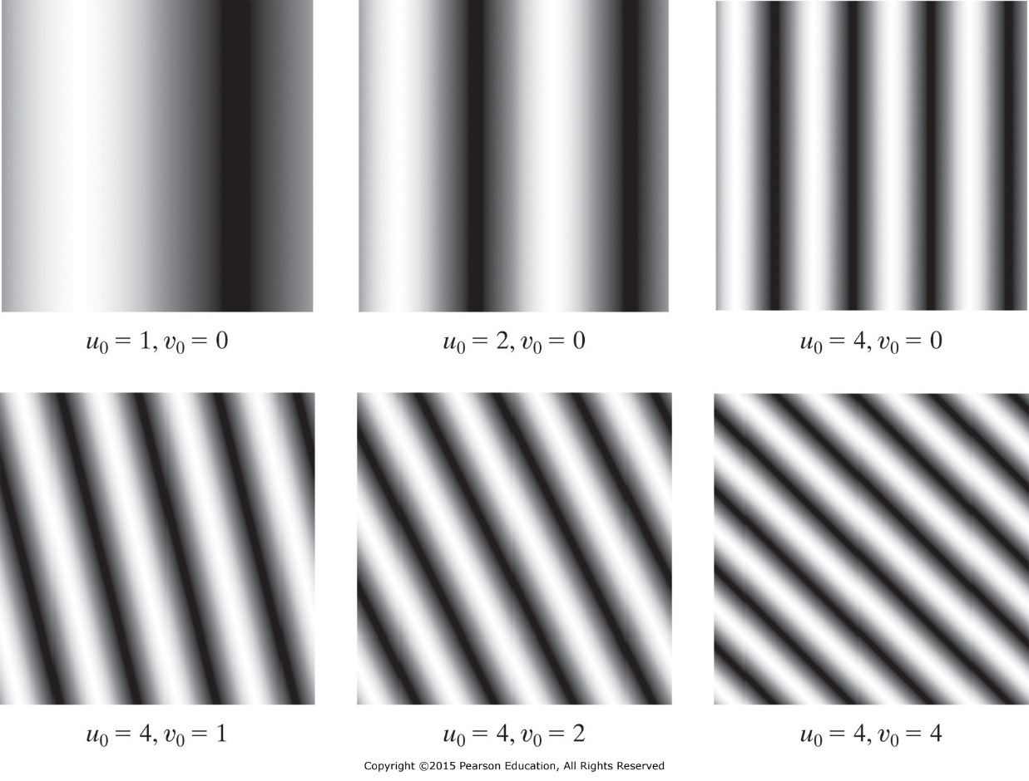
Exponential and Sinusoidal Signals
$$e(x,y)=e^{j2π\left(u_{0}x+v_{0}y\right)}$$
$$e\left(x,y\right)=cos\left[2π\left(u_{0}x+v_{0}y\right)\right]+jsin\left[2π\left(u_{0}x+v_{0}y\right)\right]$$
$$cos\left[2π\left(u_{0}x+v_{0}y\right)\right]={0.5e}^{j2π\left(u_{0}x+v_{0}y\right)}+0.5e^{−j2π\left(u_{0}x+v_{0}y\right)}$$
x and y have distance units.
u₀ and v₀ are the fundamental frequencies and their units are the inverse of the units of x and y.

Slide 12
Separable and Periodic Signals
A signal f(x, y) is separable if f(x, y)= f₁(x) f₂(y)
Separable signal model signal variations independently in the x and y direction.
Decomposing a signal to its components f₁(x) and f₂(y) might simplify signal processing.
Periodicity
A signal f(x, y) is periodic if f(x, y)= f(x+X, y) = f(x, y+Y)
X and Y are the signal periods in the x and y direction, respectively.

Slide 13
Systems
A continuous system is defined as a transformer Ϩ of an input continuous signal f(x,y) to an output continuous signal g(x,y).
g(x, y)= Ϩ [f(x, y)]
Linear Systems
$$\text{Ϩ}\left[\sum_{k=1}^{K}{w_{k}f_{k}(x,y)}\right]=\sum_{k=1}^{K}{w_{k}\text{Ϩ}}\left[f_{k}(x,y)\right]$$

Slide 14
Impulse Response
If we know the system response to an impulse
$$δ_{ξη}\left(x,y\right)=δ\left(x−ξ,y−η\right)$$
then with linearity we can know the system response to any input.
$$h\left(x,y;ξ,η\right)=\text{Ϩ}\left[δ_{ξη}\left(x,y\right)\right]$$
$h\left(x,y;ξ,η\right)$ is the system impulse response function or known as point spread function (PSF).
System output g() for any input f().
$$g\left(x,y\right)=\int_{−∞}^{∞}{\int_{−∞}^{∞}{f\left(ξ,η\right)h\left(x,y;ξ,η\right)dξdη}}$$

Slide 15
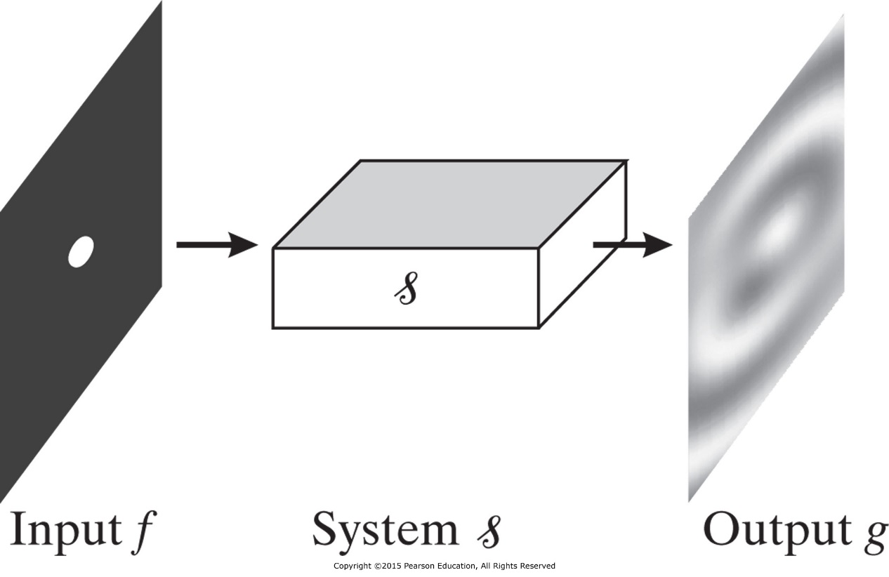
Impulse Response
System output g() for any input f().
$$g\left(x,y\right)=\int_{−∞}^{∞}{\int_{−∞}^{∞}{f\left(ξ,η\right)h\left(x,y;ξ,η\right)dξdη}}$$

Slide 16
Shift Invariance System
A system is shift invariant if an arbitrary translation of the input results in an identical translation in the output.
Then with linearity we can know the system response to any input.
Let the input
$$f_{x_{0}y_{0}}\left(x,y\right)=f\left(x−x_{0},y−y_{0}\right)$$
then the output
g($x−x_{0},y−y_{0}$)= Ϩ [$f_{x_{0}y_{0}}\left(x,y\right)$]
System response to a shifted impulse
Ϩ [$δ_{ξη}\left(x,y\right)$]= h($x−ξ,y−η$)

Slide 17
Linear Shift-Invariance (LSI) System
Linear shift-invariant (LSI) System Response
$$g\left(x,y\right)=\int_{−∞}^{∞}{\int_{−∞}^{∞}{f\left(ξ,η\right)h\left(x−ξ,y−η\right)dξdη}}$$
Convolution Integral representation of system response
$$g\left(x,y\right)=h\left(x,y\right)∗f(x,y)$$
Example: Consider a continuous system with input-output equation g(x,y) = xyf(x,y).
Is the system linear and shift-invariant?

Slide 18
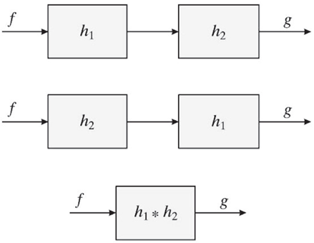
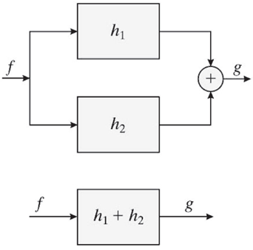
Connection of LSI Systems
Cascade
Parallel
$$g\left(x,y\right)=h_{1}\left(x,y\right)∗h_{2}\left(x,y\right)∗f(x,y)$$
$$g\left(x,y\right)=[h_{1}\left(x,y\right)+h_{2}\left(x,y\right)]∗f(x,y)$$

Slide 19
Connection of LSI Systems
Example: Consider two LSI systems connected in cascade, with Gaussian PSFs of the form:
$$h_{1}\left(x,y\right)=\frac{1}{2πσ_{1}^{2}}e^{−\left(x^{2}+y^{2}\right)/2σ_{1}^{2}}$$
$$h_{2}\left(x,y\right)=\frac{1}{2πσ_{2}^{2}}e^{−\left(x^{2}+y^{2}\right)/2σ_{2}^{2}}$$
where σ₁ and σ₂ are two positive constants.
What is the PSF of the system?
$$h\left(x,y\right)=\frac{1}{2π\left(σ_{1}^{2}+σ_{2}^{2}\right)}e^{−\left(x^{2}+y^{2}\right)/2\left(σ_{1}^{2}+σ_{2}^{2}\right)}$$

Slide 20
Separable Systems
A 2-D LSI system with PSF h(x, y) is a separable system if there are two 1-D systems with PSFs h₁(x) and h₂(y), such that h(x,y) = h₁(x)h₂(y)
$$h\left(x,y\right)=\frac{1}{2πσ^{2}}e^{−\left(x^{2}+y^{2}\right)/2σ^{2}}$$
This PSF is separable
$$h_{1}\left(x\right)=\frac{1}{\sqrt{2π}σ}e^{−x^{2}/2σ^{2}}$$
$$h_{2}\left(y\right)=\frac{1}{\sqrt{2π}σ}e^{−y^{2}/2σ^{2}}$$

Slide 21
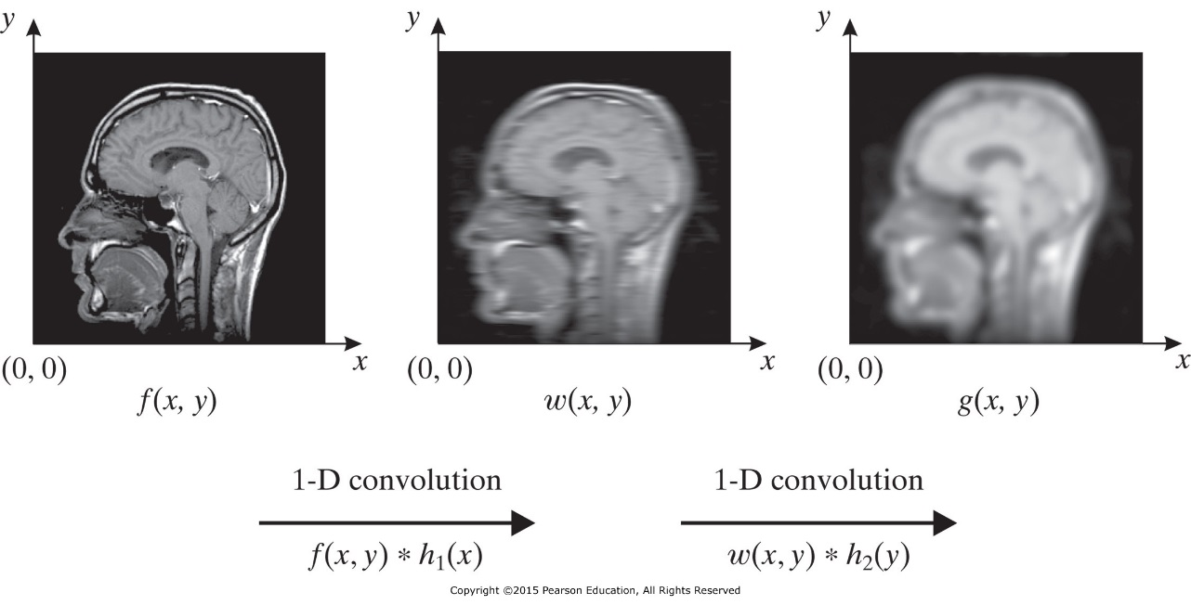
Separable Systems
In practice it is easier and faster to execute two consecutive 1-D operations than a single 2-D operation.
$$w\left(x,y\right)=\int_{−∞}^{∞}{f\left(ξ,y\right)h_{1}\left(x−ξ\right)dξ}$$
For every y
$$g\left(x,y\right)=\int_{−∞}^{∞}{w\left(x,η\right)h_{2}\left(y−η\right)dη}$$
For every x

Slide 22
Stable Systems
A system is a bounded-input bounded-output (BIBO) stable system if
For bounded input
$|f\left(x,y\right)|≤B<∞$ for every (x, y)
The output is bounded
$\left|g(x,y)\right|=\left|h\left(x,y\right)∗f(x,y) \right|≤B^{,}<∞$
and
$$\int_{−∞}^{∞}{\int_{−∞}^{∞}{|h\left(x,y\right)|dxdy}<∞}$$

Slide 23
1-D Fourier Transform (time)
Continuous 1-D Fourier Transform
Discrete 1-D Fourier Transform
T_{s} = 0.25 sec
f_{s} = 1/Ts = 4 Hz
f_{max} = fs/2 = 2 Hz
Sig length (T) = (N-1)*T_{s}=1 sec
f_{res} = 1/T = 1 Hz
x(n) = [125 145 148 140 110]
X(k) = [668 -29.2 - j38 7.7 - j12.96 7.7 - j12.96 -29.2 - j38]
|X(k)| = [668 47.9 15.1 15.1 47.9]
Phase = [0 -127.5 -59.3 59.3 127.5]

Slide 24
1-D Fourier Transform
1-D Fourier transform
$$F\left(u\right)=ℱ_{1D}\left(f\right)\left(u\right)=\int_{−∞}^{∞}{f\left(x\right)e^{−j2πux}dx}$$
u is the spatial frequency
1-D inverse Fourier transform
$$f\left(x\right)=ℱ_{1D}^{−1}\left(F\right)\left(x\right)=\int_{−∞}^{∞}{F\left(u\right)e^{j2πux}du}$$
Example:
$$rect(x)=\left\{\begin{matrix}1, \text{for}\text{ |}x|<\frac{1}{2} \\ 0\text{, }\text{for}\text{ |}x|>\frac{1}{2}\end{matrix}\right.$$
What is the Fourier transform of the

Slide 25
Fourier Transform
The 2-D Fourier transform of f(x, y)
$$F\left(u,v\right)=ℱ_{2D}\left(f\right)\left(u,v\right)=\int_{−∞}^{∞}{\int_{−∞}^{∞}{f\left(x,y\right)e^{−j2π(ux+vy)}dxdy}}$$
u and v are the spatial frequencies
The 2-D inverse Fourier transform of F(u, v)
$$f(x,y)=\int_{−∞}^{∞}{\int_{−∞}^{∞}{F\left(u,v\right)e^{j2π(ux+vy)}dudv}}$$

Slide 26
Fourier Transform
Magnitude (magnitude spectrum) of FT
$$\left|F(u,v)\right|=\sqrt{F_{R}^{2}\left(u,v\right)+F_{I}^{2}\left(u,v\right)}$$
Angle (phase spectrum) of the FT
$$∠F\left(u,v\right)=\tan^{−1}\left(\frac{F_{I}(u,v)}{F_{R}(u,v)}\right)$$
$$F(u,v)=\left|F(u,v)\right|e^{j∠F\left(u,v\right)}$$
Example: What is the Fourier transform of the point impulse $δ(x,y)$?

Slide 27
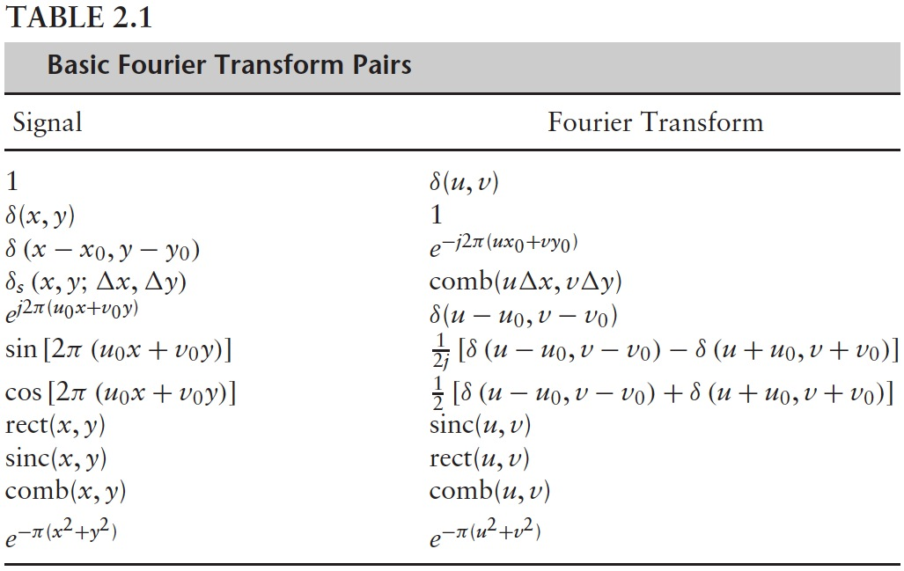
Fourier Transform Pairs

Slide 28
Examples of Fourier Transform
Example: What is the Fourier transform of
$$f\left(x,y\right)=e^{j2π(u_{0}x+v_{0}y)}$$
Answer:
$$ℱ_{2D}\left(f\right)\left(u,v\right)=δ\left(u−u_{0},v−v_{0}\right)$$
If the spatial frequency u₀ and v₀ are zero then f(x,y) =1 and the spectrum F(u,v) will be $δ\left(u,v\right)$.
Slow signal variation in space produces a spectral content that is primarily concentrated at low frequencies.

Slide 29
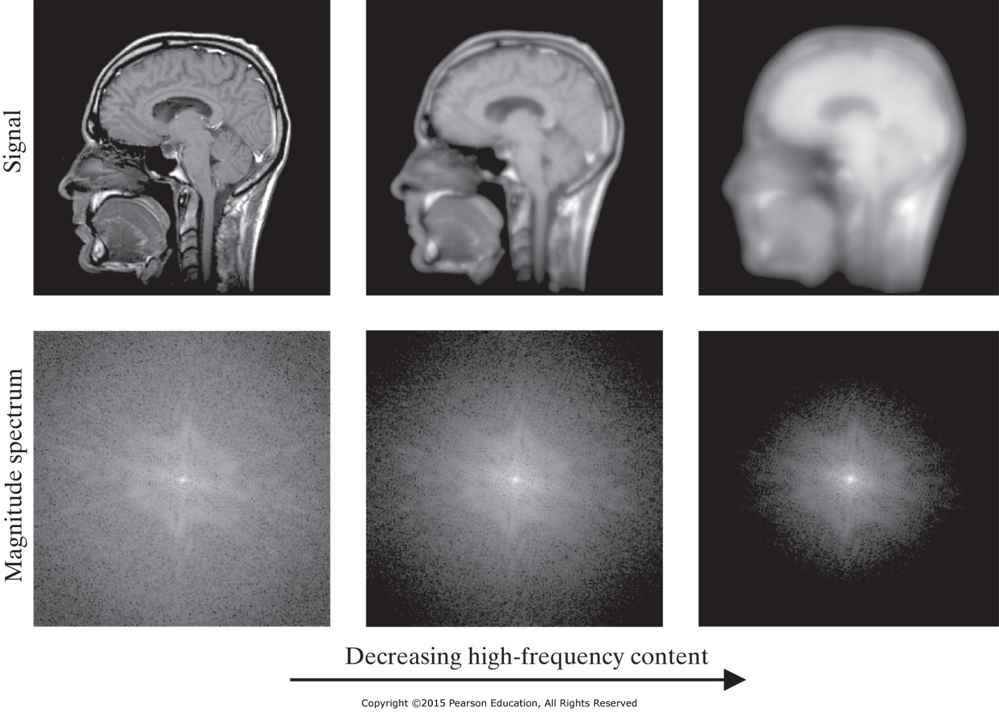
Examples of Fourier Transform
Three images of decreasing spatial variation (from left to right) and the associated magnitude spectra [depicted as log(1 + |F(u, υ)|)].

Slide 30
Examples of Fourier Transform
>> img1 = imread('\\PHYSICSSERVER\MBingabr\BiomedicalImaging\mri.tif');
>> imshow(img1)
>> size(img1)
ans = 256 256
>> FFT_img1 = fftshift(fft2(img1));
>> Abs_FFT_img1 = abs(FFT_img1)
>> surf(Abs_FFT_img1(110:140,110:140))
>> Log_Abs_FFT_img1=log10(1+Abs_FFT_img1);
>> surf(Log_Abs_FFT_img1(110:140,110:140))

Slide 31
Properties of the Fourier Transform
Properties are used in theory and application to simplify calculation.
Linearity
$$ℱ_{2D}\left(a_{1}f+a_{2}g\right)\left(u,v\right)=a_{1}F\left(u,v\right)+a_{2}G(u,v)$$
Translation
If F(u,v) is the FT of a signal f(x, y) then the FT of a translated signal
$$f_{x_{0}y_{0}}\left(x,y\right)=f\left(x−x_{0},y−y_{0}\right)$$
is
$$ℱ_{2D}\left(f_{x_{0}y_{0}}\right)\left(u,v\right)=F\left(u,v\right)e^{−j2π(ux_{0}+vy_{0})}$$

Slide 32
Properties of the Fourier Transform
Conjugation and Conjugate Symmetry
If F(u,v) is the FT of a signal f(x, y) then
$$F(u,v)=F^{∗}(−u,−v)$$
$$F_{R} (u,v)=F_{R} (−u,−v)$$
$$F_{I} (u,v)={−F}_{I} (−u,−v)$$
$$|F\left(u,v\right)|=|F \left(−u,−v\right)|$$
$∠F\left(u,v\right)=$ $−∠F\left(−u,−v\right)$

Slide 33
Properties of the Fourier Transform
Scaling
If F(u,v) is the FT of a signal f(x, y) and if
$$f_{ab}\left(x,y\right)=f\left(ax,by\right)$$
$$ℱ_{2D}\left(f_{ab}\right)\left(u,v\right)=\frac{1}{|ab|}F\left(\frac{u}{a},\frac{v}{b}\right)$$
Example
Detectors of many medical imaging systems can be modeled as rect functions of different sizes and locations. Compute the FT of the following
$$f\left(x,y\right)=rect\left(\frac{x−x_{0}}{∆x},\frac{y−y_{0}}{∆y}\right)$$

Slide 34
Properties of the Fourier Transform
Rotation
If F(u,v) is the FT of a signal f(x, y) and if
$$f_{θ}\left(x,y\right)=f\left(xcosθ−ysinθ,xsinθ+ycosθ\right)$$
$$ℱ_{2D}\left(f_{θ}\right)\left(u,v\right)=F\left(u cosθ−v sinθ, u sinθ+v cosθ\right)$$
If f(x, y) is rotated by an angle $θ$, then its FT is rotated by the same angle.

Slide 35
Properties of the Fourier Transform
Convolution
The Fourier transform of the convolution
f(x, y) * g(x, y) is
$$ℱ_{2D}\left(f∗g\right)\left(u,v\right)=F\left(u , v \right)G\left(u , v \right)$$
Convolution property simplify the difficult task of calculating the convolution in the spatial domain to multiplication in the frequency domain.
Example:
Find Fourier transform of the convolution f(x, y) * g(x, y)
$$f\left(x,y\right)=sinc\left(Ux, Vy\right)$$
$$g\left(x,y\right)=sinc\left(Vx, Uy\right)$$
0 < V ≤ U

Slide 36
Properties of the Fourier Transform
Product
The Fourier transform of the product f(x, y) g(x, y) is the convolution of their Fourier transforms.
$$ℱ_{2D}\left(fg\right)\left(u,v\right)=F\left(u , v \right)∗G\left(u , v \right)$$
$$=\int_{−∞}^{∞}{\int_{−∞}^{∞}{G\left(ξ,η\right)F\left(u−ξ,v−η\right)dξdη}}$$
Separable Product
If f(x, y)=f₁(x)f₂(y) then $ℱ_{2D}\left(f\right)\left(u,v\right)=F_{1}(u)F_{2}(v)$
where
$${F_{1}\left(u\right)=ℱ}_{1D}\left(f_{1}\right)\left(u\right)$$

Slide 37
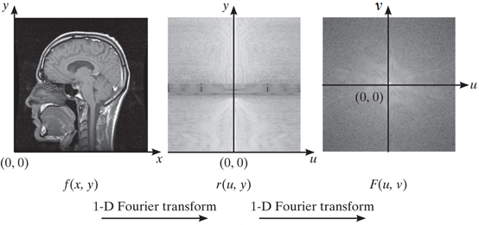
Separability of the Fourier Transform
The Fourier transform F(u,v) of a 2-D signal f(x, y) can be calculated using two simpler 1-D Fourier transforms, as follows:
1)
$$r\left(u,y\right)=\int_{−∞}^{∞}{f\left(x,y\right)e^{−j2πux}dx}$$
For every y.
$$F\left(u,v\right)=\int_{−∞}^{∞}{r\left(u,y\right)e^{−j2πvy}dy}$$
2)
For every x.

Slide 38
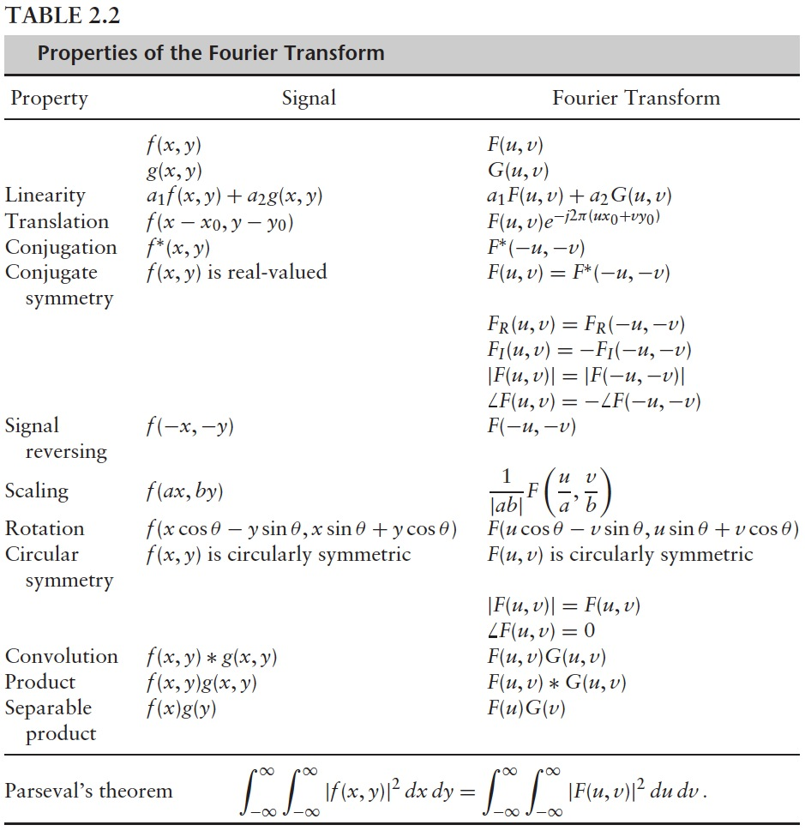

Slide 39
Transfer Function
The system’s transfer function (frequency response) H(u, v) is the Fourier transform of the system’s PSF h(x,y).
$$H\left(u,v\right)=\int_{−∞}^{∞}{\int_{−∞}^{∞}{h\left(x,y\right)e^{−j2π(ux+vy)}dxdy}}$$
The inverse Fourier transform of the transfer function H(u, v) is the point spread function h(x,y).
$$h\left(x,y\right)=\int_{−∞}^{∞}{\int_{−∞}^{∞}{H\left(u,v\right)e^{−j2π(ux+vy)}dudv}}$$
The output G(u, v) of a system in response to input F(u, v) is the product of the input with the transfer function H(u, v) .
$$G\left(u,v\right)=H\left(u , v \right)F\left(u , v \right)$$

Slide 40
Transfer Function
Example: Consider an idealized system whose PSF is
h(x,y) = δ(x-x₀, y-y₀). What is the transfer function H(u, v) of the system, and what is the system output g(x, y) to an input signal f(x, y).

Slide 41
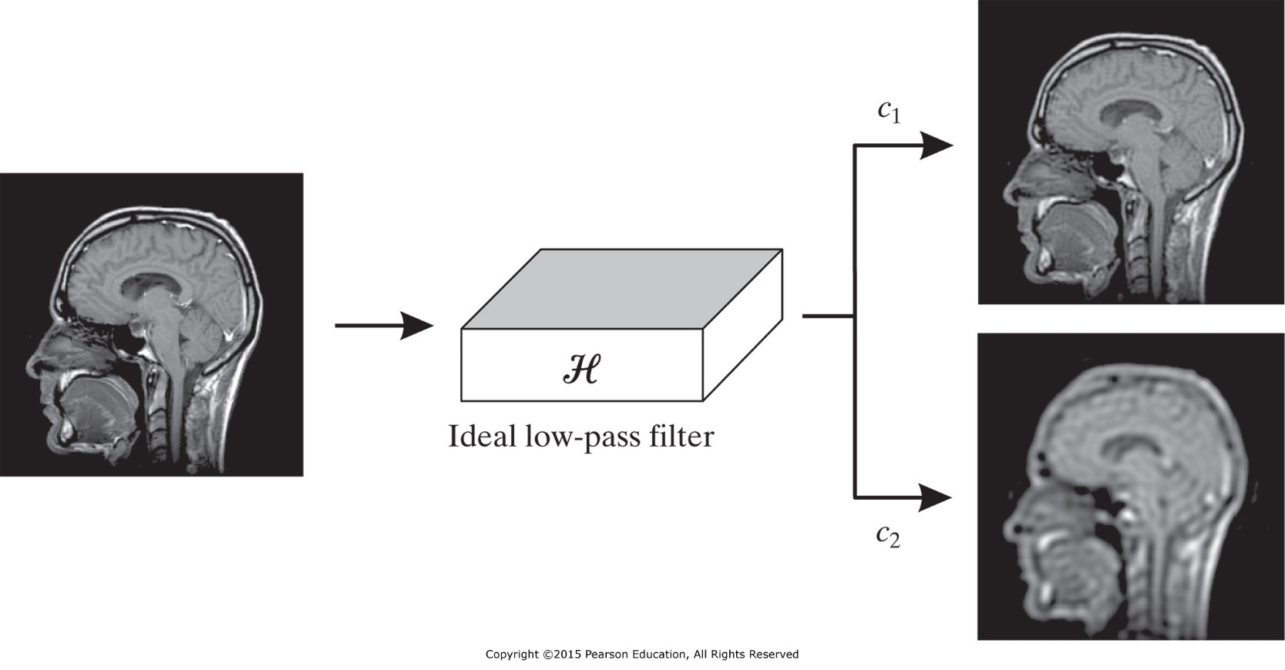
Low Pass Filter
$$H(u,v)=\left\{\begin{matrix}1, \text{for} \sqrt{u^{2}+v^{2}}≤c \\ 0\text{, }\text{for} \sqrt{u^{2}+v^{2}}>c\end{matrix}\right.$$
$$G(u,v)=\left\{\begin{matrix}F(u,v) \text{for} \sqrt{u^{2}+v^{2}}≤c \\ 0\text{, }\text{for} \sqrt{u^{2}+v^{2}}>c\end{matrix}\right.$$
c₁ > c₂

Slide 42
Circular Symmetry
Often, the performance of a medical imaging system does not depend on the orientation of the patient with respect to the system. The independence arises from the circular symmetry of the PSF.
A 2-D signal f(x, y) is circularly symmetric if
f_{θ}(x, y) = f(x, y) for every θ.

Slide 43
Property of Circular Symmetry
f(x, y) is even in both x and y
F(u, v) is even in both u and v
| F(u, v) | = F(u, v)
$∠$F(u, v) = 0
f(x, y) = f(r) where
F(u, v) = F(q) where
$$r=\sqrt{x^{2}+y^{2}}$$
$$q=\sqrt{u^{2}+v^{2}}$$
f(r) and F(q) are one dimensional signals representing two dimensional signals

Slide 44
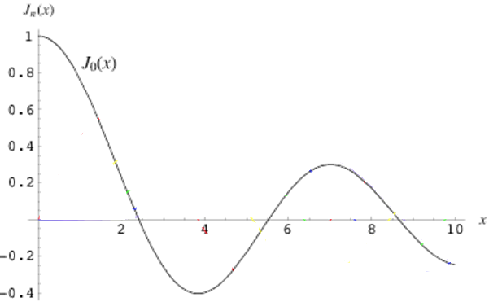
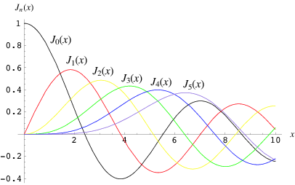
Hankel Transform
The relationship between f(r) and F(q) is determined by Hankel Transform.
$$F\left(q\right)=2π\int_{0}^{∞}{f\left(r\right)J_{o}\left(2πqr\right)rdr}$$
$$F\left(q\right)=ℋ\left\{f(r)\right\}$$
where J₀(r) is the zero-order Bessel function of the first kind.
$$J_{0}\left(r\right)=\frac{1}{π}\int_{0}^{π}{\cos\left(rsinφ\right)dφ}$$
The n^{th}-order Bessel function
$$J_{n}\left(r\right)=\frac{1}{π}\int_{0}^{π}{\cos\left(nφ−rsinφ\right)dφ}$$
for n = 0, 1, 2, …

Slide 45
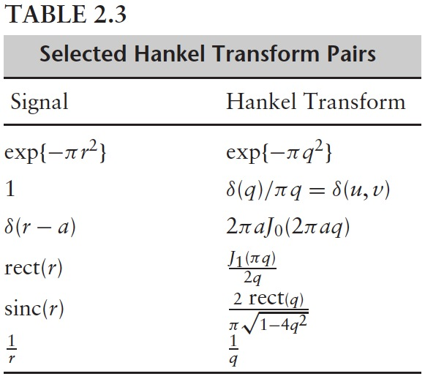
Hankel Transform
The inverse Hankel transform.
$$f\left(r\right)=2π\int_{0}^{∞}{F\left(q\right)J_{o}\left(2πqr\right)qdq}$$
jink function
unit disk

Slide 46
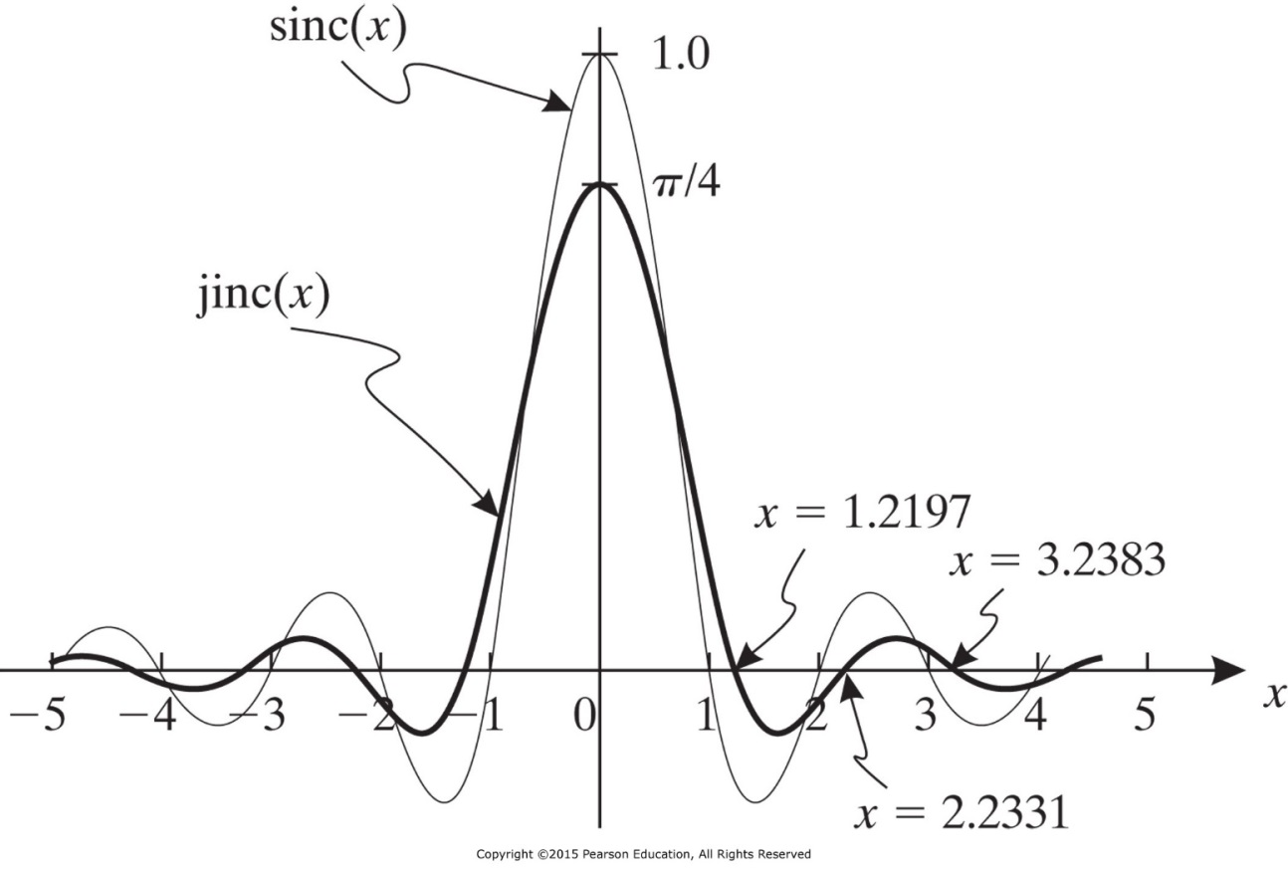
sinc and jink functions
Example
In some medical imaging systems, only spatial frequencies smaller than q₀ can be imaged. What is the function having uniform spatial frequencies within the desk of radius q₀ and what is its inverse Fourier transform.

