Slide 1
Image Quality Chapter 3
Biomedical Engineering
Dr. Mohamed Bingabr
University of Central Oklahoma

Slide 2
Image Quality Factors
Contrast
Resolution
Noise
Artifacts
Distortion
Accuracy

Slide 3
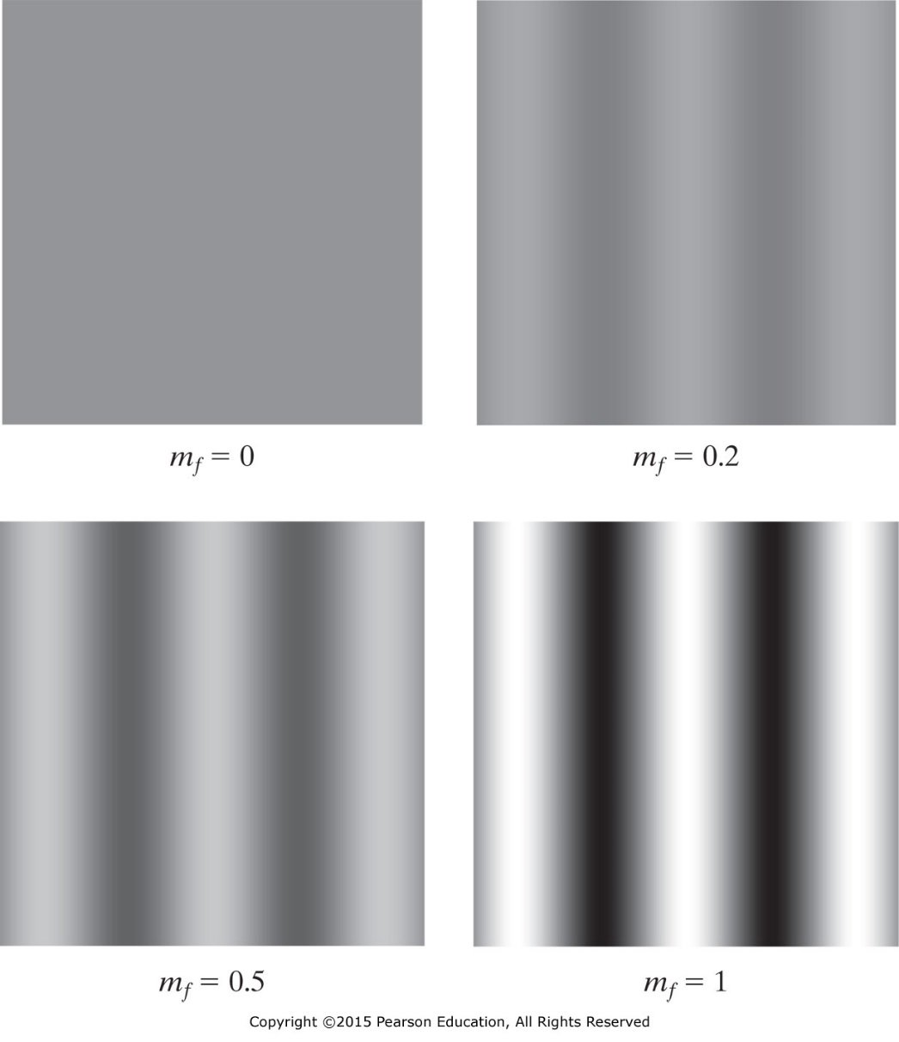
Contrast
Differences between image intensity of an object and surrounding objects or background.
How to quantify contrast for
image f(x, y)?
Modulation
$$m_{f}=\frac{f_{max}−f_{min}}{f_{max}+f_{min}}$$
$$0≤m_{f}≤1$$
$$f\left(x,y\right)=A+B sin⁡(2πu_{0}x)$$
$$m_{f}=\frac{B}{A}$$

Slide 4
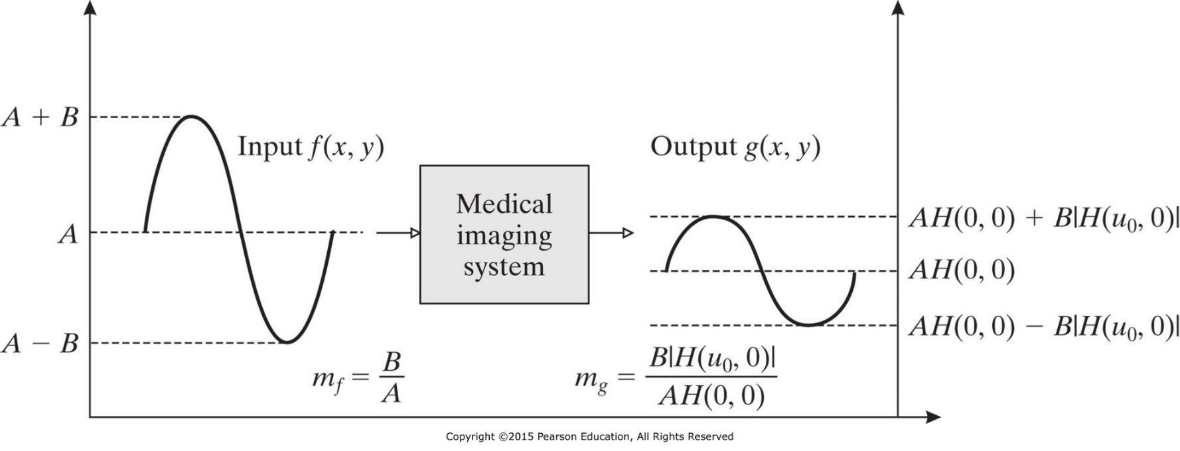
Output Image Modulation
$$f\left(x,y\right)=A+B sin⁡(2πu_{0}x)$$
$$m_{f}=\frac{B}{A}$$
$$g\left(x,y\right)=AH(0, 0)+B \left|H\left(u_{0}, 0\right)\right|sin⁡(2πu_{0}x)$$
$$m_{g}=\frac{B\left|H\left(u_{0}, 0\right)\right|}{AH(0, 0)}=m_{f}\frac{\left|H\left(u_{0}, 0\right)\right|}{H(0, 0)}$$

Slide 5
Modulation Transfer Function (MTF)
The MTF quantifies degradation of contrast as a function of spatial frequency.
Isotropic system
$$MTF\left(u\right)=\frac{m_{g}}{m_{f}}=\frac{\left|H\left(u, 0\right)\right|}{H(0, 0)}$$
For most medical imaging
$$0≤MTF\left(u\right)≤MTF\left(0\right)=1$$

Slide 6
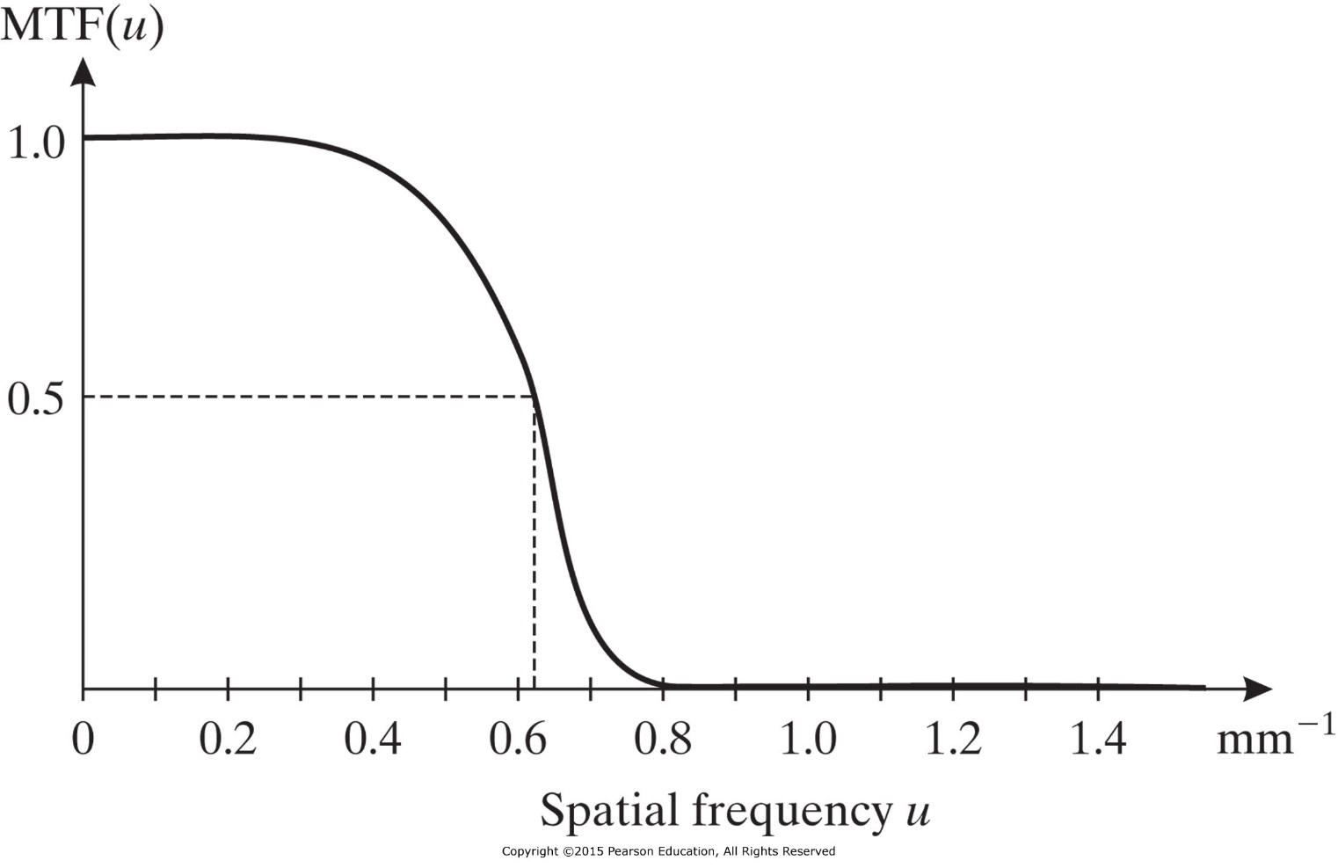
Modulation Transfer Function (MTF)
Example
What can we learn about the contrast behavior of an imaging system with this MTF?
output
input
u = 0.3
u = 0.5
u = 0.7

Slide 7
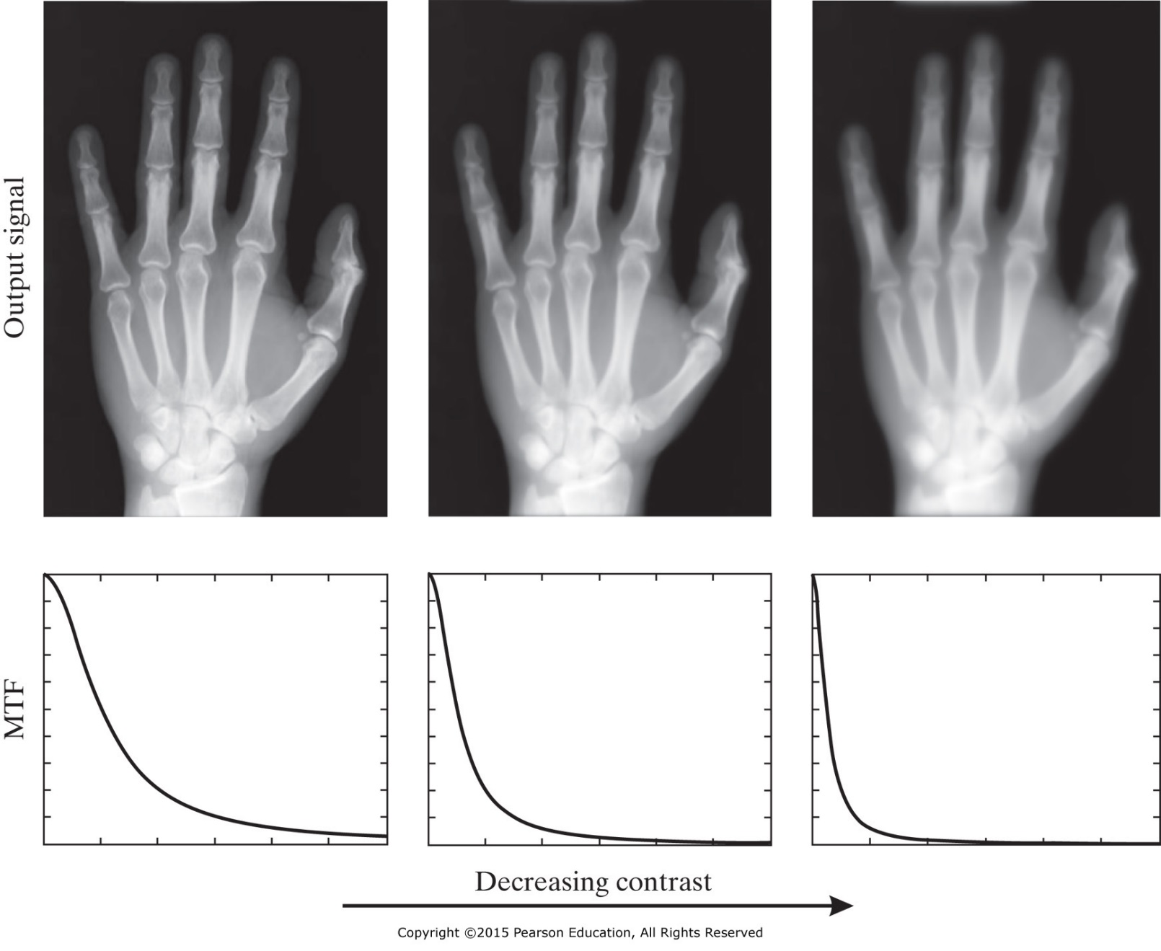
Modulation Transfer Function (MTF)

Slide 8
MTF for Nonisotropic System
The MTF for nonisotropic system (PSF changes with orientation) has an orientation-dependence response.
$$MTF\left(u,v\right)=\frac{m_{g}}{m_{f}}=\frac{\left|H\left(u, v\right)\right|}{H(0, 0)}$$
For most nonisotropic medical imaging
$$0≤MTF\left(u,v\right)≤MTF\left(0,0\right)=1$$

Slide 9
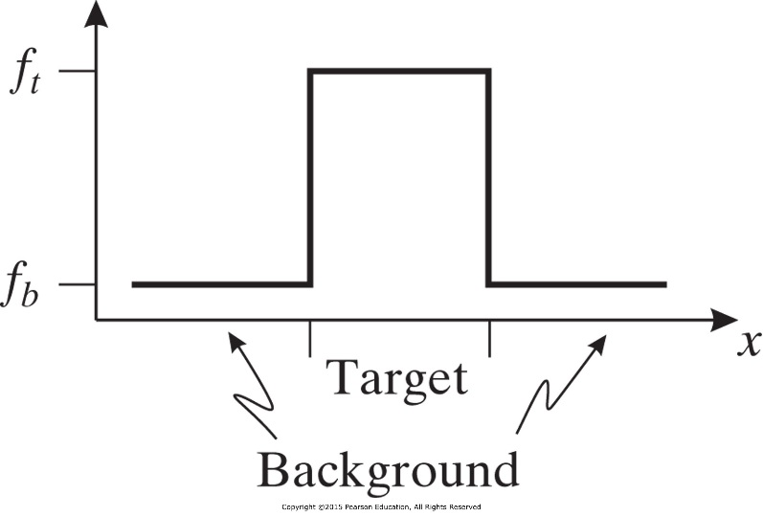
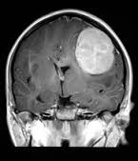
Local Contrast
Detecting a tumor in a liver requires local contrast.
$$C=\frac{f_{t}−f_{b}}{f_{b}}$$
Example
Consider an image showing an organ with intensity I₀ and a tumor with intensity I_{t} > I₀.
What is the local contrast of the tumor? If we add a constant intensity I_{c} > 0 to the image, what is the local contrast? Is the local contrast improved?

Slide 10
Resolution
The ability of a medical imaging system to accurately depict two distinct events in space, time, or frequency as separate.
Resolution could be spatial, temporal, or spectral resolution.
High resolution is equivalent to low smearing

Slide 11
Line Spread Function (LSF)
Line impulse (line source)
${f\left(x,y\right)=δ}_{l}\left(x, y\right)=δ(xcosθ+ysinθ−l)$
A vertical line impulse through the origin (θ = 0; l = 0)
$f\left(x, y\right)=δ_{l}(x)$
The output g(x, y) of isotropic system for the input f(x, y) is
$$g\left(x,y\right)=\int_{−∞}^{∞}{\int_{−∞}^{∞}{h\left(ξ,η\right)f\left(x−ξ,y−η\right)dξdη}}$$
$$=\int_{−∞}^{∞}{\left[\int_{−∞}^{∞}{h\left(ξ,η\right)δ_{l}\left(x−ξ\right)dξ}\right]dη}$$
$$=\int_{−∞}^{∞}{h(x,η)dη}$$
Line spread function (LSF)

Slide 12
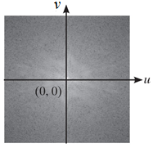
Line Spread Function (LSF)
Line spread function l(x) is related to the PSF h(x, y)
$$l(x)=\int_{−∞}^{∞}{h(x,η)dη}$$
l(x)
Since the PSF h(x, y) is isotropic then l(x) is symmetric
l(x) = l(-x)
The 1-D Fourier transform L(u) of the LSF l(x) is
$$L(u)=\int_{−∞}^{∞}{l(x)e^{−j2πux}dx}$$
$$L(u)=\int_{−∞}^{∞}{\int_{−∞}^{∞}{h(x,η)e^{−j2πux}dxdη}}$$
L(u) = H(u, 0)

Slide 13
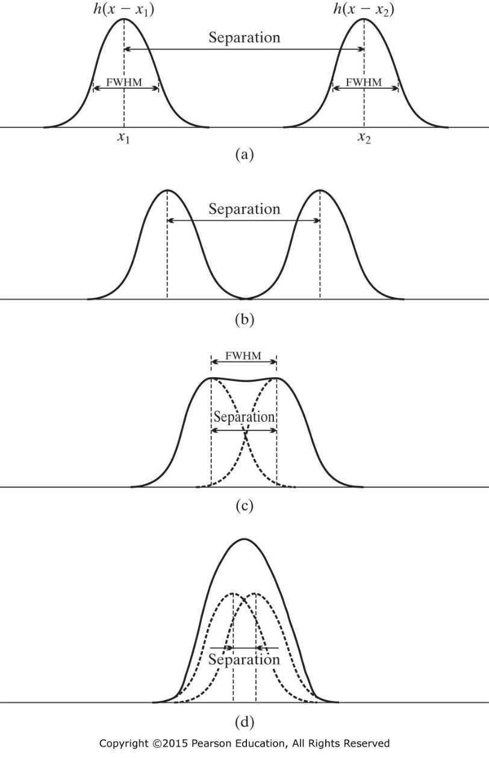
Full Width at Half Maximum (FWHM)
The FWHM is the (full) width of the LSF (or the PSF) at one-half its maximum value. FWHM is measured in mm.
The FWHM of LSF (or PSF) is used to quantify resolution of medical imaging.
The FWHM equals the minimum distance that two lines (or point) must be separated in space in order to appear as separate in the recording image.

Slide 14
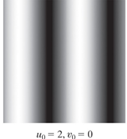
Resolution & Modulation Transfer Fun.
For a sinusoidal input $B\sin\left(2πux\right)$ the spatial resolution is 1/u.
$$g\left(x,y\right)=\left|H\left(u, 0\right)\right|Bsin⁡(2πux)$$
$$g\left(x,y\right)=MTF\left(u\right)H(0,0) Bsin⁡(2πux)$$
The spatial frequency of the output depends on MTF cutoff frequency u_{c}.
Example:
The MTF depicted in the Figure becomes zero at spatial frequencies larger than 0.8 mm⁻¹. What is the resolution of the system?

Slide 15
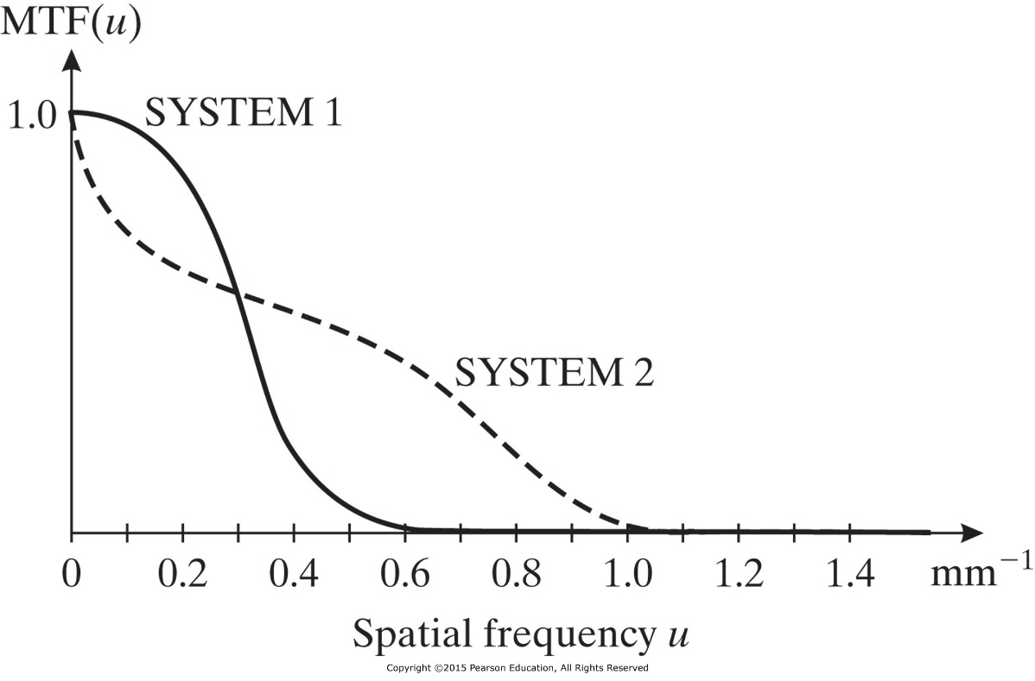
Resolution & Modulation Transfer Fun.
Two systems with similar MTF curves but with different cutoff frequencies will have different resolutions, where MTF with higher cutoff frequency will have better resolution.
It is complicated to use MTF to compare the frequency resolutions of two systems with different MTF curves.

Slide 16
Resolution & Modulation Transfer Fun.
MTF can be directly obtained from the LSF.
$$MTF\left(u\right)=\frac{\left|L\left(u\right)\right|}{L(0)}$$
for every u
Example: Sometimes, the PSF, LSF, or MTF can be described by a mathematical function by either fitting observed data or by making simplifying assumptions about the shape. Assume that the MTF of a medical imaging system is given by.
$$MTF\left(u\right)=e^{−πu^{2}}$$
What is the FWHM of this system?

Slide 17
Subsystem Cascade
If resolution is quantified by FWHM, then the FWHM of the overall system (cascaded subsystems) is determined by
$$R=\sqrt{R_{1}^{2}+R_{2}^{2}+…+R_{K}^{2}}$$
The overall resolution of the system is determined by the poorest resolution of the subsystems (largest R_{i}) .
If contrast and resolution are quantified using the MTF, then the MTF of the overall system will be given by
$MTF\left(u,v\right)={MTF}_{1}(u,v)$ ${MTF}_{2}\left(u,v\right)…{MTF}_{K}(u,v)$

Slide 18
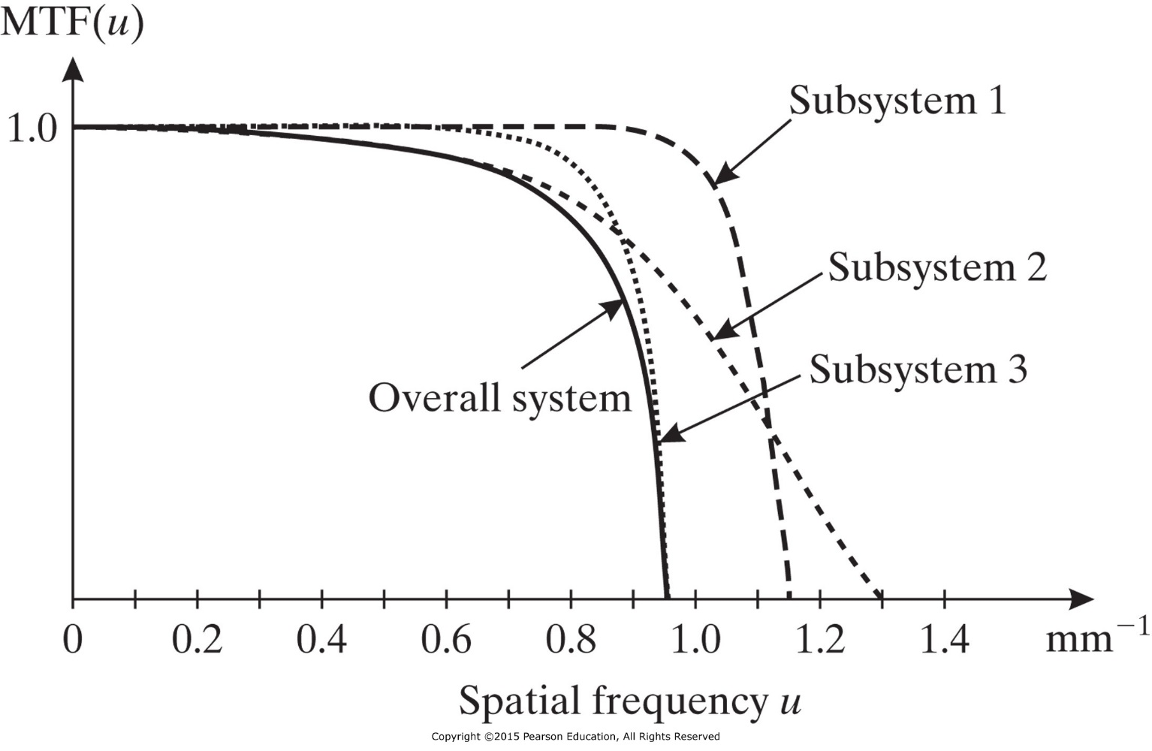
Subsystem Cascade
The MTF of the overall system will always be less than the MTF of each subsystem.
Resolution can depend on spatial and orientation, such ultrasound images.

Slide 19
Subsystem Cascade
Example 3.5: Consider a 1-D medical imaging system with PSF h(x) composed of two subsystems with Gaussian PSFs of the form
$$h_{1}\left(x\right)=\frac{1}{\sqrt{2π}σ_{1}}\text{exp}\left\{\frac{−x^{2}}{{2σ}_{1}^{2}}\right\}$$
$$h_{2}\left(x\right)=\frac{1}{\sqrt{2π}σ_{2}}\text{exp}\left\{\frac{−x^{2}}{{2σ}_{2}^{2}}\right\}$$
What is the FWHM of this system?
Hint: from example 2.4
$$h_{1}\left(x\right){∗h}_{2}\left(x\right)=\frac{1}{\sqrt{2π\left(σ_{1}^{2}+σ_{2}^{2}\right)}}\text{exp}\left\{\frac{−x^{2}}{2\left(σ_{1}^{2}+σ_{2}^{2}\right)}\right\}$$

Slide 20
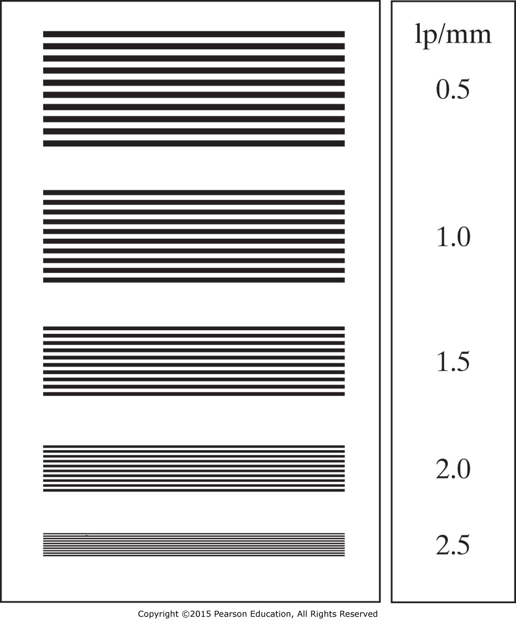
Resolution Tool (bar phantom)
Line pairs per millimeter (lp/mm)

Slide 21
Noise
Noise is any random fluctuation in an image; noise generally interferes with the ability to detect a signal in an image.
Source and amount of noise depend on the imaging method used and the particular medical imaging system at hand.
Example of source of noise: random arrival of photon in x-ray, random emission of gamma ray photon in nuclear imaging, thermal noise during amplifying radio frequency in MRI.

Slide 22
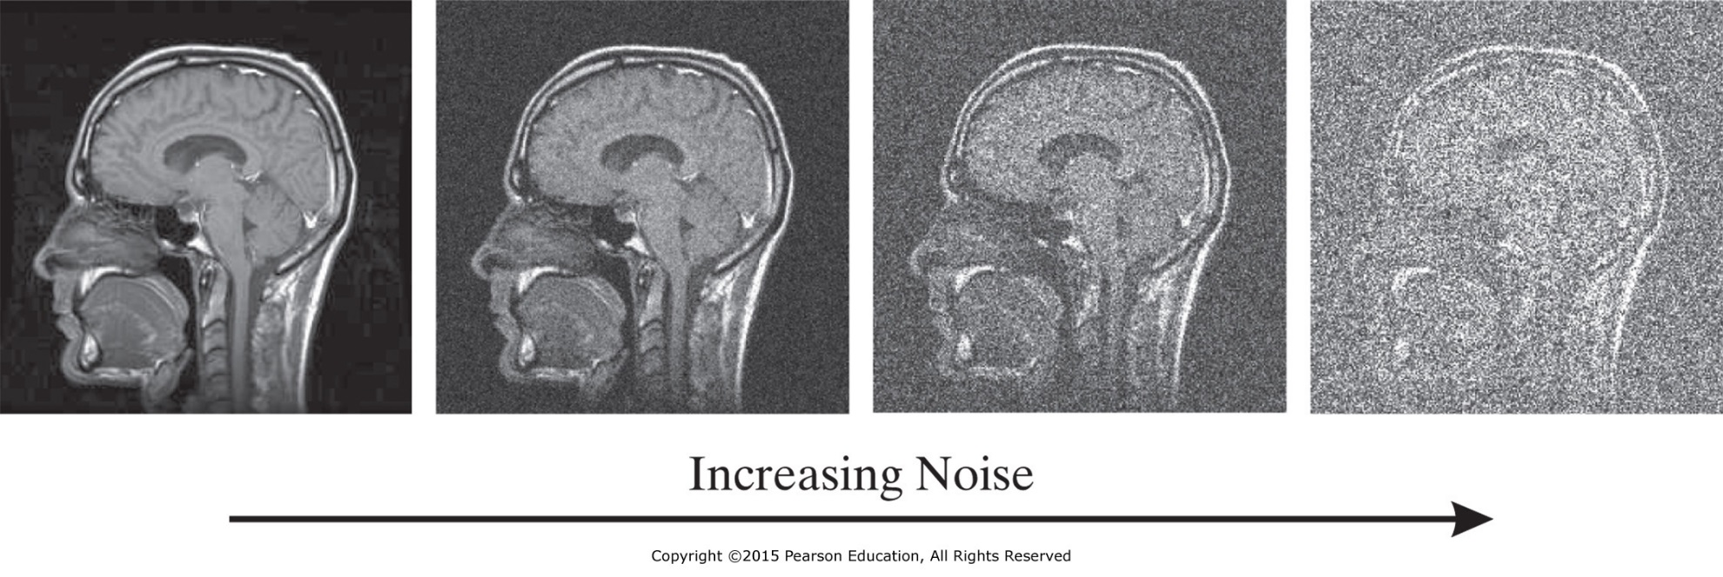
Noise
Random Variables
Different repetitions of an experiment may produce different observed values. These values is the random variable.
Probability Distribution Function (PDF)
$$P_{N}\left(η\right)=\text{Pr}\left[N≤η\right]$$

Slide 23
Continuous Random Variables
Probability density function (pdf)
$$p_{N}\left(η\right)=\frac{dP_{N}(η)}{dη}$$
$$\int_{−∞}^{∞}{p_{N}\left(η\right)dη=1}$$
$$p_{N}\left(η\right)≥0$$
$$P_{N}(η)=\int_{−∞}^{η}{p_{N}\left(u\right)du}$$
$$μ_{N}=E\left[N\right]=\int_{−∞}^{∞}{{ηp}_{N}\left(η\right)dη}$$
Expected Value (mean)
Variance
$$σ_{N}^{2}=\text{Var}\left[N\right]=E[{\left(N−μ_{N}\right)}^{2}]=\int_{−∞}^{∞}{{\left(η−μ_{N}\right)}^{2}p_{N}\left(η\right)dη}$$

Slide 24
Uniform Random Variable
Probability density function ( pdf )
The probability distribution function (PDF)
$$P_{N}\left(η\right)=\left\{\begin{matrix}0, \text{for} η<a \\ \frac{η−a}{b−a}, \text{for} a≤η<b \\ 1, \text{for} η>b\end{matrix}\right.$$
$$μ_{N}=\frac{a+b}{2}$$
$$σ_{N}^{2}=\frac{{(b−a)}^{2}}{12}$$

Slide 25
Gaussian Random Variable
Probability density function (pdf)
$$p_{N}\left(η\right)=\frac{1}{\sqrt{2πσ^{2}}}e^{−{\left(η−μ\right)}^{2}/2σ^{2}}$$
The probability distribution function
$$P_{N}\left(η\right)=\int_{−∞}^{η}{{\frac{1}{\sqrt{2πσ^{2}}}e}^{−(τ−{μ)}^{2}/2σ^{2}}dx}$$
$$P_{N}\left(η\right)=\frac{1}{2}+erf\left(\frac{η−μ}{σ}\right)$$
$$σ_{N}^{2}=σ^{2}$$
$$μ_{N}=μ$$

Slide 26
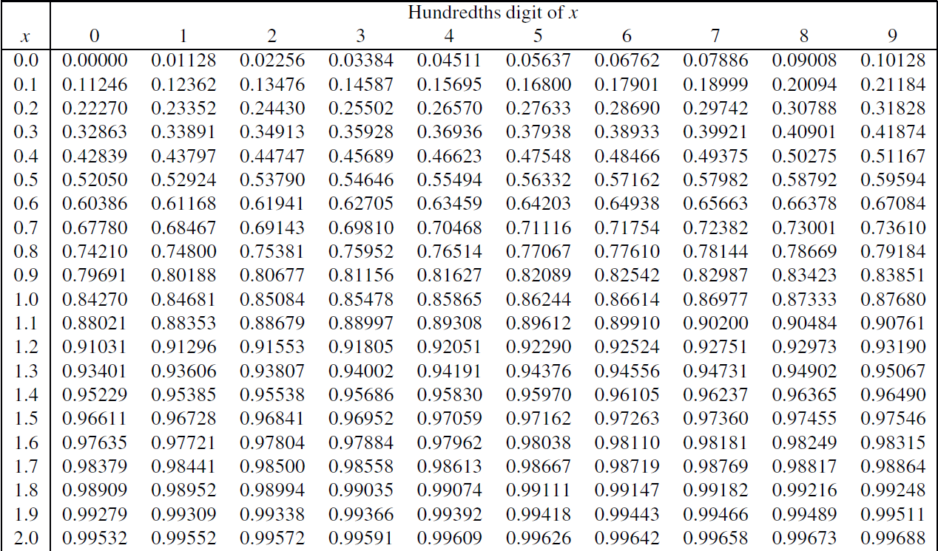
$$\operatorname{erf}\left(x\right)=\frac{2}{\sqrt{π}}\int_{0}^{x}{e^{−t^{2}}dt}$$

Slide 27
Discrete Random Variables
Probability mass function (pmf)
$$\text{0}≤\text{Pr}\left[N=η_{i}\right]≤1, \text{for} i=1,2,3,…,k$$
$$\sum_{i=1}^{k}{\text{Pr}\left[N=η_{i}\right]=1}$$
The probability distribution function
$$P_{N}\left(η\right)=\text{Pr}\left[N≤η\right]=\sum_{\text{all} η_{i}=η}{\text{Pr}\left[N≤η_{i}\right]}$$
$$μ_{N}=E\left[N\right]=\sum_{i=1}^{k}{η_{i}\text{Pr}\left[N=η_{i}\right]}$$

Slide 28
Poisson Random Variables
$$σ_{N}^{2}=\text{Var}\left[N\right]=\text{E}\left[{\left(N−μ_{N}\right)}^{2}\right]=\sum_{i=1}^{k}{{\left(η_{i}−μ_{N}\right)}^{2}\text{Pr}\left[N=η_{i}\right]}$$
Poisson Random Variable
Used in radiographic and nuclear medicine to statically characterize the distribution of photons count.
$$\text{Pr}\left[N=k\right]=\frac{a^{k}}{k^{!}}e^{−a}, \text{for} k=0,1,…$$
$$μ_{N}=a$$
$$σ_{N}^{2}=a$$

Slide 29
Poisson Random Variables
Example
In x-ray imaging, the Poisson random variable is used to model the number of photon that arrive at a detector in time t, which is a random variable referred to as a Poisson process and given that notation N(t). The PMF of N(t) is given by
$$\text{Pr}\left[N(t)=k\right]=\frac{{(λt)}^{k}}{k^{!}}e^{−λt}$$
Where λ is called the average rate of the x-ray photons.
What is the probability that there is no photon detected in time t?

Slide 30
Exponential Random Variables
Example
For the Poisson process of previous example, the time that the first photon arrives is a random variable, say T.
What is the pdf $p_{T}(τ)$ of a random variable T?
$$p_{T}(t)=λe^{−λt}$$
This is the pdf of exponential random variable T

Slide 31
Independent Random Variables
It is usual in imaging experiments to consider more than one random variable at a time.
The sum S of the random variable N₁, N₂, …, N_{m} is a random variable with pdf $p_{S}(η)$
$$μ_{s}=μ_{1}+μ_{2}+…+μ_{m}$$
Random variables are not necessary independent
When random variables are independent
$$σ_{S}^{2}=σ_{1}^{2}+σ_{2}^{2}+…+σ_{m}^{2}$$
$$p_{S}\left(η\right)=p_{1}\left(η\right)∗p_{2}\left(η\right)∗…∗p_{m}(η)$$

Slide 32
Independent Random Variables
Example:
Consider the sum S of two independent Gaussian random variables N₁ and N₂, each having a mean of zero and variance of σ².
What are the mean, variance, and pdf of the resulting random variable?

Slide 33
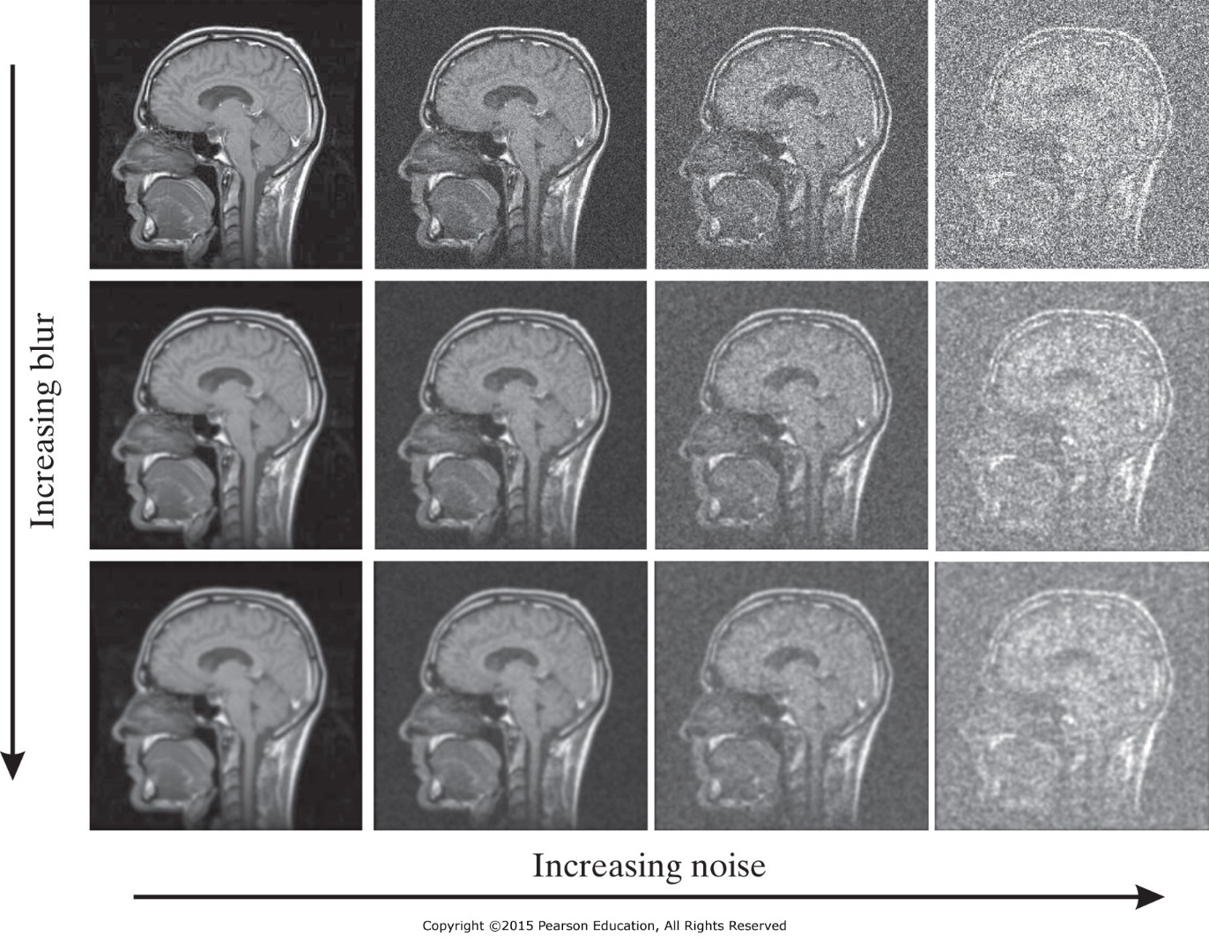
Signal-to-Noise Ration (SNR)
The output of a medical imaging system g is a random variable that consists of two components f (deterministic signal) and g (random noise).

Slide 34
Amplitude SNR
$${SNR}_{a}=\frac{\text{Amplituude}\text{ (}f\text{)}}{\text{Amplituude} \text{(}N\text{)}}$$
Example:
In projection radiography, the number of photons G counted per unit area by an x-ray image intensifier follows a Poisson distribution. In this case we may consider signal f to be the average photon count per unit area (i.e., the mean of G) and noise N to be the random variation of this count around the mean, whose amplitude is quantified by the standard deviation of G.
What is the amplitude SNR of such a system?

Slide 35
Power SNR
$${SNR}_{P}=\frac{\text{Power}\text{ (}f\text{)}}{\text{Power}\text{ (}N\text{)}}$$
Example:
If f(x, y) is the input to a noisy medical imaging system with PSF h(x, y), then output at (x, y) maybe thought of as a random variable G(x, y) composed of signal
h(x, y)*f(x, y) and noise N(x, y), with mean µ_{N}(x, y) and variance $σ_{N}^{2}(x, y)$ .
What is the power SNR of such a system?
Answer depends on the nature of the noise:
1- White noise
2- wide-sense stationary noise

Slide 36
Differential SNR
$${SNR}_{\text{diff}}=\frac{A\left(f_{t}−f_{b}\right)}{σ_{b}(A)}$$
$${SNR}_{\text{diff}}=\frac{CAf_{b}}{σ_{b}(A)}$$
f_{t} and f_{b} are the average image intensities within the target and background, respectively.
A is the area of the target.
C is the contrast.
Noise: random fluctuation of image intensity from its mean over an area A of the background.
Expressing SNR in decibels dB
SNR (in dB) = 20 x log₁₀ SNR (ratio of amplitude)
SNR (in dB) = 10 x log₁₀ SNR (ratio of power)

Slide 37
Differential SNR
Example: consider the case of projection radiography. We may take f_{b} to be the average photon count per unit area in the background region around a target, in which case f_{b} = λ_{b}, where λ_{b} is the mean of the underlying Poisson distribution governing the number of background photons count per unit area. Notice that, in this case, $σ_{b}\left(A\right)=\sqrt{λ_{b}A}$.
What is the average number of background photons counted per unit area, if we want to achieve a desirable differential SNR?

Slide 38
Sampling
Given a 2-D continuous signal f(x, y), rectangular sampling generate a 2-D discrete signal f_{d}(m, n), such that
$f_{d}\left(m,n\right)=f\left(mΔx,nΔy\right),$ for m, n = 0, 1, …
Δx and Δy are the sampling periods in the x and y directions, respectively.
The inverse 1/Δx and 1/Δy are the sampling frequencies in the x and y directions, respectively.
What are the maximum possible values for Δx and Δy such that f(x, y) can be reconstructed from the 2-D discrete signal f_{d}(m, n)?

Slide 39
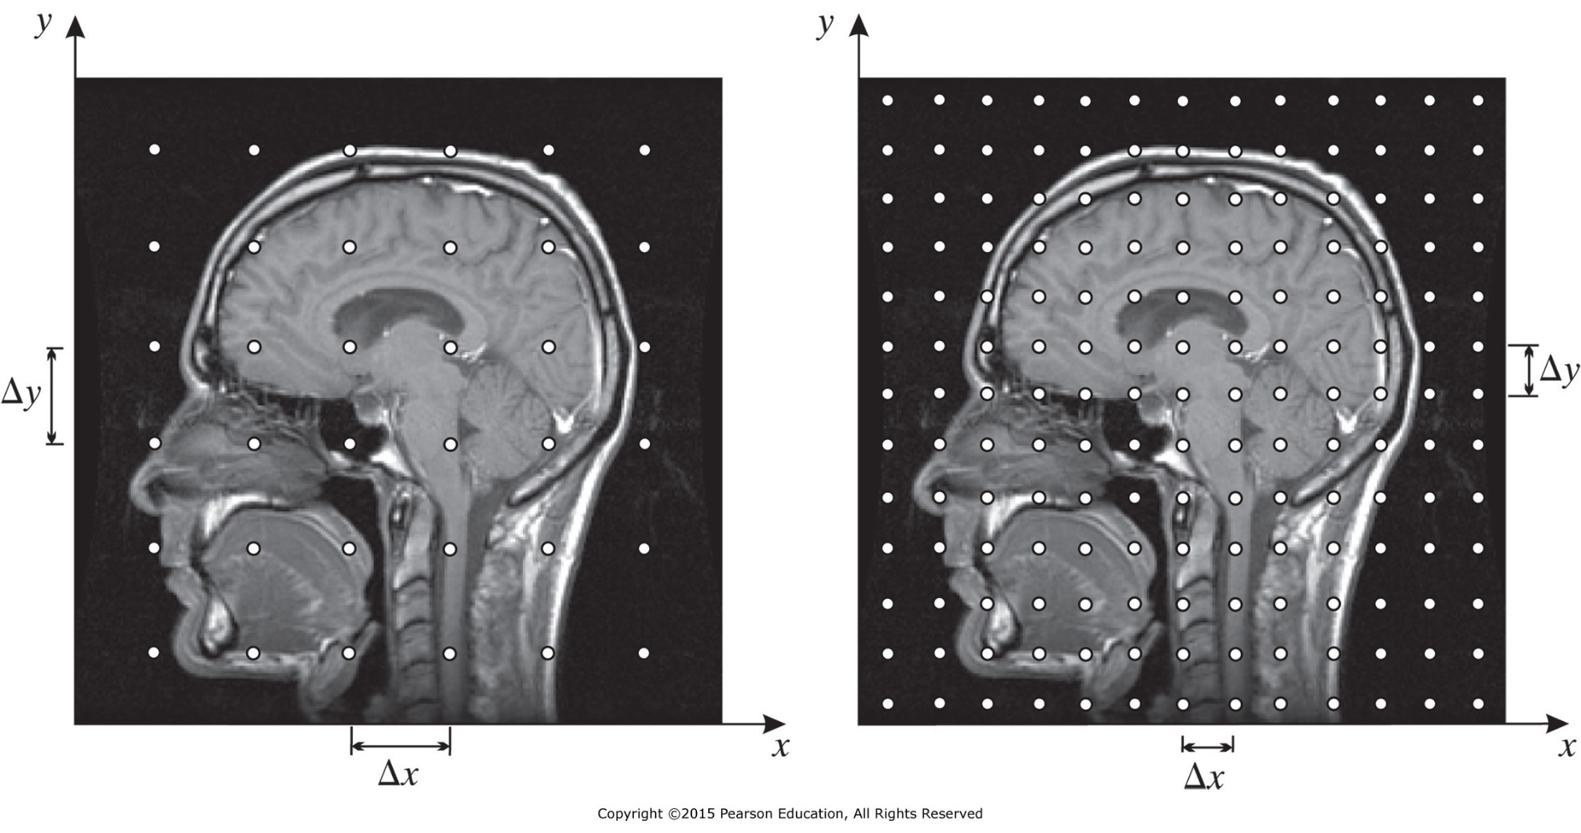
Sampling
Aliasing : When higher frequencies “take the alias of” lower frequencies due to under-sampling.

Slide 40
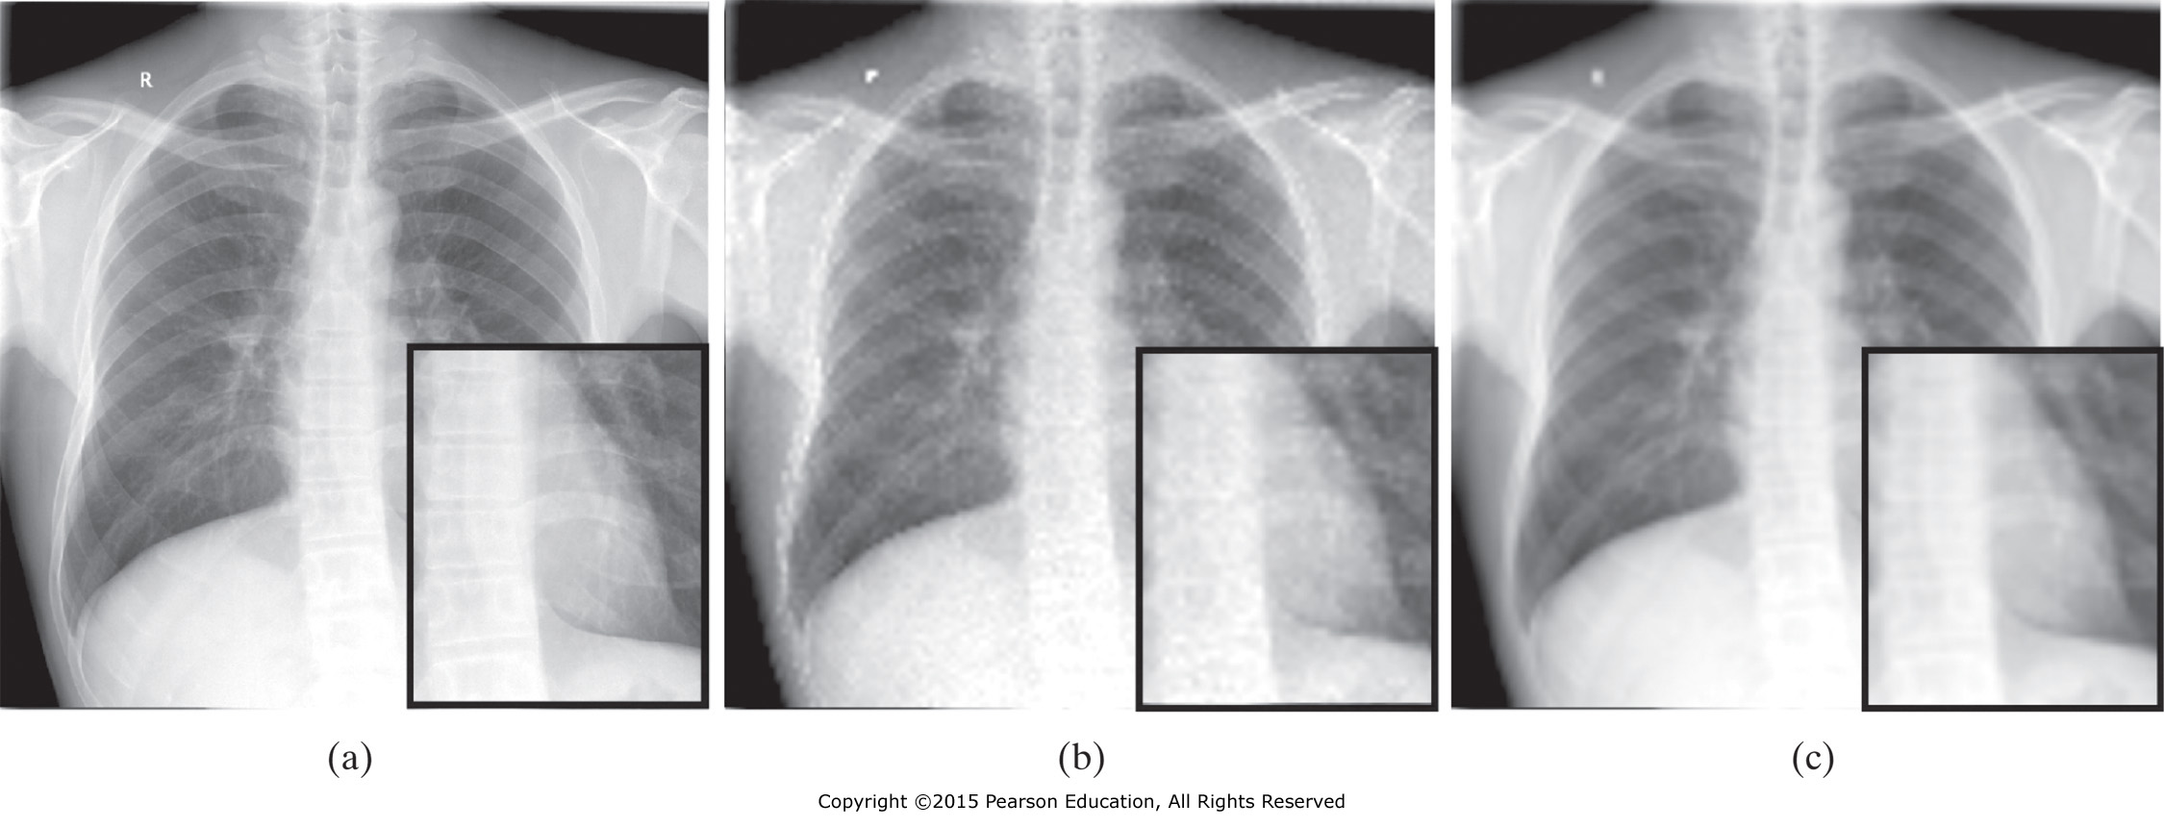
Sampling
Original chest x-ray image and sampled images,
(b) without, and (c) with anti-aliasing

Slide 41
Signal Mode for Sampling
Sampling is the multiplication of the continuous signal f(x, y) by the sampling function
$$f_{s}(x,y)=f(x,y)δ_{s}(x,y;∆x,∆y)$$
$$f_{s}(x,y)=\sum_{m=−∞}^{∞}{\sum_{n=−∞}^{∞}{f(x,y)δ(x−m∆x,y−n∆y)}}$$
Use Fourier series to represent the periodic impulses.
$$f_{s}(x,y)=\sum_{m=−∞}^{∞}{\sum_{n=−∞}^{∞}{f (x,y)\frac{1}{∆x∆y}e^{j2π\left(\frac{mx}{∆x}+\frac{ny}{∆y}\right)}}}$$
Use frequency shifting property.
$$F_{s}(u,v)=\frac{1}{∆x∆y}\sum_{m=−∞}^{∞}{\sum_{n=−∞}^{∞}{F\left(u−m/∆x, v−n/∆y\right)}}$$

Slide 42
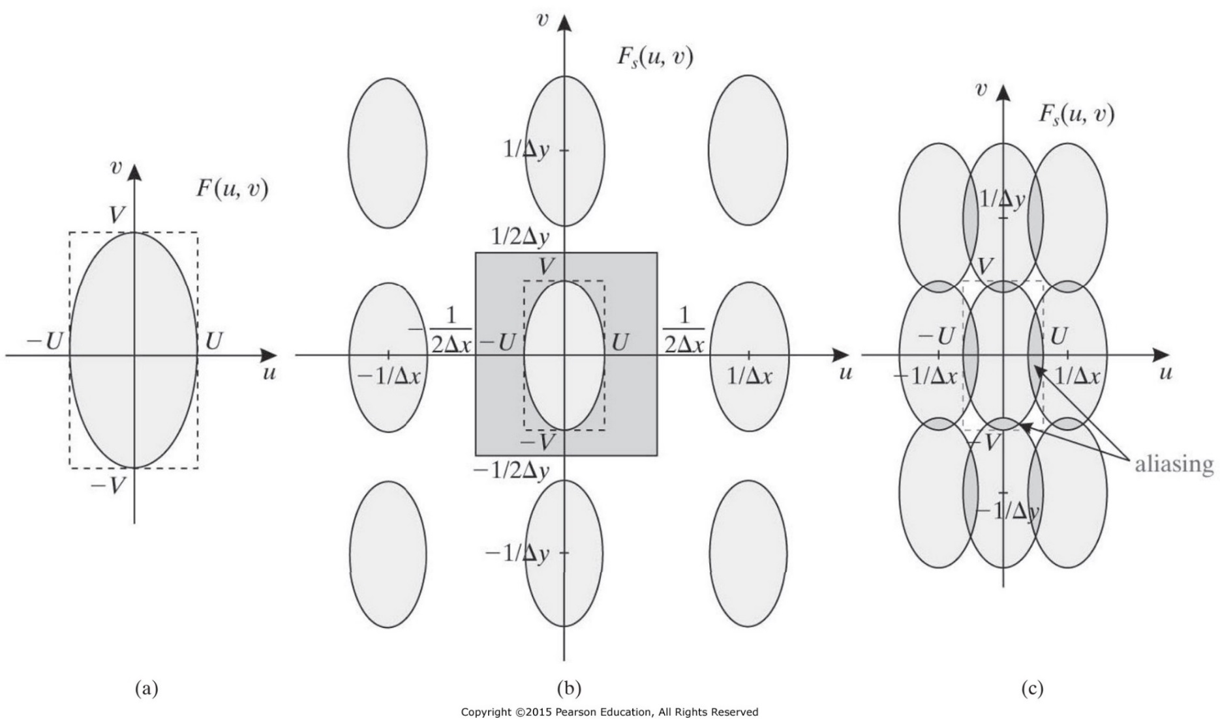
Nyquist Sampling Theorem
$$F_{s}(u,v)=\frac{1}{∆x∆y}\sum_{m=−∞}^{∞}{\sum_{n=−∞}^{∞}{F\left(u−m/∆x, v−n/∆y\right)}}$$
Sampling rate in y = $\frac{1}{∆y}$
Sampling rate in x = $\frac{1}{∆x}$
$\frac{1}{∆x}≥$ $2U$
$\frac{1}{∆y}≥$ $2V$

Slide 43
Anti-Aliasing Filters
The image is passed through low-pass filter to eliminate high frequency components and then it can be sampled at lower sampling rate. The sampling rate equals or more than twice the cutoff frequency of the low-pass filter. This way aliasing will be eliminated but the low pass filtering introduces blurring in the image.
Example
Consider a medical imaging system with sampling period Δ in both the x and y directions.
What is the highest frequency allowed in the images so that the sampling is free of aliasing? If an anti-aliasing filter, whose PSF is modeled as a rect function, is used and we ignored all the side lobes of its transfer function, what are the widths of the rect function?

Slide 44
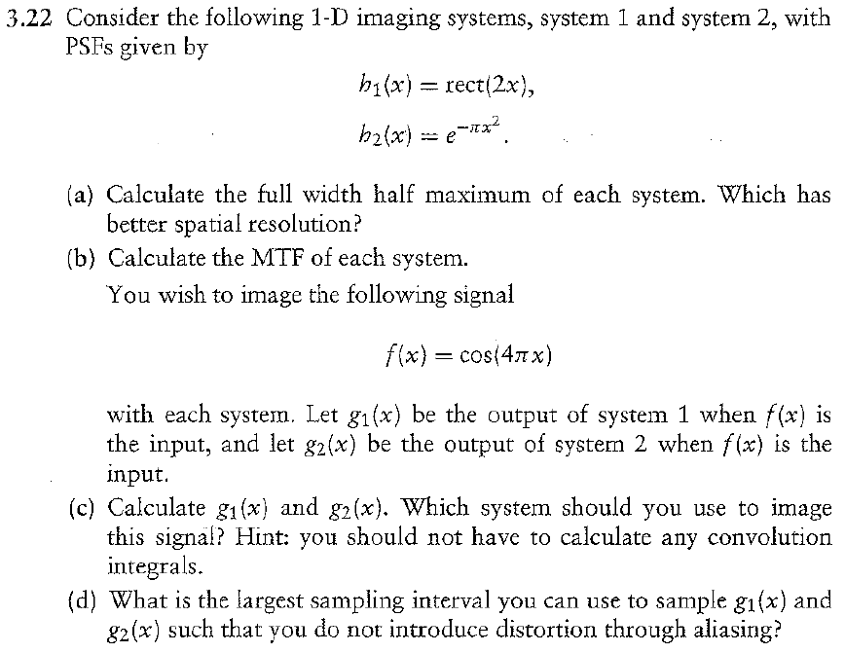
Problem 3.22

Slide 45
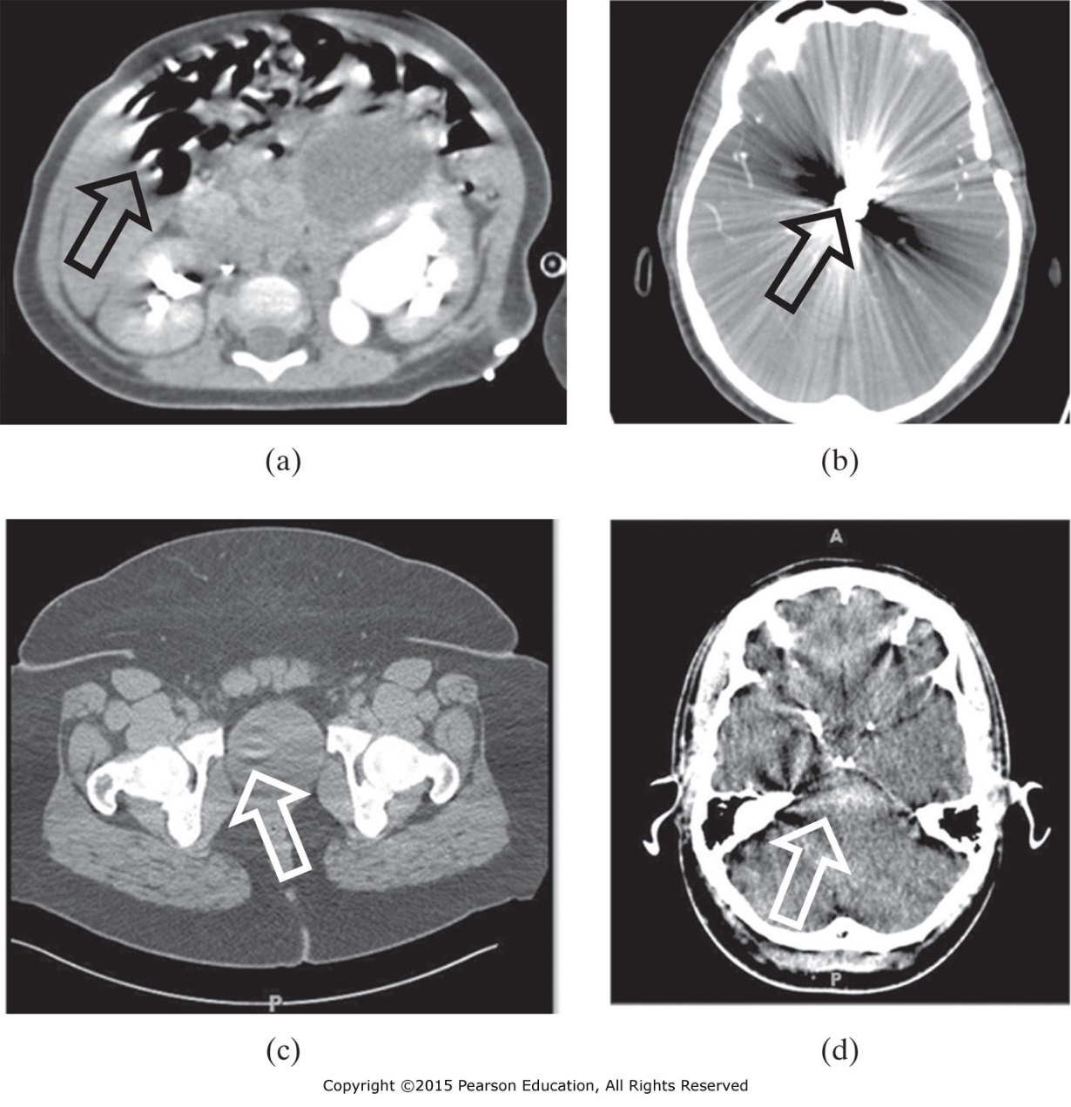
Other Effects
Artifacts
The creation of image features that do not represent valid anatomical or functional objects.
Examples of artifacts in CT: (a) motion artifact, (b) star artifact, (c) ring artifact, and (d) beam hardening artifact

Slide 46
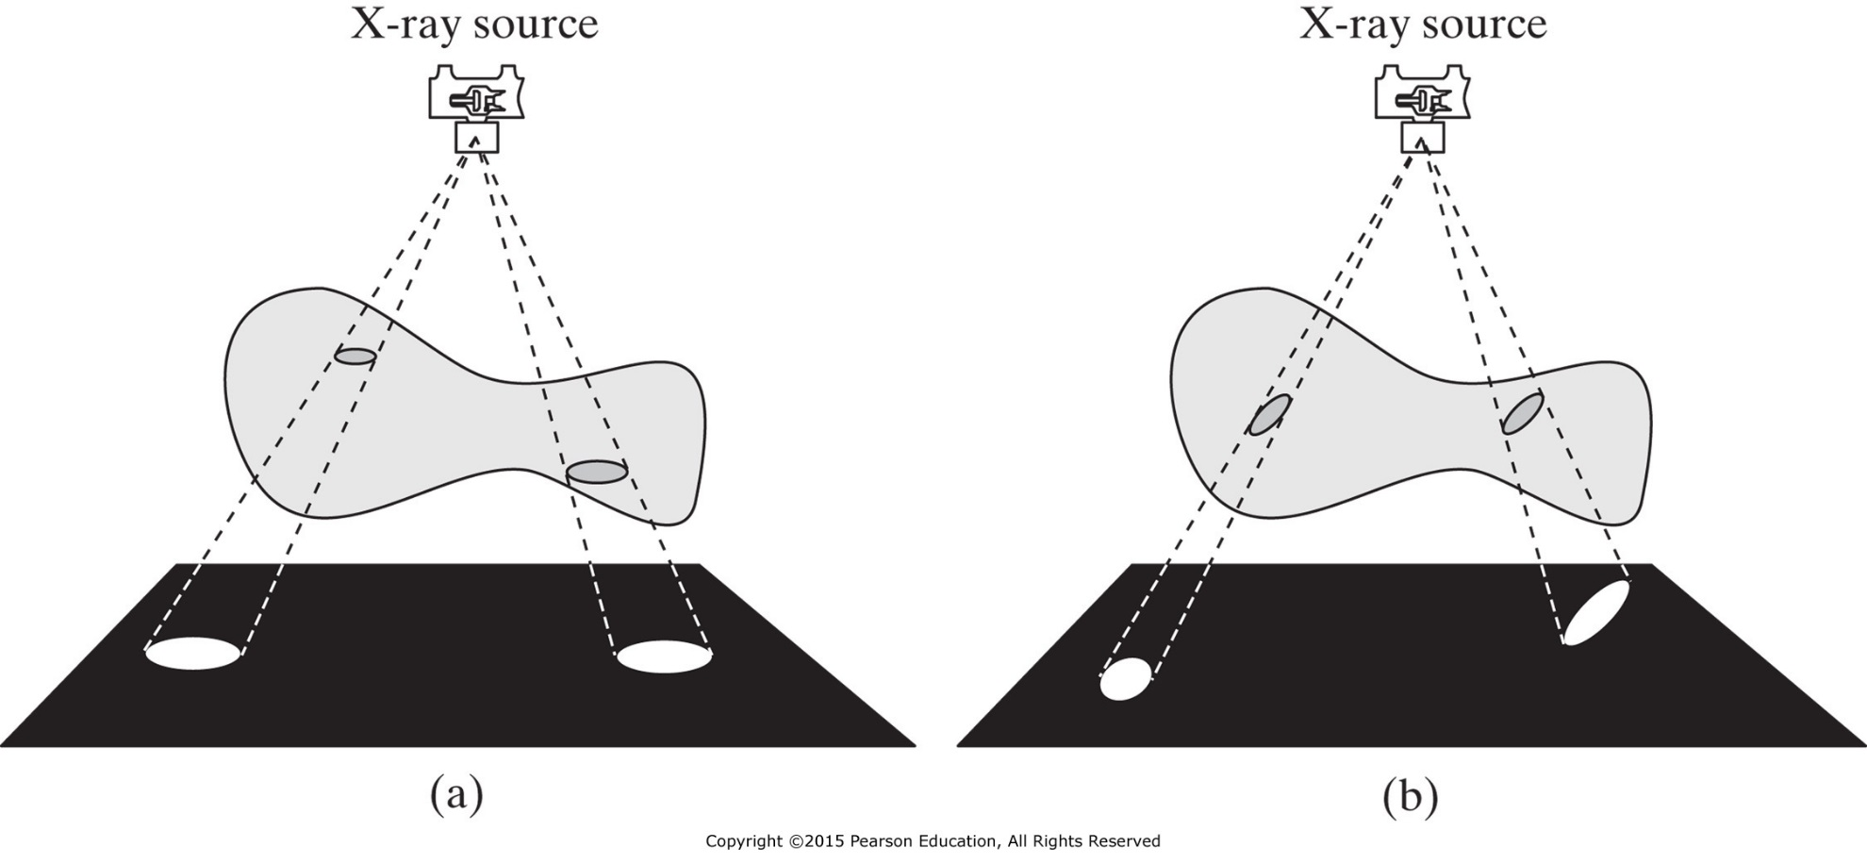
Other Effects
Distortion is geometrical in nature and refers to the inability of a medical imaging system to give an accurate impression of the shape, size, and/or position of objects of interest.

Slide 47
Accuracy
Accuracy of medical image is judged by its ability in helping diagnosis, prognosis, treatment planning, and treatment monitoring. Here “accuracy” means both conforming to truth (free from error) and clinical utility. The two components of accuracy are quantitative accuracy and diagnostic accuracy.

Slide 48
Quantitative Accuracy
Quantitative Accuracy refers to the accuracy, compared with the truth, of numerical values obtained from an image.
Source of Error
1- bias: systematic error
2- imprecision: random error

Slide 49
Diagnostic Accuracy
Diagnostic Accuracy refers to the accuracy of interpretations and conclusions about the presence or absence of disease drawn from image patterns.
Diagnostic accuracy in clinical setting
Sensitivity (true-positive fraction): fraction of patients with disease who the test calls abnormal.
Specificity (true-negative fraction): fraction of patients without disease who the test calls normal.

Slide 50
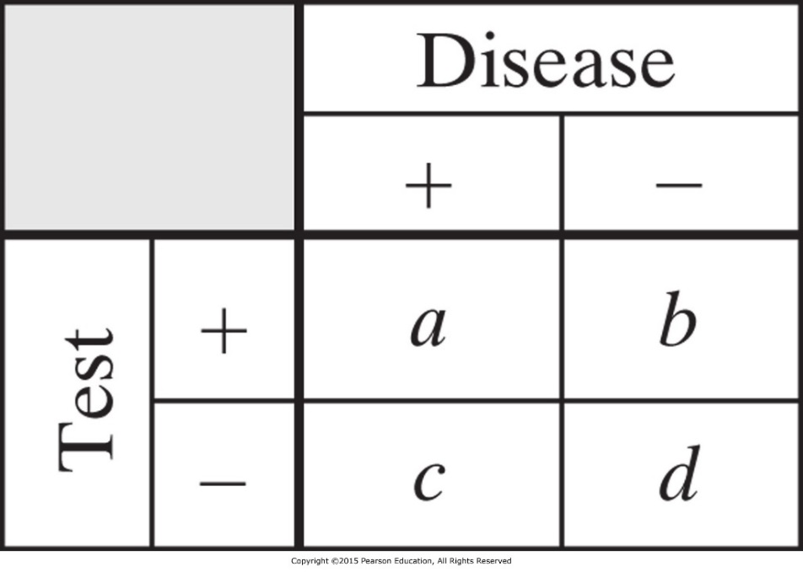
Sensitivity and Specificity
a and b, respectively, are the number of diseased and normal patients who the test calls abnormal.
c and d, respectively, are the number of diseased and normal patients who the test calls normal.
Sensitivity $=\frac{a}{a+c}$
Specificity $=\frac{d}{b+d}$
b
c
Diagnostic Accuracy (DA) $=\frac{a+d}{a+b+c+d}$

Slide 51
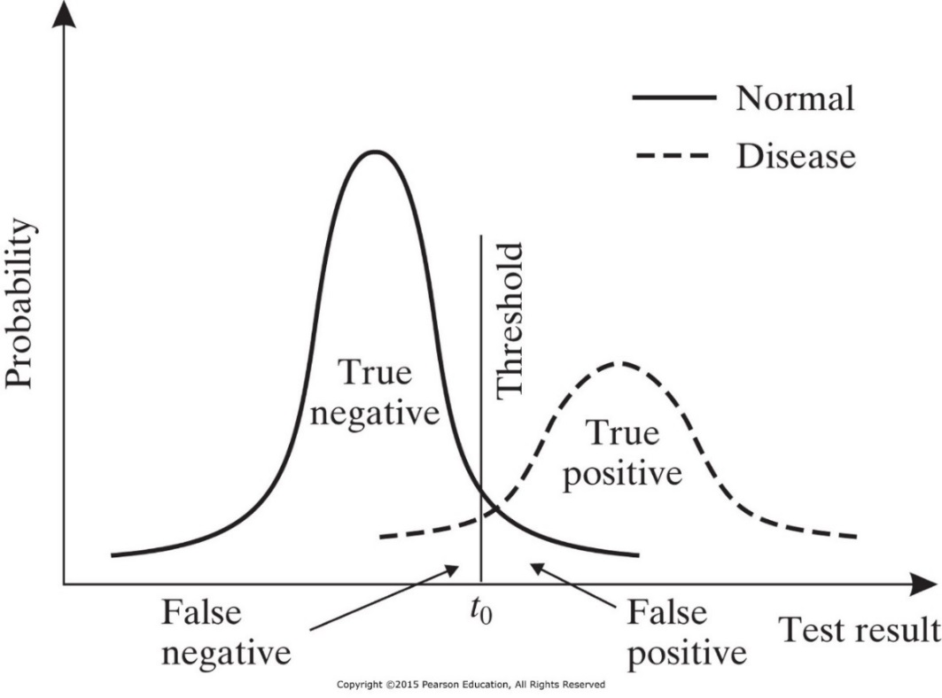
Maximizing Diagnostic Accuracy
Because of overlap in the distribution of parameters values between normal and diseased patients, a threshold must be established to call a study abnormal such that both sensitivity and specificity are maximized.
Choice of Threshold
Relative cost of error
Prevalence: is a statistical concept referring to the number of cases of a disease that are present in a particular population at a given time
PR $=\frac{a+c}{a+b+c+d}$

Slide 52
Diagnostic Accuracy
Two other parameters in evaluating diagnostic accuracy:
Positive predictive value (PPV): fraction of patients called abnormal who actually have the disease.
Negative predictive value (NPV); fraction of persons called normal who do not have the disease.
PPV $=\frac{a}{a+b}$
NPV $=\frac{d}{c+d}$
b
c

Slide 53
Diagnostic Accuracy is not Enough
Example:
Consider a group of 100 patients, among which 10 are diseased and 90 are normal. We simply label all patients as normal. Construct the contingency table for this test and determine the sensitivity, specificity, and diagnostic accuracy of the test.

Slide 54
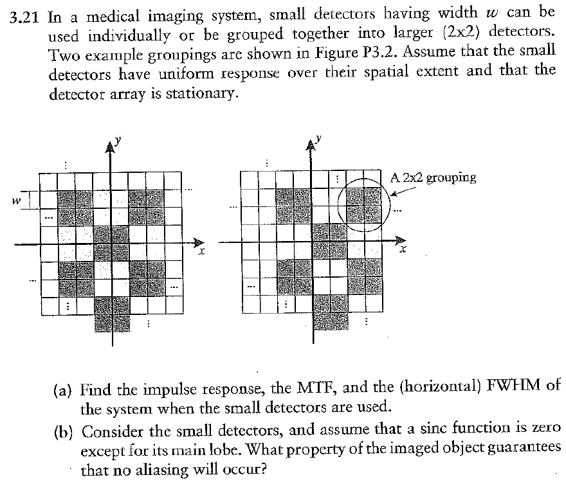
Problem 3.21

