Slide 1
Physics of Radiography Chapter 4
Biomedical Engineering
Dr. Mohamed Bingabr
University of Central Oklahoma

Slide 2
Outline
Introduction
Ionization
Forms of Ionizing Radiation
Nature and Properties of Ionizing Radiation
Attenuation of Electromagnetic Radiation
Radiation Dosimetry

Slide 3
Ionizing Radiation
Forms of radiation: visible light, x-rays, gamma rays, electron beams.
Ionizing radiation: Radiation capable of ejecting electrons from atoms.
Projection radiography and computed tomography: depends on the transmission of ionizing radiation through the body.
Different tissues and organs attenuate differently the intensity of the beam of ionizing radiation.
Projection radiography and computed tomography are anatomical imaging modalities.

Slide 4
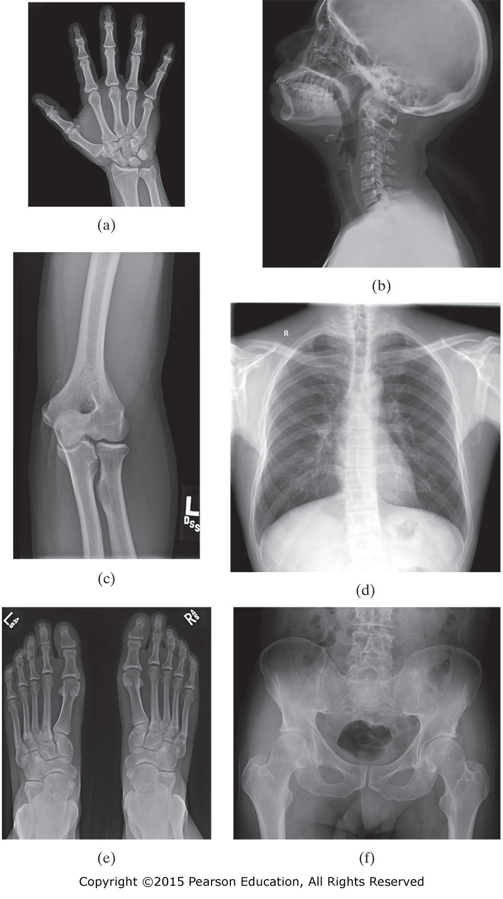
Figure II.1 Representative x-ray transmission images of various parts of the body: (a) hand, (b) head and neck, (c) knee, (d) chest, (e) feet, and (f) pelvis.

Slide 5
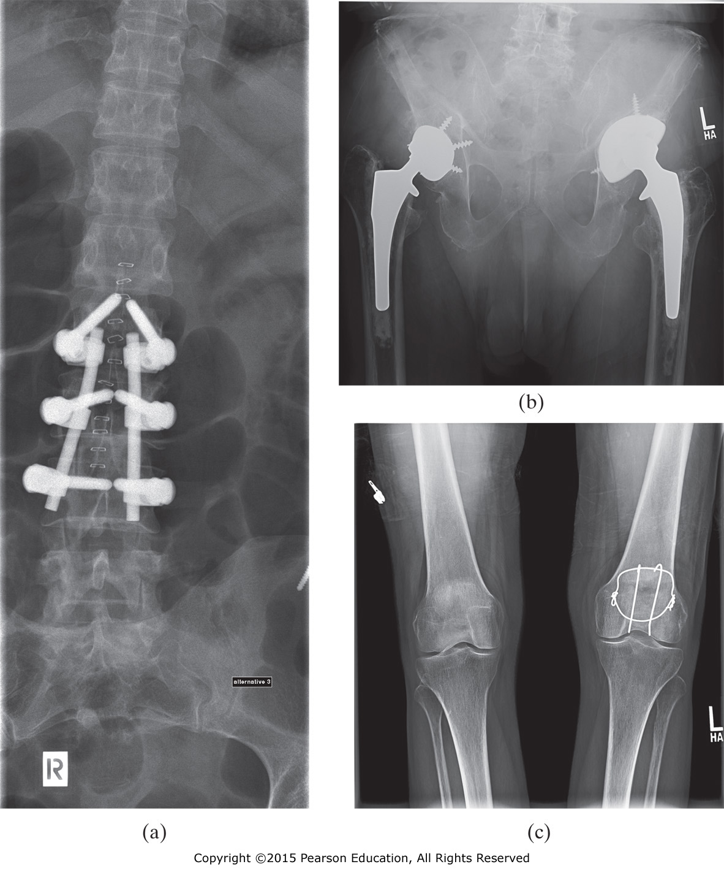
Figure II.2 X-ray images of (a) the spine shown a surgical fixation device, (b) the pelvis showing two artificial hip joints, and (c) the knee showing bone fixation wires.

Slide 6
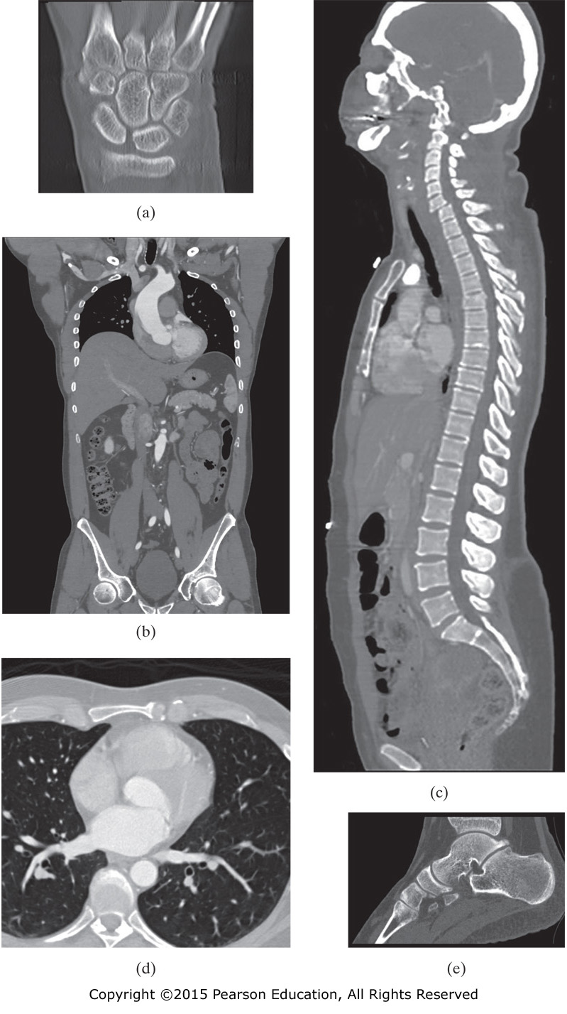
Figure II.3 Various CT images of the human body: (a) wrist, (b) torso and abdomen, (c) complete spine, (d) chest, and (e) ankle.
CT removes overlaying structures by reconstructing cross sections of the body, image with low resolution, require higher x-ray dose to the patient.

Slide 7
Forms of Ionization Radiation
1) X-ray Radiation: Electromagnetic (EM) wave whose frequencies are much higher than those of visible light.
2) Gamma-rays Radiation: EM wave originated from the nucleus
3) Particulate Radiation: electron beam
Particulate and Gamma radiation are the product of radioactive decay.

Slide 8
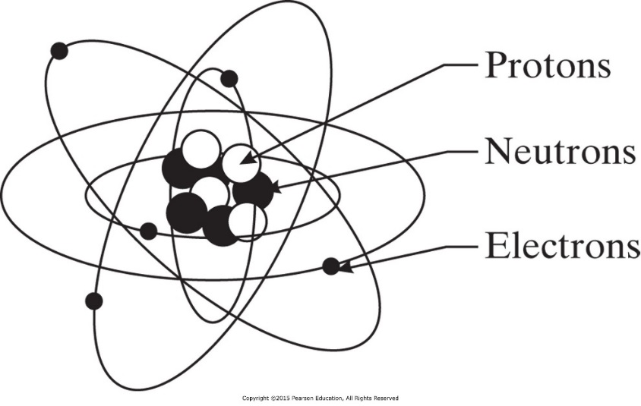
Atomic Structure
An Atom consists of nucleus of protons and neutrons surrounded by orbiting electrons.
Protons and neutrons together are called nucleons.
Proton has a positive charge and the magnitude equals the charge of the electron.
Atomic number Z: equal the number of proton in the nucleus.
Mass number A: the number of nucleons in the nucleus

Slide 9
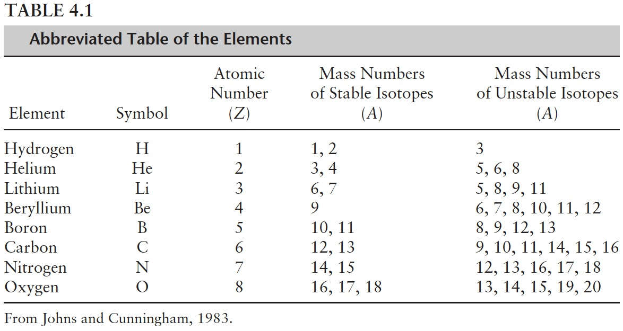
Nuclide
Nuclide refers to any unique combination of protons and neutrons forming a nucleus.
Symbol for nuclide
$${}_{Z}^{A}X$$
Example : Carbon
$${}_{6}^{12}C$$
Unstable nuclides are called radionuclides, and their atoms are radioactive.
$${}_{6}^{14}C$$
$${}_{7}^{14}{N+{}_{−1}^{0}e}$$
Beta particle

Slide 10
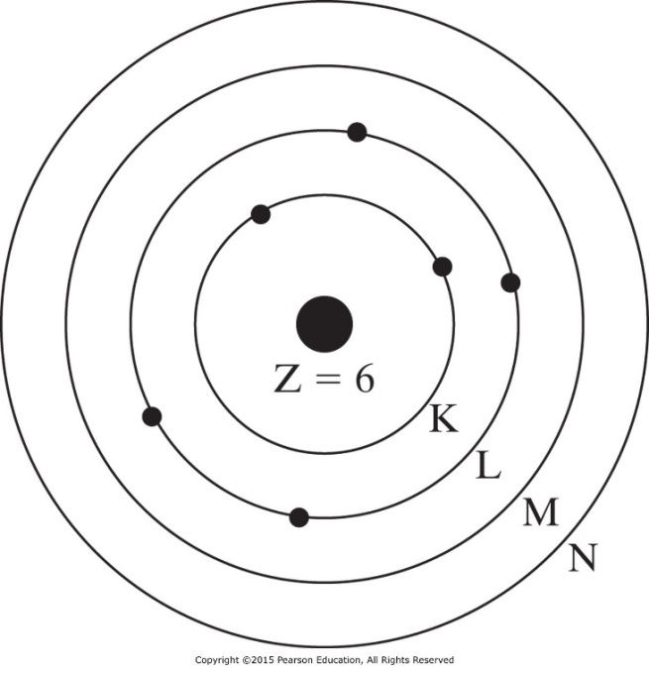
Atomic Structure
The electron orbiting the nucleus are organized into orbits (shells K L M N).
Electrons are restricted to specific quantum states within each shell.
The maximum number of electrons per shell is given by 2n², where n is the shell number (K=1, … N=4).
Atom is in the ground state when electrons are in the lowest orbital shells and within the lowest energy quantum states within each shell.
$${}_{6}^{12}C$$

Slide 11
Electron Binding Energy
It is more favorable for an electron to be bound in an atom rather than to be free.
Electron binding energy is specified in units of electron volts (eV).
1 eV is equal to the kinetic energy gained by an electron when accelerated across one volt potential.
1 eV = 1.6x10⁻¹² ergs = 1.6 x10⁻¹⁹ J
Binding energy facts:
depends on the element,
depends on the shell at which electron resides.
decreases with increasing shell number

Slide 12
Electron Binding Energy
“average” binding energy is specified by the average binding energy of the electrons in a given atom.
Average binding energy of:
Hydrogen = 13.6 eV Air = 34 eV
Lead = 1 keV Tungsten = 4 keV
Example: Suppose an electron is accelerated within a vacuum from a heated cathode held at ground potential to an anode held at 120 kV (DC).
If the anode is made of tungsten, what is the maximum number of tungsten atoms that can be ionized on average?

Slide 13
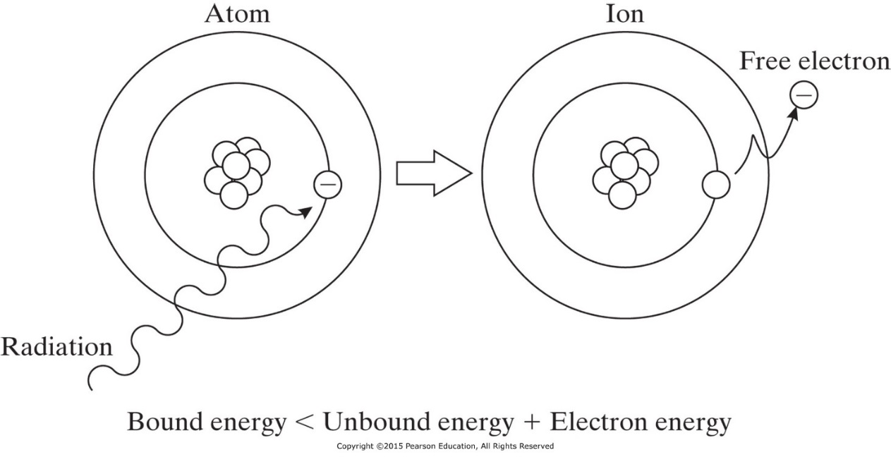
Ionization and Excitation
Ionization: If radiation (particulate or EM) transfers energy to an orbiting electron which is equal to or greater than that electron’s binding energy, then the electron is ejected from the atom.
The positive charged atom and the ejected electron are called an ion pair.
Radiation with energy greater than 13.6 eV is considered ionizing.
The ionization radiation used in medical imaging has energies ranging from 25 keV to 500 keV.

Slide 14
Ionization and Excitation
Excitation: If the radiation energy is less than the binding energy of electron, then the electron is excited and raised to a higher energy state (to more outer orbit) but is not ejected.
In both excitation and ionization, an electron shell is left with a “hole” that must be filled in order to return the atom to a lower energy.
The filling of these holes comprises an important source of secondary radiation called characteristic radiation.

Slide 15
Forms of Ionizing Radiation
Particulate (electron, proton, alpha, or neutron)
Electromagnetic (x-ray, gamma ray)
Particulate ionizing radiation
Particles possess enough kinetic energy to ionize an atom.
Particles involved in medical imaging are electrons, positrons, and alpha.
In projection radiography we consider only electrons.

Slide 16
Particulate Ionizing Radiation
Einstein’s mass-energy equivalence Theory
E = m c²
$$m=\frac{m_{0}}{\sqrt{1−v^{2}/c^{2}}}$$
m₀ is the mass at rest, for electron it is 9.11x10⁻³¹ kg.
Kinetic Energy
$$KE=mc^{2}−m_{0}c^{2}$$
When v is small relative to c, the kinetic energy reduce to
$$KE=\frac{1}{2}mv^{2}$$

Slide 17
Particulate Ionizing Radiation
Example
Consider an electron that has been accelerated between a cathode and anode held at a 120 kV potential difference. Assume the situation is nonrelativistic. What is the speed of the electron when it “slams” into the anode?
1 eV = 1.6 x10⁻¹⁹ J
mass of electron = 9.11 x 10⁻³¹ kg

Slide 18
Electromagnetic Ionizing Radiation
EM radiation comprises an electric wave and a magnetic wave traveling together at right angles to each other.
Examples: radio waves, microwaves, infrared light, visible light, ultraviolet light, x-rays, and gamma rays.
- When EM radiation is conceptualized as “packets” of energy termed photons, then the energy is
E=hv,
where h = 6.626x10⁻³⁴ joules-sec is Plank’s constant and v is the frequency of radiation in Hz.
- When EM radiation is considered as “wave” then its wavelength is
λ=c/v

Slide 19
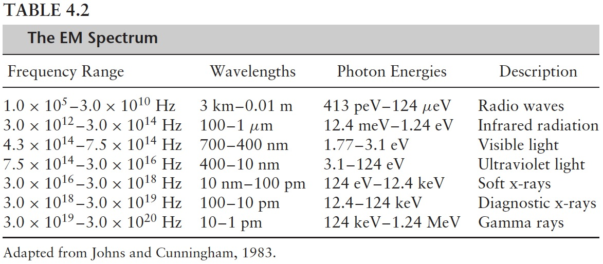
Electromagnetic Ionizing Radiation
Gamma rays are created in the nuclei and x-rays are created in the electron clouds of atoms.

Slide 20
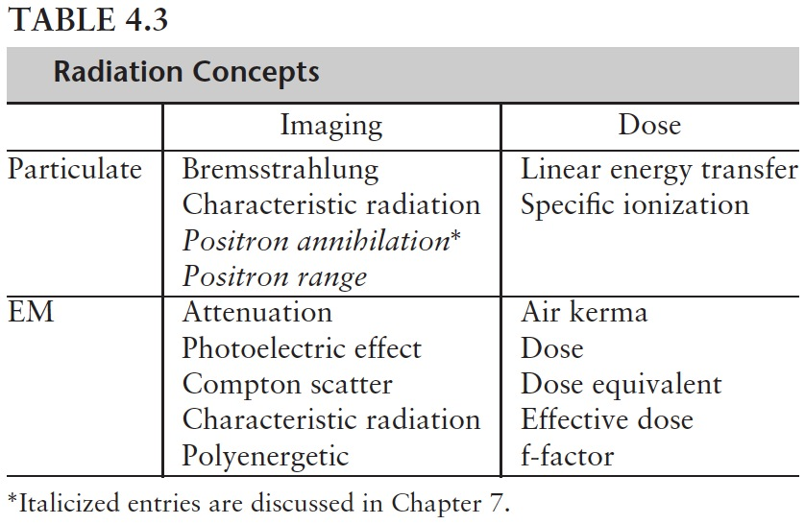
Nature and Properties of Ionizing Radiation
The important effects of radiation in medical imaging are
1- forming images and affect the imaging process,
2- contribute to dose that has biological consequence.

Slide 21
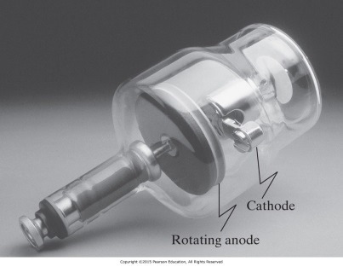
Primary Energetic Electron Interactions
The two main mechanisms by which Energetic electrons interact and transfer energy to an absorbing medium are collisional and radiative transfer. Radiative interaction produces x-ray used in medical imaging.
1) Collisional transfer (most common)
Part of electron’s energy goes to electron orbiting an atom of the medium. When the atom return to its original state it radiates infrared radiation.
Large part of electron’s energy struck an electron in the medium causing it to be a new energetic electron which forms a new path of ionization (delta ray).

Slide 22
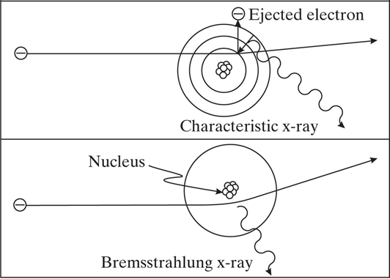
Radiative Transfer of Energetic Electron
2) Radiative transfer
The energetic electron’s interaction with an atom
produces Characteristic or Bremsstrahlung x-rays.
- Characteristic radiation
Incident electron collide with electron in the K shell and create an ion pair. When atom return to ground state it radiate characteristic x-ray.
- Bremsstrahlung radiation
as the electron attracted to the positive nucleus it decelerates and lose energy in the form of an EM photon. Radiation increases with incident
electron’s energy and the atomic number of the atom.

Slide 23
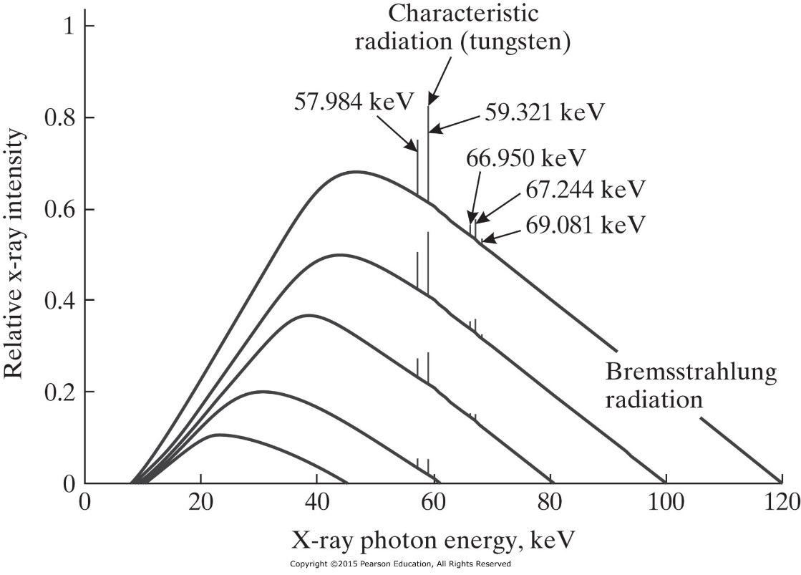
X-ray Tube
Bremsstrahlung radiation is the primary source of x-rays from an x-ray tube.
When accelerated electrons in x-ray tube strike the tungsten anode (target), they lose energy by both collisional and radiative transfer; so heat, characteristic x-rays, and bremsstrahlung x-ray are produced.
K: 69.5 keV
L: 12 keV
M: 3 keV
Figure 4.5 When energetic electrons bombard a target, two kinds of x-rays are produced: characteristic x-rays and bremsstrahlung x-rays. Low-energy x-rays of both types are absorbed by the medium.

Slide 24
Primary Electromagnetic Radiation Interactions
The three main mechanisms by which EM ionizing radiation interacts with materials to from images are:
The photoelectric effect
Incident x-ray photon totally loss energy to the atom’s electron cloud.
Provide contrast between different types of tissues in the medical image.
Compton scatter
Incident x-ray photon partially loss energy to the atom’s electron cloud and change direction.
Limit the resolution of x-ray images.
Pair production (need high energy 1.02 MeV so it isn’t applicable in medical imaging 25 - 500 keV).

Slide 25
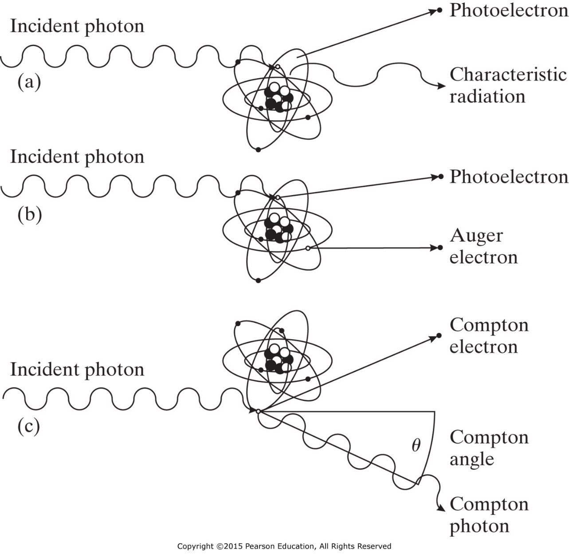
Primary Electromagnetic Radiation Interactions
photoelectric
effect
Compton scattering
Figure 4.6 The photoelectric effect, shown in (a) and (b), and Compton scattering, shown in (c).

Slide 26
EM Photoelectric Effect
The incident photon with energy hv usually eject an electron from the K-shell orbit.
The ejected electron is called photoelectron with energy
$E_{e^{−}}=hv−E_{B}$
where E_{B} is the binding energy of the ejected
electron.
The “hole” of the ejected electron (photoelectron) will be filled by an electron transition from a higher orbit, which produces characteristic radiation.
Sometimes the characteristic radiation transfer its energy to outer-orbit electron and eject it (Auger electron).
Photoelectron and Auger electrons are energetic electron contribute to radiation dose to the patient.

Slide 27
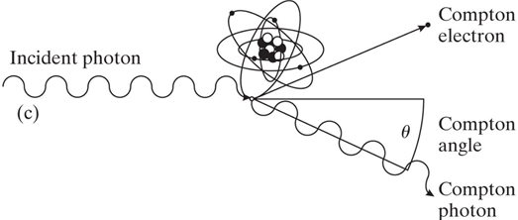
Compton Scattering
The incident photon with energy hv ejects a valence (outer-shell) electron, yielding a new energetic electron called a Compton electron.
The energy of the scattered photon (Compton photon) is
$$hv^{′}=\frac{hv}{1+\left(1−cosθ\right)hv/\left(m_{0}c^{2}\right)}$$
m₀ c² = 511 keV is the energy equivalent to the rest mass m₀ of electron.
The kinetic energy of the
Compton electron is
$$E_{e^{−}}=hv−hv^{′}$$

Slide 28
Example
Compton scattering is usually undesirable in medical imaging. In planar scintigraphy (Chapter 8), the energy of a photon is used to determine whether it has been scattered prior to arrival at the detector.
Suppose a photon with energy hv = 100 keV is incident to some material and exits with energy hv’. A detector decides that the photon has not been scattered if hv’ > 98 keV. What is the maximum angle by which the photon is scattered but is still being treated as a photon traveling along a straight path?

Slide 29
Probability of EM Interactions
Factors that make photoelectric event more likely to occur:
Materials with higher protons (Z_{eff}) in the nucleus increases the likelihood.
Higher incident photon energy (hv) reduces the likelihood.
Prob [photoectric event] $∝\frac{Z_{eff}^{4}}{{\left(hv\right)}^{3}}$

Slide 30
Probability of EM Interactions
Factors that make Compton scattering event more likely to occur:
Compton events occur with very loosely bound electrons in the outer shells, so the number of electrons per kilogram of material (Electron Density ED) increases the chance.
$$\text{ED}=\frac{N_{A}Z}{W_{m}}$$
N_{A} : Avogadro’s number (atoms/mole)
Z : atomic number (electrons/atom)
W_{m}: molecular weight of the atom (grams/mole)
Increasing the energy of the photon reduce the likelihood.
Prob [ Compton event] $∝$ ED

Slide 31
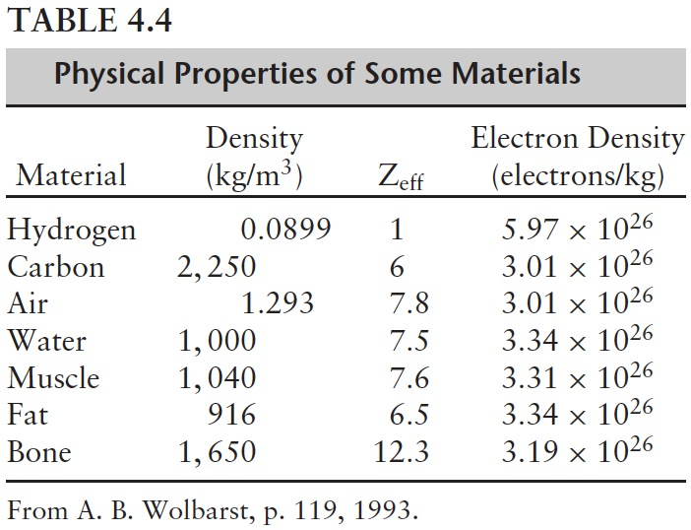
Tables

Slide 32
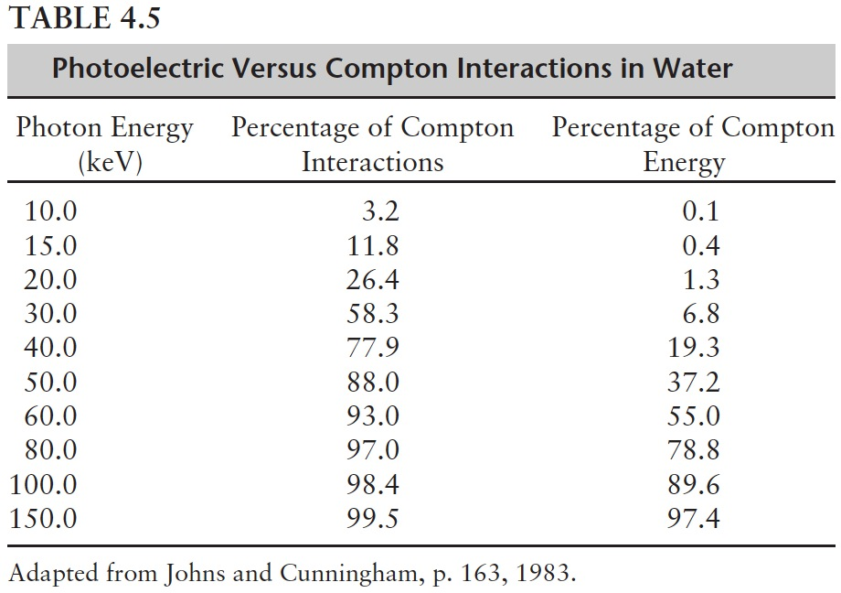
Relative Frequency of Occurrence
Relative frequency of occurrence of photoelectric and Compton events
Photoelectric events deposit all of their incident photon energy, while Compton events deposit only a fraction of their incident photon energy
At 60 keV radiation, 93% of the interactions is Compton but account for only 55% of the energy deposited in the tissue. Explain

Slide 33
Attenuation of Electromagnetic Radiation
Attenuation is the process describing the loss of strength of a beam of EM radiation.
Tissue-dependent attenuation (μ) is the primary mechanism by which contrast is created in radiography modalities.

Slide 34
Measures of X-ray Beam Strength
Reasons to measure the x-ray burst (beam)
Characterize the inherent noise in the system
Adjust the dynamic range of the detection system
Estimating the biological effects of ionizing radiation.
Photon fluence : the number of photons N per unit area A.
$$Φ=\frac{N}{A}$$
Area is oriented at a right angle to the direction of the radiation beam propagation.
Photon fluence rate: the number of photons per unit area per unit time
$$φ=\frac{N}{A∆t}$$

Slide 35
Energy for Monoenergetic X-ray Beam
For monoenergetic beam the energy fluence is
$$Ψ=\frac{Nhv}{A}$$
Energy fluence:
$$ψ=\frac{Nhv}{A∆t}=Eφ$$
Energy fluence rate:
Where E = hv
Energy fluence rate is also defined as Intensity I
$I=ψ$ =$Eφ$
Unit of I is energy per unit area per unit time.

Slide 36
Energy for Polyenergetic x-ray Beam
Each x-ray photon carries its own discrete energy.
- A line spectrum is a plot of N as a function of E.
- The line spectrum changes with each photon burst.
- The line density (number of photons per unit energy as a function of E) remain constant for a given source.
- The x-ray spectrum S(E) is the line density per unit area per unit time.

Slide 37
Energy for Polyenergetic x-ray Beam
$$φ=\int_{0}^{∞}{S\left(E^{′}\right)dE^{′}}$$
Photon fluence rate
$$I=\int_{0}^{∞}{E^{′}S\left(E^{′}\right)dE^{′}}$$
Intensity of polyenergetic x-ray

Slide 38
Example
It is often desirable to model a polyenergetic x-ray beam as a monoenergetic source. What energy would a (hypothetical) monoenergetic source have to be in order to produce the same intensity as the (true) polyenergetic source using the same number of photons?
Note: This energy is called the effective energy of a polyenergetic source.

Slide 39
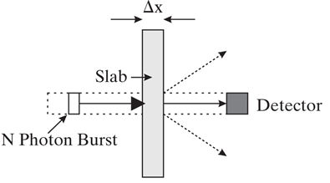
Narrow Beam, Monoenergetic Photons
Some photons will be absorbed (photoelectric effect)
Some photons will be deflected (Compton effect)
N’ photons will be counted by the detector
Number of lost photons is n = N - N’ $n∝N∆x$
Linear attenuation coefficient µ for homogeneous slab.
$$μ=\frac{n/N}{∆x}$$
µ is the fraction of photons that are lost per unit length.
Define ΔN = N’ – N= -n
$$\frac{dN}{N}=−μdx$$
$$∆N=−μN∆x$$
$$N=N_{0}e^{−μ∆x}$$
Fundamental photon attenuation law where N₀ is the number of photons at x = 0

Slide 40
Half Value Layer (HVL)
The fundamental photon attenuation law in term of Intensity is
$$I=I_{0}e^{−μ∆x}$$
I₀ is the intensity of the incident beam.
Half Value Layer (HVL)
The thickness of a given material that attenuate half of the incident photons.
$$\frac{N}{N_{0}}=e^{−μ∆x}$$
$$\frac{1}{2}=e^{−μHVL}$$
HVL$=\frac{ln⁡(2)}{μ}=\frac{0.693}{μ}$

Slide 41
Narrow Beam, Monoenergetic Photons
Example: 140 keV gamma rays are generated by the radioactive decay of technetium-99m, and that sodium iodide crystals are used to detect such gamma rays. Assume that the HVL of sodium iodide at 140 keV is 0.3 cm. What percentage of gamma rays will pass right through a 1.2 cm sodium iodide crystal? (6.26%)
Heterogeneous Slab
For heterogeneous slab, the linear attenuation coefficient depends on the position x.
$$\frac{dN}{N}=−μ(x)dx$$
$$N(x)=N_{0}e^{−\int_{0}^{x}{μ\left(x^{′}\right)dx^{′}}}$$
$$I(x)=I_{0}e^{−\int_{0}^{x}{μ\left(x^{′}\right)dx^{′}}}$$

Slide 42
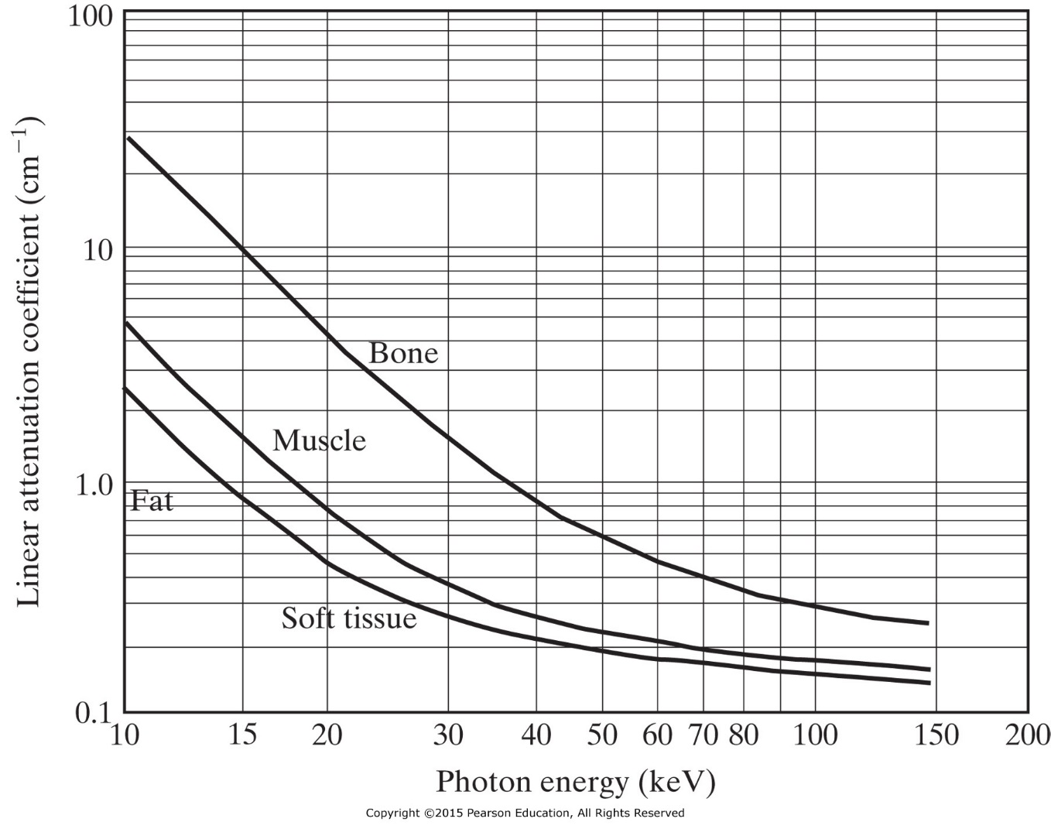
Narrow Beam, Polyenergetic Photons
In general, the linear attenuation coefficient ( μ) is different for different material, and it also varies as a function of energy for the same material.

Slide 43
Narrow Beam, Polyenergetic Photons
For a homogeneous slab of material of thickness Δx with an incident x-ray beam having spectrum S₀(E), the spectrum leaving the slab is
$$S(E)=S_{0}(E)e^{−μ(E)∆x}$$
$$I=\int_{0}^{∞}{{E^{′}S}_{0}(E^{′}) e^{−μ(E^{′})∆x}dE^{′}}$$
For a heterogeneous slab of material, the linear attenuation depends on both position and energy.
$$S(x;E)=S_{0}(E)e^{−\int_{0}^{x}{μ\left(x^{′};E\right)dx^{′}}}$$
$$I(x)=\int_{0}^{∞}{{E^{′}S}_{0}(E^{′}) e^{−\int_{0}^{x}{μ\left(x^{′};E^{′}\right)dx^{′}}}dE^{′}}$$

Slide 44
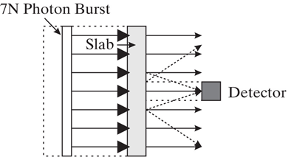
Broad Beam Case
In broad beam case, more photons are generally detected than is predicted by a monoenergetic, narrow beam analysis.
Most x-ray imaging modalities use detector collimation, which reduced the number of x-rays from nonnormal directions that can hit the detectors. Therefore, from an imaging stand point, the narrow beam geometry assumption can be viewed as fairly accurate.

Slide 45
Radiation Dosimetry
The study of the a mount of radiation that produces adverse biological effects.
Exposure (X)
The number of ion pairs produced in a specific volume of air by EM radiation (coulombs per kilogram of air).
In medical imaging the unit is Roentgen (R = 2.58x10⁻⁴ C/kg).
Example:
For a point source of radiation, the exposure at a distance d from the source follows an inverse square law. If the exposure at d = 30 cm from a point source is 1 R, what is the exposure at d = 5 cm from the source?

Slide 46
Radiation Dosimetry
Rad (unit for Dose)
The unit of absorbed dose (energy-deposition concentration) absorption of 100 ergs per gram of material. 100 rads = 1 J/kg
The SI unit for absorbed dose is Gray. 1Gy=1 J/kg.
Kerma (K)
Measure of the amount of energy per unit mass imparted directly to the electrons in a given material.
Linear Energy Transfer (LET)
Measure of the energy transferred by radiation to the material through which it is passing per unit length.
Specific ionization (SI)
The number of ion pairs formed per unit length.

Slide 47
The f-Factor (f)
The f-Factor ( f )
Determine the relationship between exposure (X) and the dose (D) to individual in the radiation field.
For air 1 R = 0.87 rad.
For other material D = f X where f is
$$f=0.87\frac{{\left(μ/ρ\right)}_{\text{material}}}{{\left(μ/ρ\right)}_{\text{air}}}$$
µ is the linear attenuation coefficient and ρ is the mass density, and µ / ρ is the mass attenuation coefficient.

Slide 48
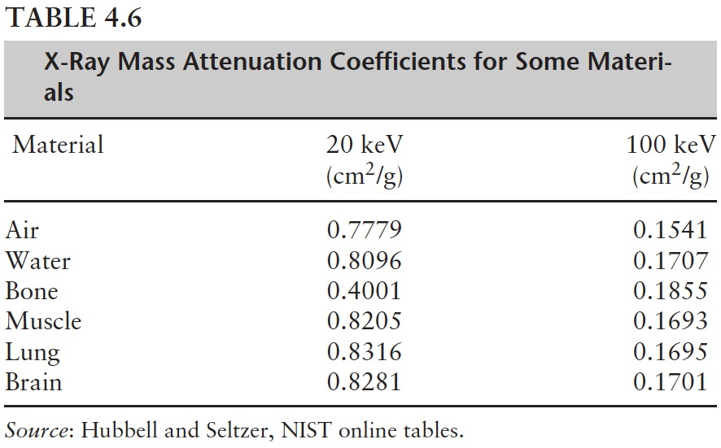
Mass Attenuation Coefficient
The mass attenuation coefficient depends of the type of material and the energy of the x-ray.

Slide 49
Dose Equivalent (H)
Example
Consider a chest x-ray at an energy of 20 keV. For simplicity ignore all tissues except the lung. If we want to keep the absorbed dose below 10 mrads, what should be the limit on the exposure?
Dose Equivalent (H)
Different types of radiation when delivering the same dose, can actually have different effects on the body.
H = DQ the unit is rems
Where Q is the quality factor of the radiation.
For x-rays, gamma rays, electrons, and beta particle Q ≈ 1
For neutrons and protons Q ≈ 10
For alpha particles Q ≈ 20

Slide 50
Effective Dose
Effective dose is obtained as the sum of dose equivalents to different organs or body tissues weighted in such a fashion as to provide a value proportional to radiation-induced somatic and genetic risk even when the body is not uniformly irradiated.
$$D_{\text{effective}}=\sum_{\text{organs}}{H_{j}w_{j}}$$
$$\sum_{\text{organs}}{w_{j}=1}$$
With effective dose, risks may be compared for different radiations and different target tissues.
Natural annual individual effective dose = 300 mrem
Chest x-ray = 3 - 4 mrem
Fluorscopic study = several rem

