Slide 1
Projection Radiography Chapter 5
Biomedical Engineering
Dr. Mohamed Bingabr
University of Central Oklahoma

Slide 2
Outline
Introduction
Instrumentation
Image formation
Noise and Scattering

Slide 3
Conventional Projection Radiography
A projection of the three-dimensional volume of the body onto a two-dimensional imaging surface.
Advantage:
1- short exposure
2- large area image
3- low cost
4- low radiation exposure (3 - 4 mR)
5- Excellent contrast and spatial resolution
Disadvantage: Lack of depth resolution
Uses: screen for pneumonia, heart disease, lung disease, bone fractures, cancer, and vascular disease.

Slide 4
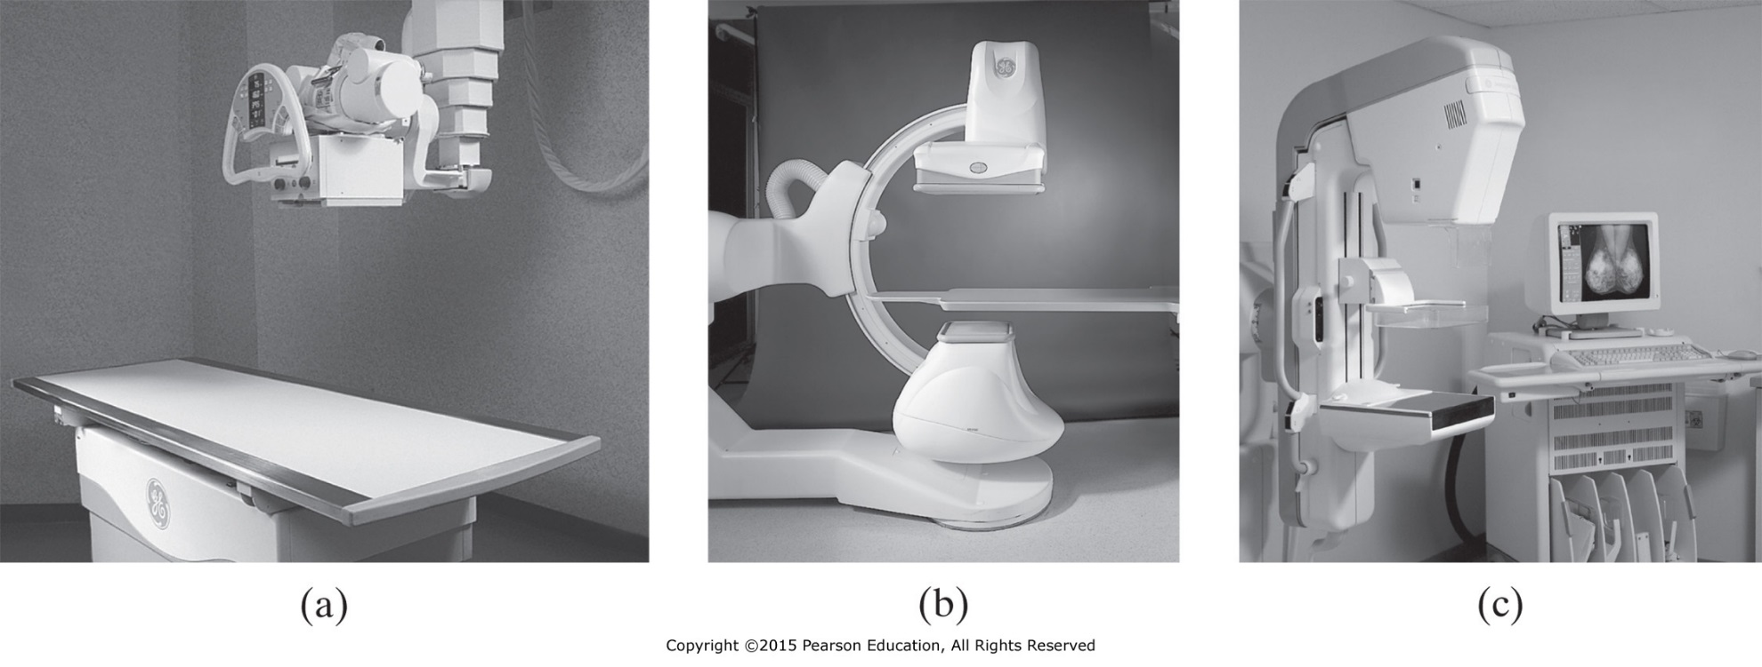
Instrumentation
Figure 5.1 (a) A general projection radiography system; (b) a fluoroscopy system; and (c) a mammography system.

Slide 5
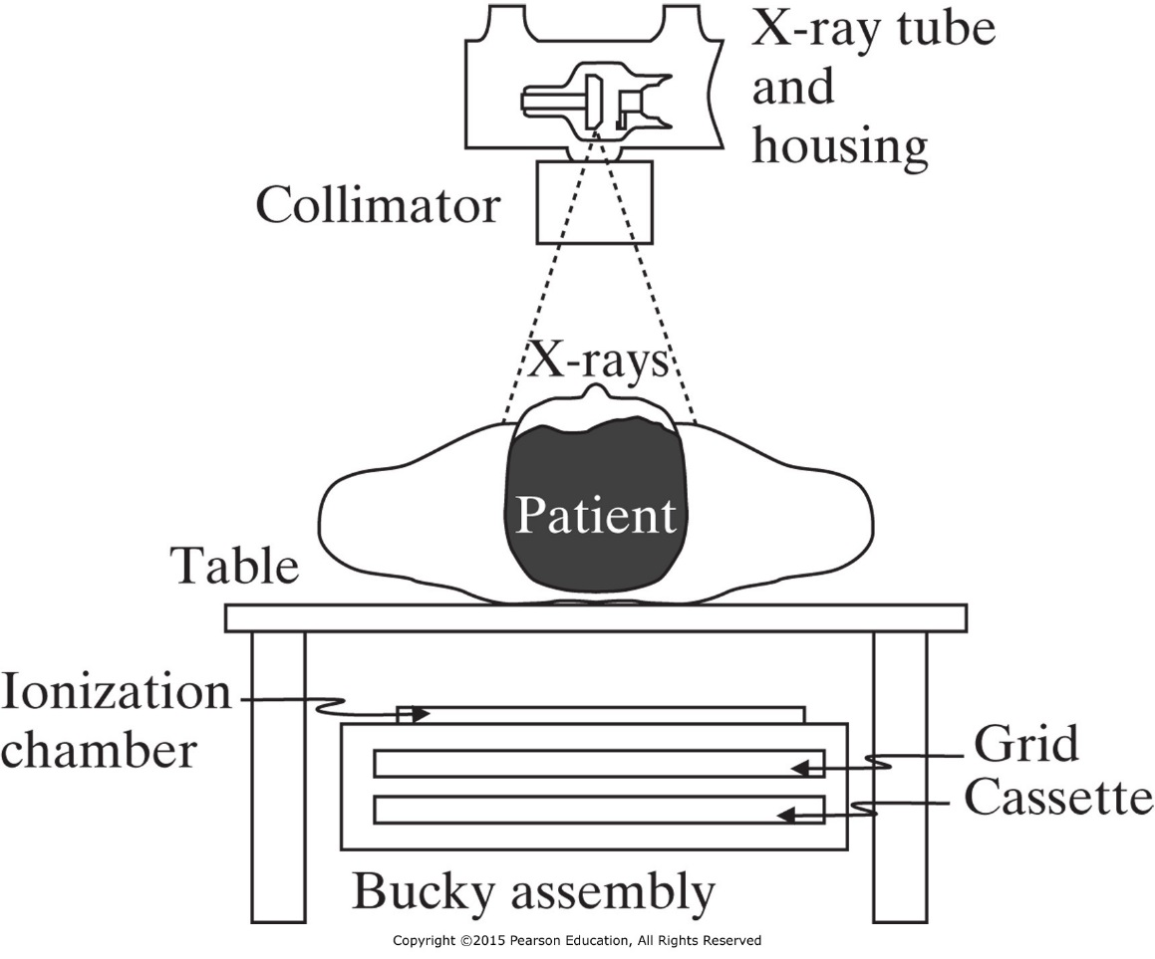
Instrumentation
X-Ray Tubes
Filtration and Restriction
Compensation Filters and Contrast Agents
Grids, Airgaps, and Scanning Slits
Film-Screen Detectors
X-Ray Image Intensifiers
Digital Radiography
Mammography

Slide 6
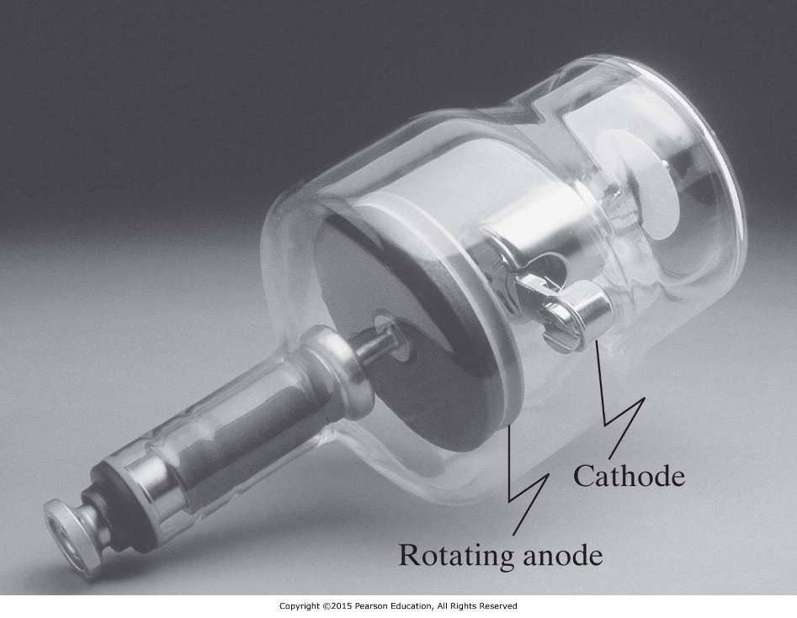
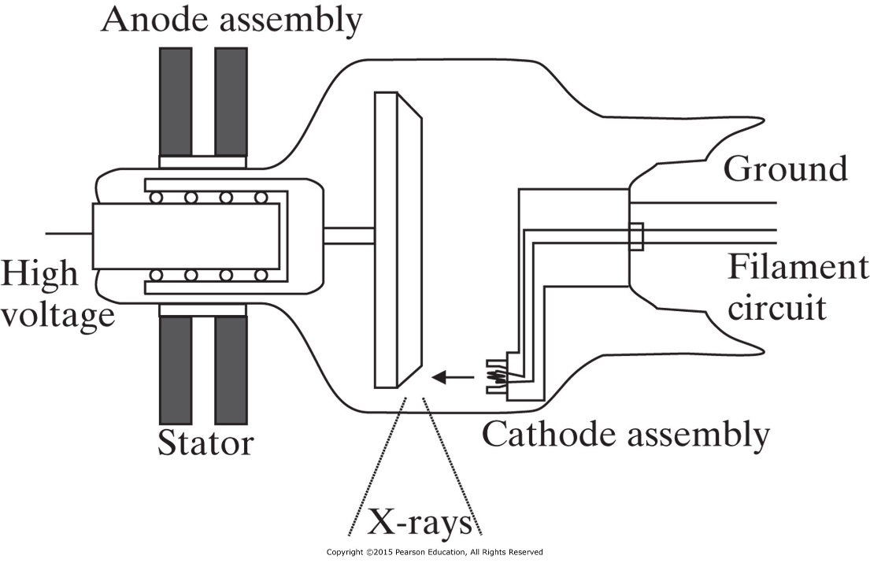
X-Ray Tubes
X-rays are used in projection radiography and computed tomography because they penetrate the body well and their wavelengths are small enough for high resolution imaging.

Slide 7
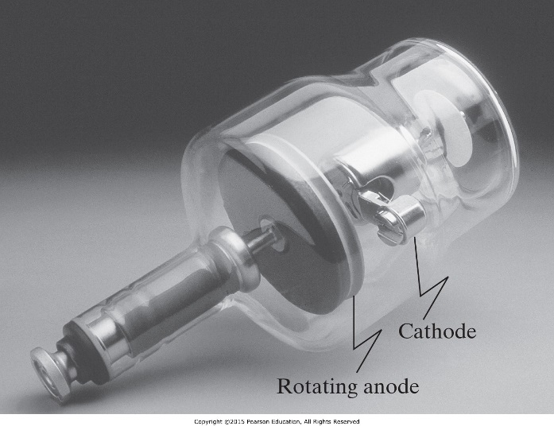
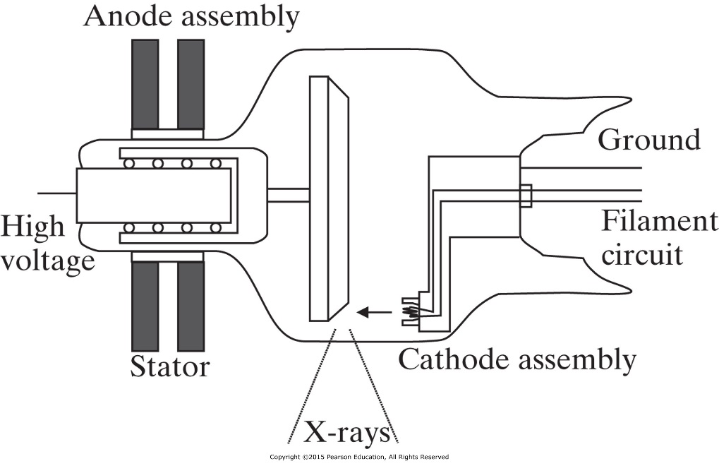
X-Ray Tubes
3-5 amperes at 6-12 volt
Tungsten wire filament
Filament is heated and discharge cloud of electrons (thermionic emission)
Anode voltage (30-150 kV_{p}) is applied so electrons from cathode flow to anode
Focusing cup, a small depression in the cathode to focus current beam toward a spot in the anode coated with a rhenium-alloyed tungsten.

Slide 8
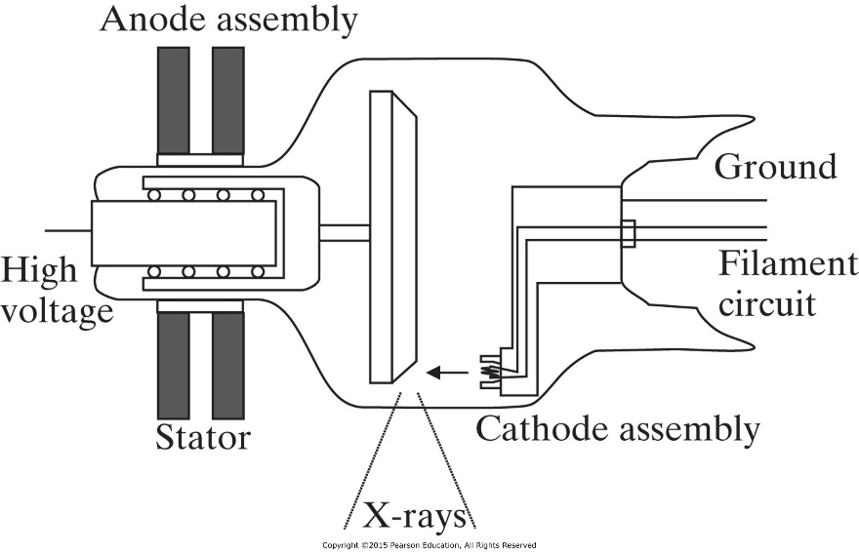
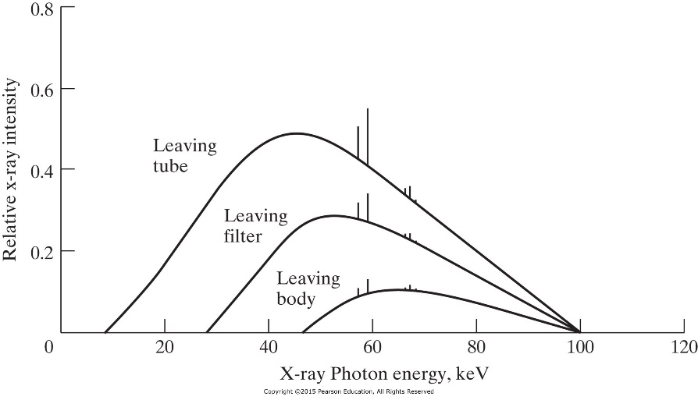
X-Ray Tubes
Electrons from the cathode bombard the target in the cathode transferring energy by both collisional and radiative transfer.
Characteristic and bremsstrahlung x-rays emitted from cathode.
1% of the energy deposited by electrons on the anode is turned into x-rays, the remaining 99% turns into heat
Alternating voltage is applied to Stator to rotate the anode (3200-6000 rev/min).

Slide 9
X-Ray Tubes
The overall exposure is determined by the duration of the applied kV_{p}.
The duration of kV_{p} is controlled by either a fixed timer circuit (silicon controlled rectifier switch ,SCR) or an automatic exposure control (AEC) timer.
AEC is controlled by the ionization chamber (radiation detector). The amount of radiation generate voltage between the plates of the chamber. When the voltage exceed a reference voltage the SCR will be triggered to shut off the tube voltage.

Slide 10
X-Ray Tubes
Milliampere-second (mAs) exposure is the product of the tube current and the exposure time.
In fixed timer: radiologist controls both mA and the exposure time directly.
In AEC timer: the mAs is set by the radiologist and the exposure time is determined automatically by the AEC circuitry.

Slide 11
Filtration and Restriction
The bremsstrahlung x-rays do not all enter the patient, and not all that enter the patient end up leaving the patient.
Filtration: is the process of absorbing low-energy x-ray photons before they enter the patient.
Restriction: is the process of absorbing the x-ray outside a certain field of view.

Slide 12
Filtration
Three type of Filtering:
The tungsten anode absorbs a large fraction of low energy photons.
Glass housing of the x-ray tube and the dielectric oil that surrounds it.
Added filtering by placing metal of different thickness such as aluminum 1-3 mm thick outside the tube in x-ray beam direction. Other metal can be used with equivalent rating of aluminum Al/Eq.
Beam hardening: filtering out the low-energy photons to increase the average energy of the x-ray.

Slide 13
Example
For radiography systems operating above 70 kVp, the National Council on Radiation Protection and Measurement (NCRP) recommends a minimum total filtration of 2.5 mm Al/Eq at the exit port of the x-ray tube. Although such filtration reduces high energy as well as low-energy x-rays, thus requiring longer exposure times to properly expose the x-ray detector, the overall dose to the patient is reduced because of the reduction in low-energy x-rays that are absorbed almost entirely by the patient.
Q: at 80 kVp, what thickness of copper would provide 2.5 mm Al/Eq of filtration? The mass attenuation coefficients μ/ρ of aluminum and copper at 80 kVp are 0.02015 and 0.07519 m²/kg, respectively. The density ρ of aluminum and copper are 2699 and 8960 kg/m³.

Slide 14
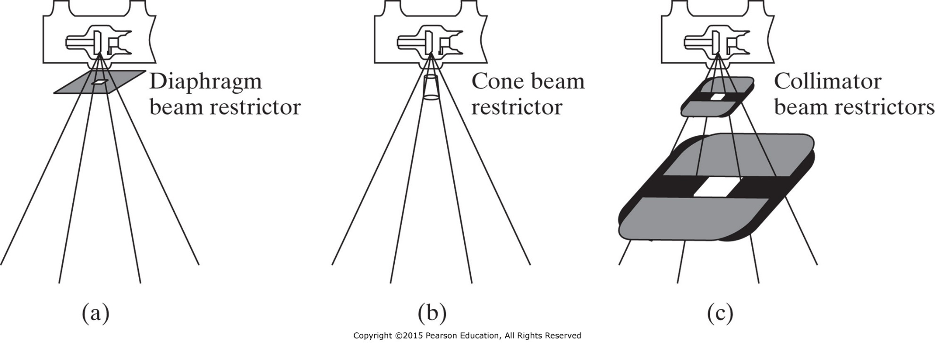
Restriction Beam
The exiting beam must be further restricted both to avoid exposing parts of the patient that need not be imaged and to reduce the deleterious effects of Compton scatter.
Types of beam restrictors: Diaphragms, cones or cylinders, and collimators

Slide 15
Compensation Filters and Contrast Agents
Effect of µ in image
Different body tissues attenuate x-ray in different amounts depending on their linear attenuation coefficients (µ) and the x-ray energies. This differential attenuation gives rise to contrast in the image and the ability to differentiate tissues.
Why do we need compensation filters and contrast agents?
Compensation filters and contrast agent artificially change the natural attenuation of the body prior to detecting the x-ray to improve image contrast.

Slide 16
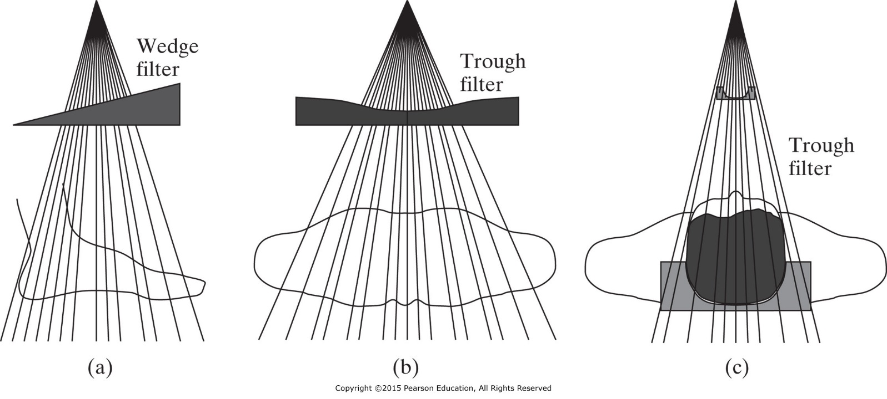
Compensation Filters
X-ray detector has small dynamic range, so imaging organ with large dynamic range of attenuation coefficients will cause part of the image to be overexposed and another part to be underexposed.
Compensation filter is a special shaped aluminum or a leaded plastic object, that can be placed between the x-ray source and the patient or between the patient and the detector.

Slide 17
Contrast Agents
Different soft tissues structures are difficult to visualize because of insufficient intrinsic contrast due to small differential attenuation.
Contrast agents (chemical compound) introduced into the body in order to increase x-ray absorption within the anatomical region, thereby enhancing image contrast.
Iodine (Z=53, E_{k}= 33.2 keV) enhance imaging blood vessels, heart chambers, tumors, infections, and thyroid.
Barium (Z=56, E_{k}= 37.4 keV) enhance imaging gastrointestinal tract.
Air (inflating the lungs) enhance imaging the lung.

Slide 18
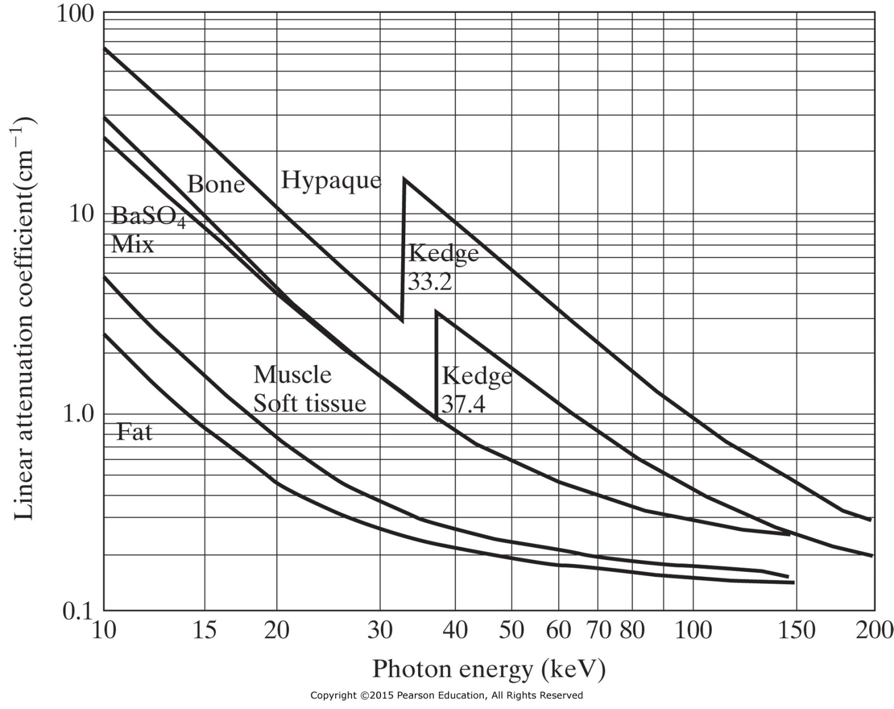
Contrast Agents
K absorption edge
for iodine
K absorption edge
for barium

Slide 19
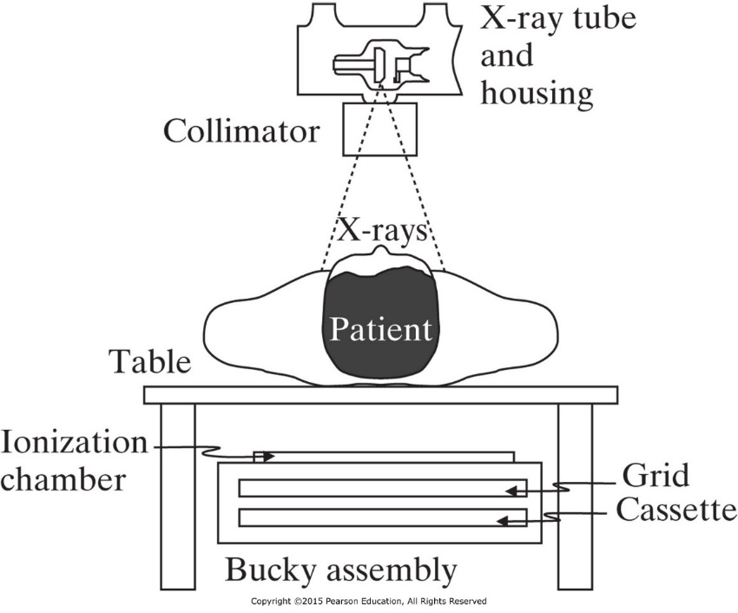
Grids, Airgaps, and Scanning Slits
X-ray photons that are not absorbed or scattered arrive at the detector from along a line segment originating at the x-ray source. Scattered photon does not image the tissue it passes though in the right location of the image, so it causes fog in the image (randomness).
Methods to reduce the effects of scatter in radiography:
1- Grids
2- Airgaps
3- Scanning slits

Slide 20
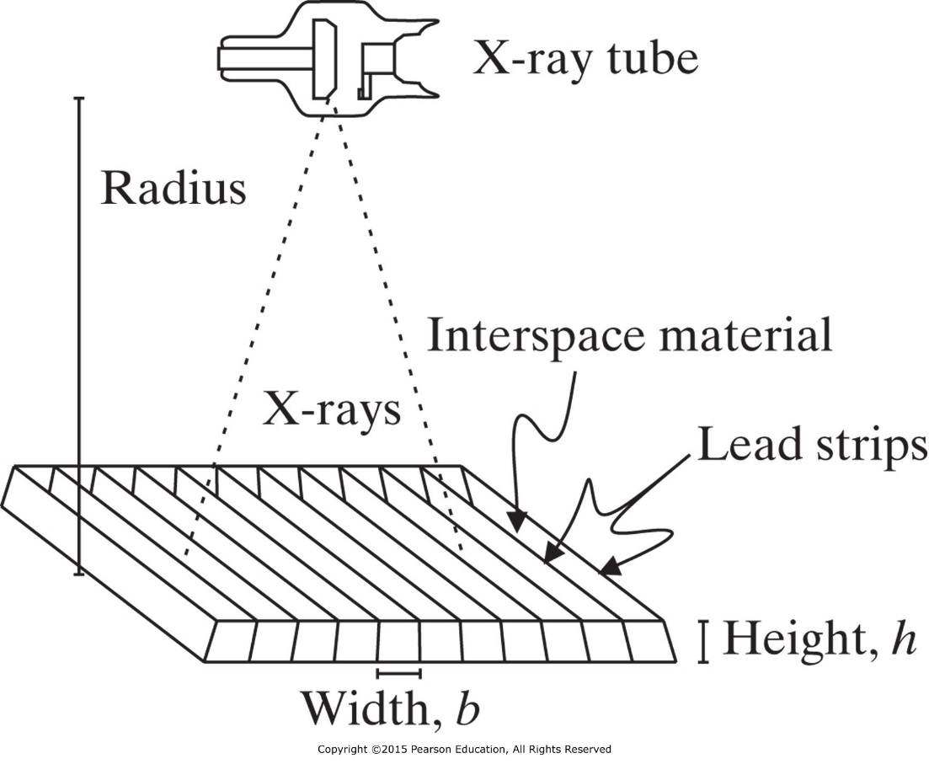
Grids
The linear, focused grid has lead strips that are arranged in lines and angled toward the x-ray tube.
The effectiveness of the grid for reducing scatter is a function of the grid ratio.
$$\text{grid} \text{ratio}= \frac{h}{b}$$
grid ratios ranging from 6:1 to 16:1.
Grid frequency = 1/b
range is 60 cm⁻¹
For mammography the grid ratio is 2:1 and grid frequency is 80 cm⁻¹

Slide 21
Grids
Grids can be mounted as stationary grids or used with a Potter-Bucky diaphragm, which moves the grid during exposure to remove artifact.
In Potter-Bucky the grid moves 2 to 3 cm during exposure in a linear or circular path.
The grid conversion factor (GCF) characterizes the amount of additional exposure required for a particular grid. Typical GCF values range from 3 to 8.
$$\text{GCF}\text{=}\frac{mAs \text{with} \text{grid}}{mAs \text{withou} \text{the} \text{grid}}$$

Slide 22
Airgaps and Scanning Slits
Airgaps: is a physical separation of air between the object and the detector. Airgaps reduces the percentage of scattered photons that reach the plane of the detector.
Disadvantage: increase geometric magnification and increased blurring.
Scanning Slits: Use of mechanical lead slits that are placed in front of and/or in back of the patient. It provides 95% scatter reduction.
Disadvantage: require complex system and longer exposure times.

Slide 23
Film-Screen Detectors
X-rays is inefficient in exposing modern photographic film to form medical image.
Intensifying screens in both sides of the photographic film are used to stop most of the x-rays and convert them to light to expose the photographic film.
Components of Film-Screen Detectors:
1- Intensifying Screens
2- Radiographic Film
3- Radiographic Cassette

Slide 24
Intensifying Screens
Phosphor: transform x-ray photons into light photons. The light photons then travel into the film, causing it to be exposed and to form a latent image.
Characteristic of intensifying screen phosphors:
1- Emission delay 10 nanosecond
2- Conversion efficiency: number of light photons emitted per incident x-ray photon (1000 light photons per incident 50 keV x-ray photon).

Slide 25
Radiographic Film
Radiographic Film is optical film of different sizes 8x10 to 14x17 inches.
Radiographic Cassette: a holder of two intensifying screens and the film “sandwiched” between. One side of the cassette is radiolucent, while the other usually includes a sheet of lead foil.

Slide 26
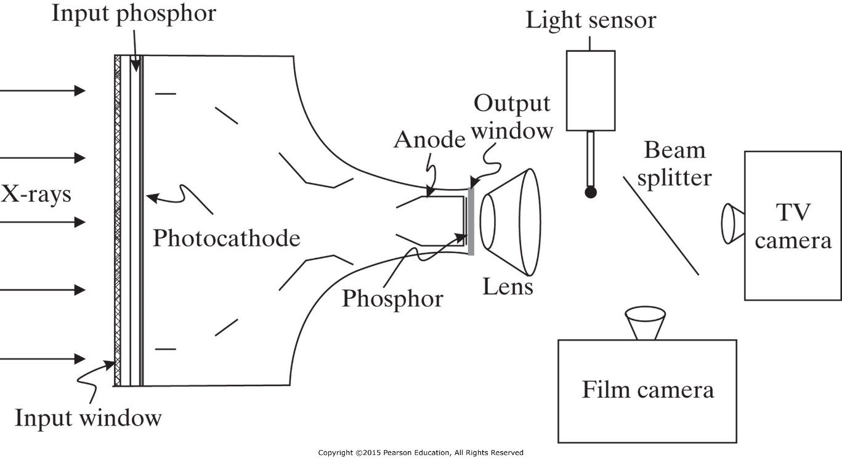
X-Ray Image Intensifiers (XRII)
XRII is used in fluoroscopy, where low-dose, real-time projection radiography is required.
Input phosphor: circular with 15 to 40 cm diameter

Slide 27
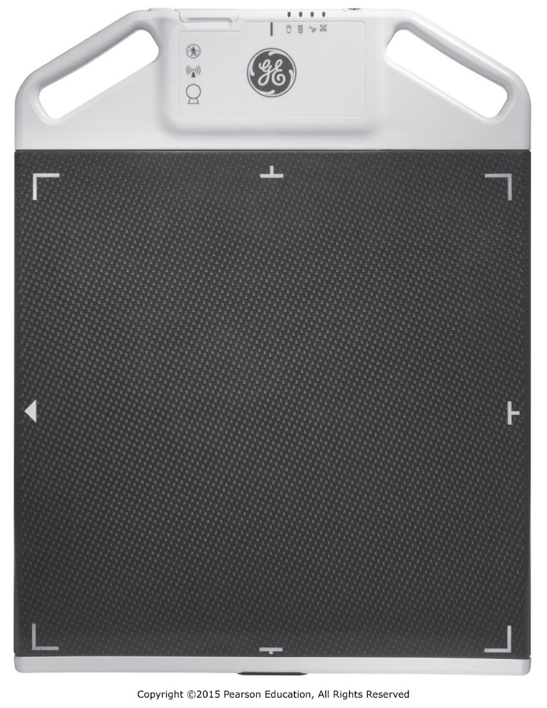
Digital Photography
Digital radiographic systems are rapidly replacing film-screen combinations.
Types:
1- Computed Radiography (CR) Systems
2- CCD-Based Digital Radiography
3- Thin-Film Transistor-Based
4- CMOS

Slide 28
Computed Radiography (CR) Systems
Store latent images in photostimulable imaging plates (PSPs), which are removed from the x-ray system and scanned using a special laser scanner to form a digital image.
Detected x-ray photons are absorbed in the phosphor by the photoelectric effect, which causes electrons to be ejected from atoms in the detector. Half of the electrons will recombine with ions and the remaining half will be scanned by a laser to form an image.
Resolution: 10 pixels/mm and each pixel value is represented by 16-bit digital code.

Slide 29
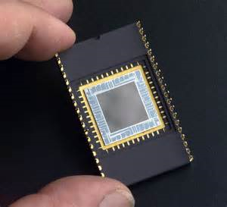
CCD-Based Digital Radiography
Charged coupled device (CCD) detectors combine a collection of light-sensitive capacitors, which store charge in proportion to incident light.
CCD detectors are small devices and projection radiography has large field of view (FOV), so lenses are used to demagnify the scintillator image to fit within the optical window of the CCD array (40x40 cm to 4x4 cm,10:1, 3000x3000 pixels, 13 μm x 13 μm).
Read
Thin-Film-Transistor-Based Digital Radiography system
CMOS-Based Digital Radiography system

Slide 30
Mammography
Mammography is used for early detection of breast cancer.
Low energy x-rays (around 30 kVp)
Integrate compression via a paddle to produce a reduced and more uniform thickness organ for imaging.
Automated intensity control system that optimize detector exposure.
Digital mammography has 6-8 line pairs/mm compared to 12 line pairs/mm for film.
Digital mammography has better dynamic range.
Digital mammography has advance signal processing for contrast enhancement, small structure enhancement, automated-aided detection.

Slide 31
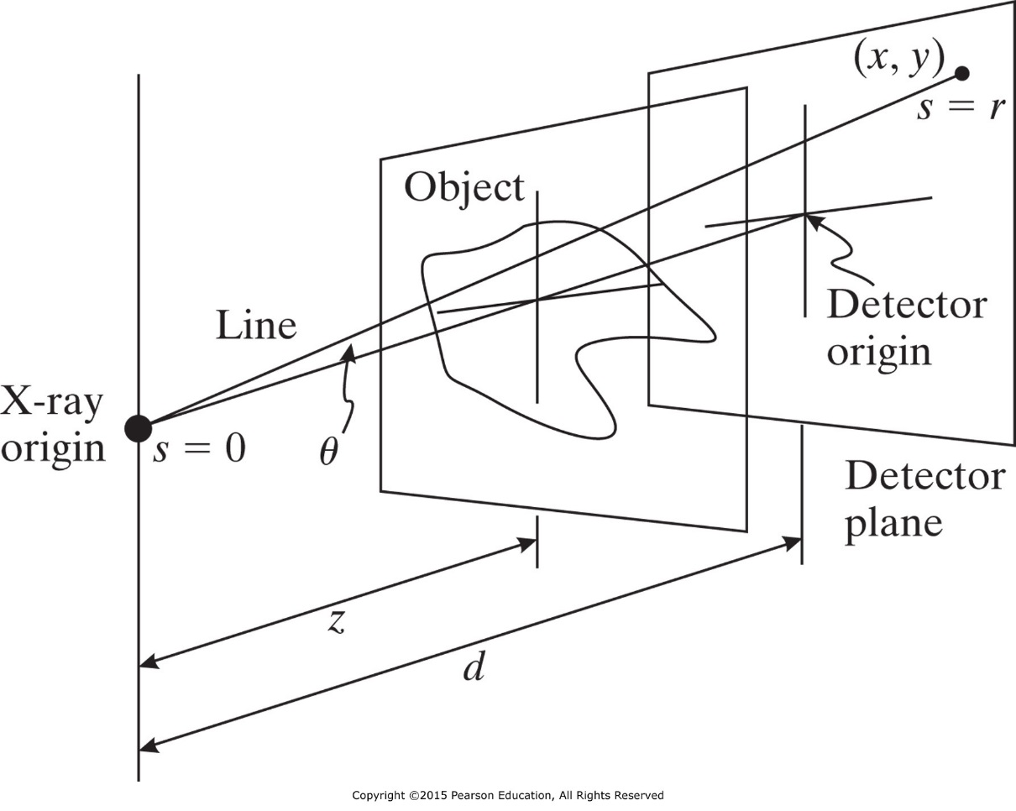
Image Formation
Basic Image Equation
$$I\left(x,y\right)=\int_{0}^{E_{max}}{S_{0}\left(E^{′}\right)E^{′}\text{exp}\left\{−\int_{0}^{r(x,y)}{μ\left(s;E^{′},x,y\right)ds}\right\}dE^{′}}$$
S₀(E’): spectrum of the incident x-rays energy
I: intensity
µ: linear attenuation

Slide 32
Geometric Effects
X-ray images are created from a diverging beam of x-rays. This divergence produce number of undesirable effects on image formation:
1- Inverse square law
2- Obliquity
3- Path Length
4- Depth-Dependent Magnification

Slide 33
Inverse Square Law
The net flux of photons decrease as 1/r², where r is the distance from the x-ray origin.
If the intensity of the source is I_{s} then intensity at the origin of the detector:
Intensity at an arbitrary point (x, y)
Thus, the inverse square law causes a cos²θ drop-off of x-ray intensity away from the detector origin, even without object attenuation.
$$I_{0}=\frac{I_{S}}{4πd^{2}}$$
$$I_{r}=\frac{I_{S}}{4πr^{2}}$$
$$I_{r}=I_{0}\frac{d^{2}}{r^{2}}=I_{0}{\text{cos}}^{2}θ$$

Slide 34
Example
The inverse square law has a very practical use in radiography. Suppose an acceptable chest radiography was taken using 30 mAs at 80 kVp from 1 m. Suppose that it was now requested that one be taken at 1.5 m at 80 kVp.
What mAs setting should be used to yield the same exposure?

Slide 35
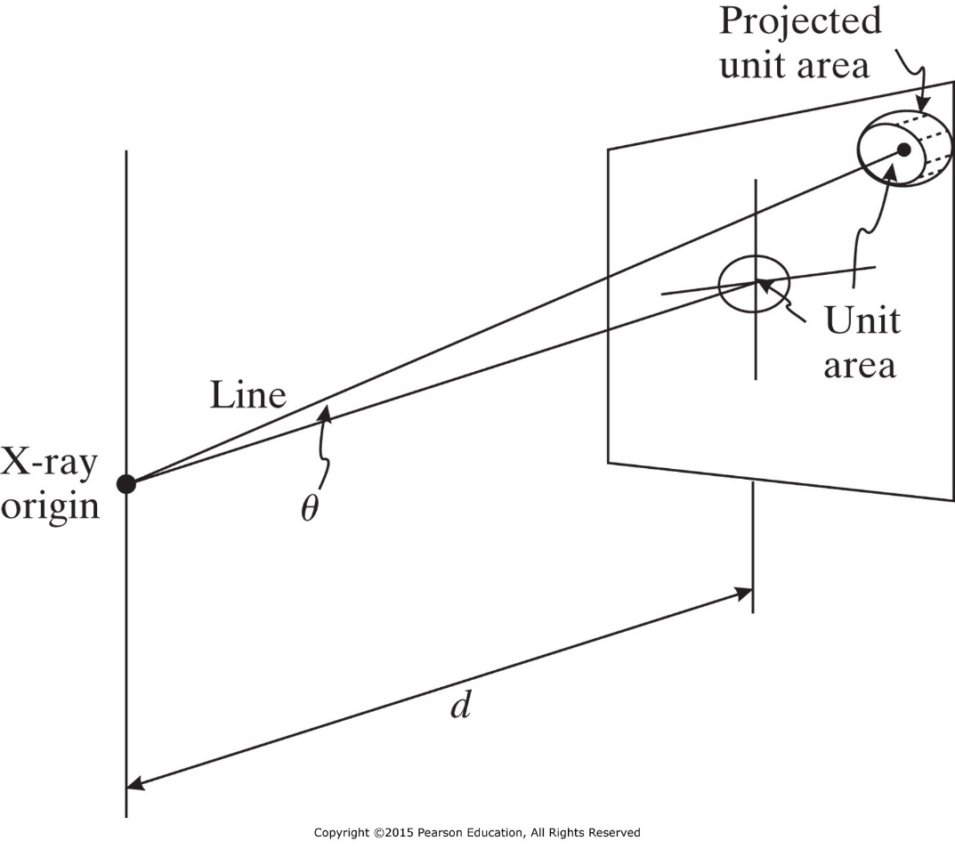
Obliquity
Obliquity decreases the beam intensity away from the detector origin. The obliquity effect is caused by the detector surface not being orthogonal to the direction of x-ray propagation (except at the detector origin).
$$E_{d}=E_{0}\text{cos} θ$$
$$I=E\frac{N}{A ∆t}$$
$$I_{d}=I_{0}\text{cos} θ$$

Slide 36
Beam Divergence and Flat Detector
So far, the two factors that reduce intensity at the detector plane are the inverse law effect and obliquity.
The combination of these two effect is multiplicative so
$$I_{d}(x,y)=I_{0}{\text{cos}}^{3} θ$$
If θ is small, then cos³ θ ≈ 1, and both effects can be ignored.
Example:
Suppose a chest x-ray is taken at 2 yards (72 inch) using 14 inch by 17 inch film.
What will be the smallest ratio I_{d}/I_{o} across the film (assuming no object attenuation)?

Slide 37
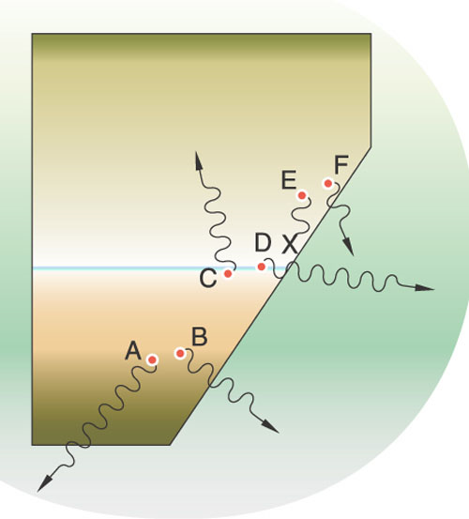
Anode Heel Effect
The cathode end will have more x-rays than the anode end because of the geometry of the anode.
The anode heel effect can be compensated by using an x-ray filter that is thicker in the cathode direction than in the anode direction.
Anode
cathode

Slide 38
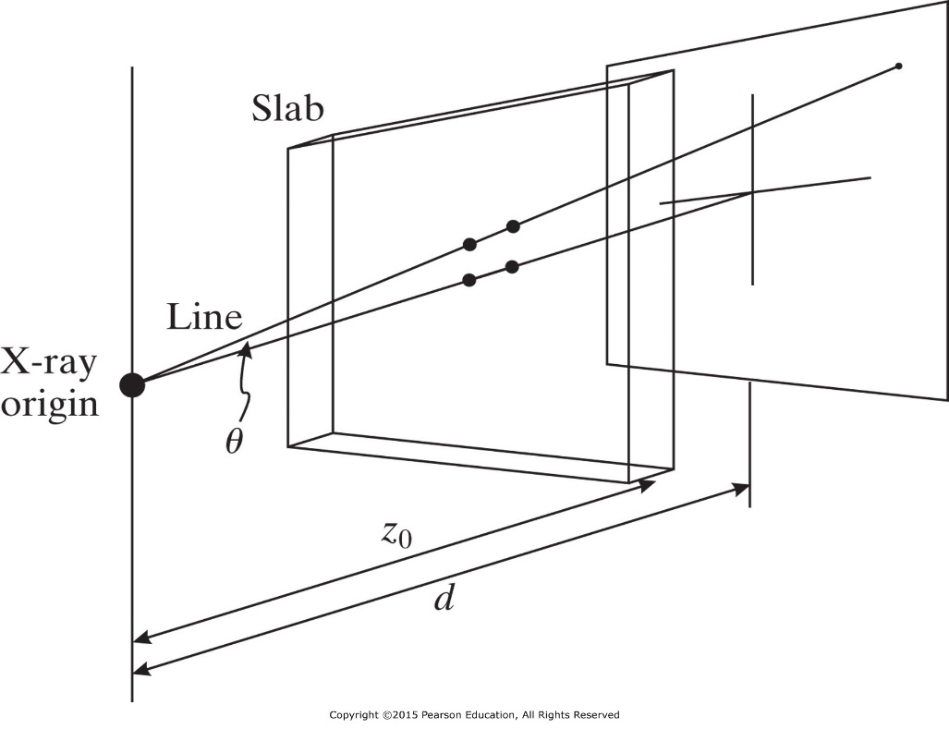
Path Length
Consider imaging a slab of materials with a constant linear attenuation µ and thickness L arranged parallel to the plane of the detector.
$$L^{′}=\frac{L}{\cos{θ}}$$
$$L^{′}$$
$$L$$
Ignoring the inverse square law, obliquity, and the anode heel effect, the intensity is given by
L’
$$θ$$
L
$$I_{d}(x,y)=I_{0}e^{−μL/\text{cos}θ}$$
If the inverse square law and obliquity are included
$$I_{d}(x,y)=I_{0}{\text{cos}}^{3} θe^{−μL/\text{cos}θ}$$

Slide 39
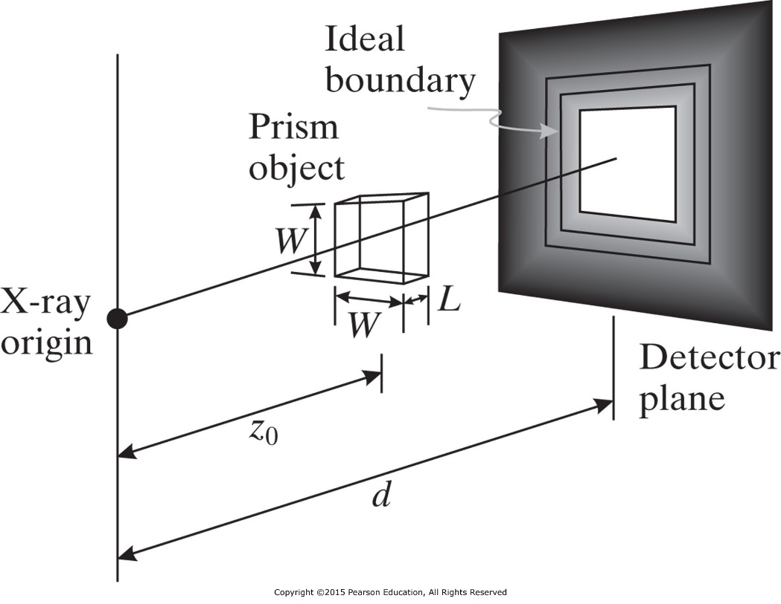
Divergent Rays Causes Edge Blurring
Example
Consider imaging the rectangular prism shown in the figure, defined by
$μ\left(x,y,z\right)=μ_{0}\text{rect}\text{(}y/W)$ $\text{rect}\text{(}x/W)$ $\text{rect}\text{(}[z−z_{0}]/L)$
How is this rectangular prism portrayed in a radiograph?
$$I_{d}(x,y)=I_{0}{\text{cos}}^{3} θe^{−μ\left(z^{′}−\left(z_{0}−L/2\right)\right)/\text{cos}θ}$$
To reduce edge blurring due to divergent rays, keep the x-ray source as far from the detector plane as possible and keep the object (patient) as close to the detector as possible.
$$z^{′}$$
$$z_{0}$$

Slide 40
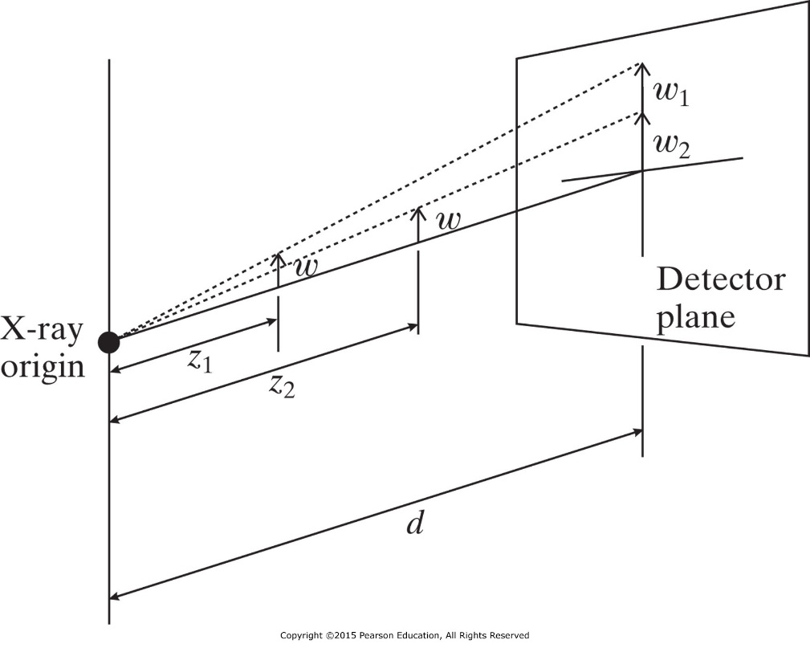
Depth-Dependent Magnification
Another consequence of divergent x-rays is object magnifications
$$w_{z}=w\frac{d}{z}$$
The magnification $M\left(z\right)=\frac{d}{z}$
Three consequence of depth-dependent magnification:
Two object of the same size at different location may appear to have different sizes on the radiograph.
Images of the same patient at different time may show same object with different sizes.
Boundaries of a single object can be blurred.

Slide 41
Imaging Equation with Geometric Effects
To develop an imaging equation that incorporates the geometric effects, we utilize an idealized object t_{z}(x,y) that is infinitesimally thin and located in a single plane given by the coordinate z and is capable of differently attenuating x-rays as a function of x and y. t_{z} is transmittivity and replaces the entire exponential factor, rather than µ itself.
Object is close to detector (no magnification)
$$I_{d}(x,y)=I_{0}{\text{cos}}^{3} θe^{−μL/\text{cos}θ}$$
$$I_{d}\left(x,y\right)=I_{0}{\text{cos}}^{3}θ{ t}_{d}(x,y)$$
$$\text{cos} θ=\frac{d}{\sqrt{d^{2}+x^{2}+y^{2}}}$$

Slide 42
Imaging Equation with Geometric Effects
Object is located at arbitrary z from source (magnification)
$$I_{d}\left(x,y\right)=I_{0}{\text{cos}}^{3}θ{ t}_{z}\left(x/{M(z)}, y/{M(z)}\right)$$
$$I_{d}\left(x,y\right)=I_{0}{\left(\frac{d}{\sqrt{d^{2}+x^{2}+y^{2}}} \right)}^{3}t_{z}\left({xz}/d, {yz}/d\right)$$
This equation is reasonable approximation for relatively thin objects that have nearly the same magnification and no variation in their attenuation in the z direction. This equation does not take into account the effect of integration along ray paths through thick objects (such as the human body).

Slide 43
Blurring Effects
There are two effects that will blur objects even if they are not thick and do not have a z extent:
1- Extended sources
2- Detector thickness
These two effects can be modeled as convolutional effects that degrade image resolution.

Slide 44
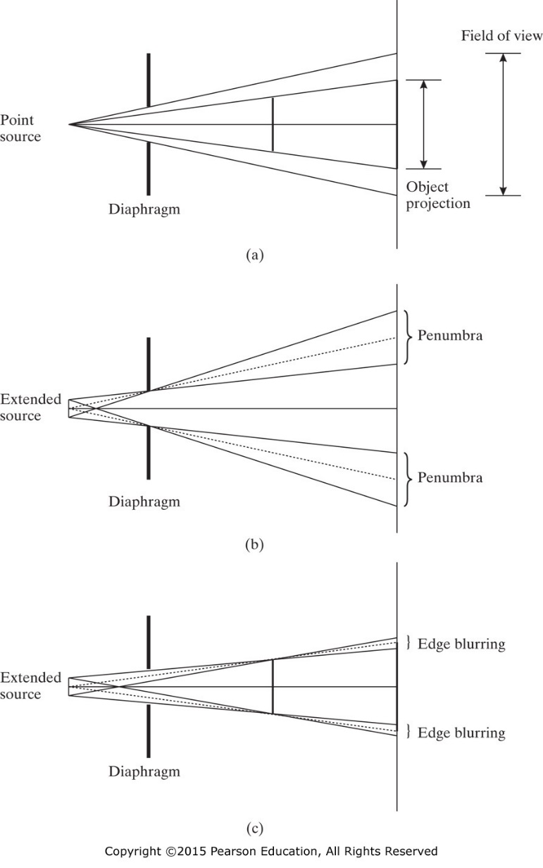
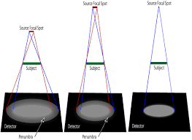
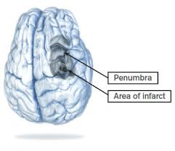
Extended Sources Blurring
The physical extent of blurring caused by an extended sources depends on the size of the source spot and the location of the object.

Slide 45
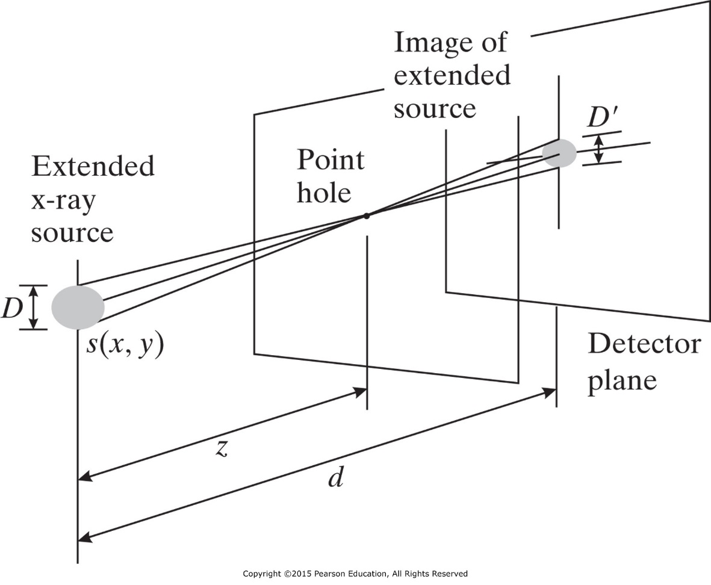
Extended Sources Blurring
The image of point hole in the figure is given by.
$$D^{′}=\frac{d−z}{z}D$$
The source magnification is
$$m\left(z\right)=−\frac{d−z}{z}$$
$$m\left(z\right)=1−M(z)$$
M(z): depth-dependent
(object) magnification
$$I_{d}\left(x,y\right)=ks\left(x/m, y/m\right)$$

Slide 46
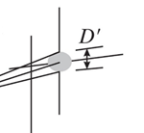
Extended Sources
To find the constant k, take the integral of both side.
$$I_{d}\left(x,y\right)=ks\left(x/m, y/m\right)$$
$$\iint{ks\left(x/m, y/m\right)dxdy}=\text{constant}$$
Using Fourier transform for u=0 and v=0 and scaling property.
$$k∝\frac{1}{m^{2}(z)}$$
$$km^{2}\left(z\right)S(0,0)=\text{constant}$$
$$I_{d}\left(x,y\right)=\frac{1}{m^{2}}s\left(x/m, y/m\right)$$
The above equation is the image of a point hole located anywhere in the same z-plane.

Slide 47
Extended Sources
A transmittivity function t_{z}(x,y) can be considered as a collection of point holes. Using superposition the image equation with source effect is the convolution of the magnified object by the magnified and scaled source function.
$$I_{d}(x,y)=\frac{{\text{cos}}^{3}θ}{4πd^{2}m^{2}}{ s\left(x/m,y/m\right)∗t}_{z}\left(x/M, y/M\right)$$
4πd²: loss of source intensity due to the inverse square law
For object close to the detector, M=1 and m=0; the object will have unity magnification and will not be blurred by the source focal spot.
For these two reasons patient is put directly against the detector.

Slide 48
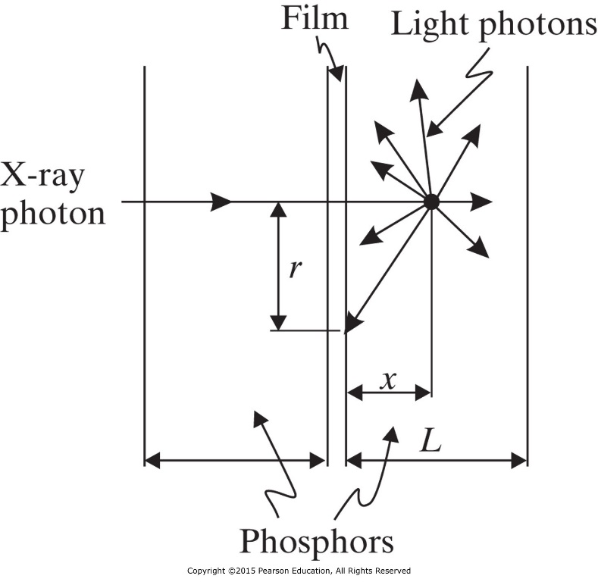
Detector Thickness: Film-Screen Blurring
The high energy x-ray photon is not absorbed efficiently by film, so phosphors is used to absorb it and release large number of lower-energy light photons.
The light photons travel isotropically from the point where the x-ray was absorbed.
The union of detected light photons form a “spot” on the film, which is effectively an impulse response to the x-ray “impulse”, h(x, y).
$$I_{d}\left(x,y\right)=\frac{{\text{cos}}^{3}θ}{4πd^{2}m^{2}}{ s\left(x/m,y/m \right)∗t}_{z}\left(x/M, y/M\right)∗h(x,y)$$

Slide 49
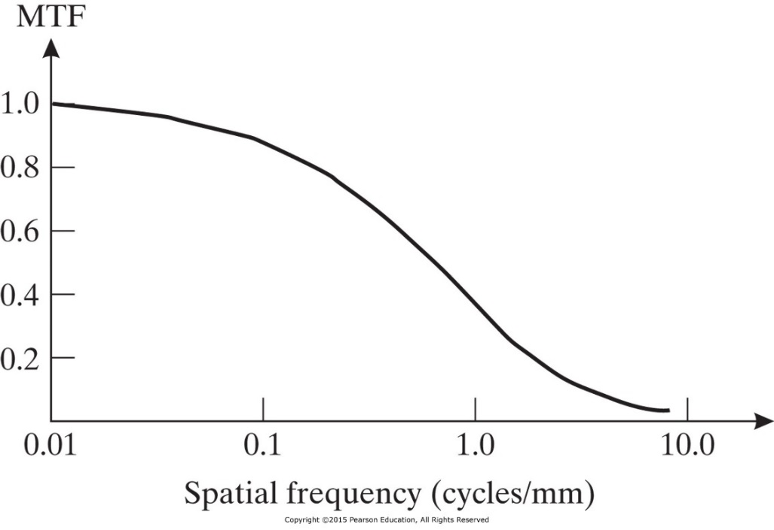
Detector Thickness: Film-Screen Blurring
The impulse response of a film-screen detector system is circularly symmetric. A modulation transfer function of a typical film-screen detector is shown below:
Thinner phosphor yields less film-screen blurring. However, thin screens do not stop as many x-rays, reducing the efficiency of the detector system.

Slide 50
Film Characteristics
The spatial resolution of film is significantly better than that of the intensifying screen; so, it is the film’s intensity transformation of importance for medical imaging.
The x-ray photons produce light photons in the phosphors adjacent to the film.
The light photons that are captured by the film produce a latent image.
When the film is developed the latent image produces a blackening of the film.
Optical density of a film is a characterization of the film transformation between exposure to light and the degree of blackening of the film.
Optical Transmissivity: Fraction of light transmitted through the exposed film.
$$T=\frac{I_{t}}{I_{i}}$$

Slide 51
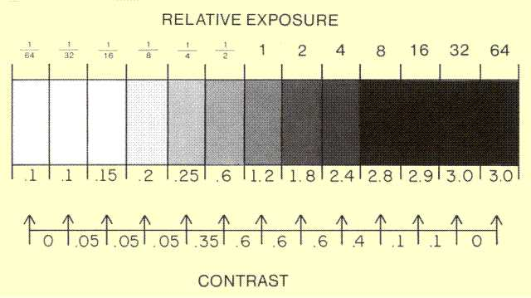
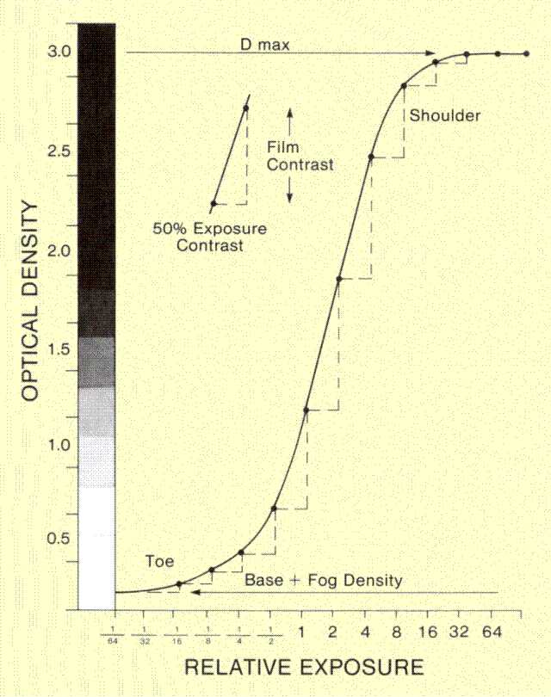
H&D Characteristic Curve
Optical Density
$$D={\text{log}}_{\text{10}}\frac{I_{i}}{I_{t}}$$
$$X/X_{0}$$
A relationship between x-ray exposure X and the optical density D is:
$$D$$
$$D=Γ{ \text{log}}_{\text{10}}\frac{X}{X_{0}}$$
$$D$$
Γ: film gamma, slope of H&D curve in the linear region.
X₀: exposure at which the linear region hits the horizontal axis (D=0)
Increasing Γ will increase contrast but reduce range of exposure at which H&D is linear.
http://www.sprawls.org/ppmi2/FILMCON/#CHAPTER CONTENTS
$$X/X_{0}$$

Slide 52
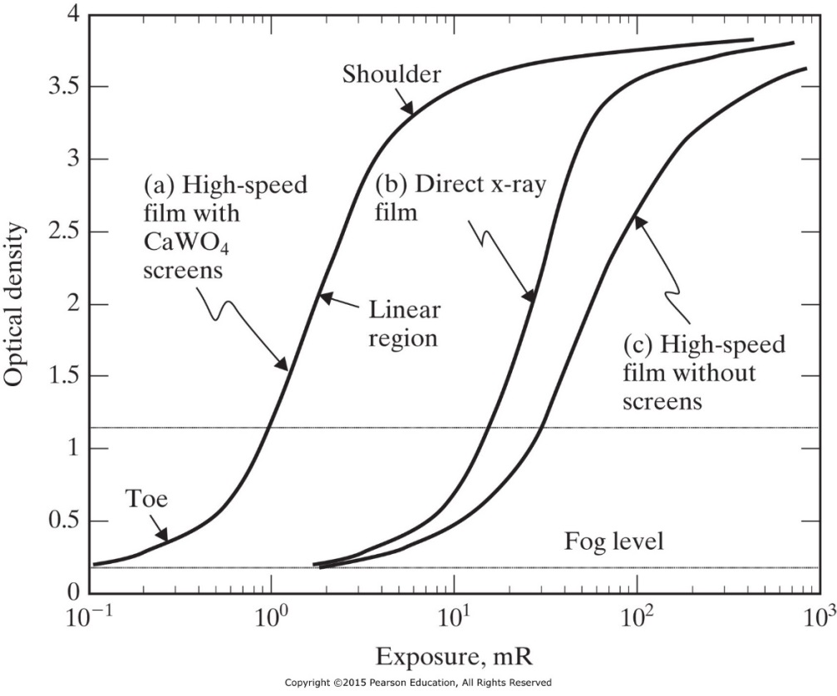
H&D Characteristic Curve
Latitude: range of exposures over which the H&D is linear.
Speed (film sensitivity): inverse of the exposure at which D=1+fog level.

Slide 53
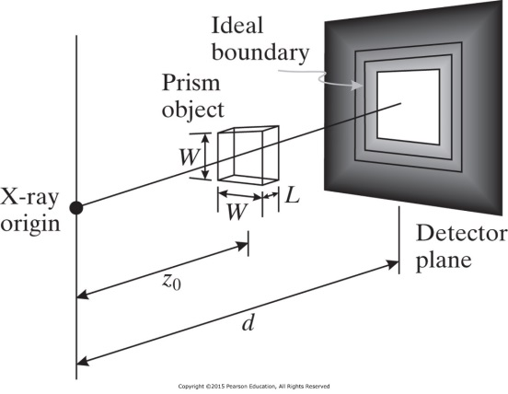
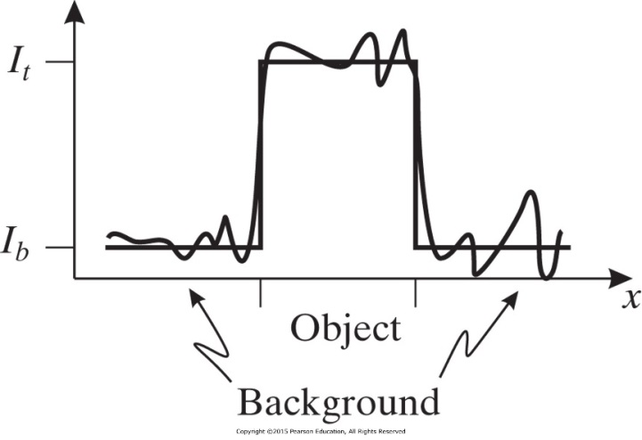
Noise and Scattering
So far we considered only the effects of the x-ray source and the composition of the object. Here we will consider the detector ability to faithfully reproduce the incident intensity distribution. Also the discrete nature of photons arrival lead to fluctuations in the image.
A 1-D slice through the intensities on the detector will look like a rect function shown in the figure.
Local Contrast
$$C=\frac{I_{t}−I_{b}}{I_{b}}$$
$$\text{SNR}=\frac{I_{t}−I_{b}}{σ_{b}}=\frac{CI_{b}}{σ_{b}}$$

Slide 54
Signal to Noise Ratio (SNR)
The effective energy of photon arriving at the detector is hv.
$$I=\frac{Nhv}{A∆t}$$
$$I_{b}=\frac{N_{b}hv}{A∆t}$$
A: Area of detector or pixel
Δt: duration of the x-ray burst
$$σ_{b}^{2}=N_{b}{\left(\frac{hv}{A∆t}\right)}^{2}$$
$$\text{SNR}=C\sqrt{N_{b}}$$
Contrast can be improved by changing the energy of the x-rays, introducing contrast agent. Number of photon can be increased by increasing the filament current, the duration of the x-ray pulse, area of detector element, or the energy of the x-ray.

Slide 55
Noise and Scattering
$$\text{SNR}=C\sqrt{ΦARtη}$$
A detailed expression of the SNR is
$Φ$: number of photons per Roentgen per cm²
A: unit area
R: body’s radiation exposure in Roentgens
t : fraction of photons transmitted through the body
$η$: detector efficiency
Example: Consider the following parameters, which are from a typical chest x-ray:
$Φ$= 637 x 10⁶ photons R⁻¹cm⁻² R = 50 mR t = 0.05 $η$= 0.25 (25% efficiency) A = 1 mm²
What is the SNR of a lesion having 10% contrast, that is C = 0.1? SNR = 6.31 => 20Log(6.31) =16 dB

Slide 56
Quantum Efficiency and Detective Quantum Efficiency
Quantum Efficiency (QE): is the probability that a single photon incident upon the detector will be detected.
Detective quantum efficiency (DQE): is a better characterization of detector performance. It considers the transformation of SNR from a detector’s input to its output.
$$\text{DQE}={\left(\frac{{\text{SNR}}_{\text{out}}}{{\text{SNR}}_{\text{in}}}\right)}^{2}$$
DQE can be viewed as a measure of the degradation in the SNR due to detection process. It also can be viewed as the fraction of photons that are detected “correctly”.

Slide 57
Examples
Example:
Consider a hypothetical detector having QE = 0.5 and the ability to perfectly localize every photon that is stopped by the detector.
What is the DQE of this detector?
Example:
Suppose that an x-ray tube is set up to fire n 10,000 photon bursts at a detector and the detector’s output x is recorded as x_{i}, i =1, 2, .., n. Suppose that the mean and variance of {x_{i}} is found to be $\overline{x}=8,000$ and $σ_{x}^{2}=40,000$ , respectively.
What is the DQE of this detector?

Slide 58
Compton Scattering
Compton scattering decreases the image contrast and SNR.
Scattering Effect on Image Contrast: Adds a constant intensity I_{s} to both target and background intensity.
$$C=\frac{I_{t}−I_{b}}{I_{b}}$$
$$C^{′}=\frac{(I_{t}+I_{s})−(I_{b}+I_{s})}{I_{b}+I_{s}}$$
$$C^{′}=\frac{C}{1+I_{s}/I_{b}}$$
$I_{s}/I_{b}$ is the scatter-to-primary ratio, it should be kept as small as possible.

Slide 59
Compton Scattering
Scattering Effect on Signal-to-Noise Ratio: Adds a constant intensity I_{s} to both target and background intensity.
$$\text{SNR}=\frac{I_{t}−I_{b}}{σ_{b}}=\frac{{CI}_{b}}{σ_{b}}=\frac{{CN}_{b}}{\sqrt{N_{b}}}=C\sqrt{N_{b}}$$
$${\text{SNR}}^{′}=\frac{CN_{b}}{\sqrt{N_{b}+N_{s}}}$$
$${\text{SNR}}^{′}=\frac{C\sqrt{N_{b}}}{\sqrt{{1+N_{s}/N}_{b}}}$$
$N_{s}$ is the number of Compton scattered photon per burst per area A on the detector.
SNR with Compton scattering is related to the SNR without Compton scattering by
$${\text{SNR}}^{′}=\frac{\text{SNR}}{\sqrt{{1+I_{s}/I}_{b}}}$$

Slide 60
Example
Example: Suppose 20 percent of the incident x-ray photons have been scattered in a certain material before they arrive at detectors. What is the scatter-to-primary ratio? By what factor is the SNR degraded?

