Slide 1
Computed Tomography Chapter 6
Biomedical Engineering
Dr. Mohamed Bingabr
University of Central Oklahoma

Slide 2
Outline
Introduction
CT Instrumentation
Image formation

Slide 3
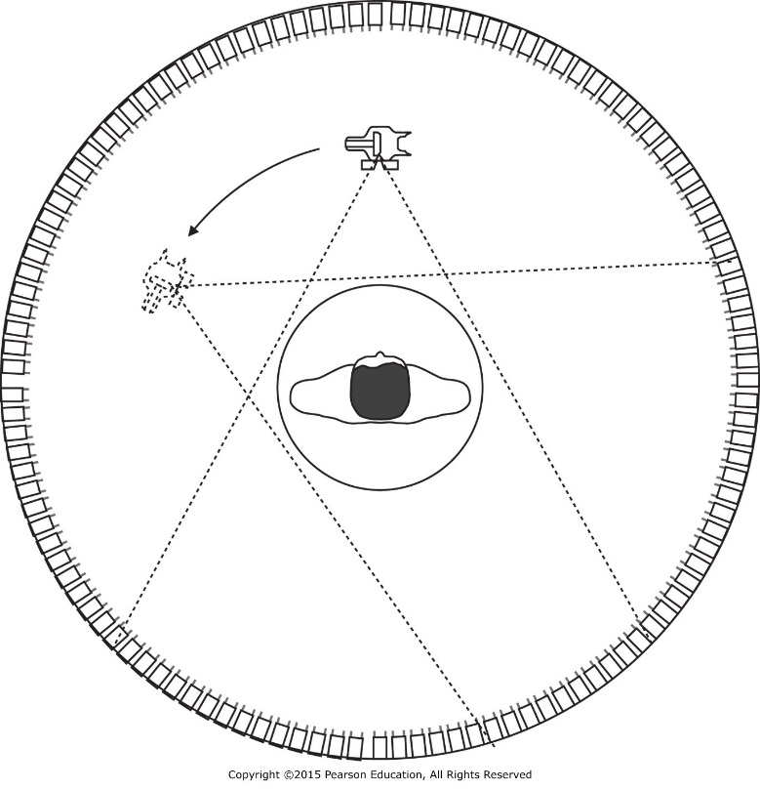
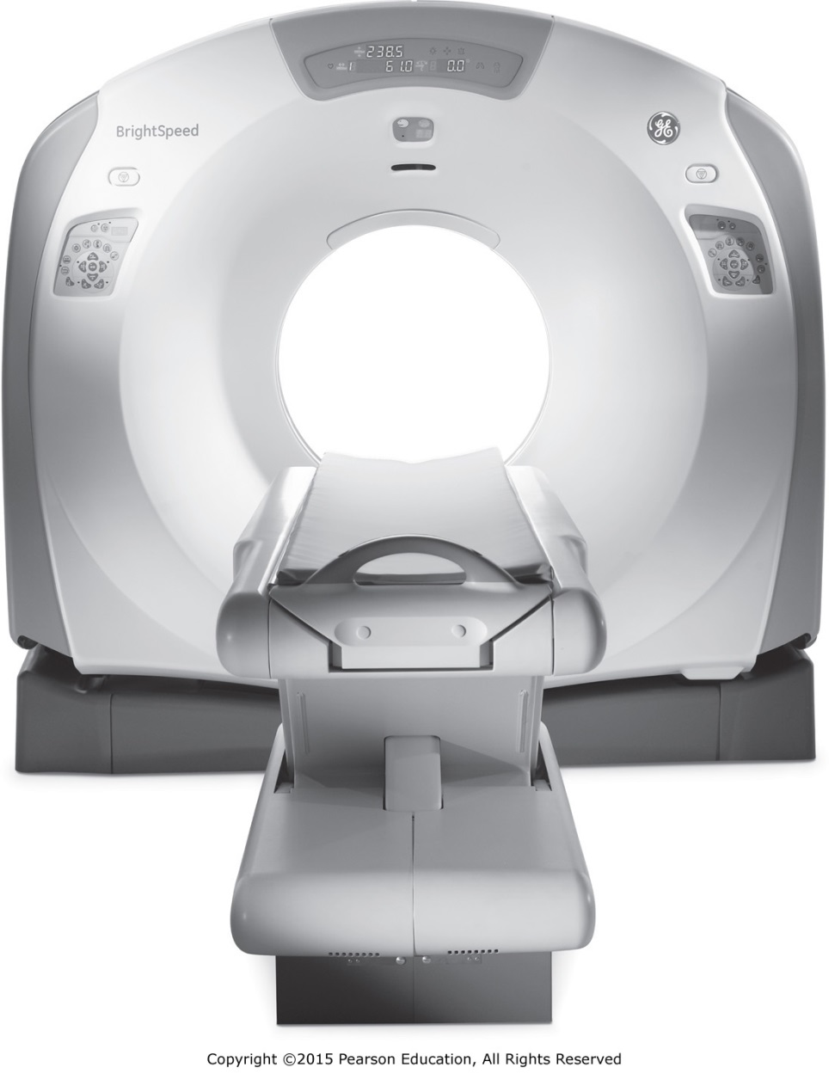
Ch 6: Computed Tomography
g
20
h
50
j
30
d
30
e
50
f
40
a
10
b
50
c
20

Slide 4
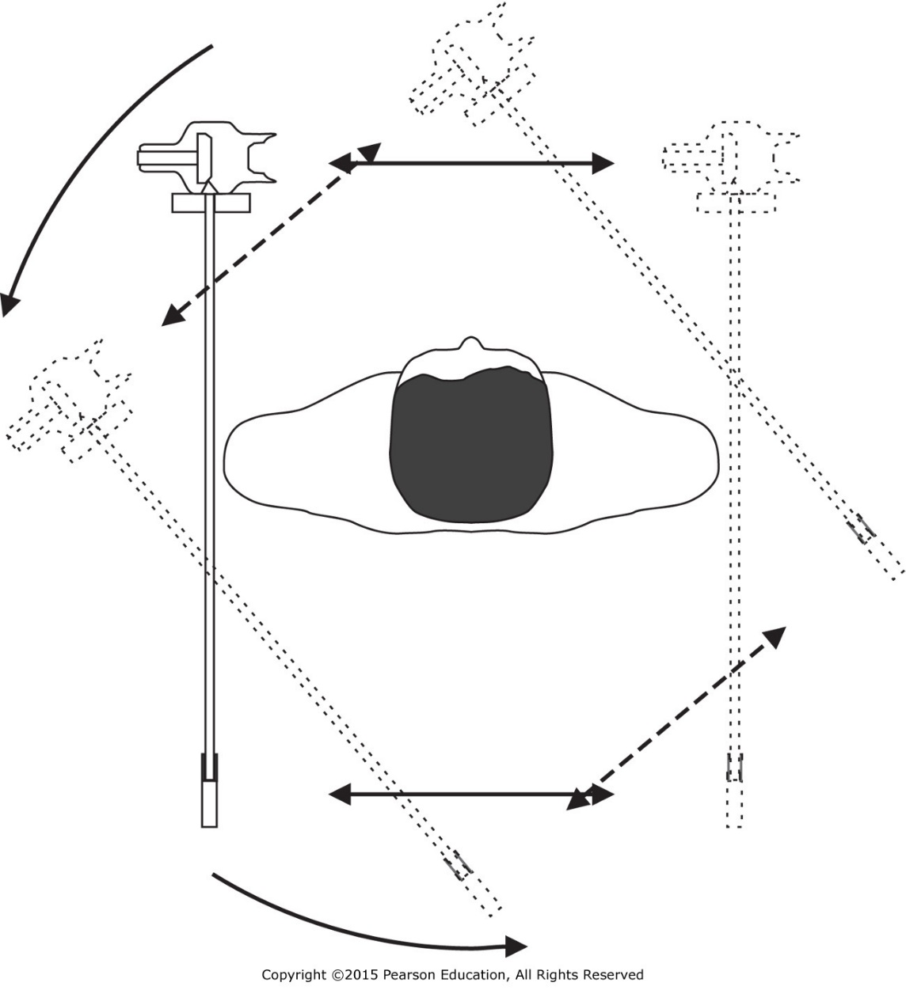
First-Generation (1G) CT scanner

Slide 5
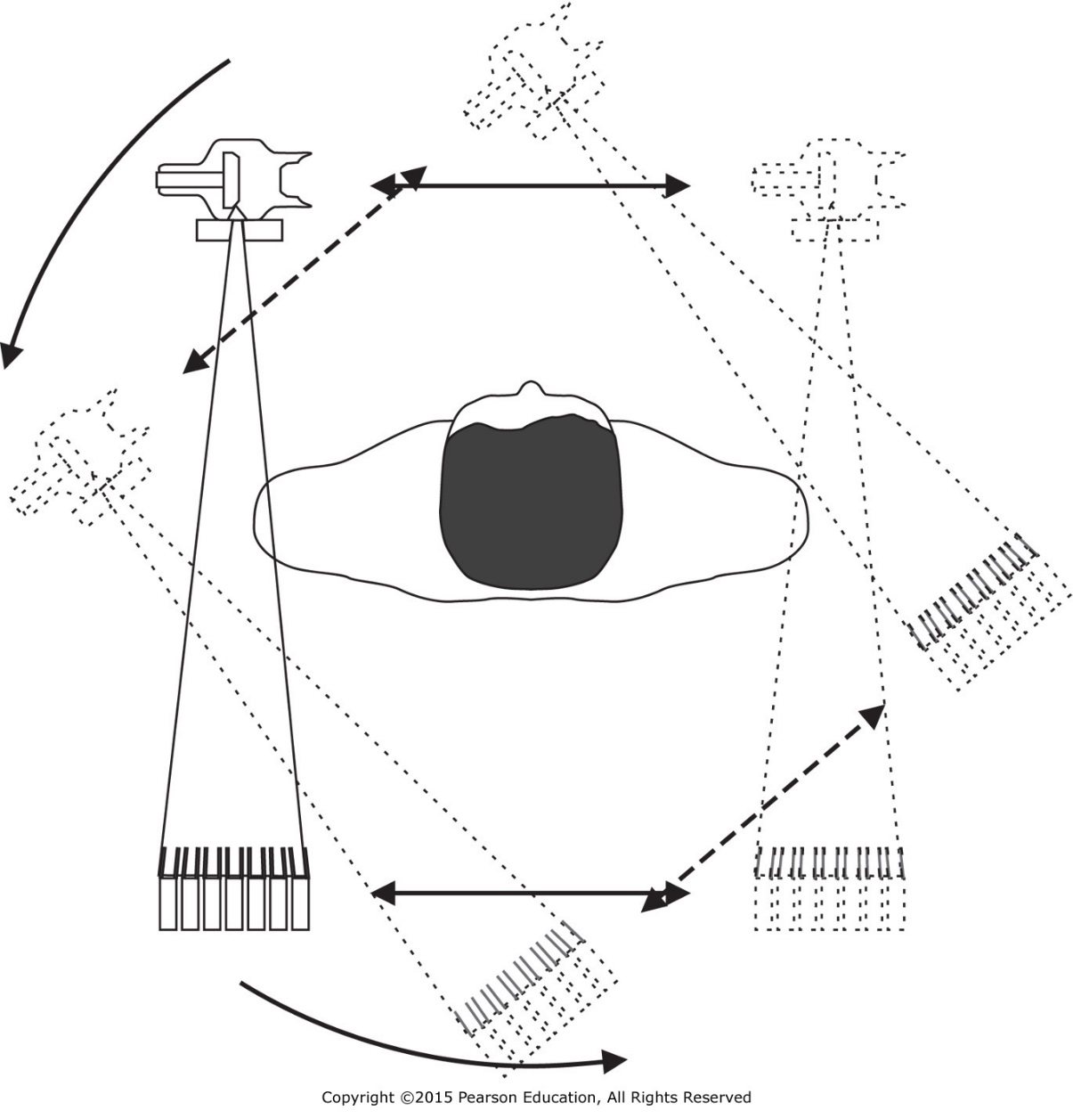
Second-Generation (2G) CT scanner

Slide 6
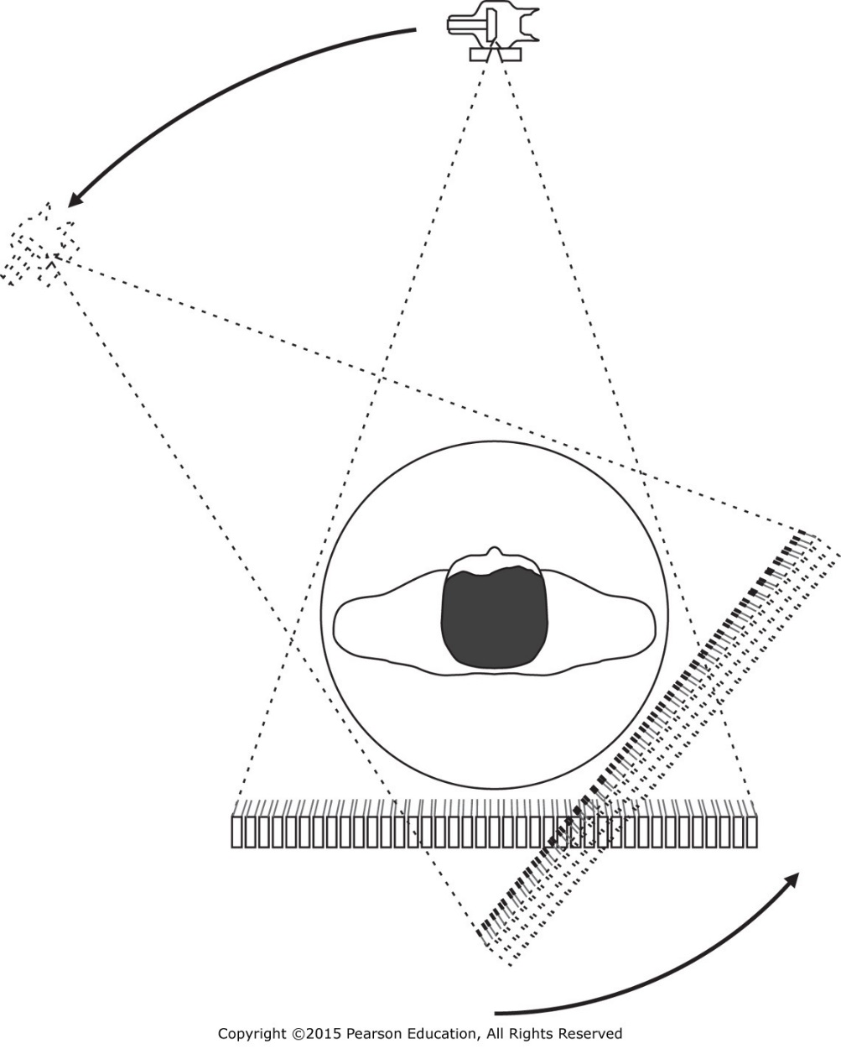
Third-Generation (3G) CT scanner

Slide 7
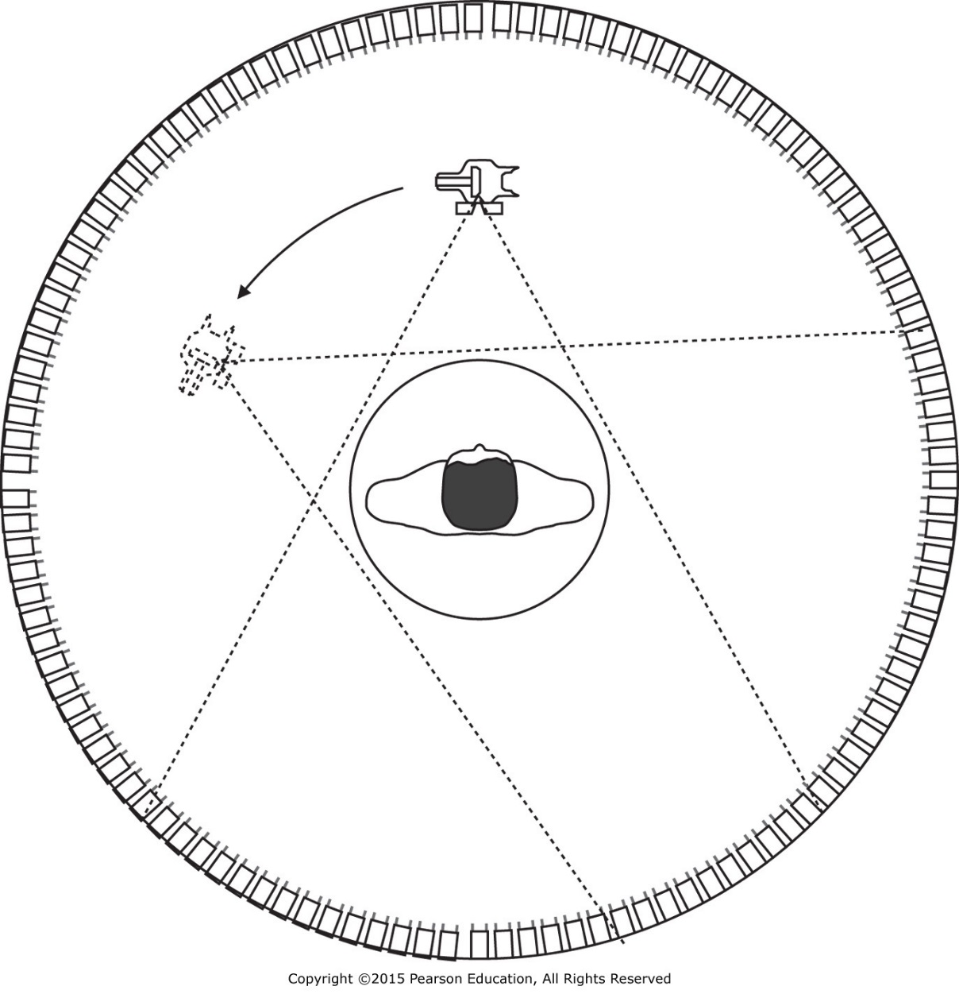
Fourth-Generation (4G) CT scanner

Slide 8
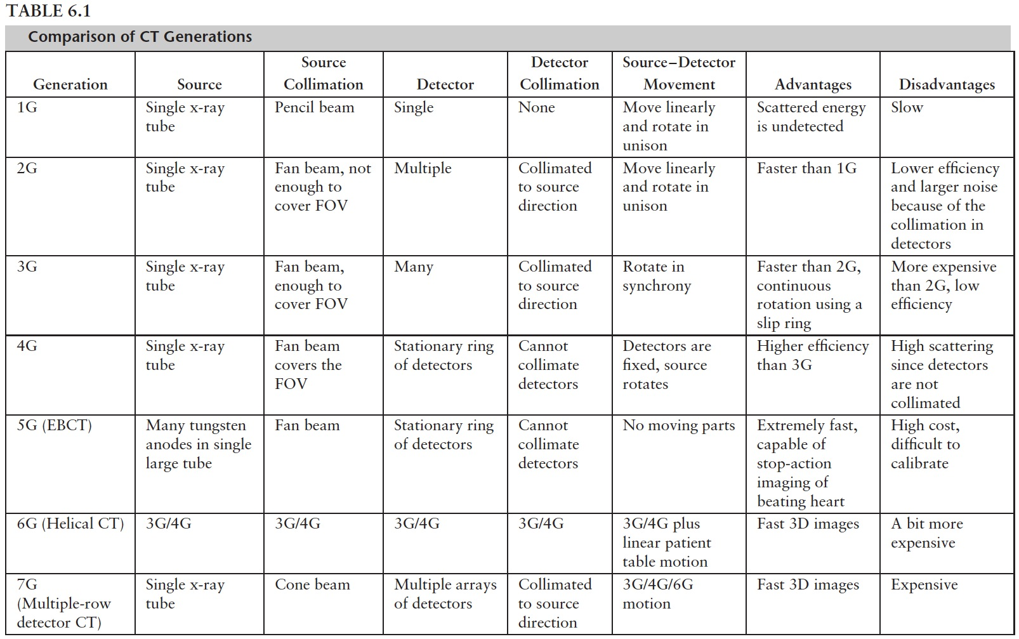
Comparison of CT Generations

Slide 9
X-Ray Detectors
Solid-state detectors,
Xenon gas detectors, and
Multiple (solid-state) detector array.

Slide 10
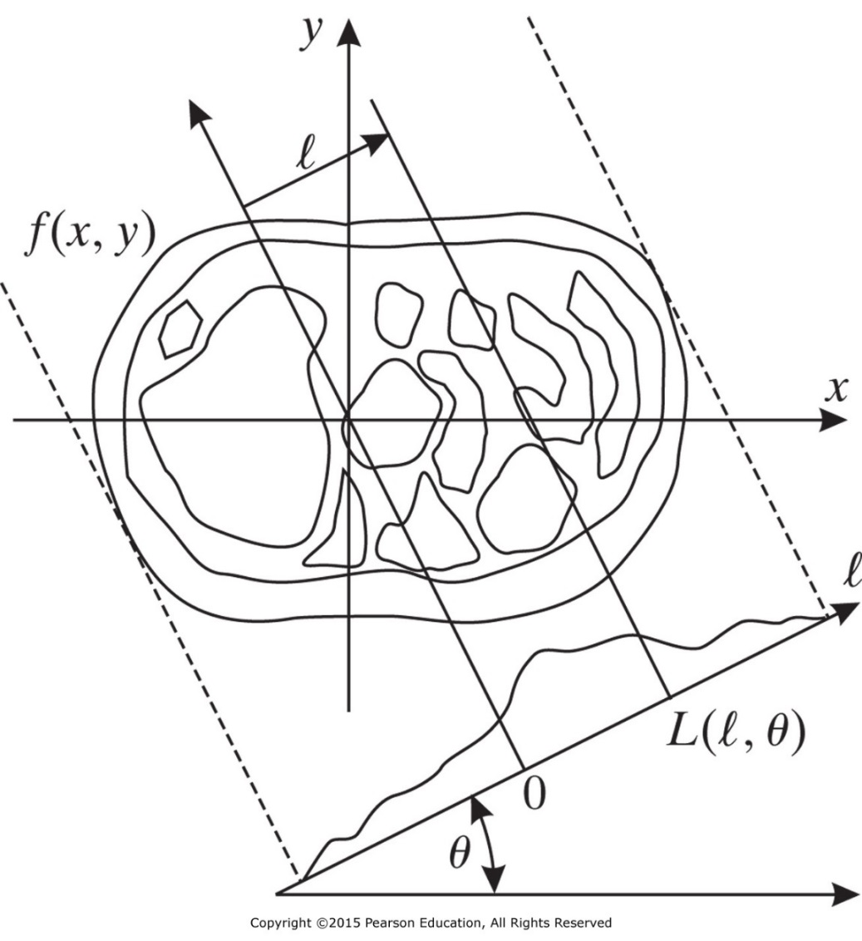
2-D Radon Transform
$$g\left(l,θ\right)=\int_{−∞}^{∞}{\int_{−∞}^{∞}{f(x,y)δ(x\text{cos}θ+y\text{sin}θ−l)dxdy}}$$
The geometry of lines and projections

Slide 11
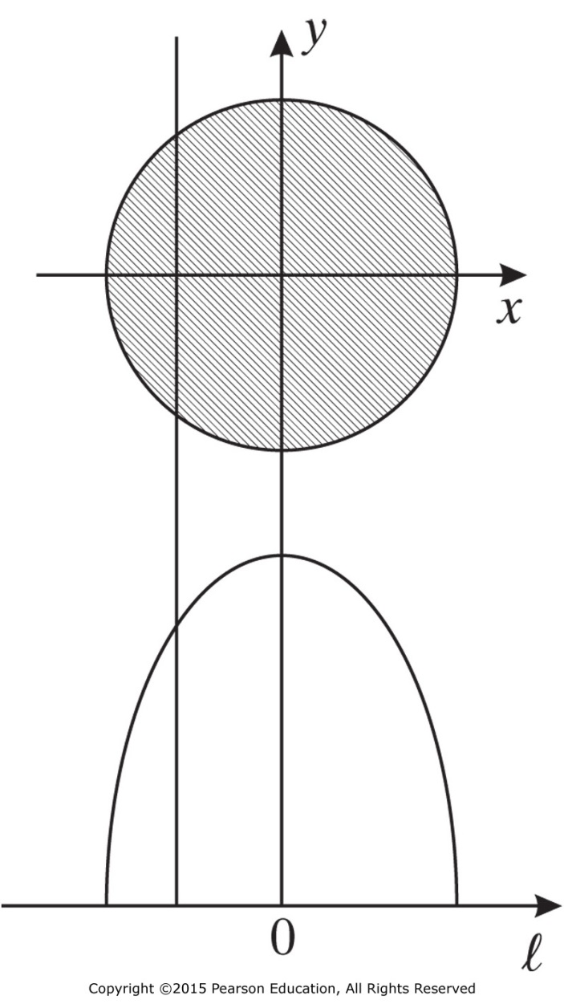
X-Ray Projection
The geometry of lines and projections
Projection of a disk.

Slide 12
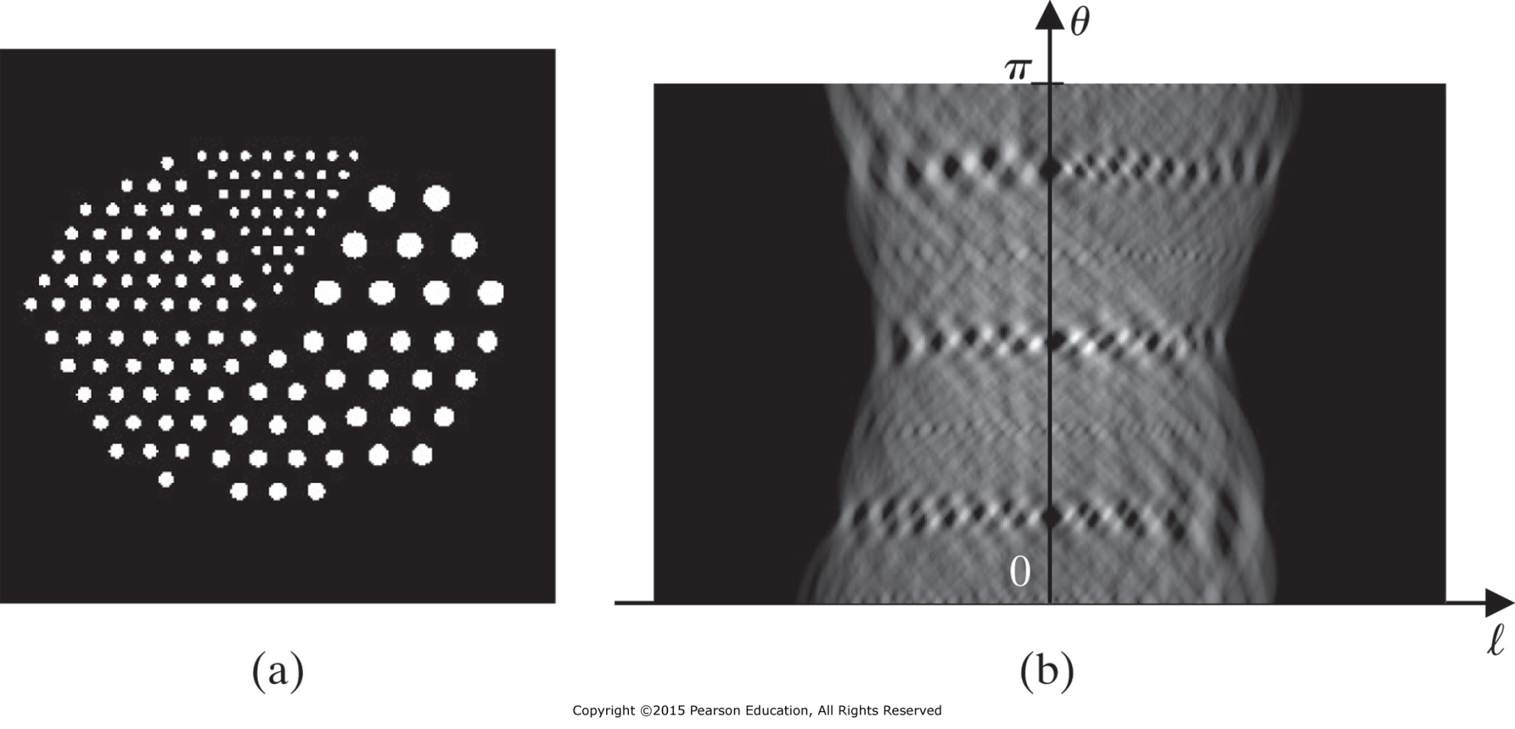
X-Ray Projection
f(x,y)
Radon transform
g(l,θ)
An object
Sinogram
By applying the inverse Radon transform to the sinogram image (date in b) we can reconstruct the image in a.

Slide 13
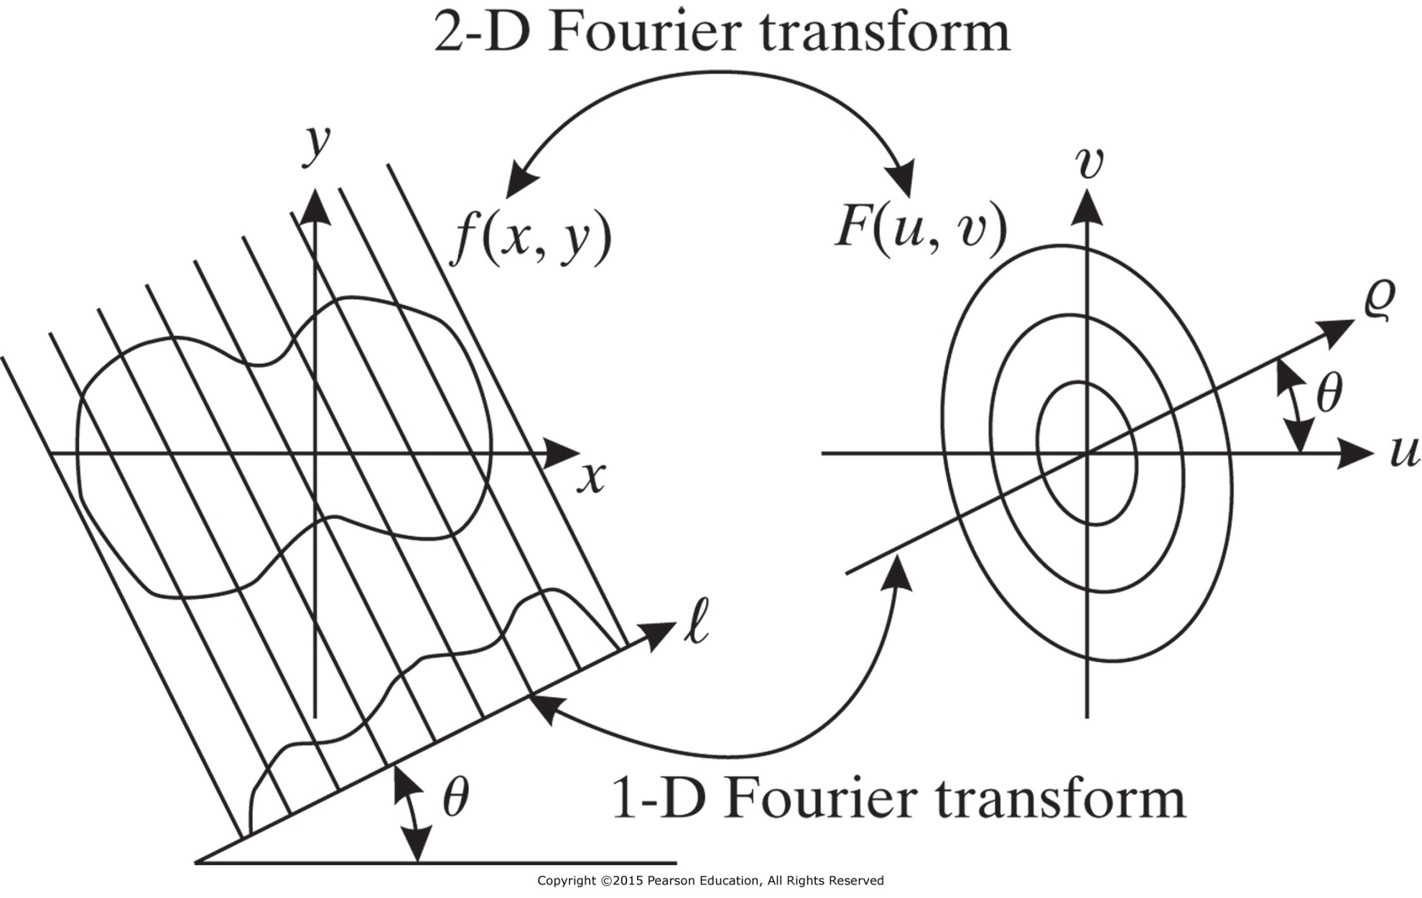
The Projection-Slice Theorem in Graphical Form

