Slide 1
ENGR 4323/5323
Digital and Analog Communication
Chapter 1
Introduction
School of Engineering
University of Central Oklahoma
Dr. Mohamed Bingabr

Slide 2
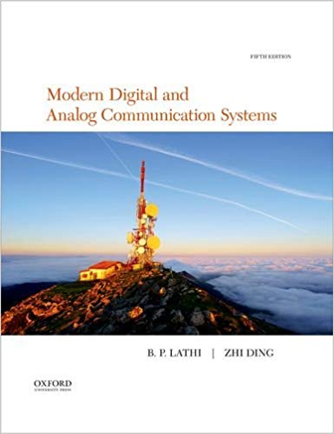
Course Materials
Textbook: “Modern Digital and Analog Communication”, 5th edition by B. P. Lathi. ISBN: 978-0190686840
Course Website: http://www.engineering.uco.edu/~mbingabr

Slide 3
Grading Policy
Grading Distribution:
Attendance 10 %
Homework 15 %
Quizzes 25 %
2 Tests 30 %
Final Exam 20 %
Grading Scale:
A: 90-100
B: 80-89
C: 70-79
D: 60-69
F: 0-59

Slide 4
Course Expectations & Conducts
Spend a total of 4 to 6 hours a week.
Ask for help for homework but don’t copy.
You can not seek help from your neighbor during quizzes and tests.
You are allowed to have one formula sheet in addition to the formula sheets I provide to you for quizzes and tests.
Makeup test will be given for emergency situation.
No phone or internet use during lecture.
Be on time for the lecture and do your best to stay focus.

Slide 5
Course Objectives
• Signals and Signal Space (Fourier Series)
• Analysis and Transmission of Signals (Fourier Transf.)
• Amplitude Modulation
• Angle Modulation (FM and PM)
• Digitization of Analog Source Signals
• Principle of Digital Data Transmission
• Fundamental of Probability Theory in Communication

Slide 6
Why Communication
Communication advances society’s development.
Before modern time verbal messages were carried by runners, carrier pigeons, lights and fires.
In modern time messages (verbal, images, data) are carried by telephone, internet, satellite, and wireless.
Job: there is high demand with high pay.
Research: very active

Slide 7
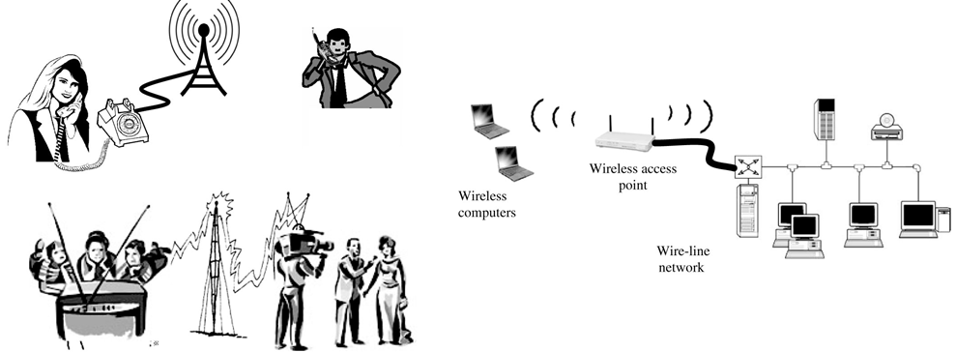
Communication System
Twisted Wires
Coaxial Cable
Fiber optic
Air
Speech
Image
Data
Medical
Environmental
Microphone
Keyboard
CCD Camera
A/D Converter
Encoder
Modulator
D/A Converter
Decoder
Demodulator
Error detection
TV Screen
Computer Screen
Speakers
Printer
Channel frequency fading and selectivity
Hardware noise and environmental interference

Slide 8
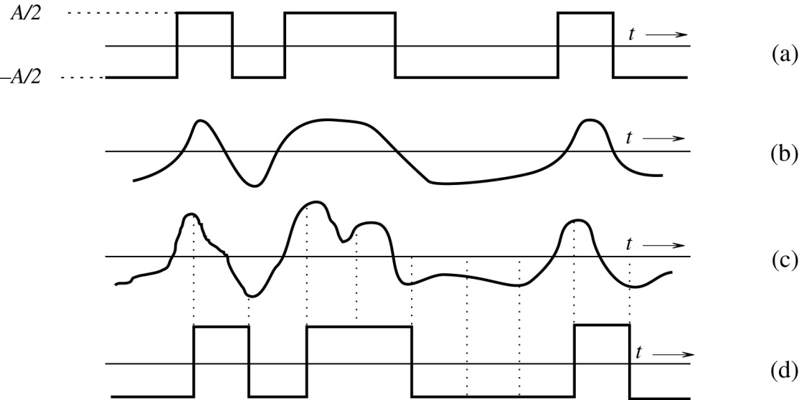
Analog and Digital Messages
Analog Signal: Speech waveform, Music sound, temperature and atmospheric pressure.
Digital Signal: English text constructed from the ASCII keyboard of 128 symbols. Binary signal (messages constructed from two symbols 0 and 1) and M-ary signals.
Advantage of Digital Signal
- Cheaper Systems (with microprocessor)
- Better Quality (immune to noise, regenerative repeaters)

Slide 9
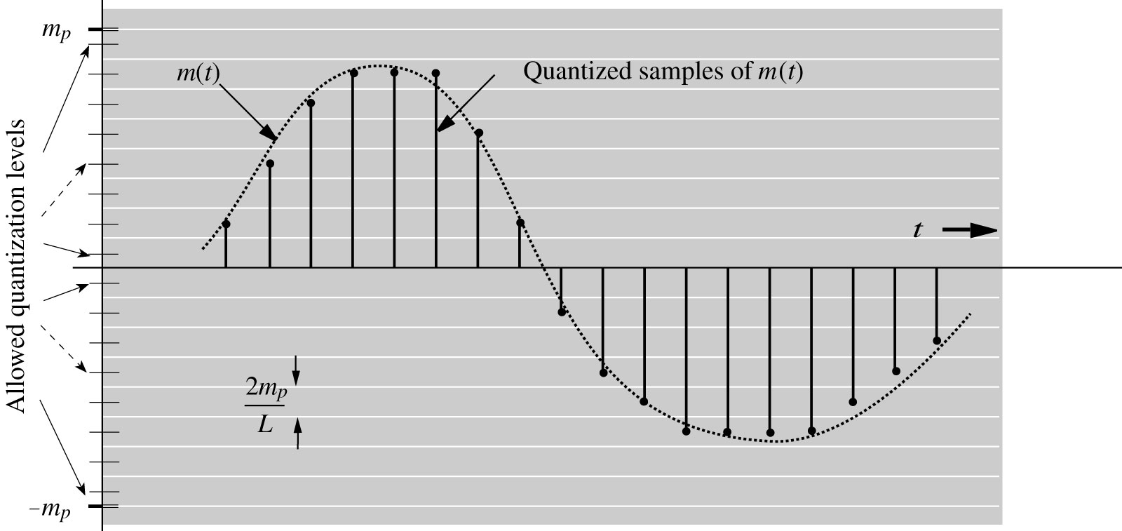
Analog to Digital Conversion
Sampling Theorem
Quantization
SNR

Slide 10
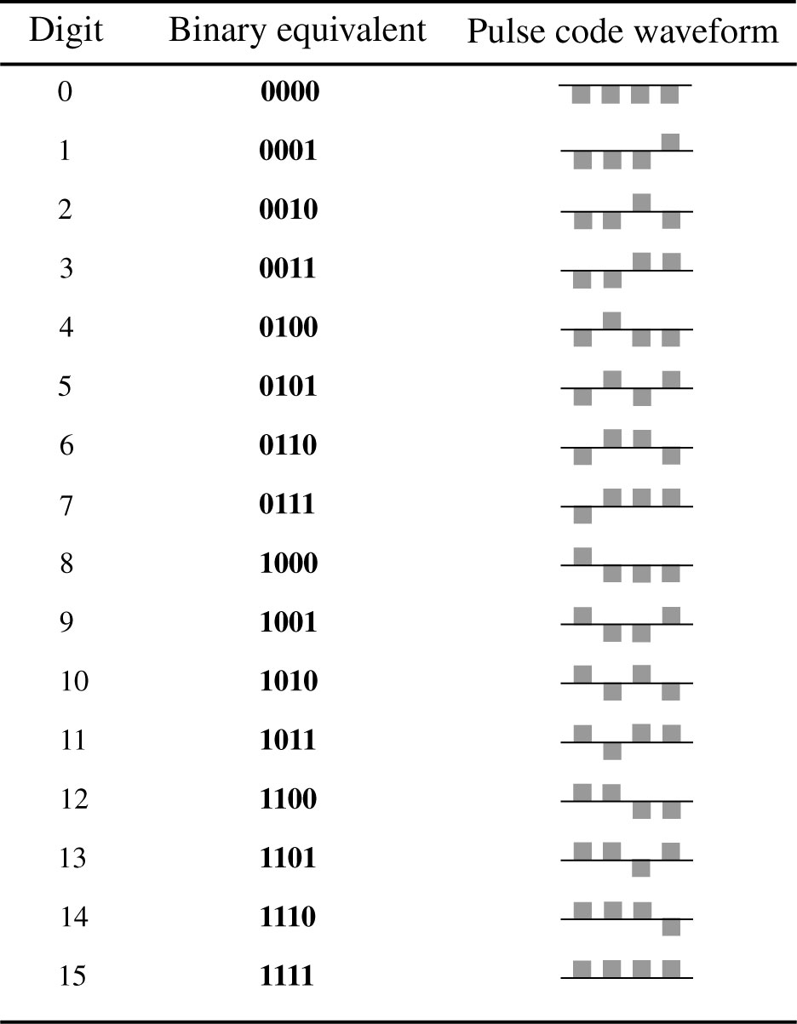
Pulse-Coded Modulation (PCM)
PCM represents each quantized sample by an ordered combination of two basic pulses: p₁(t) representing 1 and p_{o}(t) representing 0.

Slide 11
Channel Effect
Channel Bandwidth (B)
determine transmission rate
Signal power
determine the quality of the received signal
Signal-To-Noise Ratio (SNR)
SNR_{dB} = 10 log₁₀(P_{signal} / P_{noise}) = 20 log₁₀(A_{signal} / A_{noise})
Channel Capacity:
Determine the upper bound of transmission rate
C = B log₂ (1 + SNR) bit/s

Slide 12
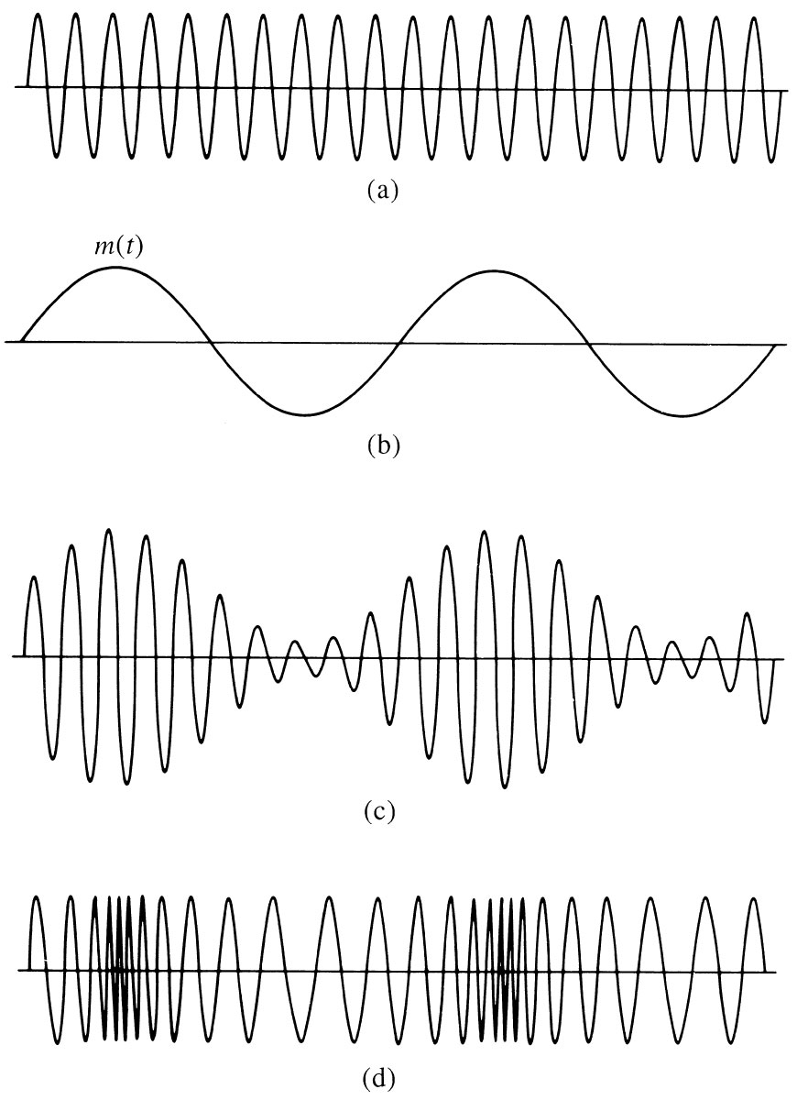
Modulation and Detection
Baseband Signal
Low frequency
Signals generated by the source
Modulation
Use the message signal to modulate certain parameters of the (RF) carrier signal of high frequency.

Slide 13
Modulation and Detection
Modulation used for
Ease of Radiation
Multiplexing: Simultaneous transmission of multiple signal
Demodulation:
Recovering the message signal from the carrier

Slide 14
Digital Source Coding and Error Correction Code
Source Coding
Compression techniques to reduce the number of bits representing a message without sacrificing the message quality and accuracy of detection.
Reduce redundancy
Channel Coding
Add redundancy to detect the error and correct it.

Slide 15
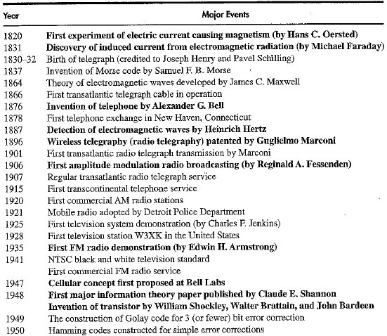
Brief History of Telecommunication

Slide 16
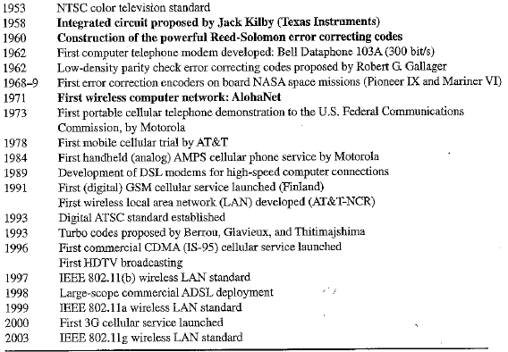
Brief History of Telecommunication

