Slide 1
ENGR 4323/5323
Digital and Analog Communication
Ch2
Signals and Signal Space
School of Engineering
University of Central Oklahoma
Dr. Mohamed Bingabr

Slide 2
Outline
Size of a Signal
Classification of Signals
Useful Signals and Signal Operations
Signals Versus Vectors
Correlation of Signals
Orthogonal Signal Sets
Trigonometric and Exponential Fourier Series

Slide 3
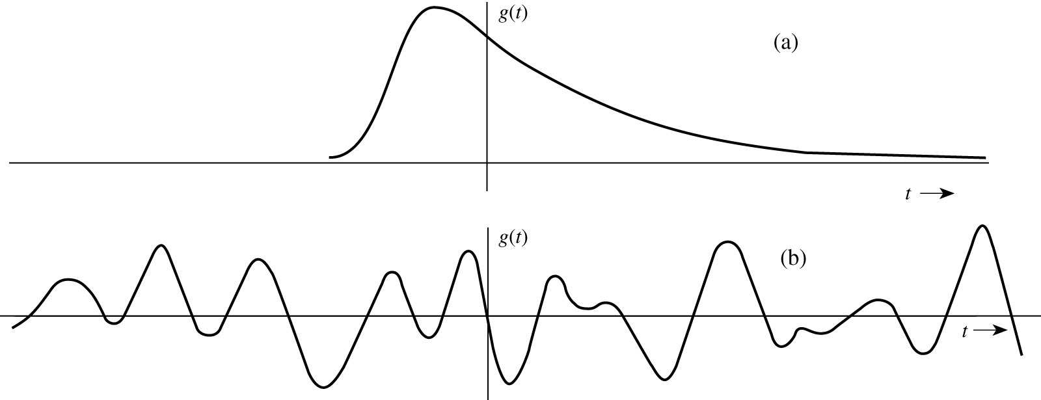
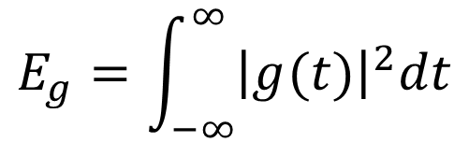
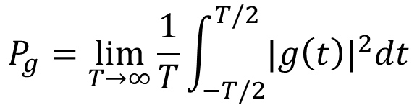
Signal Energy and Power
Energy Signal
Power Signal
$$E_{g}=\int_{−∞}^{∞}{{\left|g(t)\right|}^{2}dt}$$
Energy
$$P_{g}=\lim_{T→∞}{\frac{1}{T}}\int_{−T/2}^{T/2}{{|g\left(t\right)|}^{2}dt}$$
Power

Slide 4
Signal Classification
1. Continuous-time and discrete-time signals
2. Analog and digital signals
3. Periodic and aperiodic signals
4. Energy and power signals
5. Deterministic and probabilistic signals
6. Causal and non-causal
7. Even and Odd signals

Slide 5
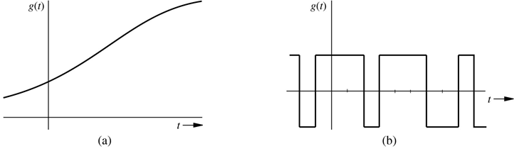
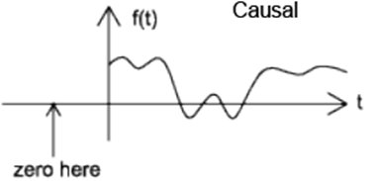
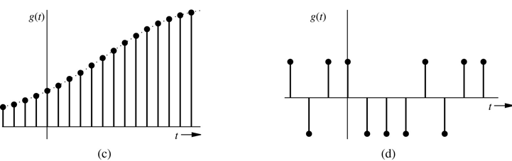
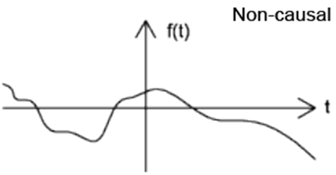
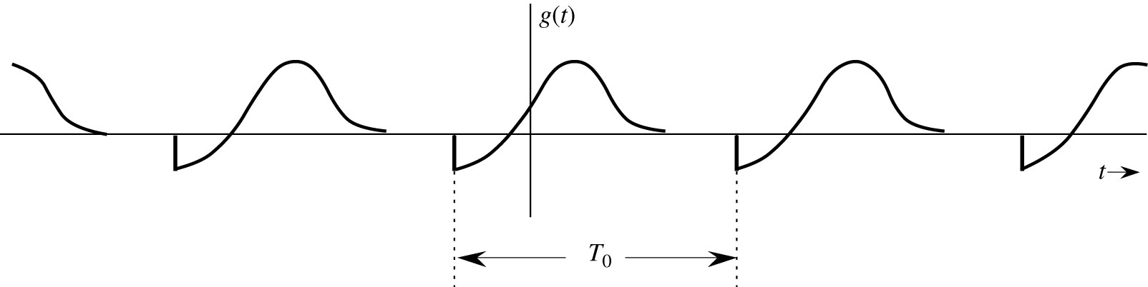

Analog continuous
Digital continuous
Analog Discrete
Digital Discrete
Periodic
Deterministic
Aperiodic Probabilistic

Slide 6
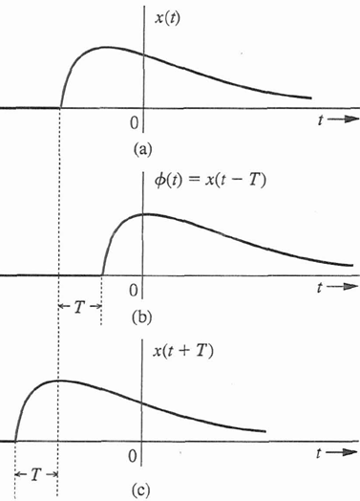
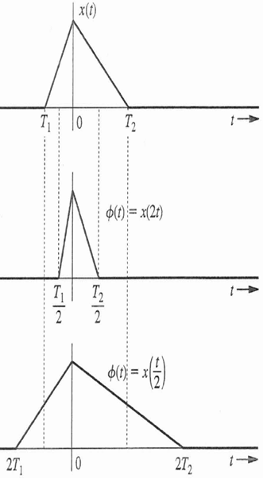
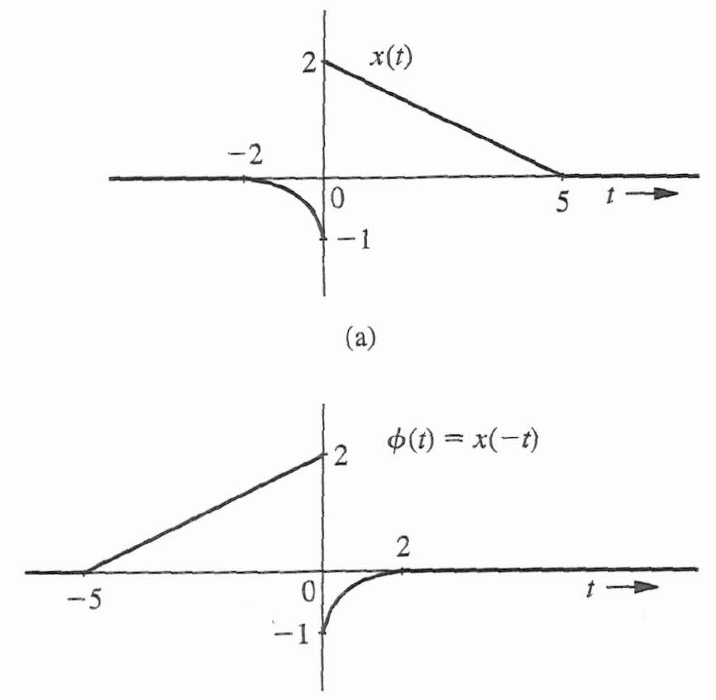
Useful Signal Operation
Time Shifting
Time Scaling
Time Inversion
x(t)
2
1
t
-1
1

Slide 7

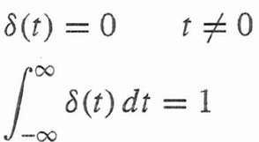
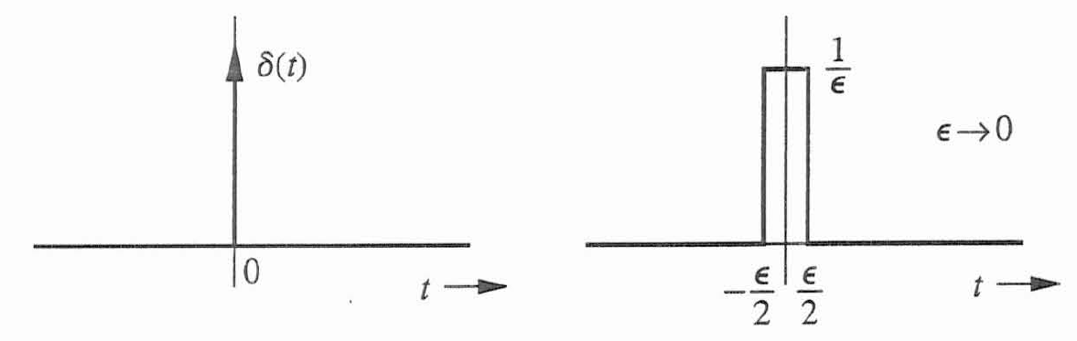
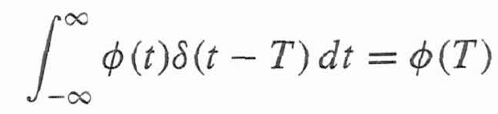

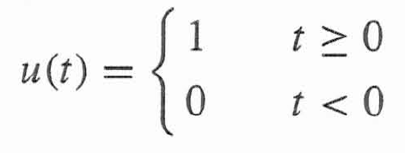
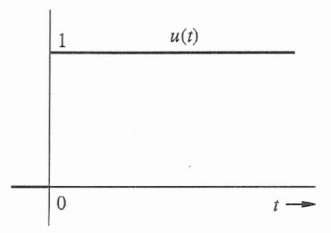
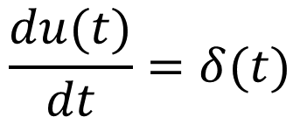
Useful Signals
Unit impulse Signal
Unit step function u(t)
$$\frac{du(t)}{dt}=δ(t)$$

Slide 8
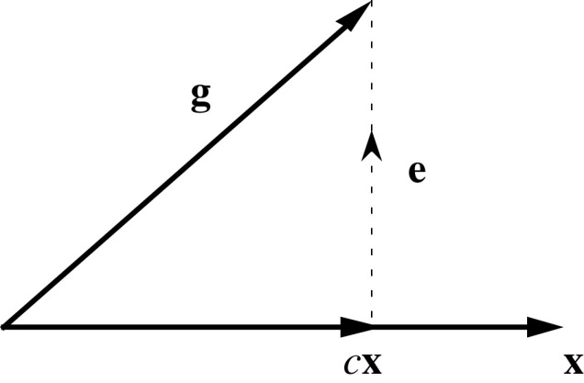
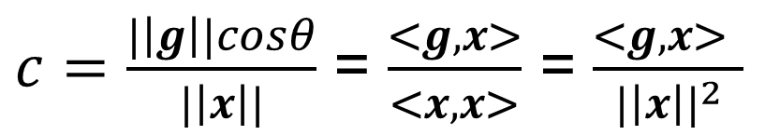

Vector Approximation
To approximate vector g using another vector x then we need to choose c that will minimize the error e.
g = cx + e
Remember: Dot product: <g, x> = ||g||.||x|| cos θ

Slide 9
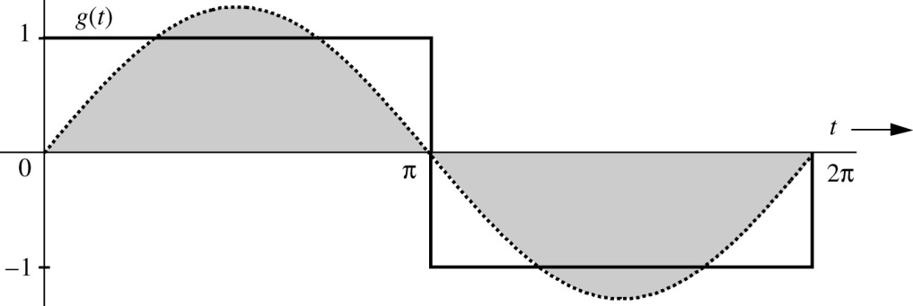
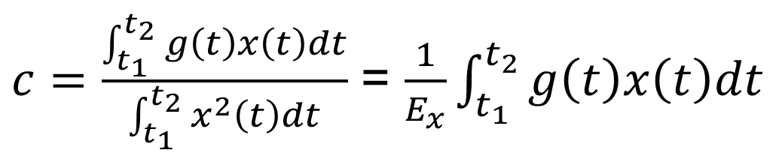
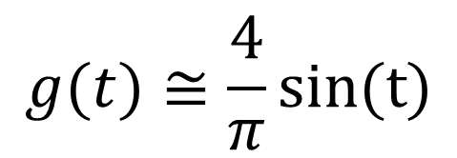
Signal Approximation
x(t)
g(t) = cx(t) + e(t)

Slide 10
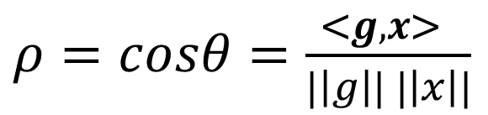
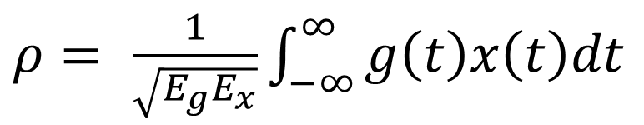
Correlation of Signals
Two vectors are similar if the angle between them is small.
Correlation coefficient
Note: Similarity between vectors or signals does not depend on the length of the vectors or the strength of the signals.

Slide 11
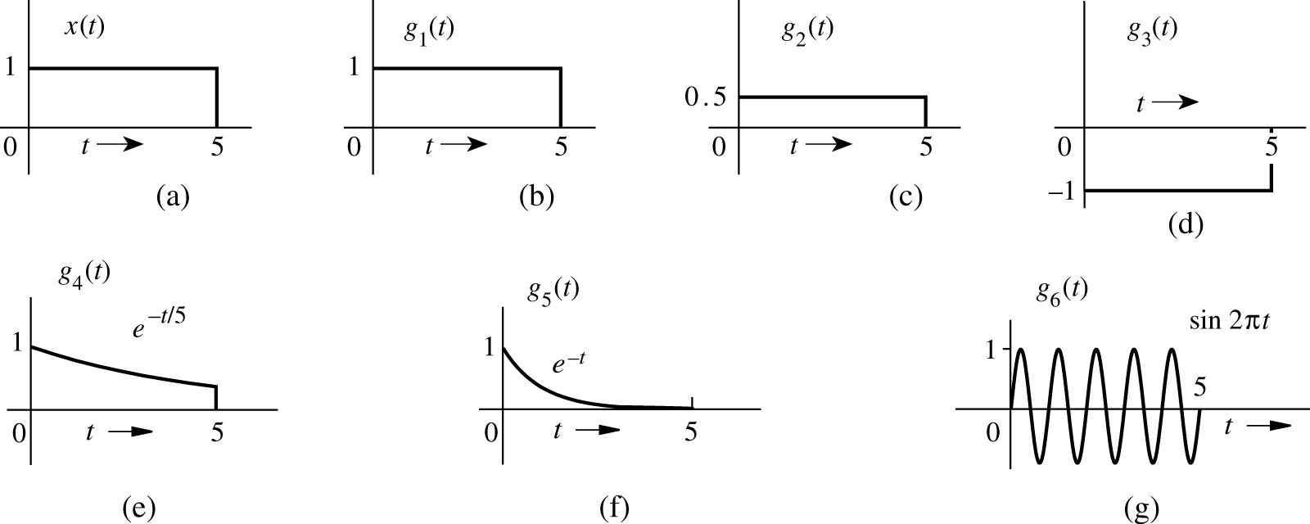
Example
Which of the signals g₁(t), g₂(t), …, g₆(t) are similar to x(t)?
ρ₁=1
ρ₂=1
ρ₃=-1
ρ₄=0.961
ρ₅=0.628
ρ₆=0

Slide 12
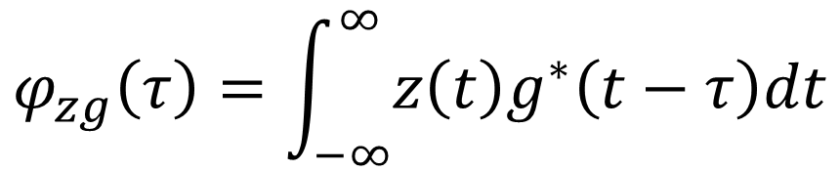
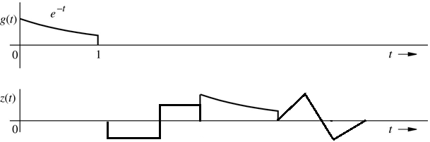

Cross-Correlation Function
1
2
3
4
g(t-τ)

Slide 13
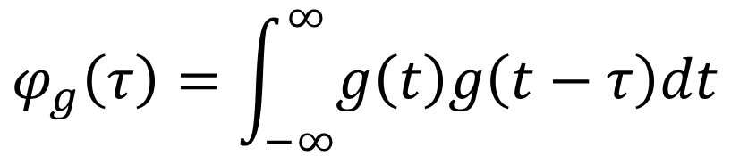
Autocorrelation Function
g(t)
g(t-τ)

Slide 14
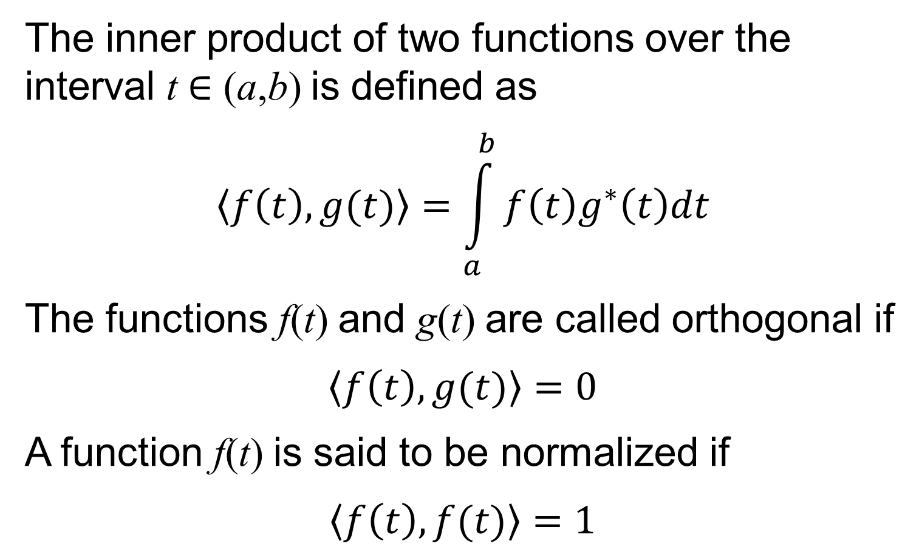
Orthogonality and Normalized Signal Sets
The inner product of two functions over the interval t ∈ (a,b) is defined as
$$\left\langle f\left(t\right),g(t)\right\rangle =\int_{a}^{b}{f\left(t\right)g^{∗}\left(t\right)dt}$$
The functions f(t) and g(t) are called orthogonal if
$$\left\langle f\left(t\right),g(t)\right\rangle =0$$
A function f(t) is said to be normalized if
$$\left\langle f\left(t\right),f(t)\right\rangle =1$$

Slide 15
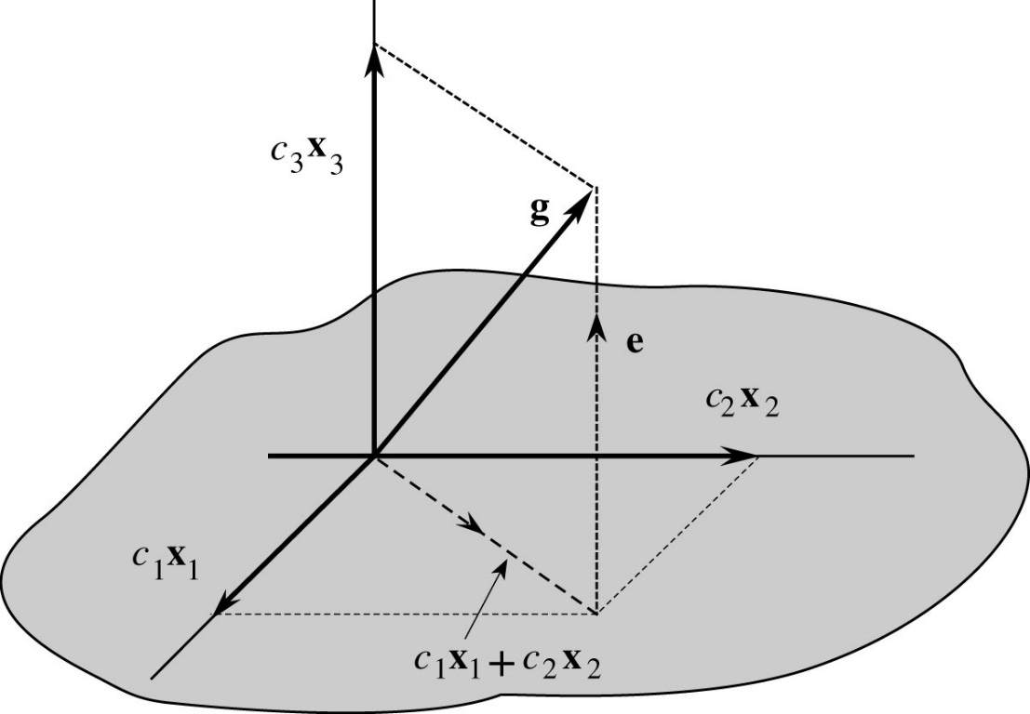
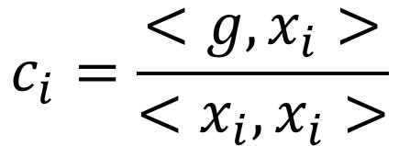
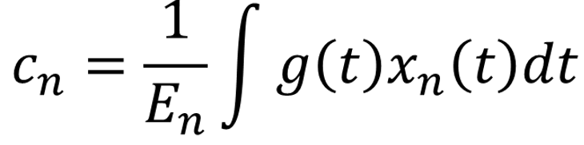
Orthogonal Signal Sets
Orthogonal Vector Space
g = c₁x₁ + c₂x₂ + c₃x₃
Orthogonal Signal Space
g(t) = c₁x₁(t)+ c₂x₂(t) + … + c_{N}x_{N}(t)

Slide 16
Trigonometric Fourier Series
For even function b_{n} = 0
For odd function a_{n} = 0

Slide 17
Compact Trigonometric Fourier Series
We can use the trigonometric identity
a cos(x) + b sin(x) = c cos(x + θ)
to find the compact trigonometric Fourier series
dc component
n^{th} harmonics
C₀, C_{n}, and θ_{n} are related to the trigonometric coefficients a_{n} and b_{n} as:

Slide 18
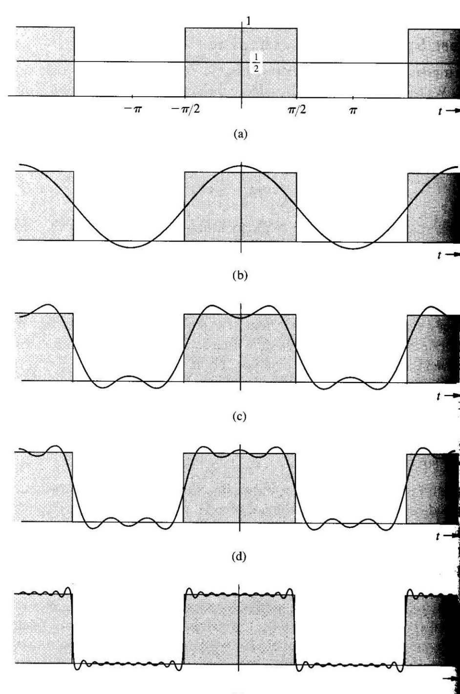
Role of Amplitude in Shaping Waveform

Slide 19
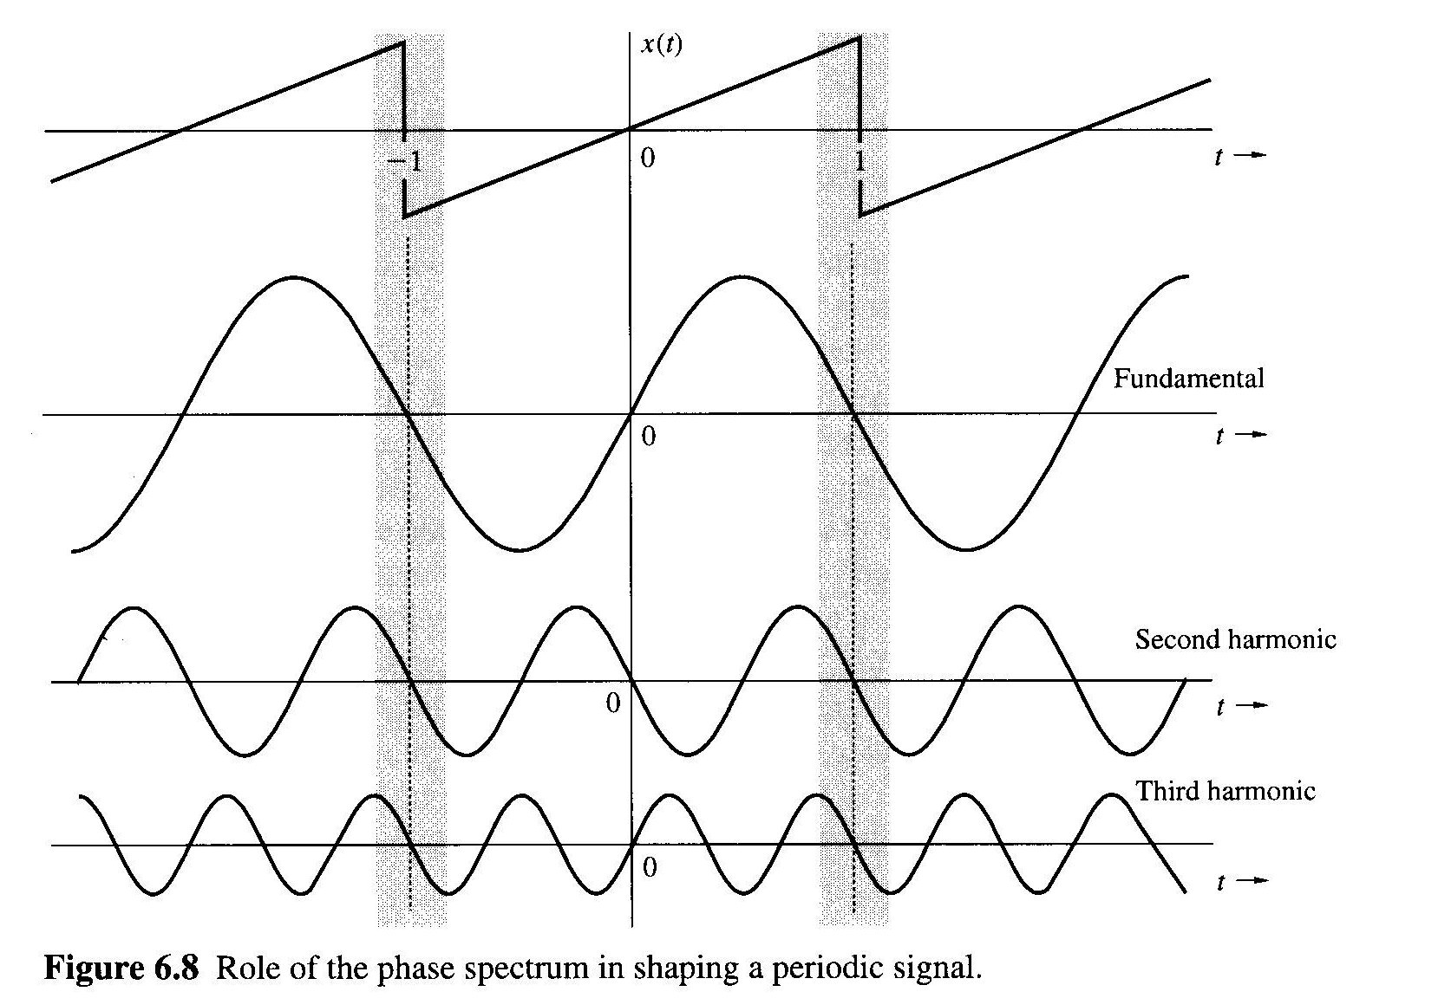
Role of the Phase in Shaping a Periodic Signal

Slide 20
Line Spectra of x(t)
The amplitude spectrum of x(t) is defined as the plot of the magnitudes |C_{n}| versus ω
The phase spectrum of x(t) is defined as the plot of the angles versus ω
This results in line spectra
Bandwidth the difference between the highest and lowest frequencies of the spectral components of a signal.

Slide 21
Line Spectra
f(t)
1
e^{-t/2}
−π
0
π
f(t)=0.504 + 0.244 cos(2t-75.96º) + 0.125 cos(4t-82.87º) +
0.084 cos(6t-85.24º) + 0.063 cos(8t-86.24º) + …
C_{n}
θ_{n}
0.504
0.244
ω
0.125
0.084
0.063
-π/2
ω
0 2 4 6 8 10

Slide 22
Exponential Fourier Series
To find D_{n} multiply both side by and then integrate over a full period, m =1,2,…,n,…∞
D_{n} is a complex quantity in general D_{n}=|D_{n}|e^{jθ}
D_{-n} = D_{n}*
|D_{n}|=|D_{-n}|
D_{n} = - D_{-n}
Even
Odd
D₀ is called the constant or dc component of x(t)

Slide 23
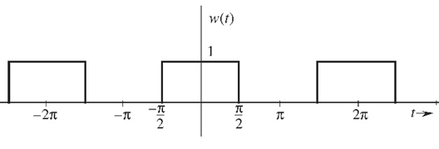
Example
Find the exponential Fourier Series for the square-pulse periodic signal.
Fundamental period T₀ = 2π
Fundamental frequency
  f₀ = 1/T₀ = 1/2π Hz
  ω₀ = 2π/T₀ = 1 rad/s

Slide 24
Line Spectra in the Exponential Form
The line spectra for the exponential form has negative frequencies because of the mathematical nature of the complex exponent.
D₀= C₀
D_{n} = C_{n}
C_{n} = 2 |D_{n}| n ≠ 0
D_{-n} = - C_{n}

Slide 25
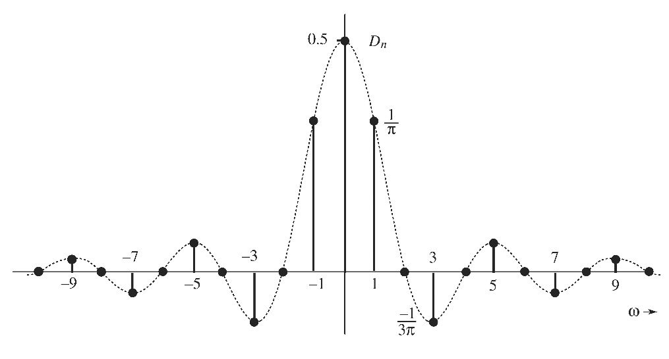
Exponential Line Spectra

Slide 26
Example
The compact trigonometric Fourier Series coefficients for the square-pulse periodic signal.
f(t)
1
−2π
−π
−π/2
π/2
π
2π
Fundamental frequency
  f₀ = 1/T₀ = 1/2π Hz
  ω₀ = 2π/T₀ = 1 rad/s

Slide 27
Example
Find the exponential Fourier Series and sketch the corresponding spectra for the impulse train shown below. From this result sketch the trigonometric spectrum and write the trigonometric Fourier Series.
Solution
-2T₀
-T₀
T₀
2T₀

Slide 28
Parseval’s Theorem
Let x(t) be a periodic signal with period T
The average power P of the signal is defined as
Expressing the signal as
it is also

Slide 29
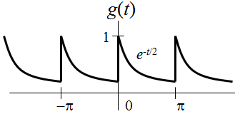
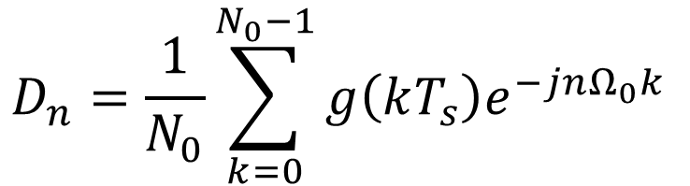
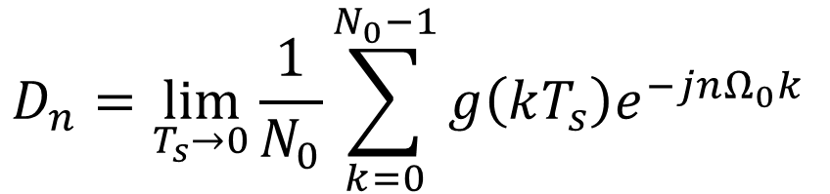
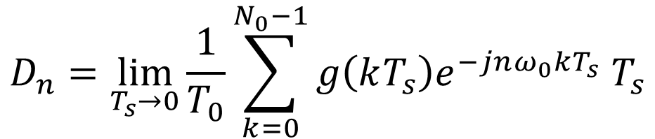
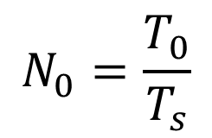

Numerical Calculation of Fourier Series
$$D_{n}=\lim_{T_{s}→0}{\frac{1}{T_{0}}\sum_{k=0}^{N_{0}−1}{g\left(kT_{s}\right)e^{−jnω_{0}kT_{s}} T_{s}}}$$
$$N_{0}=\frac{T_{0}}{T_{s}}$$
$$D_{n}=\lim_{T_{s}→0}{\frac{1}{N_{0}}\sum_{k=0}^{N_{0}−1}{g\left(kT_{s}\right)e^{−jnΩ_{0}k} }}$$
$$Ω_{0}=ω_{0}T_{s}$$
$$D_{n}=\frac{1}{N_{0}}\sum_{k=0}^{N_{0}−1}{g\left(kT_{s}\right)e^{−jnΩ_{0}k} }$$

