Slide 1
Ch 3 Analysis and Transmission of Signals
ENGR 4323/5323
Digital and Analog Communication
School of Engineering
University of Central Oklahoma
Dr. Mohamed Bingabr

Slide 2
Chapter Outline
Aperiodic Signal Representation by Fourier Integral
Fourier Transform of Useful Functions
Properties of Fourier Transform
Ideal and Practical Filters
Signal Transmission Through LTIC Systems
Signal Distortion over a Communication Channel
Signal Energy and Energy Spectral Density
Signal Power and Power Spectral Density

Slide 3
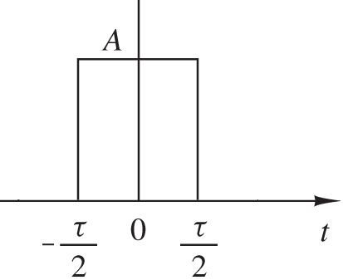
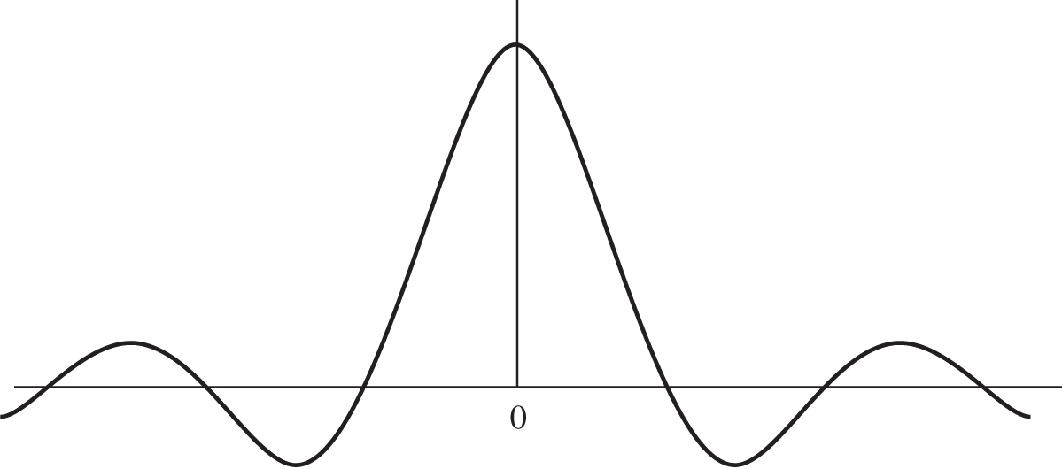
The Fourier Transform Spectrum
Fourier transform (FT) allows us to represent aperiodic (not periodic) signal in term of its frequency ω.
x(t)
The Fourier transform integrals:
|X(ω)|
ω

Slide 4
The Fourier Transform Spectrum
The Phase Spectrum
The Amplitude (Magnitude) Spectrum
The amplitude spectrum is an even function and the phase is an odd function.
The Inverse Fourier transform:

Slide 5
Useful Functions
Unit Gate Function
1
t
-τ/2
τ/2
Unit Triangle Function
1
t
-τ/2
τ/2

Slide 6
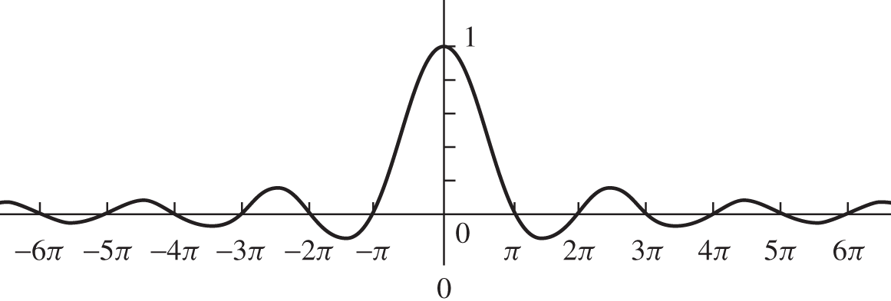
Useful Functions
Interpolation Function
sinc(t)
t

Slide 7
Example
Find the FT, the magnitude, and the phase spectrum of
x(t) = rect(t/τ).
Answer
What is the bandwidth of the above pulse?
The spectrum of a pulse extend from 0 to ∞. However, much of the spectrum is concentrated within the first lobe (ω=0 to 2π/τ)

Slide 8
Examples
Find the FT of the unit impulse δ(t).
Answer
Find the inverse FT of δ(ω).
Answer

Slide 9
Examples
Find the FT of the unit impulse train
Answer

Slide 10
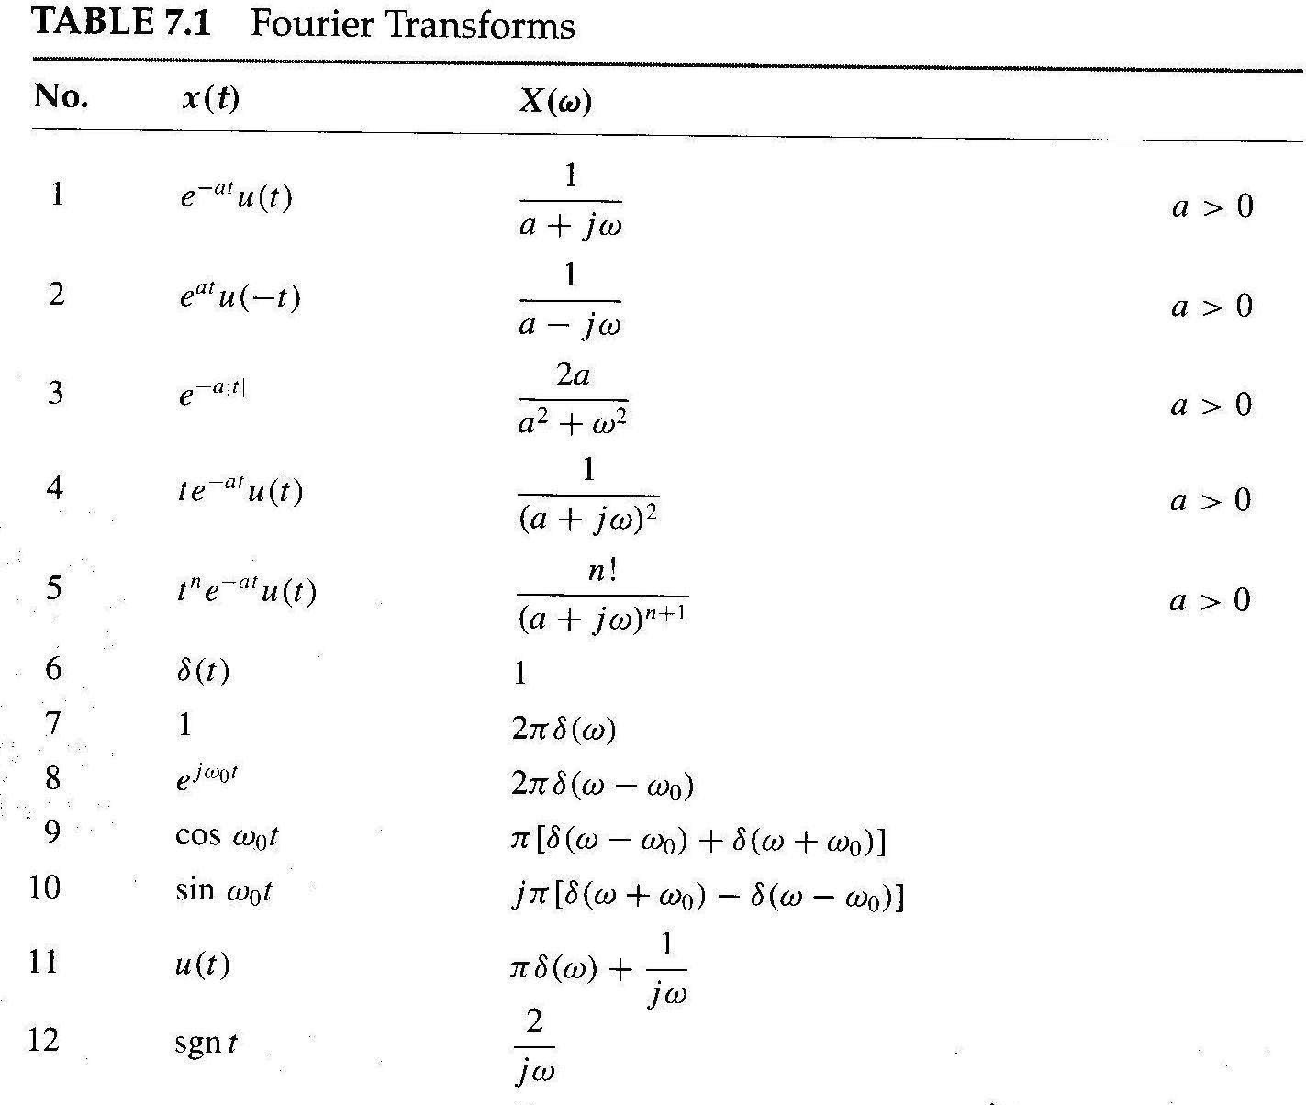

Slide 11
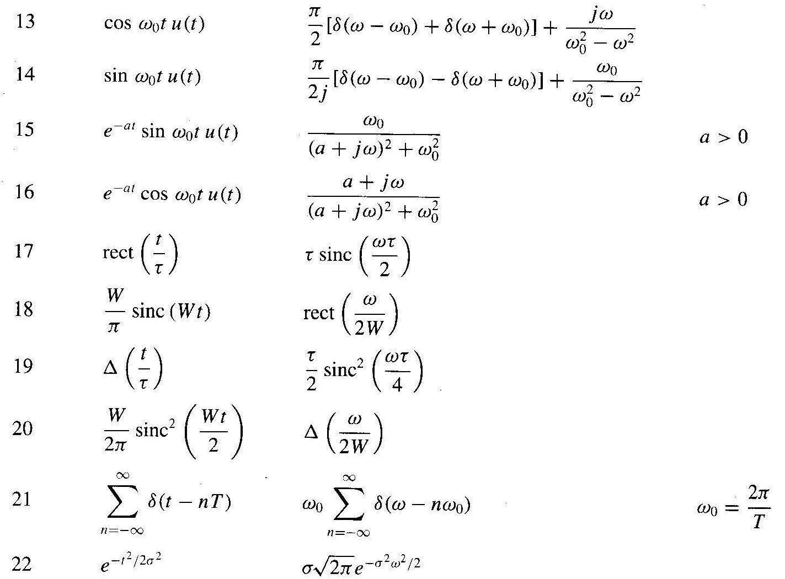

Slide 12
Properties of the Fourier Transform
Linearity:
Let and
then
Time Scaling:
Let
then
Compression in the time domain results in expansion in the frequency domain
Internet channel A can transmit 100k pulse/sec and channel B can transmit 200k pulse/sec. Which channel does require higher bandwidth?

Slide 13
Properties of the Fourier Transform
Time Reversal:
Let
then
Left or Right Shift in Time:
Let
then
Time shift effects the phase and not the magnitude.

Slide 14
Properties of the Fourier Transform
Multiplication by a Complex Exponential (Freq. Shift Property):
Let
then
Multiplication by a Sinusoid (Amplitude Modulation):
Let
then
cosω₀t is the carrier, x(t) is the modulating signal (message),
x(t) cosω₀t is the modulated signal.

Slide 15
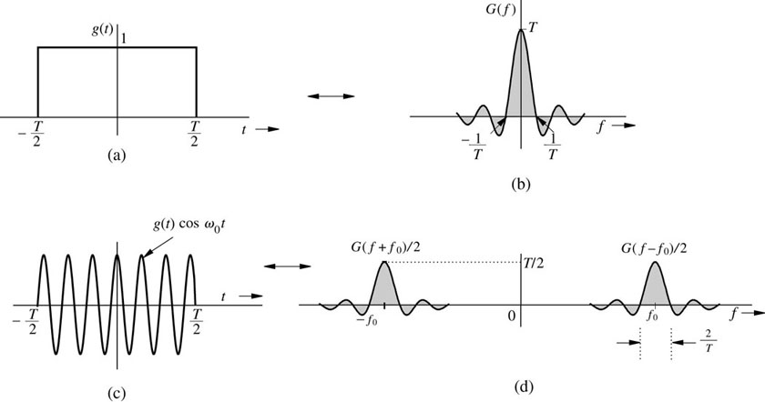
Example: Amplitude Modulation
x(t)
Example: Find the FT for the signal
A
-2
2

Slide 16
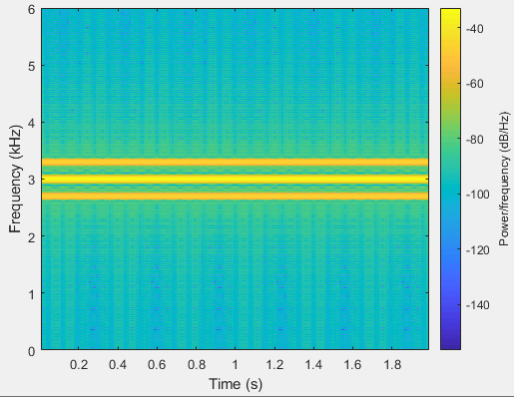
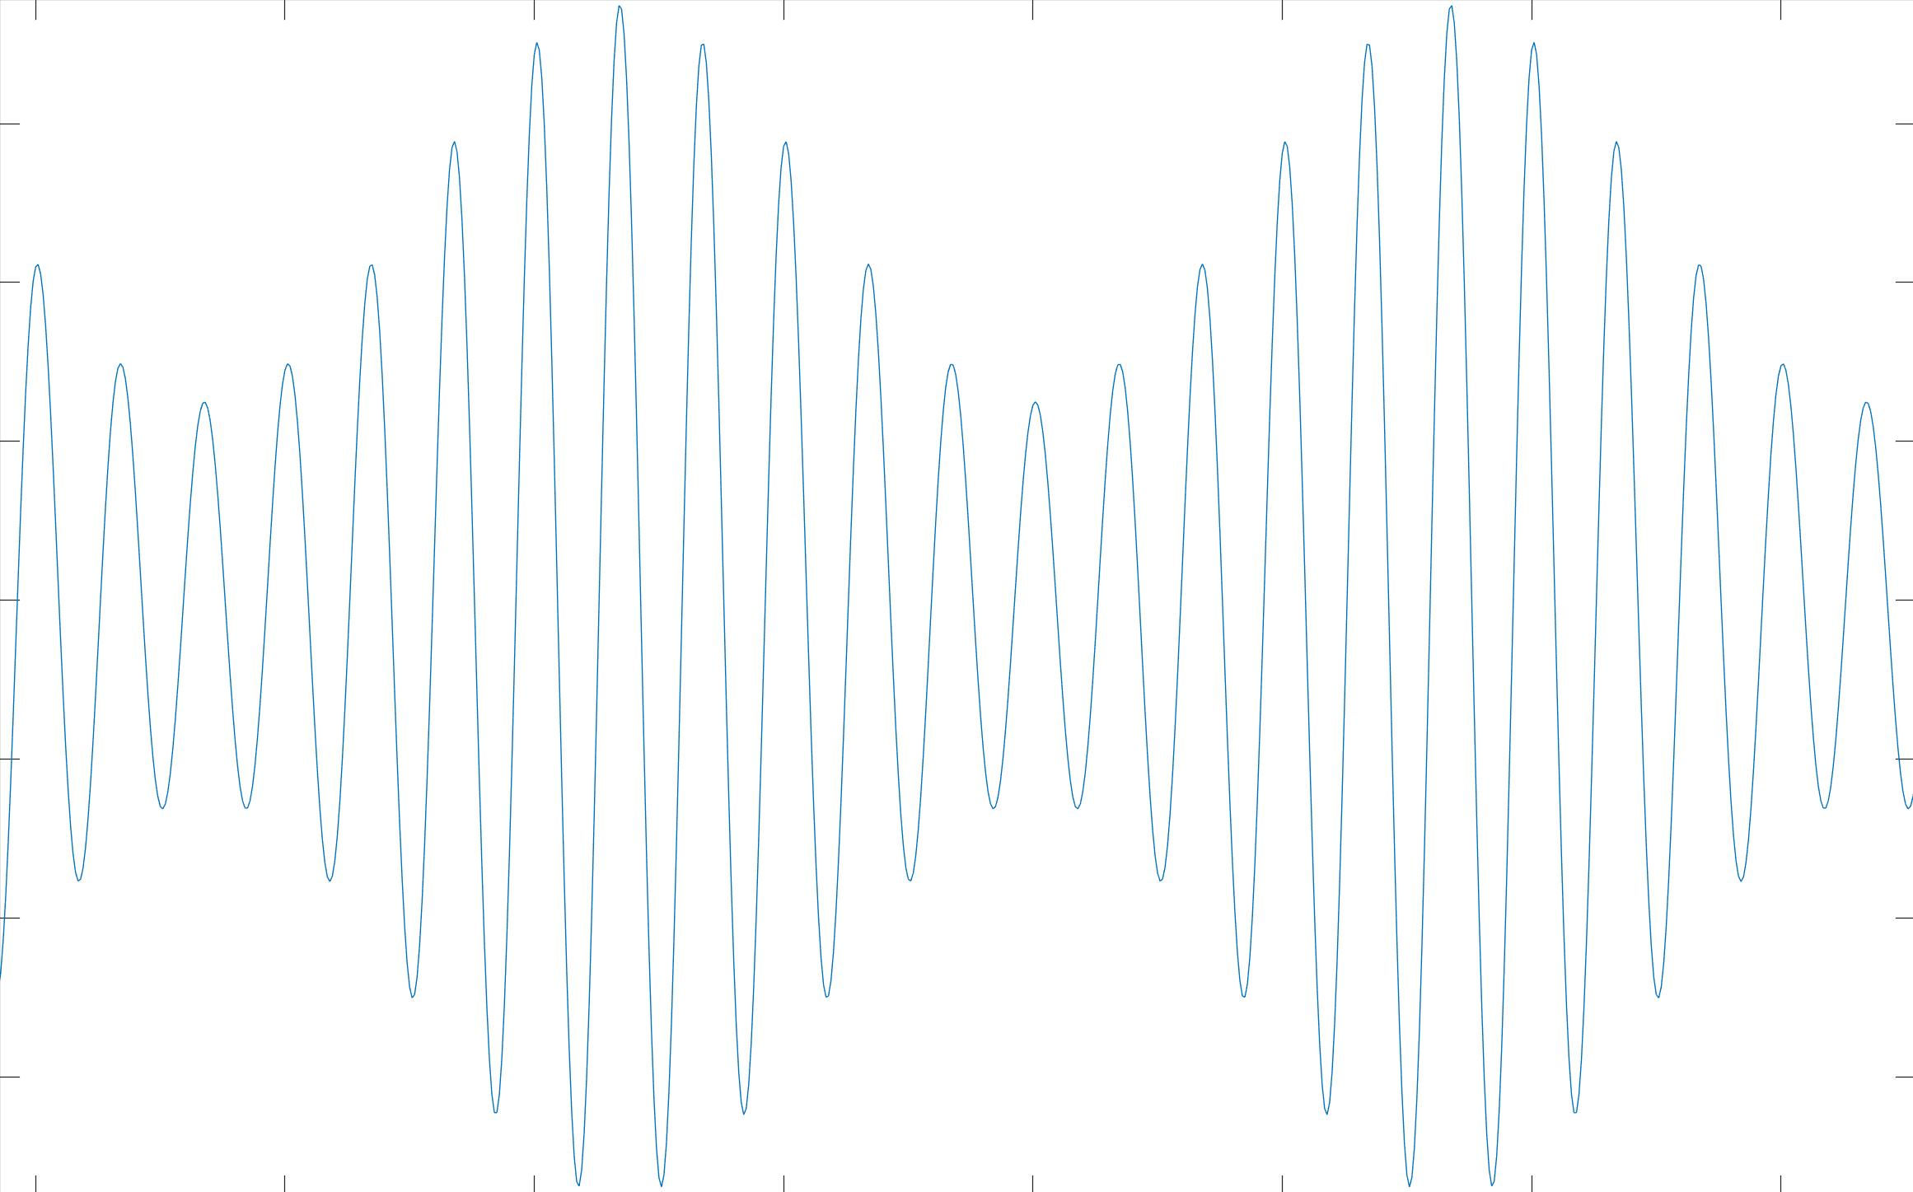
Tone Modulation
fs = 20000; t=0:1/fs:2;
fm = 300; fc=3000;
mesg=0.25*(1+0.5*cos(2*pi*fm*t));
carr=0.5*cos(2*pi*fc*t);
modSig = 2.67*mesg.*carr;
plot(modSig)
spectrogram(modSig, 512, 256,[0:10:6000],fs, 'yaxis');
sound(modSig,fs)

Slide 17
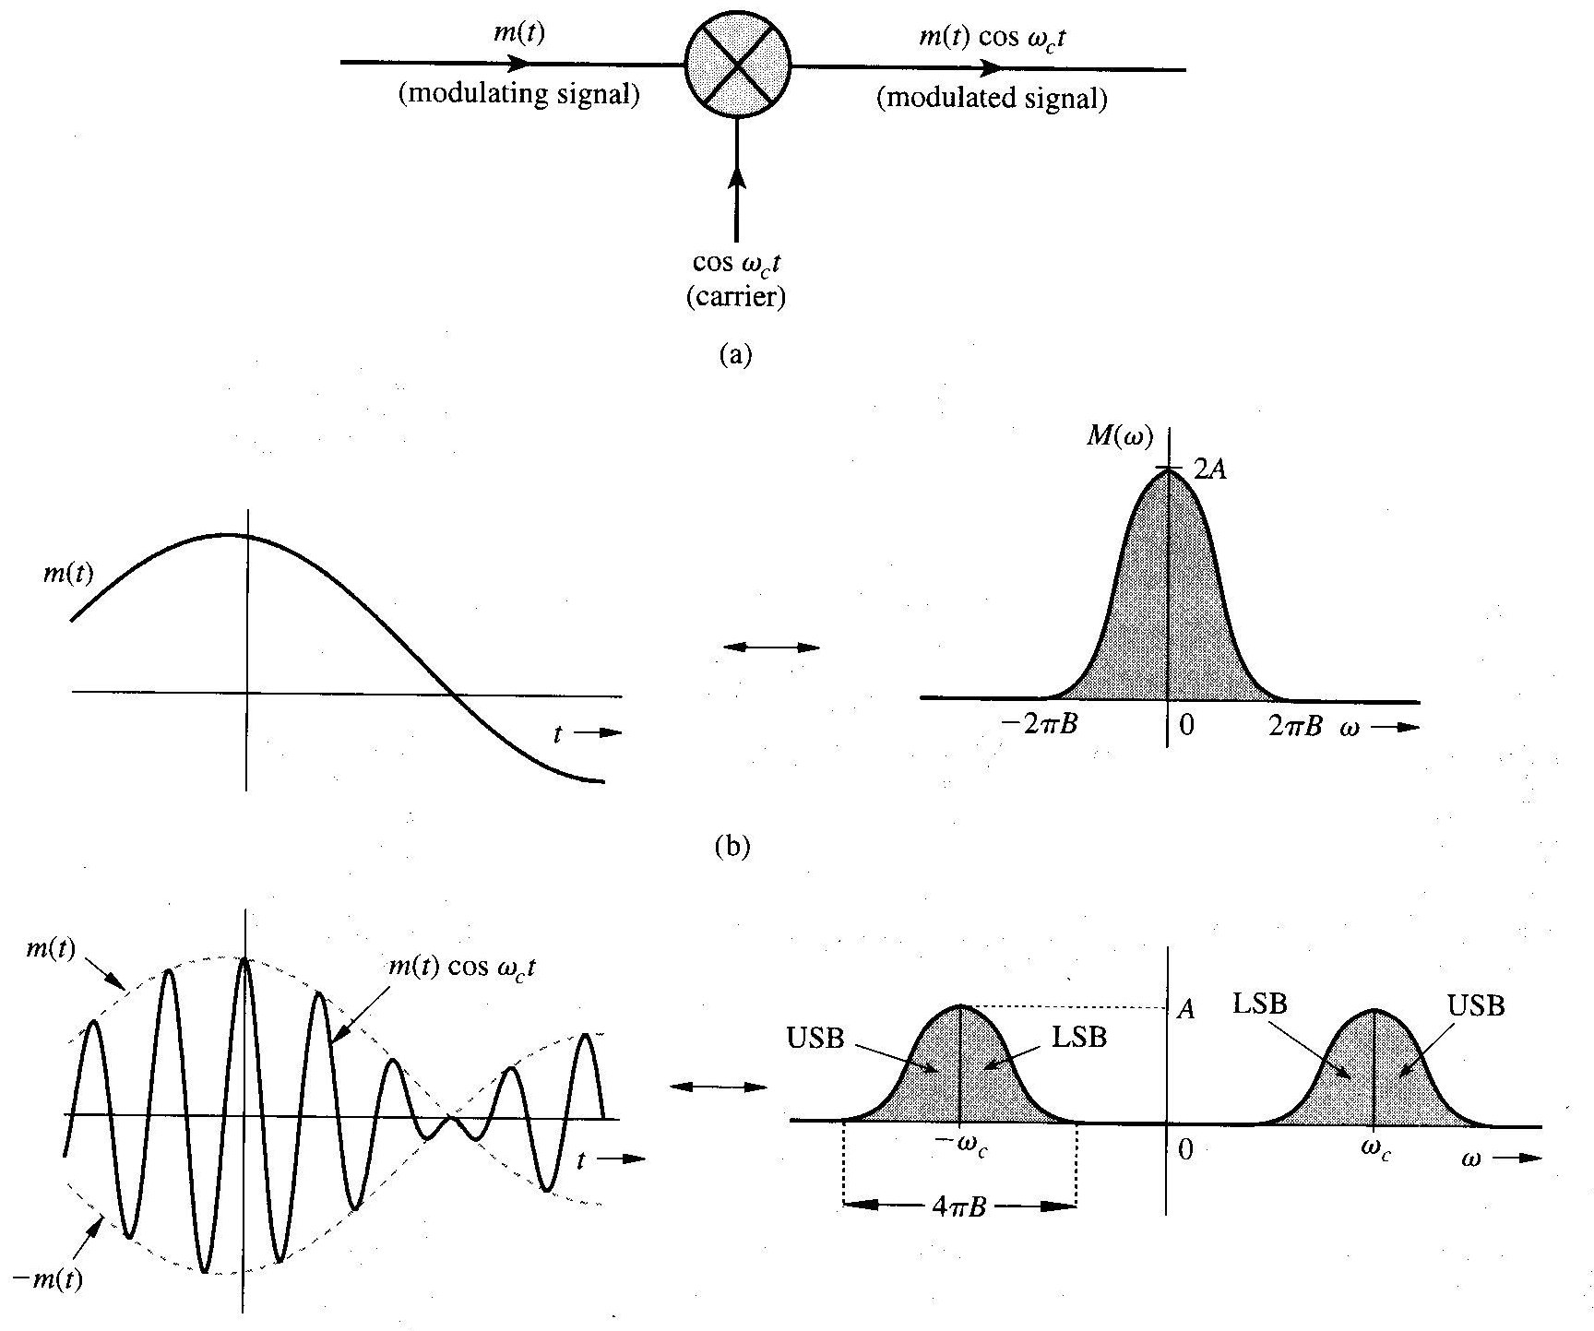
Amplitude Modulation
Modulation
Demodulation
Then lowpass filtering

Slide 18
Properties of the Fourier Transform
Differentiation in the Time Domain:
Let
then
Convolution and Multiplication in the Time Domain:
Let
Then
$x\left(t\right)⇔X\left(ω\right)$ $y\left(t\right)⇔Y\left(ω\right)$
Frequency convolution
Example: Use the time-differentiation property to find the Fourier Transform of the triangle pulse x(t) = Δ(t/τ)

Slide 19
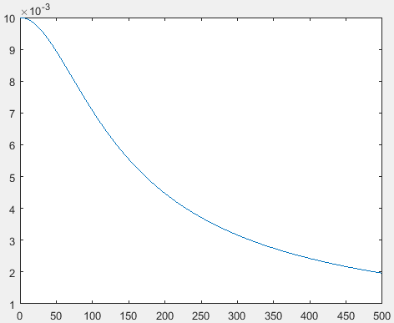
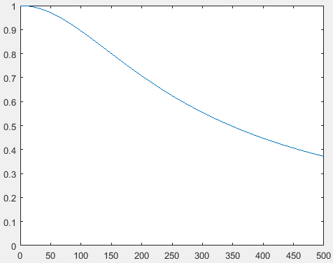
Example
Find the system response to the input x(t) = e^{-at} u(t) if the system impulse response is h(t) = e^{-bt} u(t).

Slide 20
Properties of the Fourier Transform
Parseval’s Theorem: since x(t) is non-periodic and has FT X(ω), then it is an energy signals:
Real signal has even spectrum X(ω)= X(-ω),
Example
Find the energy of signal x(t) = e^{-at} u(t) Determine the frequency ω so that the energy contributed by the spectrum components of all frequencies below ω is 95% of the signal energy E_{X}.
Answer: ω = 12.7a rad/sec
$$\int{\frac{1}{a^{2}+x^{2}}}dx=\frac{1}{a}\tan^{−1}\frac{x}{a}$$

Slide 21
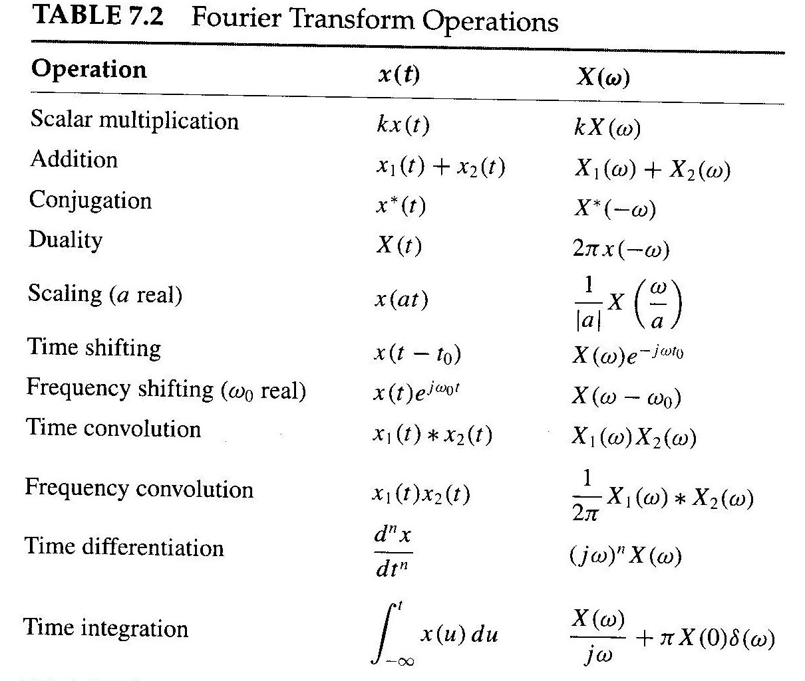

Slide 22
Signal Transmission Through a Linear System

Slide 23
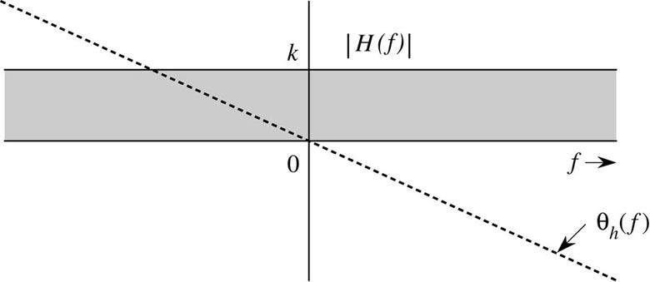
Distortionless Transmission (System)
Slope is constant for distortionless system
group delay

Slide 24
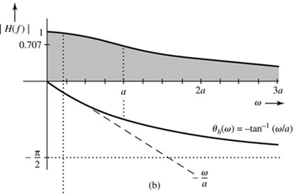
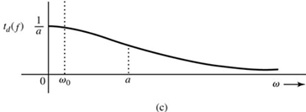
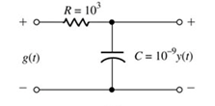
Example 3.16
A transmission medium is modeled by a simple RC low-pass filter shown below. If g(t) and y(t) are the input and the output, respectively to the circuit, determine the transfer function H(f), θ_{h}(f), and t_{d}(f). For distortionless transmission through this filter, what is the requirement on the bandwidth of g(t) if amplitude response variation within 2% and time delay variation within 5% are tolerable? What is the transmission delay? Find the output y(t).
a =1/RC
$$\frac{d}{dx}\left(\tan^{−1}ax\right)=\frac{a}{1+a^{2}x^{2}}$$
Answer: f_{o} = 32.31 kHz

Slide 25
Signal Distortion Over a Communication Channel
Linear Distortion
Channel Nonlinearities
Multipath Effects
Fading Channels
- Channel fading vary with time. Automatic gain control (AGC) is used to overcome this distortion.

Slide 26
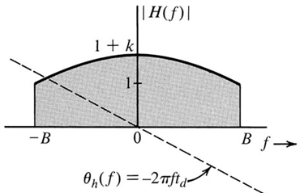
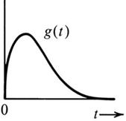
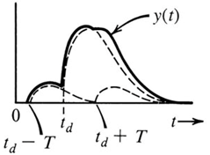
Linear Distortion
Channel causes magnitude distortion, phase distortion, or both.
Example: A channel is modeled by a low-pass filter with transfer function H(f) give by
$$H(f)=\left\{\begin{matrix}\left(1+kcos2πfT\right)e^{−j2πft_{d}} \left|f\right|<B \\ 0 \left|f\right|>B\end{matrix}\right.$$
A pulse g(t) band-limited to B Hz is applied at the input of this filter. Find the output y(t).

Slide 27
Nonlinear Distortion
y(t) = f(g(t))
f(g) can be expanded by Maclaurin series
$$y\left(t\right)=a_{0}+a_{1}g\left(t\right)+a_{2}g^{2}\left(t\right)+…+a_{k}g^{k}\left(t\right)$$
If the bandwidth of g(t) is B Hz then the bandwidth of y(t) is kB Hz.
Example: The input x(t) and the output y(t) of a certain nonlinear channel are related as
y(t) = x(t) + 0.000158 x²(t)
Find the output signal y(t) and its spectrum Y(f) if the input signal is x(t) = 2000 sinc(2000πt). Verify that the bandwidth of the output signal is twice that of the input signal. This is the result of signal squaring. Can the signal x(t) be recovered (without distortion) from the output y(t)?

Slide 28
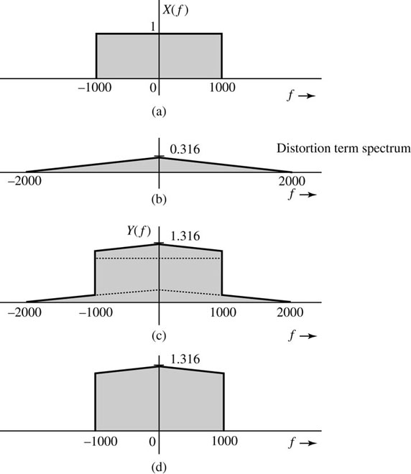
Continue Example
What is the consequence with this type of distortion if two signals are transmitted in adjacent bands?
Figure 3.36 Signal distortion caused by nonlinear operation: (a) desired (input) signal spectrum;
(b) spectrum of the unwanted signal (distortion) in the received signal; (c) spectrum of the received signal;
(d) spectrum of the received signal after low-pass filtering.

Slide 29
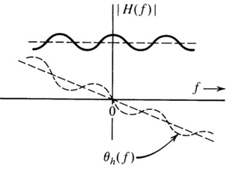
Distortion Caused by Multipath Effects
$$H\left(f\right)=e^{−j2πft_{d}}+αe^{−j2πf{(t}_{d}+∆t)}$$
$$H\left(f\right)=e^{−j2πft_{d}}(1+αe^{−j2πf∆t})$$
$$H\left(f\right)=e^{−j2πft_{d}}(1+α cos2πf∆t−jα sin2πf∆t)$$
$$H\left(f\right)=\sqrt{1+α^{2}+2α cos2πf∆t} exp\left[−j\left(2πft_{d}+\tan^{−1}\frac{α sin2πf∆t}{1+α cos2πf∆t}\right)\right]$$
Common distortion in this type of channel is frequency selective fading

Slide 30
Energy and Energy Spectral Density
$$E_{g}=\int_{−∞}^{∞}{g\left(t\right)g^{∗}\left(t\right)dt}$$
Energy in the time domain
$$E_{g}=\int_{−∞}^{∞}{{\left|G(f)\right|}^{2}df}$$
Energy in the frequency domain
Energy spectral density (ESD), $Ψ_{g}(f)$, is the energy per unit bandwidth (in hertz) of the spectral components of g(t) centered at frequency f.
$$Ψ_{g}(f)={\left|G(f)\right|}^{2}$$
The ESD of the system’s output in term of the input ESD is
$$Ψ_{x}(f)$$
$$H(f)$$
$$Ψ_{y}(f)={\left|H(f)\right|}^{2}Ψ_{x}(f)$$

Slide 31
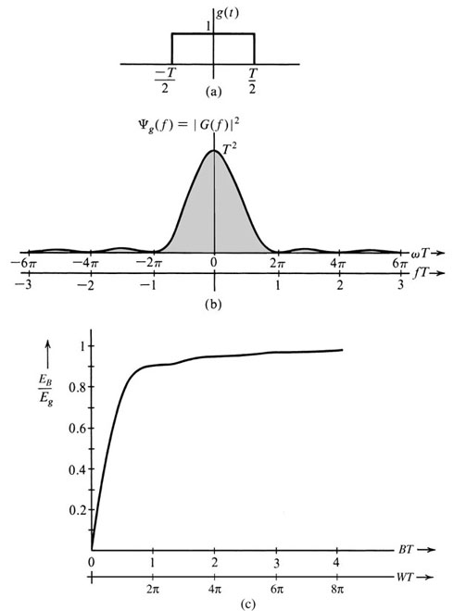
Essential Bandwidth of a Signal
Estimate the essential bandwidth of a rectangular pulse g(t) = Π(t/T), where the essential bandwidth must contain at least 90% of the pulse energy.
$$E_{g}=\int_{−∞}^{∞}{g^{2}\left(t\right)dt}=\int_{−T/2}^{T/2}{dt=T}$$
$$E_{B}=\int_{−B}^{B}{T^{2}{sinc}^{2}\left(πfT\right)df}=0.9E_{g}$$
Solve the above equation numerically to find B

Slide 32
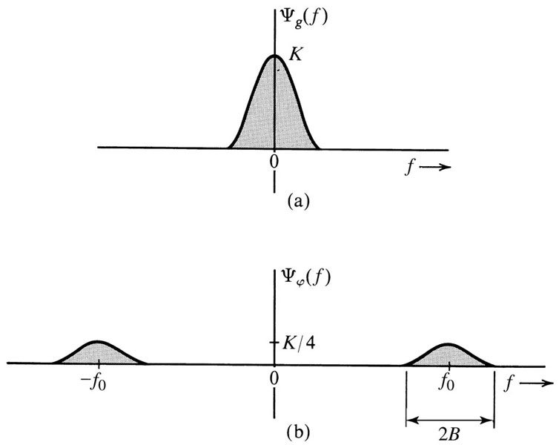
Energy of Modulated Signals
The modulated signal appears more energetic than the signal g(t) but its energy is half of the energy of the signal g(t). Why?
$$φ\left(t\right)=g\left(t\right) cos2πf_{0}t$$
$$Φ(f)=\frac{1}{2}\left[G\left(f+f_{0}\right)+G(f−f_{0})\right]$$
$$Ψ_{φ}(f)=\frac{1}{4}{\left|G\left(f+f_{0}\right)+G(f−f_{0})\right|}^{2}$$
If f₀ > 2B then
$$Ψ_{φ}\left(f\right)=\frac{1}{4}Ψ_{g}\left(f+f_{0}\right)+{\frac{1}{4}Ψ}_{g}(f−f_{0})$$
$$E_{φ}=\frac{1}{2}E_{g}$$

Slide 33
Time Autocorrelation Function and Energy Spectral Density
The autocorrelation of a signal g(t) and its ESD form a Fourier transform pair, that is
$$ψ_{g}(τ)$$
$$Ψ_{g}(f)$$
$$ψ_{g}\left(τ\right)\overset{⇔}{FT and IFT}Ψ_{g}(f)$$
Note: the autocorrelation of g(t) is the convolution of g(t) with g(-t).
Example: Find the time autocorrelation function of the signal
g(t) = e^{-at}u(t), and from it determine the ESD of g(t).
$$ψ_{g}\left(τ\right)=\int_{−∞}^{∞}{g\left(t\right)g\left(t−τ\right)dt}$$

Slide 34
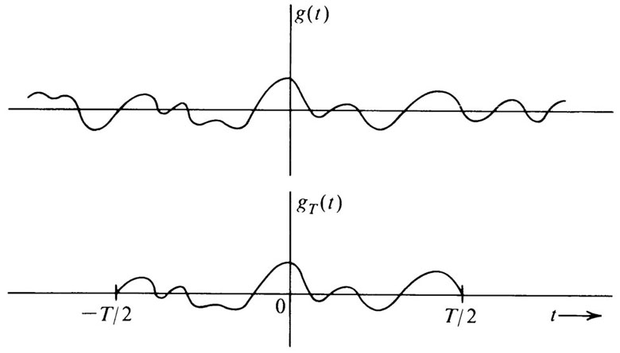
Signal Power and Power Spectral Density
Power P_{g} of the signal g(t)
$$P_{g}=\lim_{T→∞}{\frac{1}{T}}\int_{−T/2}^{T/2}{g\left(t\right)g^{∗}\left(t\right)dt}$$
$$P_{g}=\lim_{T→∞}{\frac{E_{gT}}{T}}$$
Power spectral density S_{g}(f) of the signal g(t)
$$S_{g}(f)=\lim_{T→∞}{\frac{{\left|G_{T}(f)\right|}^{2}}{T}}$$
$$P_{g}=\int_{−∞}^{∞}{S_{g}\left(f\right)df}=2\int_{0}^{∞}{S_{g}\left(f\right)df}$$
$$S_{x}(f)$$
$$H(f)$$
$$S_{y}(f)={\left|H(f)\right|}^{2}S_{x}(f)$$

Slide 35
Time Autocorrelation Function of Power Signals
Time autocorrelation $ℛ_{g}(τ)$ of a power signal g(t)
$$ℛ_{g}(τ)=\lim_{T→∞}{\frac{1}{T}}\int_{−T/2}^{T/2}{g\left(t\right)g(t−τ)dt}$$
$$ℛ_{g}(τ)=\lim_{T→∞}{\frac{1}{T}}\int_{−∞}^{∞}{g_{T}(t)g_{T}(t+τ)dt}$$
$$ℛ_{g}(τ)=\lim_{T→∞}{\frac{ψ_{gT}(τ)}{T}}$$
$$ℛ_{g}(τ)\overset{⇔}{FT and IFT}S_{g}(f)$$

Slide 36
Autocorrelation a Powerful Tool
If the energy (or power) spectral density can be found by the Fourier transform of the signal g(t), then why do we need to find the time autocorrelation?
Ans: In communication field and in general the signal g(t) is not deterministic and it is probabilistic function.

Slide 37
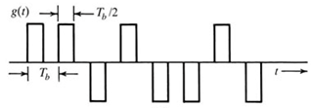
Example
A random binary pulse train g(t). The pulse width is T_{b}/2, and one binary digit is transmitted every T_{b} seconds. A binary 1 is transmitted by positive pulse, and a binary 0 is transmitted by negative pulse. The two symbols are equally likely and occur randomly. Determine the PSD and the essential bandwidth of this signal.
1
1
0
1
0
0
1
0
Challenge: g(t) is not deterministic and can not be expressed mathematically to find the Fourier transform and PSD.
g(t) is probabilistic (almost random) signal.

Slide 38
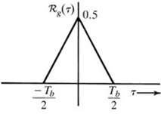
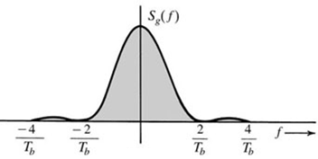
$$ℛ_{g}(τ)=\lim_{T→∞}{\frac{1}{T}}\int_{−T/2}^{T/2}{g\left(t\right)g(t−τ)dt}$$
T_{b}
g(t)
t
$$τ$$
g(t-τ)
$$For 0<τ<T_{b}/2$$
$$0$$
$Let T=NT_{b}$ and solve the above integral.
$$ℛ_{g}\left(τ\right)=\lim_{N→∞}\frac{1}{NT_{b}}\left(\frac{T_{b}}{2}−τ\right)N=\left(\frac{1}{2}−\frac{τ}{T_{b}}\right)$$
$$For τ>T_{b}/2$$
$$ℛ_{g}\left(τ\right)=0$$
$$S_{g}\left(f\right)=\frac{T_{b}}{4}{\text{sinc}}^{2}\left(\frac{πfT_{b}}{2}\right)$$

Slide 39
Homework Problem
$$ℛ_{g}(τ)=\lim_{T→∞}{\frac{1}{T}}\int_{−T/2}^{T/2}{g\left(t\right)g(t−τ)dt}$$
$$T_{b}/2<τ<T_{b}$$
$$(k+1)T_{b}$$
$$τ$$
$$kT_{b}+τ+T_{b}/2$$
$$kT_{b}$$
$$kT_{b}+τ$$
$$ℛ_{g}\left(τ\right)=\lim_{N→∞}\frac{1}{NT_{b}}\left(kT_{b}+τ+\frac{T_{b}}{2}−(k+1)T_{b}\right)\frac{N}{4}$$
$$ℛ_{g}\left(τ\right)=\frac{1}{4}\left(\frac{τ}{T_{b}}−\frac{1}{2} \right)$$
$$ℛ_{g}\left(τ\right)$$
1$/8$
$${−T}_{b}$$
$${−T}_{b}/2$$
$$T_{b}/2$$
$$T_{b}$$

