Slide 1
Ch 4 Amplitude Modulations and Demodulations
ENGR 4323/5323
Digital and Analog Communication
School of Engineering
University of Central Oklahoma
Dr. Mohamed Bingabr

Slide 2
Chapter Outline
Baseband vs. Carrier Communications
Double-Sideband Amplitude Modulations (DSB)
Amplitude Modulation (AM)
Vestigial Sideband Amplitude Modulations (VSB)
Local Carrier Synchronization
Frequency Division Multiplexing (FDM)
Phase-Locked Loop and Applications
NTSC Television Broadcasting System

Slide 3
Baseband Vs. Carrier Communications
Baseband signals produced by various information sources and its original spectrum is not modified.
Baseband Communications: Baseband signals are transmitted without any modifications of its spectrum. By conversion process (Modulation), such signals are modified to facilitate transmission.
Carrier Communication: Communication that uses modulation to shift the frequency spectrum of a signal.
Purpose of Modulation:
Ease of radiation.
Reduce noise and interference.
Multiplexing or transmission of several messages over a single channel.

Slide 4
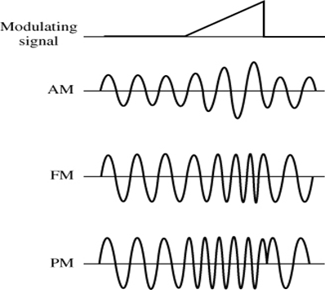
Type of Modulation
Analog Modulation: The original analog signal modulates one of the following parameters of a sinusoidal carrier of high frequency:
Amplitude Modulation (AM)
Frequency Modulation (FM)
Phase Modulation (PM)
Angle Modulation
$$s(t)=A\left(t\right)cos⁡\left[ω_{c}t+∅\left(t\right)\right]$$
Analog modulation shifts the spectrum of the original signal to be centered around the carrier frequency, ω_{c}.

Slide 5
Type of Modulation
Pulse Modulation: The original analog signal modulates the following parameters of a digital pulse train:
Pulse Amplitude Modulation (PAM)
Pulse Width Modulation (PWM)
Pulse Position Modulation (PPM)
Pulse Code Modulation (PCM)
Delta Modulation (DM)
In pulse modulation the spectrum of the original signal is not shifted. Pulse modulation is a digital pulse coding schemes used to describe the analog signal.

Slide 6
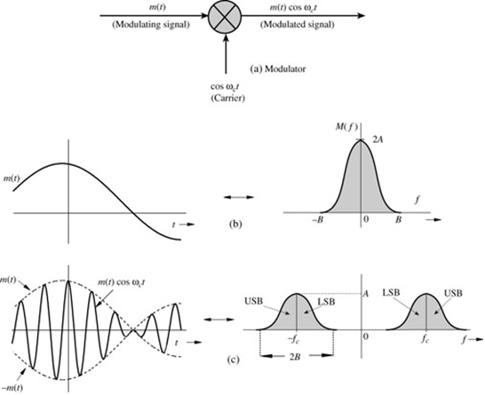
Double-Sideband Amplitude Modulation
$$m(t)\underset{⇔}{ }M(f)$$
$$m\left(t\right)\cos{2πf_{c}t}\underset{⇔}{ }\frac{1}{2}\left[M\left(f+f_{c}\right)+M\left(f−f_{c}\right)\right]$$
Double-sideband, suppressed-carrier (DSB-SC) modulation

Slide 7
Demodulation
Demodulator: recovering the message signal at the receiver from the modulated signal.
$$e\left(t\right)=m\left(t\right)\cos^{2}ω_{c}t$$
$e\left(t\right)$ $=\frac{1}{2}\left[m\left(t\right)+m\left(t\right)cos2ω_{c}t\right]$
$$E\left(f\right)=\frac{1}{2}M\left(f\right)+\frac{1}{4}\left[M\left(f+{2f}_{c}\right)+M\left(f−{2f}_{c}\right)\right]$$

Slide 8
Type of Modulators
Multiplier Modulators: A variable gain amplifier in which the gain parameter (such as the β of transistor) is controlled by the message signal m(t) and the input is the carrier signal.
Nonlinear Modulators: Nonlinear devices such as diode or transistors are used to output modulated signal.
$$y\left(t\right)=ax\left(t\right)+bx^{2}(t)$$
$z\left(t\right)=y_{1}\left(t\right)−y_{2}\left(t\right)=[ax_{1}\left(t\right)+bx_{1}^{2}(t)$]-$[ax_{2}\left(t\right)+bx_{2}^{2}(t)$]
$$z\left(t\right)={2a.m\left(t\right)+4b.m\left(t\right)cosω}_{c}t$$
Single balanced modulator because one of the input does not appear at the output z(t)

Slide 9
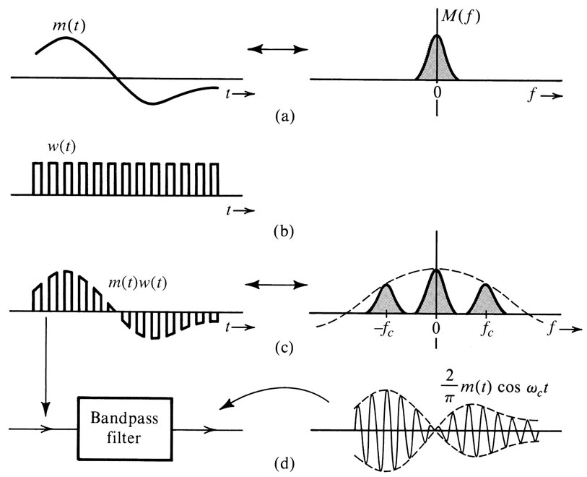
Type of Modulators
Switching Modulators: Switching is equivalent to multiplying the message signal m(t) by periodic pulses w(t) with fundamental period T_{c}.

Slide 10
Type of Modulators
Switching Modulators
$$w(t)=\sum_{n=0}^{∞}{C_{n}cos⁡\left(nω_{c}t+θ_{n}\right)}$$
$$w\left(t\right)m(t)=\sum_{n=0}^{∞}{C_{n}m(t)cos⁡\left(nω_{c}t+θ_{n}\right)}$$
$$w\left(t\right)m\left(t\right)=\frac{1}{2}m\left(t\right)+\frac{2}{π}\left[m\left(t\right)cosω_{c}t−\frac{1}{3}m\left(t\right)cos3ω_{c}t+\frac{1}{5}m\left(t\right)cos5ω_{c}t−…\right]$$

Slide 11
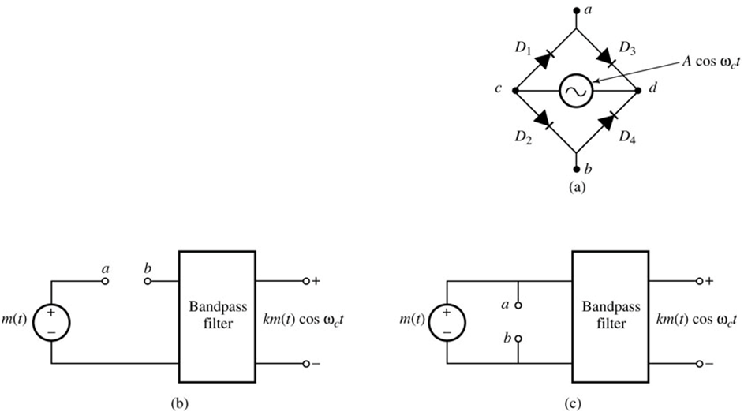
Circuit of Switching Modulators
Diode-bridge electronic switch:
When V_{c} > V_{d} all diodes are open and matched
V_{D1} = V_{D2}
V_{D1} = V_{c} – V_{a}
V_{D2} = V_{c} – V_{b}
V_{a} = V_{b}
Diode-bridge electronic switch
Series-bridge diode modulator
Shunt-bridge diode modulator

Slide 12
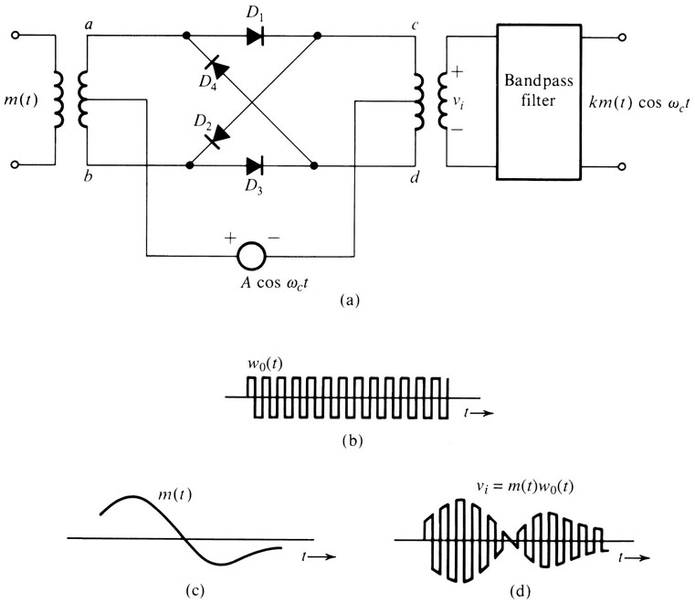
Circuit of Switching Modulators
Ring Modulator
During Positive cycle of carrier:
- D₁ & D₃ Conducts
- a connected to c & b connected to d
- output proportional to m(t)
During Negative cycle of carrier:
- D₂ & D₄ Conducts
- a connected to d & b connected to c
- output proportional to -m(t)
$$w\left(t\right)m\left(t\right)=\frac{4}{π}\left[m\left(t\right)cosω_{c}t−\frac{1}{3}m\left(t\right)cos3ω_{c}t+\frac{1}{5}m\left(t\right)cos5ω_{c}t−…\right]$$
Double Balanced Modulator

Slide 13
Demodulation of DSB-SC Signals
For demodulation, the receiver must generate a carrier that is synchronous (coherent) in phase and in frequency with incoming carrier.
Challenge of coherent demodulation for DSB-SC signals
- The received signal might suffer from some unknown frequency or
phase shift.
$$r\left(t\right)=A_{c}m\left(t−t_{0}\right)cos\left[\left(ω_{c}+∆ω\right)\left(t−t_{0}\right)\right]$$
$=A_{c}m\left(t−t_{0}\right)cos\left[\left(ω_{c}+∆ω\right)t−θ_{d}\right]$
- The receiver must be sophisticated to generate a local oscillator
cos[(ω_{c}+Δω)t - θ_{d})] purely from the received signal r(t).
- Amplitude modulation (AM) that transmit the carrier with the modulated
signal will simplify the job of the receiver.

Slide 14
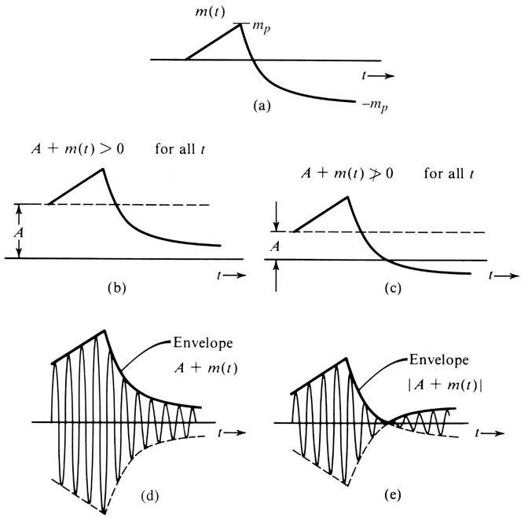
Amplitude Modulation (AM)
Transmit the modulated signal with the carrier signal to simplify the complexity of the receivers.
$$φ_{AM}\left(t\right)=Acosω_{c}t+m\left(t\right)cosω_{c}t$$
$=[A+m\left(t\right)]cosω_{c}t$
Condition for demodulation using envelope detection
$$\left[A+m\left(t\right)\right]≥0$$
for all t
Modulation index $μ=\frac{m_{p}}{A}$
$$0≤μ≤1$$
$φ_{AM}\left(t\right)\underset{⇔}{ }\frac{1}{2}\left[M\left(f+f_{c}\right)+M\left(f−f_{c}\right)\right]$+$\frac{A}{2}\left[δ\left(f+f_{c}\right)+δ\left(f−f_{c}\right)\right]$

Slide 15
Example: Tone Modulation
Sketch φ_{AM}(t) for modulation indices of µ = 0.5 and µ = 1, when m(t) = b cosω_{m}t.
$$m_{p}=b$$
$$μ=\frac{m_{p}}{A}$$
$φ_{AM}\left(t\right) =[A+m\left(t\right)]cosω_{c}t$
$${A=2m}_{p}$$
$$A=m_{p}$$

Slide 16
Sideband and Carrier Power
$$φ_{AM}\left(t\right)=Acosω_{c}t+m\left(t\right)cosω_{c}t$$
carrier
sidebands
$$P_{c}=\frac{A^{2}}{2}$$
Power of the carrier (wasted):
$$P_{s}=\frac{1}{2}\tilde{m^{2}}(t)$$
Power of the sidebands:
Power efficiency:
$$η=\frac{\text{useful} \text{power}}{\text{total} \text{power}}=\frac{P_{s}}{P_{c}+P_{s}}=\frac{\tilde{m^{2}}(t)}{A^{2}+\tilde{m^{2}}(t)}100\%$$

Slide 17
Example
Determine η and the percentage of the total power carried by the sidebands of the AM wave for tone modulation when
(a) µ =1 (b) µ = 0.5 (c) µ = 0.3
$$η=\frac{\tilde{m^{2}}(t)}{A^{2}+\tilde{m^{2}}(t)}100\%$$
$$μ=\frac{m_{p}}{A}$$

Slide 18
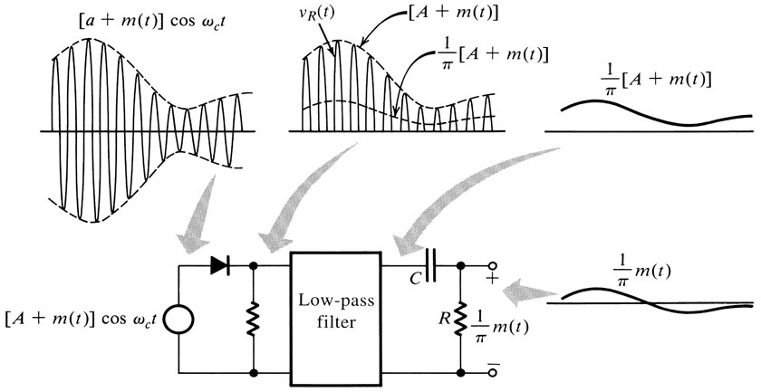
Demodulation of AM Signals
Rectifier
$$v_{r}\left(t\right)=\left\{\left[A+m(t)\right]cosω_{c}t\right\}w\left(t\right)$$
$$=\left[A+m(t)\right]cosω_{c}t\left[\frac{1}{2}+\frac{2}{π}\left(cosω_{c}t−\frac{1}{3}cos3ω_{c}t+\frac{1}{5}cos5ω_{c}t−…\right)\right]$$
$$=\frac{1}{π}\left[A+m(t)\right]+\text{other} \text{terms} \text{of} \text{higher} \text{frequencies}$$

Slide 19
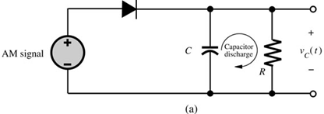
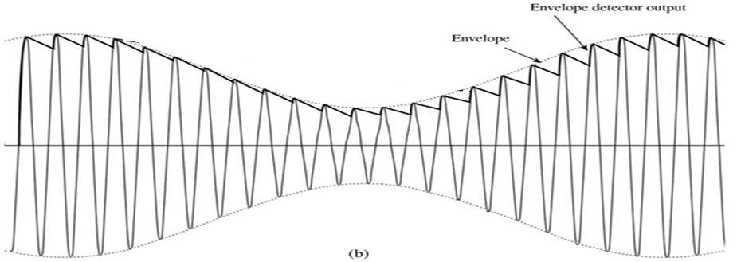
Demodulation of AM Signals
Envelope Detector
$Vc=V_{0}$e^{-t/RC}
T_{C}
RC too large
T_{B}
$${1/f}_{c}≪RC<1/B$$
T_{C}
T_{B}
$$B<1/RC<f_{c}$$

Slide 20
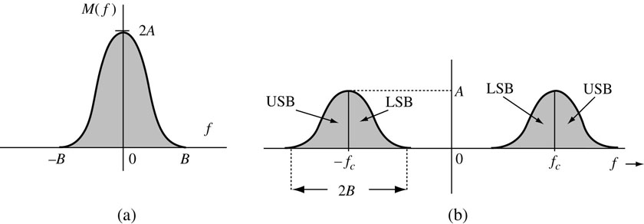
Bandwidth-Efficient Amplitude Modulations
The bandwidth of Amplitude Modulation is 2B Hz.
How to reduce bandwidth?
Single-Sideband (SSB) modulation, which remove either the LSB or the USB so that for one message signal m(t), there is only a bandwidth of B Hz.
Quadrature Amplitude (QAM) modulation, which utilize spectral redundancy by sending two messages over the same bandwidth, 2B Hz .

Slide 21
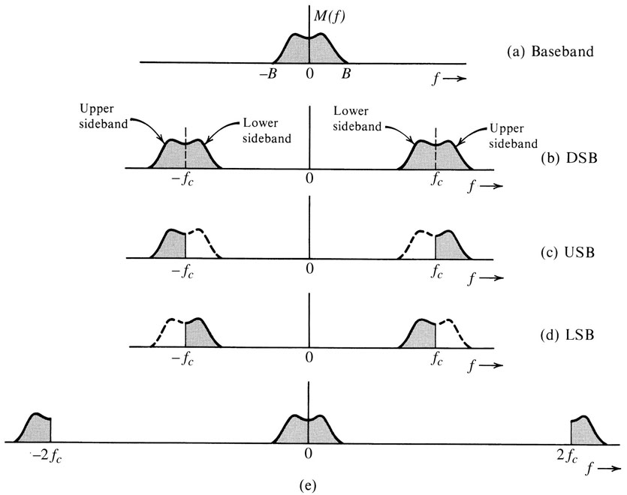
Amplitude Modulation: Single Sideband (SSB)
Single-Sideband (SSB) modulation, use Hilbert transform to remove the LSB or USB.

Slide 22
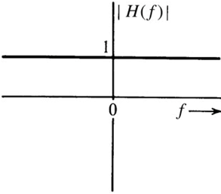
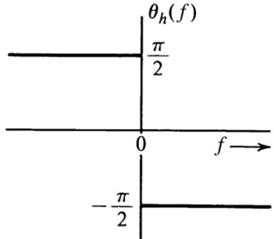
Hilbert Transform
Hilbert transform is an ideal phase shifter that shifts the phase of every positive spectral component by -π/2.
Hilbert Transform
h(t)
H(f)
m(t)
m_{h}(t)
M(f)
M_{h}(f)
$$H\left(f\right)=\left\{\begin{matrix}1.e^{−\frac{jπ}{2}}=−j f>0 \\ 1.e^{\frac{jπ}{2}} =j f<0\end{matrix}\right.$$
$$h(t)=\frac{1}{πt}$$
$$H\left(f\right)=−j sgn(f)$$
$$m_{h}\left(t\right)=m\left(t\right)∗h(t)$$
$$M_{h}\left(f\right)=−j sgn\left(f\right)M(f)$$

Slide 23
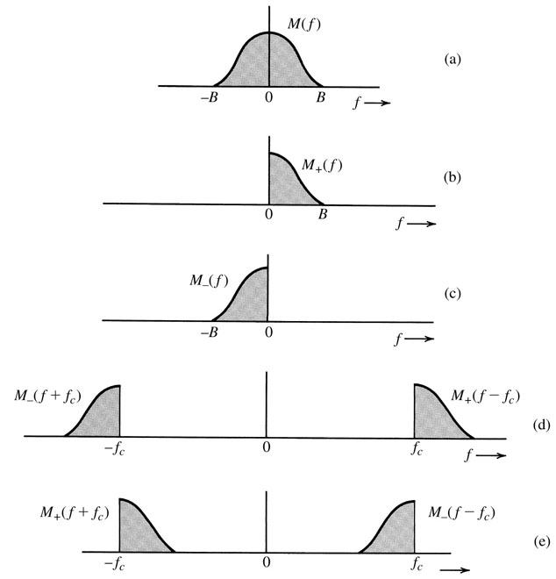
Time Domain Representation of SSB Signals
$$M_{+}\left(f\right)=M\left(f\right).u\left(f\right)=M\left(f\right)\frac{1}{2}\left[1+sgn(f)\right]$$
$$M_{+}\left(f\right)=\frac{1}{2}\left[M(f)+{jM}_{h}\left(f\right)\right]$$
$$M_{−}\left(f\right)=M\left(f\right).u\left(−f\right)=M\left(f\right)\frac{1}{2}\left[1−sgn(f)\right]$$
$M_{−}\left(f\right)$ $=\frac{1}{2}\left[M\left(f\right)−{jM}_{h}\left(f\right)\right]$
$$Φ_{USB}\left(f\right)=M_{+}\left(f−f_{c}\right)+M_{−}\left(f+f_{c}\right)$$
$$Φ_{USB}\left(f\right)=\frac{1}{2}\left[M\left(f−f_{c}\right)+M\left(f+f_{c}\right)\right]$$
$$−\frac{j}{2}\left[M_{h}\left(f+f_{c}\right)−M_{h}\left(f−f_{c}\right)\right]$$
$$φ_{USB}\left(t\right)={m\left(t\right) cosω}_{c}t−m_{h}\left(t\right) {sinω}_{c}t$$
$$φ_{LSB}\left(t\right)={m\left(t\right) cosω}_{c}t+m_{h}\left(t\right) {sinω}_{c}t$$

Slide 24
Coherent Demodulation of SSB-SC
$$φ_{SSB}\left(t\right)2cos⁡ω_{c}t={[m\left(t\right) cosω}_{c}t∓m_{h}\left(t\right) {sinω}_{c}t]2cos⁡ω_{c}t$$
$$={m\left(t\right) [1+cos2ω}_{c}t]∓m_{h}\left(t\right) {sin2ω}_{c}t$$
$$={m\left(t\right)+[m\left(t\right)cos2ω}_{c}t∓m_{h}\left(t\right) {sin2ω}_{c}t]$$
These terms can be filtered out by using low-pass filter

Slide 25
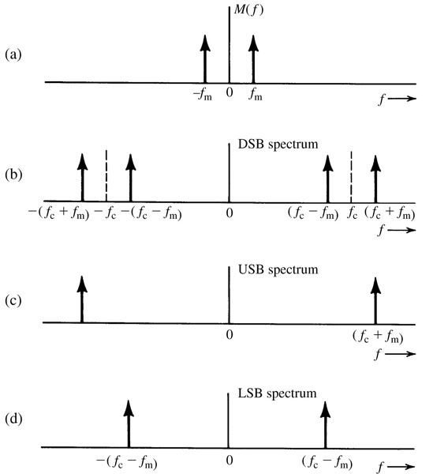
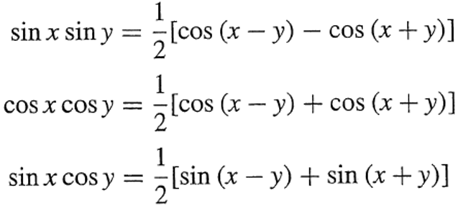
Tone Modulation Example: SSB
Find $φ_{SSB}\left(t\right)$ for the simple case of a tone modulation, that is, a modulating signal that is sinusoid m(t) = cosω_{m}t. Also demonstrate the coherent demodulation of the SSB signal.

Slide 26
SSB Modulation Systems
Common Methods to Generate SSB
1- Phase Shift
2- Selective-filtering
3- Weaver’s
These modulation methods require that the baseband signal spectrum have little power near the origin, because ideal filters and Hilbert transformer are not realizable.
Speech signal has no DC and little power near the origin. For speech recognition we can eliminate all frequency components below 300 Hz.

Slide 27
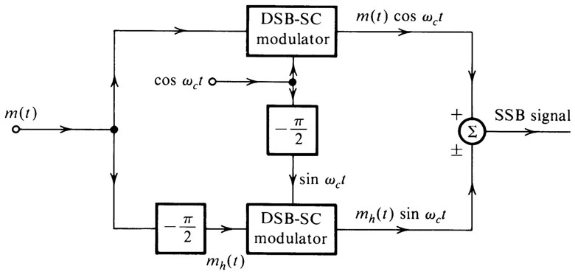
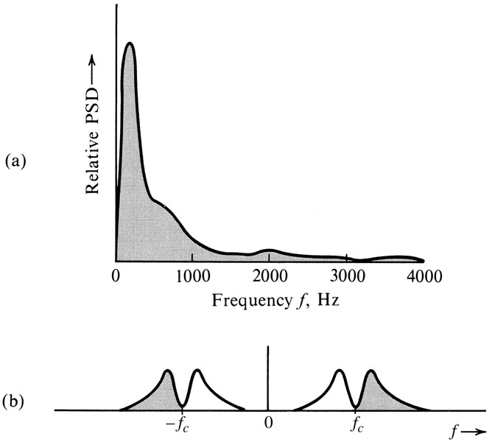
SSB Phase Shift Modulation System
$$φ_{USB}\left(t\right)={m\left(t\right) cosω}_{c}t−m_{h}\left(t\right) {sinω}_{c}t$$

Slide 28
SSB Selective-Filtering Modulation System
The signal is passed through a sharp cutoff filter to eliminate the undesired sideband. Low-pass filter to eliminate the USB spectrum, and high-pass filter to eliminate the LSB spectrum.
Weaver’s method modulates the signal to a low carrier frequency first and filter out the undesired SSB, after that modulate it again to the desired high carrier frequency.

Slide 29
Demodulation of SSB Signal with a Carrier
$$φ_{SSB+C}\left(t\right)={A cosω}_{c}t+[{m\left(t\right) cosω}_{c}t+m_{h}\left(t\right) {sinω}_{c}t]$$
$$φ_{SSB+C}\left(t\right)={[A+m\left(t\right)]cosω}_{c}t+m_{h}\left(t\right) {sinω}_{c}t$$
$$φ_{SSB+C}\left(t\right)={E\left(t\right)cos⁡(ω}_{c}t+θ)$$
Where E(t) the envelope
of $φ_{SSB+C}\left(t\right).$
$$E\left(t\right)={\left\{{[A+m\left(t\right)]}^{2}+m_{h}^{2}(t)\right\}}^{1/2}$$
$$E\left(t\right)=A{\left[1+\frac{2m(t)}{A}+\frac{m^{2}(t)}{A^{2}}+\frac{m_{h}^{2}(t)}{A^{2}}\right]}^{1/2}$$
$$E\left(t\right)≈{A\left[1+\frac{2m(t)}{A}\right]}^{1/2}$$
If A >> |m(t)|, use Power series expansion and discard higher order
$$E\left(t\right)≈A\left[1+\frac{m(t)}{A}\right]$$
$$E\left(t\right)≈A+m(t)$$

Slide 30
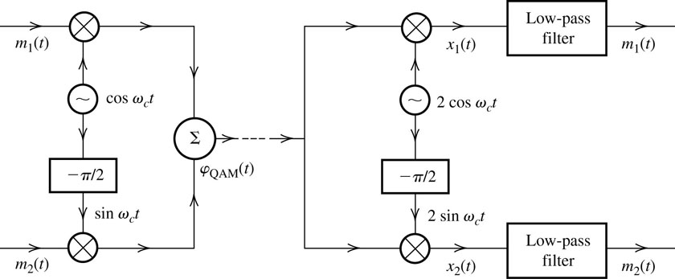
Quadrature Amplitude Modulation (QAM)
It is difficult to generate accurately SSB-SC and requires large power A >>|m(t)|, so QAM offers an attractive alternative.
QAM operates by transmitting two DSB signals via carrier of the same frequency but in phase quadrature.
$$φ_{QAM}\left(t\right)={m_{1}\left(t\right)cosω}_{c}t+m_{2}\left(t\right) {sinω}_{c}t$$
Transmitter
Receiver

Slide 31
Quadrature Amplitude Demodulation
In-phase channel
Quadrature channel
$$φ_{QAM}\left(t\right)={m_{1}\left(t\right)cosω}_{c}t+m_{2}\left(t\right) {sinω}_{c}t$$
$$x_{1}\left(t\right)=2{φ_{QAM}\left(t\right)cosω}_{c}t$$
$$={[{m_{1}\left(t\right)cosω}_{c}t+m_{2}\left(t\right) {sinω}_{c}t ]2cosω}_{c}t$$
$$={m_{1}\left(t\right)+m_{1}\left(t\right)cos2ω}_{c}t+m_{2}\left(t\right) {sin2ω}_{c}t$$
$$x_{2}\left(t\right)={m_{2}\left(t\right)−m_{2}\left(t\right)cos2ω}_{c}t+m_{1}\left(t\right) {sin2ω}_{c}t$$

Slide 32
Quadrature Amplitude Modulation (QAM)
Drawback of QAM
An error in the phase or the frequency of the carrier at the demodulator will result in loss and Cochannel interference.
$$x_{1}\left(t\right)={[{m_{1}\left(t\right)cosω}_{c}t+m_{2}\left(t\right) {sinω}_{c}t ]2cos⁡(ω}_{c}t+θ)$$
$=m_{1}\left(t\right)cosθ−m_{2}\left(t\right)sinθ+m_{1}\left(t\right) {cos⁡(2ω}_{c}t+θ)+m_{2}\left(t\right)sin⁡(2ω_{c}t+θ)$
The output of the low-pass filter:
$=m_{1}\left(t\right)cosθ−m_{2}\left(t\right)sinθ$
If θ is small then the distortion is tolerable for some applications.

Slide 33
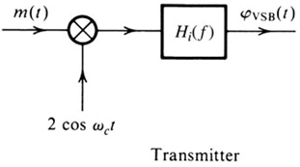
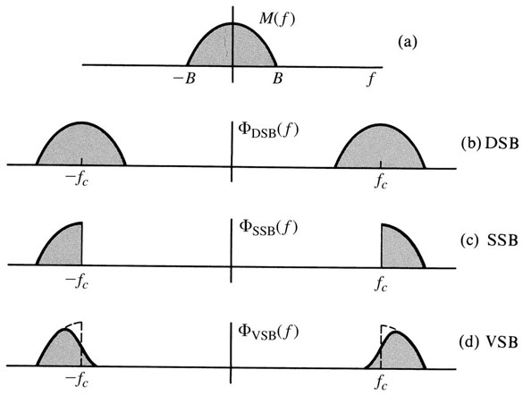
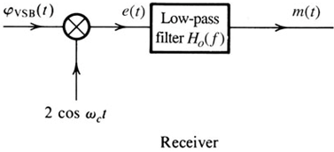
Amplitude Modulations: Vestigial Sideband (VSB)
VSB signals are relatively easy to generate, and their bandwidth is typically 25% greater than that of SSB signals.
$$Φ_{VSB}\left(f\right)=\left[M\left(f+f_{c}\right)+M\left(f−f_{c}\right)\right]H_{i}(f)$$

Slide 34
Demodulation of Vestigial Sideband (VSB)
$$Φ_{VSB}\left(f\right)=\left[M\left(f+f_{c}\right)+M\left(f−f_{c}\right)\right]H_{i}(f)$$
⁻⁻⁻⁻⁻⁻⁻⁻⁻⁻⁻> 1
$$M(f)=\left[Φ_{VSB}\left(f+f_{c}\right)+Φ_{VSB}\left(f−f_{c}\right)\right]H_{o}(f)$$
Substitute equation 1 and filter out spectra at ± 2 f_{c}
M$\left(f\right)=M(f)\left[H_{i}\left(f+f_{c}\right)+H_{i}\left(f−f_{c}\right)\right]H_{o}(f)$
$$H_{o}\left(f\right)=\frac{1}{H_{i}\left(f+f_{c}\right)+H_{i}\left(f−f_{c}\right)}$$
| f | ≤ B

Slide 35
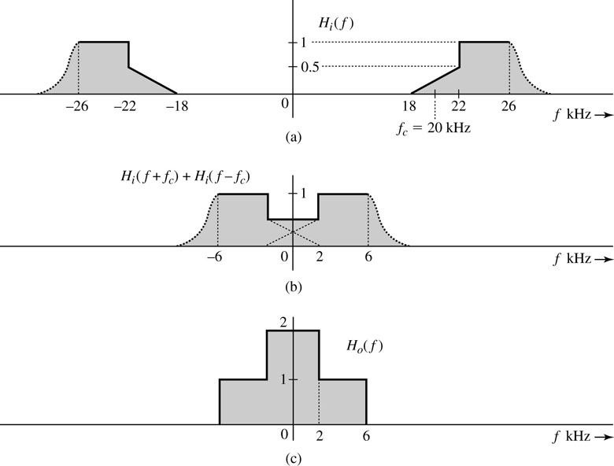
Demodulation of Vestigial Sideband (VSB)
The carrier frequency of a certain VSB signals is f_{c} = 20 kHz, and the baseband signal bandwidth is 6 kHz. The VSB shaping filter H_{i}(f) at the transmitter is shown below, find the filter H₀(f) at the receiver for distortionless reception.
$$H_{o}\left(f\right)=\frac{1}{H_{i}\left(f+f_{c}\right)+H_{i}\left(f−f_{c}\right)}$$
For envelope demodulation, VSB+C require larger carrier than DSB+C but less than SSB+C.

Slide 36
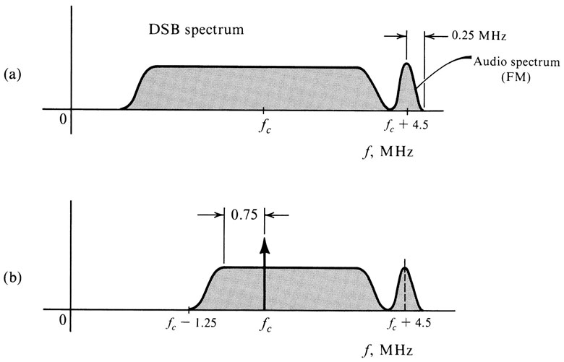
Use of VSB in Broadcast Television
TV Broadcasting
Bandwidth 4.5 MHz
Has sizable power in the low-frequency region
Envelope detector is used instead of synchronous to reduce the cost of the receiver.
BW for SSB = 4.5 MHz
BW for DSB = 9 MHz
BW for VSB = 6 MHz

Slide 37
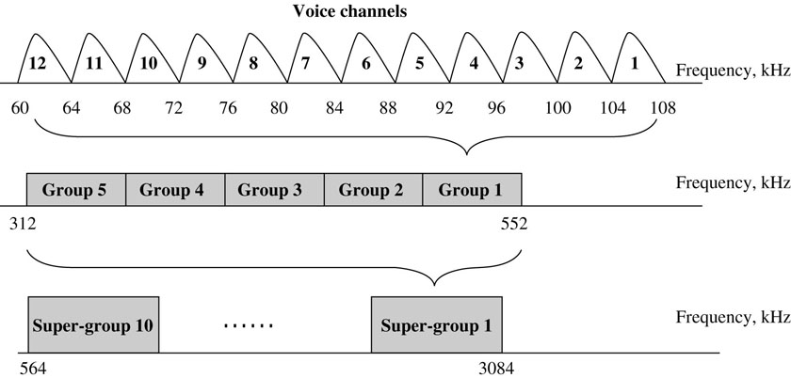
Frequency Division Multiplexing (FDM)
Signal multiplexing allows the transmission of several signals on the same channel.
Time Division Multiplexing (TDM): several signals time-share the same channel.
Frequency Division Multiplexing (FDM): several signals share the band of a channel.
Telephone Analog L-carrier hierarchy
Using SSB+C
48 kHz
240 kHz
600 voice channel
2400 kHz

Slide 38
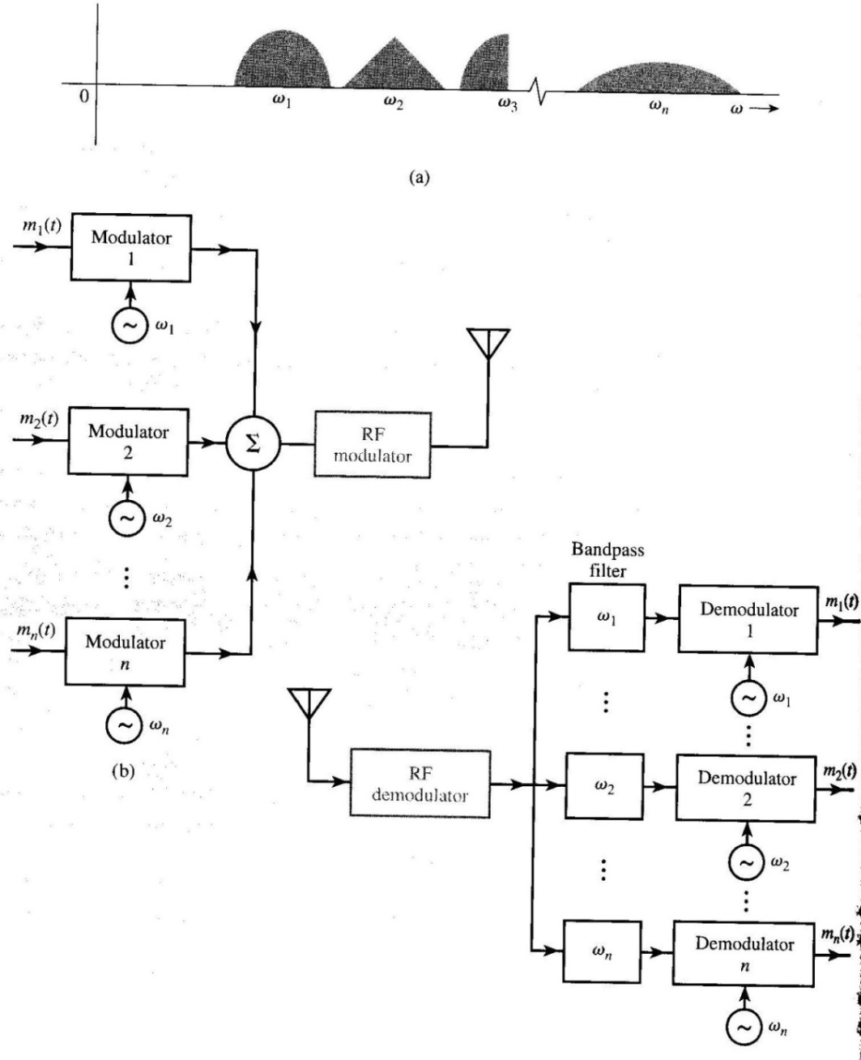
Frequency Division Multiplexing (FDM)

Slide 39
Local Carrier Synchronization
It is difficult for the receiver to generate the carrier in synchronization with the received carrier because of frequency shift due to Doppler effect and phase shift due to traveling.
$$r(t) =m\left(t\right)cos\left[\left(ω_{c}+∆ω\right)t+δ\right]−m_{h}\left(t\right)sin\left[\left(ω_{c}+∆ω\right)t+δ\right]$$
Doppler Effect
$$∆ω_{max}=\frac{v_{e}}{c}ω_{c}$$
v_{e} is the speed of receiver
Phase Shift
$$δ=−\left(ω_{c}+∆ω\right)d/c$$
d Traveled distance by radio wave
Two ways to recover the incoming carrier at the receiver:
- The transmitter transmits a pilot (sinusoid) signal
- The receiver uses nonlinear device to generate a separate
carrier component to be extracted by narrow bandpass
filters.

Slide 40
Phase-Locked Loop and Applications (PLL)
Typically used to track the phase and the frequency of the carrier component of an incoming signal.
Application of PLL
Synchronous demodulation
Timing recovery in digital receiver
Remember frequency or phase shift can be represented as phase shift:
$$sin⁡\left[\left(ω_{c}+∆ω\right)t+\left(θ_{i}+∆θ\right)\right]$$
$$sin⁡\left[ω_{c}t+\left(∆ωt+θ_{i}+∆θ\right)\right]$$
$$sin⁡\left[ω_{c}t+θ_{i}(t)\right]$$

Slide 41
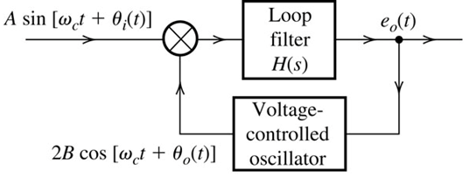
Phase-Locked Loop and Applications (PLL)
e_{o}(t) depends on the difference between the received phase θ_{i} and the generated θ_{o} at the receiver. e_{o}(t) will control the oscillation of the voltage controlled oscillator to phase locked with θ_{i}.
Output of the multiplier
$$A sin\left[ω_{c}t+θ_{i}\left(t\right)\right]∗2B cos\left[ω_{c}t+θ_{0}\left(t\right)\right]$$
$${AB[\sin\left(θ_{i}−θ_{o}\right)+ sin\left[2ω_{c}t+θ_{i}+θ_{0}\right]}$$
Output of the loop filter
$${e_{0}\left(t\right)=AB\sin\left(θ_{i}−θ_{o}\right)}$$
Instantaneous frequency of VCO =
$$\text{ω}\text{c}\text{ + }\text{ce}\text{o}\text{(}\text{t}\text{)}$$

Slide 42
Carrier Acquisition in DSB-SC
Two methods to generate the carrier at the receiver using PLL.
Signal-Squaring Method
$$x\left(t\right)={\left[m\left(t\right)cosω_{c}t\right]}^{2}$$
$$x\left(t\right)=\frac{1}{2}m^{2}\left(t\right)+\frac{1}{2}m^{2}\left(t\right)cos2ω_{c}t$$
$$\frac{1}{2}m^{2}\left(t\right)=k+∅(t)$$
$x\left(t\right)=\frac{1}{2}m^{2}\left(t\right)+kcos2ω_{c}t$ $+∅(t)cos2ω_{c}t$

Slide 43
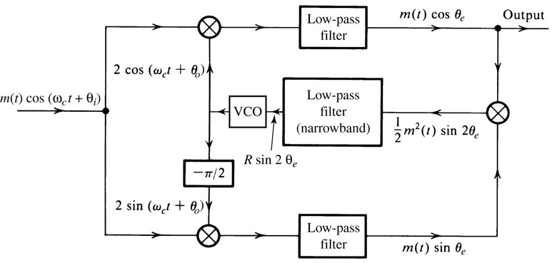
Carrier Acquisition in DSB-SC
Costas Method
$${m\left(t\right)\cos\left(θ_{i}−θ_{o}\right)+m\left(t\right)cos⁡(2ω_{c}+θ_{i}+θ_{o})}$$
$${m\left(t\right)\sin\left(θ_{i}−θ_{o}\right)+m\left(t\right) sin⁡(2ω_{c}+θ_{i}+θ_{o})}$$

Slide 44
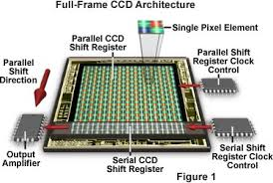
NTSC Television Broadcasting System
NTSC: National Television System Committee
The information of the entire picture is transmitted by transmitting an electrical signal proportion to the brightness level of the pixels taken in a certain sequence.
The optical system of the television camera tube generates a focused image on a photo cathode, which eventually produces electrically charged image on another surface (target mosaic).
Electron gun scans the target mosaic.
Charge Coupled Device

Slide 45
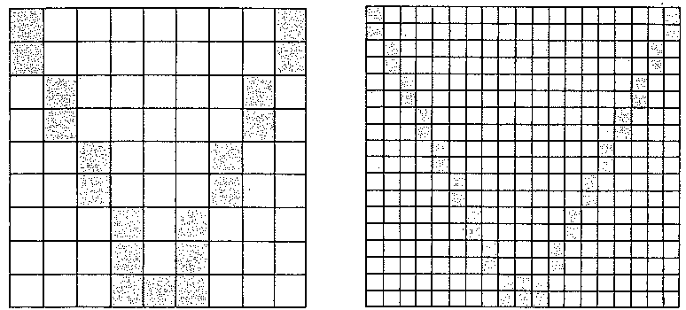
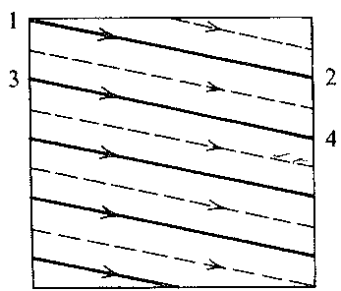
NTSC Television Broadcasting System
NTSC: National Television System Committee
Few pixels
Low Resolution
Less data
More pixels
High Resolution
More data

Slide 46
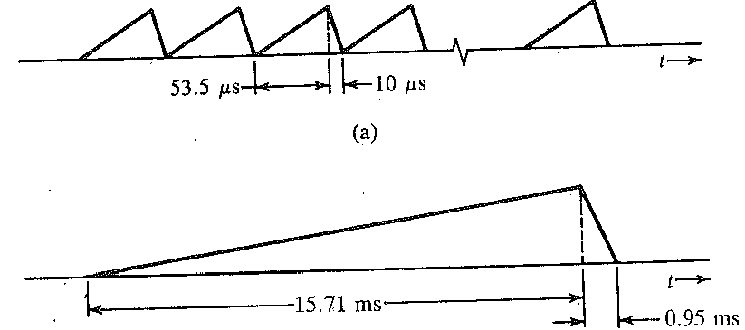
NTSC Television Broadcasting System
Scanning Pattern
Line scanning
Frame scanning
Time to scan one horizontal line: 53.5 µs
Time to fly back to scan next line (blank no data): 10 µs
Number of lines per frame 525 line/frame
Time to scan one frame: 15.71 ms
Time to fly back to scan next frame (blank): 0.95 ms
Total number of frames per second: 60 frame/sec

Slide 47
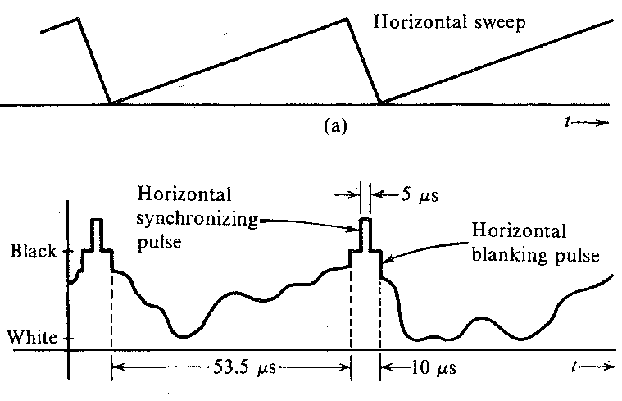
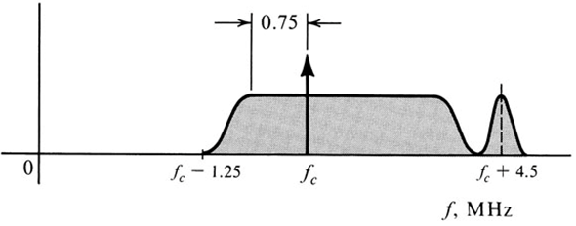
NTSC Television Broadcasting System
Scanning Pattern
white: more positive charge
VSB+C
DSB

Slide 48
NTSC Television Standard and Bandwidth
525 lines per frame
495 lines per frame are active scanning
40 frames per second needed to avoid flicker and jerky motion. 30 frames per second to conserve bandwidth in NTSC standard
Frame scanned twice and in each scan only 247.5 line is used.
First scan is the solid lines and the second scan is dashed lines.
Bandwidth
If frame consist of 525 by 525 pixels and 30 frames per second, then
BW = 525 X 525 X 30 = 8.27 X 10⁶ pixels (pulse) per second.
= 4.135 MHz

Slide 49
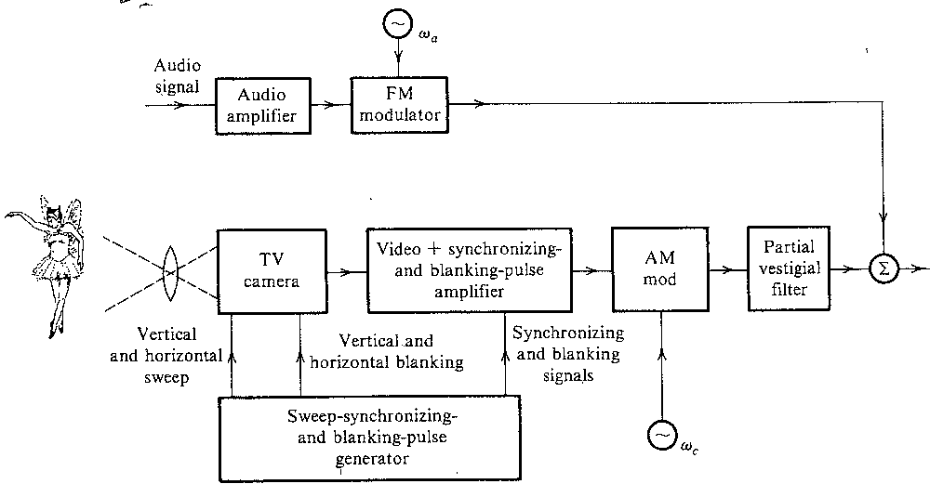
Television Transmitter

Slide 50
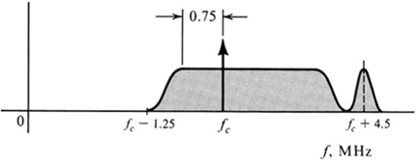
Television Receiver
Superheterodyne Receiver

Slide 51
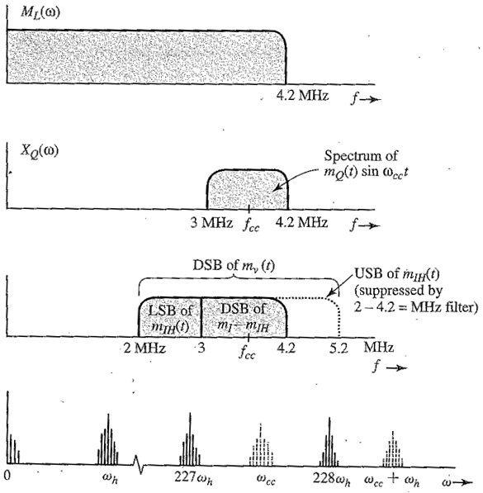
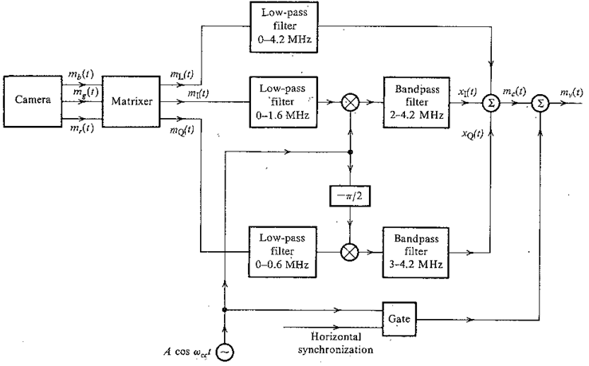
Compatible Color Television (CCTV)
$$m_{L}\left(t\right)=0.30{ m}_{r}\left(t\right)+0.59{ m}_{g}\left(t\right)+{0.11 m}_{b}\left(t\right)$$
Luminance
$$m_{I}\left(t\right)=0.60{ m}_{r}\left(t\right)+0.28{ m}_{g}\left(t\right)−{0.32 m}_{b}\left(t\right)$$
Chrominance
$$m_{Q}\left(t\right)=0.21{ m}_{r}\left(t\right)−0.52{ m}_{g}\left(t\right)+{0.31 m}_{b}\left(t\right)$$

Slide 52
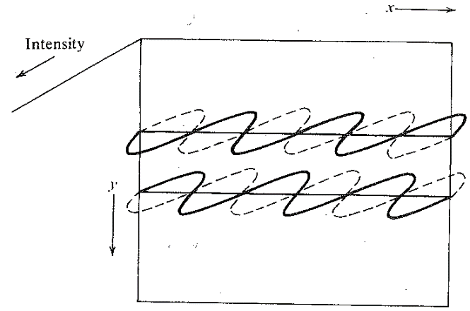
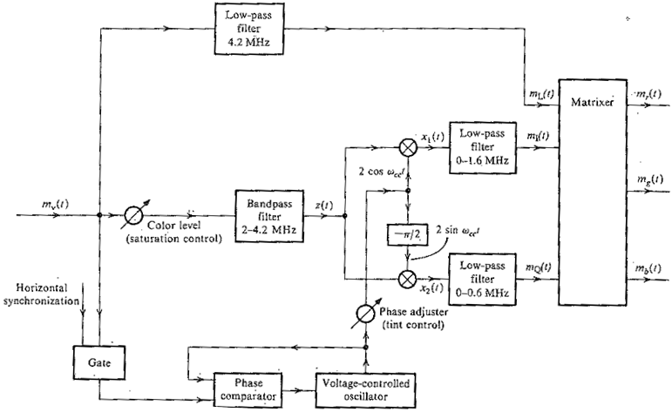
Color Television Receiver (CCTV)

