Slide 1
Ch 4 Angle Modulations and Demodulations
ENGR 4323/5323
Digital and Analog Communication
School of Engineering
University of Central Oklahoma
Dr. Mohamed Bingabr

Slide 2
Chapter Outline
Nonlinear Modulation
Bandwidth of Angle Modulation
Generating of FM Waves
Demodulation of FM Signals
Effects of Nonlinear Distortion and Interference
Superheterodyne Analog AM/FM Receivers
FM Broadcasting System

Slide 3
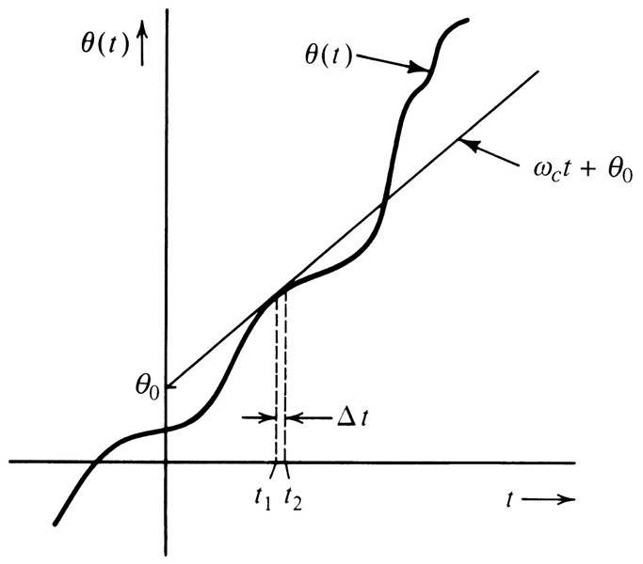
Baseband Vs. Carrier Communications
Angle Modulation: The generalized angle θ(t) of a sinusoidal signal is varied in proportion to the message signal m(t).
Two types of Angle Modulation
Frequency Modulation: The frequency of the carrier signal is varied in proportion to the message signal.
Phase Modulation: The phase of the carrier signal is varied in proportion to the message signal.
$$φ\left(t\right)=A cos⁡(θ\left(t\right))$$
$$φ\left(t\right)=A\cos\left(ω_{C}t+θ_{0}\right) t_{1}<t<t_{2}$$
Instantaneous Frequency
$$ω_{i}(t)=\frac{dθ}{dt}$$

Slide 4
Frequency and Phase Modulation
$$φ\left(t\right)=A cos⁡(θ\left(t\right))$$
Phase Modulation:
$$θ\left(t\right)=ω_{C}t+k_{p}m(t)$$
$$φ_{PM}\left(t\right)=A\cos\left[ω_{C}t+k_{p}m(t)\right]$$
$$ω_{i}\left(t\right)=\dot{θ}(t)$$
$$ω_{i}\left(t\right)=ω_{c}+k_{p}\dot{m}(t)$$
Frequency Modulation:
$$θ\left(t\right)=\int_{−∞}^{t}{ω_{i}\left(t\right)dt}=ω_{c}t+k_{f}\int_{−∞}^{t}{m\left(α\right)dα}$$
$$ω_{i}\left(t\right)=ω_{c}+k_{f}m(t)$$
$$φ_{FM}\left(t\right)=A\cos\left[ω_{C}t+k_{f}\int_{−∞}^{t}{m\left(α\right)dα}\right]$$
Power of an Angle-Modulated wave is constant and equal A²/2.

Slide 5
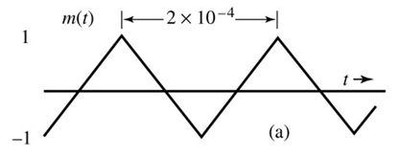
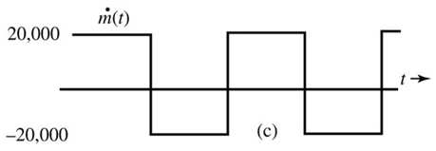
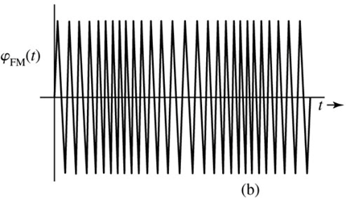
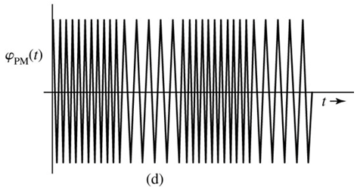
Example of FM and PM Modulation
Sketch FM and PM waves for the modulating signal m(t). The constants k_{f} and k_{p} are 2π x10⁵ and 10π, respectively, and the carrier frequency f_{c} is 100 MHz.
99.9 MHz < f_{i} < 100.1 MHz

Slide 6
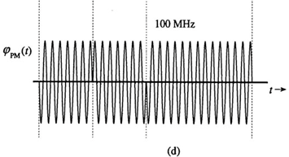
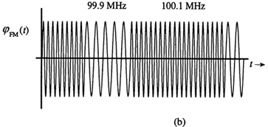
Example of FM and PM Modulation
Sketch FM and PM waves for the digital modulating signal m(t). The constants k_{f} and k_{p} are 2π x10⁵ and π/2, respectively, and the carrier frequency f_{c} is 100 MHz.
Frequency Shift Keying (FSK)
Phase Shift Keying (PSK)
Note: for discontinuous signal k_{p} should be small to restrict the phase change k_{p}m(t) to the range (-π,π).

Slide 7
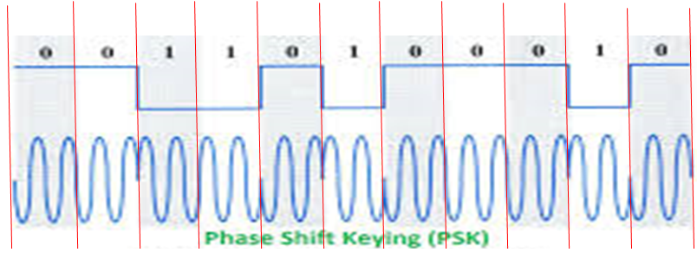
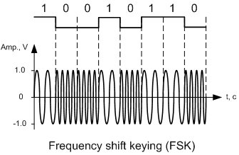
PSK & FSK in Digital Communication

Slide 8
Bandwidth of Angle Modulated Waves
$$a(t)=\int_{−∞}^{t}{m\left(α\right)dα}$$
$$φ_{FM}\left(t\right)=A\cos\left[ω_{C}t+k_{f}a(t) \right]$$
where
$$φ_{FM}\left(t\right)=A\operatorname{Re}\left[e^{j{ [ω}_{C}t+k_{f}a(t)]} \right]=A\operatorname{Re}\left[e^{jk_{f}a(t)}e^{j{ ω}_{C}t}\right]$$
Expand
$$e^{jk_{f}a(t)}$$
using power series expansion
$$φ_{FM}\left(t\right)=A\operatorname{Re}\left[\left\{1+jk_{f}a\left(t\right)−\frac{k_{f}^{2}}{2!}a^{2}\left(t\right)+…+j^{n}\frac{k_{f}^{n}}{n!}a^{n}\left(t\right)+…\right\}e^{j{ ω}_{C}t}\right]$$
$$φ_{FM}\left(t\right)=A\left[cosω_{c}t−k_{f}a\left(t\right)sinω_{c}t−\frac{k_{f}^{2}}{2!}a^{2}\left(t\right)cosω_{c}t+\frac{k_{f}^{3}}{3!}a^{3}\left(t\right)sinω_{c}t+…\right]$$
The bandwidth of a(t), a²(t), a^{n}(t) are B, 2B, and nB Hz, respectively. From the above equation it seems the bandwidth of angle modulation is infinite but for practical reason most of the power reside near B Hz since higher terms have small power because of n!.

Slide 9
Narrowband PM and FM
$$φ_{FM}\left(t\right)=A\left[cosω_{c}t−k_{f}a\left(t\right)sinω_{c}t−\frac{k_{f}^{2}}{2!}a^{2}\left(t\right)cosω_{c}t+\frac{k_{f}^{3}}{3!}a^{3}\left(t\right)sinω_{c}t+…\right]$$
When k_{f} a(t) << 1
$$φ_{FM}\left(t\right)≈A\left[cosω_{c}t−k_{f}a\left(t\right)sinω_{c}t\right]$$
The above signal is Narrowband FM and its bandwidth is 2B Hz.
Same steps can be carried out to find the Narrowband PM.
$$φ_{PM}\left(t\right)≈A\left[cosω_{c}t−k_{p}m\left(t\right)sinω_{c}t\right]$$
Note: the above equation is similar to amplitude modulation but the waveform are different.

Slide 10
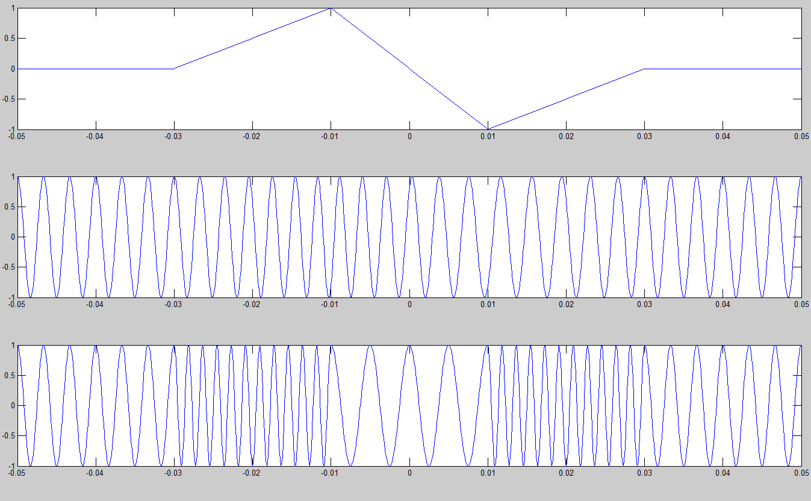
m(t)
f_{c} = 300 FM modulation k_{f} = 120 π k_{f} a(t) = 6 NBFM (k_{f} a(t)_{max} <<1)
f_{c} = 300 PM modulation k_{p} = 10 π k_{p} m_{p} = 31.4 NBPM (k_{p}m(t)_{max} << 1)
$$φ_{FM}\left(t\right)=A\cos\left[ω_{C}t+k_{f}\int_{−∞}^{t}{m\left(α\right)dα}\right]$$
$$φ_{PM}\left(t\right)=A\cos\left[ω_{C}t+k_{p}m(t)\right]$$

Slide 11
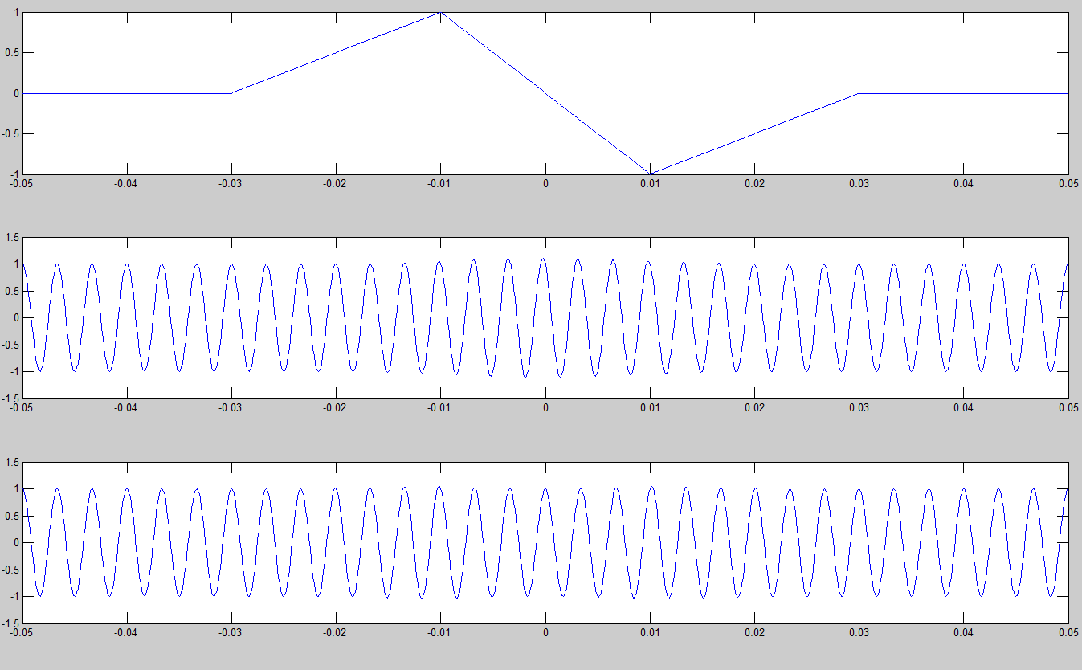
m(t)
f_{c} = 300 FM modulation k_{f} = 10 π k_{f} a(t) = 0.5 NBFM (k_{f} a(t)_{max} <<1)
f_{c} = 300 PM modulation k_{p} = 0.1 π k_{p} m_{p} = 0.314 NBPM (k_{p}m(t)_{max} << 1)
$$φ_{NBFM}\left(t\right)≈A\left[cosω_{c}t−k_{f}a\left(t\right)sinω_{c}t\right]$$
$$a\left(t\right)=\int_{−∞}^{t}{m\left(α\right)dα}$$
$$φ_{NBPM}\left(t\right)≈A\left[cosω_{c}t−k_{p}m\left(t\right)sinω_{c}t\right]$$

Slide 12
ts=1.e-4; kf = 10*pi; kp = 0.1*pi;
fc = 300; t=-0.05:ts:0.05; Ta = 0.02;
triangle = @(z)(1-abs(z)).*(z>=-1).*(z<1);
m_sig = 1*(triangle((t+0.01)/Ta) - triangle((t-0.01)/Ta));
m_intg = ts*cumsum(m_sig);
s_fm = cos(2*pi*fc*t + kf*m_intg);
s_pm = cos(2*pi*fc*t + kp*m_sig);
subplot(311);
plot(t, m_sig)
subplot(312);
plot(t, s_fm)
subplot(313);
plot(t, s_pm)
s_nbfm = cos(2*pi*fc*t) - kf*m_intg.*sin(2*pi*fc*t);
s_nbpm = cos(2*pi*fc*t) - kp*m_sig.*sin(2*pi*fc*t);
figure;
subplot(311);
plot(t, m_sig)
subplot(312);
plot(t,s_nbfm)
subplot(313);
plot(t, s_nbpm)
figure; plot(t, m_intg)
Code to demonstrate the effect of the condition for
NBFM (k_{f} a(t)_{max} <<1) and
NBPM (k_{p}m(t)_{max} << 1)

Slide 13
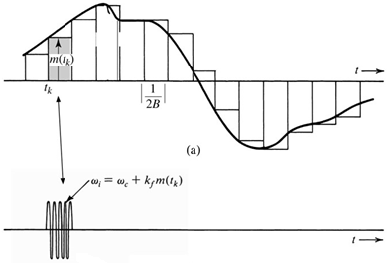
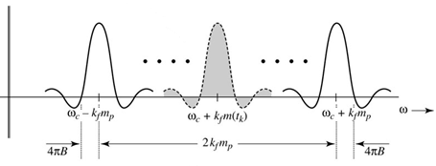
Wideband FM (WBFM)
In many application FM signal is meaningful only if its frequency deviation is large enough, so k_{f} a(t) << 1 is not satisfied, and narrowband analysis is not valid.
$$rect\left(2Bt\right)cos\left[{\{ω}_{c}+k_{f}m\left(t_{k}\right)\}t\right]$$
Fourier Transform
$\frac{1}{2}sinc\left[\frac{ω+ω_{c}+k_{f}m(t_{k})}{4B}\right]$+ $\frac{1}{2}sinc\left[\frac{ω−ω_{c}−k_{f}m(t_{k})}{4B}\right]$
$B_{FM}=\frac{1}{2π}\left(2k_{f}m_{p}+8πB\right)$
Hz
$$B_{FM}=2\left(\frac{k_{f}m_{p}}{2π}+2B\right)$$
Hz

Slide 14
Wideband FM (WBFM)
$$B_{FM}=2\left(\frac{k_{f}m_{p}}{2π}+2B\right)$$
$$∆f=\frac{k_{f}m_{p}}{2π}$$
Peak frequency deviation in hertz
$B_{FM}=2\left(∆f+2B\right)$ Hz
A better estimate: Carson’s rule
$$B_{FM}=2\left(∆f+B\right) Hz$$
$$β=\frac{∆f}{B}$$
is the deviation ratio
$$=2B\left(β+1\right)$$
Where
When Δf >> B the modulation is WBFM and the bandwidth is B_{FM} = 2 Δf
When Δf << B the modulation is NBFM and the bandwidth is B_{FM} = 2B

Slide 15
Wideband PM (WBPM)
The instantaneous frequency
$$ω_{i}=ω_{c}+k_{p}\dot{m}(t)$$
$$∆f=\frac{k_{p}{\dot{m}}_{p}}{2π}$$
Peak frequency deviation in hertz
$$β=\frac{∆f}{B}$$
Deviation ratio
$B_{PM}=2\left(∆f+B\right) Hz$
$=2B\left(β+1\right)$

Slide 16
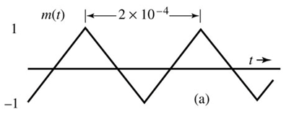
Example
Estimate BW_{FM} and BW_{PM} for the modulating signal m(t) for k_{f} =2π x10⁵ and k_{p} = 5π. Assume the essential bandwidth of the periodic m(t) as the frequency of its third harmonic.
Repeat the problem if the amplitude of m(t) is doubled.
Repeat the problem if the time expanded by a factor of 2: that is, if the period of m(t) is 0.4 msec.
B_{FM} = 230 B_{PM} = 130 kHz
B_{FM} = 430 B_{PM} = 230 kHz
B_{FM} = 215 B_{PM} = 65 kHz

Slide 17
Example
An angle-modulated signal with carrier frequency ω_{c} = 2π ×10⁵ is described by the equation
$$φ_{EM}\left(t\right)=10cos\left(ω_{c}t+5 sin3000t+10 sin2000πt\right)$$
Find the power of the modulated signal.
Find the frequency deviation Δf.
Find the deviation ratio β.
Find the phase deviation Δø.
Estimate the bandwidth of $φ_{EM}\left(t\right)$.
P = 50
Δf = 12,387 Hz
β = 12.387
Δø = 15 rad
B = 26,775 Hz
Read the Historical Note: Edwin H. Armstrong (page 242)

Slide 18
Generating FM Waves
Two Methods:
Direct method
Indirect method using NBFM Generation
The Direct Method
The frequency of a voltage-controlled oscillator (VCO) is controlled by the voltage m(t).
$$ω_{i}(t)=ω_{c}+k_{f}m(t)$$
Use an operational amplifier to build an oscillator with variable resonance frequency ω_{o}. The resonance frequency can be varied by variable capacitor or inductor. The variable capacitor is controlled by m(t).

Slide 19
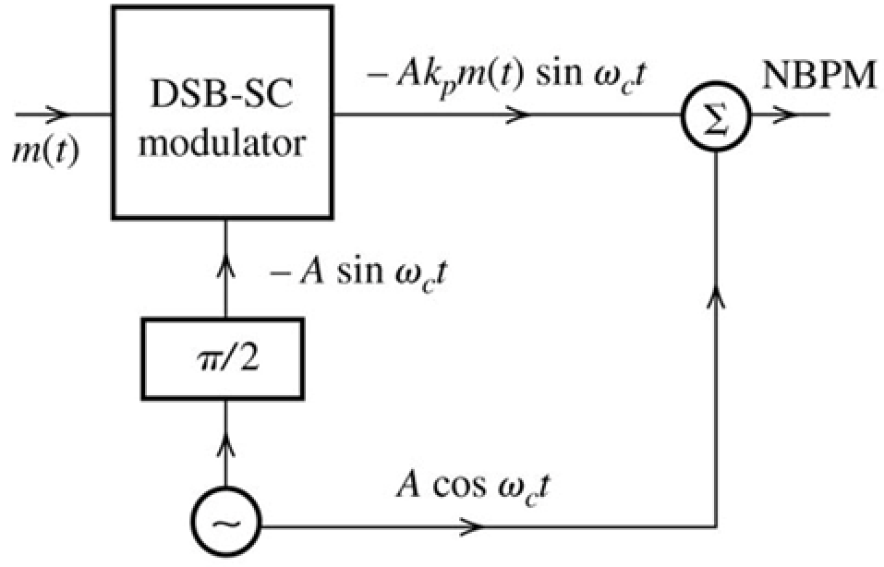
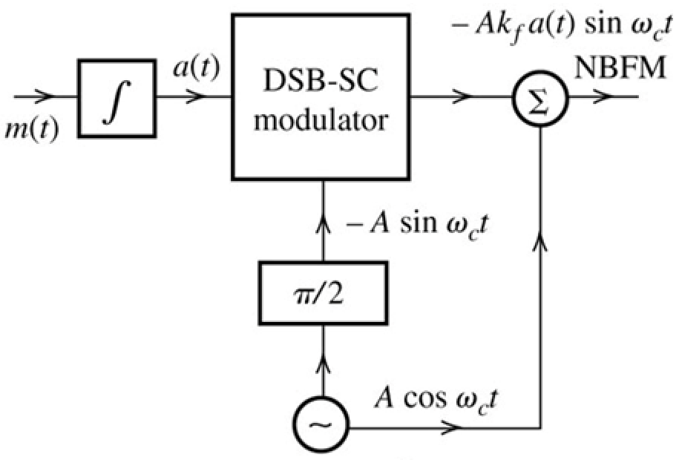
The NBFM Generation
$$φ_{NBPM}\left(t\right)≈A\left[cosω_{c}t−k_{p}m\left(t\right)sinω_{c}t\right]$$
$$φ_{NBFM}\left(t\right)≈A\left[cosω_{c}t−k_{f}a\left(t\right)sinω_{c}t\right]$$
With the NBFM generation, the amplitude of the NBFM modulator will have some amplitude variation due to approximation.

Slide 20
Distortion with NBFM Generation
Example 5.6: Discuss the nature of distortion inherent in the Armstrong indirect FM generator.
Amplitude and frequency distortions.
$$φ_{NBFM}\left(t\right)=A\left[cosω_{c}t−k_{f}a\left(t\right)sinω_{c}t\right]$$
$$φ_{NBFM}\left(t\right)=AE\left(t\right)cos\left[ω_{c}t+θ(t)\right]$$
$$E\left(t\right)=\sqrt{1+k_{f}^{2}a^{2}(t)}$$
$$θ\left(t\right)=\tan^{−1}\left[k_{f}a(t)\right]$$
$$ω_{i}\left(t\right)=ω_{c}+\frac{dθ}{dt}=ω_{c}+\frac{k_{f}\dot{a}(t)}{1+k_{f}^{2}a^{2}(t)}=ω_{c}+\frac{k_{f}m (t)}{1+k_{f}^{2}a^{2}(t)}$$
k_{f} a(t) << 1
$$ω_{i}\left(t\right)=ω_{c}+k_{f}m \left(t\right)\left[1−k_{f}^{2}a^{2}\left(t\right)+k_{f}^{4}a^{4}\left(t\right)−…\right]$$

Slide 21
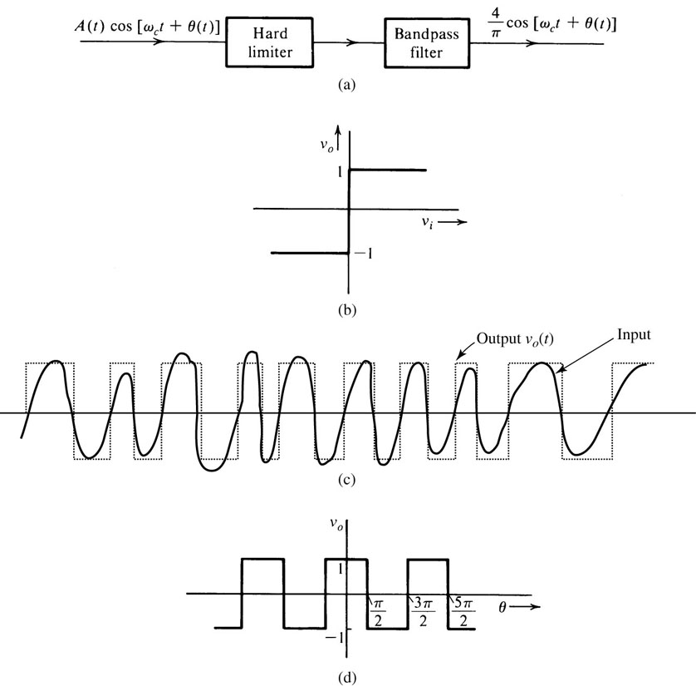
Distortion Removal on NBFM Generation
Bandpass Limiter
$$v_{o}(t)$$
$$e_{o}(t)$$
$$v_{i}\left(t\right)=A\left(t\right) cos⁡\left(θ(t)\right)$$
$$θ\left(t\right)=ω_{c}t+k_{f}\int_{−∞}^{t}{m\left(α\right)dα}$$
$$v_{o}(θ)=\left\{\begin{matrix}+1 cosθ>0 \\ −1 cosθ<0\end{matrix}\right.$$
$$v_{o}\left(t\right)=\frac{4}{π}\left(\cos{θ−\frac{1}{3}\cos{3θ}+\frac{1}{5}\cos{5θ+…}}\right)$$
$$e_{o}\left(t\right)=\frac{4}{π}cos\left[ω_{c}t+k_{f}\int_{−∞}^{t}{m\left(α\right)dα}\right]$$

Slide 22
Indirect Method of Armstrong
NBFM is generated first and then converted to WBFM by using additional frequency multipliers.
Example of frequency multiplier is a nonlinear device
$$y\left(t\right)= a_{2}x^{2}(t)$$
$$y\left(t\right)= a_{2}\cos^{2}\left[ω_{c}t+k_{f}\int{m\left(α\right)dα}\right]$$
$$y\left(t\right)= {0.5a}_{2}+{0.5a}_{2}cos\left[{2ω}_{c}t+2k_{f}\int{m\left(α\right)dα}\right]$$
Devices of higher multiplier
$$y\left(t\right)=a_{0}+{a_{1}x\left(t\right) +a}_{2}x^{2}\left(t\right)+…+{a_{n}x}^{n}\left(t\right)$$

Slide 23
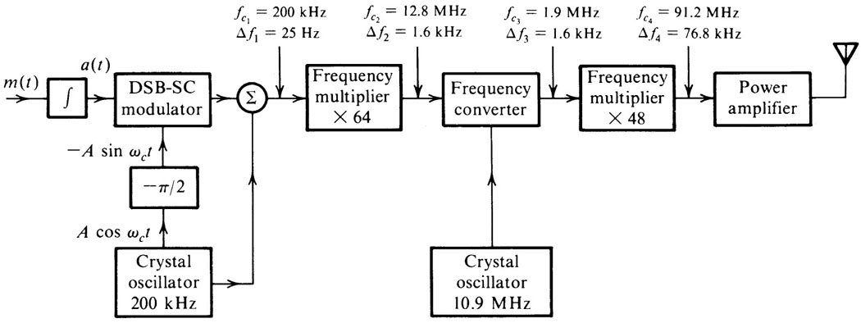
Indirect Method of Armstrong
For NBFM β << 1.
For speech f_{min} = 50Hz, so if Δf = 25 then β ≤ 25/50 = 0.5,
$$φ_{FM}\left(t\right)≈A\left[cosω_{c}t−k_{f}a\left(t\right)sinω_{c}t\right]$$
$$ω_{i}\left(t\right)=ω_{c}+k_{f} m\left(t\right)$$

Slide 24
Example
Design an Armstrong indirect FM modulator to generate an FM signal with carrier frequency 97.3 MHz and Δf = 10.24 kHz. A NBFM generator of f_{c1} = 20 kHz and Δf = 5 Hz is available. Only frequency doublers can be used as multipliers. Additionally, a local oscillator (LO) with adjustable frequency between 400 and 500 kHz is readily available for frequency mixing.
M₁ = 2⁴ M₂ = 2⁷ f_{LO} = 440 kHz

Slide 25
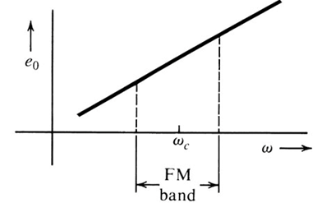
Demodulation of FM Signals
A frequency-selective network with a transfer function of the form |H(f)|=a2πf + b over the FM band would yield an output proportional to the instantaneous frequency.
Differentiator
$$φ_{FM}\left(t\right)=A\cos\left[ω_{C}t+k_{f}\int_{−∞}^{t}{m\left(α\right)dα}\right]$$
|H(f)|
$${\dot{φ}}_{FM}\left(t\right)=\frac{d}{dt}\left\{A\cos\left[ω_{C}t+k_{f}\int_{−∞}^{t}{m\left(α\right)dα}\right]\right\}$$
$${\dot{φ}}_{FM}\left(t\right)=A\left[ω_{c}+k_{f}m(t)\right]\sin\left[ω_{C}t+k_{f}\int_{−∞}^{t}{m\left(α\right)dα}\right]$$

Slide 26
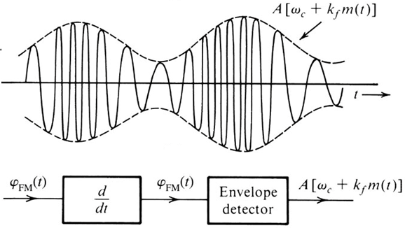
Demodulation of FM Signals
$${\dot{φ}}_{FM}\left(t\right)=A\left[ω_{c}+k_{f}m(t)\right]\sin\left[ω_{C}t+k_{f}\int_{−∞}^{t}{m\left(α\right)dα}\right]$$

Slide 27
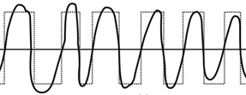
Practical Frequency Demodulators
$$H\left(f\right)=\frac{j2πfRC}{1+j2πfRC}≈j2πfRC$$
if
$$2πfRC≪1$$
$$ω_{carrier}<ω_{cutoff}=\frac{1}{RC}$$
The slope is linear over small band, so distortion occurs if the signal band is larger than the linear band.
Zero-crossing detectors: First step is to use amplitude limiter and then the zero-crossing detector.
Instantaneous frequency = the rate of zero crossing

Slide 28
FM Broadcasting Standard
Federal Communications Commission (FCC) specifications for FM communication
Frequency range = 88 to 108 MHz
Channel separations = 200 kHz,
Peak frequency deviation = 75 kHz
Transmitted signal should be received by monophonic and stereophonic receivers.
Filter
150 KHz
75 KHz
88
89.8
90
90.2
108 MHz
200 KHz
10.7
MHz

Slide 29
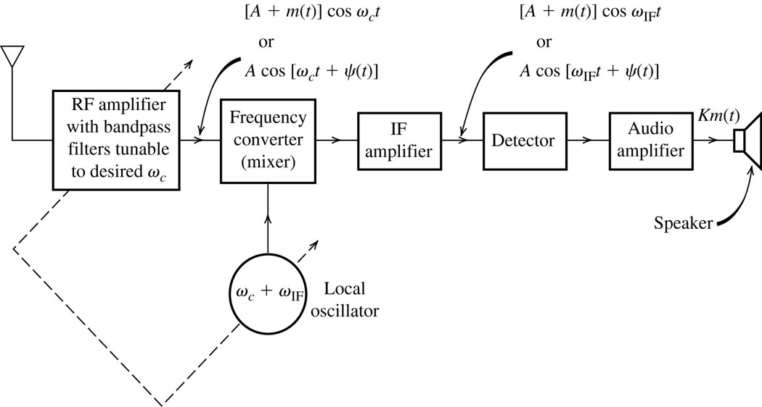
Superheterodyne Analog AM/FM Receivers
90 desired signal
90.2 adjacent
111.4 image
f_{c} = 10.7
10.7
90
90.2
111.4
10.7 , 190.7
10.5 , 190.9
10.7, 212.1
90+10.7=100.7
f_{IF} = 455KHz (AM radio);
10.7 MHz (FM);
38 MHz (TV)
AM stations that are 2 f_{IF} apart are called image stations and both would appear simultaneously at the IF output.
RF filter eliminates undesired image station, while IF filter eliminates undesired neighboring stations.

Slide 30
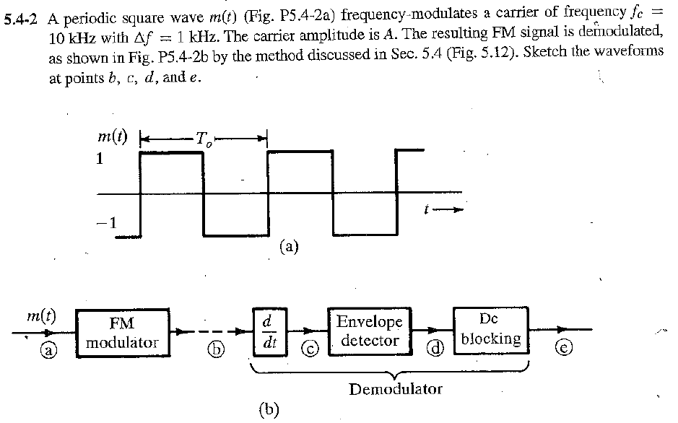
Homework Problem 5.4-2

Slide 31
Homework Problem 5.6-2

Slide 32
Effect of Nonlinear Distortion and Interference
Immunity of Angle Modulation to Nonlinearities
$$y\left(t\right)=a_{0}+a_{1}x\left(t\right)+a_{2}x^{2}\left(t\right)+…+a_{n}x^{n}(t)$$
$$x\left(t\right)=A\cos\left[ω_{C}t+ψ(t)\right]$$
$$y\left(t\right)=c_{0}+c_{1}\cos\left[ω_{C}t+ψ(t)\right]+c_{2}\cos\left[2ω_{C}t+2ψ(t)\right]$$
$+…+c_{n}\cos\left[{nω}_{C}t+nψ(t)\right]$
Vulnerability of Amplitude Modulation to Nonlinearities
$$y\left(t\right)=a m\left(t\right)cos⁡(ω_{C}t)+bm^{3}(t)\cos^{3}(ω_{C}t)$$
$$y\left(t\right)=\left[a m\left(t\right)+\frac{3b}{4}m^{3}(t)\right]\cos\left(ω_{C}t\right)+\frac{b}{4}m^{3}\left(t\right) cos(3ω_{C}t)$$

Slide 33
Interference Effect
Angle Modulation is less vulnerable than AM to small-signal interference from adjacent channels.
$$r\left(t\right)=Acos ω_{c}t+Icos({ω_{C}+ω)t}$$
$$r\left(t\right)=(A+I cos ωt)cos ω_{c}t−I sin{ωt sin ω_{c}t}$$
$$r\left(t\right)=(A+I cos ωt)cos ω_{c}t−I sin{ωt sin ω_{c}t}$$
$r\left(t\right)=E_{r}(t)$ $cos {[ω}_{c}t+ψ_{d}(t)]$
$$ψ_{d}\left(t\right)=\tan^{−1}\frac{I sin ωt}{A+I cos ωt}$$
$ψ_{d}\left(t\right)≈$ $\frac{I}{A}sin ωt$
for I << A
The output of ideal phase and frequency demodulators are
For PM
$y_{d}\left(t\right)=$ $\frac{I}{A}sin ωt$
Interference is inversely proportional to the carrier amplitude (capture effect).
For FM
$y_{d}\left(t\right)=$ $\frac{Iω}{A}cos ωt$

Slide 34
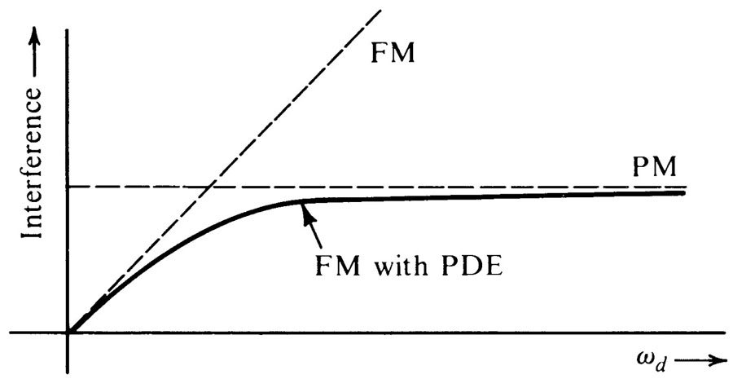
Preemphasis and Deemphasis in FM
$$\frac{Iω}{A}$$
With white noise, the amplitude interference is constant for PM but increase with ω for FM.
$$\frac{I}{A}$$
For audio signal the PSD is concentrated at low frequency below 2.1 kHz, so interference at high frequency will greatly deteriorate the quality of audio signal.
Preemphasis
Filter
Deemphasis
Filter
Noise

Slide 35
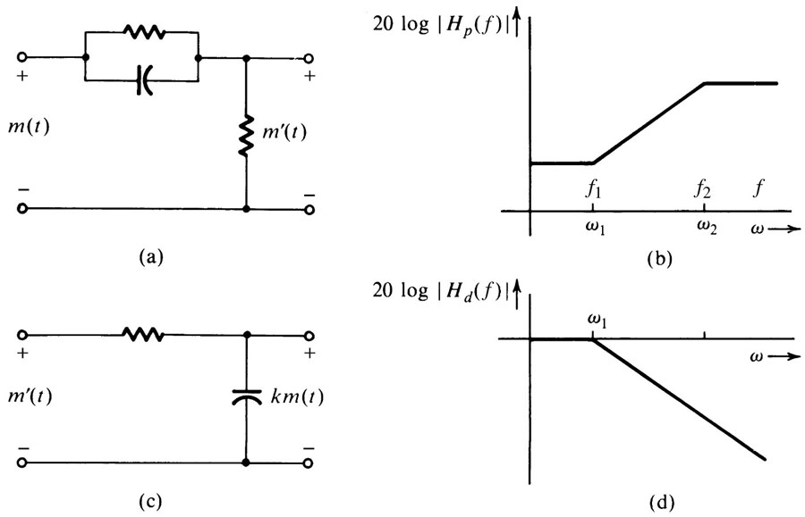
Preemphasis and Deemphasis (PDE) in FM
30 kHz
2.1 kHz
Preemphasis Filter
Deemphasis Filter

Slide 36
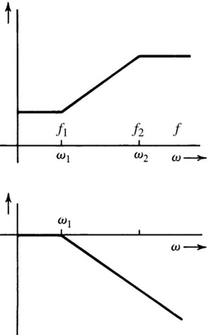
Preemphasis and Deemphasis (PDE) in FM
$$H_{p}\left(f\right)=K\frac{j2πf+ω_{1}}{j2πf+ω_{2}}$$
Where K is the gain and = ω₂ / ω₁
For 2πf << ω₁
$$H_{p}\left(f\right)≅1$$
$$H_{p}\left(f\right)≅\frac{j2πf}{ω_{1}}$$
For ω₁ << 2πf << ω₂
$$H_{d}\left(f\right)=\frac{ω_{1}}{j2πf+ω_{1}}$$
PDE is used in many applications such as recording of audiotape and photograph recording, where PDE depends on the band.

Slide 37
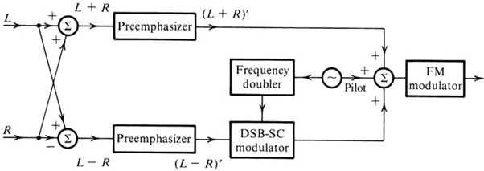
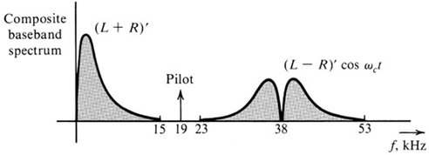
FM Broadcasting System (Transmitter)
Monophonic and Stereophonic Broadcasting System
$$m\left(t\right)={\left(L+R\right)}^{′}+{\left(L−R\right)}^{′}\cos{ω_{c}t+αcos\frac{ω_{c}}{2}t}$$

Slide 38
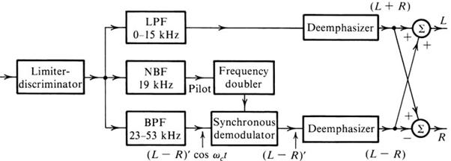
FM Broadcasting System (Receiver)
$$m\left(t\right)={\left(L+R\right)}^{′}+{\left(L−R\right)}^{′}\cos{ω_{c}t+αcos\frac{ω_{c}}{2}t}$$

