Slide 1
Ch 5 Digitization of Analog Source Signals
ENGR 4323/5323
Digital and Analog Communication
School of Engineering
University of Central Oklahoma
Dr. Mohamed Bingabr

Slide 2
Chapter Outline
Sampling Theorem
Pulse Code Modulation (PCM)
Digital Telephony: PCM IN T1 Carrier Systems
Digital Multiplexing
Differential Pulse Code Modulation (DPCM)
Adaptive Differential PCM (ADPCM)
Delta Modulation
Vocoders and Video Compression

Slide 3
Sampling Theorem
Sampling is the first step in converting a continuous signal to a digital signal.
Sampling Theorem determines the minimum number of samples needed to reconstruct perfectly the continuous signal again from its samples.
Sampling Theorem: A continuous function x(t) bandlimited to B Hz can be reconstructed from its samples if it was sampled at rate equal or greater than 2 B samples per second. If the sampling rate equals 2 B then it is called the Nyquist rate.

Slide 4
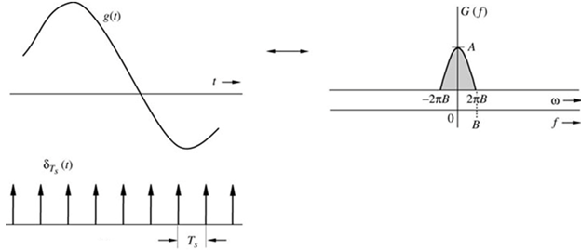
Sampling Theorem
Sampling Rate
f_{s}= 1/T_{s}
$$\overline{g}\left(t\right)=g\left(t\right)δ_{T_{s}}\left(t\right)$$
$$δ_{T_{s}}=\frac{1}{T_{s}}+\frac{2}{T_{s}}\sum_{n=1}^{∞}{cos\left(nω_{s}t\right)}$$
$$\overline{g}\left(t\right)=\frac{1}{T_{s}}g(t)+\frac{2}{T_{s}}\sum_{n=−∞}^{n=∞}{g(t)cos\left(nω_{s}t\right)}$$
$$\overline{G}\left(f\right)=\frac{1}{T_{s}}\sum_{n=−∞}^{n=∞}{G(f−nf_{s}) }$$
Nyquist Rate f_{s} = 2B
f_{s} > 2B

Slide 5
Sampling Theorem
$$δ_{T_{s}}\left(t\right)=\sum_{n}{δ(t−nT_{s})}$$
$$\overline{g}\left(t\right)=g\left(t\right)δ_{T_{s}}\left(t\right)=\sum_{n}{g(nT_{s})δ(t−nT_{s})}$$
$$δ_{T_{s}}\left(t\right)=\frac{1}{T_{s}}\sum_{n=−∞}^{n=∞}{e^{jnω_{s}t}}$$
$$\overline{g}\left(t\right)=g\left(t\right)δ_{T_{s}}\left(t\right)=\frac{1}{T_{s}}\sum_{n=−∞}^{n=∞}{g(t)e^{jnω_{s}t}}$$
Use the frequency shifting property to find the spectrum of the sampled signal
$$\overline{G}\left(f\right)=\frac{1}{T_{s}}\sum_{n=−∞}^{n=∞}{G(f−nf_{s}) }$$

Slide 6
Reconstruction from Uniform Samples
To reconstruct the continuous signal g(t) from the samples, pass the samples through a low-pass filter with cutoff frequency =B Hz.
$$H\left(f\right)=T_{s} Π\left(\frac{ω}{4πB}\right)$$
$$h\left(t\right)=2BT_{s}sinc(2πBt)$$
Sampling at Nyquist rate: 2BT_{s} = 1
$$h\left(t\right)=sinc(2πBt)$$
h(t)
$$\overline{g}\left(t\right)$$
LPF
$$g\left(t\right)$$
$$\overline{g}\left(t\right)=\sum_{n}{g(nT_{s})δ(t−nT_{s})}$$
$$g\left(t\right)=\sum_{k}{g\left(kT_{s}\right)h(t−kT_{s})}=\sum_{k}{g\left(kT_{s}\right)sinc\left[2πB(t−kT_{s})\right]}$$

Slide 7
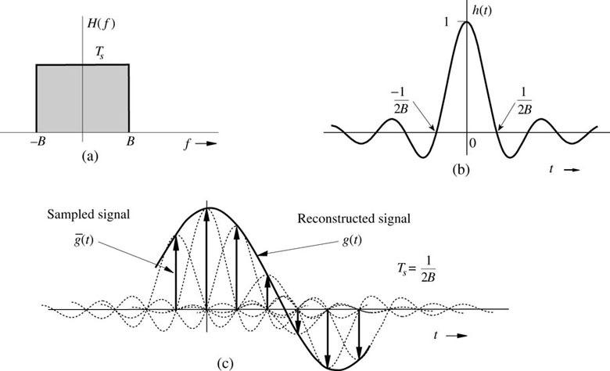
Reconstruction from Uniform Samples
$$g\left(t\right)=\sum_{k}{g\left(kT_{s}\right)sinc\left[2πB(t−kT_{s})\right]}$$
Interpolation formula
$$g\left(t\right)=\sum_{k}{g\left(kT_{s}\right)sinc\left[2πBt−kπ\right]}$$

Slide 8
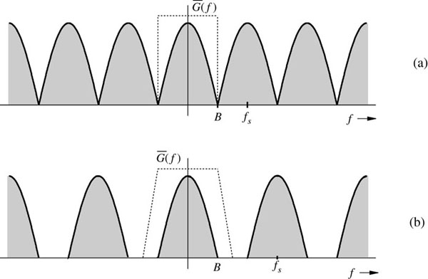
Practical Issues in Sampling
Sampling at the Nyquist rate require ideal low-pass filter which is unrealizable in practice.
f_{s}=2B
f_{s} > 2B

Slide 9
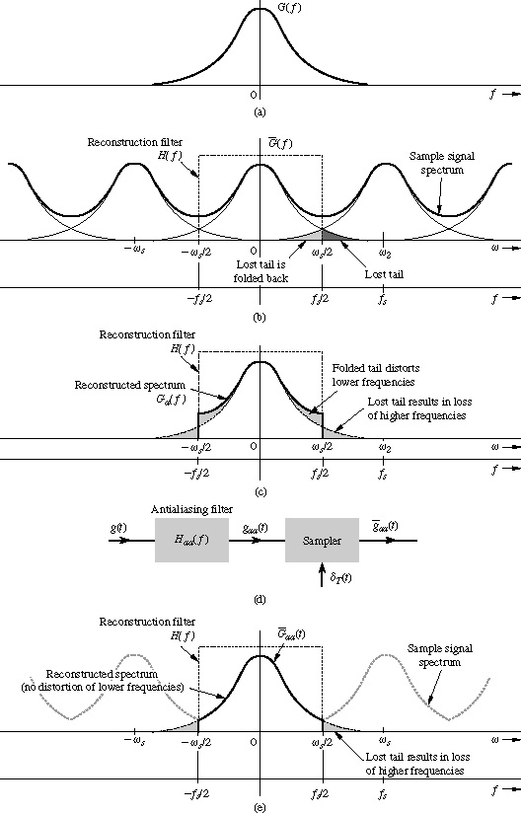
Practical Issues in Sampling
Aliasing
Practical signals are time-limited by nature which means they can not be band-limited at the same time.

Slide 10
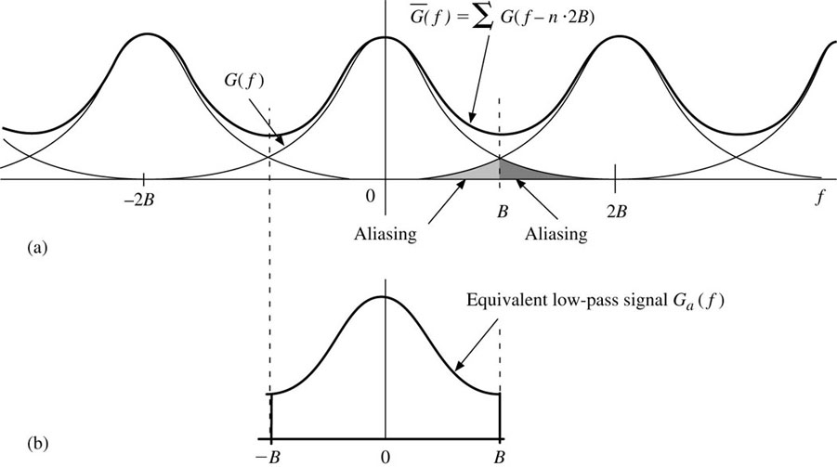
Maximum Information Rate
A maximum of 2B independent pieces of information (pulse) per second can be transmitted, error free, over a noiseless channel of bandwidth B Hz.
$$C=B{\text{Log}}_{2}\left(1+\frac{S}{N}\right)$$
The Shannon–Hartley theorem states the channel capacity C, meaning the theoretical tightest upper bound on the information rate of data that can be communicated at an arbitrarily low error rate using an average received signal power S through an analog communication channel subject to additive white Gaussian noise of power N:

Slide 11
Example 6.1
Find a signal g(t) that is band-limited to B Hz and whose samples are g(0) = 1 and g(±T_{s}) = g(±2T_{s}) = g(±3T_{s}) =…= 0 where the sampling interval T_{s} is the Nyquist interval, that is T_{s} = 1/2B.

Slide 12
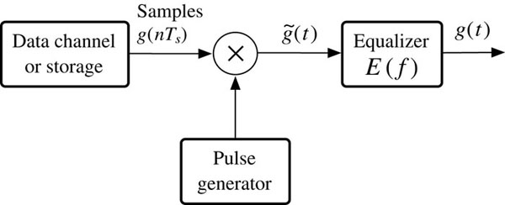
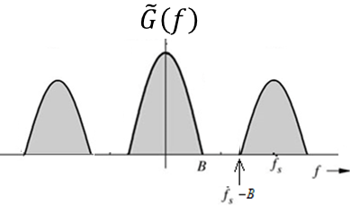
Practical Signal Reconstruction
Assume sampling is ideal:
p(t)
$$\tilde{g}\left(t\right)=\sum_{n}{g\left(nT_{s}\right)p\left(t−nT_{s}\right)=}p\left(t\right)∗\left[\sum_{n}{g\left(nT_{s}\right)δ\left(t−nT_{s}\right)}\right]$$
$$\tilde{G}\left(f\right)=P(f)\frac{1}{T_{s}}\sum_{n}{G(f−nf_{s})}$$
To recover g(t) from $\tilde{g}(t)$ we pass it through an equalizer E( f )

Slide 13
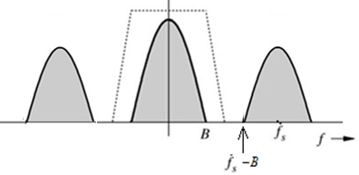
Practical Signal Reconstruction
p(t)
$$G\left(f\right)=E\left(f\right)\tilde{G}\left(f\right)=E(f)P(f)\frac{1}{T_{s}}\sum_{n}{G(f−nf_{s})}$$
$$E(f)P(f)$$
$$E(f)P(f)=\left\{\begin{matrix}\begin{aligned}T_{s} \left|f\right|≤B \\ \text{Flexible} B<\left|f\right|<\left(f_{s}−B\right) \end{aligned} \\ 0 \left|f\right|>f_{s}−B \end{matrix}\right.$$
The equalizer filter E( f ) must be low-pass in nature to stop all frequency content above f_{s} - B, and it should be the inverse of P( f ) within the signal bandwidth of B Hz.

Slide 14
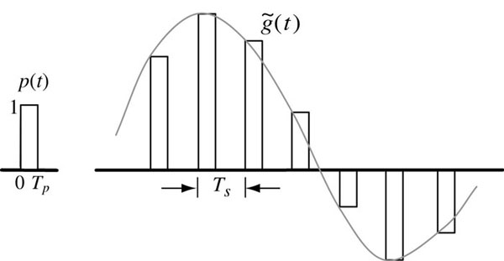
Practical Signal Reconstruction-Example
p(t)
$$p(t)=Π\left(\frac{t−0.5T_{p}}{T_{p}}\right)$$
$$P(f)=T_{p}sinc\left(πfT_{p}\right)e^{−jπfT_{p}}$$
$$\tilde{G}\left(f\right)=P(f)\frac{1}{T_{s}}\sum_{n}{G(f−nf_{s})}$$
$$P\left(f\right)E(f)=T_{s}$$
$$E\left(f\right)=T_{s}.\frac{πf}{sin\left(πfT_{p}\right)}≈\frac{T_{s}}{T_{p}}$$
When T_{p} is very small

Slide 15
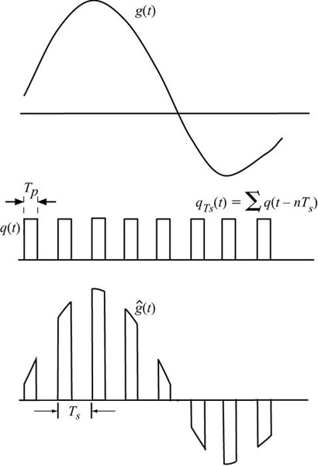
Practical Sampling Analysis
Read details in textbook section (6.1.4 in 3rd edition) (5.1.5 in 4th edition)
$$q_{T_{s}}\left(t\right)=\sum_{n=−∞}^{∞}{Q_{n}e^{jnω_{0}t}}$$
$$\hat{g}\left(t\right)=g(t)q_{T_{s}}(t)$$
$$g_{1}\left(t\right)=h_{a}(t)∗\hat{g}\left(t\right)$$
$$\tilde{g}\left(t\right)=\sum_{k}{g_{1}(kT_{s})δ(t−kT_{s})}$$
$$G_{1}\left(f\right)=H_{a}(f)\sum_{n=−∞}^{∞}{Q_{n}G(f−nf_{s})}$$
$$\tilde{G}\left(f\right)=\frac{1}{T_{s}}\sum_{m}{G_{1}(f+mf_{s})}$$

Slide 16
Sampling Theorem and Pulse Modulation
The continuous signal g(t) is sampled, and sample values are used to modify certain parameters (amplitude, width, position) of a periodic pulse train.
Techniques for communication using pulse modulation:
1- Pulse Amplitude Modulation (PAM)
2- Pulse Width Modulation (PWM)
3- Pulse Position Modulation (PPM)
4- Pulse Code Modulation (PCM)
5- Time Division Multiplexing (TDM)

Slide 17
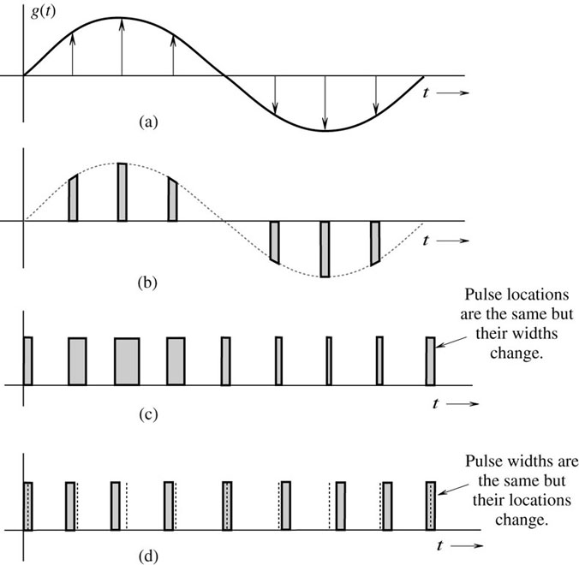
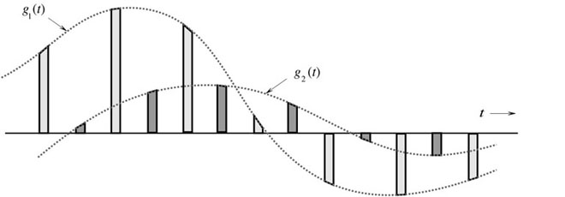
Pulse Modulation
TDM
PAM
PWM
PPM

Slide 18
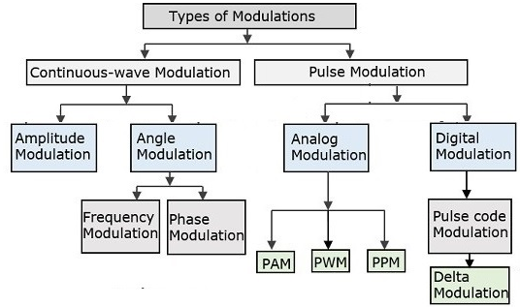
Type of Modulation
DSB
DSB-SC
SSB
QAM
VSB

Slide 19
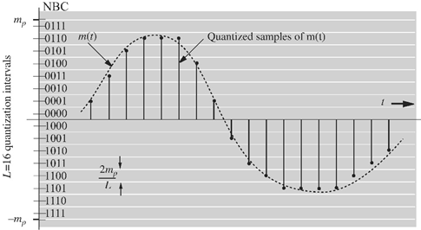
Pulse Code Modulation (PCM)
PCM is widely used as a tool to convert analog signal to digital signal.
The signal range
[-m_{p} , m_{p}] is divided into L subintervals (Δv = 2m_{p}/L).
L levels require n binary digits (bits) where L = 2^{n}.
Δv =
Quantization Error
q_{e} = Δv /2

Slide 20
Telephone Vs. Music
Phone conversation for 5 minutes
1- Bandwidth = 3500 Hz
2- sampling rate = 8000 samples/sec
3- number of bits = 8 bits/sample
CD music recording
1- Bandwidth = 20,000 Hz
2- sampling rate = 44,100 samples/sec
3- number of bits = 16 bits/sample
Compare the channel bandwidth required to transmit speech vs. music.
Compare the storage capacity required to store 5 minutes phone conversation vs. 5 minutes music.

Slide 21
Example
A signal m(t) band-limited to 3 kHz is sampled at a rate 33.333% higher than the Nyquist rate. The maximum acceptable error in the sample amplitude (the maximum quantization error) is 0.5% of the peak amplitude m_{p}. The quantization samples are binary coded. Find the minimum bandwidth of a channel required to transmit the encoded binary signal. If 24 such signals are time-division-multiplexed, determine the minimum transmission bandwidth required to transmit the multiplexed signal.

Slide 22
Advantage of Digital Communication
Withstand channel noise and distortion much better than analog.
With regenerative repeater it is possible to transmit over long distance.
Digital hardware implementation is flexible
Digital coding provide further error reduction, high fidelity and privacy.
Easier to multiplex several digital signals.
More efficient in exchanging SNR for bandwidth.
Digital signal storage is relatively easy and inexpensive.
Reproduction with digital messages is reliable without deterioration.
Cost of digital hardware is cheaper and continue to decrease.

Slide 23
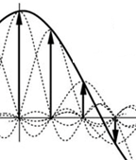
Quantization Error Analysis
Original signal
$$m\left(t\right)=\sum_{k}{m\left(kT_{s}\right)sinc\left(2πBt−kπ\right)}$$
Quantized signal
$$\hat{m}\left(t\right)=\sum_{k}{\hat{m}\left(kT_{s}\right)sinc\left(2πBt−kπ\right)}$$
Quantization noise
$$q\left(t\right)=\sum_{k}{\left[\hat{m}\left(kT_{s}\right)−m\left(kT_{s}\right)\right]sinc\left(2πBt−kπ\right)}$$
$$q\left(t\right)=\sum_{k}{q\left(kT_{s}\right)sinc\left(2πBt−kπ\right)}$$
Power of q(t)
$$\tilde{q^{2}(t)}=\lim_{T→∞}{\frac{1}{T}\int_{−T/2}^{T/2}{{\left[\sum_{k}{q\left(kT_{s}\right)sinc\left(2πBt−kπ\right)}\right]}^{2}dt}}$$

Slide 24
Quantization Error Analysis
$$\int_{−T/2}^{T/2}{sinc\left(2πBt−mπ\right)sinc\left(2πBt−nπ\right)dt}=\left\{\begin{matrix}0 m≠n \\ \frac{1}{2B} m=n\end{matrix}\right.$$
$$\tilde{q^{2}(t)}=\lim_{T→∞}{\frac{1}{T}\sum_{k}{q^{2}\left(kT_{s}\right)}\int_{−T/2}^{T/2}{{sinc}^{2}\left(2πBt−kπ\right)dt}}$$
$$\tilde{q^{2}(t)}=\lim_{T→∞}{\frac{1}{2BT}\sum_{k}{q^{2}\left(kT_{s}\right)}}$$
2BT: number of samples over averaging interval T
$$\tilde{q^{2}}=\frac{1}{∆v}\int_{−∆v/2}^{∆v/2}{q^{2}dq=\frac{{(∆v)}^{2}}{12}=\frac{m_{p}^{2}}{3L^{2}}}$$
Mean square quantization error
$$\frac{S_{0}}{N_{0}}=3L^{2}\frac{\tilde{m^{2}(t)}}{m_{p}^{2}}$$
Signal to Noise Ration (SNR)

Slide 25
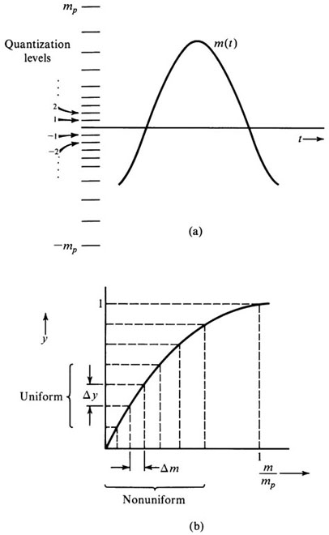
Nonuniform Quantization
Nonuniform quantization reduces the quantization error by reducing the quantization level where the signal is more frequently exist (at low amplitude).
The µ-law (North America and Japan)
µ is the compression parameter
$$y=\frac{1}{ln⁡(1+μ)}\text{ln}\left(1+\frac{μm}{m_{p}}\right)$$
$$0≤\frac{m}{m_{p}}≤1$$
The A-law (rest of the world)
$$y=\left\{\begin{matrix}\frac{A}{1+ln⁡A}\left(\frac{m}{m_{p}}\right) \\ \frac{1}{1+ln⁡A}\left(1+\text{ln}\frac{Am}{m_{p}}\right)\end{matrix}\right.$$
$$0≤\frac{m}{m_{p}}≤\frac{1}{A}$$
$$\frac{1}{A}≤\frac{m}{m_{p}}≤1$$

Slide 26
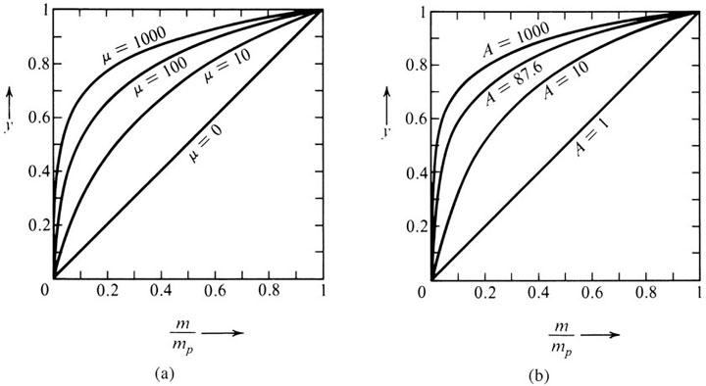
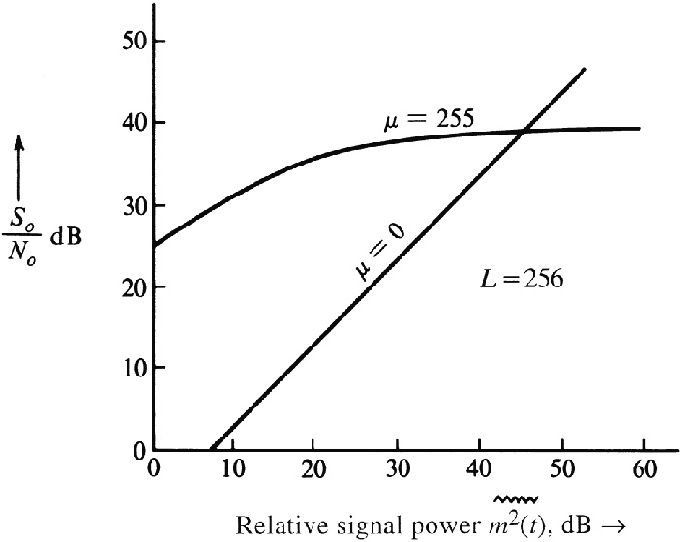
Nonuniform Quantization
For L=128 (7-bit), µ = 100
For L=256 (8-bit), µ = 255
SNR for µ-law
$$\frac{S_{0}}{N_{0}}≅\frac{3L^{2}}{{\left[\text{ln}\text{(1+}μ\text{)}\right]}^{2}}$$
$$μ^{2}≫\frac{m_{p}^{2}}{\tilde{m^{2}(t)}}$$
Compandor

Slide 27
Transmission Bandwidth
B : Signal bandwidth in Hz
L : Quantization Level
n : Number of bits per sample
f_{s} = 2*B Samples per second
n = log₂ L Number of bits per sample
Bit Rate = 2*B*n Number of bits per second
B_{T} = B*n Transmission Channel Bandwidth (Bit Rate/2)
Usually the sampling rate is higher than the Nyquist rate 2B to improve signal to noise ratio (SNR).

Slide 28
Channel Bandwidth and SNR
Output SNR increase exponentially with the transmission bandwidth B_{T}.
$$c=\left\{\begin{matrix}\frac{3\tilde{m^{2}(t)}}{m_{p}^{2}} \\ \frac{3}{{\left[ln⁡(1+μ\right]}^{2}}\end{matrix}\right.$$
Uniform quantization
$$\frac{S_{0}}{N_{0}}=3L^{2}\frac{\tilde{m^{2}(t)}}{m_{p}^{2}}=cL^{2}$$
where
Non-uniform quantization
$$\frac{S_{o}}{N_{o}}=c{(2^{n})}^{2}=c{(2)}^{2n}$$
$$\frac{S_{o}}{N_{o}}=c{(2)}^{2{B_{T}}/B}$$
Increasing channel bandwidth improve SNR
$${\left(\frac{S_{o}}{N_{o}}\right)}_{dB}=10\log_{10}\left(\frac{S_{o}}{N_{o}}\right)=10\log_{10}c+6n$$
$${\left(\frac{S_{o}}{N_{o}}\right)}_{dB}=\left(α+6n\right)$$
dB
Increasing n by 1 (1 bit increase in the code word would increase the BW by 14%) quadruples the output SNR (6 dB increase).

Slide 29
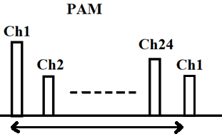
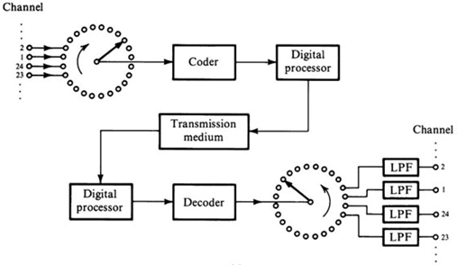
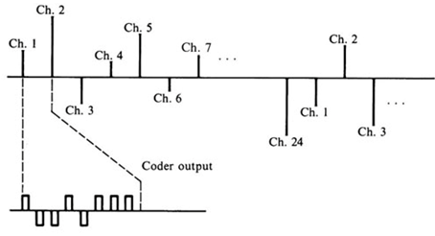
Digital Telephony: PCM in T1 Carrier Systems
T1 Specifications
24 Channels
Sampling: 8000 samp/s
PAM (Pulse Amp. Mod.)
Pulse Width: 2 µs
Rate: 1.544 Mbit/s
DS1: digital signal level 1
125 µs
Regenerative repeater every 6000 feet (1.13 mile)
ITU-T Specifications
30 Channels
Sampling: 2 µs pulse
Rate: 2.048 Mbit/s

Slide 30
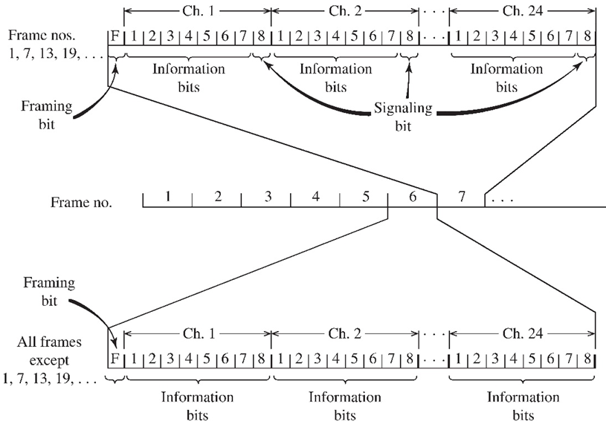
Synchronizing and Signaling
100011011100
Every 6th sample
125 μs
193 bits
0.4-0.6 ms to detect
50 ms to reframe

Slide 31
Synchronizing and Signaling
8000 samples/sec
24 channels
1 frame bit
193 bits/frame
125 µs/frame
The framing bits pattern: 100011011100 (12 frame)
0.4 to 6 msec for frame detection
Up to 50 ms to reframe.
LSB of every sixth sample used for switching communication (robbed-bit signaling).
Read the detail of frame signaling in textbook

Slide 32
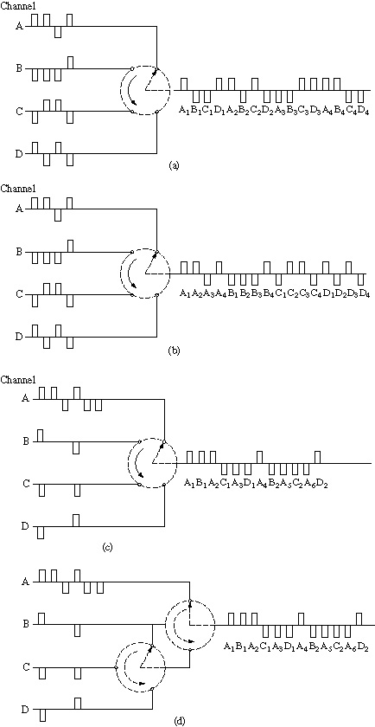
Digital Multiplexing (DM)
Time division multiplexing of digital signals:
digit interleaving;
word (or byte) interleaving;
(c) interleaving channel having different bit rate;
(d) alternate scheme for (c).

Slide 33
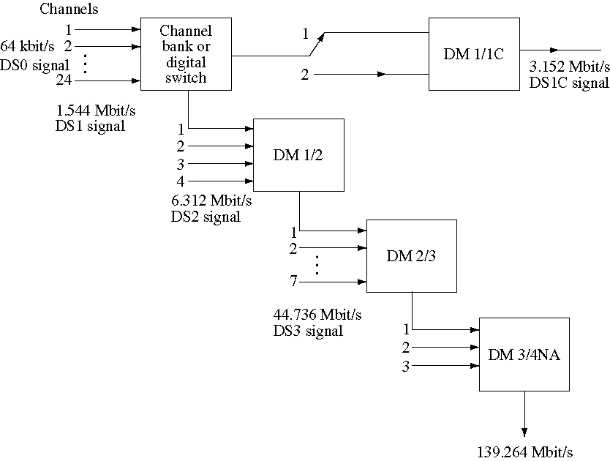
North America Digital Hierarchy (AT&T)

Slide 34
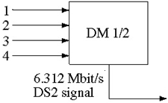
Signal Format DM 1/2
subframe
The F digits are periodic 01010101
F digits identify the frames
The M digits 0111 identify subframes
The C digits for bit stuffing and Asynchronous
Bit interleaving
4 channels
Channel rate1.544 Mbit/s
Overhead frames are M,C,F
Each frame consist of four subframe
Each subframe has six overhead bits
Each subframe has six 48-interleaved data bits
The 48 interleaved data bits from the four channels (12 bits/ch).
Each frame has 1152 data bits (48*6*4) and 24 overhead bits(6*4).
Efficiency =1152/1176=98%

Slide 35
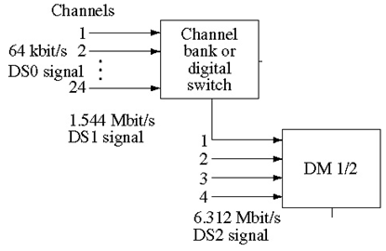
16 subframe in each channel
12 bits from each channel

Slide 36
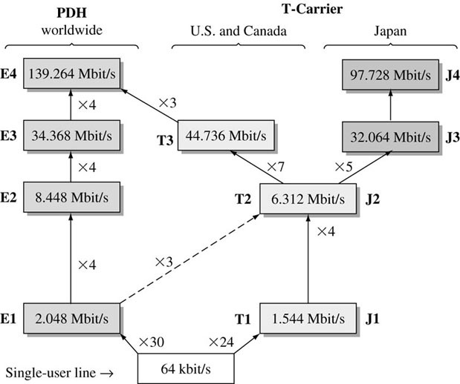
Europe ITU System
Plesiochronous digital hierarchy (PDH) according to ITU-T Recommendation G.704.

Slide 37
Differential Pulse Code Modulation (DPCM)
DPCM exploits the characteristics of the source signals. It reduce the number of bits needed per sample by taking advantage of the redundancy between adjacent samples. Instead of transmitting sample m[k] we transmit
d[k] = m[k] – m[k-1]
d[k] has lower amplitude so it require less bits per sample or
the size of quantization level will be smaller if we keep the number of bits unchanged which reduces the quantization error.
We can improve the DPCM by estimating the k^{th} value $\hat{m}\left[k\right]$ from previous values and then transmit the difference
$$d\left[k\right]=m\left[k\right]−\hat{m}\left[k\right]$$
Example: [120 126 128 131 129 132 ]

Slide 38
Differential Pulse Code Modulation (DPCM)
Linear predictor
$$\hat{m}\left[k\right]=a_{1}m\left[k−1\right]+a_{2}m\left[k−2\right]+…+a_{N}m\left[k−N\right]$$
128
126
120
[120 126 128 131 129 ]
131
Taylor Series
$$m\left(t+T_{s}\right)=m\left(t\right)+T_{s}\dot{m(t)}+\frac{T_{s}^{2}}{2^{!}}\ddot{m}\left(t\right)+\frac{T_{s}^{3}}{3^{!}}\overset{⃛}{m}\left(t\right)+…≈m\left(t\right)+T_{s}\dot{m(t)}$$
$$m\left[k+1\right]≈m\left[k\right]+T_{s}\left[\frac{m\left[k\right]−m\left[k−1\right]}{T_{s}}\right]$$
For small T_{s}
$$m\left[k+1\right]≈m\left[k\right]+(m\left[k\right]−m\left[k−1\right])≈2m\left[k\right]−m\left[k−1\right]$$

Slide 39
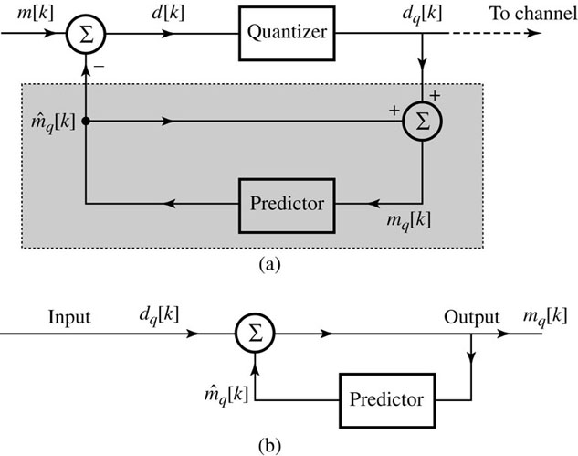
Analysis of DPCM System
[120 126 128 131 129 ]
Linear predictor
$$d\left[k\right]=m\left[k\right]−{\hat{m}}_{q}\left[k\right]$$
$$d_{q}\left[k\right]=d\left[k\right]+q\left[k\right]$$
$$m_{q}\left[k\right]={\hat{m}}_{q}\left[k\right]+d_{q}\left[k\right]$$
$$m_{q}\left[k\right]=m\left[k\right]−d[k]+d_{q}\left[k\right]$$
$$m_{q}\left[k\right]=m[k]+q[k]$$
m_{q}[k] is a quantized version of m[k]
DPCM system
transmitter (b) receiver
Read the section in textbook

Slide 40
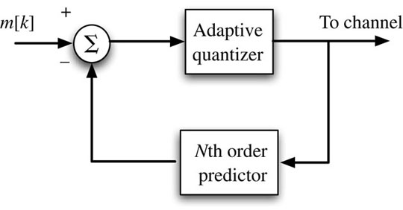
Adaptive Differential PCM (ADPCM)
Adaptive DPCM further improve the efficiency of DPCM encoding by incorporating an adaptive quantizer (varied Δv) at the encoder.
The quantized prediction error d_{q}[k] is a good indicator of the prediction error size. It can be used to change Δv to minimize d_{q}[k]. When the d_{q}[k] fluctuate around large positive or negative value then the prediction error is large and Δv needs to grow and when d_{q}[k] fluctuates around zero then Δv needs to decrease.
8-bit PCM sequence can be encoded into a 4-bit ADPCM sequence at the same sampling rate. This reduce channel bandwidth or storage by half with no loss in quality.

Slide 41
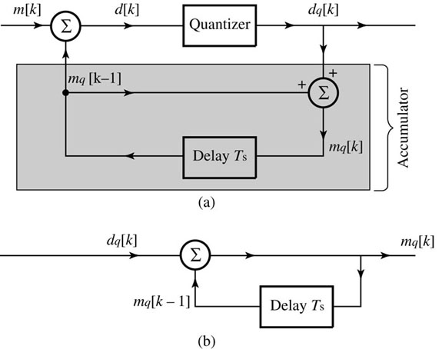
Delta Modulation (DM)
Delta modulation oversample the baseband signal (4 time the Nyquist rate) to increase the correlation between adjacent samples. The increase in correlation results in a small prediction error that can be encoded using only one bit (L = 2).
In DM the information of the difference between successive samples is transmitted by a 1-bit code word.
$$m_{q}\left[k\right]=m_{q}\left[k−1\right]+d_{q}\left[k\right]$$
$$m_{q}\left[k−1\right]=m_{q}\left[k−2\right]+d_{q}\left[k−1\right]$$
$$m_{q}\left[k\right]=m_{q}\left[k−2\right]+{d_{q}\left[k\right]+d}_{q}\left[k−1\right]$$
$$m_{q}\left[k\right]=\sum_{m=0}^{k}{d_{q}\left[m\right]}$$
Example: m[k] = [120 126 128 130 129 132 ]
L = 2→ E = ± 3
d_{q}[k] = [120 3 3 3 -3 3 ]

Slide 42
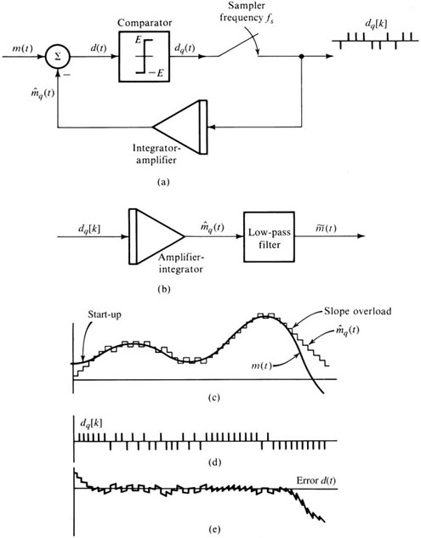
Delta Modulator and Demodulator
a) Delta modulation
b) Delta demodulators
c) Message signal versus integrator
output signal
d) Delta-modulated pulse trains
e) Modulation errors
Threshold of Coding and overloading
1- small step size E causes slope overload
2- Large step size (E) causes granular noise.
$$E/Ts>\left|\dot{m(t)}\right|$$
$$Efs>\left|\dot{m(t)}\right|$$

Slide 43
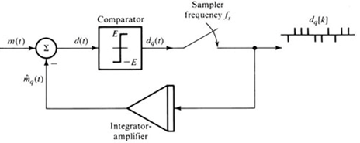
$$\frac{E}{T_{s}}>\left|\dot{m(t)}\right|$$
$$Ef_{s}>\left|\dot{m(t)}\right|$$
If m(t) = A cos ωt
$$\dot{|m\left(t\right)|}=Aω$$
$$E>\frac{\left|Aω \right|}{f_{s}}$$
$${\left[A_{max}\right]}_{voice}≤\frac{Ef_{s}}{ω}$$

Slide 44
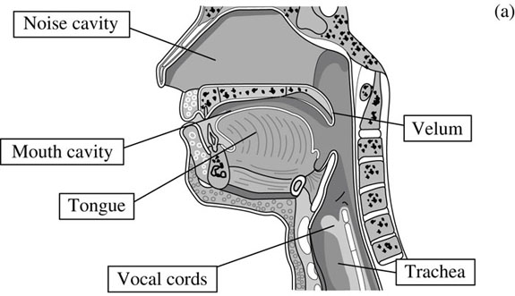
Linear Prediction Coding (LPC) Vocoders
$$H\left(z\right)=\frac{g}{A(z)}$$
$$H\left(z\right)=g.{\left(1−\sum_{i=1}^{p}{a_{i}z^{−i}}\right)}^{−1}$$
The human speech production mechanism.
Typical pressure impulses.

Slide 45
Linear Prediction Coding (LPC) Vocoders
$$H\left(z\right)=\frac{g}{A(z)}=g.{\left(1−\sum_{i=1}^{p}{a_{i}z^{−i}}\right)}^{−1}$$
The LPC analyzer
- Estimate the all-pole filter coefficients in A(z).
The optimum filter coefficients are determined by minimizing the mean square error (MSE) of the linear prediction error.
Speech segment is 22.5 ms, sampling rate 8000 Hz.
PCM = 64 kbit/s ADPCM = 32 kbit/s LPC10 = 2.4 kbit/s.

Slide 46
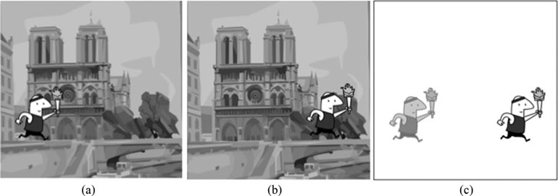
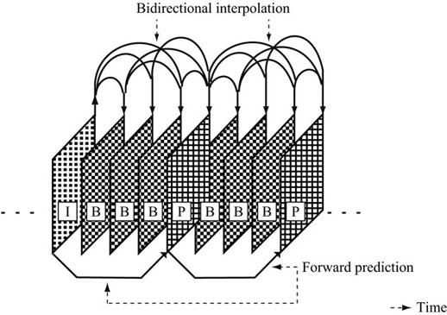
Video Compression

Slide 47
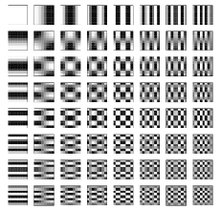
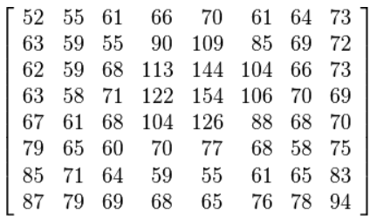
Basis Function of image
u = 0
v = 0
u = 8
v = 0
g_{x,y}
frequencies
u = 8
v = 8
y-axis 0→7
x-axis 0→7
>> G = dct2(g);

Slide 48
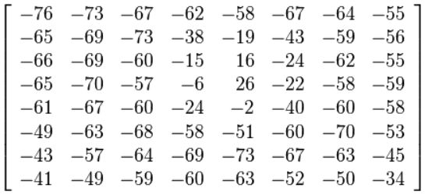
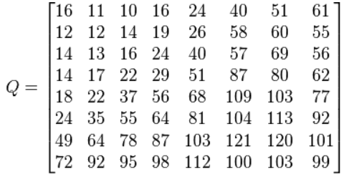
Video Compression
Pixel intensity
Pixel intensity-128
DCT Coefficients
Quantization Table

Slide 49
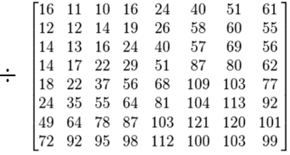
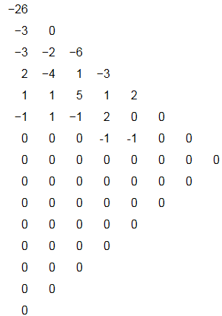
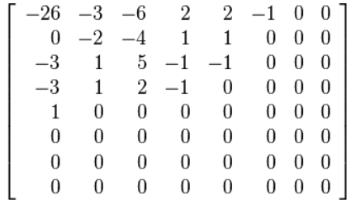
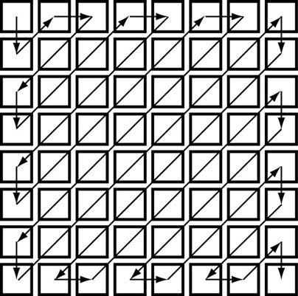
Video Compression
Quantized DCT Coefficients
>> ImgOut = blockproc(imgIn, [8,8], ‘dct2’);

