Slide 1
Ch 6 Principles of Digital Data Transmission
ENGR 4323/5323
Digital and Analog Communication
School of Engineering
University of Central Oklahoma
Dr. Mohamed Bingabr

Slide 2
Chapter Outline
Digital Communication Systems
Line Coding
Pulse Shaping
Scrambling
Digital Receiver and Regenerative Repeaters
PAM: M-ARY Baseband Signaling for Higher Data Rate
Digital Carrier Systems
M-ARY Digital Carrier Modulation

Slide 3
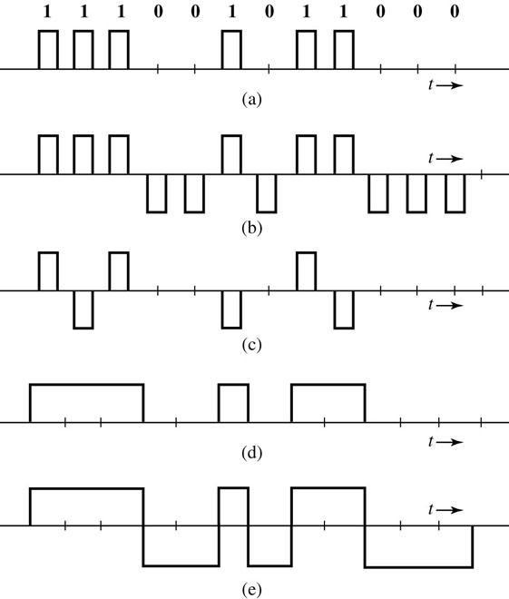
Digital Communication Sys. (Line Coding)
On-Off (RZ)
Polar (RZ)
Line Coding
Bipolar (RZ)
On-Off (NRZ)
Polar (NRZ)

Slide 4
Digital Communication Systems
Digital Carrier Modulation
- Amplitude Modulation
- Frequency Modulation
- Phase Modulation
Multiplexer
- Time Division
- Frequency Division
- Code Division (CDMA)

Slide 5
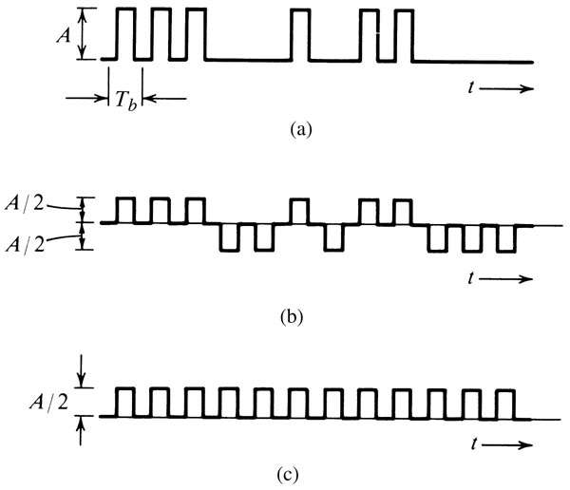
Digital Communication Systems
Regenerative Repeater
Used at regularly spaced interval.
Timing information extracted from the received signal.
Transparent line code does not effect the accuracy of the timing information.

Slide 6
Line Coding
Property of Line Code
Transmission Bandwidth
Power Efficiency
Error Detection and Correction Capacity
Favorable Power Spectral Density
Adequate Timing Content
Transparency

Slide 7
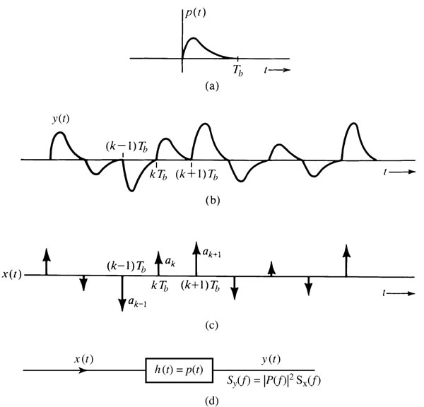
PSD of Line Codes
The PSD will depend on the line code pattern x(t) and the pulse shape p(t).
$$y\left(t\right)=\sum{a_{k}p\left(t−kT_{b}\right)}$$
$$S_{y}\left(f\right)={\left|P\left(f\right)\right|}^{2}S_{x}(f)$$

Slide 8
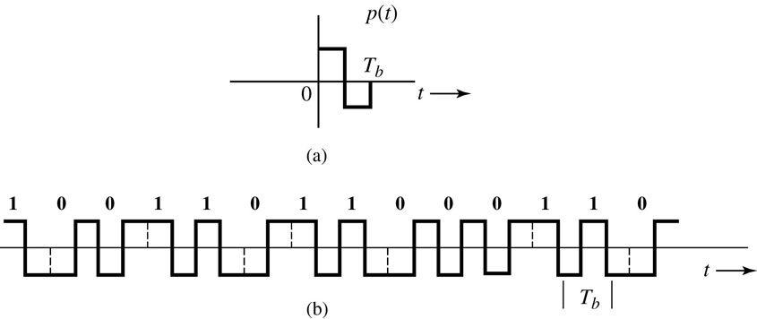
Constructing a DC Null in PSD by Pulse Shaping
Split-phase (Manchester or twinned-binary) signal.
Fig. a: Basic pulse p(t) for Manchester signaling.
Fig. b: Transmitted waveform for binary data sequence using Manchester signaling.
$$P(f)=\int_{−∞}^{∞}{p(t)e^{−j2πft}dt}$$
$$P(0)=\int_{−∞}^{∞}{p\left(t\right)dt=0}$$
Read On-Off Signaling

Slide 9
Pulse Shaping
The pulse shape p(t) effect the PSD S_{y}( f ) more than the choice of line code.
Intersymbol Interference (ISI): Spreading of a pulse beyond its allocated time interval T_{b} will cause it to interfere with neighboring pulses.

Slide 10
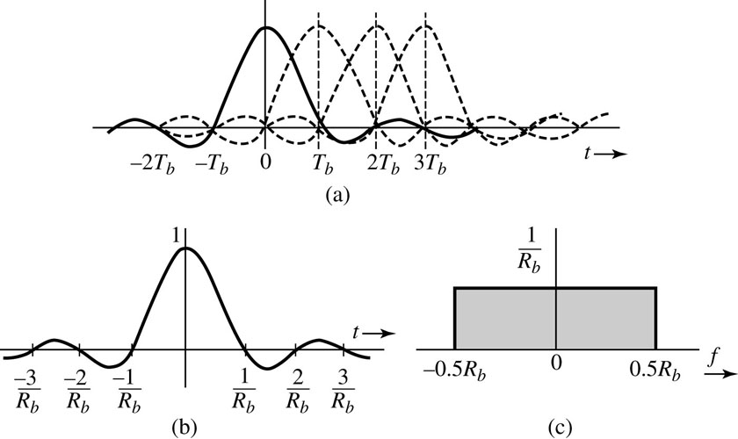
Nyquist 1st criteria for Pulse Shaping
Nyquist criteria for pulse shaping to eliminate ISI:
Pulse shape that has a nonzero amplitude at its center and zero amplitudes at t = ± nT_{b} (n =1, 2, 3, …)
$$p\left(t\right)=\left\{\begin{matrix}1 t=0 \\ 0 t=±nT_{b}\end{matrix}\right.$$
$$T_{b}=\frac{1}{R_{b}}$$

Slide 11
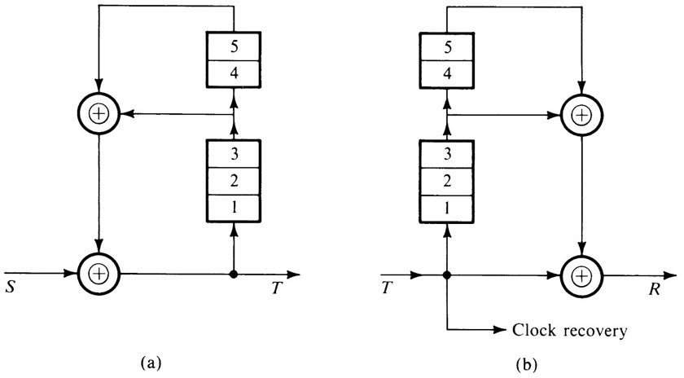
Scrambling
Scrambler tends to make the data more random by removing long strings of 1s and 0s. Removing long 0s or 1s help in timing extraction. However, the main purpose of scrambling is to prevent unauthorized access to the data.
$$T=S⨁D^{3}T⨁D^{5}T$$
$$S=T⨁(D^{3}T⨁D^{5}T)$$
Modulo
2 sum
XOR
00 0
01 1
1
0

Slide 12
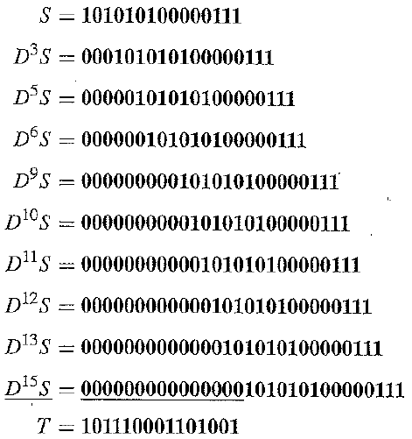
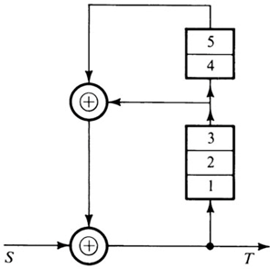
Scrambling Example
The data stream 101010100000111 is fed to the scrambler. Find the scrambler output T, assuming the initial content of the registers to be zero.

Slide 13
Scrambling Example
The data stream 101010100000111 is fed to the scrambler. Find the scrambler output T, assuming the initial content of the registers to be zero.
S 1 2 3 4 5 F T
1 0 0 0 0 0 0 1
0 1 0 0 0 0 0 0
1 0 1 0 0 0 0 1
0 1 0 1 0 0 1 1
1 1 1 0 1 0 0 1
0 1 1 1 0 1 0 0
1 0 1 1 1 0 1 0
0 0 0 1 1 1 0 0
0 0 0 0 1 1 1 1
0 1 0 0 0 1 1 1
0 1 1 0 0 0 0 0
0 0 1 1 0 0 1 1
F
T=101110001101001

Slide 14
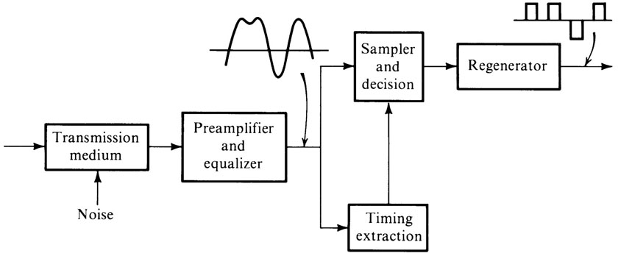
Digital Receivers and Regenerative Repeaters
Tasks of Receivers or repeaters:
Reshaping incoming pulses by means of an equalizer.
Extracting the timing information required to sample incoming pulses.
Making symbol detection decisions based on the pulse samples.

Slide 15
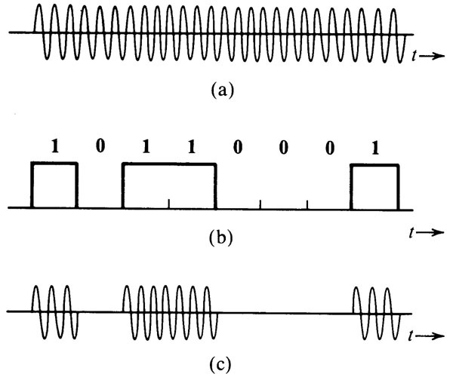
Digital Carrier Systems 6.8
In transmitting and receiving digital carrier signals, we need a modulator and demodulator to transmit and receive data. The two devices, modulator and demodulator are usually packaged in one unit called a modem for two-way (duplex) communication.
Amplitude Shift Keying (ASK)
The carrier cos ω_{c}t.
(b) The modulating signal m(t). (c) ASK: the modulated signal m(t) cos ω_{c}t.
$$φ_{ASK}\left(t\right)=A_{i}cos\left(ω_{c}t\right)$$

Slide 16
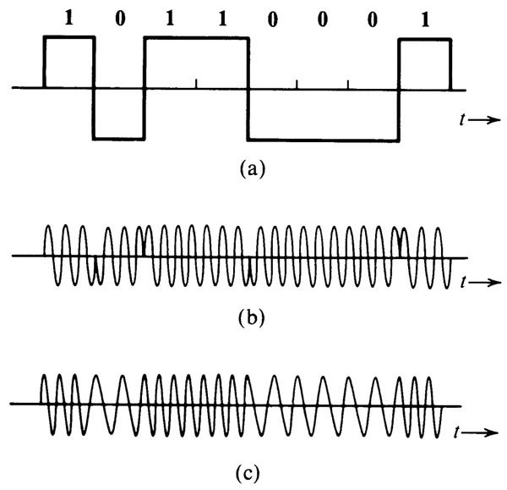
Digital Carrier Systems (Modulator)
Phase Shift Keying (PSK)
$$φ_{PSK}\left(t\right)=Acos\left(ω_{c}t+θ_{i}\right)$$
Frequency Shift Keying (FSK)
$$φ_{FSK}\left(t\right)=Acos\left((ω_{c}+iΔω)t\right)$$

Slide 17
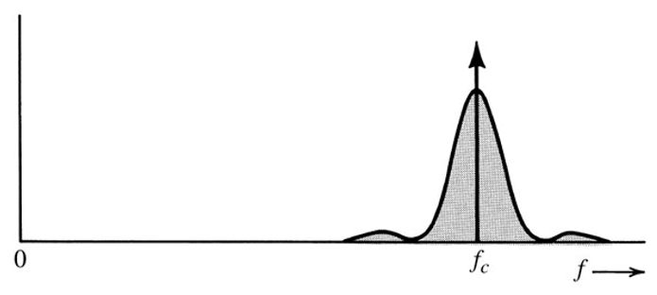
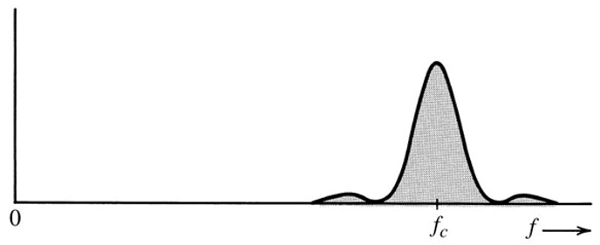
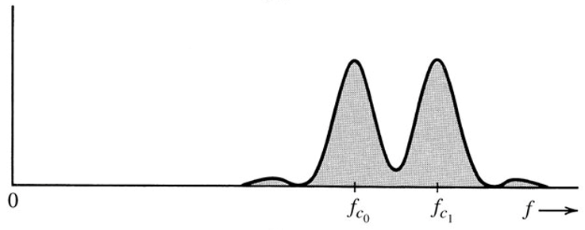
Spectrum of Modulated Digital Signals
ASK uses the highest PSD, but easy to demodulate but.
PSK uses the least PSD and bandwidth, but more complex in demodulation.
FSK uses the highest bandwidth, but easy to demodulate and more resilient to error.
PSD of ASK
PSD of PSK
PSD of FSK

Slide 18
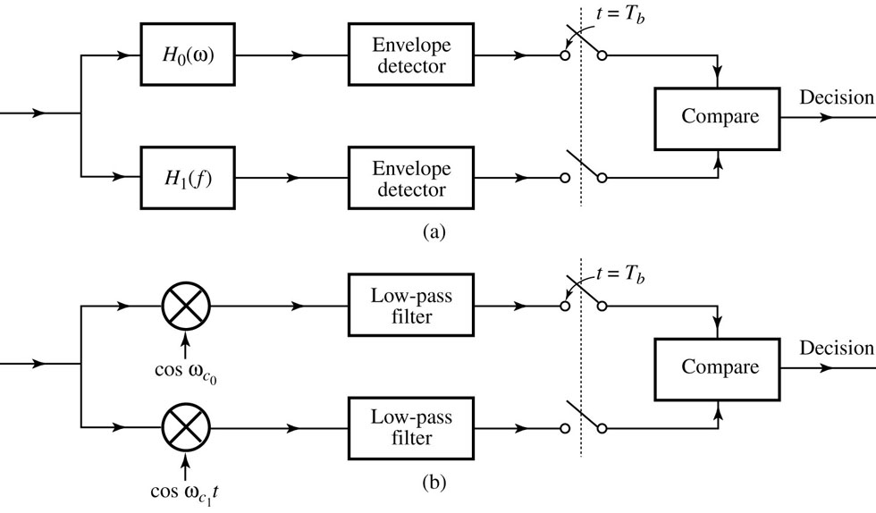
Digital Carrier Systems (Demodulator)
Noncoherent detection of FSK
Coherent detection of FSK
Coherent binary PSK detector

Slide 19
Differential PSK (DPSK)
DPSK allows noncoherent demodulation at the receiver.
A 0 is encoded by the same pulse used to encode the previous data bit (no transition), and a 1 is encoded by the negative of the pulse used to encode the previous data bit (transition).
The transmitter encodes the information data into the phase difference θ_{k} - θ_{k-1}. For example, a phase difference of zero represent 0 whereas a phase difference of π signifies 1.
Transmitter Encoding
q_{k}

Slide 20
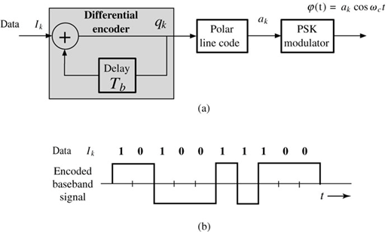
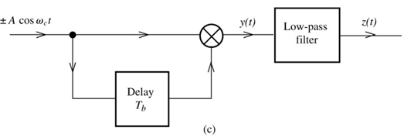
Differential PSK (DPSK)
Transmitter Encoding
Receiver Decoding

Slide 21
M-Ary Digital Carrier Modulation 6.9
Higher bit rate transmission can be achieved by either reducing T_{b} or by applying M-ary signaling; the first option requires more bandwidth; the second requires more power to keep the error bit rate within acceptable level.
M-ary shift keying can send Log₂ M bits each time by transmitting any one of M signals.
M-ary ASK and noncoherent Detection
$φ\left(t\right)=0, A cos ω_{c}t, 2A cos ω_{c}t,$ $…, \left(M−1\right)A cos ω_{c}t$
M-ary FSK and noncoherent Detection
$φ\left(t\right)=A cos {2πf}_{i}t$ where
$f_{i}=f_{1}+(m−1)δf$ and $i=1, 2, …, M$

Slide 22
Choice of the Frequencies for FSK
The choice of $δf$ will determine the performance and bandwidth of the FSK modulation.
$$∆f=\frac{f_{M}−f_{1}}{2}= \frac{1}{2}\left(M−1\right)δf$$
Large $δf$ leads to bandwidth waste, whereas small $δf$ is prone to detection error due to transmission noise interference.
To minimize error detection the choice of $f_{i}$ should be large enough to make the FSK modulating signals $A cos {2πf}_{i}t$ orthogonal over the period T_{b}.
$$\int_{0}^{T_{b}}{Acos\left(2πf_{m}t\right)Acos\left(2πf_{n}t\right)dt=0}$$
$$δf=\frac{1}{2T_{s}}=\frac{1}{2T_{b}\log_{2}M}Hz$$

Slide 23
Comparison between ASK and FSK
FSK does not require increase in power but the bandwidth increase linearly with M (compared with binary FSK or M-ary ASK).
ASK does not require increase in bandwidth but the power increase linearly with M.

Slide 24
M-ary PSK
$$φ_{PSK}\left(t\right)=A cos\left(ω_{c}t+θ_{m}\right)$$
$$m=1, 2, …, M$$
$$θ_{m}=θ_{0}+\frac{2π}{M}\left(m−1\right)$$
$$θ_{0}=\frac{2π}{M}$$
$$θ_{0}=180$$
$$θ_{0}=90$$
$$θ_{0}=45$$
M-ary PSK symbols in the orthogonal signal space: (a) M = 2; (b) M = 4; (c) M = 8.

Slide 25
M-ary PSK
$$φ_{PSK}\left(t\right)=a_{m}\sqrt{\frac{2}{T_{b}}} cos{ ω}_{c}t+b_{m}\sqrt{\frac{2}{T_{b}}} sin{ ω}_{c}t$$
$$0≤t<T_{b}$$
$$ψ_{1}\left(t\right)=\sqrt{\frac{2}{T_{b}}} cos{ ω}_{c}t$$
$$ψ_{2}\left(t\right)=\sqrt{\frac{2}{T_{b}}}sin{ ω}_{c}t$$
$$φ_{PSK}\left(t\right)=a_{m}ψ_{1}\left(t\right)+b_{m}ψ_{2}\left(t\right)$$
M-ary PSK symbols in the orthogonal signal space: (a) M = 2; (b) M = 4; (c) M = 8.

Slide 26
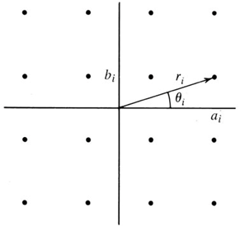
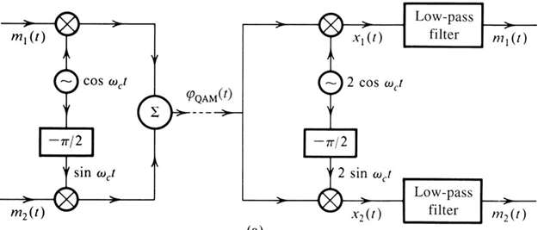
Quadrature Amplitude Modulation (QPSK)
$$p_{i}\left(t\right)=a_{i}p(t) cos{ ω}_{c}t+b_{i}p(t) sin{ ω}_{c}t$$
$$0≤t<T_{b}$$
$$p_{i}\left(t\right)=r_{i}p\left(t\right)cos{ (ω}_{c}t−θ_{i})$$
$$r_{i}=\sqrt{a_{i}^{2}+b_{i}^{2}}$$
$$θ_{i}=\tan^{−1}\frac{b_{i}}{a_{i}}$$
p(t) is a properly shaped baseband pulse.
A simple choice $p\left(t\right)=\sqrt{\frac{w}{T_{b}}}\left[u\left(t\right)−u(t−T_{b})\right]$
16-point QAM (M = 16)
QAM or Multiplexing

