Slide 1
Ch 7 Fundamentals of Probability Theory
ENGR 4323/5323
Digital and Analog Communication
School of Engineering University of Central Oklahoma
Dr. Mohamed Bingabr

Slide 2
Chapter Outline
Concept of Probability
Random Variables
Statistical Averages (MEANS)
Correlation
Linear Mean Square Estimation
Sum of Random Variables
Central Limit Theorem

Slide 3
Deterministic and Random Signals
Deterministic Signals: Signals that can be determined by mathematical equation or graph. It is possible to predict the future values with 100% certainty.
Random Process Signals: Unpredictable message signals and noise waveform. These type of signal are information-bearing signals and they play key roles in communications.

Slide 4
Concept of Probability
Experiment: In probability theory an experiment is a process whose outcome cannot be fully predicted. (Throwing a die)
Sample space: A set that contain all possible outcomes of an experiment. {1, 2, 3, 4, 5, 6}
Sample point (element): an outcome of an experiment. {3}
Event: A subset of the sample space that share some common characteristics. {2, 4, 6} even number
Complement of event A (A^{c}): Event containing all points not in A. {1, 3, 5}

Slide 5
Concept of Probability
Null event (ø): Event that has no sample point.
Union of events A and/or B (A U B): The event that contains all points in A or in B or in both.
Intersection (joint) of events A and B (A ∩ B, AB): The event that contain all points common to event A and B.
Mutually Exclusive: Events A and B are mutually exclusive if A occur then B can not occur.
Relative frequency and Probability: If event A is of interest and an experiment is conducted N times then the relative frequency of A occurrence (probability) is
$$f\left(A\right)=\lim_{N→∞}{\frac{N(A)}{N}}=P(A)$$

Slide 6
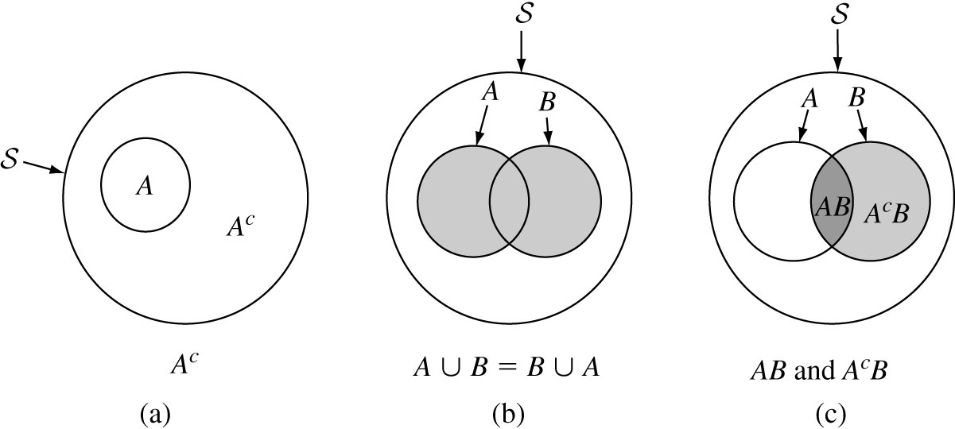
Concept of Probability
S
A
B

Slide 7
Concept of Probability
Joint Probability:
$P\left(A∪B\right)=P\left(A\right)+P\left(B\right)−P(A∩B)$
If A and B are mutually exclusive A ∩ B = ø then
$P\left(A∪B\right)=P\left(A\right)+P(B)$
Conditional Probability: the probability of one event is influenced by the outcome of another event.
$$P\left(A/B\right)=\frac{P(A∩B)}{P(B)}$$
Independent Events: The occurrence of one event is not influenced by the occurrence of the other event.
$$P\left(A∩B\right)=P\left(A\right)P\left(B\right)$$
$$P\left(A/B\right)=P(A)$$
A
B
S
A
B
S

Slide 8
Bernoulli Trials
Bernoulli trial is an experiment where there are two possible outcomes, success or failure. If the probability of success is p then the probability of failure is (1-p).
$$p(k \text{success} \text{in} \text{a} \text{specific} \text{order} \text{in} \text{n} \text{trials}\text{) = }p^{k}{(1−p)}^{n−k}$$
Number of way to arrange k success in n trials = $\left(\begin{matrix}n \\ k\end{matrix}\right)=\frac{n^{!}}{k^{!}{(n−k)}^{!}}$
$$p(k \text{success} \text{in} \text{n} \text{trials}\text{) =}\left(\begin{matrix}n \\ k\end{matrix}\right)p^{k}{(1−p)}^{n−k}$$
$$\text{ =}{\frac{n^{!}}{k^{!}{(n−k)}^{!}}p}^{k}{(1−p)}^{n−k}$$

Slide 9
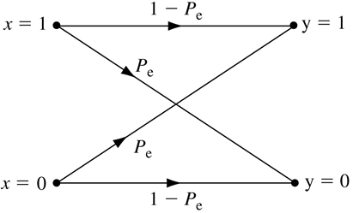
Example 1
A binary symmetric channel (BSC) has an error probability P_{e} = 0.001 (i.e., the probability of receiving 0 when 1 is transmitted, or vice versa). Note that the channel behavior is symmetrical with respect to 0 and 1. A sequence of 8 binary digits is transmitted over this channel. Determine the probability of receiving exactly 2 digits in error.
R=[0 1 1 1 0 1 0 0]
T = [0 1 1 1 0 1 0 0]
R=[0 0 1 1 0 1 1 0]
R=[0 1 1 0 1 1 1 0]
R=[0 1 1 1 0 1 0 1]
Ans = 27.832 * 10⁻⁶

Slide 10
Example 2
In binary communication, one of the techniques used to increase the reliability of a channel is to repeat a message several times. For example, we can send each message (0 or 1) three times. Hence, the transmitted digits are 000 (for message 0) or 111 (for message 1). Because of channel noise, we may receive any one of the eight possible combinations of three binary digits. The decision as to which message is transmitted is made by the majority rule. If P_{e} is the error probability of one digit, and P(ϵ) is the probability of making a wrong decision in this scheme. Find P(ϵ) in term of P_{e}. If P_{e} = 0.01 then what is P(ϵ) ?
Ans = ${3P}_{e}^{2}−{2P}_{e}^{3}$

Slide 11
Multiplication Rule for Conditional Probability
$$P\left(A∩B\right)=P\left(A\right)P\left(B/A\right)$$
$$P\left(A_{1}A_{2}…A_{n}\right)=P\left(A_{1}\right).P\left(A_{2}/A_{1}\right).P\left(A_{3}/A_{1}A_{2}\right)…P\left(A_{n}/A_{1}A_{2}…A_{n−1}\right)$$
Example
Suppose a box of diodes consist of N_{g} good diodes and N_{b} bad diodes. If five diodes are randomly selected, one at a time, without replacement, determine the probability of obtaining the sequence of diodes in the order of good, bad, good, good, bad.

Slide 12
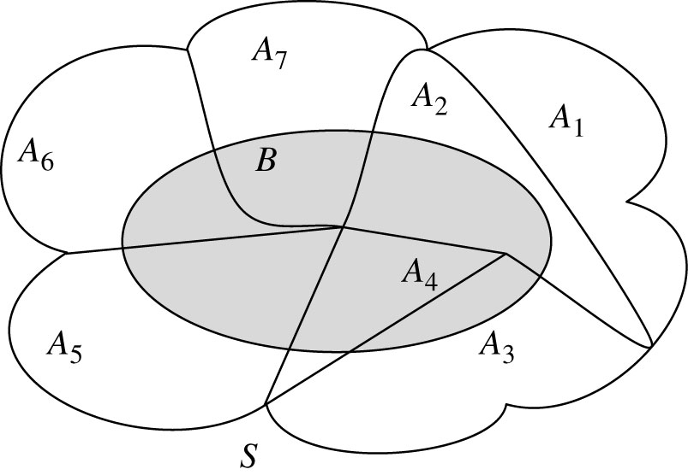
The Total Probability Theorem
Let n disjoint events A₁, …, A_{n} from a partition of the sample spaces S such that
$$\bigcup_{i=1}^{n}{A_{i}}=S \text{and} A_{i}∩A_{j}=∅, \text{if} i≠j$$
Then the probability of an event
B can be written as
$$P(B)=\sum_{i=1}^{n}{P(B/A_{i})P(A_{i}) }$$
This theorem simplifies the analysis of the more complex events of interest, B, by identifying all different causes A_{i}.

Slide 13
Example
A communication system always encounter one of three possible interference waveforms: F₁, F₂, or F₃. The probability of each interference is 0.8, 0.16, and 0.04, respectively. The communication system fails with probability 0.01, 0.1, and 0.4 when it encounters F₁, F₂, and F₃, respectively. Find the probability of system failure P(B).
$$P(B)=\sum_{i=1}^{n}{P(B/E_{i})P(E_{i}) }$$

Slide 14
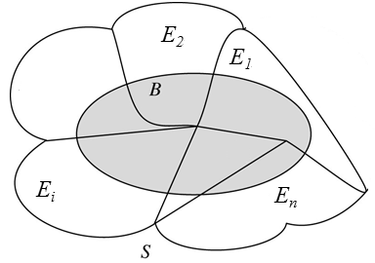
Example
The decoding of a data packet may be in error because of N distinct error patterns E₁, E₂, …, E_{n} it encounters. These error patterns are mutually exclusive, each with probability P(E_{i}) = p_{i}. When the error pattern E_{i} occurs, the data packet would be incorrectly decoded with probability q_{i}. Find the probability that the data packet is incorrectly decoded.
$$P(B)=\sum_{i=1}^{n}{P(B/E_{i})P(E_{i}) }$$

Slide 15
Baye’s Theorem
Baye’s theorem determines the likelihood of a particular cause of an event among many disjoint possible causes.
Theorem
Let n disjoint events A₁, …, A_{n} form a partition of the sample space S. Let B be an event with P(B) >0. Then for j=1, …, n,
$$P(A_{j}/B)=\frac{P\left(B/A_{j}\right)P(A_{j})}{P(B)}=\frac{P\left(B/A_{j}\right)P(A_{j})}{\sum_{i=1}^{n}{P(B/A_{i})P(A_{i}) }}$$

Slide 16
Example
A communication system always encounter one of three possible interference waveforms: F₁, F₂, or F₃. The probability of each interference is 0.8, 0.16, and 0.04, respectively. The communication system fails with probability 0.01, 0.1, and 0.4 when it encounters F₁, F₂, and F₃, respectively. Given that the system has failed, find the probability that the failure is a result of F₁, F₂, or F₃, respectively.
$$P(A_{j}/B)=\frac{P\left(B/A_{j}\right)P(A_{j})}{P(B)}=\frac{P\left(B/A_{j}\right)P(A_{j})}{\sum_{i=1}^{n}{P(B/A_{i})P(A_{i}) }}$$

Slide 17
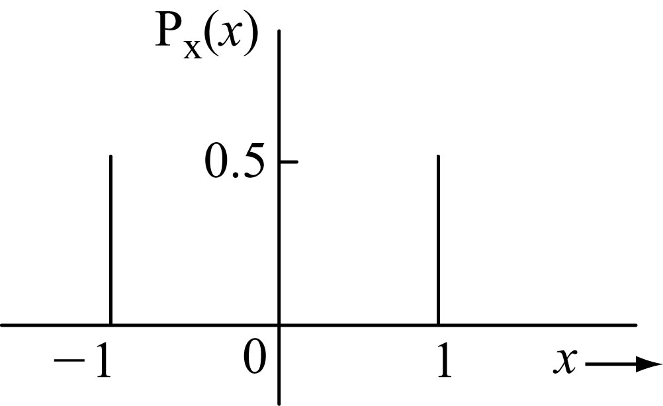
Random Variable
A discrete random variable has numerical values that resulted from mapping sample points (outcomes of experiment) to these numbers.
The outcomes of tossing a coin are {H, T} we can assign 1 for head and -1 for tail. The random variable X = {1, -1}
T
H
$$\sum_{i}{P_{x}\left(x_{i}\right)=1}$$

Slide 18
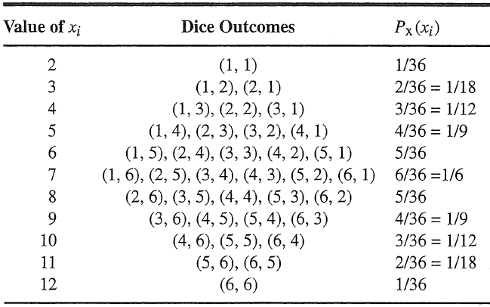
Random Variable
Two dice are thrown. The sum of the points appearing on the two dice is an RV x. Find values taken by x, and the corresponding probabilities.

Slide 19
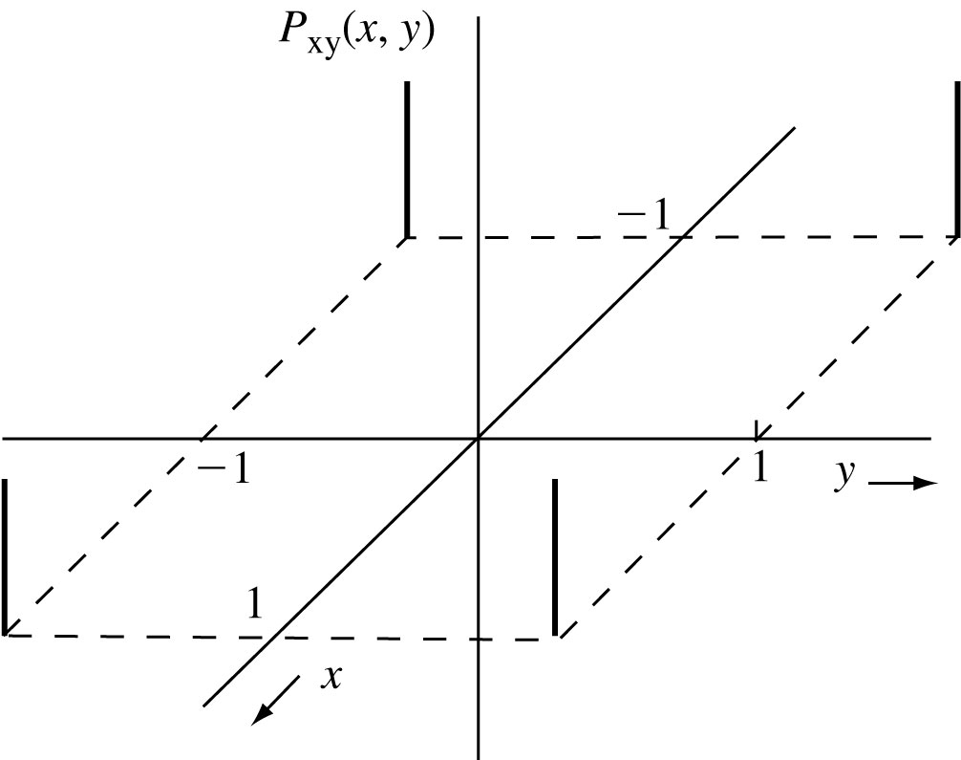
Random Variable
For two independent random variables X and Y (tossing two coins):
$$P_{xy}\left(x_{i},y_{j}\right)=P_{x}\left(x_{i}\right)P_{y}\left(y_{j}\right)$$
TH
TT
$$\sum_{i}{\sum_{j}{P_{xy}\left(x_{i},y_{j}\right)=1}}$$
HT
HH

Slide 20
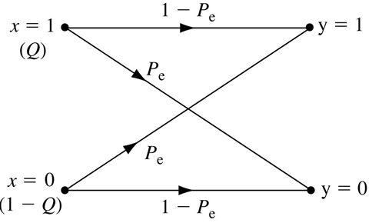
Conditional Probabilities
If x and y are two RVs, then the conditional probability of x = x_{i} given y = y_{j} is denoted by P_{x|y}(x_{i}|y_{j})
$$P_{y}(y_{j})=\sum_{i}{P_{xy}(x_{i},y_{j})}$$
$$P_{x}\left(x_{i}\right)=\sum_{j}{P_{xy}(x_{i},y_{j})}$$
$$P_{y}\left(y_{j}\right)=\sum_{i}{P_{y|x}\left(y_{j} | x_{i}\right)P_{x}\left(x_{i}\right)}$$
$$P_{x}\left(x_{i}\right)=\sum_{j}{P_{x|y}\left(x_{i} | y_{j}\right)P_{y}\left(y_{j}\right)}$$

Slide 21
Example
A binary symmetric channel (BSC) error probability is P_{e}. The probability of transmission 1 is Q, and that of transmitting 0 is 1-Q. Determine the probability of receiving 1 and 0 at the receiver.
$$P_{y}\left(y_{j}\right)=\sum_{i}{P_{y|x}\left(y_{j} | x_{i}\right)P_{x}\left(x_{i}\right)}$$

Slide 22
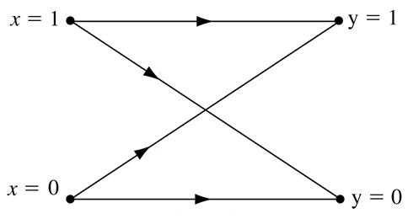
Example
Over a certain binary communication channel, the symbol 0 is transmitted with probability 0.4 and 1 is transmitted with probability 0.6. It is given that P(ϵ|0) = 10⁻⁶ and P(ϵ|1) = 10⁻⁴, where P(ϵ|x_{i}) is the probability of detecting the error given that x_{i} is transmitted. Determine P(ϵ), the error probability of the channel.
$$P\left(\text{ϵ}\right)=\sum_{i}{P_{\text{ϵ}|x}\left(\text{ϵ} | x_{i}\right)P_{x}\left(x_{i}\right)}$$
P(ϵ|1)
P(ϵ|0)

Slide 23
Cumulative Distribution Function (CDF)
A CDF, F_{x}(x), of an RV X is the probability that X takes a value less than or equal to x.
Property of CDF
F_{x}(x) ≥0
F_{x}(∞) = 1
F_{x} (-∞)=0
F_{x}(x) is a nondecreasing function.

Slide 24
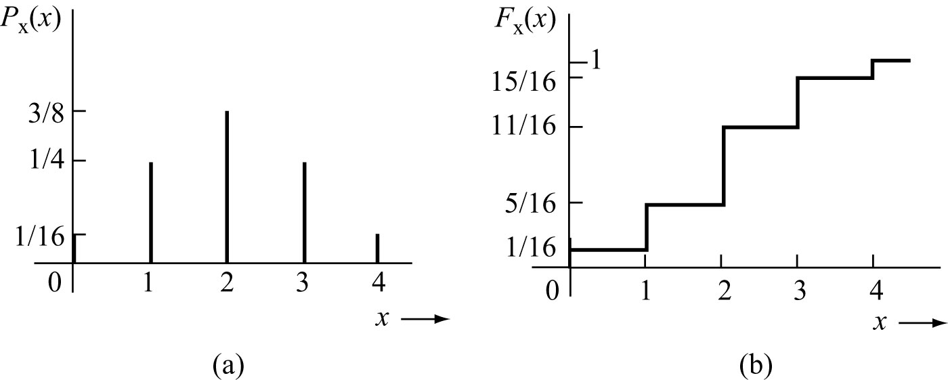
Example
In an experiment, a trial consists of four successive tosses of a coin. If we define an RV x as the number of heads appearing in a trial, determine P_{x}(x) and F_{x}(x).

Slide 25
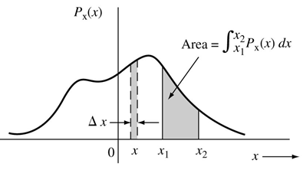
Continuous Random Variable
The random variable has continuous value.
p_{x}(x) is the probability density function (pdf) that describes the relative frequency of occurrence of different values of x.
Properties of the probability density function:
$$\int_{−∞}^{∞}{p_{x}\left(x\right)dx}=1$$
$$p_{x}\left(x\right)≥0$$
$$F_{x}\left(x\right)=\int_{−∞}^{x}{p_{x}\left(u\right)du}=1$$
Cumulative distribution function:
$$p_{x}\left(x\right)=\frac{dF_{x}\left(x\right)}{dx}$$
$$P\left(x_{1}<x≤x_{2}\right)=\int_{x_{1}}^{x_{2}}{p_{x}\left(x\right)dx=F_{x}(x_{2})}−F_{x}(x_{1})$$

Slide 26
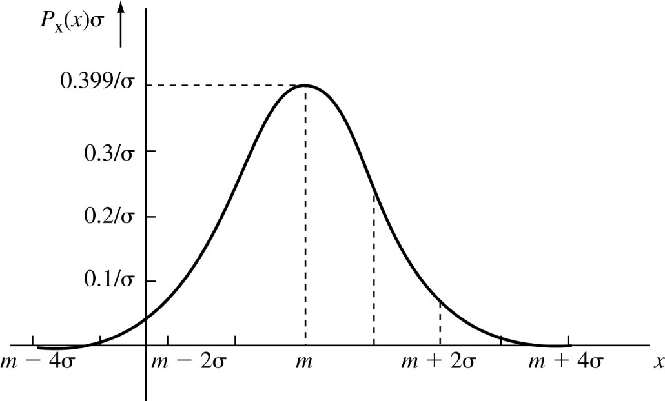
The Gaussian (Normal) Random Variable
General Gaussian RV (µ , σ)
$$p_{x}\left(x\right)=\frac{1}{σ\sqrt{2π}}e^{−{(x−m)}^{2}/2σ^{2}}$$
$$F_{x}\left(x\right)=\frac{1}{σ\sqrt{2π}}\int_{−∞}^{x}{e^{−{(x−m)}^{2}/2σ^{2}}dx}$$
$$F_{x}\left(x\right)=P\left(\text{x}≤x\right)=1−Q\left(\frac{x−m}{σ}\right)$$
$$P\left(\text{x}>x\right)=Q\left(\frac{x−m}{σ}\right)$$

Slide 27
Example
Over a certain binary channel, message m = 0 and 1 are transmitted with equal probability by using a positive and negative pulse, respectively. The received pulse corresponding to 1 is p(t), shown in the figure, and the received pulse corresponding to 0 is –p(t). Let the peak amplitude of p(t) be A_{p} at t = T_{p}. The channel noise n(t) has a normal distribution with zero mean and $σ_{n}$ standard deviation. Because of the channel noise, the received pulse will be
What is the probability of error P_{e}.
$$r\left(t\right)=±p\left(t\right)+n(t)$$

Slide 28
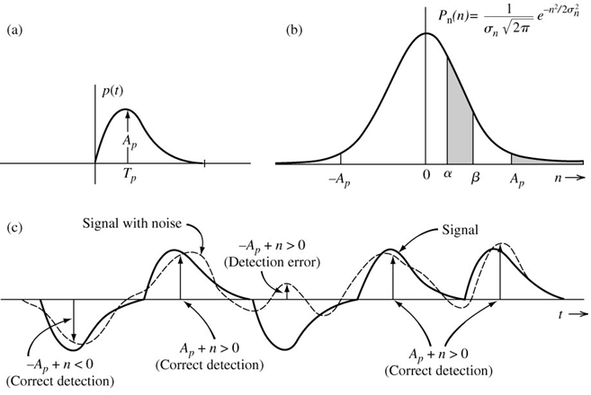
Example (cont.)
$$P_{e}=\sum_{i}{P(ε,m_{i})}$$
$$P_{e}=\sum_{i}{P(ε|m_{i})P(m_{i})}$$
$P_{e}=P\left(ε | 0\right)P\left(0\right)+P(ε|1)$ $P(1)$
$$P\left(ε | 0\right)=P\left(n>A_{P}\right)=Q\left(\frac{A_{p}}{σ_{n}}\right)$$
$$P\left(ε | 1\right)=P\left(n<−A_{P}\right)=Q\left(\frac{A_{p}}{σ_{n}}\right)$$
$$P_{e}=Q\left(\frac{A_{p}}{σ_{n}}\right)$$

Slide 29
Statistical Averages (MEANS)
The average value or expected value of RV x
$$\overline{x}=E[x]=\sum_{i=1}^{n}{x_{i}P_{x}(x_{i})}$$
$$\overline{x}=E[x]=\int_{−∞}^{∞}{xp_{x}\left(x\right)dx}$$
Mean of a function g(x) of a random variable x
$$\overline{g(x)}=\sum_{i=1}^{n}{{g(x}_{i})P_{x}(x_{i})}$$
The random variable x can be the alphabetic letters and the function could be the PCM
$$\overline{g(x)}=\int_{−∞}^{∞}{g(x)p_{x}\left(x\right)dx}$$

Slide 30
Statistical Averages (MEANS)
Mean of the Sum
$\overline{x+y}=\overline{x}$ + $\overline{y}$
Mean of the product
$$\overline{g_{1}(x)g_{2}(y)}=\int_{−∞}^{∞}{\int_{−∞}^{∞}{g_{1}(x)g_{2}(y)p_{xy}\left(x,y\right)dxdy}}$$
If RVs x and y are independent, then
$\overline{xy}=\overline{x}$ $\overline{y}$
$$\overline{g_{1}(x)g_{2}(x)}=\int_{−∞}^{∞}{g_{1}(x)p_{x}\left(x\right)dx\int_{−∞}^{∞}{g_{2}(y)p_{y}\left(y\right)dy}}$$

Slide 31
Moments
The nth moment of an RV x
$$\overline{x^{n}}=\int_{−∞}^{∞}{x^{n}p_{x}\left(x\right)dx}$$
The nth central moment of an RV x
$$\overline{{(x−\overline{x})}^{n}}=\int_{−∞}^{∞}{{(x−\overline{x})}^{n}p_{x}\left(x\right)dx}$$
The variance $σ_{x}^{2}$ and standard deviation $σ_{x}$
$$σ_{x}^{2}=\overline{{(x−\overline{x})}^{2}} =\overline{x^{2}}−{\overline{x}}^{2}$$

Slide 32
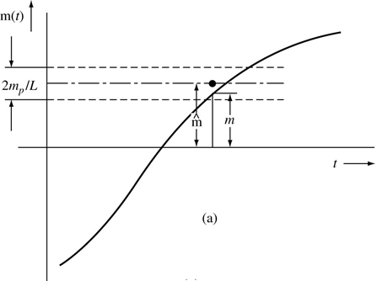
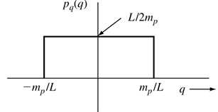
Example
Find the mean, variance, and the Mean Square of the Uniform Quantization Error in PCM.

