Slide 1
Digital Signal Processing ENGR 4333/5333
Prof. Mohamed Bingabr
School of Engineering
University of Central Oklahoma

Slide 2
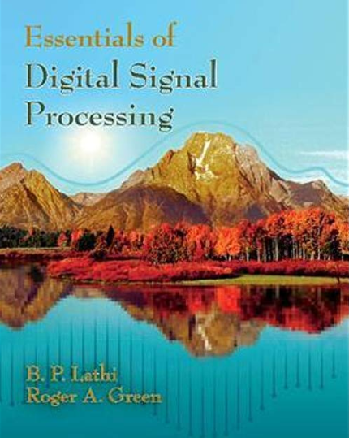
Course Materials
Textbook: “Essentials of Digital Signal Processing”, by Lathi and Green. ISBN: 978-1-107-05932-0
Course Website: http://www.engineering.uco.edu/~mbingabr

Slide 3
Course Information
Instructor: Mohamed Bingabr, Prof. of Engineering.
Office Location: Howell Hall 221C
Phone: (405) 974 5718
Email: mbingabr@uco.edu
Course Meeting Time: TR 5:30 – 6:45 pm
Course Meeting Location: HOH 201
Office Hours: MW 10:15 –11:30 am, T 1:00 to 2:00pm, and by appointment.

Slide 4
Grading Policy
Grading Distribution:
Attendance 10 %
Homework 10 %
Quizzes 30 %
2 Tests 30 %
Final Exam 20 %
Grading Scale:
A: 90-100
B: 80-89
C: 70-79
D: 60-69
F: 0-59

Slide 5
Course Expectations & Conducts
Spend a total of 6 to 8 hours a week.
Ask for help for homework but don’t copy.
You can’t use unallowed resources during quizzes and tests.
You are allowed to have the formula sheet on the course website and 2 page of your own for quizzes and tests.
Makeup test will be given for emergency situation.
Please don’t use the phone or the internet during lecture.
Be on time for the lecture and do your best to stay focus.

Slide 6
Course Outline
• Review Continuous-Time Signals and Systems
• Sampling
• Discrete-Time Signals and Systems
- System modeling and difference equation
• Time-Domain Analysis of Discrete-Time Systems
- Zero-input & Zero-state response
• Discrete-Time System Analysis using the z-Transform
- Transfer function H(z)
• Discrete-Time Fourier Analysis
- Frequency response H(Ω)
• Digital Filters
- IIR and FIR
• Discrete Fourier Transform H(k)

Slide 7
To Do Well in This Course
Focus on lectures & problems solved in the lecture.
Do and understand the homework problems.
Use the video resources
Enjoy and reflect on the physical meaning of the equations.
Study and do homework first and then socialize and have fun.

