Slide 1
Continuous-Time Analog Filters
ENGR 4333/5333: Digital Signal Processing
Chapter 1 and 2
Dr. Mohamed Bingabr
University of Central Oklahoma

Slide 2
Outline Review
Fourier Series (Section 1.7)
Fourier Transform (Section 1.8)
Laplace Transform (Section 1.10)
Frequency Response of and LTIC System (Section 2.1)
Signal Transmission through LTIC Systems (Section 2.2)

Slide 3
1.7 The Fourier Series

Slide 4
The Fourier Series
The exponential Fourier series representation of a periodic signal with fundamental frequency ω_{o}.
$$x\left(t\right)=\sum_{k=−∞}^{∞}{X_{k}e^{jkω_{o}t}}$$
Note:
X_{k} is equivalent to D_{n} in signals and systems.
The Fourier series coefficient X_{k}.
$$X_{k}=\frac{1}{T_{0}}\int_{T_{0}}{x(t)e^{−j{kω}_{o}t}dt}$$
The compact trigonometric Fourier series representation of periodic.
$$x\left(t\right)=C_{0}+\sum_{k=1}^{∞}{C_{k}cos\left({kω}_{o}t+θ_{k}\right)⁡}$$
where C₀ = X₀ , C_{k} = 2|X_{k}| , and θ_{k} =∠ X_{k}

Slide 5
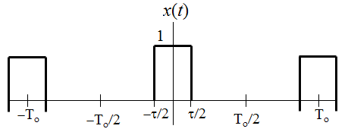
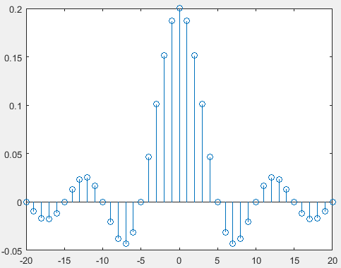
Fourier Series of Pulse Train
Find the Fourier series representation of the periodic signal x(t) below.
A=
Answer:
$$X_{k}=\frac{Aτ}{T_{0}}sinc\left(\frac{{kω}_{o}τ}{2π}\right)$$
$$T0=0.5π$$
$$x\left(t\right)=\sum_{k=−∞}^{∞}{\frac{Aτ}{T_{0}}sinc\left(\frac{{kω}_{o}τ}{2π}\right)e^{jkω_{o}t}}$$
$$τ=0.1π$$
$$x\left(t\right)=\frac{Aτ}{T_{0}}+\sum_{k=1}^{∞}{\frac{2Aτ}{T_{0}}sinc\left(\frac{{kω}_{o}τ}{2π}\right)cos\left({kω}_{o}t+θ_{k}\right)⁡}$$
$$sinc\left(x\right)=\frac{sin⁡(πx)}{πx}$$

Slide 6
Fourier Series of Impulse Train
Find the Fourier series representation of the periodic signal x(t) = $δ_{T_{0}}(t)$.
x(t)
Answer:
$$X_{k}=\frac{1}{T_{0}}$$
-2T₀
-T₀
T₀
2T₀
$$x\left(t\right)=\frac{1}{T_{0}}\sum_{k=−∞}^{∞}{e^{jkω_{o}t}}$$
$$x\left(t\right)=\frac{1}{T_{0}}+\sum_{k=1}^{∞}{\frac{2}{T_{0}}cos\left({kω}_{o}t\right)⁡}$$

Slide 7
1.8 The Fourier Transform

Slide 8
Fourier Transform
The Fourier transform of a signal represent the spectrum of the signal.
$$X(ω)=\int_{−∞}^{∞}{x(t)e^{−jωt}dt}$$
|X(ω)|
The inverse Fourier transform of the spectrum of the signal.
$$x(t)=\frac{1}{2π}\int_{−∞}^{∞}{X(ω)e^{jωt}dω}$$
ω

Slide 9
Fourier Transform of a Rectangular Pulse
Find the Fourier transform of the rectangular pulse x(t) = $Π\left(\frac{t}{τ}\right)$
Answer:
$$X(ω)=τsinc\left(\frac{τω}{2π}\right)$$
Modulation Property: $x\left(t\right)\cos\left(ω_{o}t\right) \underset{↔}{ FT } \frac{1}{2}\left[X\left(ω+ω_{o}\right)+X\left(ω−ω_{o}\right)\right]$
$$Π\left(\frac{t}{τ}\right)\cos\left(ω_{o}t\right)$$
$${x_{s}\left(t\right)=x\left(t\right)δ}_{T_{0}}\left(t\right)=\frac{1}{T_{0}}x\left(t\right)+\sum_{k=1}^{∞}{\frac{2}{T_{0}}cos\left({kω}_{o}t\right)x\left(t\right)⁡}$$
Sampling Theorem:
What is the spectrum of a sampled rectangular pulse?

Slide 10
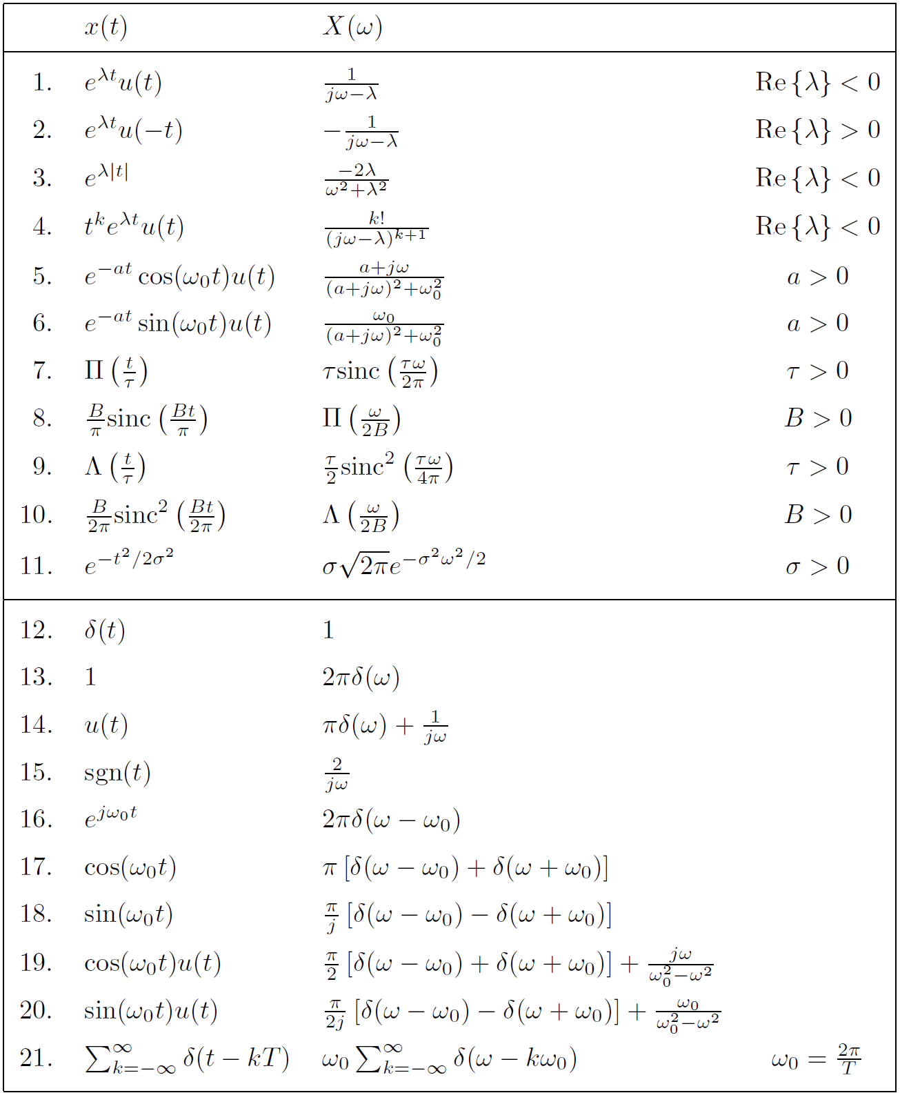
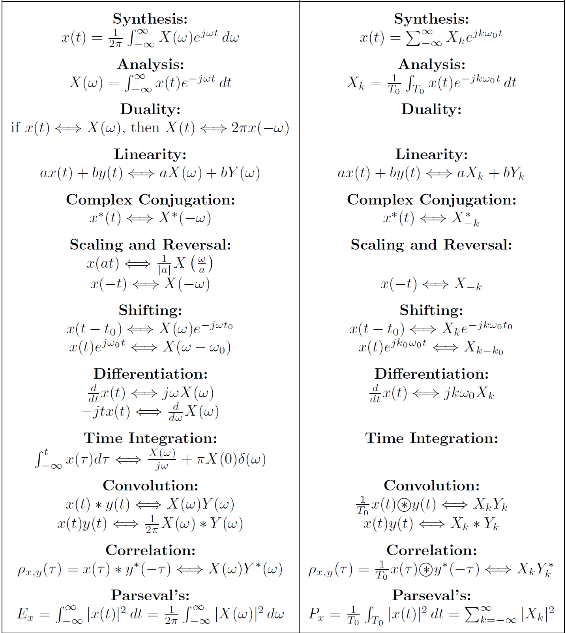

Slide 11
1.10 The Laplace Transform

Slide 12
The Laplace Transform
The Laplace transform of a signal represent the complex spectrum of the signal.
$$X(s)=\int_{−∞}^{∞}{x(t)e^{−st}dt}$$
s-plane: |X(s)|
jω
Where s is the complex frequency s = σ + jω.
σ
The inverse Laplace transform of X(s).
$$x(t)=\frac{1}{2πj}\int_{σ−j∞}^{σ+j∞}{X(s)e^{st}ds}$$
Use partial fraction expansion and the table to find the inverse Laplace transform

Slide 13
The Laplace Transform of a Unit Step Function
s-plane: |X(s)|
Find the Laplace transform of x(t) = u(t)
jω
Answer:
$$X(s)=\frac{1}{s}$$
ROC Re{s} > 0
σ
Note: X(ω) can be obtained from X(s) by setting σ = 0 and the ROC of X(s) include the jω axis.
$$e^{λt}u\left(t\right) \underset{↔}{ LT } \frac{1}{s−λ}$$
$$e^{λt}u\left(t\right) \underset{↔}{ FT } \frac{1}{jω−λ}$$
Re{s} > λ

Slide 14
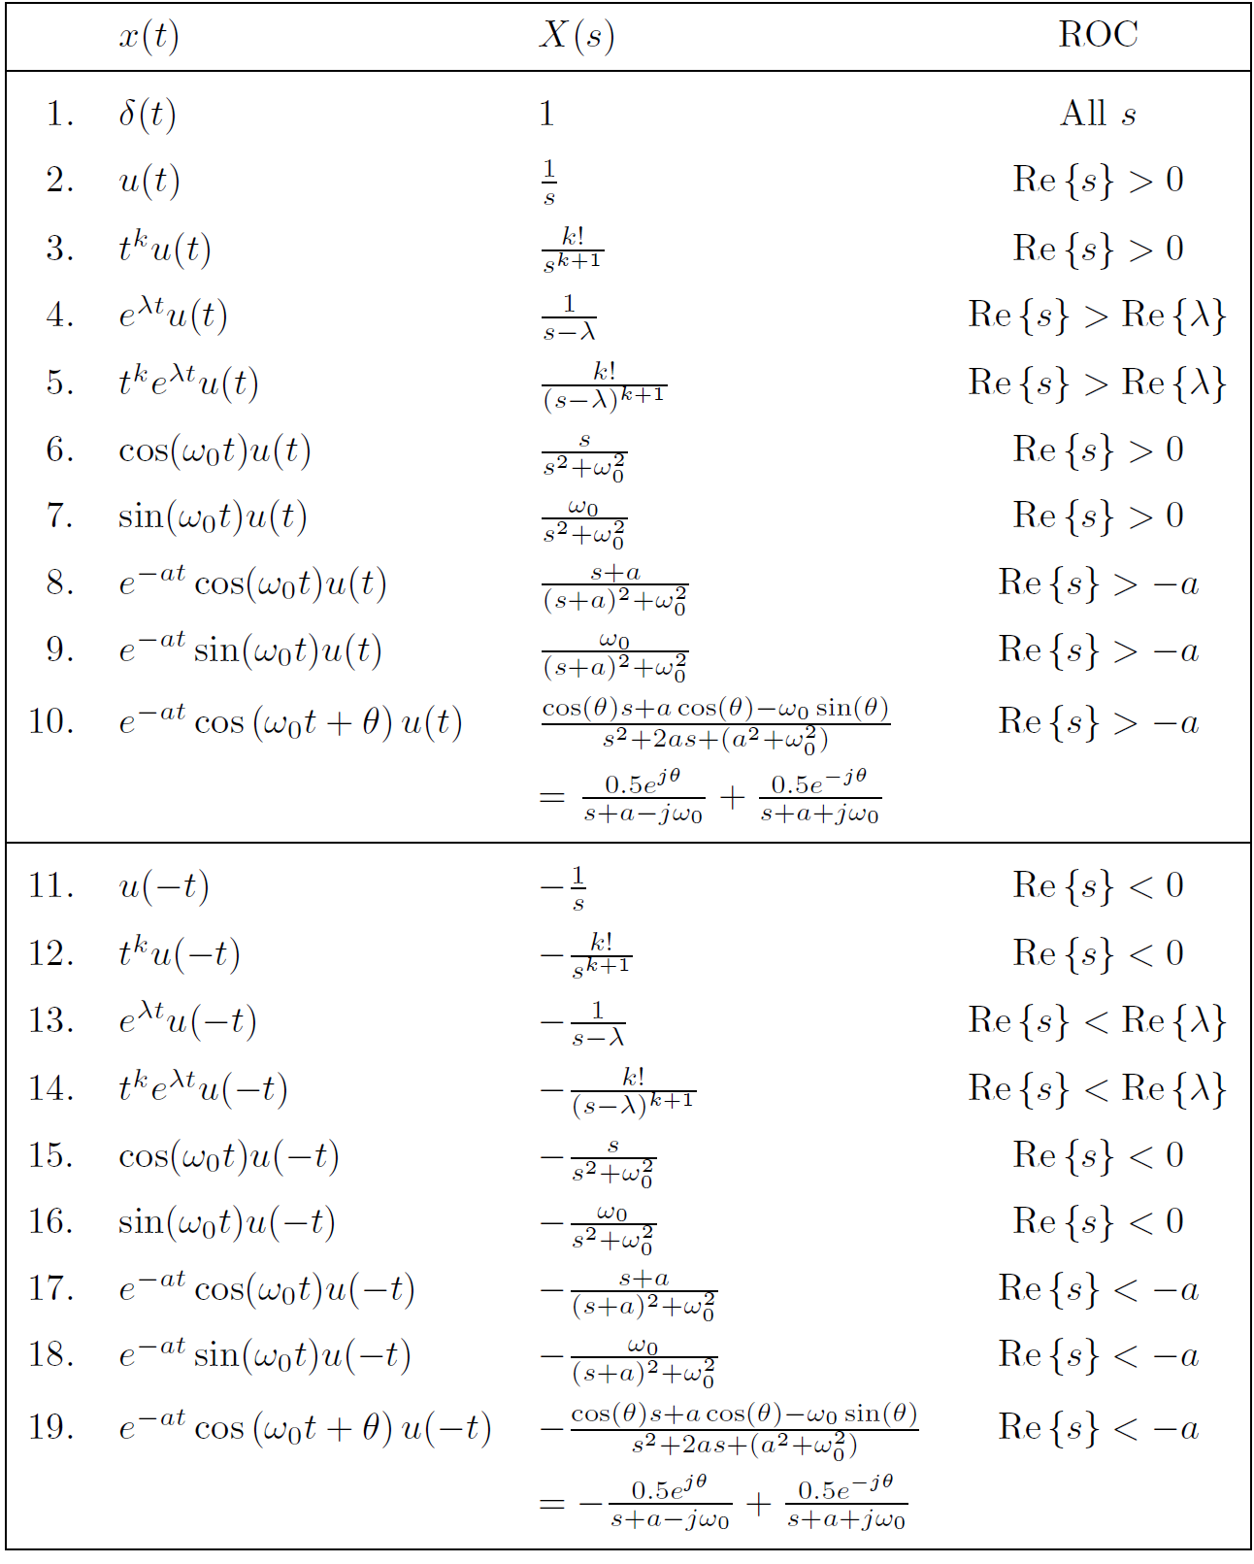
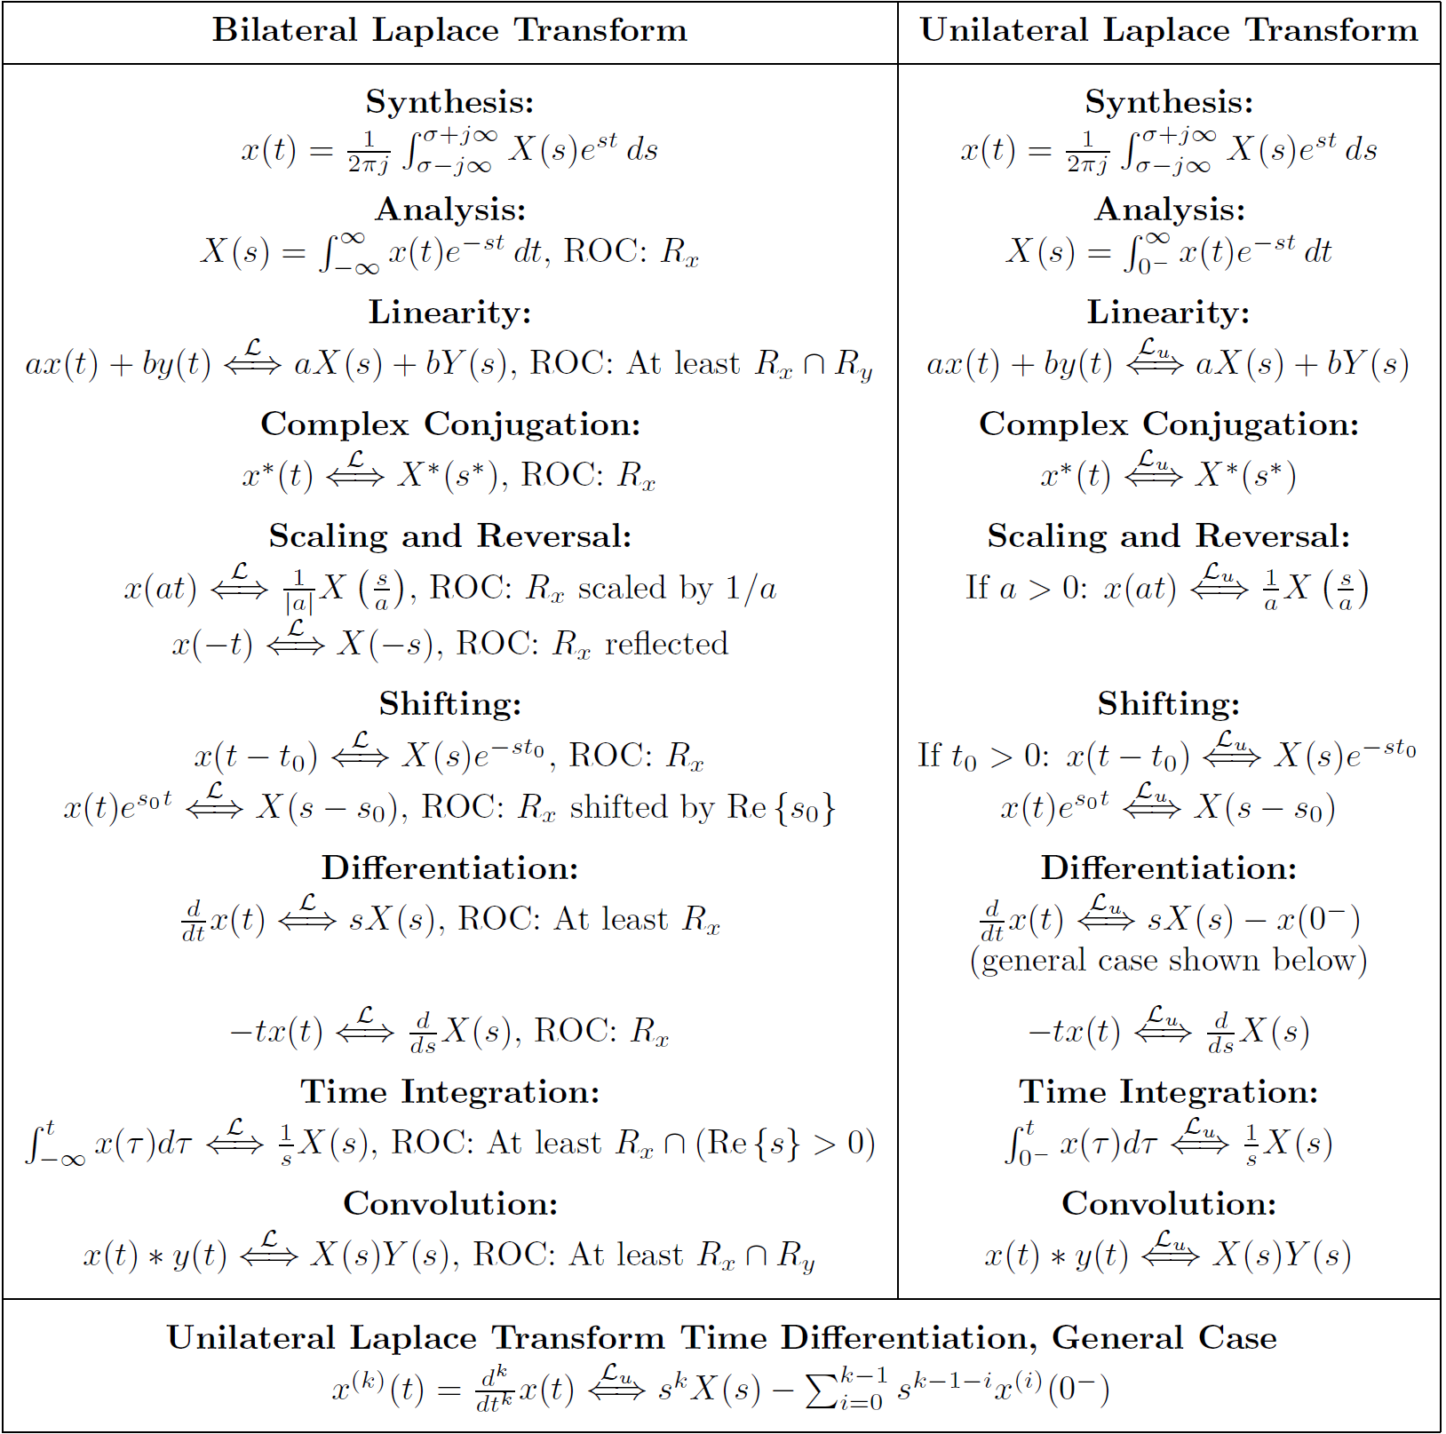

Slide 15
2.1 Frequency Response of an LTIC System

Slide 16
Frequency Response of an LTIC System
Time Domain
δ (t)
y(t)=h(t)
h(t)
x(t)
y(t) = x(t) ∗ h(t)
Laplace Domain
X(s)
H(s)
Y(s) = X(s) H(s)
$${x\left(t\right)=e}^{s_{o}t}$$
$${y\left(t\right)=H\left(s_{o}\right)e}^{s_{o}t}$$
Frequency Domain
X(ω)
Y(ω) = X(ω) H(ω)
H(ω)
$${x\left(t\right)=e}^{jω_{o}t}$$
$${y\left(t\right)=H\left(ω_{o}\right)e}^{jω_{o}t}$$
$$x\left(t\right)=Acos\left(ω_{o}t+θ\right)$$
$$y\left(t\right)=\left\lceil H\left(ω_{o}\right)\right\rceil Acos\left(ω_{o}t+θ+∠H\left(ω_{o}\right)\right)$$

Slide 17
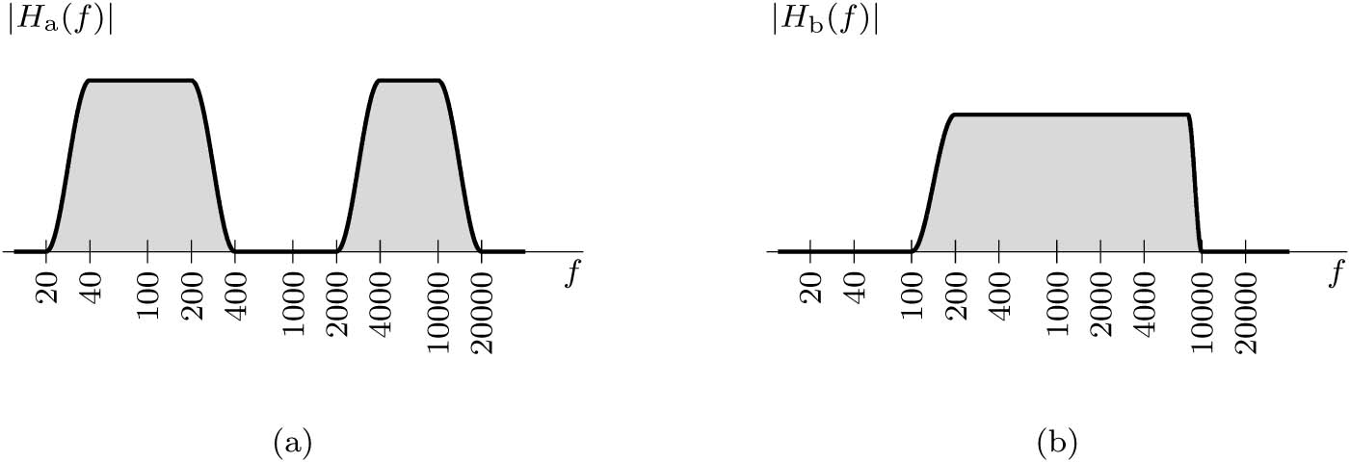
Time Domain Verses Frequency Domain
h(t)
H(ω)

Slide 18
Frequency Response of Common Systems
An Ideal Time Delay of T seconds
$$y\left(t\right)=x(t−T)$$
$${H\left(ω\right)=e}^{−jTω}$$
$$H\left(ω\right)=jω$$
An Ideal Differentiator
$$y\left(t\right)=\frac{dx}{dt}$$
$$y\left(t\right)=\int{x\left(τ\right)dτ}$$
$$H\left(ω\right)=1/jω$$
An Ideal Integrator

Slide 19
Pole-Zero Plots
LTIC system is described by the constant-coefficient linear differential Equation.
Example:
Find the transfer function H(s) and the frequency response H(ω) of the system described by the differential equation
$$\frac{d^{2}y}{{dt}^{2}}+2\frac{dy}{dt}+5y=2\frac{dx}{xt}$$
Answer:
$$H\left(s\right)=\frac{2s}{s^{2}+2s+5}$$

Slide 20
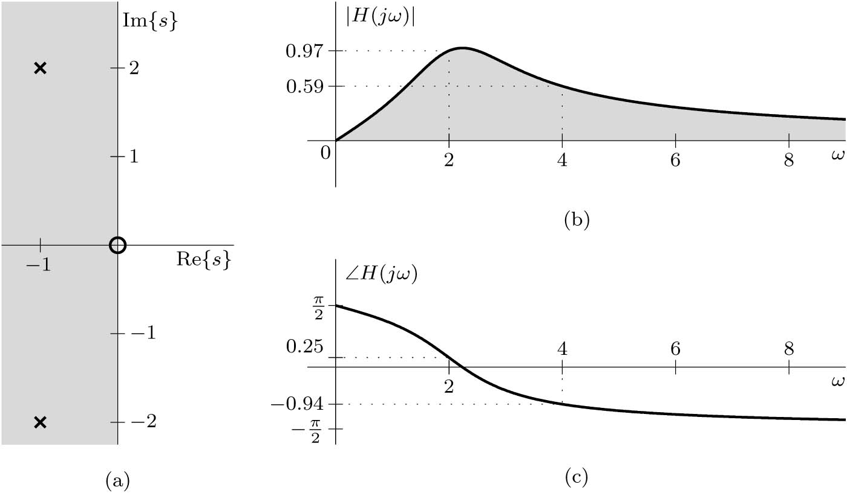
Example
$$H\left(s\right)=\frac{2s}{s^{2}+2s+5}$$
Consider a system whose transfer function is
Determine and plot the poles and zeros of H(s), and use the pole-zero information to predict
overall system behavior. Confirm this predicted behavior by computing and graphing the system’s frequency response (magnitude and phase). Lastly, find and plot the system response y(t) for the inputs (a) x_{a}(t) = cos(2t) (b) x_{b}(t) = 2sin(4t − π/3)

Slide 21
Continue Example
For input x_{a}(t) = cos(2t)
For input x_{b}(t) = 2sin(4t − π/3)

Slide 22
2.4 Data Truncation by Windows

Slide 23
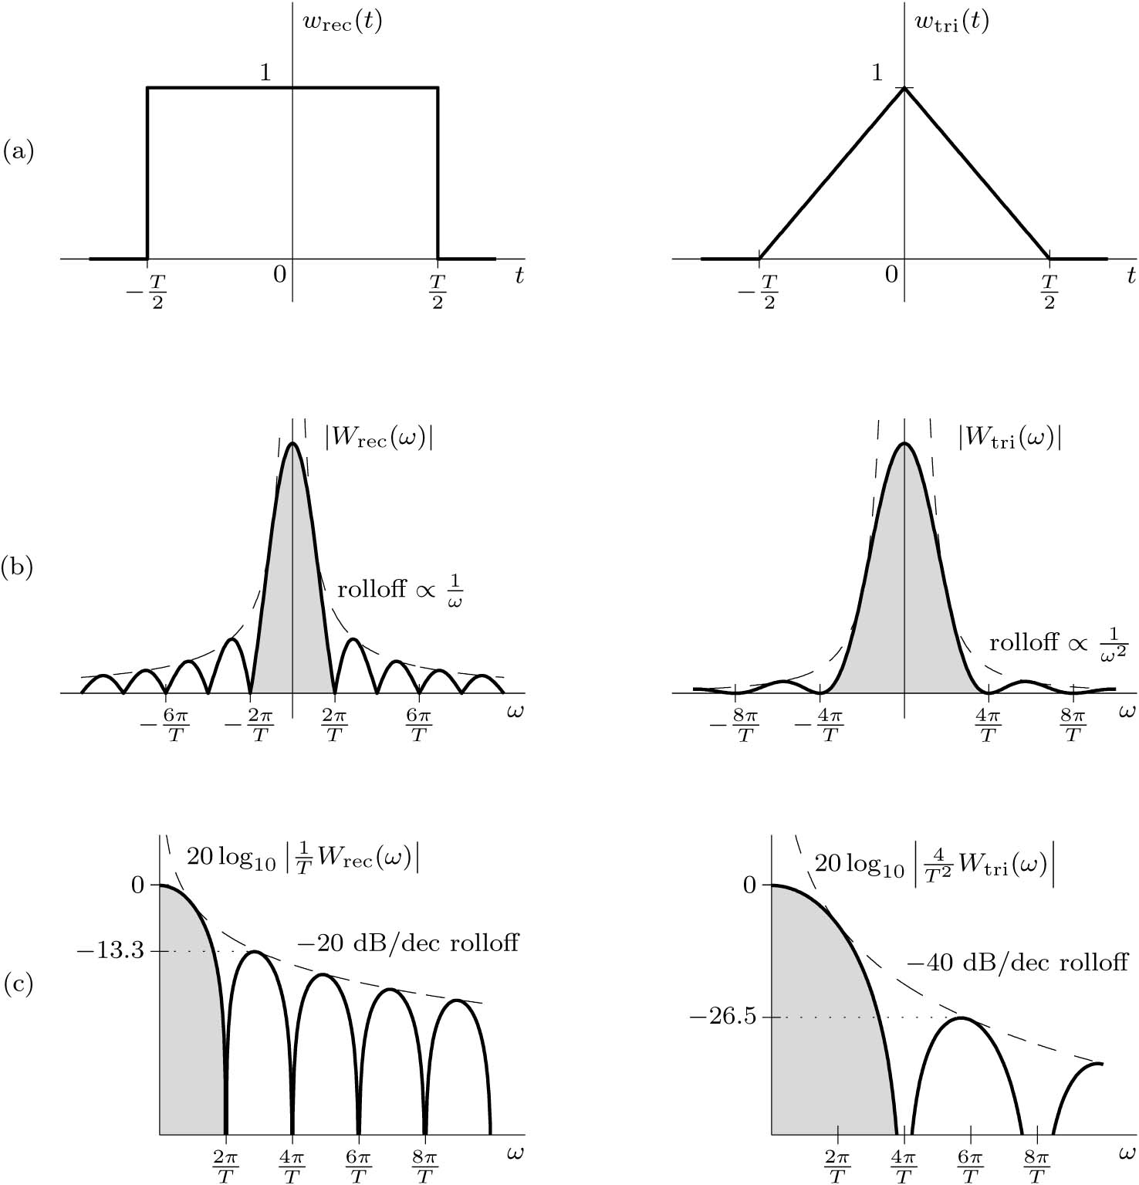
Data Truncation by Windows
x(t): is the signal
w(t): is the window
x_{w}(t): is the truncated x(t).
The two side effects of truncation is spectral spreading and spectral leakage.
Example: What is the effect of truncating a dc signal?

Slide 24
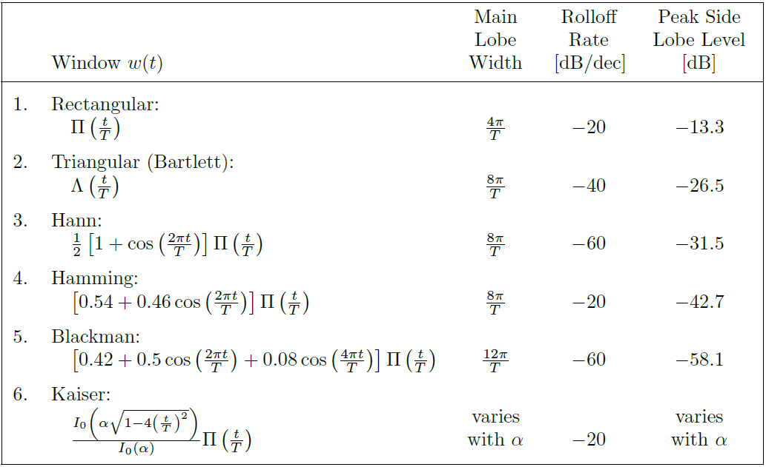
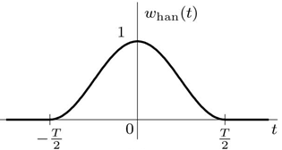
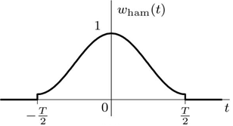
Common Window Functions

