Slide 1
Sampling: The Bridge from Continuous to Discrete
ENGR 4333/5333: Digital Signal Processing
Chapter 3
Dr. Mohamed Bingabr
University of Central Oklahoma

Slide 2
Outline
Sampling Theorem
Signal Reconstruction
Practical Difficulty in Sampling and Reconstruction
Sampling of Bandpass Signals
Spectral Sampling Theorem
Analog to Digital Conversion
Digital to Analog Conversion

Slide 3
3.1 & 3.2 Sampling and Signal Reconstruction

Slide 4
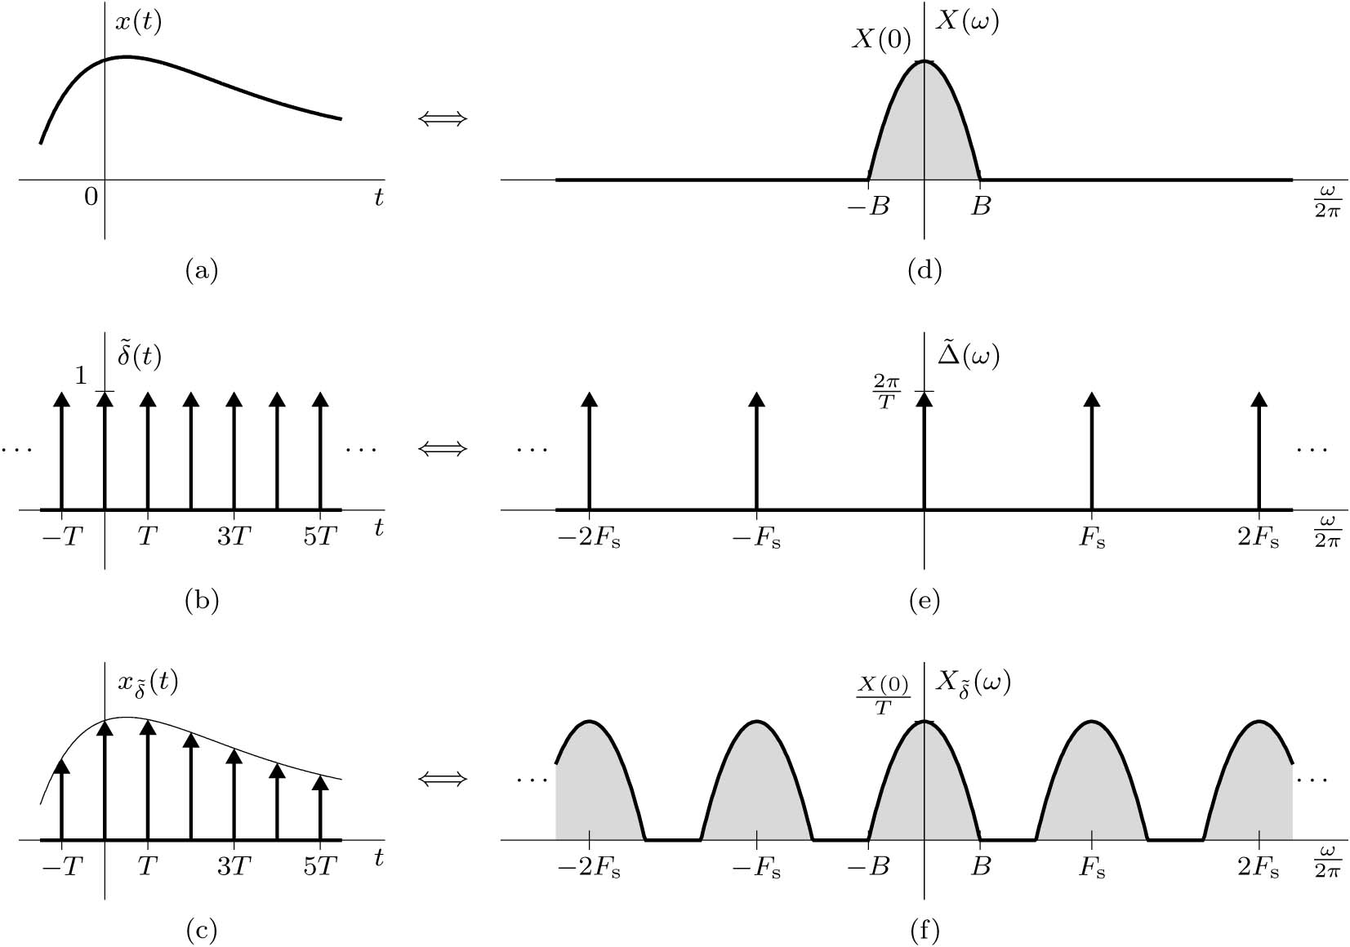
Sampling Theorem
A real signal whose spectrum is bandlimited to B Hz [X( f ) = 0 for | f | >B ] can be reconstructed exactly from its samples taken uniformly at a rate F_{s} > 2B samples per second. When F_{s} = 2B then F_{s} is the Nyquist rate.
$$\tilde{δ}\left(t\right)=\sum_{k=−∞}^{k=∞}{δ\left(t−kT_{s}\right)}=\sum_{k=−∞}^{∞}{\frac{1}{T_{s}}e^{jkω_{s}t}}$$
$$x_{\tilde{δ}}(t)=\sum_{k=−∞}^{∞}{\frac{1}{T_{s}}e^{jkω_{s}t}}x(t)$$
$$X_{\tilde{δ}}(ω)=\frac{1}{T_{s}}\sum_{k=−∞}^{k=∞}{X(ω−kω_{s}) }$$

Slide 5
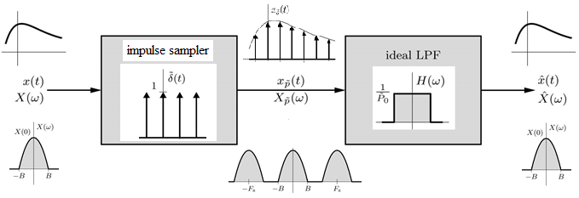
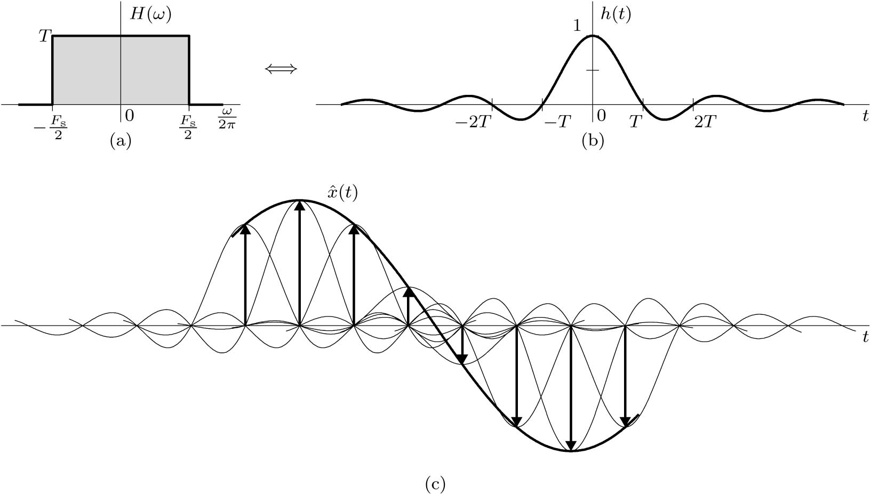
Ideal Signal Reconstruction from Samples
In Frequency Domain
$$X_{\tilde{δ}}\left(ω\right)=\frac{1}{T_{s}}\sum_{k=−∞}^{∞}{X\left(ω−kω_{s}\right)}$$
$$H\left(ω\right)=T_{s}Π\left(\frac{ω}{ω_{s}}\right)$$
$${\hat{X}\left(ω\right)=X}_{\tilde{δ}}\left(ω\right)H(ω)$$
In Time Domain
$$x_{\tilde{δ}}(t)=\sum_{k=−∞}^{∞}{x(kT_{s})δ\left(t−kT_{s}\right)}$$
$$h\left(t\right)=\frac{1}{2π}sinc\left(t/2πT_{s}\right)$$
$$\hat{x}\left(t\right)=\sum_{k=−∞}^{∞}{x(kT_{s})h\left(t−kT_{s}\right)}$$
$$\hat{x}\left(t\right)=\sum_{k=−∞}^{∞}{\frac{1}{2π}x\left(kT_{s}\right)sinc\left(\frac{t−kT_{s}}{{2πT}_{s}}\right)}$$

Slide 6
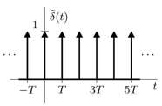
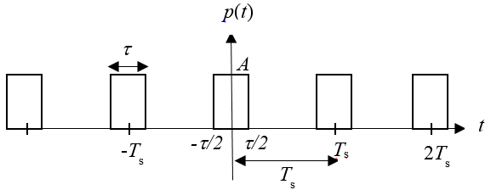
Review of Pulse Train
Ideal sampling impulses
$$e^{jkω_{s}t}$$
FT
$$2πδ\left(ω−kω_{s}\right)$$
$$\tilde{δ}\left(t\right)=\sum_{k=−∞}^{∞}{\frac{1}{T_{s}}e^{jkω_{s}t}}$$
$$\tilde{δ}\left(ω\right)=\sum_{k=−∞}^{∞}{\frac{2π}{T_{s}}δ\left(ω−kω_{s}\right)}$$
Practical sampling pulses
$$p\left(t\right)=\sum_{k=−∞}^{∞}{\frac{Aτ}{T_{s}}\text{sinc}\left(\frac{kω_{s}τ}{2π}\right)e^{jkω_{s}t}}$$
X_{k}
$$P\left(ω\right)=\sum_{k=−∞}^{∞}{\frac{2πAτ}{T_{s}}\text{sinc}\left(\frac{kω_{s}τ}{2π}\right)δ\left(ω−kω_{s}\right)}$$
P_{k}
-2ω_{s}
-ω_{s}
ω_{s}
2ω_{s}

Slide 7
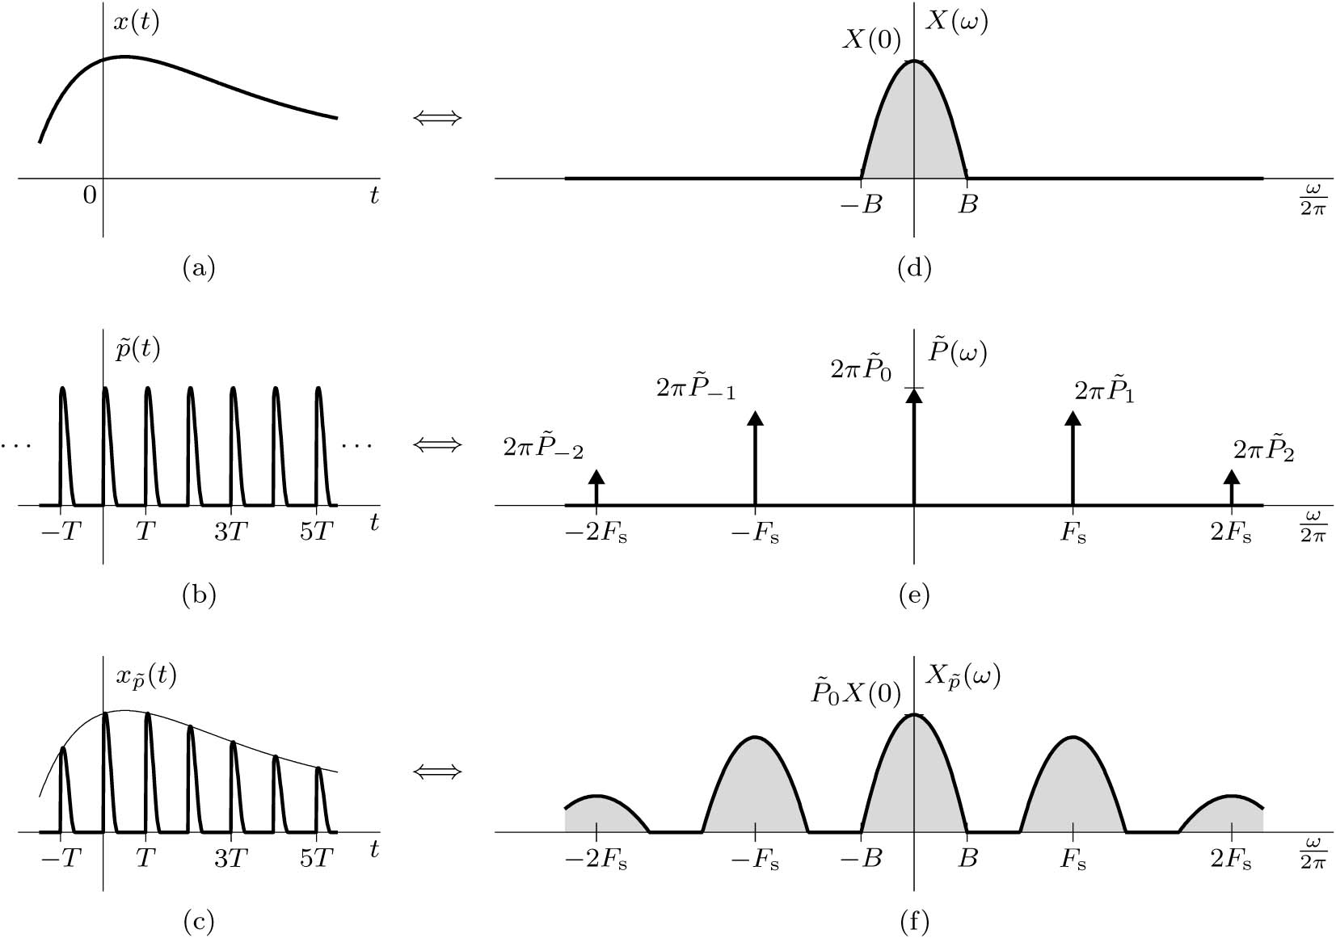
Practical Sampling
In practice we sample the signal x(t) by multiplying it by a T-periodic train $\tilde{p}\left(t\right).$
$$\tilde{p}\left(t\right)=\sum_{k=−∞}^{k=∞}{p\left(t−kT_{s}\right)}$$
$$X_{\tilde{p}}(ω)=\sum_{k=−∞}^{k=∞}{{\tilde{P}}_{k}X(ω−kω_{s}) }$$

Slide 8
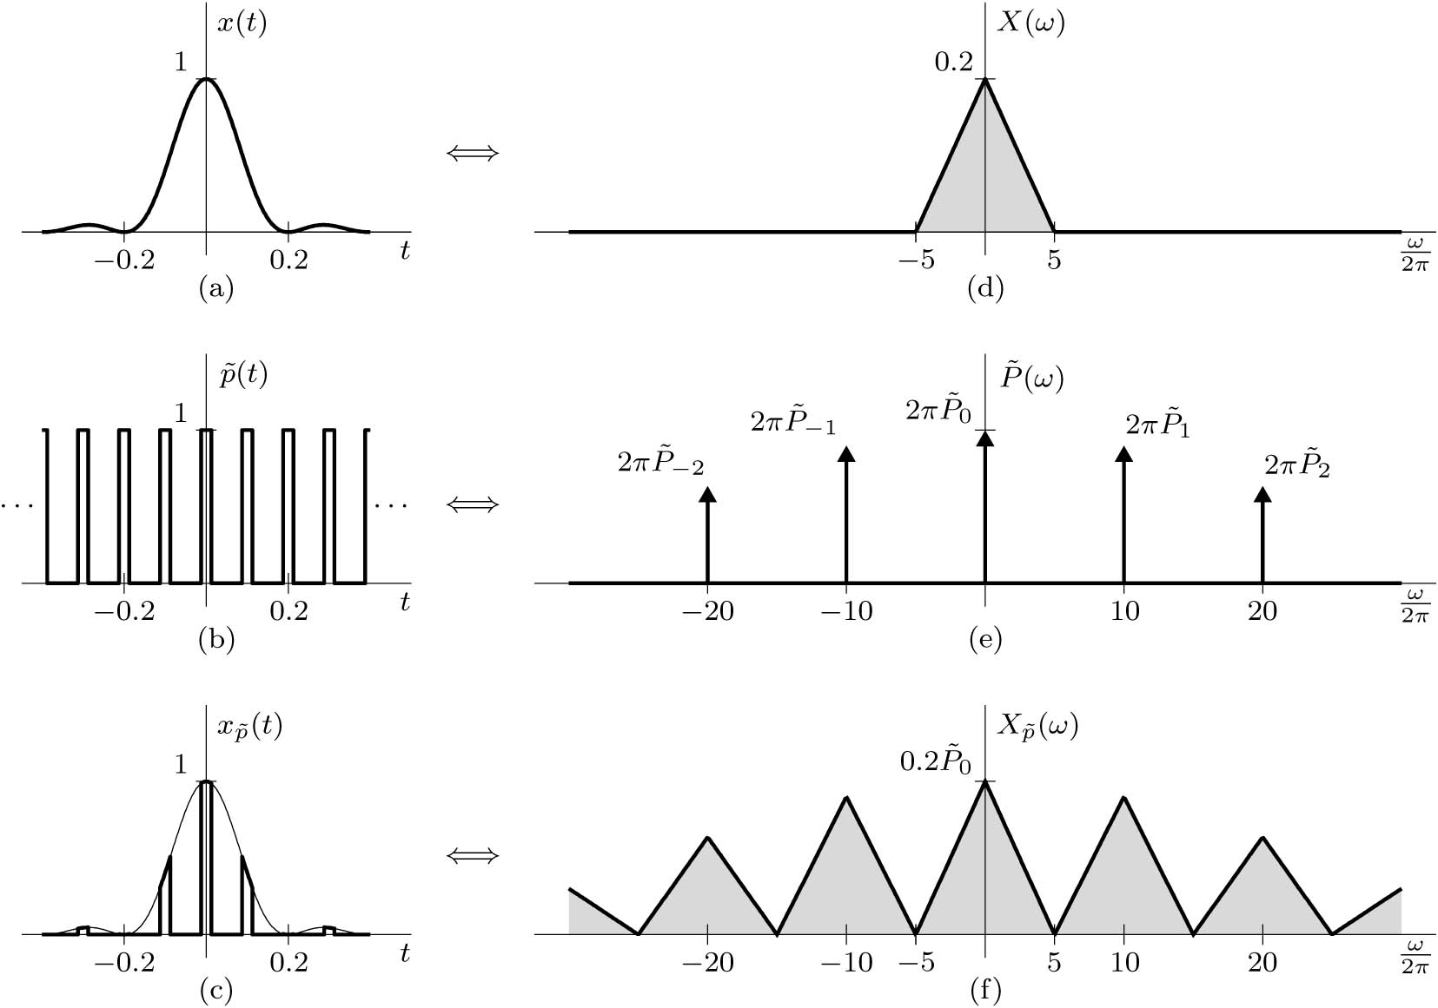
Example of Practical Sampling
$$x_{\tilde{P}}(t)=\sum_{k=−∞}^{∞}{\frac{1}{4}sinc\left(k/4\right)e^{jkω_{s}t}}x(t)$$
$$X_{\tilde{p}}(ω)=\sum_{k=−∞}^{k=∞}{\frac{1}{4}sinc\left(k/4\right)X(ω−kω_{s}) }$$

Slide 9
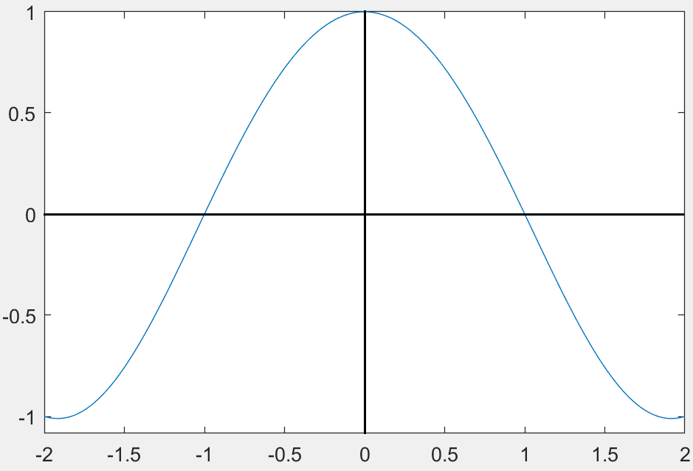
Matlab Example for Signal Reconstruction
x = @(t) cos(pi*t/2);
t = linspace(-2,2,501);
xhatN = 0; T = 1;
for n = -2:2,
xhatN = xhatN + x(n*T)*sinc((t-n*T)/T);
End
plot(t,xhatN);
dt = t(2)-t(1); RMSerror = sqrt(sum((xhatN-x(t)).^2)*dt)
Ans: RMSerror = 0.0030

Slide 10
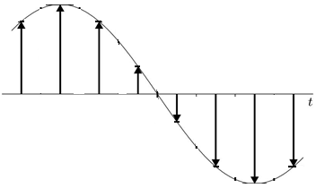
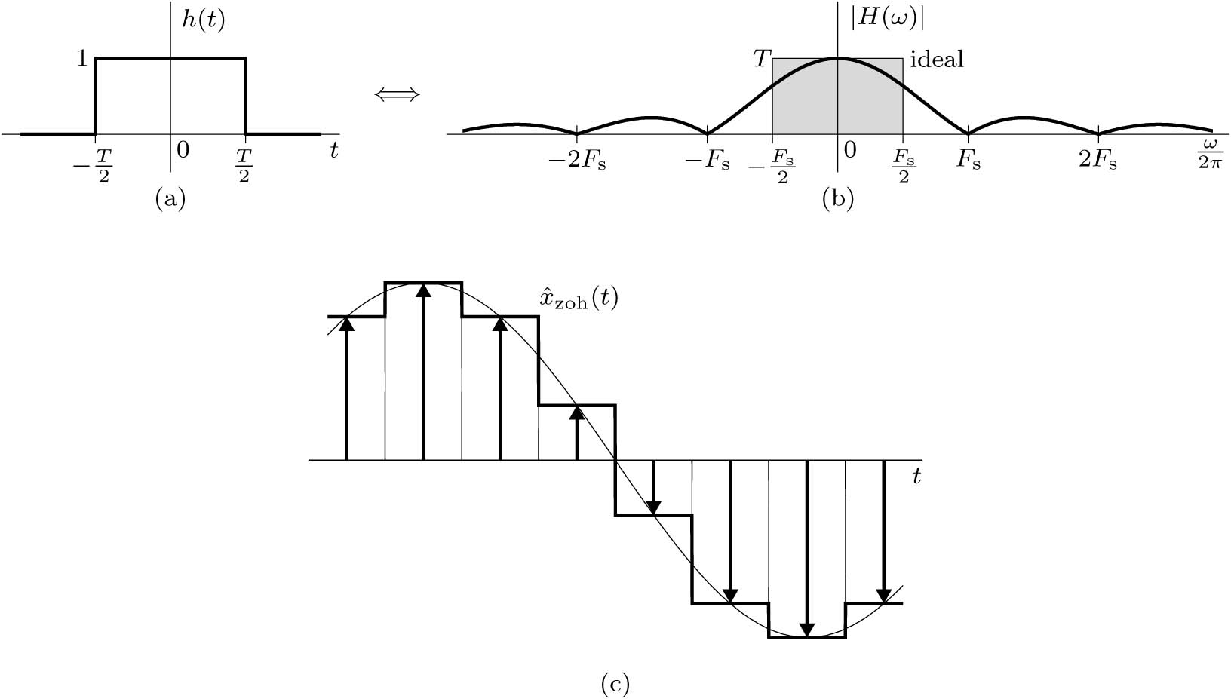
Practical Interpolation
The Zero-Order Hold Filter

Slide 11
3.3 Practical Difficulties in Sampling

Slide 12
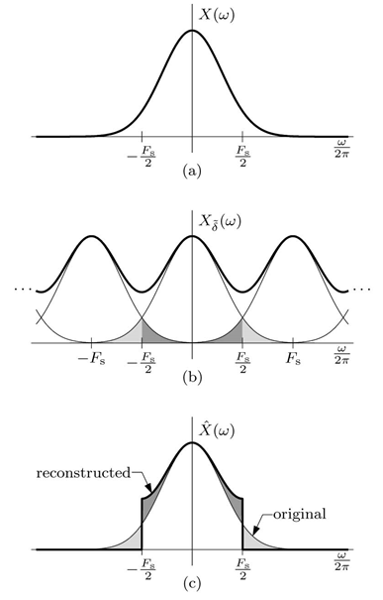
Practical Difficulty in Sampling and Reconstruction
Aliasing: If a continuous time signal is sampled below the Nyquist rate then some of the high frequencies will appear as low frequencies and the original signal can not be recovered from the samples.
For the spectra of real signals, the tail appears to fold or invert about F_{s}/2. Thus, a component of frequency F_{s}/2 + f₁ shows up as or impersonates a component of lower frequency F_{s}/2−f₁ in the reconstructed signal. This causes distortion of low-frequency (|f| < F_{s}/2) signal content. The frequency F_{s}/2 is called the folding frequency, and the tail inversion is known as spectral folding or aliasing.
If a signal is time limited, it cannot be bandlimited, and vice versa.

Slide 13
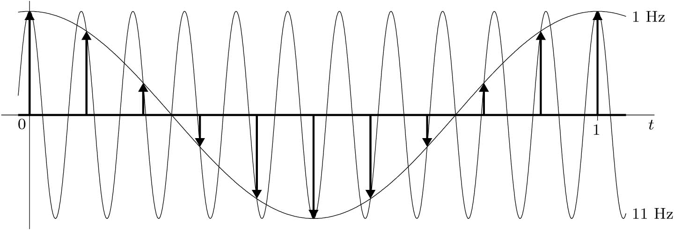
Aliasing in Sinusoids
A sinusoid with 11 Hz frequency sampled with sampling rate F_{s} = 10 z.
-11
11
LPF with BW = 5
-21
-11
-1
1
11
21

Slide 14
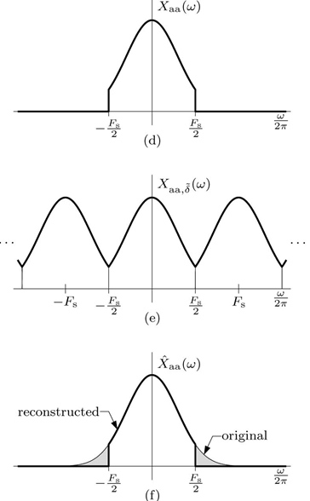
Practical Difficulty in Sampling and Reconstruction
Anti-Aliasing Filter

Slide 15
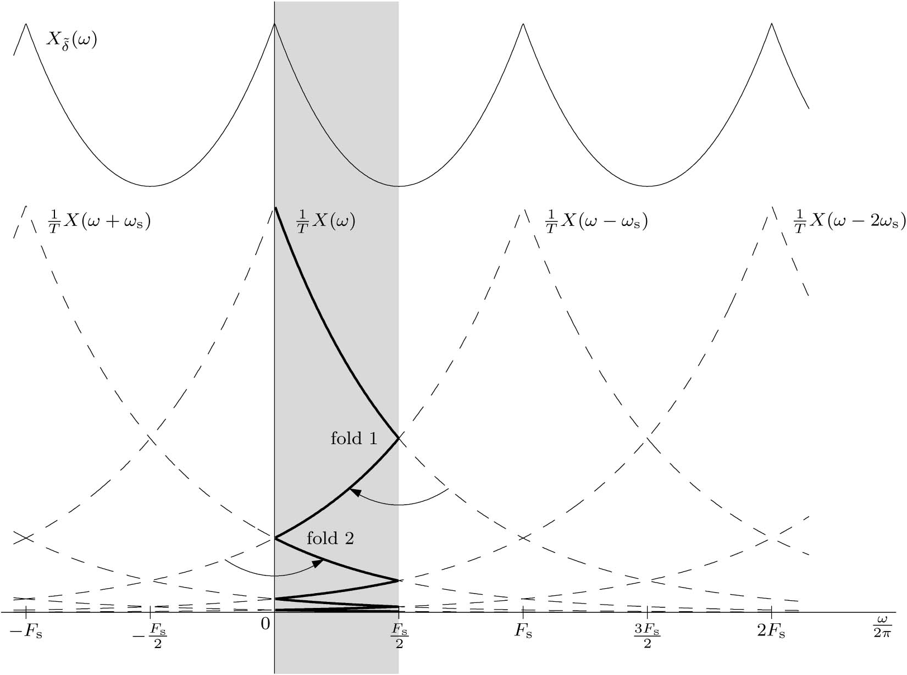
Multiple Aliasing
The apparent frequency f_{a} that is in the fundamental band (−F_{s}/2 ≤ f_{a} ≤ F_{s}/2) of undersampled signal of frequency f₀ is.
$$f_{a}=\left|{\left\langle f_{0}+F_{s}/2\right\rangle }_{F_{s}}−F_{s}/2\right|$$
where ${\left\langle a\right\rangle }_{b}$ is the modulo operation a modulo b.
Example:
What are the apparent frequencies of sinusoidals with 3, 8, 23 Hz frequency sampled with sampling rate F_{s} = 10 z.

Slide 16
3.4 Sampling of Bandpass Signals

Slide 17
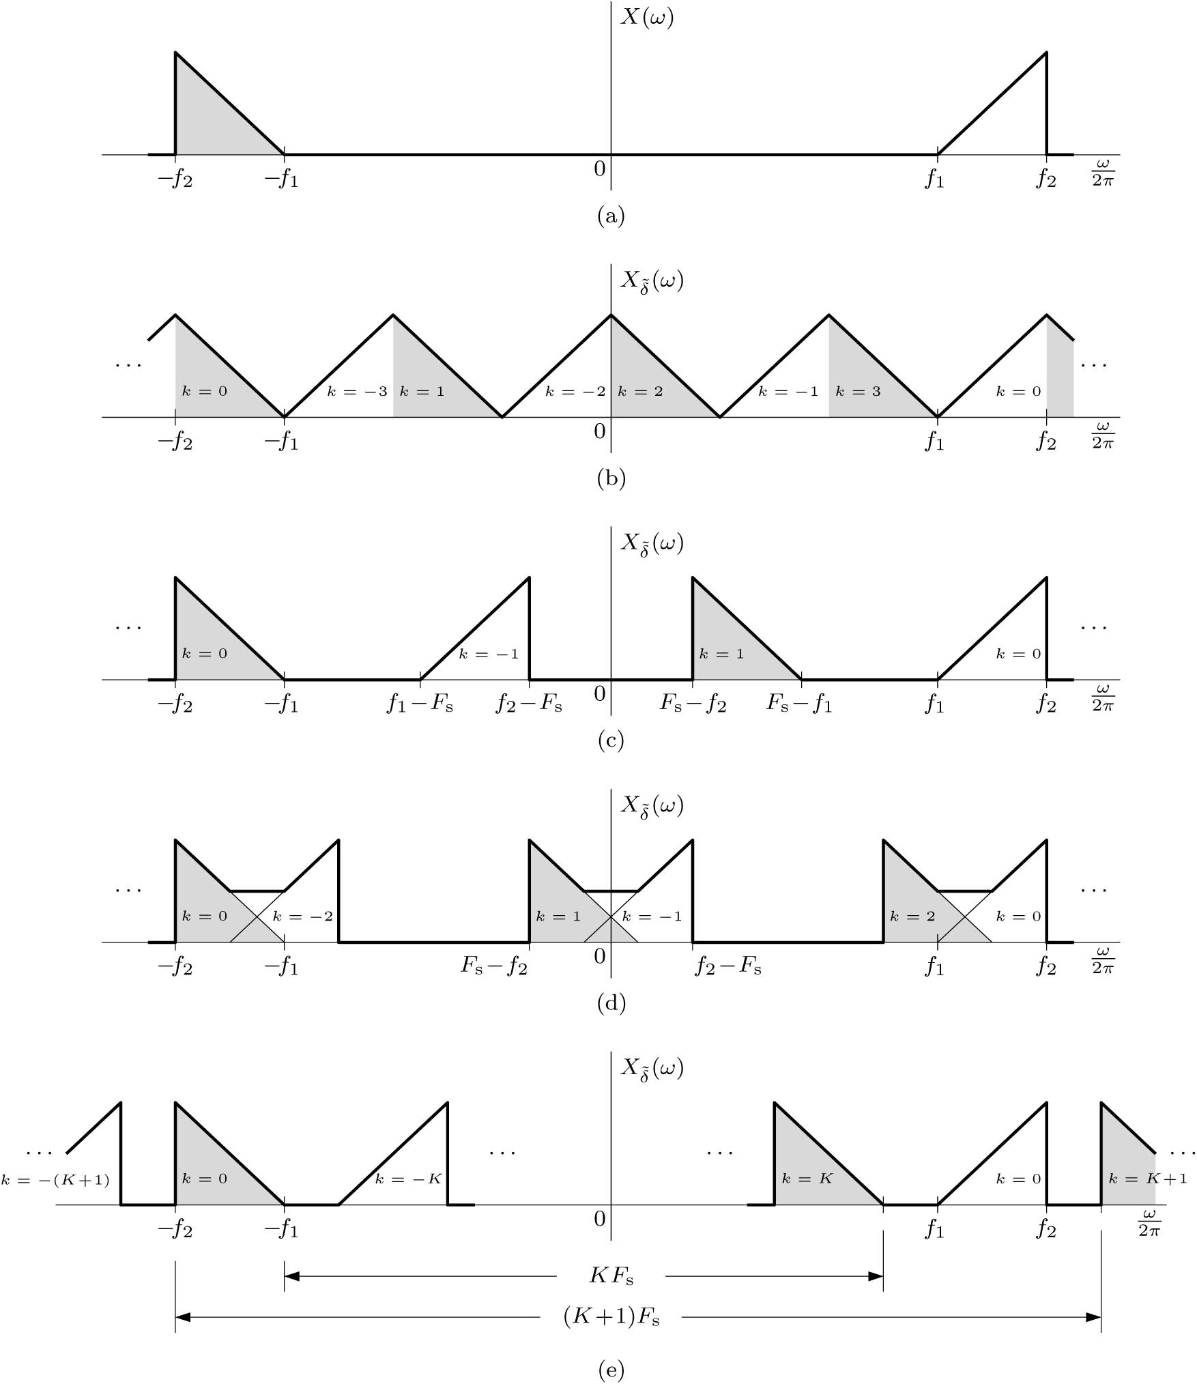
Sampling of Bandpass Signals
B=1k
Sampling a bandwidth B bandpass signal:
original spectrum,
f₂ = 4B and F_{s} = 2B,
f₂ = 4B and F_{s} = 4.75B,
f₂ = 4B and F_{s} = 3.25B,
general sampling case
$$\frac{2f_{2}}{K+1}<F_{s}<\frac{2f_{1}}{K}$$
$$\frac{2f_{2}}{K+1}<F_{s}<\frac{2{(f}_{2}−B)}{K}$$
K = 0, 1, 2, . . .
$$\frac{2{(f}_{2}−B)}{K}>\frac{2f_{2}}{K+1}$$

Slide 18
2f₂
B = f₂ – f₂
F_{s} =2B
2f₁
f₁
f₂
F_{s}
B
Sampling a bandwidth B bandpass signal:
original spectrum,
f₂ = 4B and F_{s} = 2B,
f₂ = 4B and F_{s} = 4.5B,
f₂ = 4B and F_{s} = 3.5B,
$$\frac{2f_{2}}{K+1}<F_{s}<\frac{2f_{1}}{K}$$
$$\frac{2{(f}_{2}−B)}{K}>\frac{2f_{2}}{K+1}$$
Example 3.6: Determine the permissible range of the uniform sampling rate for a bandpass signal with f₁ = 25 kHz and f₂ = 35 kHz.

Slide 19
3.5 Spectral Sampling Theorem Skip section 3.5: will be covered in DFT

Slide 20
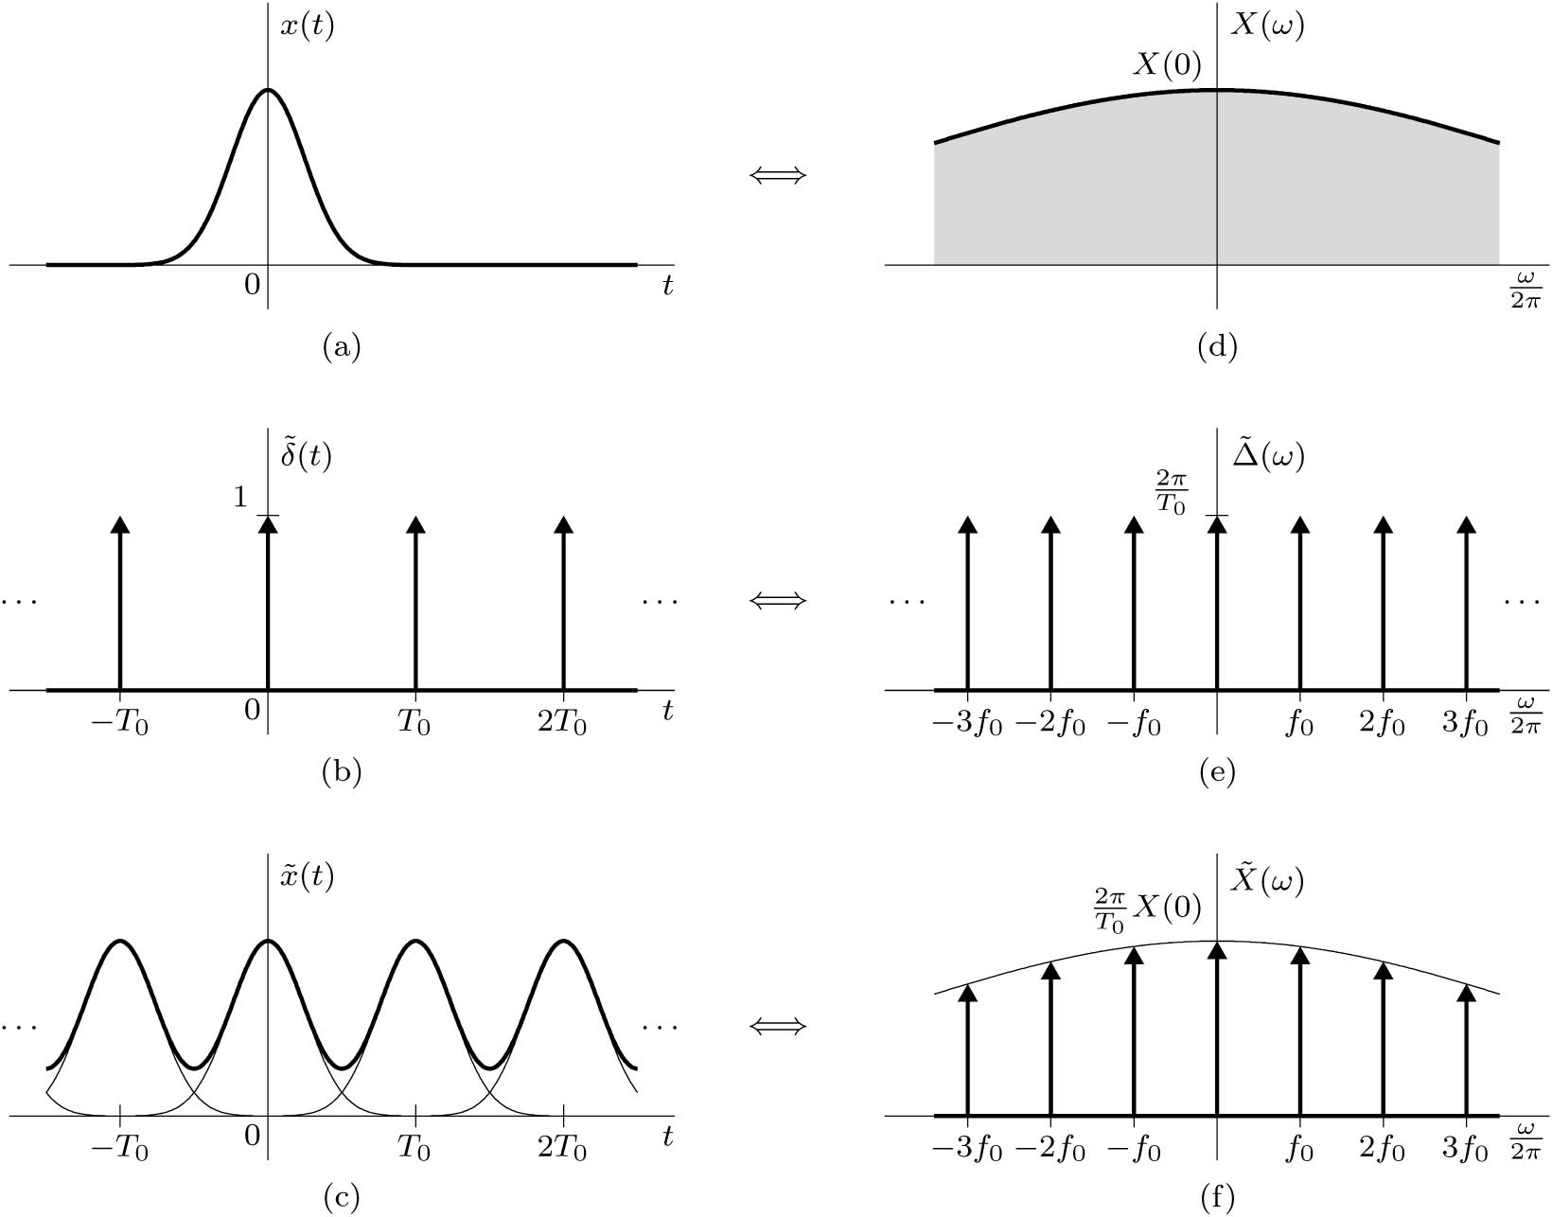
The Spectral Sampling Theorem
The spectral sampling theorem states that the spectrum X(ω) of a signal x(t) timelimited to a
duration of T_{o} seconds can be reconstructed from the samples of X(ω) taken at a rate R samples/Hz, where R ≥ T_{o} (the signal width or duration) is in seconds. The frequency resolution f_{o} = 1/ T_{o}.

Slide 21
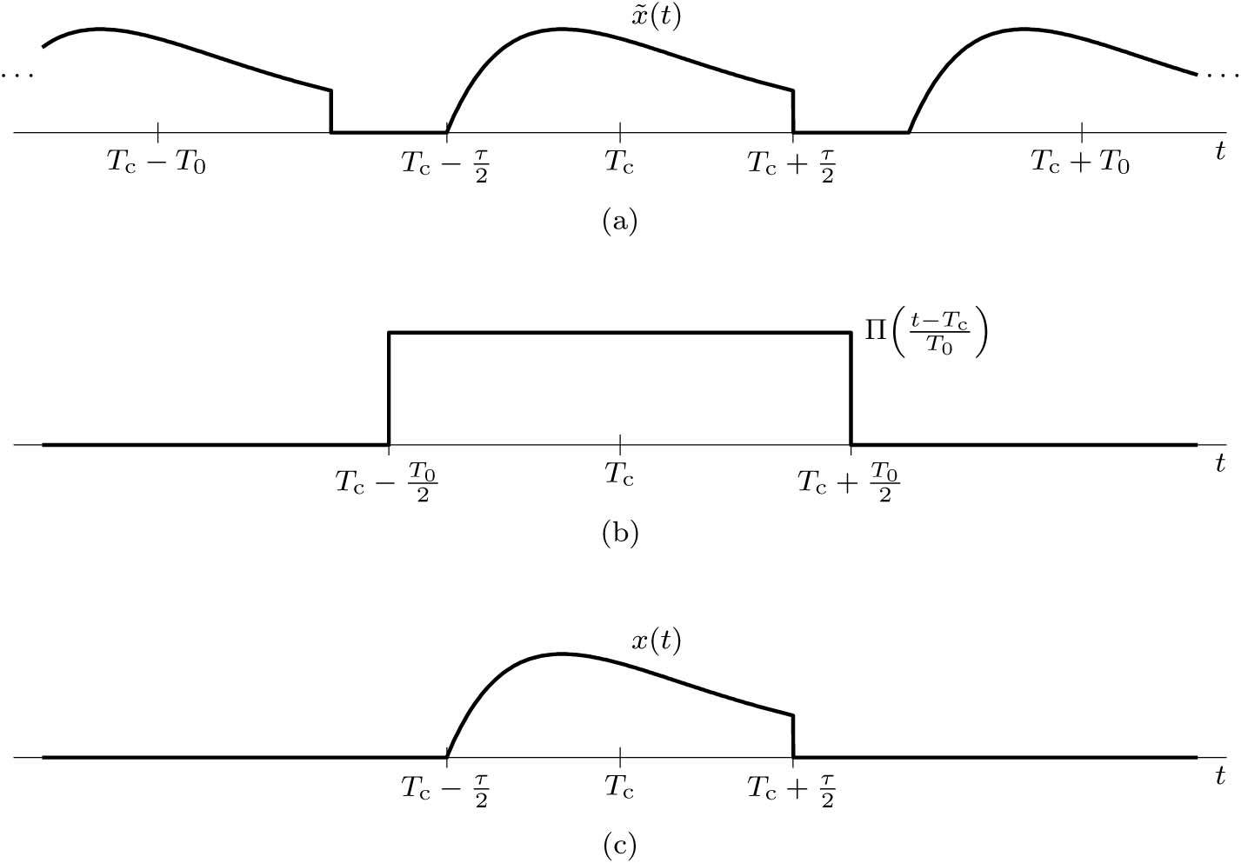
Reconstructing x(t) from Spectral Samples
If the pulse x(t) is centered at the origin, then T_{c} = 0
Example 3.7: Find the unit duration signal x(t), centered at the origin, whose spectrum X(ω), when sampled at intervals of f_{o} = 1 Hz (the Nyquist rate), is X(k2πf_{o}) = 1 for k = 0 and zero otherwise.

Slide 22
3.6 Analog to Digital Conversion

Slide 23
3.6 Analog to Digital Conversion (ADC)
ADC
01110011 11001101 01011100

Slide 24
3.6 Analog to Digital Conversion
Sampling and Linear Quantization
Analog signal: Its amplitude can take on any value over a continuous range.
Digital signal: Its amplitude can take on only a finite number of values.

Slide 25
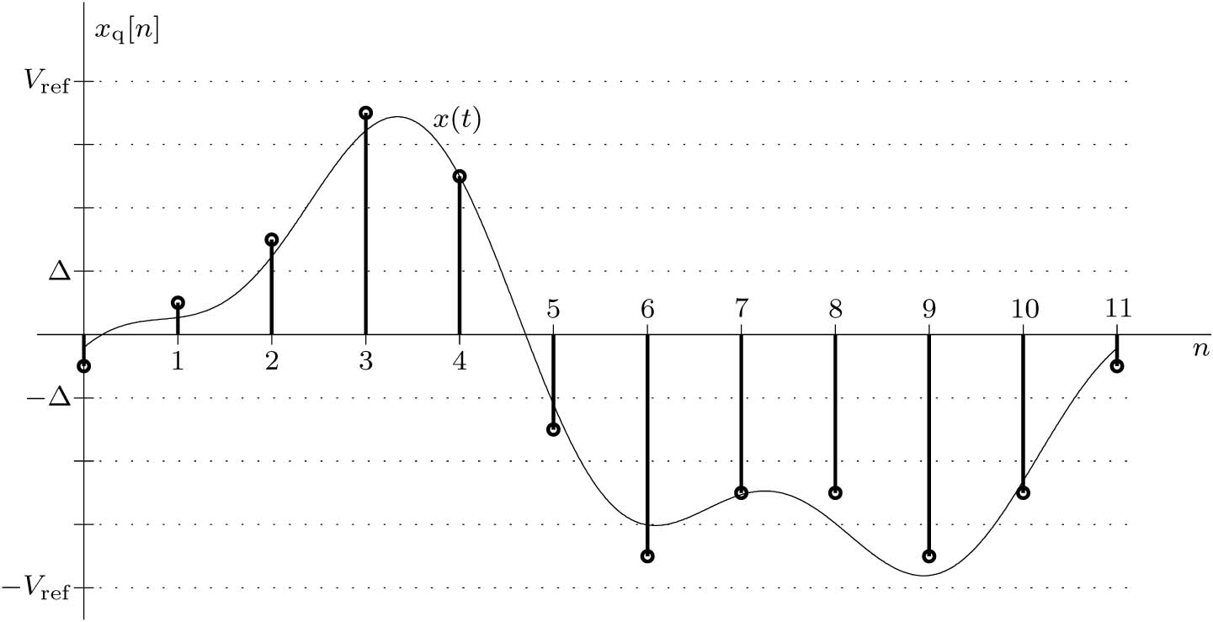
3.6 Analog to Digital Conversion
Linear Quantization
How many bits per sample?
$$L= 2^{B}$$
$$B={\text{log}}_{2}L$$
Δ = 2 V_{ref} / L
Δ = V_{ref} / $2^{B−1}$
Δ : Quantization level
L : Number of levels between -V_{ref} and V_{ref}
B : Number of bits for each sample
Quantization error Q_{e} = Δ/2
Q_{e} = V_{ref} / $2^{B}$

Slide 26
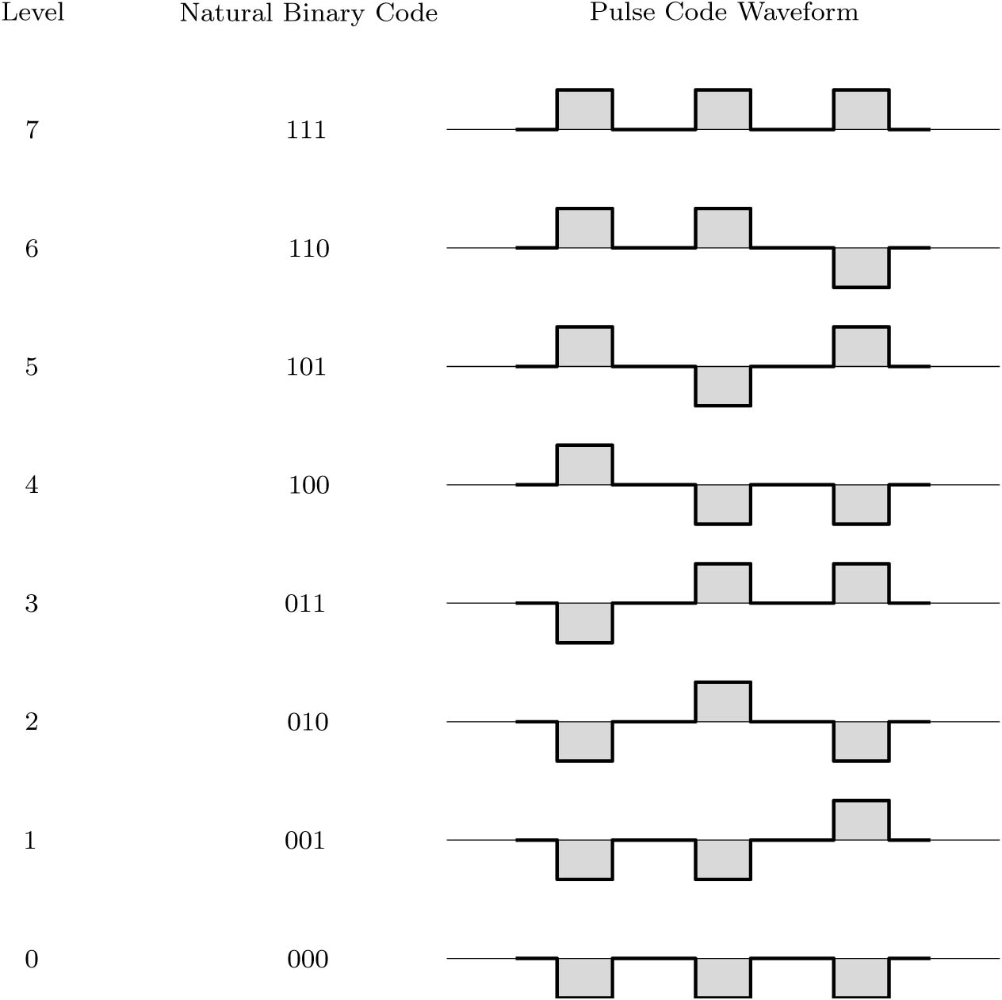
3.6 Analog to Digital Conversion
Pulse Code Modulation (PCM)
Data Transmission = 3 F_{s} bits/sec

Slide 27
Digitizing Voice and Audio
Telephone Communication:
Sampling Rate f_{s} = 8000 samples/sec
Number of bits = 7 bits/sample
Data transmission = 8000*7 = 56000 bits/sec (56 kbps)
Music:
Sampling Rate f_{s} = 44100 samples/sec
Number of bits = 16 bits/sample
Data transmission = 44100*16 = 1.4 million bits/sec (1.4 Mbps)
Example
A signal x(t) bandlimited to 3 kHz is sampled at a rate $30$% higher than the Nyquist rate. The maximum acceptable error in the sample amplitude (the maximum error due to quantization) is 0.5% of the peak amplitude V_{ref} . The quantized samples are binary coded. Find the required sampling rate, the number of bits required to encode each sample, and the bit rate of the resulting PCM signal.

Slide 28
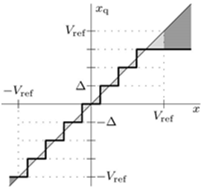
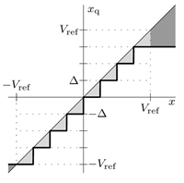
Asymmetric Quantization Converter
Zero is included and levels above zero does not equals levels below zero.
$$∆$$
Rounding Asymmetric
$$x_{q}=∆\left\lfloor \frac{x}{∆}+\frac{1}{2} \right\rfloor$$
Truncating Asymmetric
$$x_{q}=∆\left\lfloor \frac{x}{∆} \right\rfloor$$
Find x_{q} for x =7.74 and B = 3bits. V_{ref} = 10

Slide 29
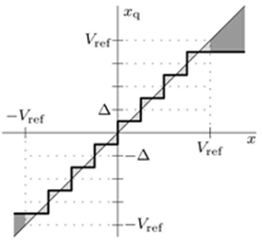
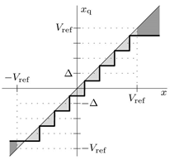
Symmetric Quantization Converter
Zero is not included and levels above zero equals levels below zero.
$$∆$$
Rounding Symmetric
$$x_{q}=∆\left(\left\lfloor \frac{x}{∆} \right\rfloor +\frac{1}{2}\right)$$
Truncating Symmetric
$$x_{q}=∆\left(\left\lfloor \frac{x}{∆} −\frac{1}{2}\right\rfloor +\frac{1}{2}\right)$$
Find x_{q} for x =7.74 and B = 3bits. V_{ref} = 10

Slide 30
Rounding Asymmetric
clear all
[sig Fs]=audioread('Song.wav');
Vref = max(abs(sig));
B = 2; Delta = 2*Vref/(2^(B-1));
xqra = Delta*floor(sig/Delta+1/2);
xqra(xqra>Vref-Delta) = Vref-Delta; xqra(xqra<-Vref) = -Vref;
sound(xqra, Fs)
$$x_{q}=∆\left(\left\lfloor \frac{x}{∆} \right\rfloor +\frac{1}{2}\right)$$
8 Bits
# Levels = 256
2 Bits
# Levels = 4

Slide 31
Example
Drill 3.14: Consider the common situation where a signal x(t) becomes 0 for an extended period of time. Explain why an asymmetric rounding converter is better than symmetric rounding converter in the case where low-level noise corrupts x(t). Which asymmetric converter is best, rounding or truncating? Explain.

Slide 32
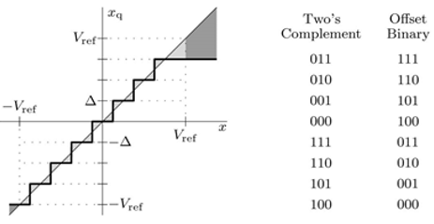
Example of Two’s Complement
3 → 011
To find the binary for a negative value then reverse the bits of the positive value and add 1.
-3 → 100 + 001 = 101
c₂
c₁
c₀
Coding Method for asymmetric
Two’s Complement
Offset Binary
Note: for symmetric add Δ/2 to x_{q}
Example 3.9: Assuming a 4-bit asymmetric converter is used, determine the value x_{q} that corresponds to the two’s complement code word 1101. What is the value if the code word is offset binary? How do the values change if the converter is instead a symmetric converter?

Slide 33
Example 3.10: Consider the signal x(t) = cos(2πt/25). Using sampling interval T = 1 s, reference V_{ref} = 1, and B = 2 bits, plot the quantized signal x_{q}[n] over one period of x(t) using rounding asymmetric quantization methods of Eq. (3.23).
Matlab Code
T = 1; Vref = 1; B = 2; Delta = 2*Vref/(2^B);
x = @(t) cos(2*pi*t/25); n = (0:25);
xqra = Delta*floor(x(n*T)/Delta +1/2);
xqra(xqra>Vref-Delta) = Vref-Delta; xqra(xqra<-Vref) = -Vref;
stem(n,xqra);
$$x_{q}=∆\left\lfloor \frac{x}{∆}+\frac{1}{2}\right\rfloor$$
Rounding asymmetric
Truncating asymmetric
Rounding symmetric
Truncating symmetric

Slide 34
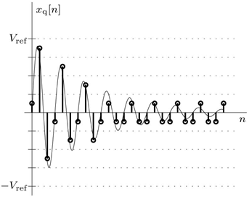
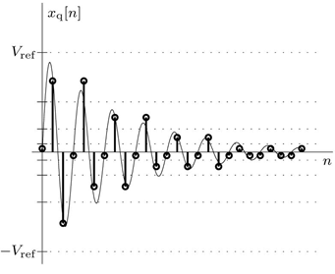
Nonlinear Quantization
Reduce quantization error for smaller signal amplitudes at the expense of larger signal amplitudes.
In telephone the bit rate for linear quantization is twice that for nonlinear to establish the same sound quality.
Linear quantization
Nonlinear quantization

Slide 35
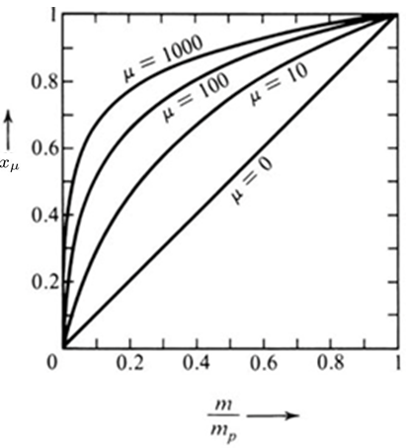
Nonlinear Quantization
μ-law Compression
The compression parameter μ determines the level of compression. Large μ increases resolution for small signal amplitudes, all at the price of more coarseness for large amplitudes.
Inverse μ-law Compression
$$x=V_{ref}sgn⁡(x_{μ})\left(\frac{1}{μ}\right)\left[{\left(1+μ\right)}^{\left\lfloor x_{μ}/V_{ref}\right\rfloor }−1\right]$$
Example
V_{ref} = 10 µ = 100
x₁ = 1 x_{μ1} = 5.196
x₂ = 8 x_{μ2} = 9.52

Slide 36
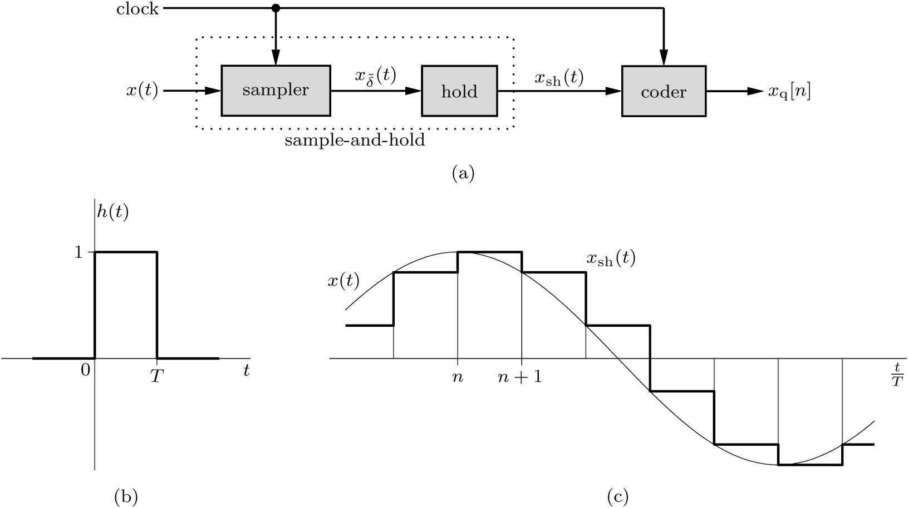
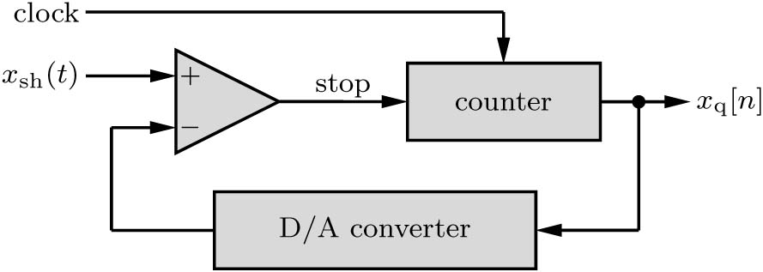
Analog-to-Digital Converter Implementation
Counting Converter

Slide 37
3.7 Digital to Analog Conversion

Slide 38
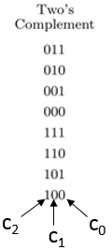
Digital-to-Analog Conversion

Slide 39
Source of Distortion in Signal Reconstruction
1- Aperture Effect: Distortion from the Zero-Order- Hold
H_{zoh}(ω)
H(ω)
=
H_{lpf}(ω)
$$H\left(ω\right)=\frac{H_{lpf}(ω)}{H_{zoh}(ω)}$$

Slide 40
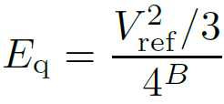
Source of Distortion in Signal Reconstruction
2- Distortion from Linear Quantization
Quantization error e_{q} value is in the range (-Δ/2, Δ/2)
Energy (or power) of the quantization error is the means square quantization error E_{q}
From probability the e_{q} is a random variable with uniform density function

Slide 41
Example 3.11
A periodic sinusoidal signal x(t) of amplitude 12 volts is quantized and binary coded. Assuming the power of the signal-to-quantization noise ratio must exceed 20000, determine the smallest number of bits B needed to encode each sample.
Answer: B ≥ 6.8514 so choose B = 7

