Slide 1
Discrete-Time Signals and Systems
ENGR 4333/5333: Digital Signal Processing
Chapter 4
Dr. Mohamed Bingabr
University of Central Oklahoma

Slide 2
Outline
Continuous to Discrete Signal
DT Signal Models
Signal Operations
DT Signal Classifications
DT Systems and Examples
DT System Properties
Digital Resampling

Slide 3
Exponential Continuous Signal to Discrete
x(t) = e^{-t}
t
= e^{-nT}
= e^{-0.1n} = (0.905)^{n}
T = 0.1

Slide 4
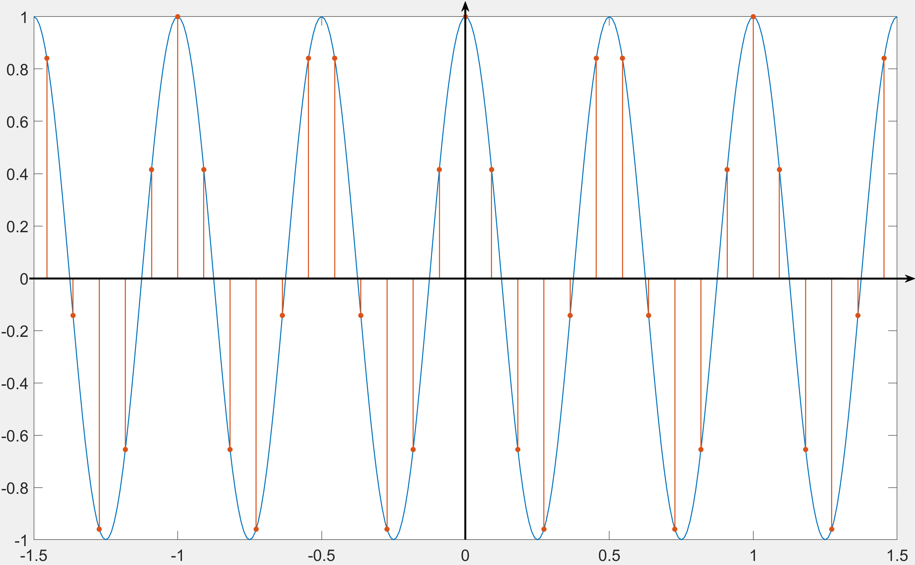
Sinusoidal Continuous Signal to Discrete
$$x\left(t\right)=\cos\left(ωt\right)=cos⁡(2πft)$$
f = 2 cycles/sec (Hz)
f_{s} = 11 samples/sec
T = 1/f_{s} = 1/11 second
t → Tn
$$x[n]=cos⁡(ωTn)$$
$$x[n]=cos⁡(Ωn)$$
$$x[n]=cos⁡\left(2π\frac{f}{f_{s}}n\right)$$
$$x[n]=cos⁡(2πFn)$$
F = 2/11 cycles/samples

Slide 5
Operation on the Independent DT Variable
DT Time Shifting

Slide 6
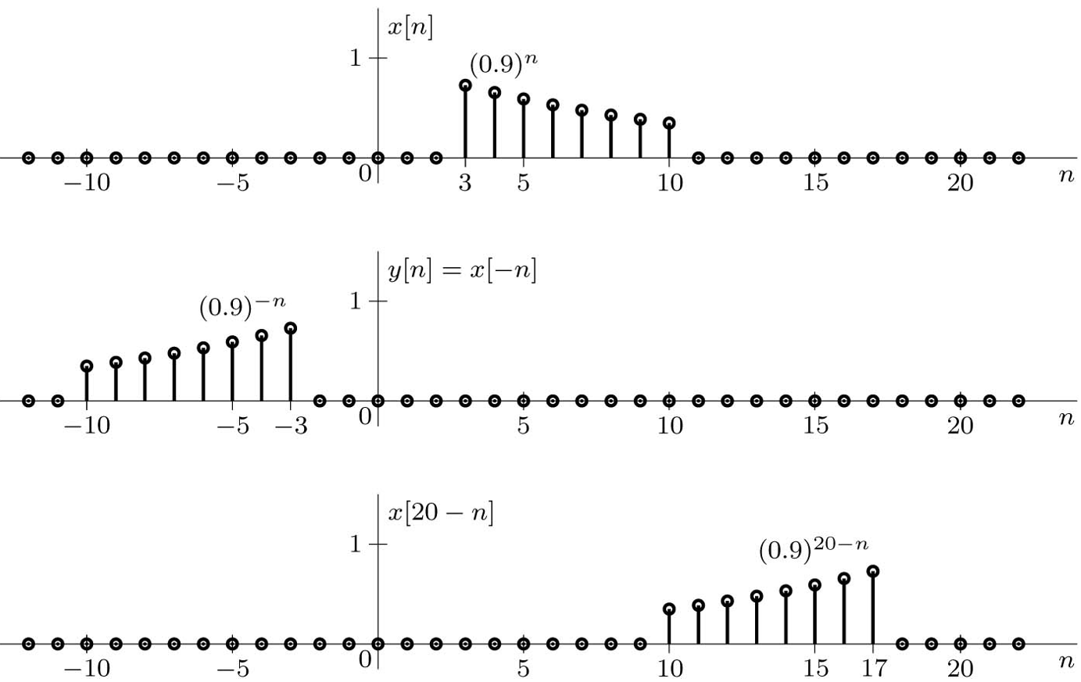
Operation on the Independent DT Variable
DT Time Reversal
Replace n by -n
Example: Plot y[n] = x[20 - n]
y[n] = x[-(n - 20)]

Slide 7
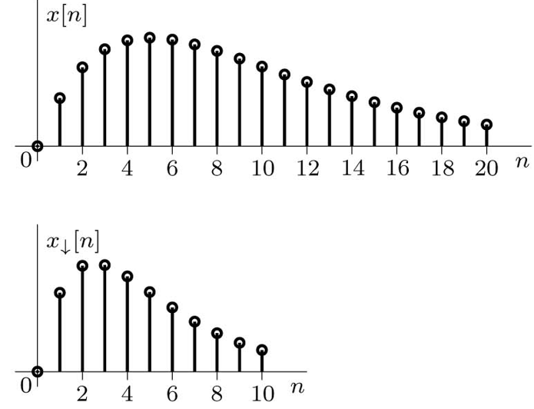
DT Time Scaling: Sampling Rate Conversion
Compression: Downsampling and Decimation
Replacing n with Mn in x[n] compresses the signal by factor M to produce
x↓[n] = x[Mn].
This means that x[Mn] selects every M th sample of x[n] and deletes all the samples in between.

Slide 8
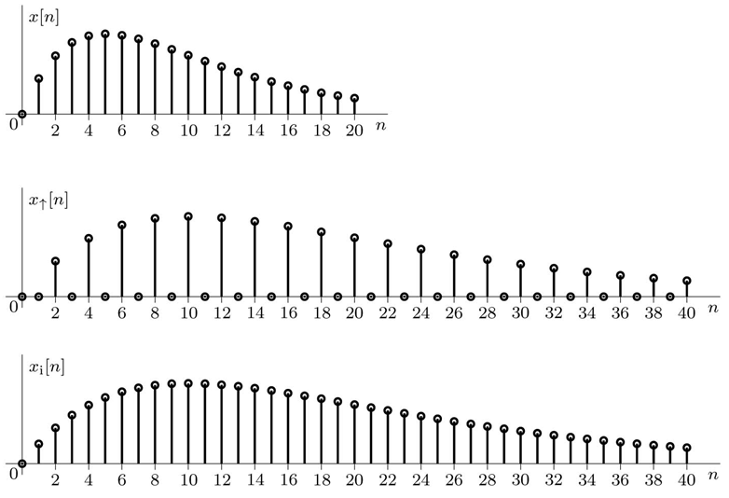
DT Time Scaling: Sampling Rate Conversion
Expansion: Upsampling, and Interpolation
An interpolated signal is generated in two steps: an expansion followed by filtering. Expand x[n] by an integer factor L to obtain the expanded signal x↑[n]
Linear Interpolation
y_{i}[n] = y↑[n] + (y↑[n-1] + y↑[n+1])/2

Slide 9
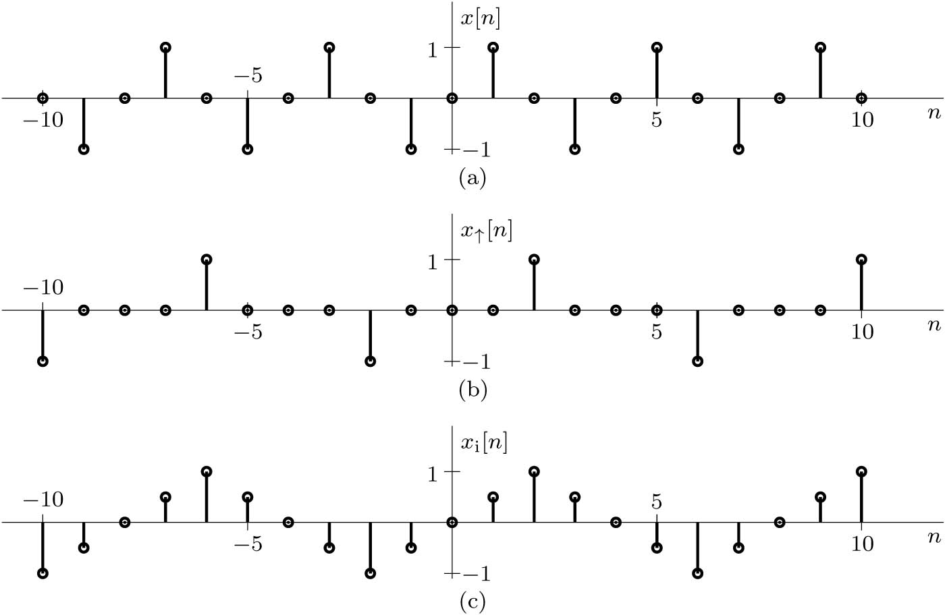
Example: Upsampling and Interpolation
A signal x[n] = sin(2πn/4) is expanded by L = 2 to produce x↑[n]. Next, this signal is interpolated according to x_{i}[n] = 0.5x↑[n − 1] + x↑[n] + 0.5x↑[n + 1]. Sketch x[n], x↑[n], and x_{i}[n], and comment on the overall quality of the signal interpolation.

Slide 10
4.2 Signal Models

Slide 11
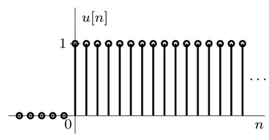
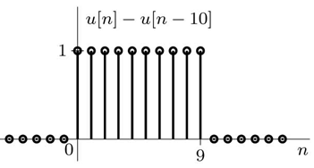
DT Signal Models: Unit Step Function u[n]
10
Example: Plot u[n] - u[n-10]

Slide 12
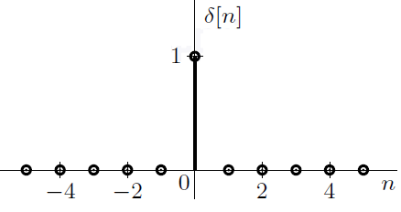
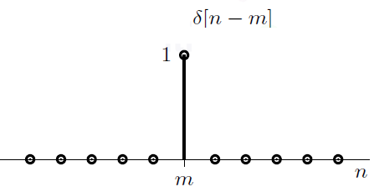
DT Unit Impulse Function δ [n]
Multiplication by a DT Impulse δ[n]
Relationship between δ[n] and u[n]
$$=\sum_{m=0}^{∞}{δ[n−m]}$$
Integral of δ[n]
Derivative of u[n]

Slide 13
Example
Describe the signal x[n] shown below by a single expression, valid for all n, comprised of unit impulse and step functions

Slide 14
DT Sinusoid
The frequency of a DT sinusoid cos(Ω n) must meet the following constrains: Ω ≤ $π$
cos(ωt) → cos(ωTn) → cos(2π f/f_{s} n) → cos(2πFn) → cos(Ω n) Ω = 2π f/f_{s} ≤ $π$
The unit of Ω is radians per samples The unit of F is cycles per samples
If we sample below the Nyquist rate, then Ω > $π$ and the apparent frequency will be
Similar to
$$f_{a}=\left|{\left\langle f_{o}+f_{s}/2\right\rangle }_{f_{s}}−f_{s}/2\right|$$
Example: Express the following signals in terms of (positive) apparent frequency |Ω_{a}|:
(a) cos(0.5πn + θ) (b) cos(1.6πn + θ) (c) cos(2.3πn + θ)

Slide 15
The Apparent Laziness of DT Exponential
Our Eyes acts like a lowpass filter and we will not see the fast motion in the counterclockwise direction. We will see slower motion in the clockwise direction. The actual frequency is π + x but it will appear as π - x. (wagon wheel effect)

Slide 16
DT Exponential Function z^{n}
Sampling
$$x\left(t\right)=e^{st}$$
$$x\left[n\right]=e^{sTn}={\left(e^{sT}\right)}^{n}=z^{n}$$
t → Tn
In general, s is a complex $s=σ+jω$, so z $=e^{σT}e^{jωT}$
Letting r = |z| = $e^{σT}$and Ω = ∠ z = $ωT$ so that z = re^{jΩ}.
$$x\left[n\right]=r^{n}e^{jΩn}$$
The following functions are special cases of z^{n}

Slide 17
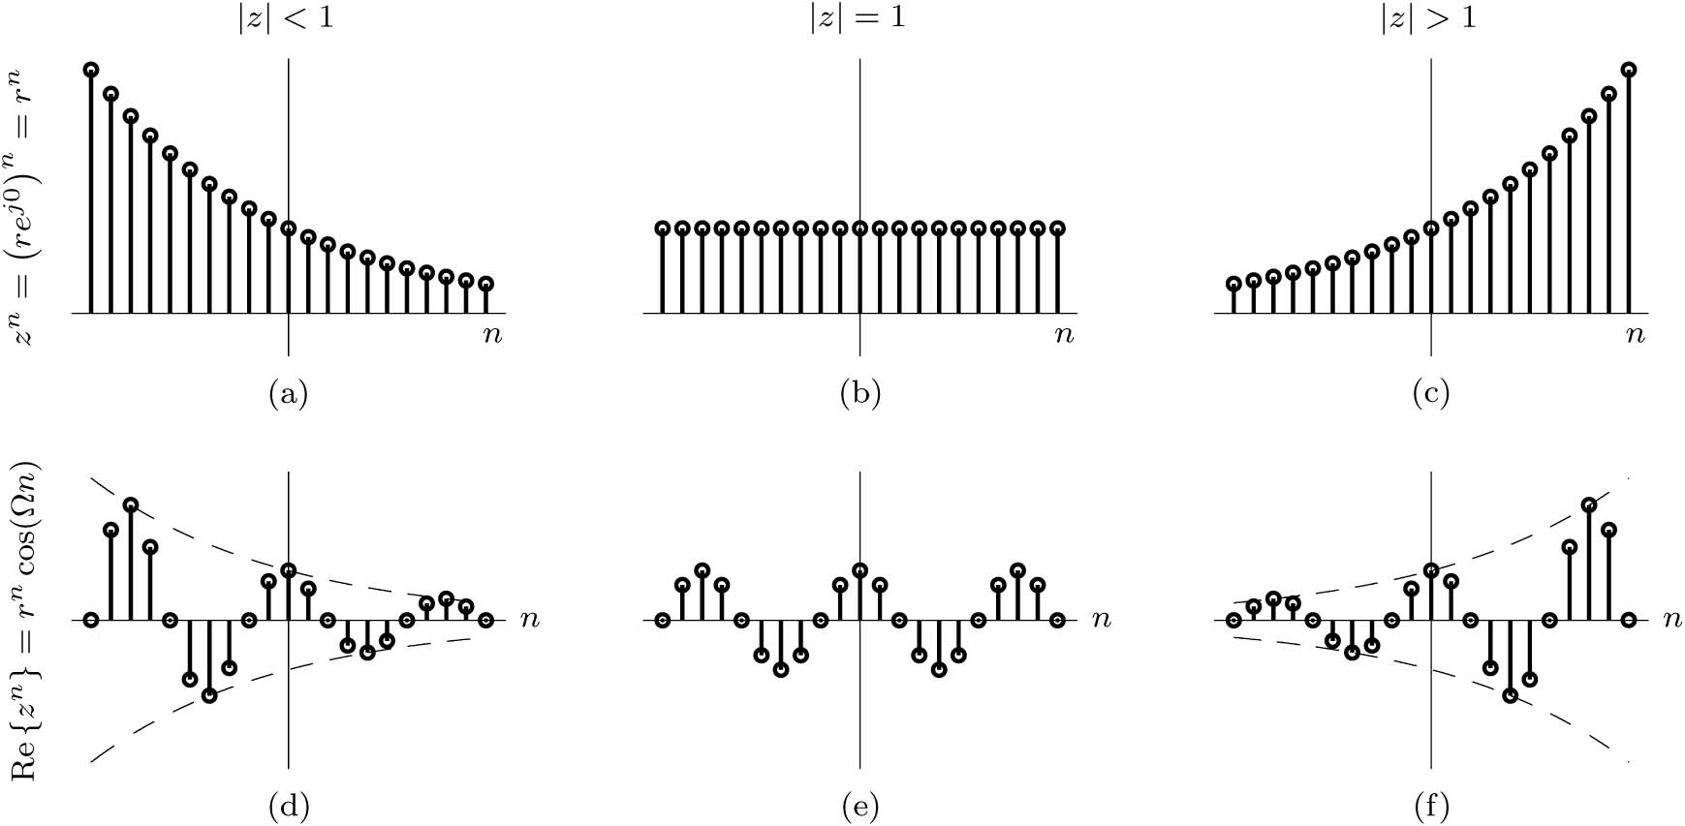
DT Exponential Function z^{n} = (re^{jΩ})^{n} = r^{n}e^{jΩn}

Slide 18
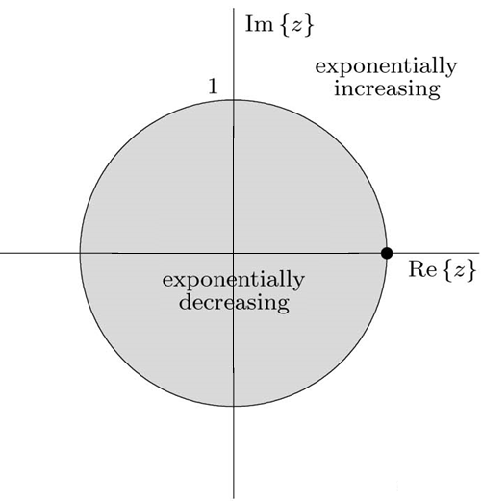
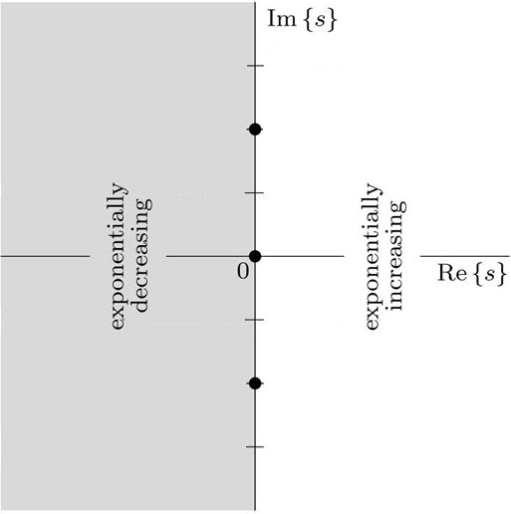
DT Exponential Function z^{n} in the Complex Plane
s-plane
x(t) $={Re[e}^{sit}]$
x[n] $={Re[z}^{n}]$
z-plane
$$f_{s}=16$$
$$s_{i}=−3+j2π6$$
$$z_{i}=0.83e^{j3π/4}$$
$$ω_{max}$$
The s-plane imaginary axis becomes the z-plane unit circle |z| = 1.

Slide 19
Example
Consider the DT exponential Re {z^{n}} obtained from sampling the signal Re {e^{st}} with T = 1.
Using z = e^{sT} , plot Re {z^{n}}, as well as Re{e^{st}} for reference, over −5 ≤ n ≤ 5 for the cases
s = −0.1 and s = −0.1+ j2π. Comment on the results.
B =1Hz so f_{s} should be 2 and T = 0.5 sec.
Note:
Many points in the s-plane maps to one point in the z-plane (aliasing).

Slide 20
4.3 DT Signal Classification
Causal, Noncausal, and Anti-causal signals
Even and Odd Signals
Periodic and Aperiodic signals
Energy and Power Signals.

Slide 21
DT Signal Classifications
Causal, noncausal, and anti-causal signals,
Causal is a signal that has values at positive values of n
x[n] = 0 for n < 0
Noncausal is a signal that has values at positive and negative values of n
Anti-causal is a signal that has values at negative values of n
x[n] = 0 for n ≥ 0

Slide 22
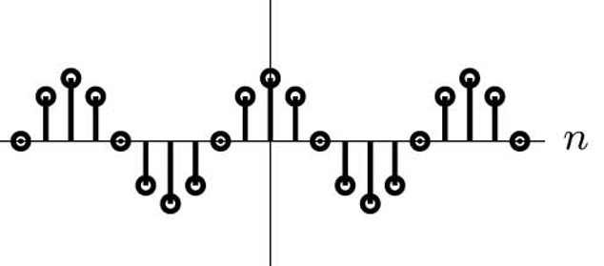
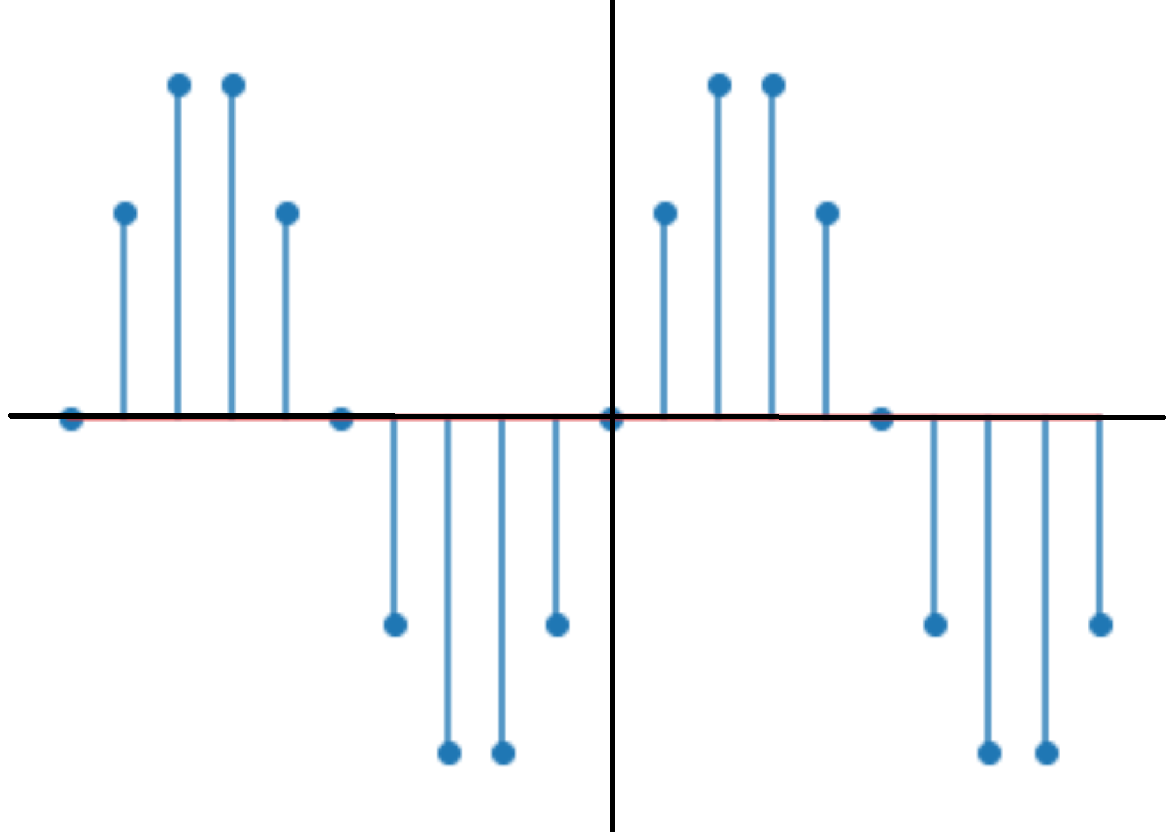
DT Signal Classifications
Even and Odd DT Signals
Even x[n] = x[-n]
Odd x[n] = - x[-n]
n

Slide 23
DT Signal Classifications
Periodic and Aperiodic DT Signals
N-periodic x[n] = x[n - N] for all n.
The smallest value of N that satisfy periodicity is called the fundamental period N_{o}.
The fundamental frequency F_{o} = 1 / N_{o} or Ω_{o} = 2π / N_{o}
How do we find the fundamental period N₀?
The cos(2πFn) is discretely periodic if F can be expressed as F = m / N₀ where m is an integer and N₀ is the fundamental period. The ratio should be reduced, where the numerator and denominator are coprime.

Slide 24
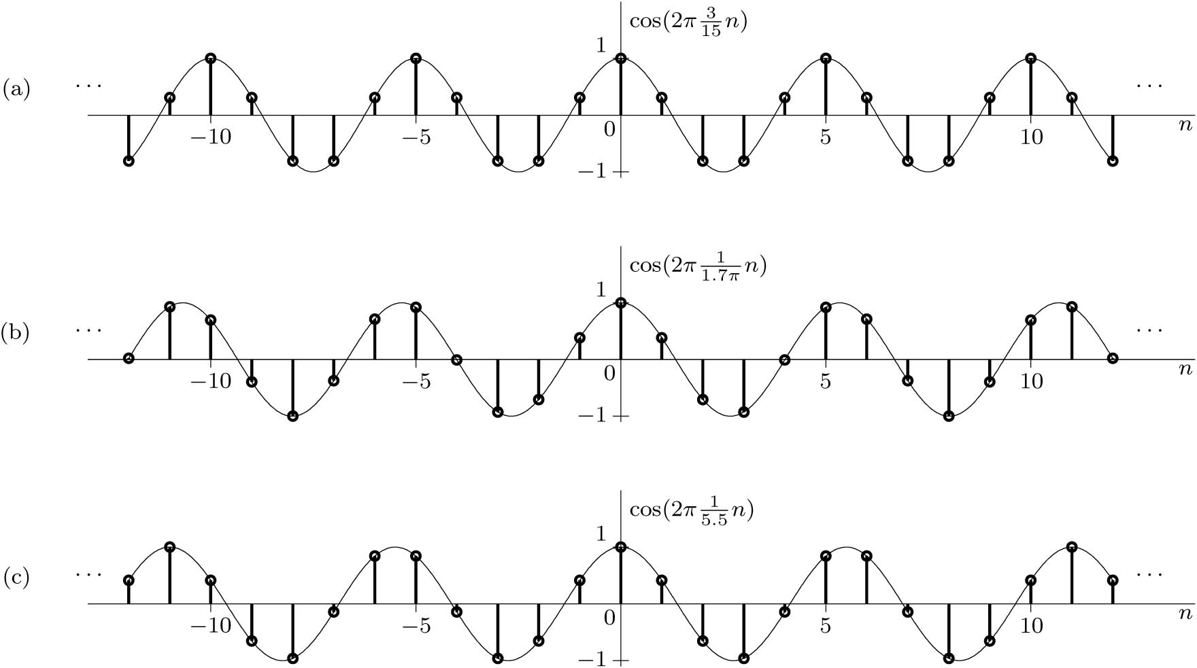
Example
a) Periodic, F = 3/15 = 1/5, so N_{o} = 5
b) Not periodic, F cannot be expressed as rational number.
c) Periodic, F = 1/5.5 = 2/11,
so N_{o} = 11

Slide 25
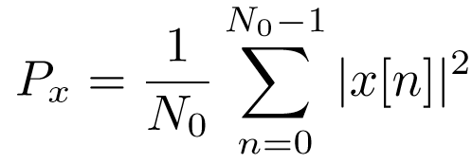
DT Signal Classifications
DT Energy Signals
DT Power Signal
For periodic signal

Slide 26
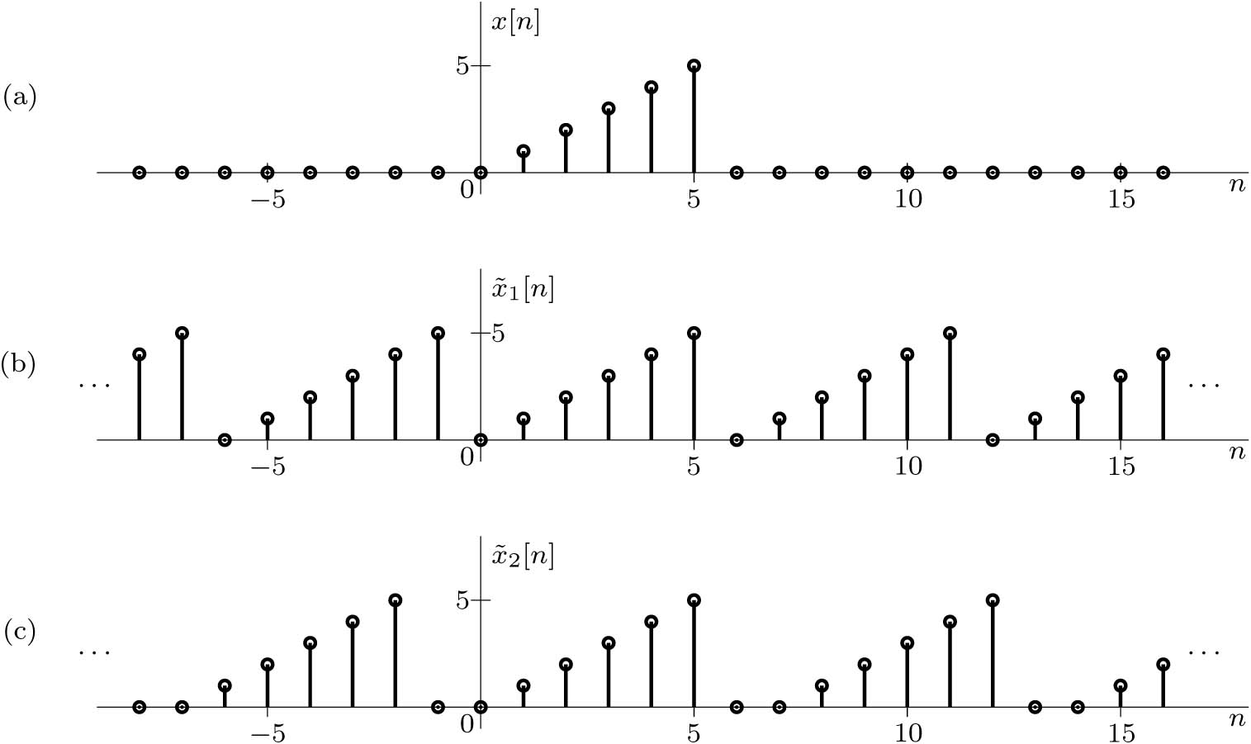
Example

Slide 27
4.4 DT Systems and Examples

Slide 28
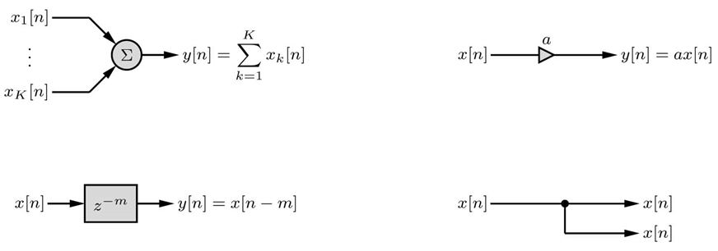
DT Systems and Examples
Discrete-time systems process discrete-time signals (inputs) to yield another set of discrete time signals (outputs). Operator H is used to represent the system function.
$$y\left[n\right]=H\left\{x[n]\right\}$$
The four major blocks in any DT systems are
Adder
Scalar Multiplier
Delay
Branch Node

Slide 29
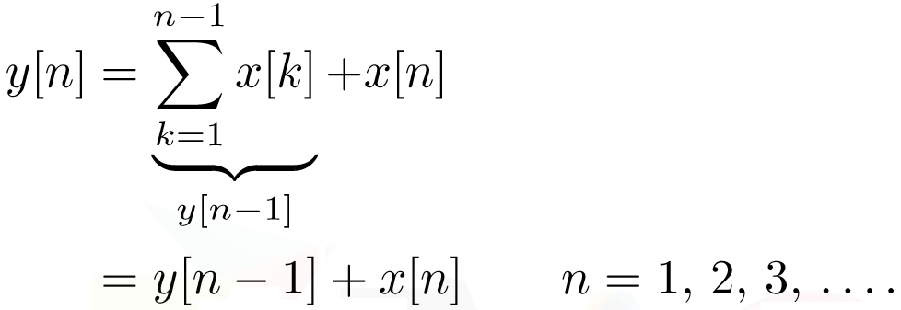
Recursive and Non-Recursive Systems
Non-recursive System: Output is calculated from current and previous inputs.
Recursive System: Output is calculated from previous output and current input.

Slide 30
DT Systems and Examples
Delay and Advance Forms
Delay
$$y\left[n\right]−y\left[n−1\right]=x\left[n\right] n=0, 1, 2, …$$
Advance
$$y\left[n+1\right]−y\left[n\right]=x\left[n+1\right] n=0, 1, 2, …$$
Advance form is noncausal and unrealizable but can be used to predict future value if we are welling to wait for the output.
The Accumulator
$$y\left[n\right]=\sum_{k=−∞}^{n}{x[k]}$$
$$y\left[n\right]−y\left[n−1\right]=x\left[n\right]$$
Accumulator is analogous to the integrator in continuous-time system

Slide 31
Example (Bank Balance)
A person makes a deposit (the input) in a bank regularly at an interval of T = 1 month. The bank pays a certain interest on the account balance during the period T and mails out a periodic statement of the account balance (the output) to the depositor. Find the equation relating the output y[n] (the balance) to the input x[n] (the deposit). Assuming that a person invests $100 monthly starting at n = 1 and earns a 0.5% monthly interest rate, how much money is earned at n = 60 (5 years)? Provide a block diagram representation of the system.
Solution
Let a₁ = (1 + r)
$$y\left[n\right]=a_{1}y\left[n−1\right]+x\left[n\right]$$

Slide 32
Example (Digital Differentiator)
Design a discrete-time system to diﬀerentiate continuous-time signals. Construct a block diagram representation of the system and investigate its response to a ramp input x(t) = tu(t). Suggest an appropriate sampling interval if this is used in an audio system where the input signal bandwidth is below 20 kHz.
Solution
Non-causal so not realizable

Slide 33
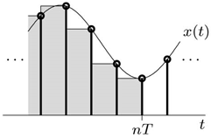
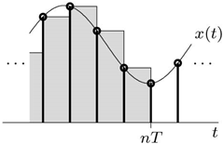
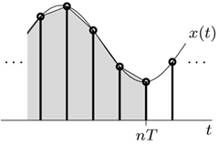
Example (Digital Integrator)
Design discrete-time systems to integrate continuous-time signals using (a) a backward-staircase approximation, (b) a forward-staircase approximation, and (c) a trapezoidal
approximation. Construct a block diagram representation for each system.
Solution
Backward
Forward
Trapezoidal
$$y\left[n\right]=y\left[n−1\right]+Tx\left[n\right]$$
$$y\left[n\right]=y\left[n−1\right]+Tx\left[n−1\right]$$
$$y\left[n\right]=y\left[n−1\right]+\frac{T}{2}\left(x\left[n\right]+x\left[n−1\right]\right)$$

Slide 34
Example (Digital Integrator)
Trapezoidal
$$y\left[n\right]=y\left[n−1\right]+\frac{T}{2}\left(x\left[n\right]+x\left[n−1\right]\right)$$

Slide 35
Order and General Form of Difference Equations
Just as the highest-order derivative of the input or output represents the order of a differential equation, the highest-order difference of the input or output represents the order of a difference equation. Order is reflective of system complexity. For CT systems, order indicates the number of energy storage elements, such as capacitors and inductors, required for implementation. For DT systems, order indicates the required amount of memory.
In advance form

Slide 36
Order and General Form of Difference Equations
Advance Form
Example
Assuming a sampling interval T = 0.1, determine a difference equation model for the differential equation
$\ddot{y}\left(t\right)+4\dot{y}\left(t\right)+3y\left(t\right)=100x(t)$
with initial conditions y(0) = 0 and $\dot{y}(0)$ = 10.
Answer:

Slide 37
Advantage of Digital Signal Processing
Digital systems can tolerate considerable variation in signal values and, hence, are less sensitive to changes in the component parameter values.
Digital systems are extremely flexible and easy to implement.
Even in the presence of noise, reproduction with digital messages is extremely reliable, often without any deterioration whatsoever.
Digital signals are easily and inexpensively stored electronically, without any loss of signal quality.
Digital filters can be easily time shared and therefore can serve a number of inputs simultaneously.
Digital implementation permits the use of a wide variety of hardware options, including computers and microprocessors, DSPs.
Disadvantage: Power consumption, limited frequency range and resolution, system complexity.

Slide 38
4.5 DT System Properties

Slide 39
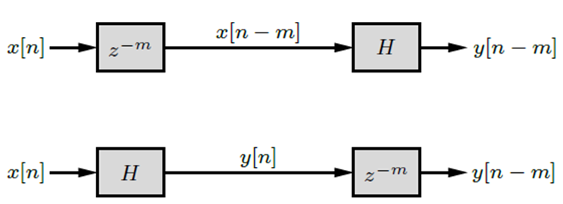
DT System Properties
Time Invariance
Example: A system is described by the equation y[n] = e^{-n} x[n]. Is the system time invariant?
Linearity
If
then

Slide 40
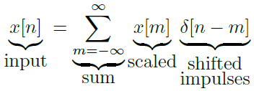
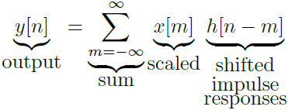
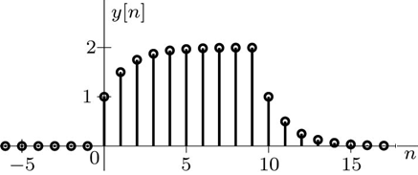
The Zero-State Response of an LTID Systems
Example: Consider an LTID system that has an impulse response h[n] = 2^{−n}u[n]. Using the input x[n] = u[n] − u[n − 10], determine and sketch the zero-state response of this system over −10 ≤ n ≤ 20.
h = @(n) 2.^(-n).*(n>=0); y = @(n) 0;
for m = 0:9,
y = @(n) y(n)+h(n-m);
end
n = -10:20; stem(n,y(n)); xlabel('n'); ylabel('y[n]');

Slide 41
DT System Properties
Causality:
A causal system is one for which the output at any instant n = n₀ depends only on the value of the input x[n] for n ≤ n₀.
h[n] = 0 for n < 0
Example: The general-order difference equation in advance form is
. Show that for the system to be causal K ≥ L.
If L = K and replace n + K by n then the general causal difference equation is

Slide 42
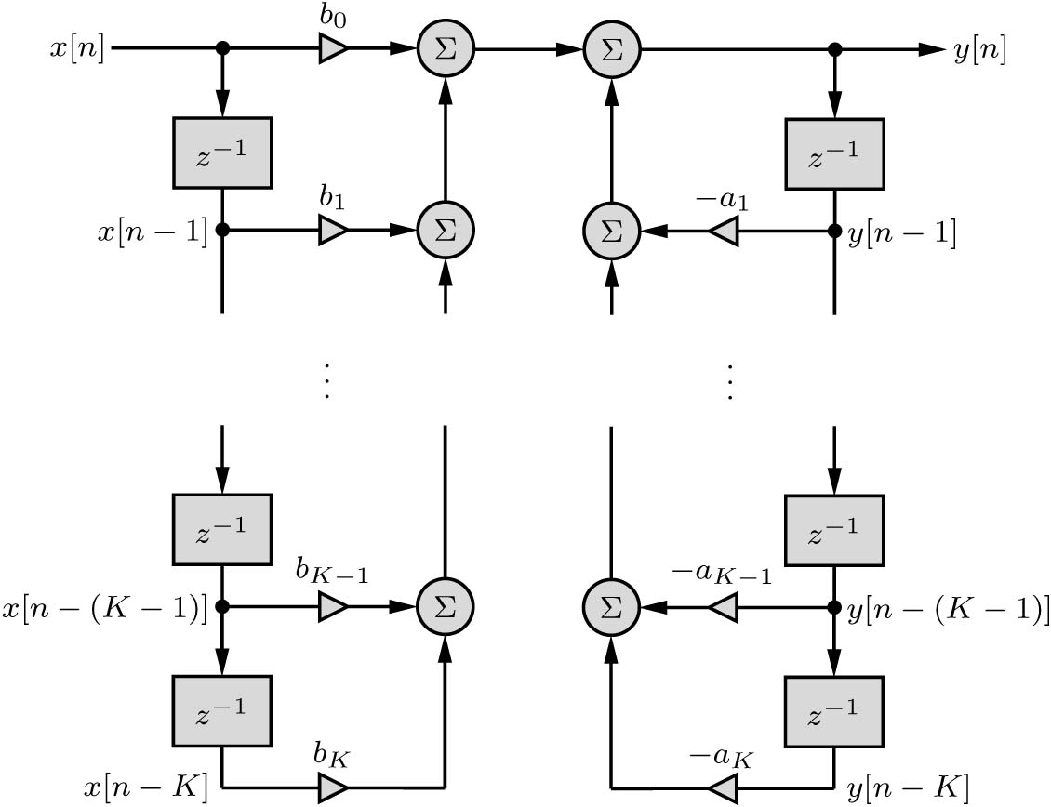
Direct Form 1 Realization of a K^{th} order Difference Equation

Slide 43
DT System Properties
Stability
External Stability (BIBO)
|y[n]| ≤ K_{y} < ∞ if |x| ≤ K_{x} < ∞
Internal Stability (asymptotic and marginal stability): depends on the parameter of the system (Chapter 5)
Memory
If the output of a discrete-time system depends on input values other than the present one, then
the system has memory. Systems with memory are also called dynamic systems. A system without memory is called a memoryless, instantaneous, or static system.
Invertibility
A discrete-time system H is invertible if an inverse system H_{i} exists such that the cascade of H and H_{i} results in an identity system (output equals input).

Slide 44
4.6 Digital Resampling

Slide 45
Digital Resampling
Combined with appropriate filtering, expansion and compression are the backbone operations for multirate systems. These operations provide an effective means to digitally alter the sampling rate of a DT signal, even by non-integer factors.
Compressor (Downsampling )
Antialiasing Filter
Expander (Upsampling)
Interpolator Filter
Cascade ordering of compression and expansion systems does matter in certain cases, see next example.

Slide 46
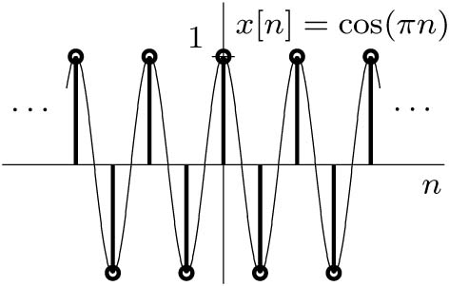
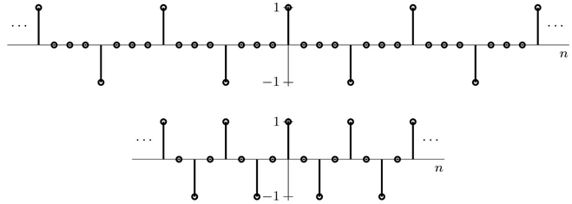
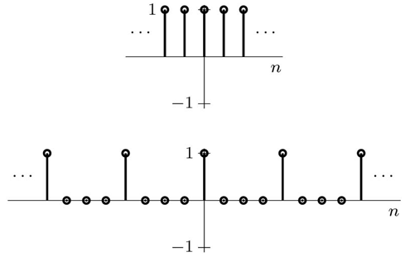
Example: Consider the signal x[n] = cos(πn), whose frequency is the highest possible without aliasing. Determine the output when this signal is applied to the following systems:
(a) An upsample by L = 4 operation followed by a downsample by M = 2 operation.
(b) A downsample by M = 2 operation followed by an upsample by L = 4 operation.
(c) An upsample by L = 3 operation followed by a downsample by M = 2 operation.
(d) A downsample by M = 2 operation followed by an upsample by L = 3 operation.
Upsample L = 4 → Downsample M = 2
Downsample M = 2→Upsample L = 4

Slide 47
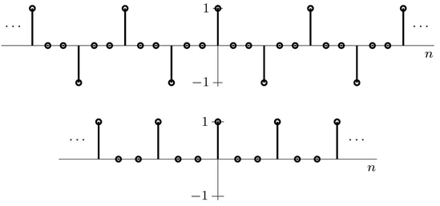
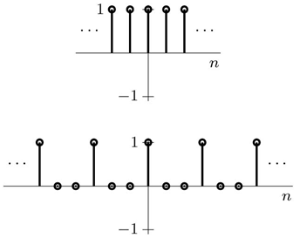
Upsample L = 3 → Downsample M = 2
Downsample M = 2→Upsample L = 3
if L and M are coprime, which is to say they have no common factors other than 1, then the operations of expansion and compression commute. In practice ordering may change aliasing, and speed of operation.

