Slide 1
Time-Domain Analysis of Discrete-Time Systems
ENGR 4333/5333: Digital Signal Processing
Chapter 5
Dr. Mohamed Bingabr
University of Central Oklahoma

Slide 2
Outline
Iterative Solutions to Difference Equations
The Zero-Input Response
The Unit Impulse Response
The Zero-State Response
Total Response
System Stability
Intuitive Insight into System Behavior

Slide 3
Iterative Solutions to Difference Equations
From Chapter 4
A system can be described by the K^{th} order difference equation.
The output y[n] at the n^{th} instant is computed from 2K + 1 pieces of information. These
are the past K output values y[n − 1], y[n − 2], . . . , y[n − K], the past K input values x[n −1], x[n − 2], . . . , x[n − K], and the present input value x[n].

Slide 4
Example for Iterative Solution
Example: Using initial condition y[−1] = 6 and causal input x[n] = cos(nπ/2)u[n], iteratively solve the first-order system given by y[n] − 0.5y[n − 1] = x[n] − 0.5x[n − 1].
y[n] = 0.5y[n − 1] + x[n] − 0.5x[n − 1]
n = (-1:12); x = cos(pi*n/2).*(n>=0);
y = zeros(size(n)); y(n==-1) = 6;
for ind = find(n>=0),
y(ind) = 0.5*y(ind-1)+x(ind)-0.5*x(ind-1);
end
stem(n,y)
y_{zi}
y_{zs}

Slide 5
Recursive and Nonrecursive Equation
IIR System
When a_{k} = 0 for k = (1, . . .,K) then the equation is nonrecursive
FIR System
To calculate the output y[n] we don’t need past values of the outputs so there is no need to calculate the output recursively.
Example
A digital differentiator is represented as
$y\left[n\right]=\frac{1}{T}\left(x\left[n\right]−x[n−1]\right)$
Determine the response of this system to (a) x[n] = u[n] and (b) x[n] = nT u[n].

Slide 6
Recursive versus Nonrecursive Implementations
Recursive require less operation to find the output in comparison to nonrecursive.
Example
Consider a five-point sum, where the current output is simply a sum of the five most recent input values. Express this system using both nonrecursive and recursive forms, and compare the two implementations.
Nonrecursive form requires 4 additions:
y[n] = x[n] + x[n − 1] + x[n − 2] + x[n − 3] + x[n − 4].
4 operations + 4 memories
Recursive form requires 2 additions:
y[n] = x[n] + y[n − 1] − x[n − 5]
2 operations + 2 memories

Slide 7
5.2 Operator Notation

Slide 8
Operator Notation
E{ } notation stands for time shift
$$E\left\{x[n]\right\}≡x\left[n+1\right]$$
$$E^{−1}\left\{x[n]\right\}≡x\left[n−1\right]$$
$$E^{2}\left\{x[n]\right\}≡x\left[n+2\right]$$
$$E^{−2}\left\{x[n]\right\}≡x\left[n−2\right]$$
$$E^{K}\left\{x[n]\right\}≡x\left[n+K\right]$$
$$E^{−K}\left\{x[n]\right\}≡x\left[n−K\right]$$
Example: Express the difference equation using the operator notation
y[n] − 2y[n − 1] − 7y[n − 2] = x[n] + 3x[n − 1]
y[n] − 2E⁻¹{y[n]} − 7E⁻²{y[n]} = x[n] + 3E⁻¹{x[n]}
(1− 2E⁻¹ –7E⁻²){y[n]} = (1+ 3E⁻¹){ x[n]}
Multiply by E² to convert it to advance form
(E²− 2E –7){y[n]} = (E²+ 3E){ x[n]}
A(E) {y[n]} = B(E) {x[n]}

Slide 9
5.3 The Zero-Input Response

Slide 10
The Zero-Input Response
The zero-input response y[n] is the system response to the internal conditions (initial conditions) when the input is zero
Eq. (1)
The only function y[n] that can be summed with its shifted versions to zero for all values of n is the exponential function γ^{n}.
y[n] = cγ^{n}
E{y[n]} = y[n+1] = cγ^{n+1} = γ¹ cγ^{n}
E²{y[n]} = y[n+2] = γ² cγ^{n}

Slide 11
The Zero-Input Response
The total zero-input response is a combination of all possible solutions.
A(γ) = 0 is the characteristic equation
A(γ) is the characteristic polynomial
γ₁, γ₂, … , γ_{K} are the characteristic roots, eigenvalues
$γ_{k}^{n}$ is the characteristic mode

Slide 12
Example
Using initial conditions y[−1] = 0 and y[−2] = 25/4 , determine the zero-input response of an LTID system described by the difference equation
y[n + 2] − 0.6y[n+ 1] − 0.16y[n] = 5x[n + 2].
Solution
>> c = inv([-5 5/4; 25 25/16])*[0; 25/4]

Slide 13
Repeated Roots
Example: Using initial conditions y[−1] = − 1/3 and y[−2] = − 2/9 , determine the zero-input response of an LTID system described by the difference equation
y[n + 2] + 6y[n+ 1] + 9y[n] = 2x[n + 2]+ 6x[n + 1].
Solution
y[n] = (c₁ + c₂n)(-3)^{n}
y[n] = (4 + 3n)(-3)^{n}
>> c = inv([(-3)^(-1) (-1)*(-3)^(-1); (-3)^(-2) (-2)*(-3)^(-2)]) * [-1/3; -2/9]

Slide 14
Complex Roots
If one of the characteristic root is complex, then a second root will be its conjugate.

Slide 15
Example
Using initial conditions y[−1] = 2 and y[−2] = 1 , determine and plot the zero-input response of an LTID system described by the difference equation
(E² – 1.5588 E + 0.81){y[n]} = (E + 3){x[n]}.
Solution
>> gamma = roots([1 -1.5588 0.81])
gamma = 0.7794+0.4500i 0.7794-0.4500i
$$γ^{2}−1.5588γ+0.81=0$$
c = inv([gamma(1)^(-1) gamma(2)^(-1);gamma(1)^(-2) gamma(2)^(-2)])*([2;1])
c = 1.1538-0.1984i 1.1538+0.1984i

Slide 16
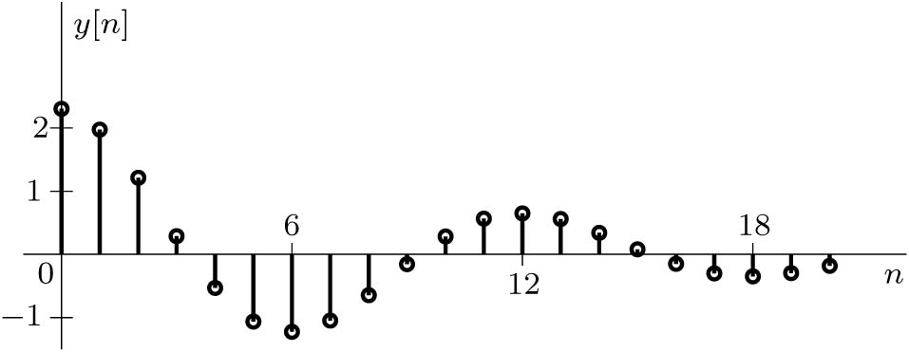
Example-Real form solution of Complex Roots
To express the output in a real form
then find the magnitude and angle of the complex roots and constants.
$$γ_{1}=\left|γ\right|e^{jβ}$$
$$c_{1}=\frac{c}{2}e^{jθ}$$
γ₁= 0.78 + j0.45 = 0.9e^{jπ/6} so |γ| = 0.9 and β = π/6
c₁= 1.154 − j0.1984 = 1.171e^{-j0.17} so c = 2 c₁= 2.342 and θ = − 0.17 rad

Slide 17
Insights into the Zero-Input Behavior of a System
Combination of the characteristic mode
Due to energy stored at the system due to previous inputs.
Resonance Response

Slide 18
5.4 The Unit Impulse Response

Slide 19
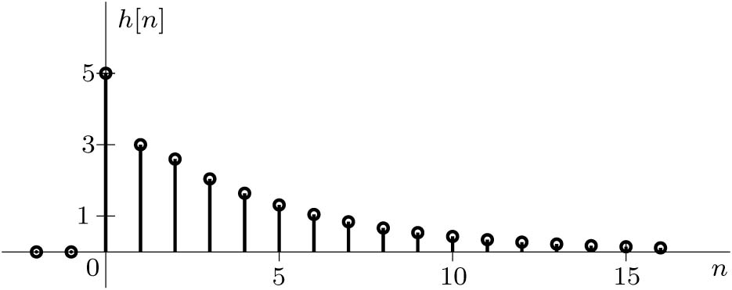
The Unit Impulse Response h[n]
The K th-order system is described by
The unit impulse response h[n] is the system output for input δ[n] with all initial conditions are set to zeros (no energy stored in the system).
To determine h[n], the above equation can be solved iteratively or in a closed form.
Example 5.8: Iteratively find and then plot the unit impulse response h[n] of a system described by the equation
y[n] − 0.6y[n − 1] − 0.16y[n − 2] = 5x[n].
Solution
n = (-2:16); delta = (n==0); h = zeros(size(n));
for ind = find(n>=0),
h(ind) = 0.6*h(ind-1)+0.16*h(ind-2)+5*delta(ind);
end
stem(n,h)

Slide 20
The Unit Impulse Response-Closed Form
The unit impulse response will consist of response at n = 0 due to the impulse and combinations of the characteristic modes for n > 0 since the impulse input does not exist for n ≠ 0.
y[n] + a₁y[n-1] + a₂y[n-2] + … + a_{K}y[n-K] = b₀x[n] + b₁x[n-1] + … + b_{L}x[n-L]
First Case: L < K
h[n] = c₁(γ₁)^{n} + c₂(γ₂)^{n} + … + c_{K}(γ_{K})^{n}
Second Case: L = K
h[n] = (b_{K}/a_{K})δ[n] + c₁(γ₁)^{n} + c₂(γ₂)^{n} + … + c_{K}(γ_{K})^{n}
Third Case: R Zero Characteristic Roots
h[n] = A₀δ[n] + A₁δ[n-1] +…+ A_{R}δ[n-R] + c₁(γ₁)^{n} + c₂(γ₂)^{n} + … + c_{K-R}(γ_{K-R})^{n}
The constants c₁, c₂, … and A₀, A₁, … can be found by using h[0], h[1], …, h[K] as initial conditions and then solve the polynomial equations. h[0], h[1], …, h[K] can be found by iterative calculation.

Slide 21
Example-Finding h[n] in closed Form
Determine a closed-form representation of the unit impulse response h[n] for the system specified by the difference equation
y[n] − 0.6y[n − 1] − 0.16y[n − 2] = 5x[n]
Solution
By iterative calculation wih h[n] = 0 for all n < 0 we can find h[0] = 5 and h[1] = 3. Use these values to solve for the constants c₁ and c₂ in the above equation. (c₁ = 1 and c₂ = 4).
h[n] = [(−0.2)^{n} + 4(0.8)^{n}] u[n]

Slide 22
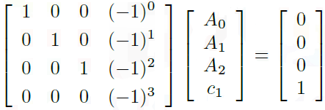
Example-Finding h[n] with Zero Characteristic Roots
Determine the impulse response h[n] of a system described by the equation
(E³ + E²) {y[n]} = x[n].
Solution
γ²(γ+1) = 0
h[n] = A₀δ[n] + A₁δ[n − 1] + A₂δ[n − 2] + c₁(−1)^{n}u[n].
To solve for A₀, A₁, A₂, c₁ we need to solve the above equation iteratively to obtain vlaues for h[0], h[1], h[2], and h[3].
coef = inv([1 0 0 1;0 1 0 -1;0 0 1 1;0 0 0 -1])*([0;0;0;1])
coef = 1 -1 1 -1
n = (-3:3); delta = (n==0); h = zeros(size(n));
for ind = find(n>=0),
h(ind) = -h(ind-1)+delta(ind-3);
end
h(n>=0)
ans = 0 0 0 1
h[n] = δ[n] − δ[n − 1] + δ[n − 2] − (−1)^{n}u[n].

Slide 23
Impulse Response of Nonrecursive System
y[n] = b₀x[n] + b₁x[n − 1] + · · · + b_{K}x[n − K]
Let x[n] = δ[n] and y[n] = h[n]
A nonrecursive system has no natural modes.

Slide 24
5.5 The Zero-State Response

Slide 25
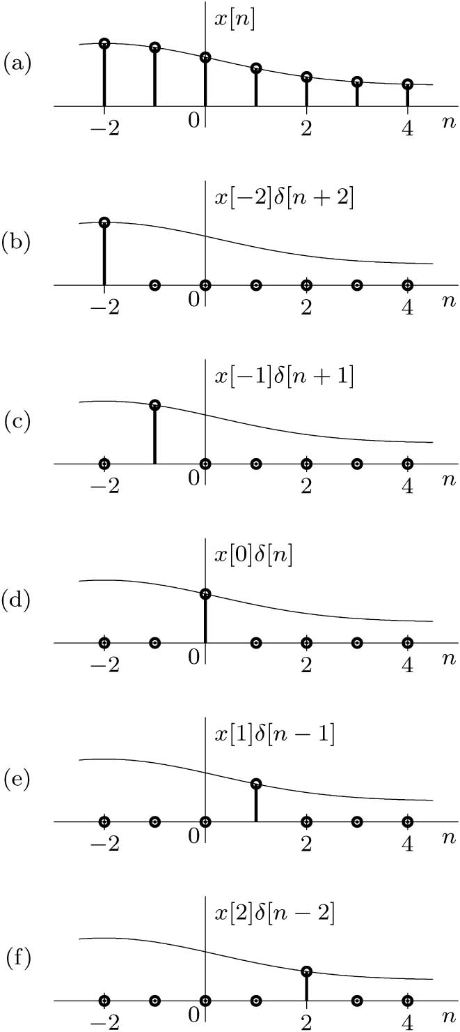
The Zero-State Response
The zero-state response y[n] is the system response to an input x[n] when the system is in zero state (all initial conditions are zeros).
Any signal can be expressed as a linear sum of impulses
x[n] = · · · + x[-2] δ[n+2]+ x[-1] δ[n+1]+
x[0] δ[n]+ x[1] δ[n-1]+ x[2] δ[n-2]+ · · ·
$$x\left[n\right]=\sum_{m=−∞}^{∞}{x\left[m\right]δ[n−m]}$$
x[n]
y[n]
S
δ[n]
h[n]
$$y\left[n\right]=\sum_{m=−∞}^{∞}{x\left[m\right]δ[n−m]∗h[n]}$$
Convolution
$$y\left[n\right]=\sum_{m=−∞}^{∞}{x\left[m\right]h[n−m]}$$
y[n] = x[n] ∗ h[n]

Slide 26
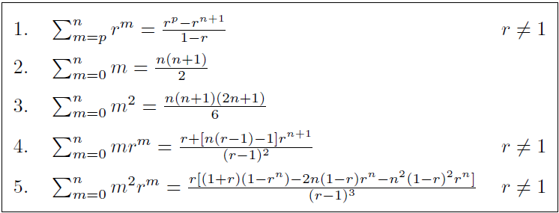
The Zero-State Response
For a causal input and causal system, the input output relationship is
$$y\left[n\right]=\sum_{m=0}^{n}{x\left[m\right]h[n−m]}$$
Example: Analytically determine the DT convolution for x[n] = (0.8)^{n}u[n] and h[n] = (0.3)^{n}u[n].
Answer:
y[n] = 2 [(0.8)^{n+1} − (0.3)^{n+1}]u[n]

Slide 27
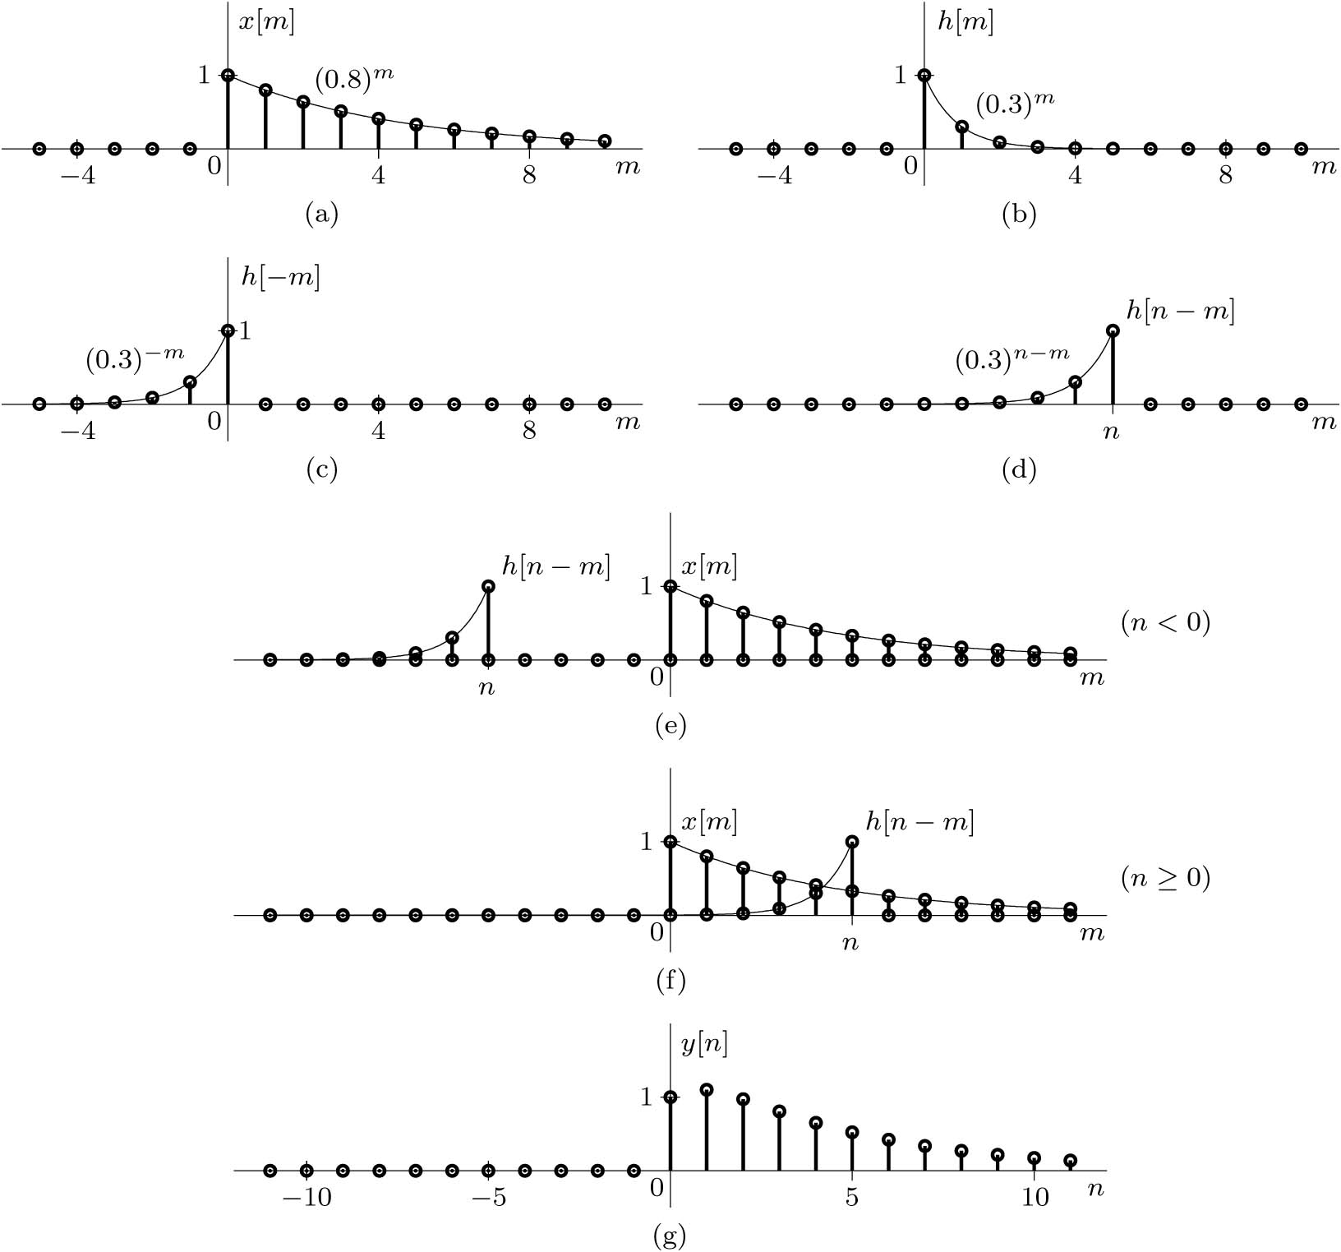
Graphical Procedure for the Convolution Sum
$$y\left[n\right]=\text{x}\text{[}\text{n}\text{] ∗} \text{h}\text{[}\text{n}\text{] =}\sum_{m=−∞}^{∞}{x\left[m\right]h[n−m]}$$
Example: Using the graphical approach, show the DT convolution y[n] = x[n]∗h[n]
For x[n] = (0.8)^{n}u[n] and h[n] = (0.3)^{n}u[n].

Slide 28
Convolution Sum Properties
Commutative Property: x[n] ∗ h[n] = h[n] ∗ x[n]
Distributive Property: x[n] ∗ (h₁[n] + h₂[n] ) = x[n] ∗ h₁[n] + x[n] ∗ h₂[n]
Associative Property: x[n] ∗ (h₁[n] ∗ h₂[n] ) = (x[n] ∗ h₁[n]) ∗ h₂[n]
Shifting Property: if x[n] ∗ h[n] = y[n] then x[n-m] ∗ h[n-p] = y[n-m-p]
Convolution with an impulse: x[n] ∗ δ[n] = x[n]
Width and Length Property: if x[n] has width W_{x} (length L_{x}) and h[n] has width W_{h} (length L_{h}) then the width of the convolution y[n]= x[n] ∗ h[n] is W_{y} = W_{x}+W_{h} (length L_{y} = L_{x}+ L_{h} - 1)

Slide 29
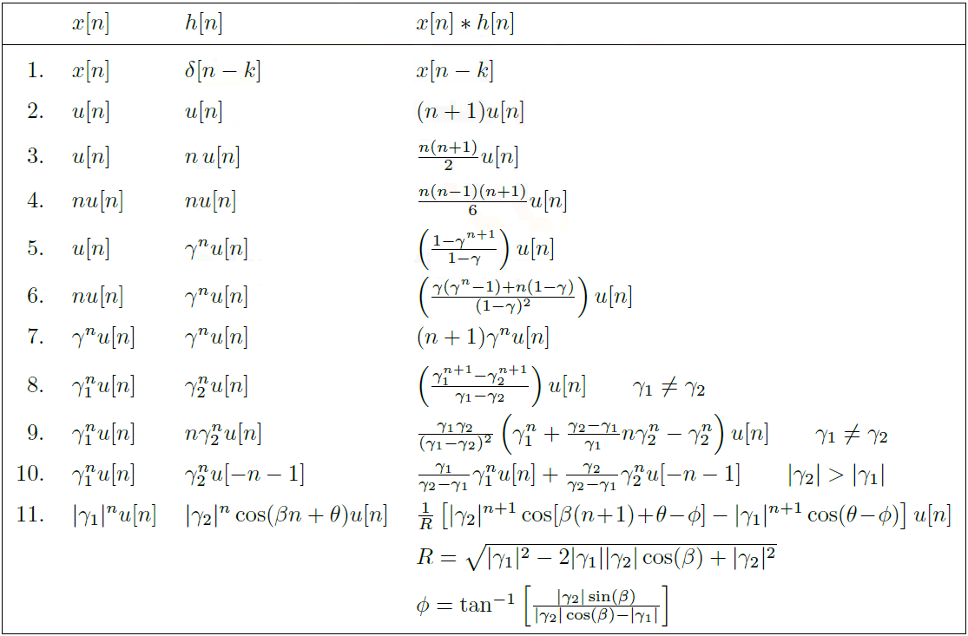

Slide 30
Example
Use the convolution properties and the table to find the zero-state response y[n] for the input x[n] = 4^{−n}u[n] of an LTID system described by the equation
y[n + 2] − 0.6y[n+ 1] − 0.16y[n] = 5x[n + 2];
Answer
h[n] = [(−0.2)^{n} + 4(0.8)^{n}] u[n].
y[n] = [−1.26(4)^{−n} + 0.444(−0.2)^{n} + 5.82(0.8)^{n}]u[n]
What if the system is modified as follow
y[n + 2] − 0.6y[n+ 1] − 0.16y[n] = 5x[n + 1];

Slide 31
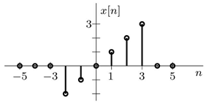
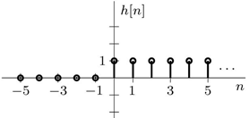
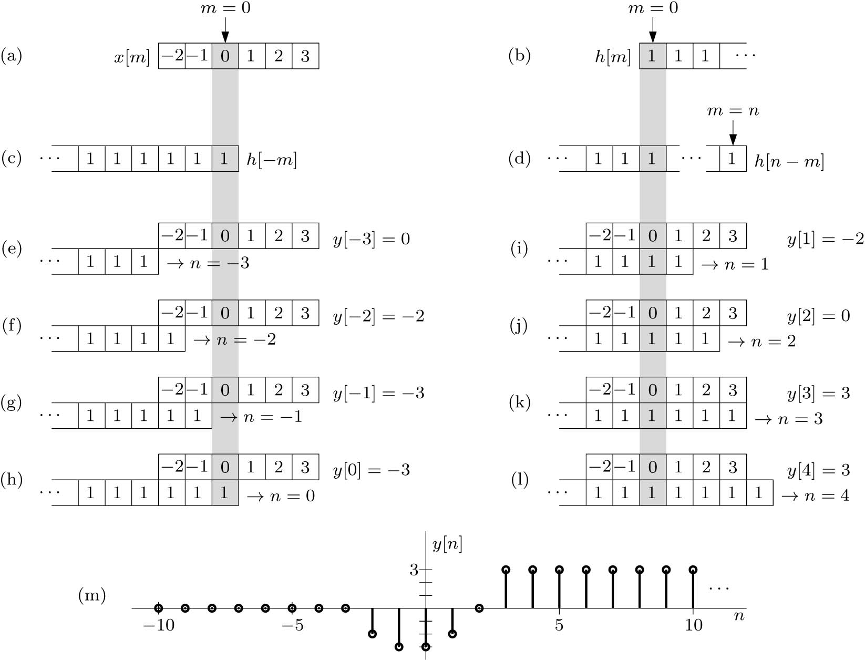
Graphical Procedure: Sliding-Tape Method
$$y\left[n\right]=\sum_{m=−∞}^{∞}{x\left[m\right]h[n−m]}$$
Example: Using the sliding-tape approach, determine the DT convolution y[n] = x[n] ∗ h[n] using the signals x[n] = n(u[n + 2] − u[n − 4]) and h[n] = u[n]
h[n-m]
Matlab Code
x = [-2,-1,0,1,2,3]; h = ones(1,10);
n = (-2:-2+length(x)-1+length(h)-1);
stem(n,conv(x,h));

Slide 32
Graphical Procedure: Sliding-Tape Method
x[n]
h[n]
-3
-1
0
2
1
3
1
0
0
1
2
3
4
n
n
$$y\left[n\right]=\sum_{m=−∞}^{∞}{x\left[m\right]h[n−m]}$$
x[m]
-3
-1
0
2
1
3
1
0
m
h[n-m]
4
3
2
1
0
m
-6
-5
-4
-3
-2
-1
1
2
3
4
5
6
7
8
9
0
-3
-7
-11
-13
1
11
18
15
15
4
0
y[n]

Slide 33
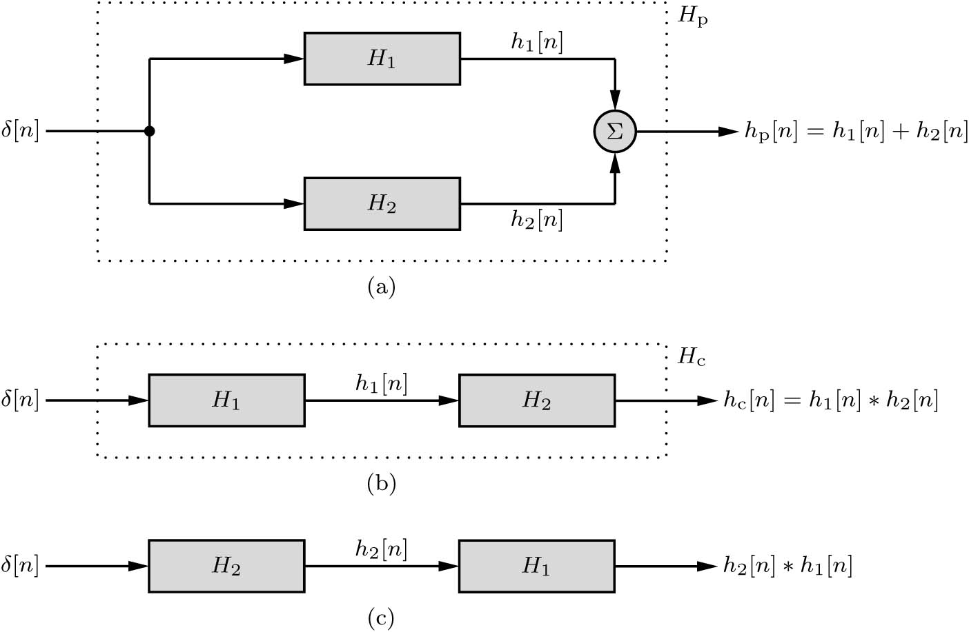
Interconnected Systems
Parallel Connection
Cascade Connection
Example: Show that the inverse of a discrete-time accumulator (CT integrator) is a first-order backward difference system (CT differentiator). Hint: h[n] ∗ h_{i}[n] = δ[n].

Slide 34
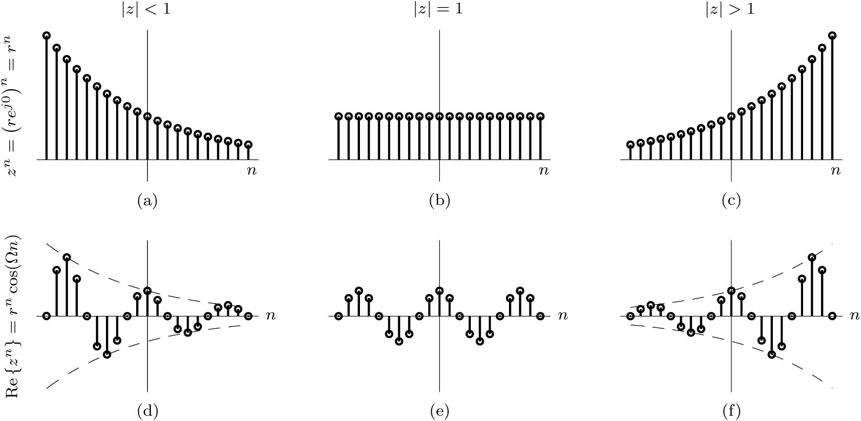
LTID System Response to an Everlasting Exponential x[n] = Z^{n}
Let
Then
x[n] = Z^{n} = (re^{jΩ} )^{n}
For a given z, H(z) is a constant (could be real or complex).
H(z) is the transfer function of the system. It is the system response to different values of z.
The output converges if H(z) converge, and H(z) converges if |z| < 1 and the system is stable.

Slide 35
Systems Transfer Function and Frequency Response
LTID systems is described by
For a special case z = e^{jΩn}
Where
is the frequency response of the system.

Slide 36
Example
Determine the transfer function and frequency response of the following systems:
a) digital differentiator given by y[n +1] = 1/T (x[n + 1] − x[n])
Find the output y[n] for the input x[n] = (0.8)^{n}
b) a unit-delay system given by y[n] = x[n − 1]
x[n]
1
0.8
0.64
0.51
0.41
1
2
3
4
n
x[n-1]
1
0.8
0.64
0.51
0.41
1
2
3
4
5
n

Slide 37
5.6 Total Response

Slide 38
Total Response
y_{zsr} [n]
y_{zir} [n]
Example: Using the initial conditions y[−1] = 0 and y[−2] = 25/4 and the input x[n] = 4^{−n}u[n], determine and sketch the total response y[n] of an LTID system described by the equation
y[n + 2] − 0.6y[n+ 1] − 0.16y[n] = 5x[n + 2].
Solution

Slide 39
5.7 System Stability

Slide 40
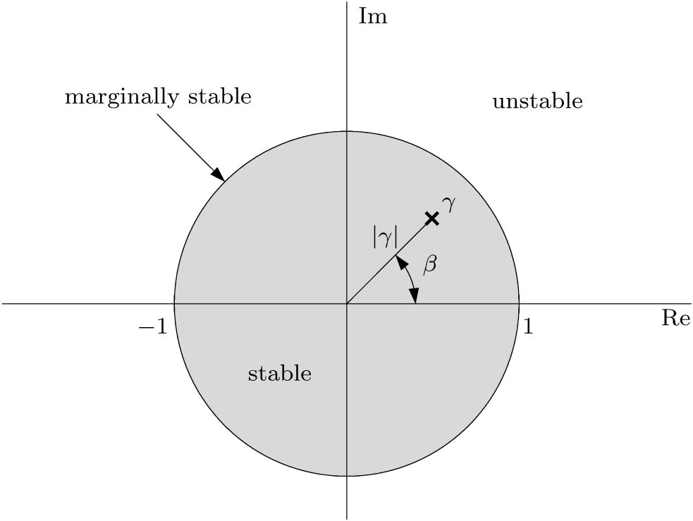
System Stability
External Stability (BIBO)
If the input x[n] is bounded, then the output will be bounded if
$$\sum_{n=−∞}^{∞}{|h[n]}|<∞$$
Internal Stability (Asymptotic)
The output of a system consist of a wave similar to the input and a combination of the characteristic modes of the system γ.
γ = |γ|e^{jβ} and γ^{n} = |γ|^{n} e^{jβn}
if |γ| < 1, then γ^{n} → 0 as n → ∞; Stable
if |γ| > 1, then γ^{n} → ∞ as n → ∞; Unstable
and if |γ| = 1, then |γ|^{n} = 1 for all n Marginally Stable

Slide 41
System Stability
A causal LTID system is asymptotically stable if and only if all the characteristic roots are inside the unit circle. The roots may be simple or repeated.
A causal LTID system is marginally stable if and only if there are no roots outside the unit circle, and there are non-repeated roots on the unit circle.
A causal LTID system is unstable if and only if at least one root is outside the unit circle or there are repeated roots on the unit circle or both.
Repeated roots (r roots) on the unit circle will cause the system to be unstable because the characteristic modes will be n^{r-1}γ^{n}.
n^{r-1}γ^{n}→ ∞ as n → ∞, because | γ|^{n}=1

Slide 42
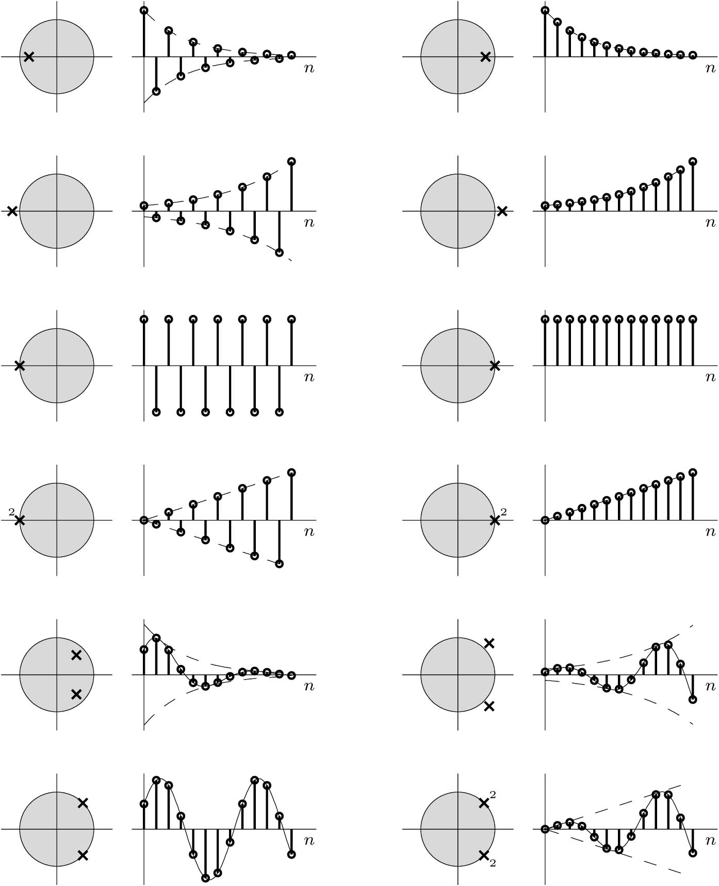

Slide 43
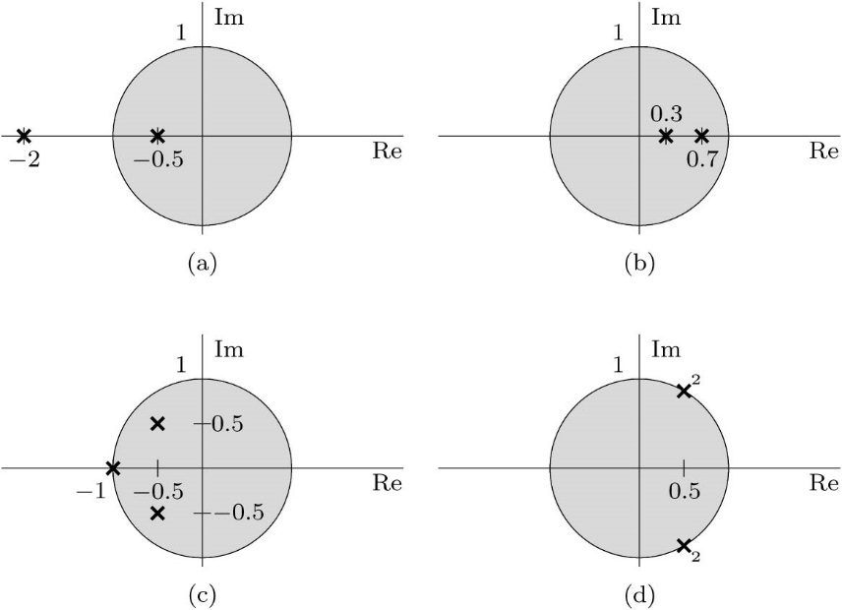
Example
Determine the internal and external stabilities of the systems specified by the following equations. In each case, plot the characteristic roots in the complex plane. Each system is both controllable and observable.
(a) y[n + 2] + 2.5y[n + 1] + y[n] = x[n + 1] − 2x[n]
(b) y[n] − y[n − 1] + 0.21y[n − 2] = 2x[n − 1] + 3x[n − 2]
(c) y[n + 3] + 2y[n + 2] + 3/2y[n + 1] + 1/2y[n] = x[n + 1]
(d) (E² − E + 1)² {y[n]} = (3E + 1) {x[n]}
(e) Two cascaded systmes with h₁[n] = 4δ[n] − 3(0.5)^{n}u[n] and h₂[n] = 2^{n}u[n].
h_{c}[n] = (0.5)^{n}u[n]

Slide 44
5.8 Intuitive Insights into System Behavior

Slide 45
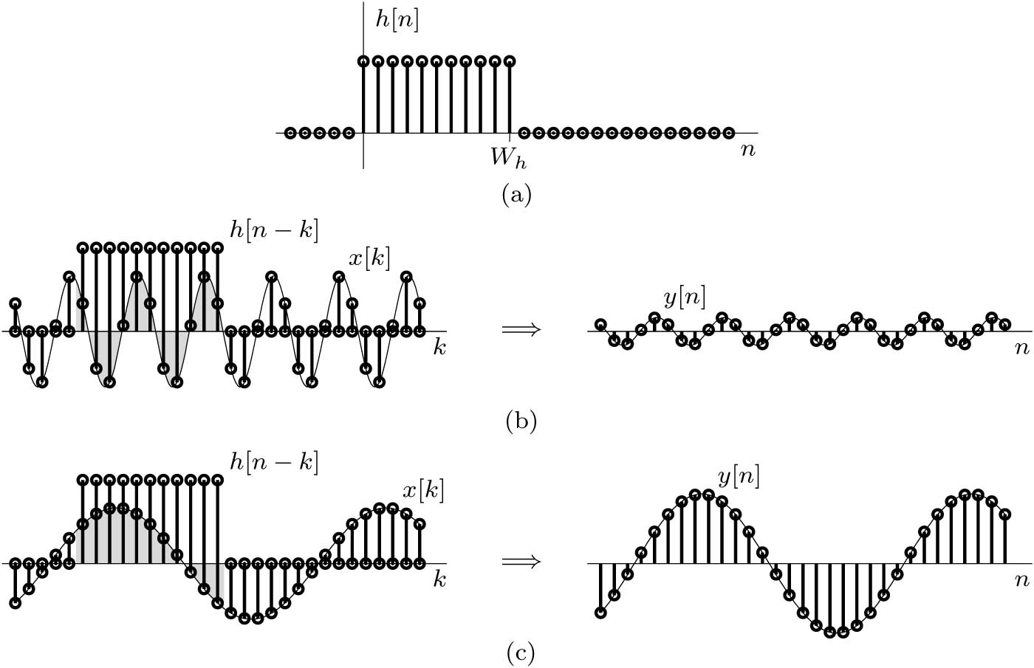
Characteristic Roots and System Behavior
Dependence of System Behavior on Characteristic Modes.
Response Time of a System: The System Time Constant.
Time Constant and Rise Time of a System.
Time Constant and Filtering (W_{h} α 1/f_{c} )
Time Constant and Pulse Dispersion
The Resonance Phenomenon
Time Constant Approximation
$$\left(W_{\hat{h}}+1\right)h\left[m\right]=\sum_{n=−∞}^{∞}{h[n]}$$
Time Constant and Filtering
Time Constant as Rise Time

Slide 46
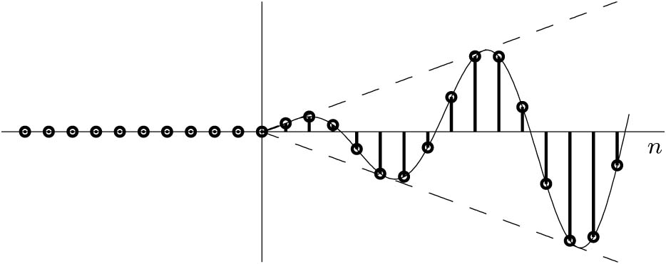
Resonance Phenomenon
The system respond strongly (large output) to an input that is similar or the same as one of the system characteristic modes.
If |γ| < 1 then the output y[n] will eventually goes to zero.
If |γ| = 1 then the output will oscillate and grow to infinity.

