Slide 1
Discrete-Time System Analysis Using the z-Transform
Chapter 7
Dr. Mohamed Bingabr
University of Central Oklahoma

Slide 2
Outline
The z-Transform
The inverse z-Transform
Properties of the z-Transform
Z-Transform Solution of Linear Difference Equations
Block Diagram and System Realization
Frequency Response of Discrete-Time Systems
System Design by Poles and Zeros Placement.

Slide 3
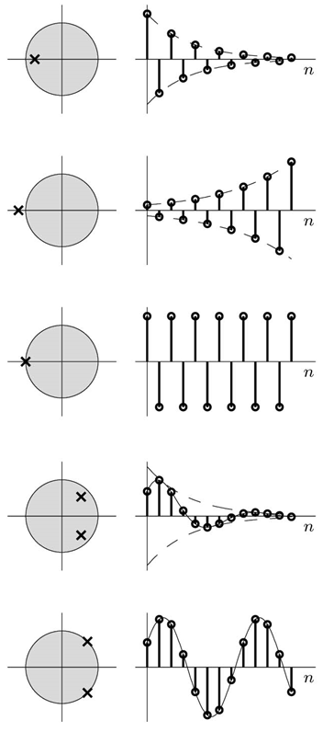
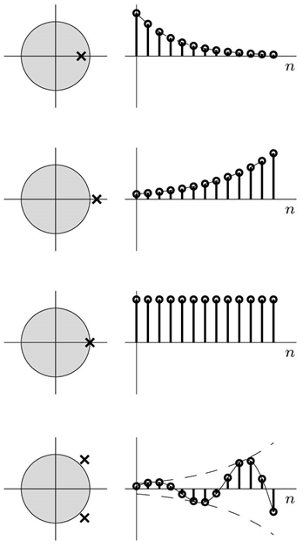
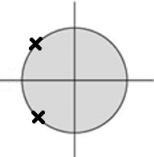
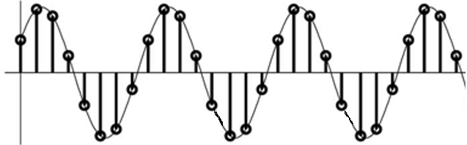

x[n] = z^{n}
z = -0.8
z = 0.8
z = -1.2
z = 1.2
z = -1
z = 1
$$x\left[n\right]=z_{1}^{n}+z_{2}^{n}$$
z₁ = 0.8e^{jπ/4}
z₂ = 0.8e^{-jπ/4}
z₁ = 1.2e^{jπ/4}
z₂ = 1.2e^{-jπ/4}
z₁ = 1e^{jπ/4}
z₂ = 1e^{-jπ/4}
z₁ = 1e^{j3π/4}
z₂ = 1e^{-j3π/4}

Slide 4
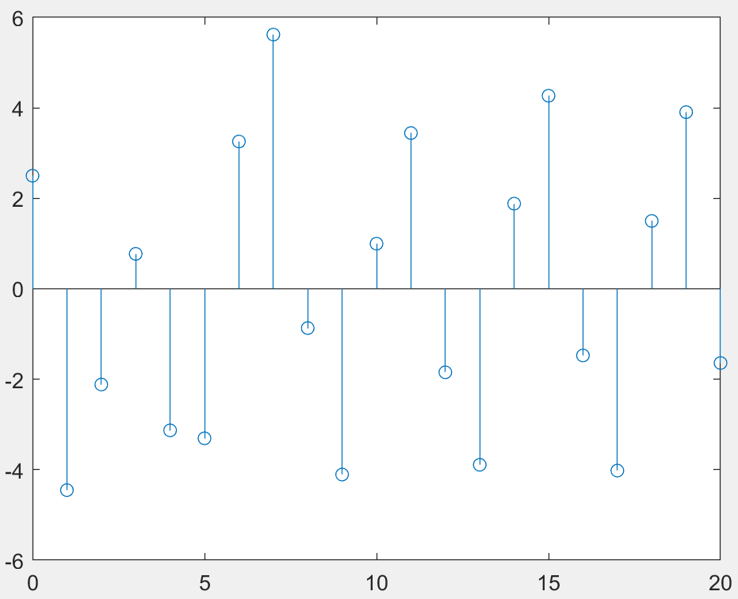
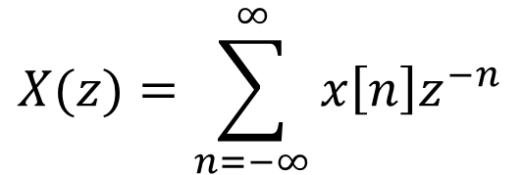
Z-Transform
Discrete Time Domain
Z – Domain and z-plane
$$X(z)=\sum_{n=−∞}^{∞}{x\left[n\right]z^{−n}}$$
$$x\left[n\right]={(0.5)(0.8)}^{n} + \left(−0.4\right){\left(−0.7\right)}^{n} + {(2+j3){(0.8e}^{\frac{jπ}{4}})}^{n} +{ (2−j3){(0.8e}^{−\frac{jπ}{4}})}^{n}+$$
$$(−0.8+j2){{(1e}^{jπ/2})}^{n}+{(−0.8−j2){(1e}^{−jπ/2})}^{n}$$

Slide 5
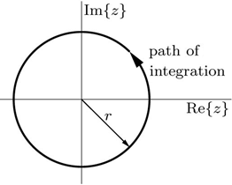

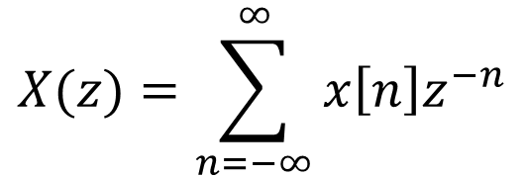
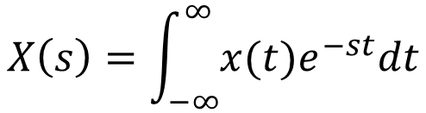
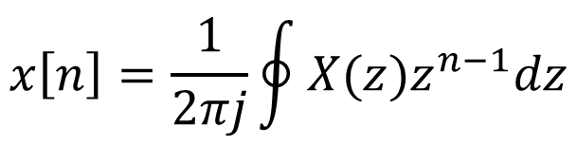
The Bilateral z-Transform
The z-transform is a mathematical tool in system analysis and design. It represent input x[n] as a sum of everlasting exponentials (complex frequency) of the form z^{n}.
The Bilateral z-transform: x[n] exist for positive and negative n.
$$X(z)=\sum_{n=−∞}^{∞}{x\left[n\right]z^{−n}}$$
$$z={re}^{jΩ}$$
The Laplace Transform
$$X\left(s\right)=\int_{−∞}^{∞}{x(t)e^{−st}dt}$$
s = σ + jω
$$x\left[n\right]=\frac{1}{2πj}\oint{X(z)z^{n−1}dz}$$
The inverse z-transform
Complex variable theory

Slide 6

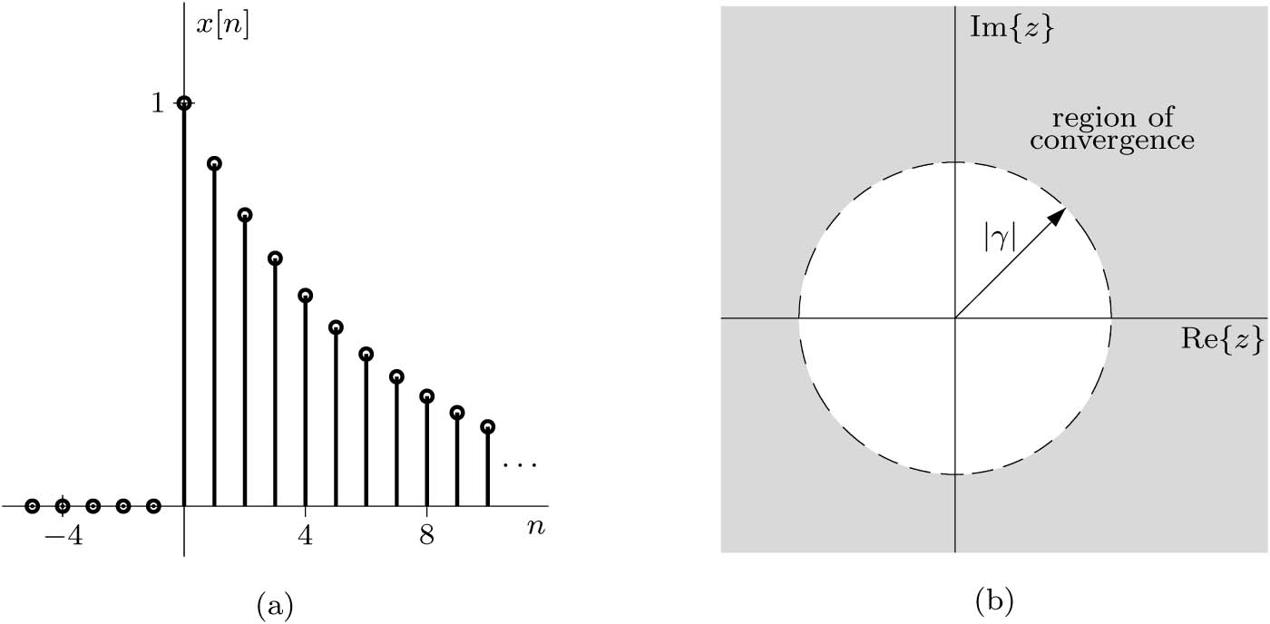



Example
Find the z-transform and the corresponding ROC for the causal signal x[n] = γ^{n} u[n].
Solution
$$\sum_{n=p}^{m}{r^{n}=\frac{r^{p}−r^{m+1}}{1−r}}$$
Note: for causal signal the ROC extend outward to the centered circle.

Slide 7
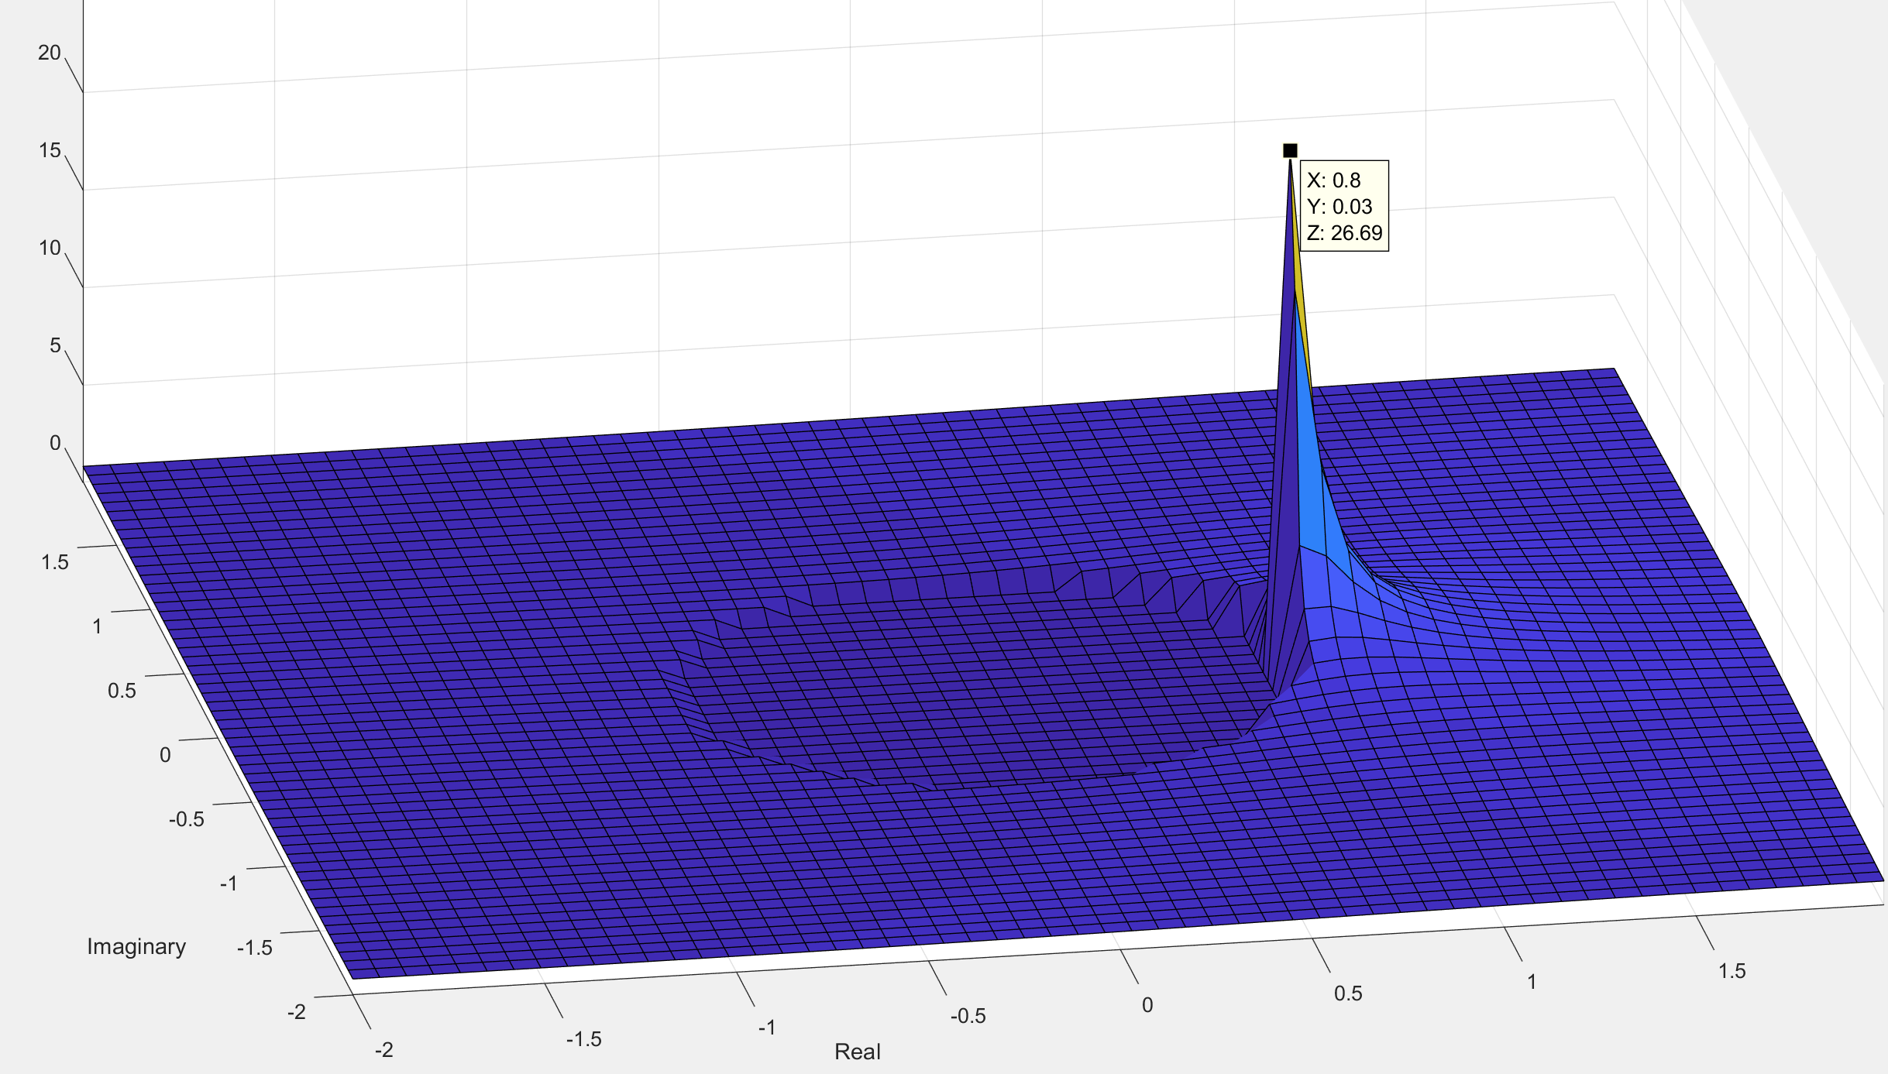


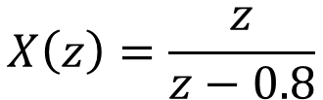



Z-Plane
$$z=re^{jΩ}$$
$$x\left(n\right)={(0.8)}^{n} u[n]$$
$$\left|X(z)\right|$$
$$X\left(z\right)=\frac{z}{z−0.8}$$
ROC |Z| > 0.8

Slide 8
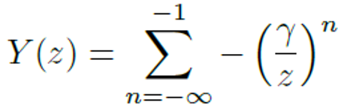
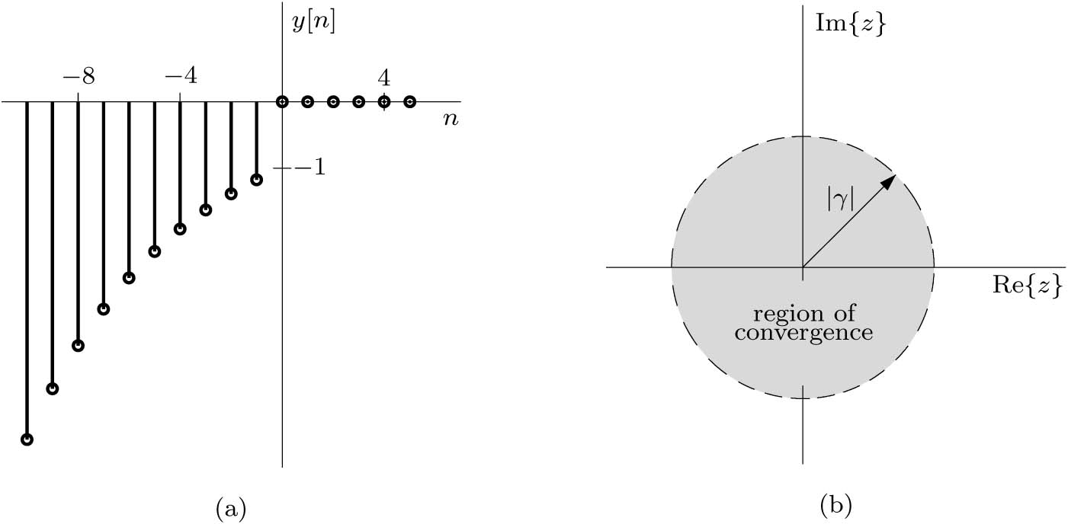



Example
Find the z-transform and the corresponding ROC for the non-causal signal y[n] = -γ^{n} u[-n-1].
Solution
$$\sum_{n=p}^{m}{r^{n}=\frac{r^{p}−r^{m+1}}{1−r}}$$
Note: for anti-causal signal the ROC extend inward to the centered circle.

Slide 9
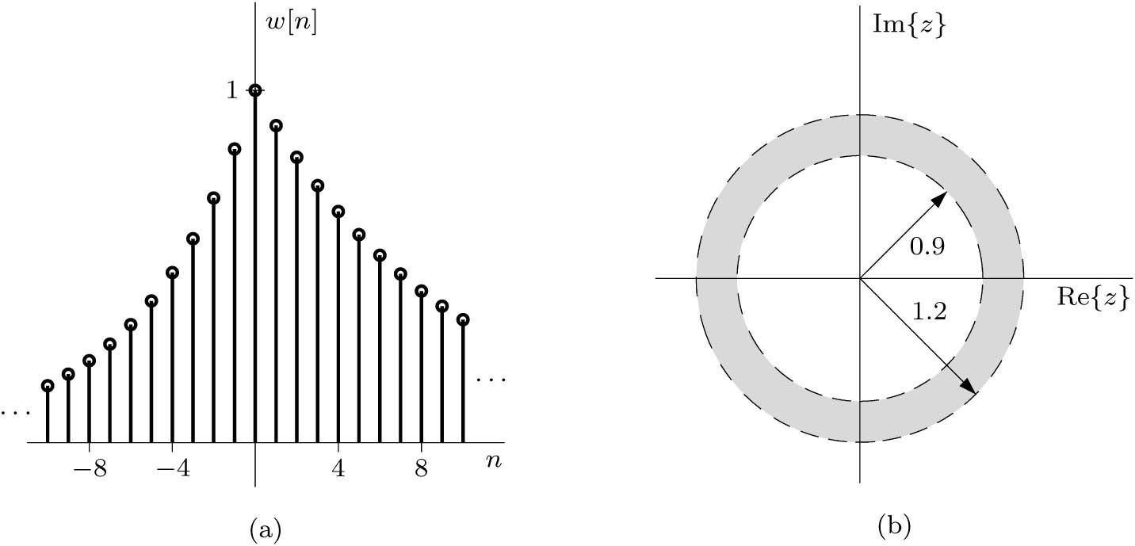


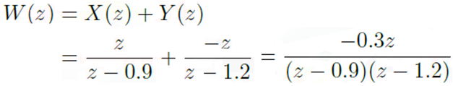
Example
Find the z-transform of w[n] = x[n] + y[n] where x[n] = (0.9)^{n} u[n] and y[n] = (1.2)^{n} u[-n-1].
What is the z-transform of w[n] if x[n] is changed to (2)^{n} u[n].
Solution
If x[n] is changed to (2)^{n} u[n] then the ROC of X(z) becomes |z| > 2 and there is no common ROC for X and Y so the z-transform for w does not exist.

Slide 10


The Unilateral z-Transform
When the signal is causal, x[n] = 0 for n < 0, then the z-transform is unilateral:
Example: Determine the unilateral z-transforms of
(a) x_{a}[n] = δ[n], (b) x_{b}[n] = u[n] − u[n − 5].

Slide 11


Existence of the Bilateral z-Transform
The z-transform exist for any signal x[n] that grows no faster than an exponential signal r^{n}, for some real and positive r.
For a finite length sequence, the ROC is the entire z-plane except zero if x[n] is nonzero for some positive n, and ∞ if x[n] is nonzero for some negative n.
If z = x + y then the region of convergence R_{z} for z is at least R_{x} ∩ R_{y}.

Slide 12
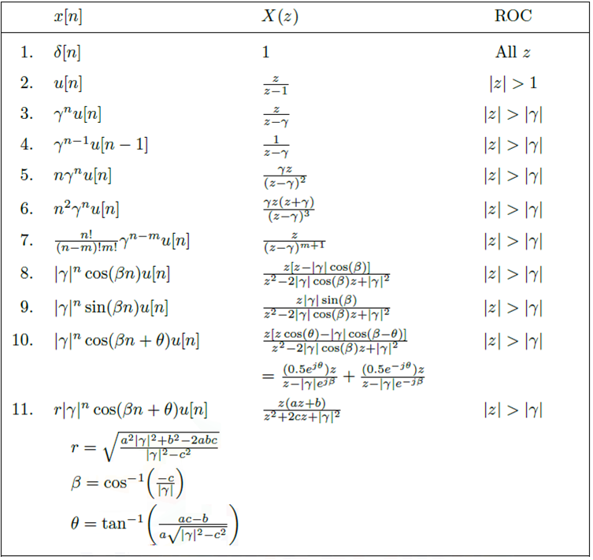
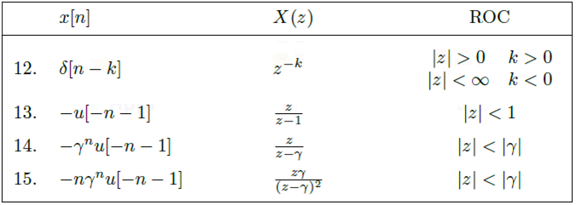
Z-Transform of Popular Functions

Slide 13
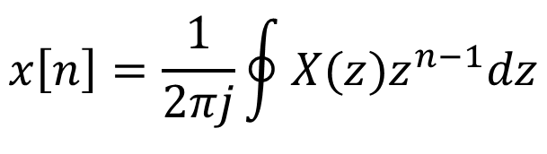
The Inverse Z-Transform
$$x\left[n\right]=\frac{1}{2πj}\oint{X(z)z^{n−1}dz}$$
Using the contour integral to find the inverse z-transform require the knowledge of complex variable theory so we will use the table and partial fraction expansions to find the inverse z-transform.

Slide 14
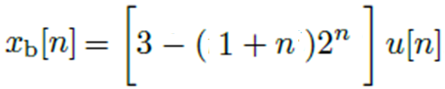
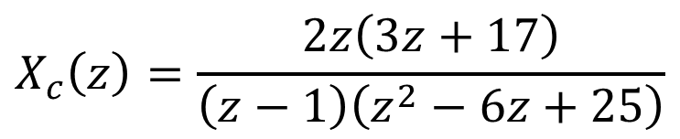
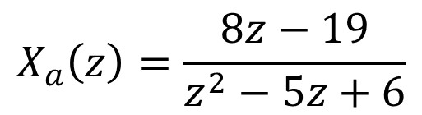
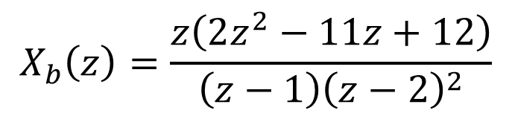

The Inverse z-Transform
Distinct Real Roots (Poles)
$$X_{a}\left(z\right)=\frac{8z−19}{z^{2}−5z+6}$$
Repeated Roots (Poles)
$$X_{b}\left(z\right)=\frac{z\left(2z^{2}−11z+12\right)}{\left(z−1\right){\left(z−2\right)}^{2}}$$
Complex Roots (Poles)
$$X_{c}\left(z\right)=\frac{2z\left(3z+17\right)}{\left(z−1\right)\left(z^{2}−6z+25\right)}$$

Slide 15

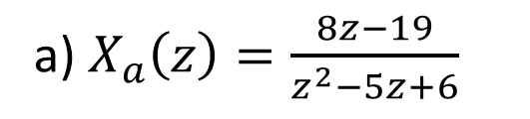
The Inverse z-Transform
Example: Using partial fraction expansion and the table, determine the inverse unilateral z-transform of the following: (Distinct roots)
a) $X_{a}\left(z\right)=\frac{8z−19}{z^{2}−5z+6}$
Answer
or

Slide 16


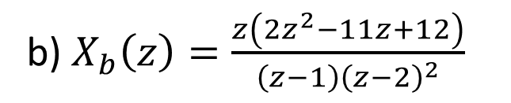
The Inverse z-Transform
Example: Using partial fraction expansions and the table, determine the inverse unilateral z-transform of the following: (Repeated roots)
b) $X_{b}\left(z\right)=\frac{z\left(2z^{2}−11z+12\right)}{\left(z−1\right){\left(z−2\right)}^{2}}$
Answer

Slide 17


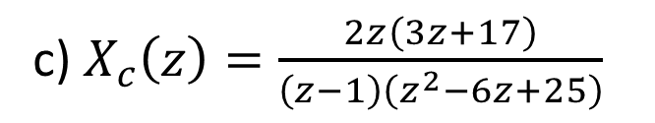
The Inverse z-Transform
Example: Using partial fraction expansions and the table, determine the inverse unilateral z-transform of the following: (Complex roots)
c) $X_{c}\left(z\right)=\frac{2z\left(3z+17\right)}{\left(z−1\right)\left(z^{2}−6z+25\right)}$
Answer

Slide 18
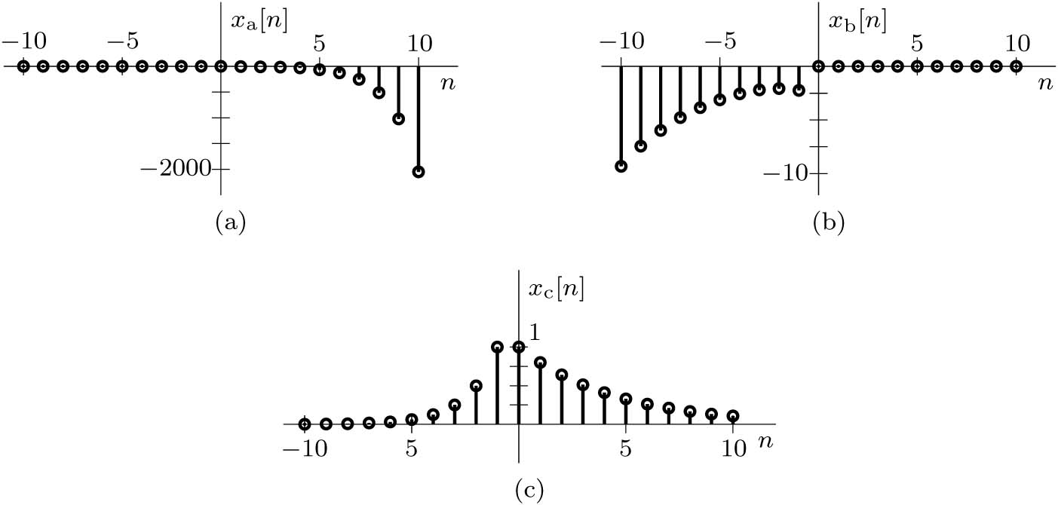

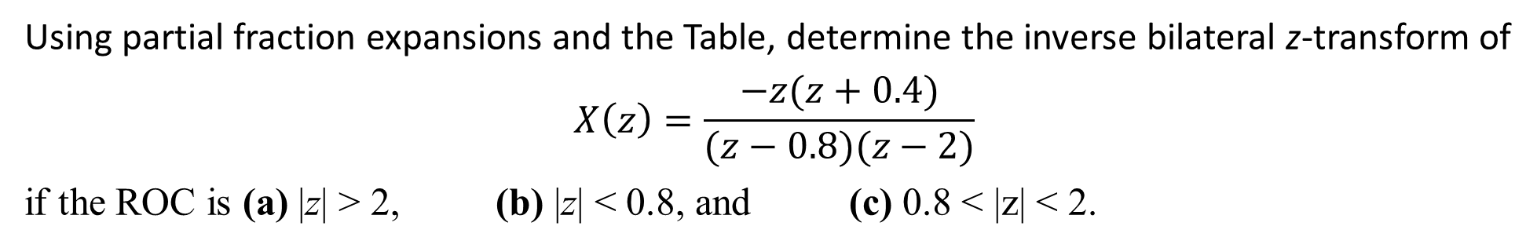
Example
Using partial fraction expansions and the Table, determine the inverse bilateral z-transform of
$$X\left(z\right)=\frac{−z(z+0.4)}{(z−0.8)(z−2)}$$
if the ROC is (a) |z| > 2, (b) |z| < 0.8, and (c) 0.8 < |z| < 2.
Solution

Slide 19
Properties of the z-Transform
Linearity
Time Reversal
Time Scaling
Time Shifting
Z-Domain Scaling
Z-Domain Convolution
Z-Domain Differentiation

Slide 20
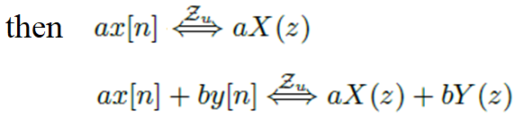
Linear Property
Linear Property

Slide 21
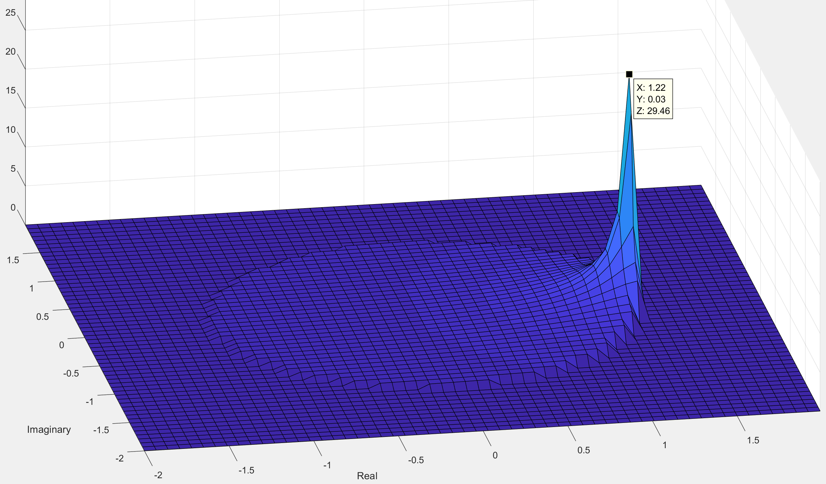
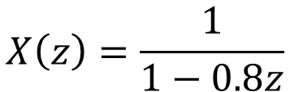


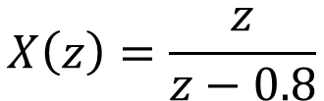

Time-Reversal Property
$$x[n]={(0.8)}^{n} u[n]$$
$$x[−n]={(0.8)}^{−n} u[−n]$$
$$X\left(z\right)=\frac{z}{z−0.8}$$
$$X\left(z\right)=\frac{1}{1−0.8z}$$
ROC |Z| > 0.8
ROC |Z| < 1/0.8=1.25
$$\left|X(z)\right|$$

Slide 22
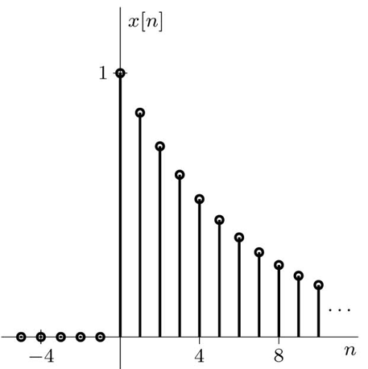
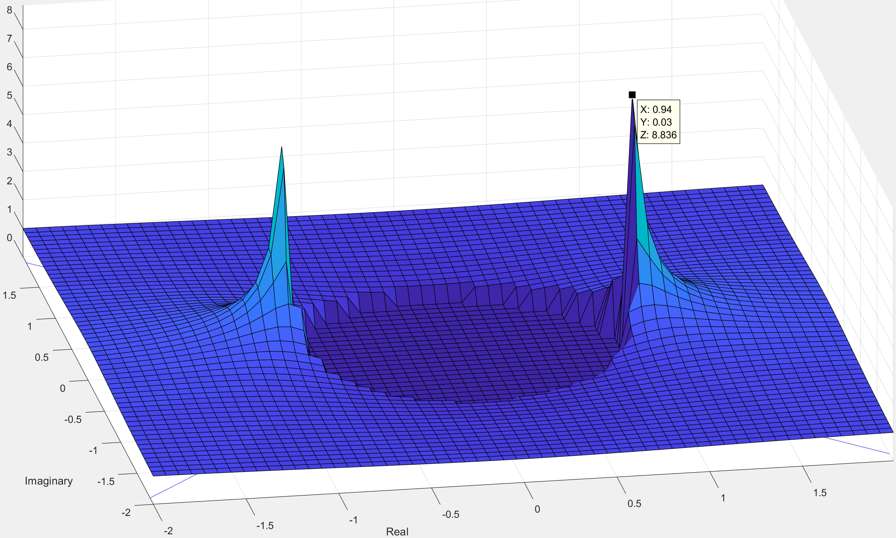


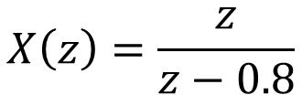
Time Scaling Property
Up-sampling by inserting L-1 zeros between samples
ROC |z| > γ
ROC |z| > γ^{1/L}
$$x\left[n\right]={(0.8)}^{n} u[n]$$
$$X\left(z\right)=\frac{z}{z−0.8}$$
$$X\left(z\right)=\frac{z^{L}}{z^{L}−0.8}$$
ROC |Z| > 0.8
ROC |Z| > (0.8)^{1/L} =0.9

Slide 23
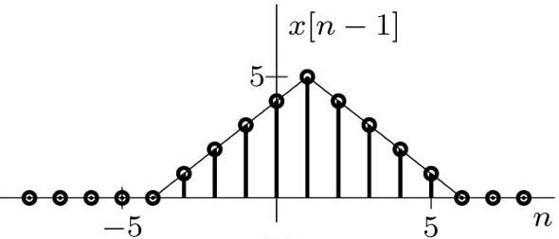
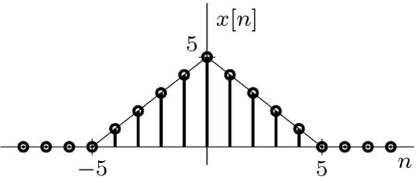

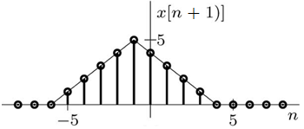
Bilateral z-Transform Time-Shifting Property

Slide 24


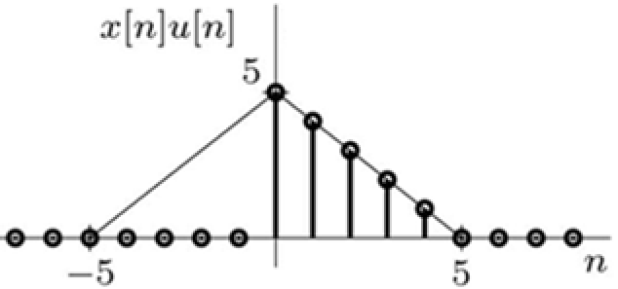
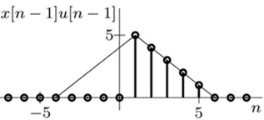
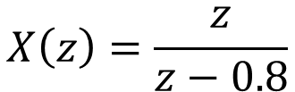
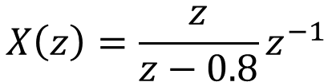


Unilateral z-Transform Time-Shifting Property
$$x[n]={(0.8)}^{n} u[n]$$
$$x[n−1]={(0.8)}^{n−1} u[n−1]$$
$$X\left(z\right)=\frac{z}{z−0.8}$$
$$X\left(z\right)=\frac{z}{z−0.8}z^{−1}$$
ROC |Z| > 0.8

Slide 25
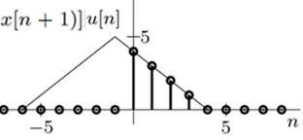
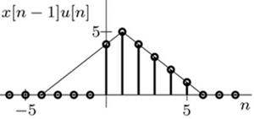





Unilateral z-Transform Time-Shifting Property
Left Shift (Advance)
Right Shift (Delay)

Slide 26
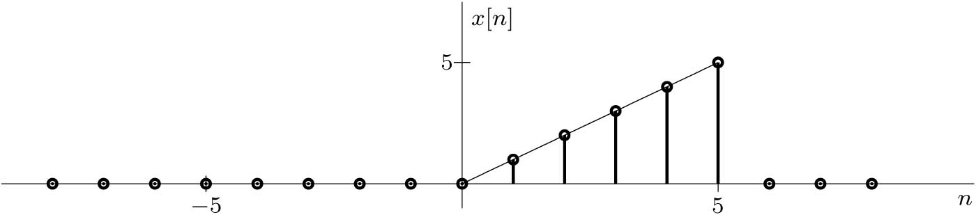



Example
Find the z-transform of the signal x[n] depicted in Figure below.
Solution

Slide 27


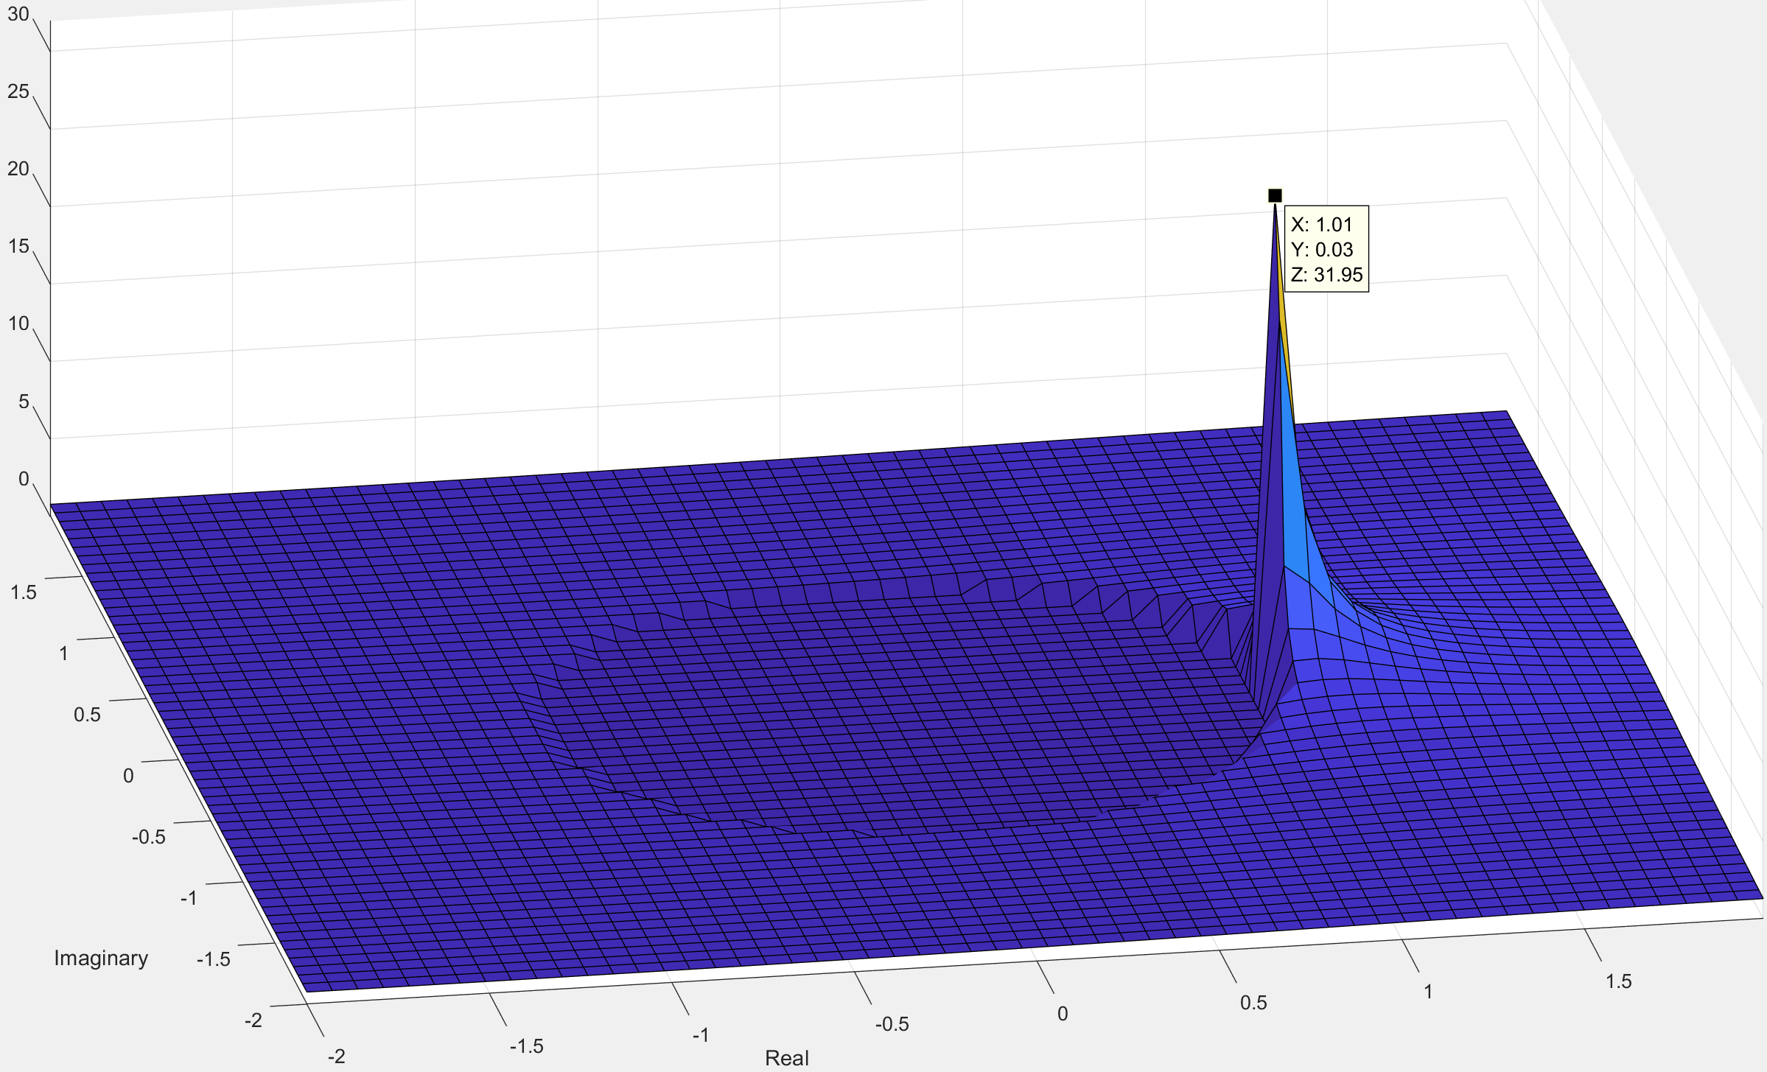


Z-Domain Scaling Property
r
rγ
$$γ=0.8e^{jπ/3}$$

Slide 28








Z-Domain Convolution Property
Example: Find the system zero-state response if the input is x[n] = u[n] and the system impulse response is h₁[n] = (0.8)^{n} u[n].
$$h_{1}\left[n\right]={(0.8)}^{n} u[n]$$
$$x\left[n\right]= u[n]$$
$$H_{1}\left(z\right)=\frac{z}{z−0.8}$$
$$X\left(z\right)=\frac{z}{z−1}$$

Slide 29





Z-Domain Convolution Property
Example: Find the system zero-state response if the input is x[n] = u[n] and the system impulse response is h₂[n] = (-0.8)^{n} u[n] .
$$h_{2}\left[n\right]={(−0.8)}^{n} u[n]$$
$$x\left[n\right]= u[n]$$
$$H_{2}\left(z\right)=\frac{z}{z+0.8}$$
$$X\left(z\right)=\frac{z}{z−1}$$

Slide 30





Z-Domain Differentiation Property
$$X(z)=\sum_{n=−∞}^{∞}{x\left[n\right]z^{−n}}$$
$$x[n]={(0.8)}^{n} u[n]$$
$$X\left(z\right)=\frac{z}{z−0.8}$$

Slide 31


Slide 32



z-Transform Solution of Linear Difference Equations
y[n] + 0.4 y[n - 1] – 0.32 y[n-2] = 5x[n] + 3x[n-1]
Topics
Zero-Input Response
Transfer Function H(z)
Zero-State Response
System Stability
$$H\left(z\right)=\frac{z(5z+3)}{z^{2}+0.4z−0.32}$$
x
x
$$Y\left(z\right)=\frac{z\left(5z+3\right)z}{{(z}^{2}+0.4z−0.32)(z+0.5)}+\frac{z(0.24z+0.32)}{z^{2}+0.4z−0.32}$$
Y_{zs}(z)
Y_{zi}(z)

Slide 33



Example 1: Zero-Input Response
When initial conditions are present, the unilateral z-transform is generally the appropriate
analysis tool.
Example: Given the initial conditions y[−1] = 1 and y[−2] = 2, use the unilateral z-transform to solve the second-order (K = 2) constant-coefficient linear difference equation to find y[n] with zero input.
y[n] + 0.4 y[n - 1] – 0.32 y[n-2] = 5x[n] + 3x[n-1]
Solution
$$Y\left(z\right)=\frac{z(0.24z+0.32)}{z^{2}+0.4z−0.32}$$
$$Y\left(z\right)=\frac{−0.11z}{z+0.8}+\frac{0.35z}{z−0.4}$$
y[n] = -0.11(-0.8)^{n} u[n] + 0.35(0.4)^{n} u[n]
Read and do the example

Slide 34


Example 2: The Transfer Function H(z) of LTID
The general difference equation in the advance form of a system is
Take the z-transform, shifting property, and setting all IC to zero the above equation will be
Example: Find the transfer function H(z) and the impulse response h[n] of the system described by the difference equation
y[n] + 0.4 y[n - 1] – 0.32 y[n-2] = 5x[n] + 3x[n-1]
$$H\left(z\right)=\frac{z(5z+3)}{z^{2}+0.4z−0.32}$$
Solution
h[n] = 0.83(-0.8)^{n} u[n] + 0.417(0.4)^{n} u[n]

Slide 35


Zero-State Response (ZSR) of LTID
Time Domain
Z Domain
x[n]
h[n]
y[n]
X(z)
H (z)
Y (z)
$$y\left[n\right]=x\left[n\right]∗h[n]$$
$$Y(z)=X\left(z\right)H(z)$$

Slide 36




Example 3: Zero-State Response
Example: Given input x[n] = (−0.5)^{n}u[n], use the z-transform to determine the zero-state response y[n] of a causal LTID system described by the difference equation
y[n] + 0.4 y[n - 1] – 0.32 y[n-2] = 5x[n] + 3x[n-1]
Solution
$$H\left(z\right)=\frac{z(5z+3)}{z^{2}+0.4z−0.32}$$
$$X\left(z\right)=\frac{z}{z+0.5}$$
$$Y\left(z\right)=X\left(z\right)H\left(z\right)=\frac{z\left(5z+3\right)z}{{(z}^{2}+0.4z−0.32)(z+0.5)}$$
$$Y\left(z\right)=\frac{20}{9}\left(\frac{z}{z+0.8}\right)+\frac{50}{27}\left(\frac{z}{z−0.4}\right)+\frac{25}{27}\left(\frac{z}{z+0.5}\right)$$
$$y[n]=2.22{\left(−0.8\right)}^{n}u\left[n\right]+1.85{\left(0.4\right)}^{n}u\left[n\right]+0.93{\left(−0.5\right)}^{n}u\left[n\right]$$
ROC |z| > 0.8

Slide 37
Example 4: Zero-Input + Zero-State Responses
Example: Given the initial conditions y[−1] = 1 and y[−2] = 2 and the input x[n] = (−0.5)^{n}u[n], use the z-transform to determine the total response y[n] of a causal LTID system described by the difference equation
y[n] + 0.4 y[n - 1] – 0.32 y[n-2] = 5x[n] + 3x[n-1]
Solution
$$Y\left(z\right)=\frac{z\left(5z+3\right)z}{{(z}^{2}+0.4z−0.32)(z+0.5)}+\frac{z(0.24z+0.32)}{z^{2}+0.4z−0.32}=\frac{{z(5.24z}^{2}+3.44z+0.16)}{{(z}^{2}+0.4z−0.32)(z+0.5)}$$
Y_{zs}(z)
Y_{zi}(z)
$$Y\left(z\right)=2.12\left(\frac{z}{z+0.8}\right)+2.2\left(\frac{z}{z−0.4}\right)+0.93\left(\frac{z}{z+0.5}\right)$$
$$y[n]=2.12{\left(−0.8\right)}^{n}u\left[n\right]+2.2{\left(0.4\right)}^{n}u\left[n\right]+0.93{\left(−0.5\right)}^{n}u\left[n\right]$$
ROC |z| > 0.8

Slide 38



Example 5: Causal and Non-causal Inputs
Example: Given two-sided input x[n] = (0.8)^{n}u[n] + 2(2)^{n}u[−n − 1], use the z-transform to determine the zero-state response y[n] of a causal LTID system described by the transfer function H(z) = z / (z − 0.5).
Solution
$$y[n]={−\left(−0.5\right)}^{n}u\left[n\right]+\frac{8}{3}{\left(0.8\right)}^{n}u\left[n\right]+\frac{8}{3}{\left(2\right)}^{n}u\left[−n−1\right]$$

Slide 39



Example 6: Inputs with Disjoint ROC
Example: For the system H(z) = z / (z − 0.5), find the zero-state response to the input
x[n] = (0.8)^{n}u[n] + (0.6)^{n}u[−n − 1].
Solution
x₁[n]
x₂[n]
There is no common ROC between x₁[n] and x₂[n] so use superposition to find the system response to both inputs separately.

Slide 40
Example 7: Input and Transfer Function with Disjoint ROC
Example: For the system H(z) = z / (z − 0.5), find the zero-state response to the input
x[n] = (0.3)^{n}u[−n − 1].
Solution
Undefined. The convolution of x[n] with h[n] will not converge.

Slide 41
System Stability and the Transfer Function H(z)
A causal LTID system is asymptotically stable if and only if all the characteristic roots are inside the unit circle. The roots may be simple or repeated.
A causal LTID system is marginally stable if and only if there are no roots outside the unit circle and there are non-repeated roots on the unit circle.
A causal LTID system is unstable if and only if at least one root is outside the unit circle, there are repeated roots on the unit circle, or both.
HW 9 is Due

Slide 42



Block Diagrams and System Realization
$$H(z)=\frac{b_{0}z^{L}+b_{1}z^{L−1}+…+b_{L−1}z+b_{L}}{z^{K}+a_{1}z^{K−1}+…+a_{K−1}z+a_{K}}$$
Topics
Form I & II Realization
Transpose Realization
Cascade and Parallel Realization
FIR System Realization

Slide 43


Basic Connections
The following is true if there is no loading effect between connected subsystems.
Parallel Connection
Cascade Connection
Feedback System

Slide 44





Direct Form Realization
$$H(z)=\frac{b_{0}z^{L}+b_{1}z^{L−1}+…+b_{L−1}z+b_{L}}{z^{K}+a_{1}z^{K−1}+…+a_{K−1}z+a_{K}}$$
For causal systems, K ≥ L.
Multiply numerator and denominator by z^{-K}. Next express H(z) as a cascade of two systems.
$$H(z)=\frac{b_{0}z^{L−k}+b_{1}z^{L−k−1}+…+b_{L−1}z^{−k+1}+b_{L}z^{−k}}{1+a_{1}z^{−1}+…+a_{K−1}z^{−k+1}+a_{K}z^{−k}}$$
Feedback H₂(z)
Next express H(z) as a cascade of two systems.
$$H(z)=\left(b_{0}z^{L−k}+b_{1}z^{L−k−1}+…+b_{L−1}z^{−k+1}+b_{L}z^{−k}\right)\left(\frac{1}{1+a_{1}z^{−1}+…+a_{K−1}z^{−k+1}+a_{K}z^{−k}}\right)$$
$$H_{1}(z)$$
$$H_{2}(z)$$
Direct Form I
Direct Form II

Slide 45





Direct Form I Realization (DF1)
Example:

Slide 46


Direct Form II Realization (DFII)
DFII is canonic since the number of delays equal to the order of the transfer function.

Slide 47

Transpose Realization (TDFII)

Slide 48


Example
Find the DFII and TDFII realizations of an LTID system with transfer function
$$H\left(z\right)=\frac{2z−3}{4z^{2}−1}$$
Direct Form II
Transpose Direct Form II

Slide 49






Cascade and Parallel Realization
$$H\left(z\right)=\frac{2z−3}{4z^{2}−1}$$
$$=\frac{1/2\left(z−3/2\right)}{\left(z+1/2\right)\left(z−1/2\right)}$$
Cascade
Parallel
$$H\left(z\right)=\left(\frac{1/2}{z+1/2}\right)\left(\frac{z−3/2}{z−1/2}\right)$$
$$H\left(z\right)=\frac{1}{z+1/2}+\frac{−1/2}{z−1/2}$$
H₁(z)
H₂(z)
H₃(z)
H₄(z)

Slide 50




Realization of Complex-Conjugate Roots
$$H\left(z\right)=\frac{z^{3}+z}{16z^{3}−28z^{2}+20z−6}= \frac{\frac{1}{16}z(z^{2}+1)}{(z−0.75)(z^{2}−z+0.5)}$$
Cascade
Parallel

Slide 51



Realization of Repeated Roots
For parallel connection you need to reuse some of the blocks so the number of delay equal the order of the transfer function.
$$H\left(z\right)=\frac{\frac{3}{16}\left(z^{2}+1\right)}{\left(z+1/2\right){\left(z−1/2\right)}^{2}}$$
Example: Determine a parallel realization of

Slide 52


Realization of FIR Filters
FIR filters does not have feedback from the output. The output depends on inputs of different delay.
y[n] = b₀ x[n] + b₁ x[n - 1] + b₂ x[n - 2] + … +b_{k} x[n - k]
Example: Using direct, transposed direct, and cascade forms, realize the FIR filter
$$y\left[n\right]=\frac{1}{2}x\left[n\right]+\frac{1}{4}x\left[n−1\right]+\frac{1}{8}x\left[n−2\right]+\frac{1}{16}x[n−3]$$
For direct and transposed direct
$$H\left(z\right)=\frac{1}{2}+\frac{1}{4}z^{−1}+\frac{1}{8}z^{−2}+\frac{1}{16}z^{−3}$$

Slide 53
Do All Realization Lead to the Same Performance?
Theoretically all realization are equivalent if parameters are implemented with infinite precision.
The finite word-length errors that plague these implementations include coefficient quantization, overflow errors, and round-off errors.
From a practical viewpoint, parallel and cascade forms using low-order filters minimize finite word-length effects.
In practice, high-order filters are most commonly realized using a cascade of multiple second-order sections, which are not only easier to design but are also less susceptible to coefficient quantization and round-off errors.
Parallel realization is better than cascade realization in terms of faster processing and less vulnerable to error propagation.

Slide 54



Frequency Response and Discrete-Time System Design
Topics
Frequency Response
System Design by Poles and Zeros Placement
$$H\left(z\right)=b_{0}\frac{z^{2}+a_{1}z+a_{2}}{z^{2}+b_{1}z+b_{2}}=b_{0}\frac{(z−z_{1})(z−z_{2})}{(z−p_{1})(z−p_{2})}$$

Slide 55






System Response to Everlasting Sinusoid
The output of a stable LTID system to a sinusoidal input (or exponential) is the same as the sinusoid (exponential) input but modified only in gain and phase.
|H(z)|
$$x\left[n\right]=z_{o}^{n}={\left(γe^{jΩ_{o}}\right)}^{n}$$
$$x\left[n\right]=z_{o}^{n}$$
H(z)
$$y\left[n\right]=H(z_{o})z_{o}^{n}$$
$$=e^{jΩ_{o}n}$$
$$y\left[n\right]=H\left(e^{jΩ_{o}}\right)e^{jΩ_{o}n}$$
$=$cos$\left(Ω_{o}n+θ\right)$
$$y\left[n\right]=\left|H\left(e^{jΩ_{o}}\right)\right|\text{cos}\left(Ω_{o}n+θ+∠H\left(e^{jΩ_{o}}\right)\right)$$
Steady-State Response to Causal Sinusoidal Inputs
$$y_{ss}\left[n\right]=\left|H\left(e^{jΩ}\right)\right|\text{cos}\left[Ωn+θ+∠H\left(e^{jΩ}\right)\right]u[n]$$

Slide 56




Example
Determine the frequency response H(e^{jΩ}) of the system specified by the equation
y[n + 1] − 0.8y[n] = x[n + 1].
Determine the system responses to the inputs (a) x_{a}[n] = 1^{n} = 1, (b) x_{b}[n] = cos( π/6 n − 0.2), and (c) x_{c}(t) = cos(1500t) sampled using sampling interval T = 0.001.
Solution
$$H\left(z\right)=\frac{1}{1−0.8z^{−1}}$$
$$H\left(e^{jΩ}\right)=\frac{1}{1−0.8e^{−jΩ}}=\frac{1}{1−0.8\text{cos}(Ω)+j0.8sin⁡(Ω)}$$

Slide 57

Continue Example
y_{a}[n] = 5
y_{b}[n] = 1.983 cos( π/6 n − 1.116)
y_{c}[n] = 0.8093 cos( 1.5 n − 0.702)
Omega = linspace(-2*pi,2*pi,500); H = 1./(1-0.8*exp(-1j*Omega));
subplot(121); plot(Omega,abs(H)); subplot(122); plot(Omega,angle(H));

Slide 58








Frequency Response from Pole-Zero Locations
$$H\left(z\right)=\frac{z^{2}−0.64}{z^{2}−1.4z+0.65}$$
$$H\left(z\right)=\frac{(z−0.8)(z+0.8)}{(z+0.7−j0.4)(z+0.7+j0.4)}$$

Slide 59

To enhance the magnitude response at a frequency Ω, place a pole close to the point e^{jΩ}.
Placing a pole or a zero at the origin does not influence the magnitude response, but it adds angle −Ω (or Ω) to the phase response ∠H(e^{jΩ}).
To suppress the magnitude response at a frequency Ω, we should place a zero close to the point e^{jΩ}.
Repeating poles or zeros further enhances their influence.
Placing a zero close to a pole tends to cancel the effect of that pole on the frequency response (and vice versa).
For a stable system, all the poles must be located inside the unit circle.

Slide 60



Example
Design a tuned (bandpass) analog filter with zero transmission at 0 Hz and also at the highest frequency f_{max} = 500 Hz. The resonant frequency is required to be 125 Hz.
Solution
f 0 500 125
Ω 0 π π/4
f_{s} ≥ 2f_{max} = 1000 Hz
Ω = ωT = 2πf/f_{s}
p₁= |γ|e^{jπ/4}
p₂= |γ|e^{-jπ/4}

Slide 61


Continue Example
H = @(z,gamma) (z.^2-1)./(z.^2-sqrt(2)*abs(gamma)*z+(abs(gamma))^2);
T = 10^(-3); Omega = linspace(-pi,pi,1001);
f = Omega/(2*pi*T); z = exp(j*Omega);
plot(f,abs(H(z,0.7)),f,abs(H(z,0.85)),f,abs(H(z,1)));
axis([-500 500 -1 10]);

Slide 62


Example
Design a second-order notch filter with zero transmission at 250 Hz and a sharp recovery of gain to unity on both sides of 250 Hz. The highest significant frequency to be processed is f_{max} = 400 Hz. Find the difference equation.
Solution
F_{s} ≥ 2f_{max} ≥ 800 samples/sec
Choose F_{s} = 1000
f Ω
0 0
400 0.8π
250 π/2
Ω = ω / F_{s} = 2πf / F_{s}
H = @(z,gamma) (1+(abs(gamma)).^2)/2*(z.^2+1)./(z.^2+(abs(gamma))^2);
T = 10^(-3); Omega = linspace(-pi,pi,1001); f = Omega/(2*pi*T); z = exp(1j*Omega);
plot(f,abs(H(z,0.30)),f,abs(H(z,0.7)),f,abs(H(z,0.95))); axis([-500 500 -1 10]);
HW 10 is Due

