Slide 1
Discrete Fourier Transform
ENGR 4333: Digital Signal Processing
Chapter 9
Dr. Mohamed Bingabr
University of Central Oklahoma

Slide 2
Outline
The Discrete Fourier Transform
Discrete-Time Filtering Using the DFT

Slide 3
CTFT
$$X\left(Ω\right)=\sum_{n=−∞}^{n=∞}{x[n]e^{−jΩn}}$$
$Ω=ωT$= $ω/f_{s}$
DTFT
$$X\left[k\right]=\sum_{n=0}^{N−1}{x\left[n\right]e^{−jΩ_{0}kn}} 0≤k≤N−1$$
DFT

Slide 4
The Discrete Fourier Transform
The direct and inverse relationships between a length-N signal x[n] and the N samples of the spectrum X[k] deﬁne the discrete Fourier transform (DFT). The DFT proves extremely useful in numerical computations of the discrete time Fourier transform and its inverse (DTFT).
$$x[n]$$
$$X[k]$$
Frequency resolution
$$f_{0}=\frac{1}{T_{0}}$$
$$N=\frac{T_{0}}{T}$$
$$Ω_{0}=ω_{0}T=2πf_{0}T=\frac{2πf_{0}}{f_{s}}=\frac{2π}{N}$$
$$N=\frac{f_{s}}{f_{0}}$$
$$f_{0}=\frac{f_{s}}{N}$$
$$X\left[k\right]=\sum_{n=0}^{N−1}{x\left[n\right]e^{−jΩ_{0}kn}}$$
DFT
$$x\left[n\right]=\frac{1}{N}\sum_{k=0}^{N−1}{X\left[k\right]e^{jΩ_{0}kn}}$$
$$0≤k≤N−1$$
$$0≤n≤N−1$$
X[k] = X*[N - k] where k =1, 2, … , (N-1)/2 for odd N or (N-2)/2 for even N.

Slide 5
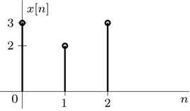
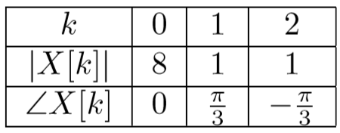
Example
Find the DFT of the length-3 signal x[n] = 3δ[n] + 2δ[n−1] + 3δ[n−2]. Compare the DFT spectrum X[k] with the corresponding DTFT spectrum X(Ω).
Solution
$$Ω_{0}=\frac{2π}{N}=\frac{2π}{3}$$
$$=e^{−j\frac{2π}{3}k}\left[2+6cos\left(\frac{2π}{3}k\right)\right]$$
k = 0, 1, 2

Slide 6
The Discrete Fourier Transform with Zero Padding
The DFT yields samples of the DTFT spaced at frequency intervals of Ω₀ =2π/N. In this way, the DFT size N determines the frequency resolution Ω₀. To see more frequency components of DTFT we improve the frequency resolution by increasing N (number of samples in the signal x[n]). Since the number of samples already determined based on the sampling theorem, we can increase N by padding x[n] with zeros.
Zero padding allows us to obtain more samples of X(Ω) for clarity. Furthermore, this process does not change the underlying signal x[n], which means that zero padding does not aﬀect the underlying spectrum X(Ω).
Example: a signal x(t) = sin(2πt) + sin(2π1.5t) + sin(2π3t) sampled at the Nyquist rate f_{s} = 6 samples/second. The signal is sampled for 1 second. What are the DFT components X[k]? Will you be able to see the 1.5 Hz sinusoidal signal?

Slide 7
Example
Using zero padding, ﬁnd the 6-point DFT of the length-3 signal x[n] = 3δ[n] + 2δ[n−1] + 3 δ[n−2]. Compare the 6-point DFT X[k] with the corresponding DTFT spectrum X(Ω).
Solution
$$Ω_{0}=\frac{2π}{N}=\frac{2π}{6}$$

Slide 8
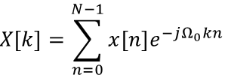
Matrix Representation of the DFT and Its Inverse
For large N it is cumbersome to manually evaluate the DFT and its inverse. Fortunately, both represent sets of N linear equations in N unknowns. Consequently, both can be expressed in matrix form, suitable for simple computer evaluation.

Slide 9
Example (read in textbook)
Use MATLAB to compute and plot the DFT of the length-3 signal x[n] = 3δ[n] + 2δ[n−1] + 3 δ[n−2]. Determine the zero padding needed to achieve a DFT frequency resolution of Ω₀ = π/10. Compare the DFT spectrum X[k] with the corresponding DTFT spectrum X(Ω).
Solution
N = 20; Omega0 = 2*pi/N; k = (0:N-1); n = (0:N-1);
x = [3;2;3;zeros(N-3,1)];
DN = exp(-1j*Omega0*k'*n); X = DN*x;
Omega = linspace(0,2*pi,6001); XOmega = exp(-1j*Omega).*(2+6*cos(Omega));
subplot(121); stem(k*Omega0,abs(X)); line(Omega,abs(XOmega));
subplot(122); stem(k*Omega0,angle(X)); line(Omega,angle(XOmega));

Slide 10
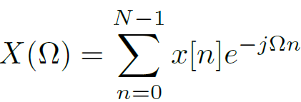
DFT Interpolation to Obtain the DTFT
We can determine the entire X(Ω) from the samples of the DFT using interpolation. This is similar to finding x(t) from x[n] samples by interpolation.
The inner sum on the right-hand side is a geometric progression and can be simplified as follow in the next slide.

Slide 11
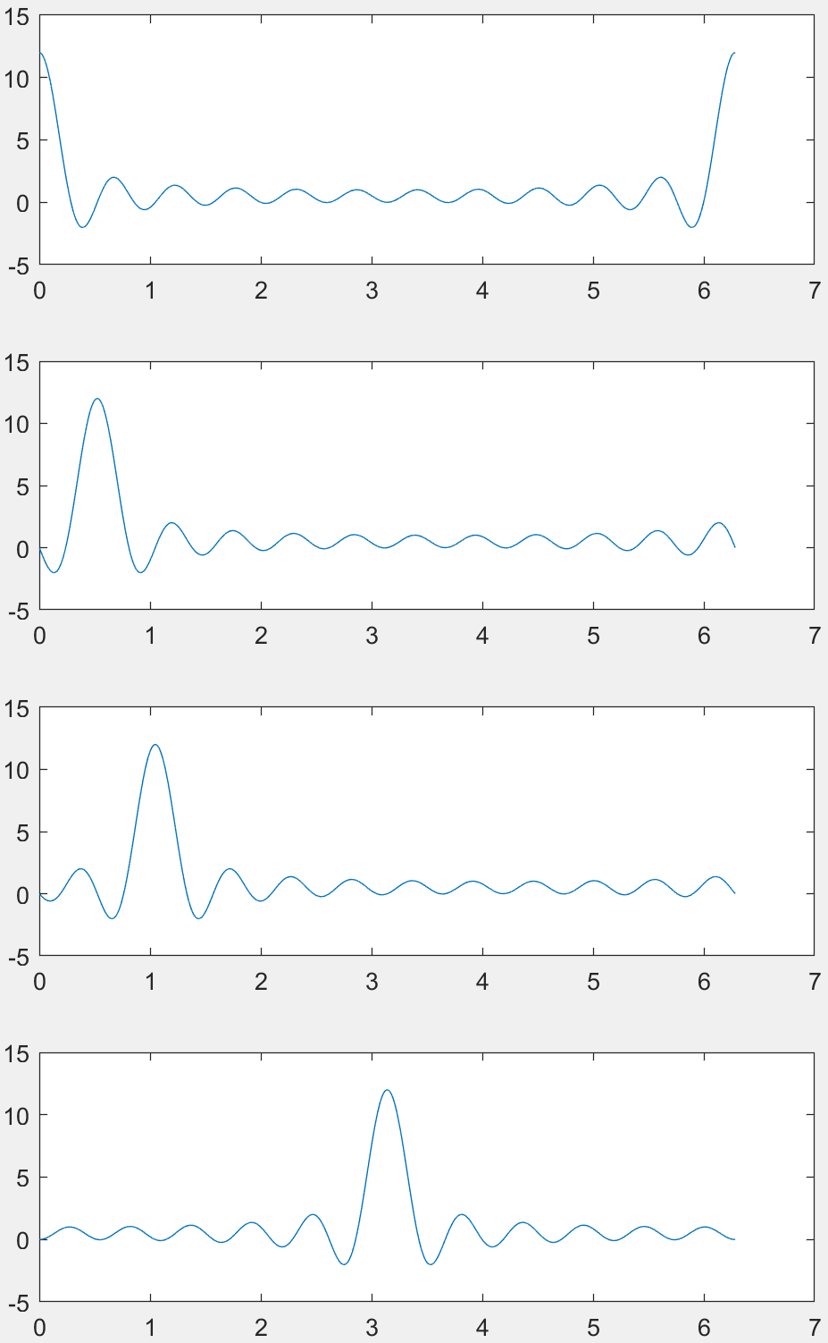
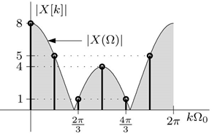
DFT Interpolation to Obtain the DTFT
N = 12
Ω₀ = 2π/N = π/6
k = 0
Ω₀ = 2π/N
k = 1
π/6
k = 2
π/3
k = 6
π

Slide 12
Example (read it textbook)
Using interpolation, determine the DTFT X(Ω) if the DFT of the corresponding 3-point x[n] is given by X[0] = 8, X[1] = e^{jπ/3}, and X[2] = e^{−jπ/3}.
Solution

Slide 13
DTFT ←→ DFT
IFT
FT
Time Sampling
$$t=nT$$
$$x(t)$$
$$X\left(Ω\right)=\sum_{n=−∞}^{n=∞}{x[n]e^{−jΩn}}$$
IDTFT
Time Sampling
DTFT
Frequency
Sampling
Frequency
Interpolation
Time
Interpolation
$$x[n]$$
$$x(t)$$
DFT
$$Ω=kΩ_{0}$$
IDFT

Slide 14
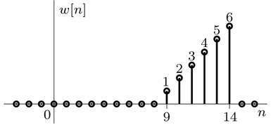
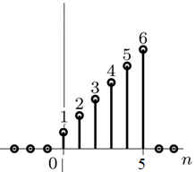
Confining x[n] to 0 ≤ n ≤ N-1for Unique DFT
The summation in the DFT definition starts from n = 0 to N-1, so how do we find the DFT for a signal that starts at n = 9?
Can we just shift it to start at zero? NO
So, how do we confine x[n] to 0 ≤ n ≤ N-1 ?
The DFT for the signals x_{a}[n], x_{b}[n], and x_{c}[n], are the same.

Slide 15
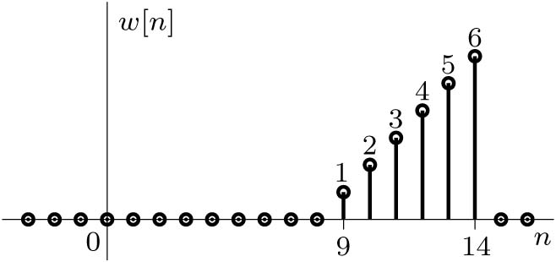
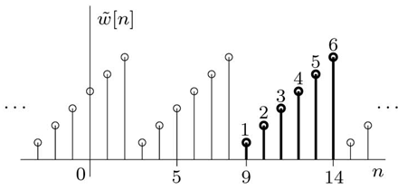
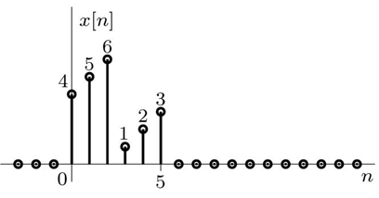
How to Confine x[n] to 0 ≤ n ≤ N-1for Unique DFT
The inverse DFT will produce a periodic x[n] signal.
The DFT for the signals w[n] and x[n] of size N = 6 are the same.
$$W\left[k\right]=\sum_{n=9}^{14}{x[n]e^{−j\frac{2π}{6}kn}}$$
n = 9 to 14
$$W\left[k\right]=1e^{−j\frac{2π}{6}9k}+2e^{−j\frac{2π}{6}10k}+3e^{−j\frac{2π}{6}11k}+4e^{−j\frac{2π}{6}12k}+…+6e^{−j\frac{2π}{6}14k}$$
n = 0 to 5
$$X\left[k\right]=4+5e^{−j\frac{2π}{6}k}+6e^{−j\frac{2π}{6}2k}+1e^{−j\frac{2π}{6}3k}+…+3e^{−j\frac{2π}{6}5k}$$

Slide 16
Confining x[n] to 0 ≤ n ≤ N-1 for Unique DFT
Modulo-N Shift
Modulo-N is used in DFT to shift an arbitrary N-point sequence into the range 0 to N-1.
The N uniform samples of the DTFT of a length-N sequence remain unchanged under the modulo-N shift of the sequence.
Modulo-N value of a positive n is the remainder of the division of n by N.
Modulo-N value of a negative n is N minus the remainder of the division of |n| by N.
$${\left\langle n\right\rangle }_{N}=n−rN where 0≤n−rN≤N−1$$
$$r=±1,2,3,…$$
If DFT requires the confinement of the signal x[n] between 0 and N-1 then how do we perform time shifting, reversal, and convolution for signal processing?

Slide 17
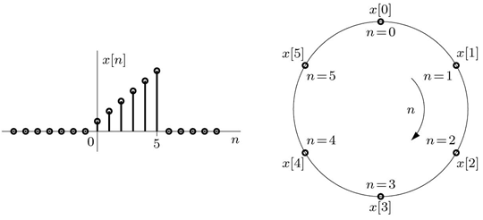
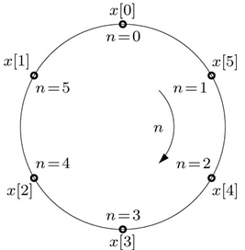
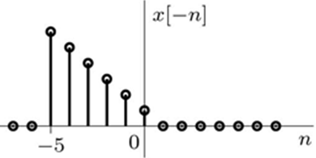
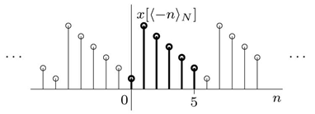
Modulo-N Shift of x[-n]
The Modulo-N Reflection
Just as with a linear representation, the circular representation of time reversal is just a reflection about the vertical axis.
Time Reversal Property

Slide 18
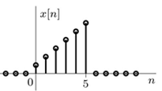
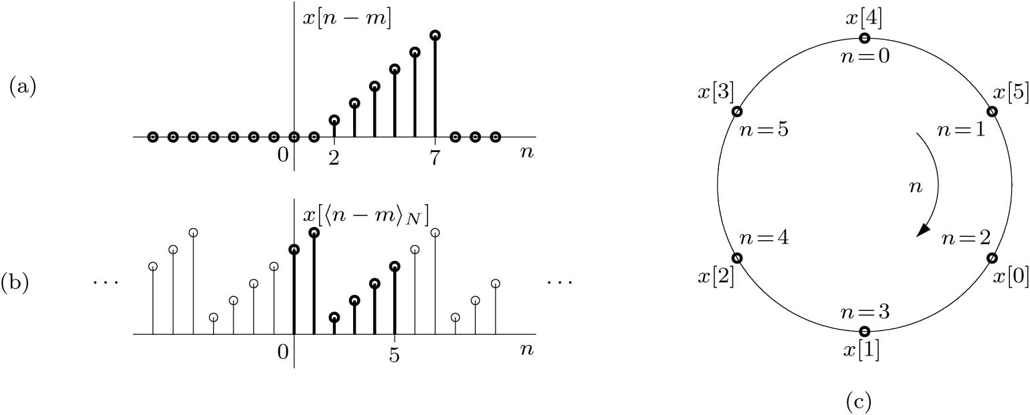
Modulo-N Shift of x[n-m]
The Circular Shift Modulo-N Reflection x[⟨n − m⟩_{N}]
A linear shift of x[n] by m samples yields the signal x[n − m], which is a length-N signal with a range m ≤ n ≤ m + N − 1.
As with the case of reflection, we instead seek a form that will retain the range 0 ≤ n ≤ N − 1.
A modulo-N shift of x[n − m], also called a circular shift, accomplishes exactly this task.
N = 6
Circular Shifting Property

Slide 19
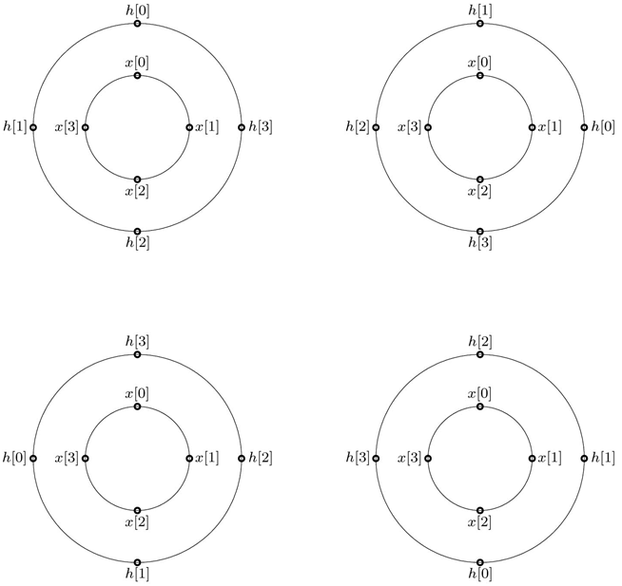
Circular Convolution
Y(k) = X [k] H [k]
The two sequences to be convolved must have the same length. If not, we should append enough zeros to the smaller sequence to ensure equal lengths of both sequences.
y[0]
y[1]
y[3]
y[2]

Slide 20
Signal Processing and Filtering Using the DFT
Find the output y[n] of the system described by the impulse response
h[n] = δ[n] + δ[n−1] + δ[n−2] and with input x[n] = δ[n−1] + 2δ[n−2] + 3δ[n−3]+ 4δ[n−4]
Size of y[n]: N_{y} = N_{x} + N_{h} -1
h[n]
Y(z) = X(z) H(z)
H(z)
y[n] = x[n] * h[n]
x[n]
Y(Ω) = X(Ω) H(Ω)
H(Ω)
H[k]
Y [k] = X [k] H [k]
What is the size of y[n]?
Will the inverse DFT of Y[k] give us y[n]?

Slide 21
Circular and Linear Convolution
Circular Convolution is different from linear convolution. In Circular all N samples of x[n] and h[n] are aligned and multiplied for any value of n.
For linear system analysis we need to modify circular convolution to be similar to linear convolution.
The length N of the signal y[n] which is the result of convolving x[n] with h[n] is N = N_{x} + N_{h} -1.
If linear and circular convolutions are to yield identical results, then a necessary condition is that the length of each signal x[n] and h[n] must be extended to N = N_{x}+ N_{h}− 1. In other words, we must pad N_{h} - 1 zeros to x[n] and pad N_{x} - 1 zeros to h[n].

Slide 22
Discrete-Time Filtering Using the DFT
The DFT is useful in the computation of direct and inverse Fourier transforms, filtering, convolution, correlation, and others. It can perform these tasks not only for discrete-time systems but also for continuous-time signals and systems. The efficient FFT algorithm, makes the DFT even more appealing.
The DFT-based procedure to find the linear convolution of two signals x[n] and h[n], whose
lengths are N_{x} and N_{h}, respectively, is summarized in four steps as follows:
1. Pad N_{h} − 1 zeros to x[n] to form x_{pad}[n], and pad N_{x} − 1 zeros to h[n] to form h_{pad}[n].
2. Find X_{pad}[k] and H_{pad}[k], the DFTs of x_{pad}[n] and h_{pad}[n].
3. Multiply X_{pad}[k] by H_{pad}[k] to obtain Y[k].
4. The desired convolution y[n] is the IDFT of Y[k].
Example: N_{x} = 7 N_{h} = 3

Slide 23
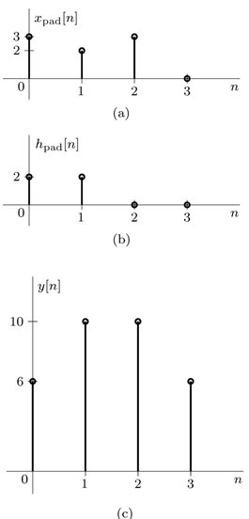
Example
Using DFT-based convolution, determine the output y[n] of an LTID filter with impulse response h[n] = 2δ[n] + 2δ[n − 1] to an input x[n] = 3δ[n] + 2δ[n − 1] + 3δ[n − 2].
Solution
After padding h[n] and x[n] with zeros, N = 4 and Ω₀ = π/2.
x_{pad}[n] = [3, 2, 3, 0] h_{pad}[n] = [2, 2, 0, 0]
0 ≤ k ≤ 3
[ 8 –j2 4 j2]
0 ≤ k ≤ 3
[ 4 2–j2 0 2+j2]
[ 32 -4 – j4 0 -4 + j4]

Slide 24
Continue Example
Solution
For small signal convolution might be easier than DFT, but for large signal DFT is faster
x = [3;2;3]; h = [2;2]; Nx = length(x); Nh = length(h);
xpad = [x;zeros(Nh-1,1)]; hpad = [h;zeros(Nx-1,1)];
N = Nx+Nh-1; n = (0:N-1); k=(0:N-1); Omega0 = 2*pi/N; DN = exp(-1j*Omega0*k’*n);
Xpad = DN*xpad; Hpad = DN*hpad; y = conj(DN)/N*(Xpad.*Hpad)
Ans y = 6 10 10 6

Slide 25
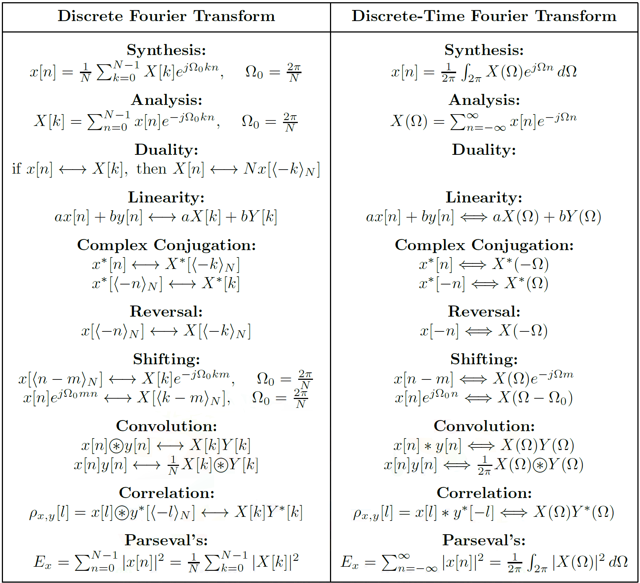

Slide 26
Block Convolution
In real application the input signal is acquired in real time so its length is not known and it may be very large. This will cause delay and excessive use of memory and processing time. Block convolution is the solution. It break the coming input signal into blocks of determined length N and convolve each block with h[n] and then add the results of all the convolutions.
There are two methods for block convolution:
1- Overlap-and-Add
2- Overlap-and-Save

Slide 27
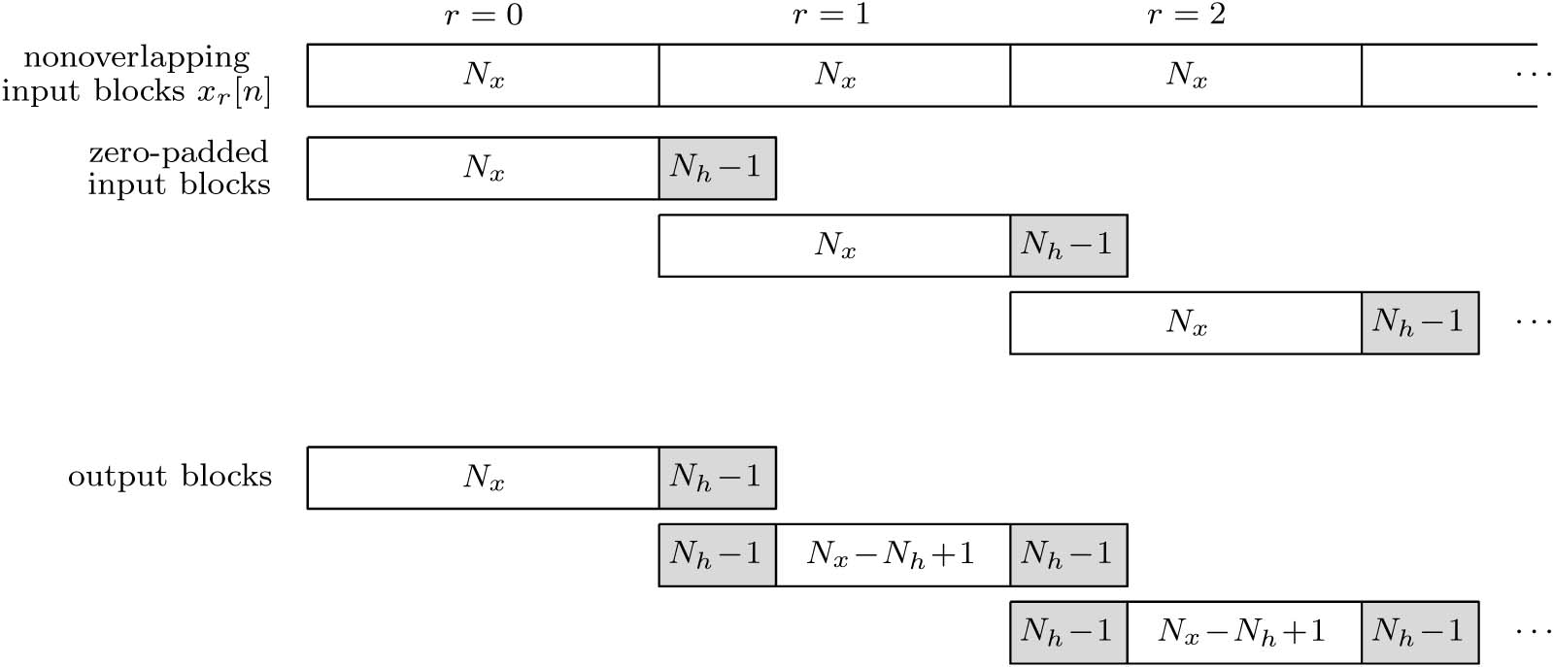
Overlap-and-Add Method
In practice the length of the filter impulse response h[n], N_{h}, is usually smaller than the length of the input blocks N_{x}. For circular convolution we pad N_{h}-1 zeros at the end of each data block.

Slide 28
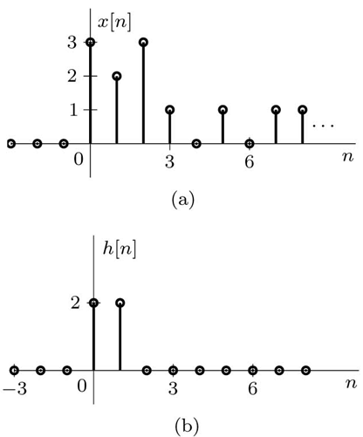
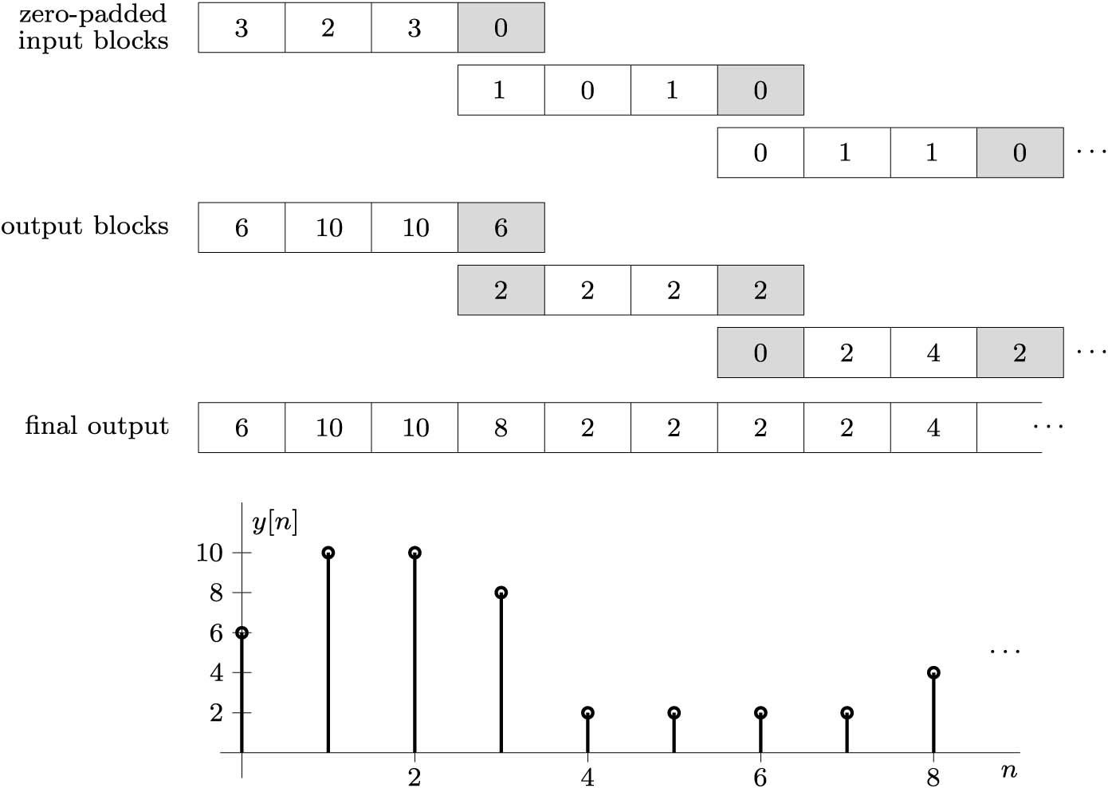
Example
Using the overlap-and-add method with an N_{x} = 3 input block size, find the response y[n] of an
LTID system with the N_{h} = 2 finite impulse response h[n] and input x[n] shown in Figure below.
Solution

Slide 29
Continue Example

Slide 30
Continue Example (Matlab Code)
Nx = 3; Nh = 2; N = Nx+Nh-1; Omega0 = 2*pi/N; k = (0:N-1); n = (0:N-1);
DN = exp(-1j*Omega0*k’*n); x0pad = [3;2;3;zeros(Nh-1,1)]; hpad = [2;2;zeros(Nx-1,1)];
X0pad = DN*x0pad; Hpad = DN*hpad; y0 = conj(DN)/N*(X0pad.*Hpad)
Ans y0 = 6 10 10 6
x1pad = [1;0;1;zeros(Nh-1,1)]; X1pad = DN*x1pad; y1 = conj(DN)/N*(X1pad.*Hpad)
Ans y1 = 2 2 2 2
x2pad = [0;1;1;zeros(Nh-1,1)]; X2pad = DN*x2pad; y2 = conj(DN)/N*(X2pad.*Hpad)
Ans y2 = 0 2 4 2

Slide 31
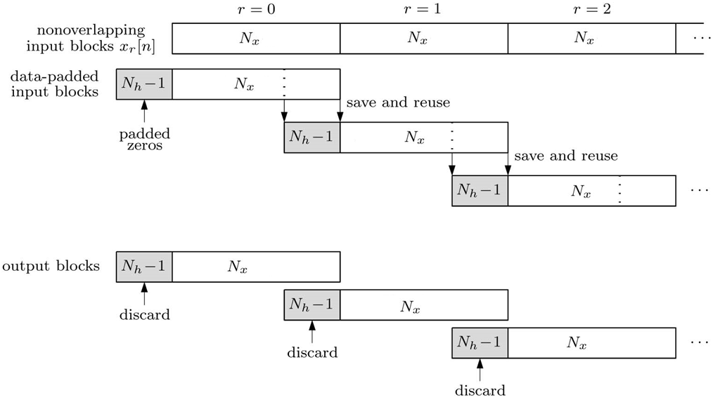
Overlap-and-Save Method
1- Section input signal into blocks of length N_{x} .
2- Augment (padded) the beginning of each block with N_{h}-1 data points from the end of the previous block.
3- The first block is augmented with N_{h}-1 zeros.
4- Padd h[n] with N_{x}-1 zeros to make a length-N_{x} + N_{h}-1 signal h_{pad}[n].

Slide 32
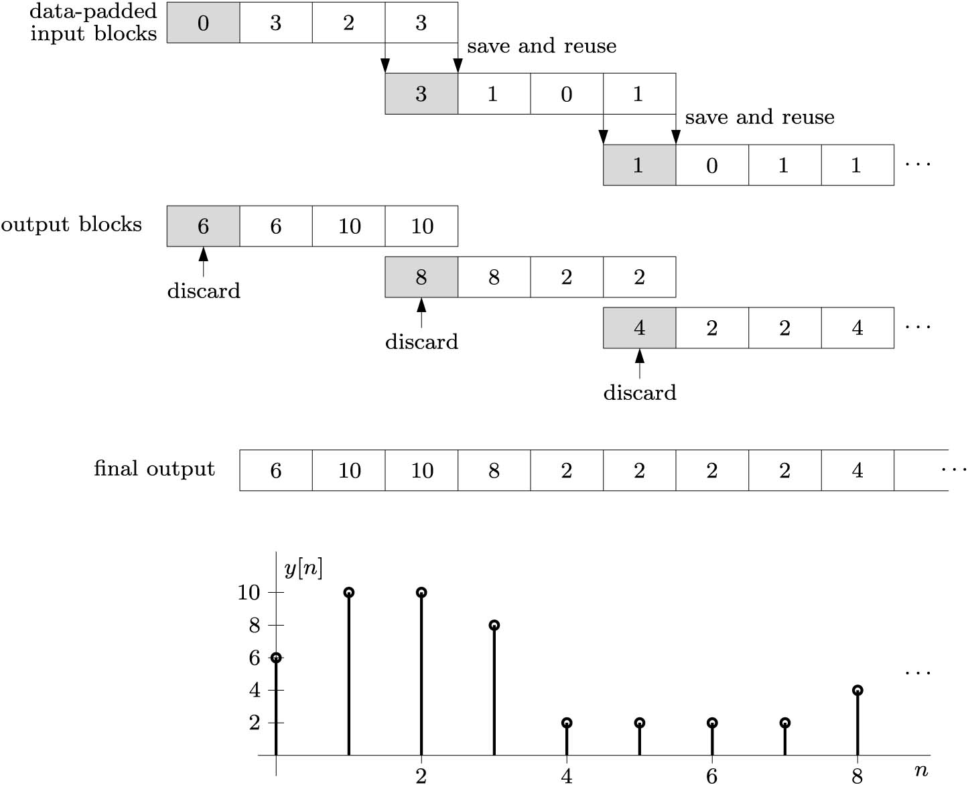
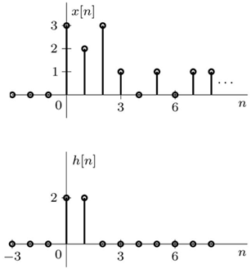
Example
Using the overlap-and-save method with an N_{x} = 3 input block size, find the response y[n] of an LTID system with the N_{h} = 2 finite impulse response h[n] and input x[n] shown in Figure below.
Solution

Slide 33
Continue Example
Nx = 4; Nh = 2; N = Nx; Omega0 = 2*pi/N; k = (0:N-1); n = (0:N-1);
DN = exp(-1j*Omega0*k’*n); x0 = [zeros(Nh-1,1);3;2;3]; hpad = [2;2;zeros(Nx-Nh,1)];
X0 = DN*x0; Hpad = DN*hpad; y0 = conj(DN)/N*(X0.*Hpad)
Ans: y0 = 6 6 10 10
x1 = [x0(end-(Nh-1)+1:end);1;0;1]; X1 = DN*x1; y1 = conj(DN)/N*(X1.*Hpad)
Ans: y1 = 8 8 2 2
x2 = [x1(end-(Nh-1)+1:end);0;1;1]; X2 = DN*x2; y2 = conj(DN)/N*(X2.*Hpad)
Ans: y2 = 4 2 2 4

Slide 34
The Fast Fourier Transform (FFT)
FFT is a computational algorithm developed by in 1965 by Tukey and Cooley to reduce the complexity of calculating the DFT from O(N²) to O(N log₂ N). The computational saving are substantial for large N. The FFT algorithm is largely what has made the Fourier transform accessible for digital signal processing.
DFT of size N= 1024 requires on order of approximately one million operation and FFT reduce it to on order of approximately 10 thousand operation. A reduction of 100 fold. The values obtained by the FFT are identical to those obtained by the DFT.
There are many variation of the FFT algorithm but the two main variation are:
1- Decimation in Time (DIT)
2- Decimation in Frequency (DIF)

Slide 35
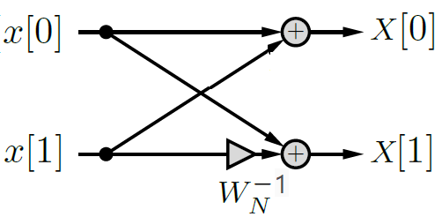
Decimation-in-Time Algorithm of FFT
The DFT of N points:
$$X\left[k\right]=\sum_{n=0}^{N−1}{x[n]e^{−jΩ_{o}kn}}=\sum_{n=0}^{N−1}{x[n]W_{N}^{−nk} }$$
0≤ k ≤ N-1;
Ω₀ = 2π/N ; $W_{N}=e^{−jΩ_{0}}$
The DFT of 2 points:
X[0] = x[0] + x[1]
X[1] = x[0] + $W_{N}^{−1}$ x[1]

Slide 36
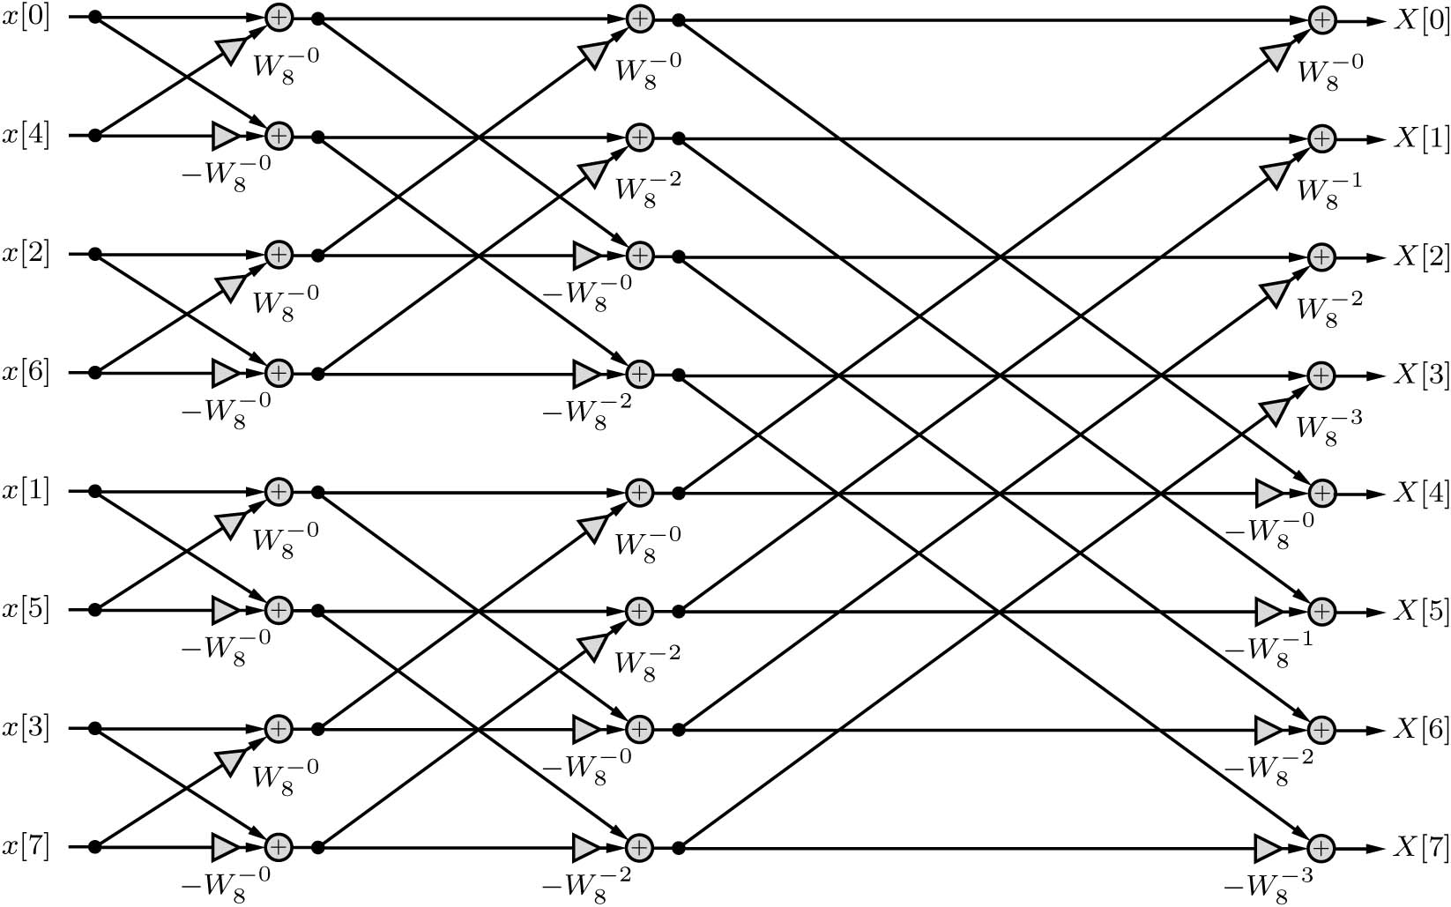
Decimation-in-Time Algorithm of FFT

