Slide 1
General Physics II
Chapter 18
Electric Charge and Electric Field
Mohamed Bingabr
University of Central Oklahoma

Slide 2
Goals for Chapter 18
To study electric charge and charge conservation
To see how objects become charged
To calculate the electric force between objects using Coulomb’s law
To learn the distinction between electric force and electric field
To calculate the electric field due to many charges
To visualize and interpret electric fields

Slide 3
Introduction
Water makes life possible as a solvent for biological molecules. What electrical properties allow it to do this?
We now begin our study of electromagnetism, one of the four fundamental forces.
We start with electric charge and look at electric fields.

Slide 4
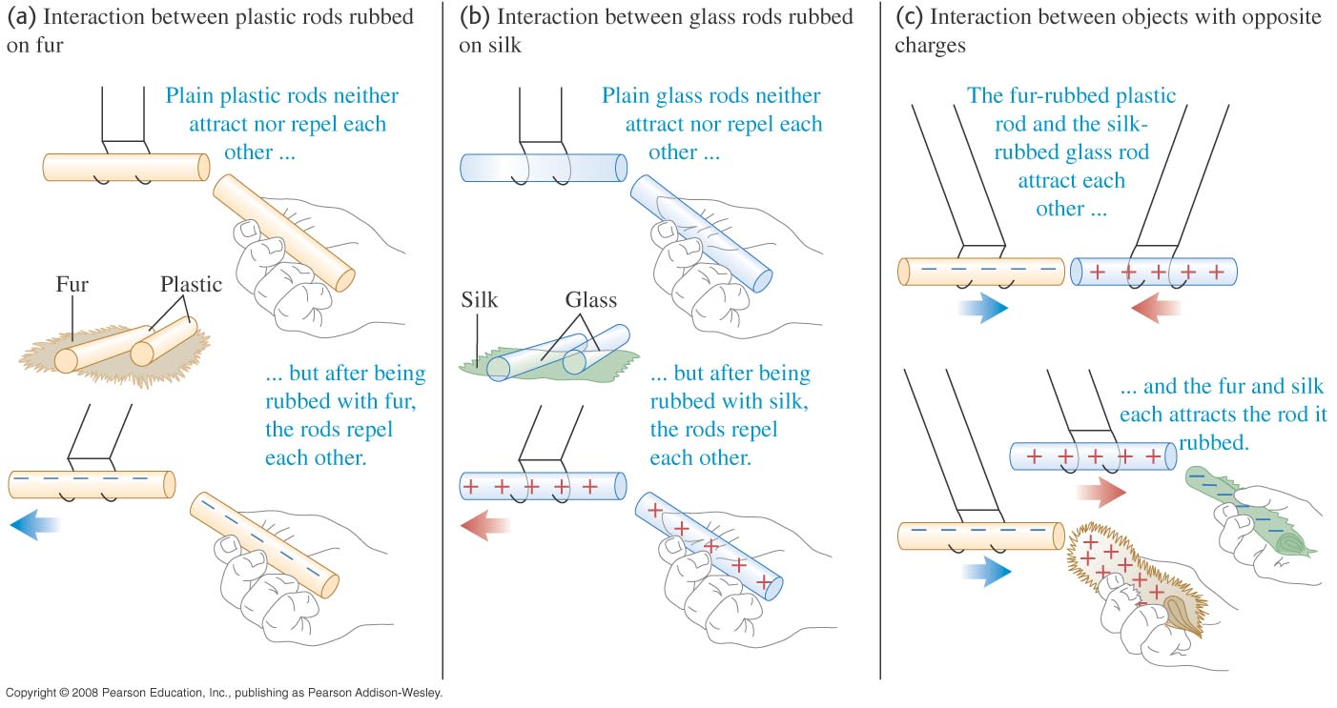
Electric charge
Two positive or two negative charges repel each other. A positive charge and a negative charge attract each other.

Slide 5
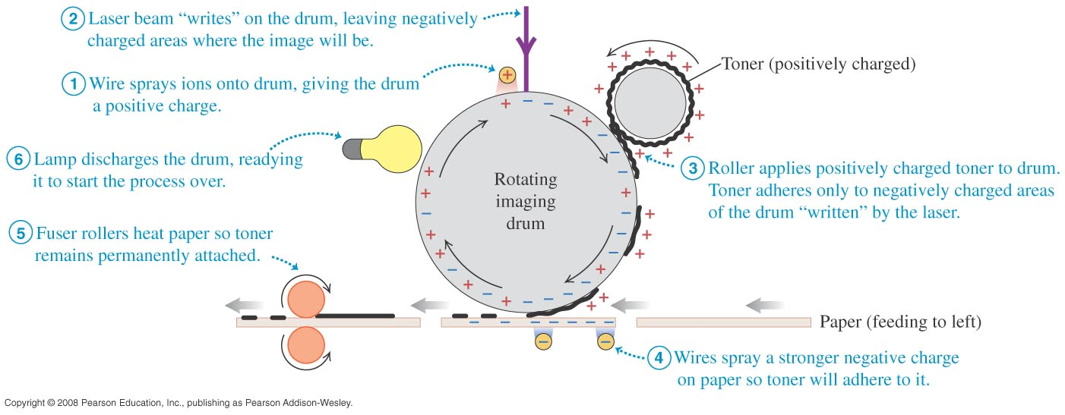
Laser printer
A laser printer makes use of forces between charged bodies.

Slide 6
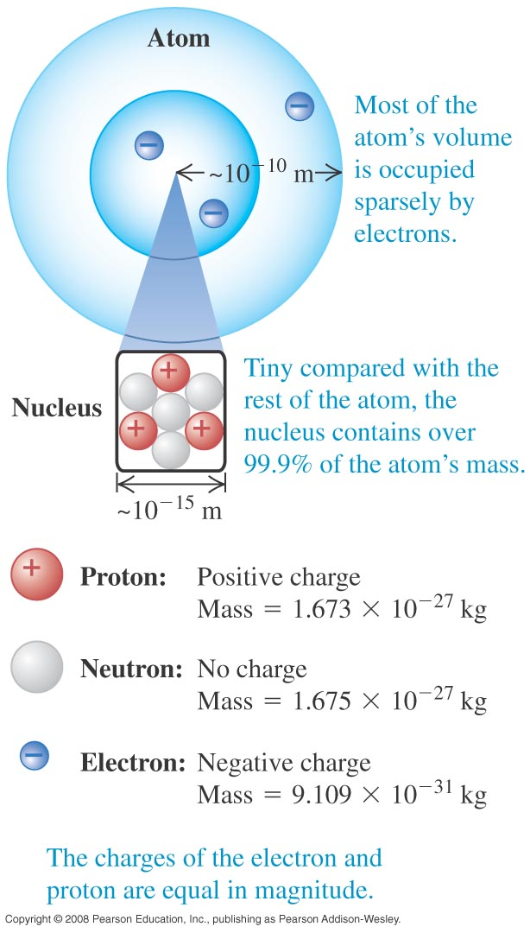
Electric charge and the structure of matter
The particles of the atom are the negative electron, the positive proton, and the uncharged neutron.
Protons and neutrons make up the tiny dense nucleus which is surrounded by electrons (see Figure 21.3 at the right).
The electric attraction between protons and electrons holds the atom together.

Slide 7
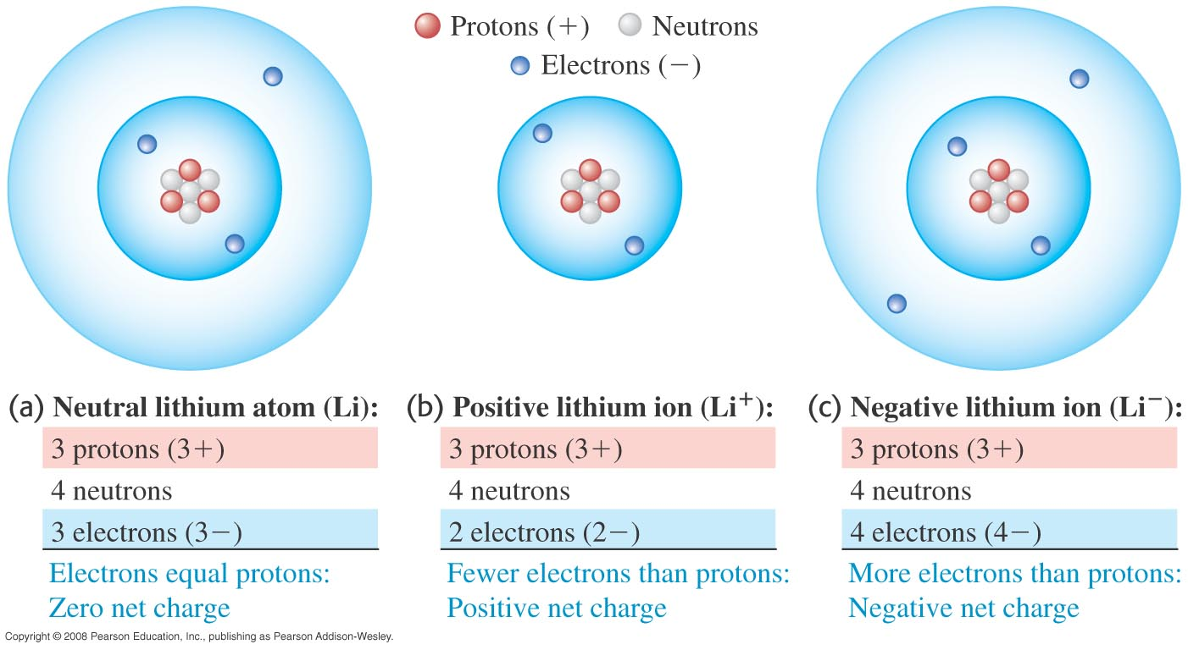
Atoms and ions
A neutral atom has the same number of protons as electrons.
A positive ion is an atom with one or more electrons removed. A negative ion has gained one or more electrons.

Slide 8
Conservation of charge
The proton and electron have the same magnitude charge.
The magnitude of charge of the electron or proton is a natural unit of charge. All observable charge is quantized in this unit.
The universal principle of charge conservation states that the algebraic sum of all the electric charges in any closed system is constant.

Slide 9
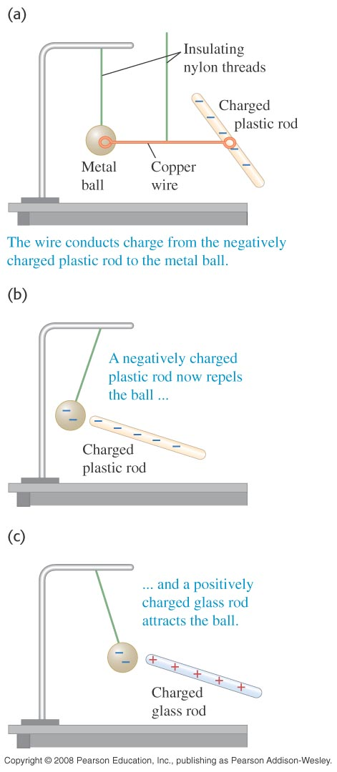
Conductors and insulators
A conductor permits the easy movement of charge through it. An insulator does not.
Most metals are good conductors, while most nonmetals are insulators. (See Figure 21.6 at the right.)
Semiconductors are intermediate in their properties between good conductors and good insulators.

Slide 10
Charging by induction
In Figure 21.7 below, the negative rod is able to charge the metal ball without losing any of its own charge. This process is called charging by induction.

Slide 11
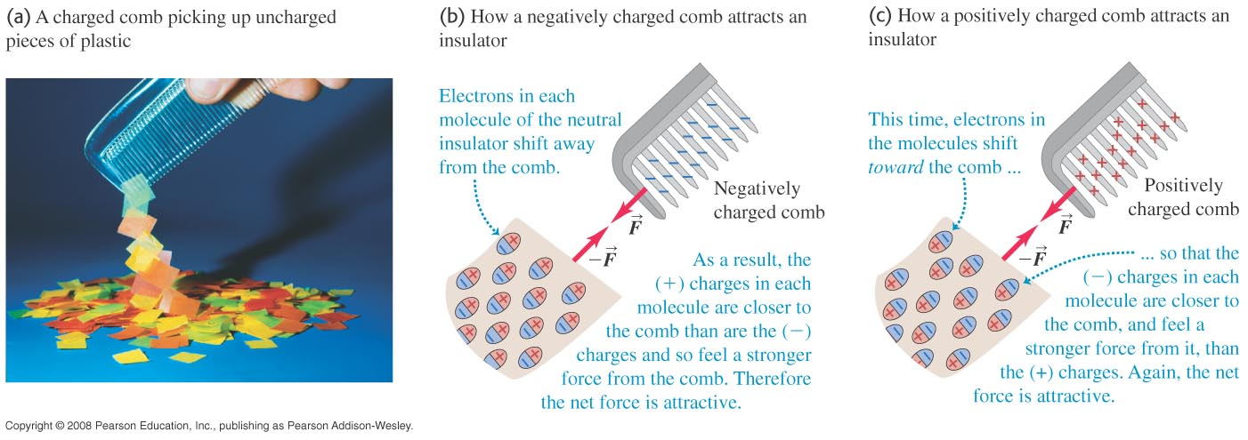
Electric forces on uncharged objects
The charge within an insulator can shift slightly. As a result, two neutral objects can exert electric forces on each other, as shown in Figure 21.8 below.

Slide 12
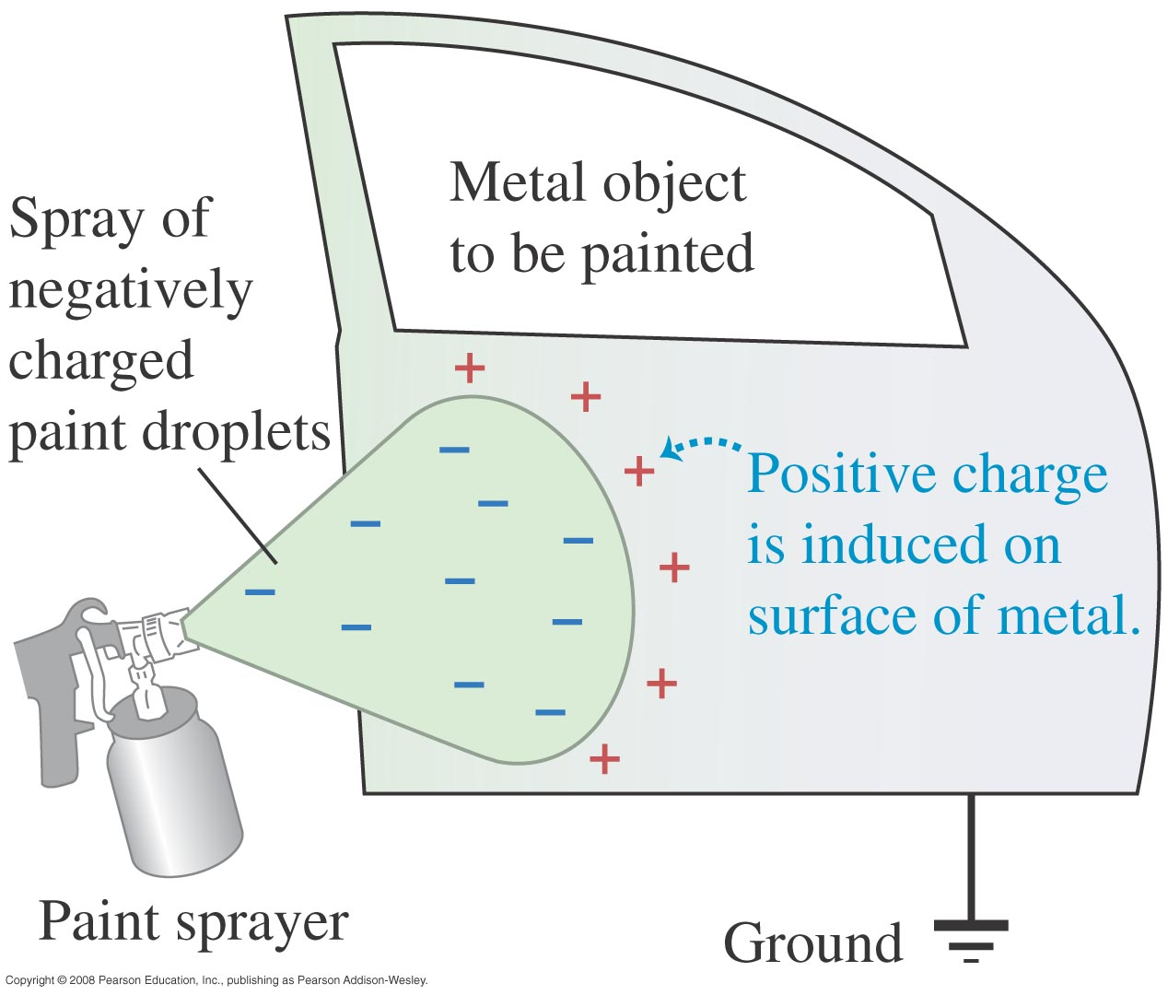
Electrostatic painting
Induced positive charge on the metal object attracts the negatively charged paint droplets.

Slide 13
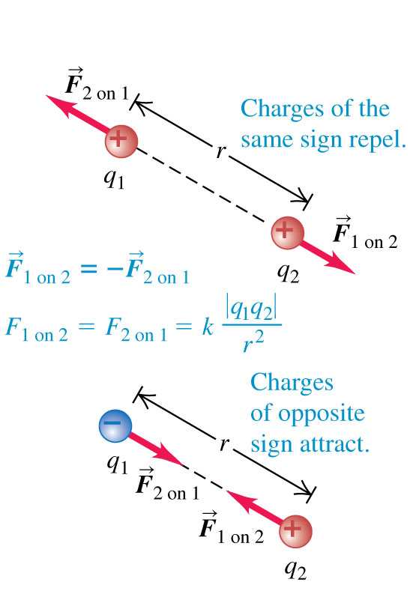
Coulomb’s law
Coulomb’s Law: The magnitude of the electric force between two point charges is directly proportional to the product of their charges and inversely proportional to the square of the distance between them. (See the figure at the right.)
Mathematically: F = k|q₁q₂|/r²

Slide 14
Force between charges along a line
What is the total force exerted on the test charge q₃ by the two point charges q₁ and q₂.

Slide 15
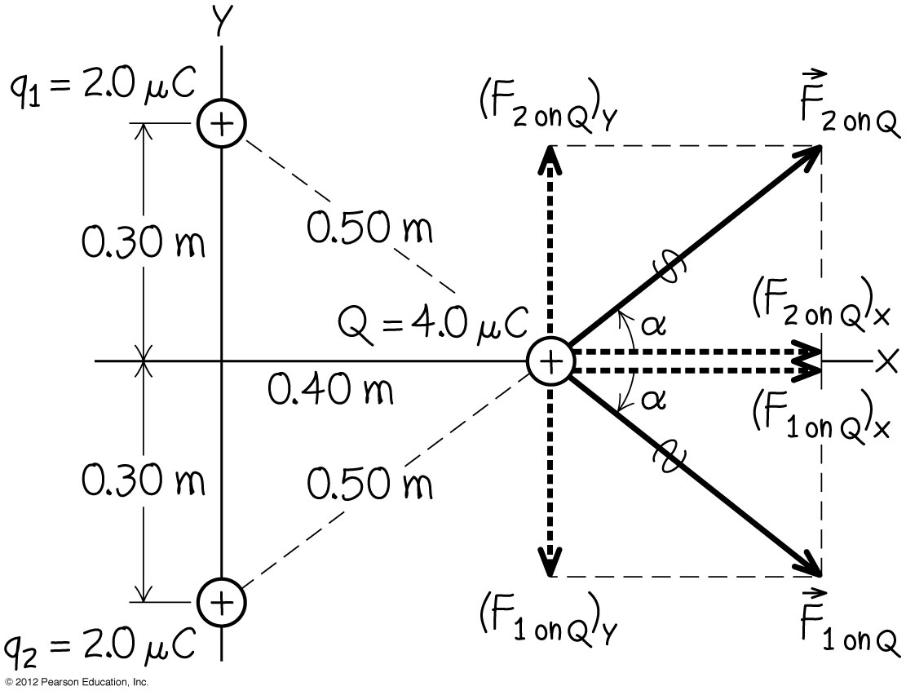
Vector addition of electric forces
What is the total force exerted on the test charge Q by the two point charges q₁ and q₂.

Slide 16
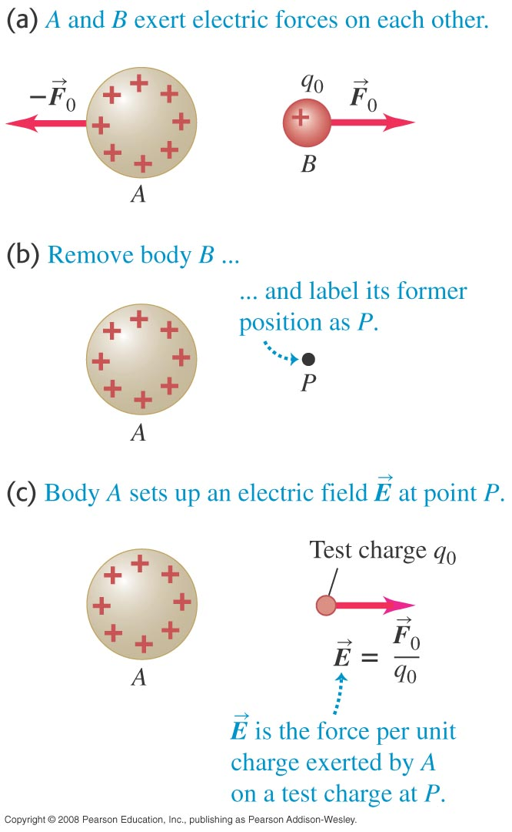
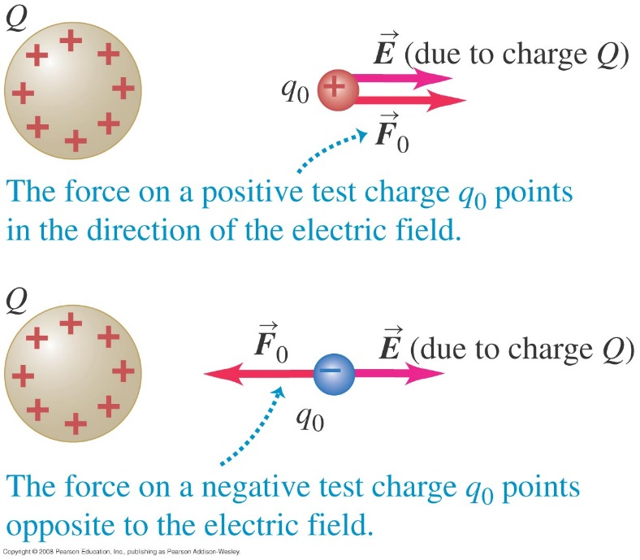
Electric field
A charged body produces an electric field in the space around it.
We use a small test charge q₀ to find out if an electric field is present.

Slide 17
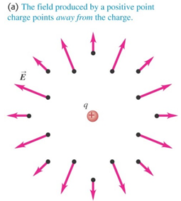
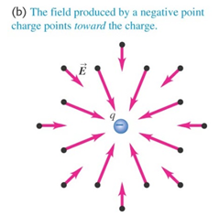
Definition of the electric field
Electric Field: a region around a charged particle or object within which a force would be exerted on other charged particles or objects
E = F/q
E = kQ/r²

Slide 18
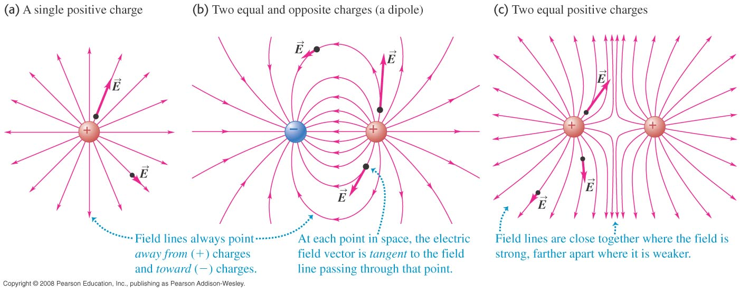
Electric field lines of point charges
Figure below shows the electric field lines of a single point charge and for two charges of opposite sign and of equal sign.

Slide 19
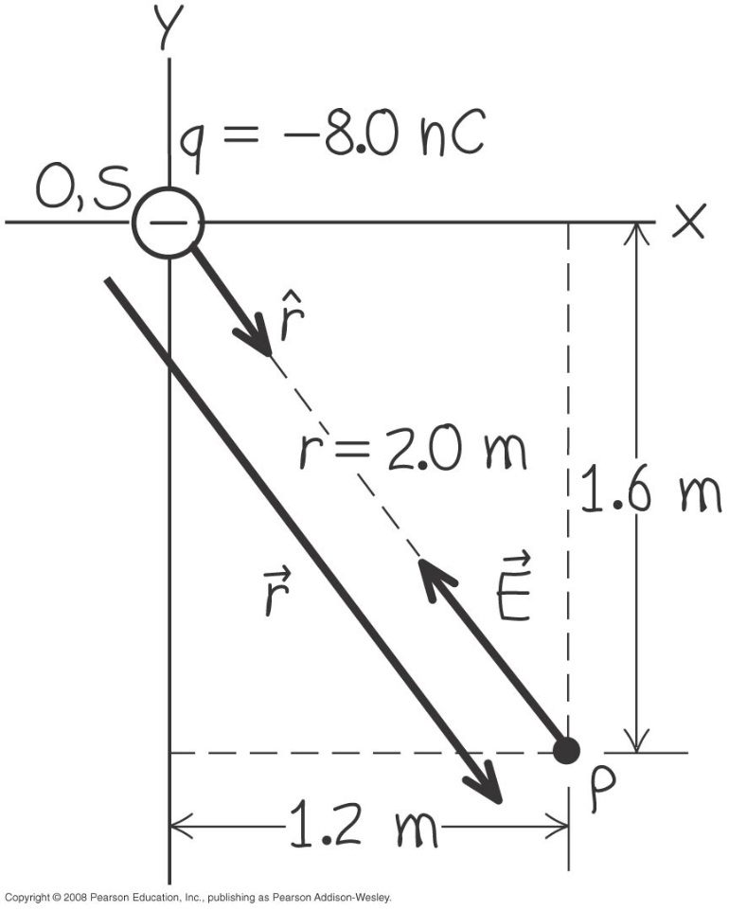
Electric-field vector of a point charge
Calculate the strength and direction of the electric field E due to a point charge of -8 nC at a distance of 2 m from the charge as shown below. What is the force does the electric field exert at a point charge + 3 nC.

Slide 20
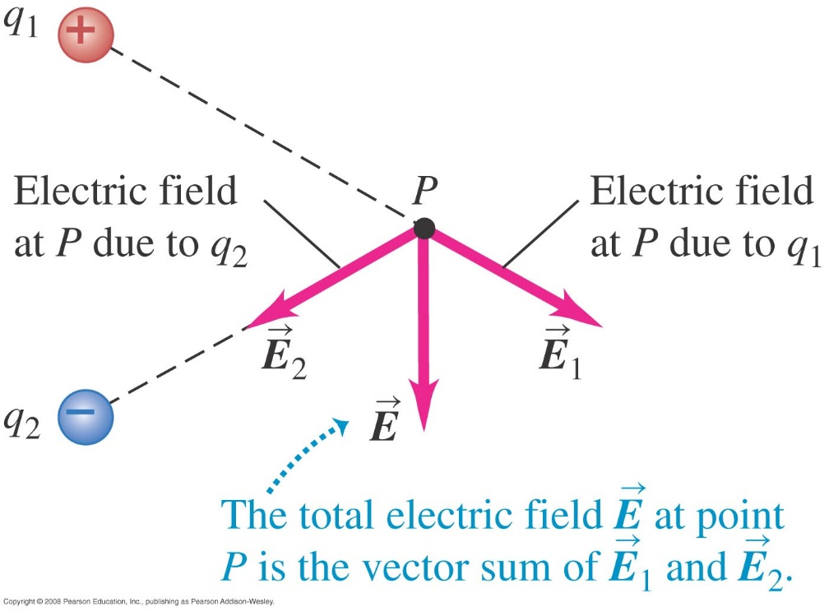
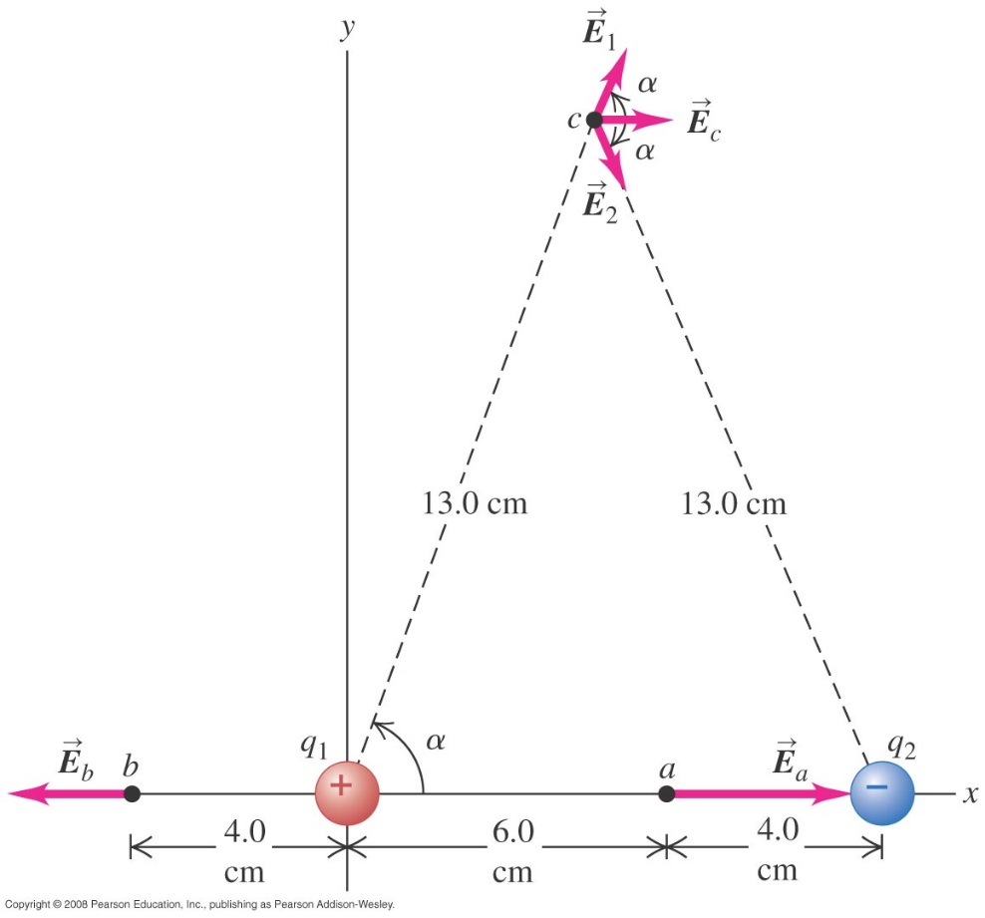
Superposition of electric fields
The total electric field at a point is the vector sum of the fields due to all the charges present.
Ex: Find the electric fields at points a, b, and c.
q₁ = 2 nC and q₂ = 4 nC

Slide 21
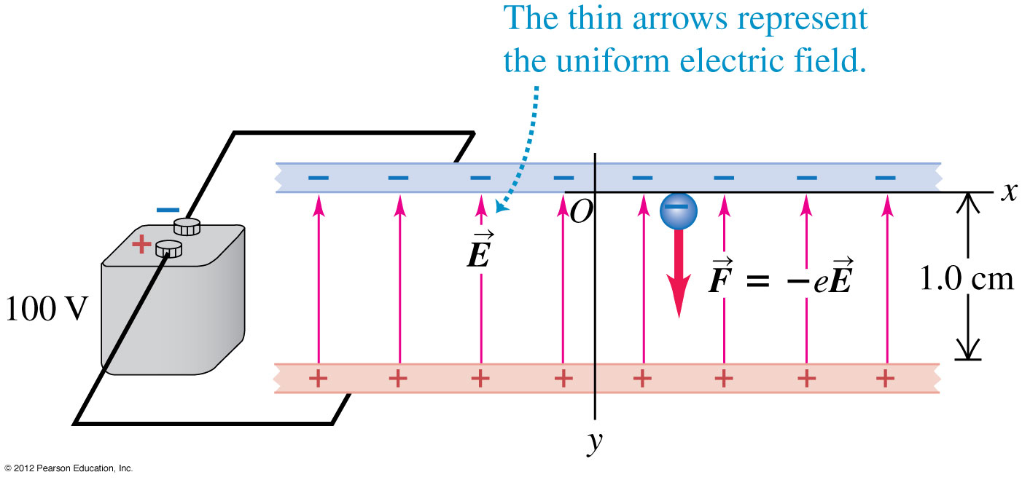
Electron in a uniform field
Find the force on a charge that is in a known electric field.

Slide 22
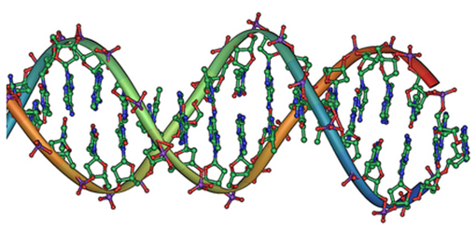
Electric Force in Biology
DNA is a highly charged molecule. The DNA double helix shows the two coiled strands each containing a row of nitrogenous bases, which “code” the genetic information needed by a living organism. The strands are connected by bonds between pairs of bases. While pairing combinations between certain bases are fixed (C-G and A-T), the sequence of nucleotides in the strand varies. (credit: Jerome Walker)

Slide 23
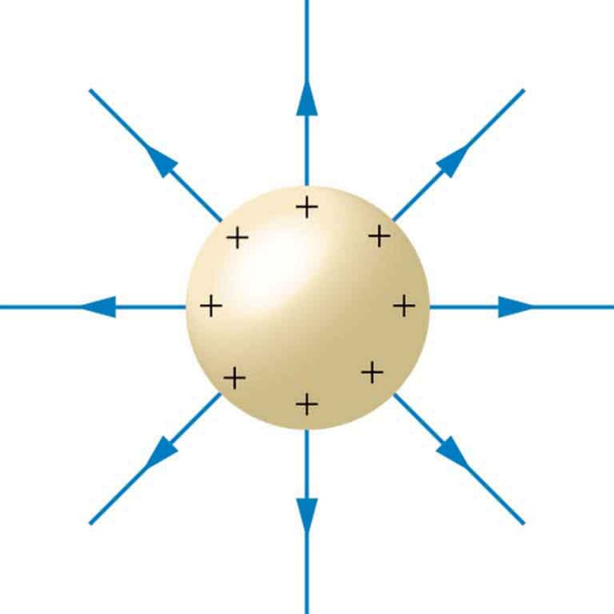
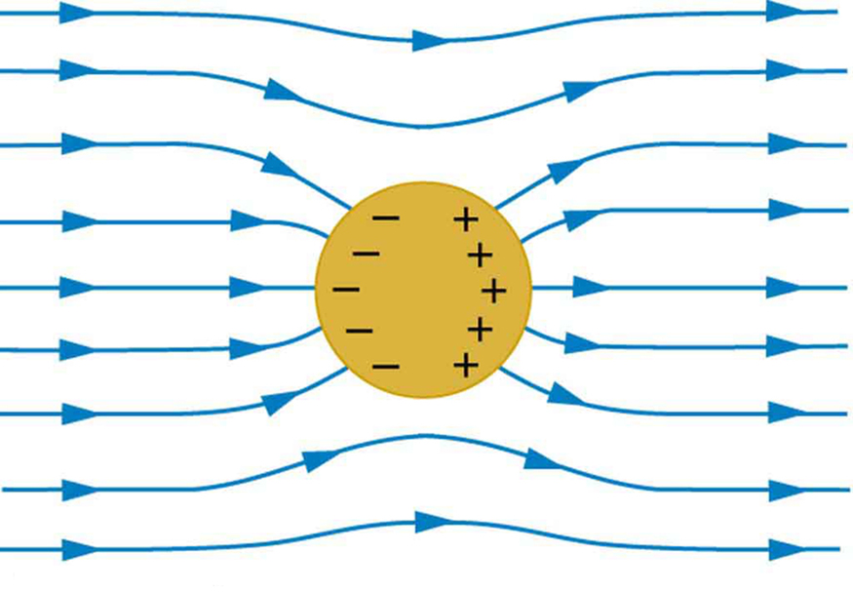
Conductor and Electric Fields
Electric Field in static equilibrium (Electrostatics)
Free Charge will be distributed such that the electric field is perpendicular to the surface.
No electric field inside a conductor

Slide 24
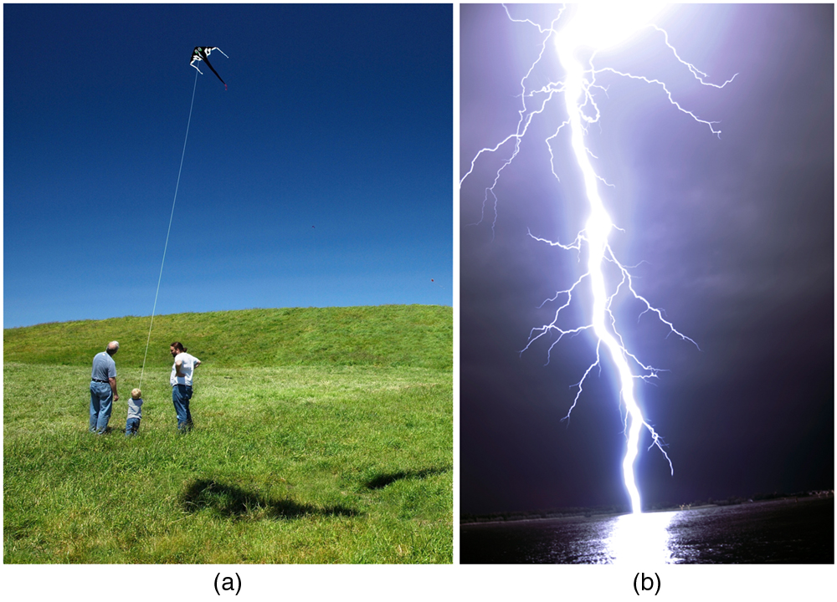
Earth’s Electric Field
Fair weather field. Earth and the ionosphere (a layer of charged particles) are both conductors. They produce a uniform electric field of about 150 N/C. (credit: D. H. Parks)
Storm fields. In the presence of storm clouds, the local electric fields can be larger. At very high fields, the insulating properties of the air break down and lightning can occur. (credit: Jan-Joost Verhoef)

