Slide 1
PHY 1214
General Physics 2
Chapter 19
Electric Potential and Electrical Field
Engineering and Physics
University of Central Oklahoma
Dr. Mohamed Bingabr

Slide 2
Chapter Outline
Electric Potential Energy: Potential Difference
Electric Potential in a Uniform Electric Field
Electric Potential due to a Point Charge
Equipotential Lines
Capacitors and Dielectrics
Capacitors in Series and Parallel
Energy Stored in Capacitor

Slide 3
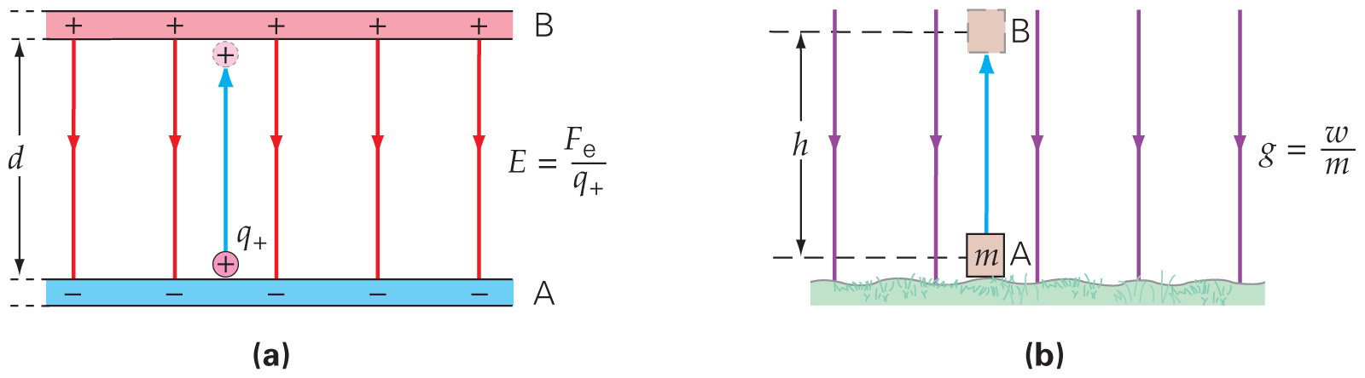
Electric Potential Energy: Potential Difference
It takes work to move a charge against an electric field. Just as with gravity, this work increases the potential energy of the charge.
$$∆U_{e}=U_{B}−U_{A}=F_{e}d=q_{+}Ed$$
U = PE

Slide 4
Electric Potential Energy: Potential Difference
Just as with the electric field, it is convenient to define a quantity that is the electric potential energy per unit charge. This is called the electric potential.
Unit of electric potential: the volt, V

Slide 5
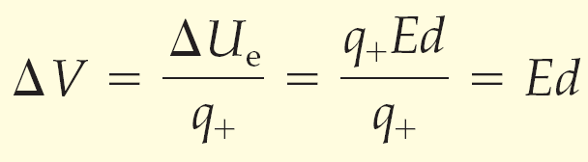
Electric Potential Energy: Potential Difference
The potential difference between parallel plates can be calculated relatively easily:
For a pair of oppositely charged parallel plates, the positively charged plate is at a higher electric potential than the negatively charged one by an amount ΔV.

Slide 6
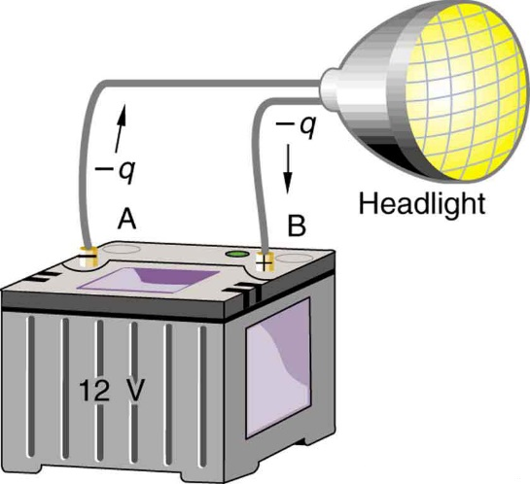
Electric Potential Energy: Potential Difference
Ex 19.1 : A 12 V motorcycle battery can move 5000 C of charge and a 12 V car battery can move 60,000 C of charge. How much energy does each deliver?
A battery moves negative charge from its negative terminal through a headlight to its positive terminal. Appropriate combinations of chemicals in the battery separate charges so that the negative terminal has an excess of negative charge, which is repelled by it and attracted to the excess positive charge on the other terminal. In terms of potential, the positive terminal is at a higher voltage than the negative. Inside the battery, both positive and negative charges move.

Slide 7
Electron Volt
One electron volt is the energy given to one electron to accelerate through a potential difference of 1 V.
Ex: 5 eV of energy is required to break certain organic molecule.
Ex 19.3 Conservation of Energy: Calculate the final speed of a free electron accelerated from rest through a potential difference of 100 V.
Note: Mass of electron is 9.11x10⁻³¹ Kg
KE_{i} + PE_{i}= KE_{f} + PE_{f}

Slide 8
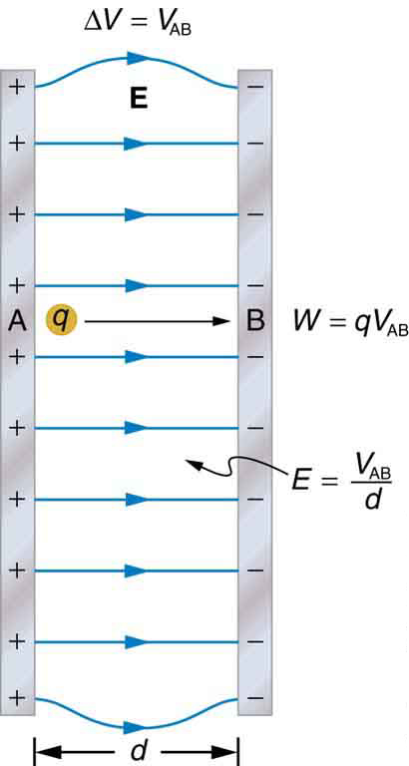
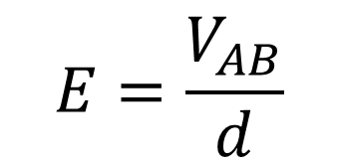


Electric Potential in a Uniform Electric Field
$V_{AB}$ is the voltage difference between point A and point B
$$V_{AB}=V_{A}−V_{B}$$
$$E=\frac{V_{AB}}{d}$$
$$V_{AB}=Ed$$
Ex 19.4: Dry air will support a maximum electric field strength of about 3 million V/m. Above that value, the field creates enough ionization in the air to make the air a conductor. This allows a discharge or a spark that reduces the field. What is the maximum voltage between two parallels conducting plates separated by 2.5 cm of dry air?

Slide 9
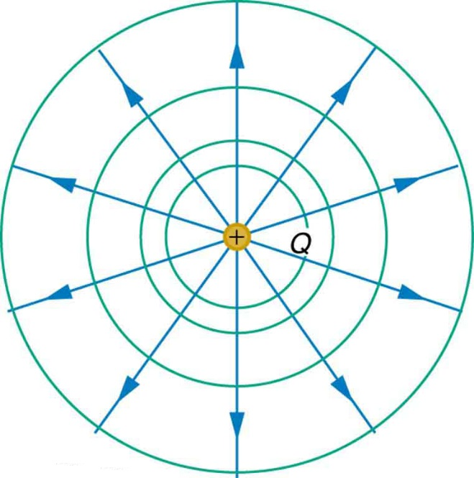
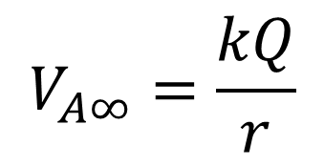
Electric Potential Due to a Point Charge
The voltage at a distance r from a charge with respect to a point far away from the charge is
$$V_{A∞}=\frac{kQ}{r}$$
Ex 19.6: What is the voltage 5 cm away from the center of 1-cm diameter metal sphere that has -3 nC static charge.

Slide 10
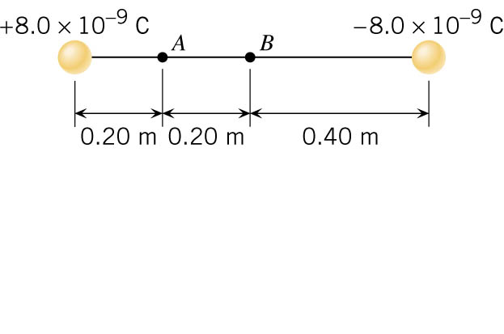
Electric Potential Due to a Point Charge
Ex: Find the voltage at points A and B.

Slide 11
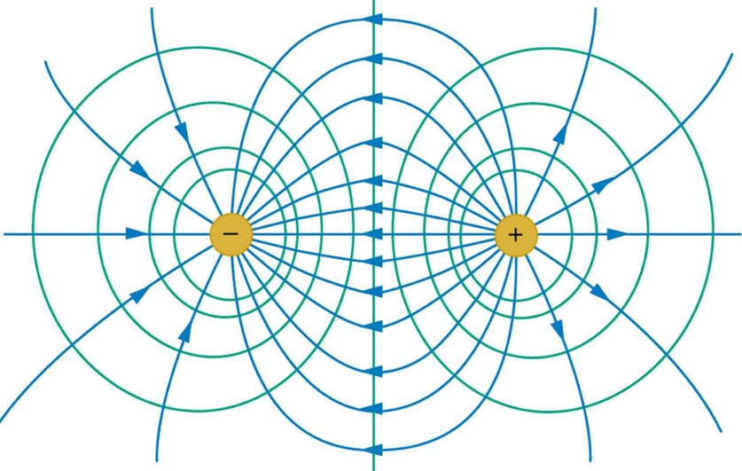
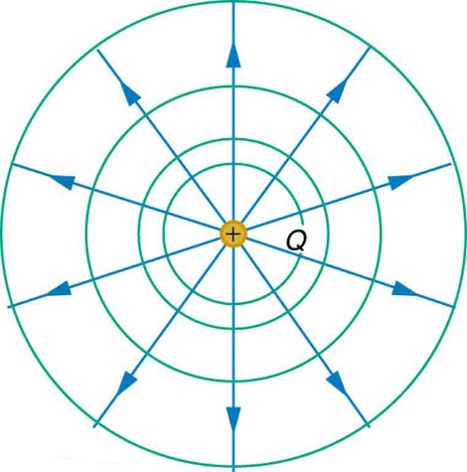
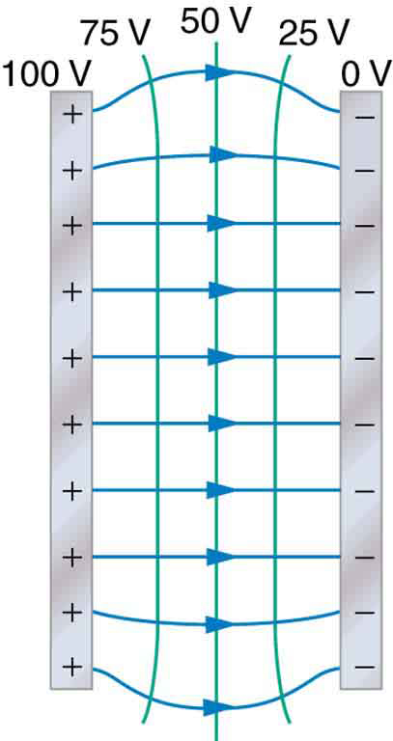
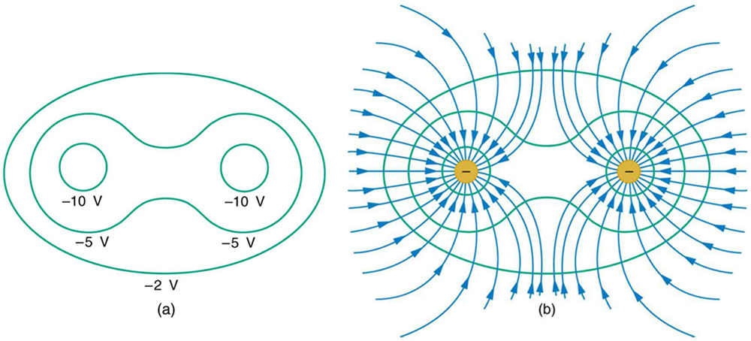
Equipotential Lines
The potential is the same along each equipotential line, meaning that no work is required to move a charge anywhere along one of those lines.

Slide 12
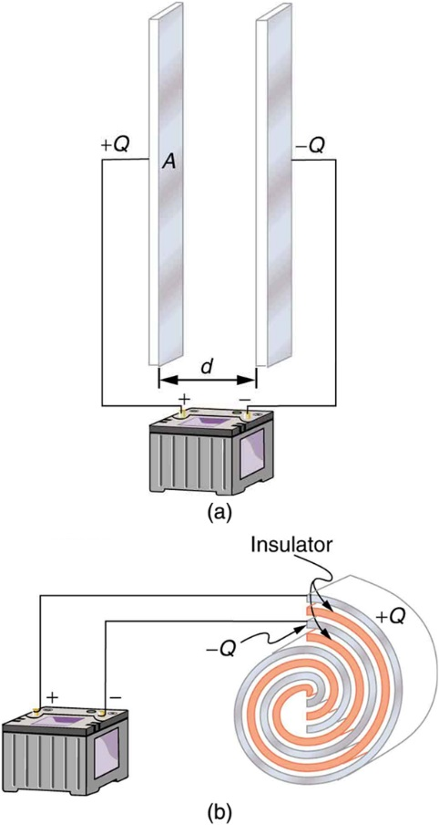
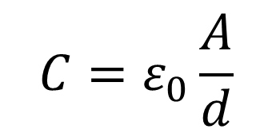

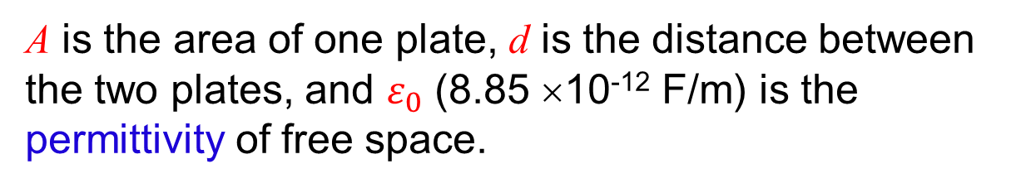
Capacitor and Dielectrics
A capacitor is a device used to store electric charge.
The amount of charge Q a capacitor can store depends on two factors: (1) the voltage applied and (2) the capacitors physical characteristics such as size.
$$C=ε_{0}\frac{A}{d}$$
C : Capacitance Unit: Farad (F)
A is the area of one plate, d is the distance between the two plates, and $ε_{0}$ (8.85 ×10⁻¹² F/m) is the permittivity of free space.
$$Q=CV$$

Slide 13
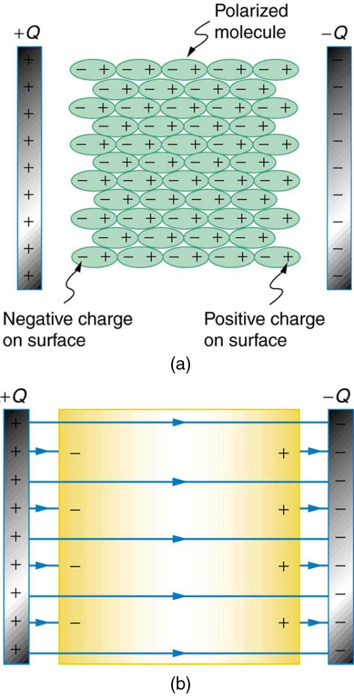
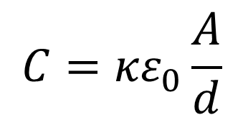

Capacitor and Dielectrics
Dielectric between the plates increase the capacitance and the amount of charge that can be stored for the same voltage.
$$C={κε}_{0}\frac{A}{d}$$
$κ$ is dielectric constant.
The molecules in the insulating material between the plates of a capacitor are polarized by the charged plates. This produces a layer of opposite charge on the surface of the dielectric that attracts more charge onto the plate, increasing its capacitance.
The dielectric reduces the electric field strength inside the capacitor, resulting in a smaller voltage between the plates for the same charge. The capacitor stores the same charge for a smaller voltage, implying that it has a larger capacitance because of the dielectric.

Slide 14
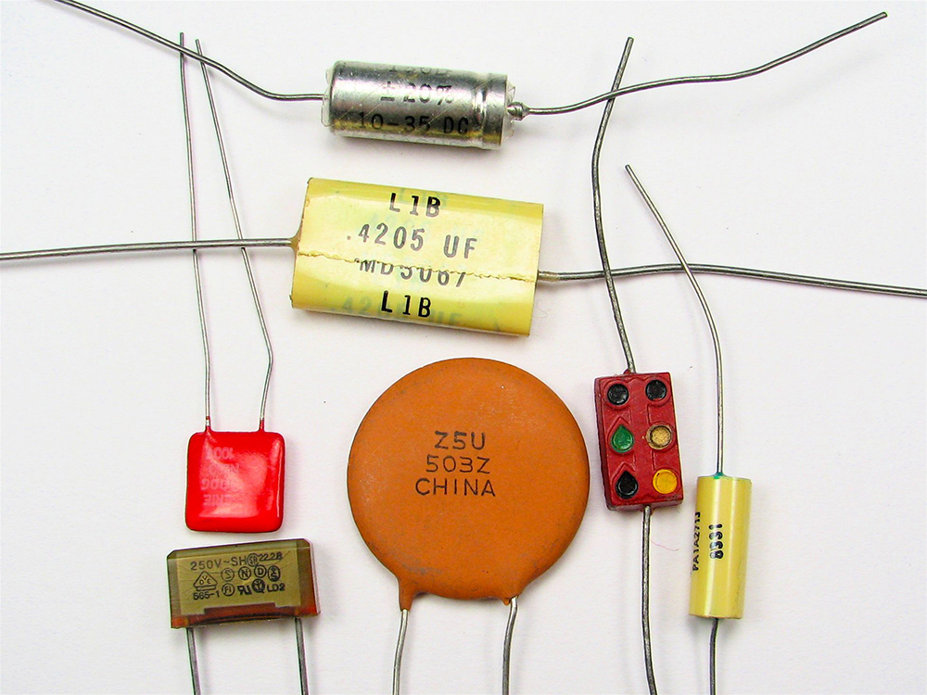
Capacitor and Dielectrics
Ex 19.8: What is the capacitance of a parallel plate capacitor with metal plates, each of area 1.00 m², separated by 1.00 mm? What charge is stored in this capacitor if a voltage of 3.00 ×10³ V applied to it?

Slide 15
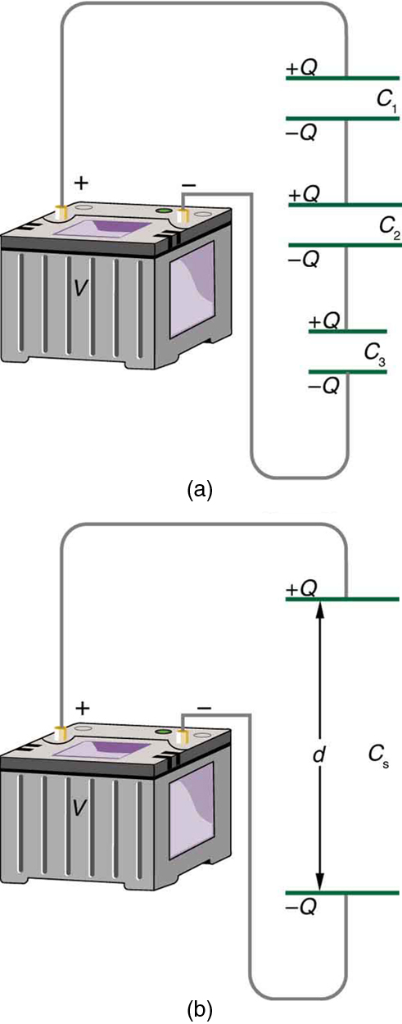
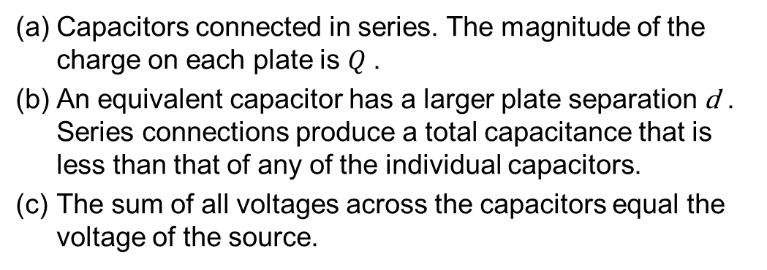
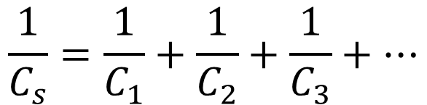
Capacitors in Series
Total Capacitance in Series C_{s}
$$\frac{1}{C_{s}}=\frac{1}{C_{1}}+\frac{1}{C_{2}}+\frac{1}{C_{3}}+…$$
Capacitors connected in series. The magnitude of the charge on each plate is $Q$.
An equivalent capacitor has a larger plate separation d . Series connections produce a total capacitance that is less than that of any of the individual capacitors.
The sum of all voltages across the capacitors equal the voltage of the source.
Ex: if C₁ = 2 μF, C₂= 4 μF, C₃= 6 μF, and V= 12 V, Find Q, V₁, V₂, V₃.

Slide 16
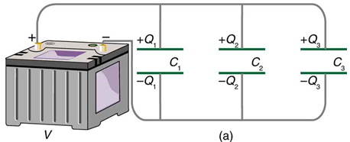
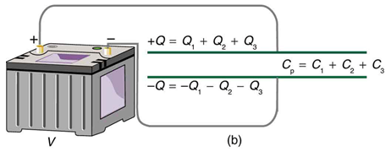

Capacitors in Parallel
Total Capacitance in Parallel C_{p}
$$C_{p}=C_{1}+C_{2}+C_{3}+…$$
Capacitors in parallel. Each is connected directly to the voltage source just as if it were all alone, and so the total capacitance in parallel is just the sum of the individual capacitances.
The equivalent capacitor has a larger plate area and can therefore hold more charge than the individual capacitors.
The voltage across each capacitor is the same as the voltage of the source.
Ex: if C₁ = 2 μF, C₂= 4 μF, C₃= 6 μF, and V= 12 V, Find Q, Q₁, Q₂, Q₃.

Slide 17
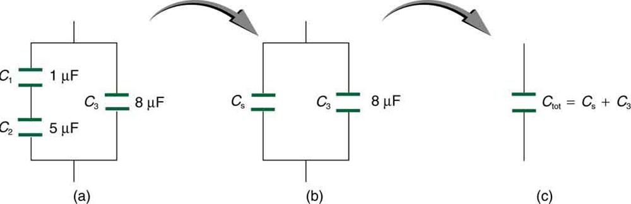
Capacitors in Series and Parallel
Ex 19.9: Find the total capacitance of the combination of capacitors shown in Figure (a). C₁ = 1.000 μF, C₂ = 3.000 μF, and C₃ = 8.000 μF.

Slide 18
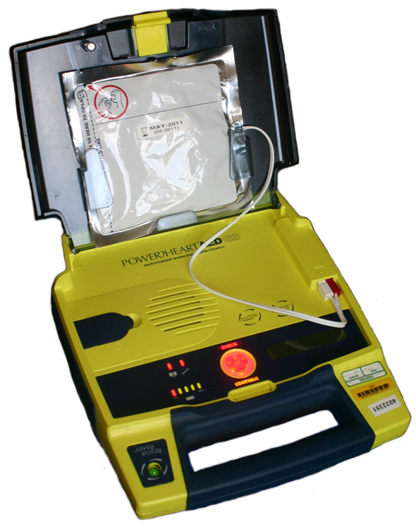
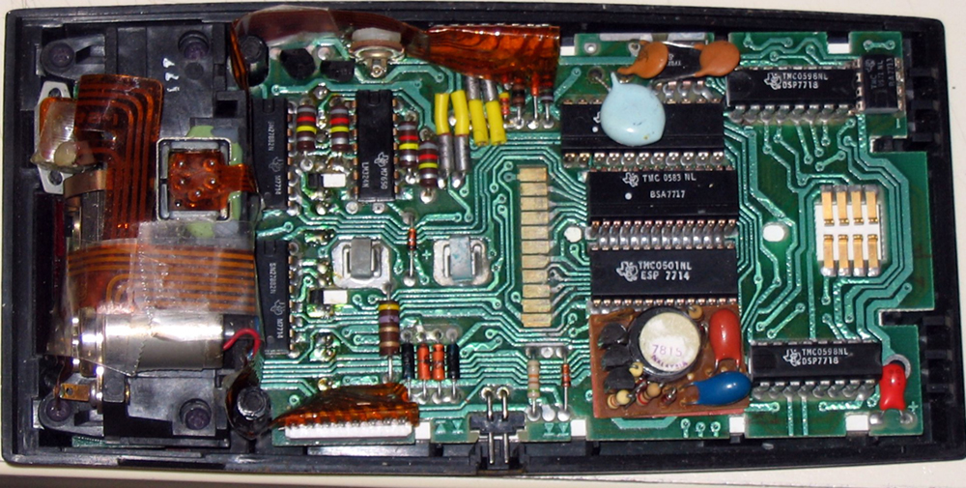

Energy Stored in Capacitors
$$E_{cap}=\frac{QV}{2}=\frac{CV^{2}}{2}=\frac{Q^{2}}{2C}$$
Ex 19.11: A heart defibrillator delivers 4.00 ×10² J of energy by discharging a capacitor initially at 1.00 ×10⁴ V. What is its capacitance?

