Slide 1
PHY 1214
General Physics 2
Chapter 20
Electric Current, Resistance & Ohm’s Law
Engineering and Physics
University of Central Oklahoma
Dr. Mohamed Bingabr

Slide 2
Chapter Outline
Current
Ohm’s Law
Resistance and Resistivity
Electric Power and Energy
Alternating Current versus Direct Current
Electric Hazards and the Human Body
Nerve Conduction-Electrocardiograms

Slide 3
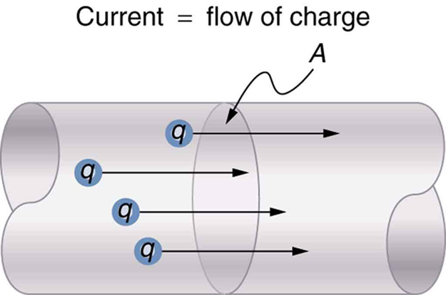
Electric Current
Electric Current: The rate at which charge flows.
$$I=\frac{∆Q}{∆t}$$
$$1 A=\frac{1 C}{s}$$

Slide 4
Electric Current
Ex 20.1: What is the current involved when a truck battery gets in motion 720 C of charge in 4.00 s while starting an engine? (b) How long does it take 1.00 C of charge to flow through a handheld calculator if a 0.300-mA current is flowing?

Slide 5
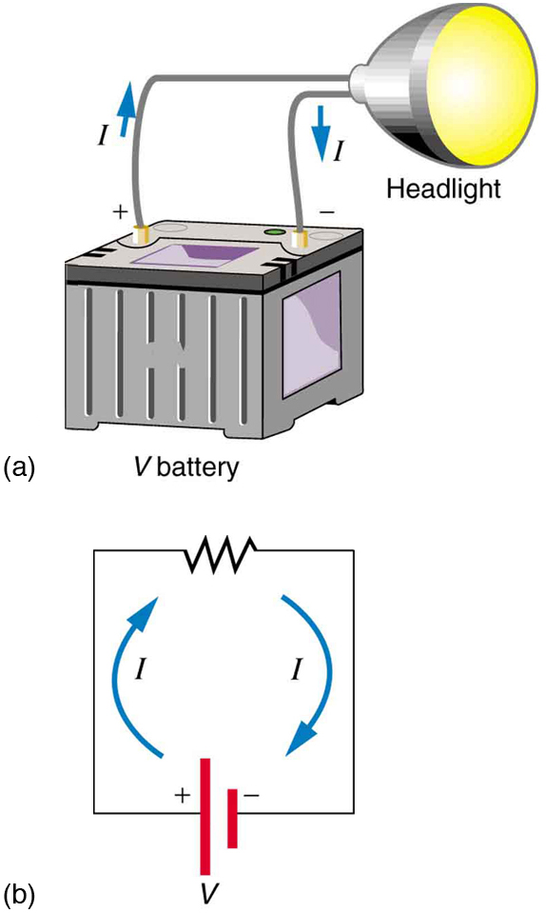
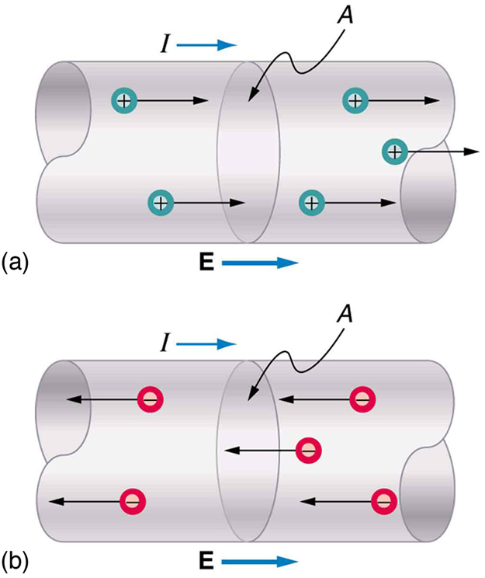
Current Flow
Conventional current is defined to move in the direction of the electric field. Positive charges move in the same direction as current and negative charge in the opposite direction.

Slide 6
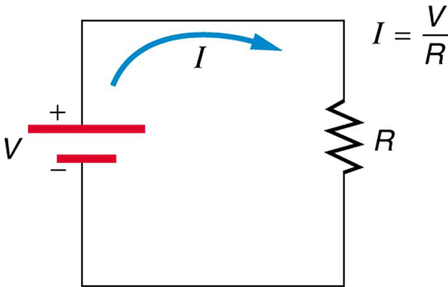
Ohm’s Law
Ohm’s Law: The current that flows through most substance is directly proportional to the voltage V applied to it.
$$I=\frac{V}{R}$$
R is the resistance of the substance and its unit is ohm Ω.
Ex 20.4: What is the resistance of an automobile headlight through which 2.5 A flows when 12.0 V is applied to it?

Slide 7
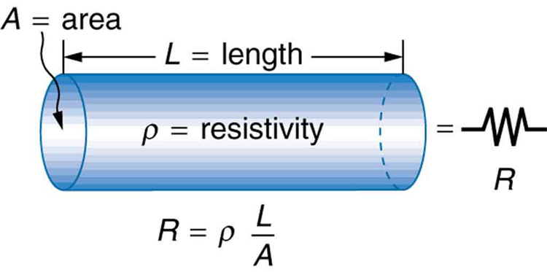
Resistance and Resistivity
Resistivity of a substance depends on the atomic structure of the material.
Ex 20.5 A car headlight filament is made of tungsten and has a cold resistance of 0.35 Ω. If the filament is a cylinder 4.00 cm long what is its diameter? The resistivity of tungsten is 5.6 ᵡ 10⁻⁸ Ω.m.

Slide 8
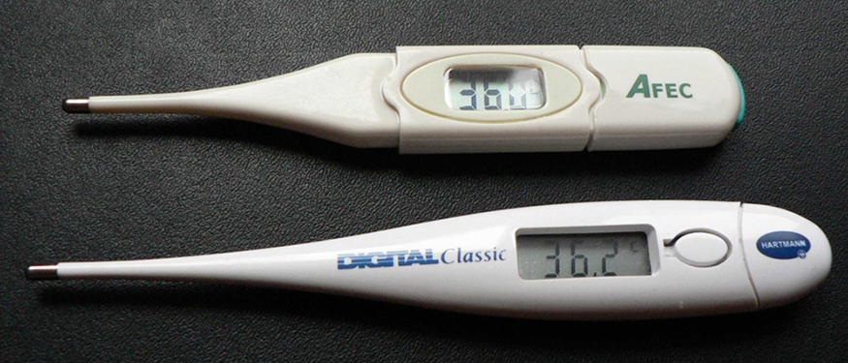
Temperature Variation of Resistance
Resistivity of all materials depends on temperature
$$ρ=ρ_{o}\left(1+α∆T\right)$$
$$R=R_{o}\left(1+α∆T\right)$$

Slide 9
Electric Power
Power is the rate of energy use.
$$P=\frac{PE}{t}=\frac{qV}{t}=IV$$
Unit: Watts
$$P=\frac{V^{2}}{R}$$
$$P=IV$$
$$P=I^{2}R$$
Ex 20.7: Find the power dissipated by an automobile headlight through which 2.5 A flows when 12.0 V is applied to it? What is the power dissipated if the resistance when it is cold is 0.35 Ω.

Slide 10
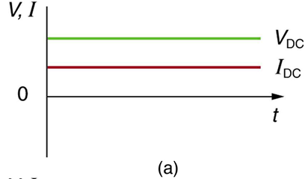
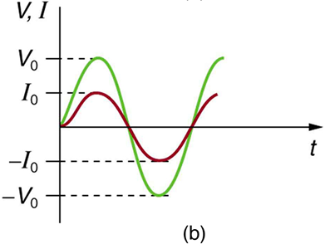
Alternating Current Versus Direct Current
Direct Current (DC) is the flow of electric charge in only one direction.
Alternating Current (AC) is the flow of electric charge that periodically reverse direction.

Slide 11
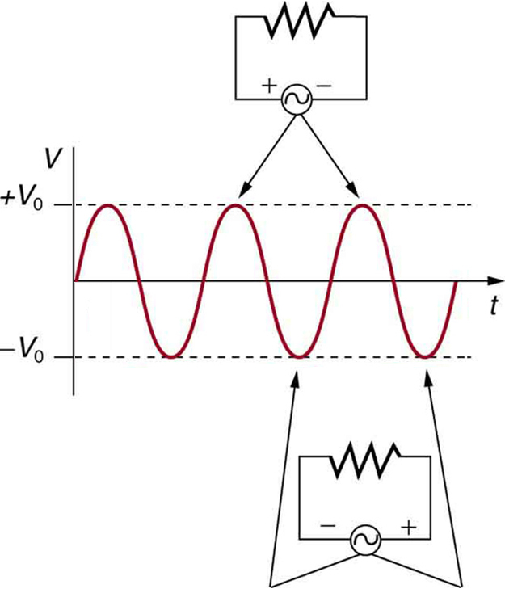
Alternating Current Versus Direct Current
$$V=V_{o}\sin{2πft}$$
$$I=I_{o}\sin{2πft}$$
$$P_{avg}={\frac{1}{2}I}_{o}V_{o}$$
$$I_{rms}={\frac{1}{\sqrt{2}}I}_{o}$$
$$V_{rms}={\frac{1}{\sqrt{2}}V}_{o}$$
$$P_{avg}=I_{rms}V_{rms}$$

Slide 12
Why Use AC for Power Distribution
Ex 20-10) (a) What current is needed to transmit 100 MW of power at 200 kV? (b) What is the power dissipated by the transmission lines if they have a resistance of 1.00 Ω? (c) What percentage of the power is lost in the transmission lines?

Slide 13
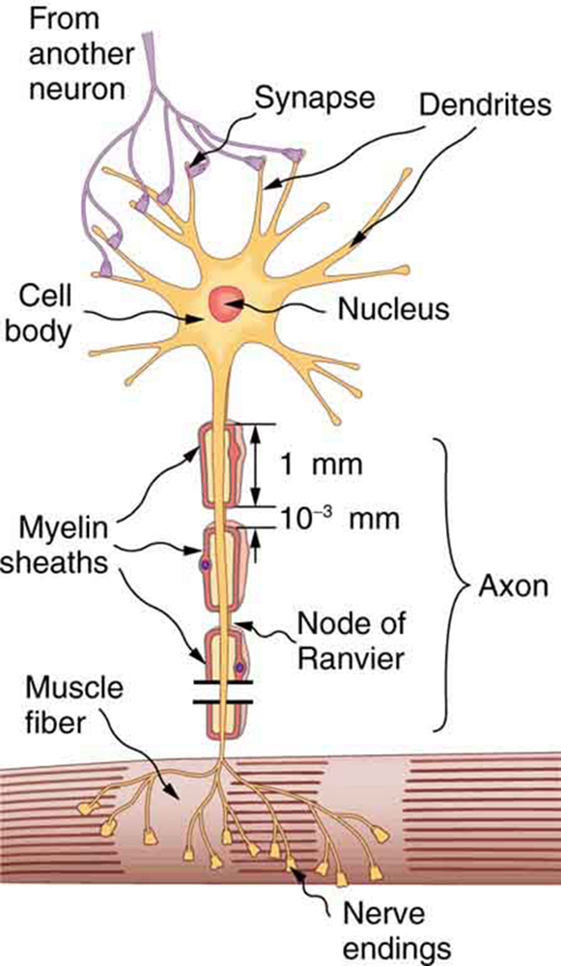
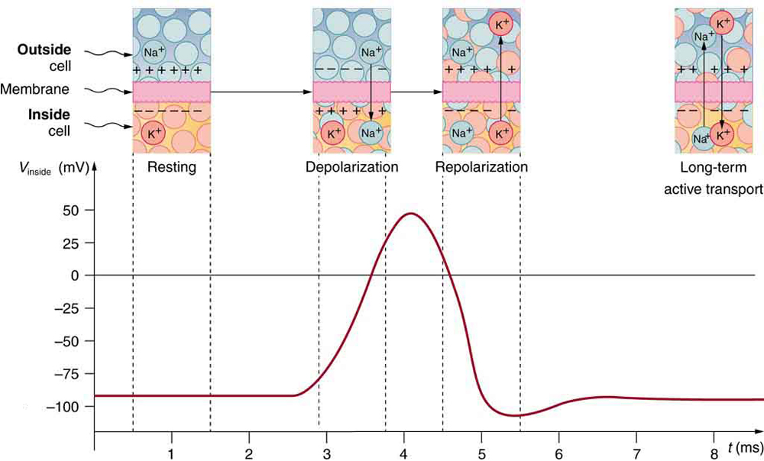
Nerve Conduction-Electrocardiograms
An action potential is the pulse of voltage inside a nerve cell graphed here. It is caused by movements of ions across the cell membrane as shown. Depolarization occurs when a stimulus makes the membrane permeable to $Na+$, ions. Repolarization follows as the membrane again becomes impermeable to $Na+$, and $K+$ moves from high to low concentration. In the long term, active transport slowly maintains the concentration differences, but the cell may fire hundreds of times in rapid succession without seriously depleting them.

