Slide 1
PHY 1214
General Physics 2
Chapter 21
Circuit in DC Instruments
Engineering and Physics
University of Central Oklahoma
Dr. Mohamed Bingabr

Slide 2
Chapter Outline
Resistors in Series and Parallel
Electromotive Force: Terminal Voltage
Kirchhoff’s Rules
DC Voltmeters and Ammeters
DC Circuits Containing Resistors and Capacitors

Slide 3
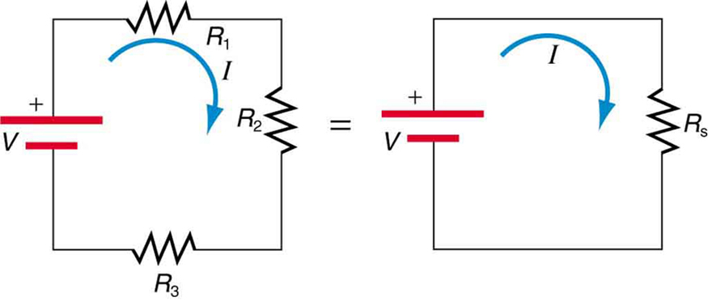
Resistors in Series
The current is the same through all resistors connected in series.
I
V₁
V₂
V₃
V₄
$$R_{S}=R_{1}+R_{2}+R_{3}+R_{4}$$
$$V_{AB}=V_{1}+V_{2}+V_{3}+V_{4}$$
I
$$V_{AB}=IR_{S}$$

Slide 4
Resistors in Series
Ex 21.1: Suppose the voltage output of the battery is 12.0 V, and the resistances are R₁ = 1.00Ω, R₂= 6.00 Ω, and R₃=13.0 Ω. (a) What is the total resistance? (b) Calculate the power dissipated by each resistor. (c) Find the power output of the source, and show that it equals the total power dissipated by the resistors.

Slide 5
Resistor in Parallel
The voltage is the same across resistors connected in parallel.
$$\frac{1}{R_{p}}=\frac{1}{R_{1}}+\frac{1}{R_{2}}+\frac{1}{R_{3}}$$
$$I_{1}=\frac{V}{R_{1}}$$
$$I_{2}=\frac{V}{R_{2}}$$
$$I_{3}=\frac{V}{R_{3}}$$
$$I=\frac{V}{R_{P}}$$
$${I=I}_{1}+I_{2}+I_{3}$$

Slide 6
Resistor in Parallel
Ex 21.2: Suppose the voltage output of the battery is 12.0 V, and the resistances are R₁ = 1.00Ω, R₂= 6.00 Ω, and R₃=13.0 Ω. (a) What is the total resistance? (b) Find the total current. (c) Calculate the current in each resistor, and show these add to equal the total current output of the source. (d) Calculate the power dissipated by each resistor. (c) Find the power output of the source, and show that it equals the total power dissipated by the resistors.

Slide 7
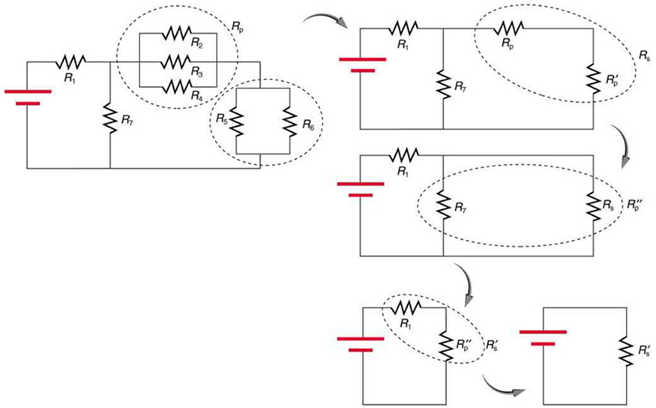
Combination of Series and Parallel
Combinations of series and parallel can be reduced to a single equivalent resistance.

Slide 8
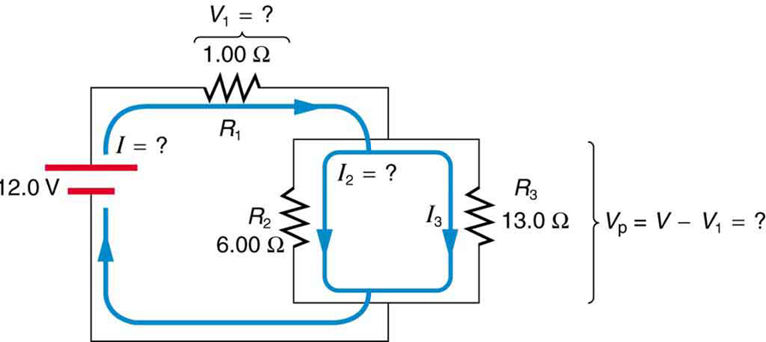
Combination of Series and Parallel
(a) Find the total resistance. (b) What is the voltage drop in R₁? (c) Find the current I₂ through R₂. (d) What power is dissipated by R₂?

Slide 9
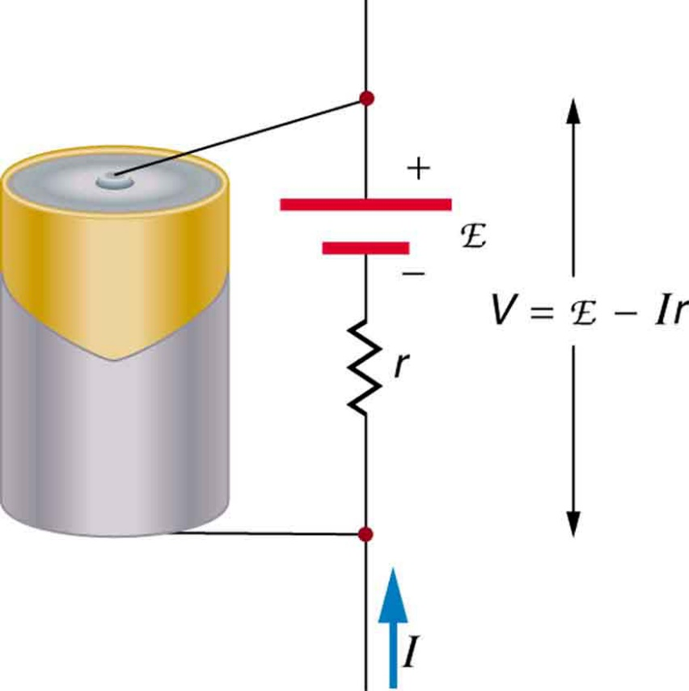
Electromotive Force: Terminal Voltage
Electromotive force (emf) is the potential difference of a source when no current is flowing. Units of emf are volts.
$$V = emf − Ir$$
Ex 21.4: A battery has a 12.0 V emf and an internal resistance of 0.10 Ω. (a) Calculate its terminal voltage when connected to a a10.0 Ω load. (b) What is the terminal voltage when connected to a 0.5 Ω, find the current, terminal voltage, and power dissipated by a 0.5 Ω load.

Slide 10
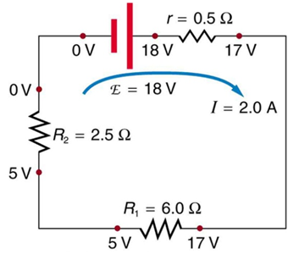
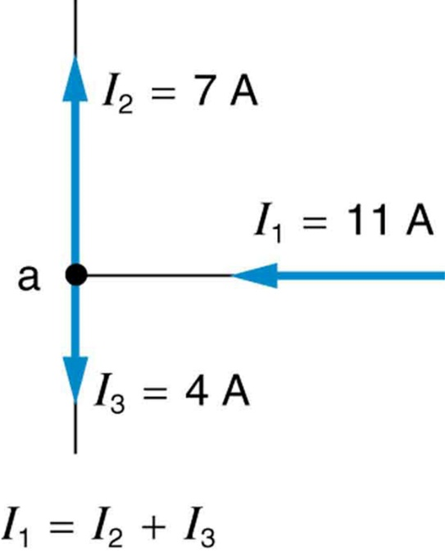
Kirchhoff’s Rules
First Rule-the junction rule: The sum of all current entering a junction must equal the sum of all currents leaving the junction.
Second Rule-the loop rule: The algebraic sum of changes in potential around any closed circuit path (loop) must be zero.

Slide 11
Kirchhoff’s Rules
Reasoning Strategy
Applying Kirchhoff’s Rules
Draw the current in each branch of the circuit. Choose any direction.
If your choice is incorrect, the value obtained for the current will turn out
to be a negative number.
Mark each resistor with a + at one end and a – at the other end in a way
that is consistent with your choice for current direction in step 1. Outside a
battery, conventional current is always directed from a higher potential (the
end marked +) to a lower potential (the end marked -).
Apply the junction rule and the loop rule to the circuit, obtaining in the process as many independent equations as there are unknown variables.
4. Solve these equations simultaneously for the unknown variables.

Slide 12
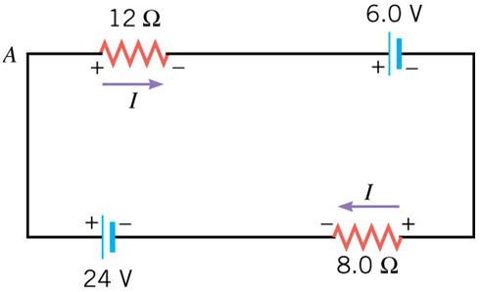
Kirchhoff’s Rules
Ex 21.5: Find the currents flowing in the circuit below

Slide 13
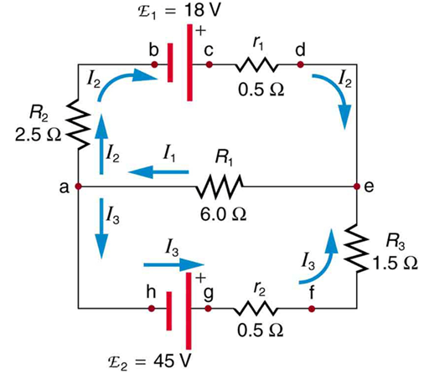
Kirchhoff’s Rules
Ex 21.5: Find the currents flowing in the circuit below

Slide 14
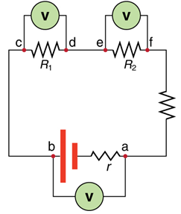
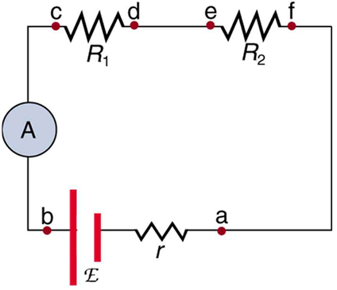
DC Voltmeters and Ammeters
Voltmeter is used to measure voltage and it is connected in parallel with the device you want to measure the voltage across it.
Ammeter is used to measure current and it is connected in series with the device you want to measure the current through it.

Slide 15
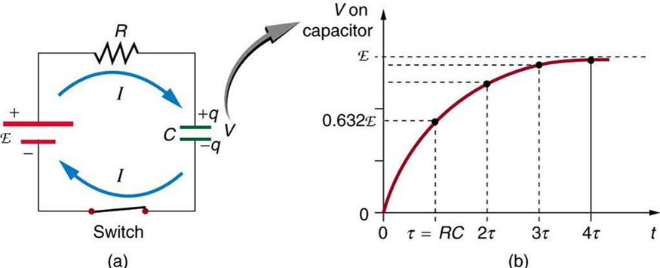
DC Circuits Containing Resistors and Capacitors
$$V=emf (1−e^{−\frac{t}{RC}})$$
RC Circuits (Charging)
$$τ=RC$$
$$V=emf (1−e^{−\frac{t}{τ}})$$
$τ$is the time constant. It is the time it takes to charge the capacitor 63% of its final voltage.
$$I=I_{0}e^{−\frac{t}{RC}}$$

Slide 16
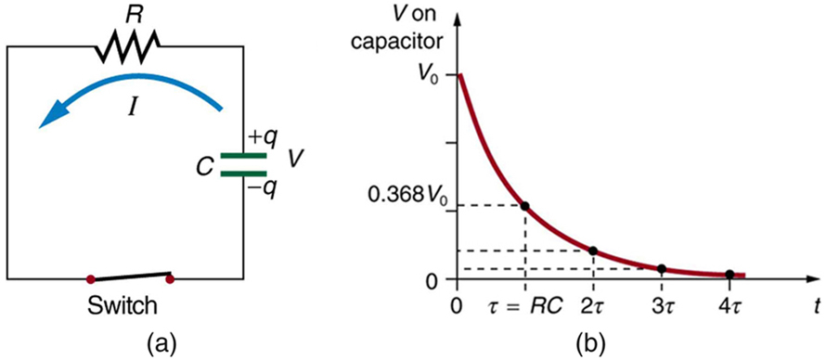
DC Circuits Containing Resistors and Capacitors
$$V=V_{0}e^{−\frac{t}{RC}}$$
RC Circuits (Discharging)
$V_{0}$ is the initial voltage across the capacitor
$$V=V_{0}e^{−\frac{t}{τ}}$$
$$τ=RC$$

