Slide 1
PHY 1214
General Physics 2
Chapter 22
Magnetism
Engineering and Physics
University of Central Oklahoma
Dr. Mohamed Bingabr

Slide 2
Chapter Outline
Magnets, Ferromagnets, and Electromagnets
Magnetic Fields and Magnetic Field Lines
Magnetic Field Strength
Force on a moving Charge in a Magnetic Field
The Hall Effect
Magnetic Force on a Current-Carrying Conductor
Torque on a Current Loop: Motors and Meters
Magnetic Fields Produced by Current: Ampere’s Law
Magnetic Field between Two Parallel Conductors

Slide 3
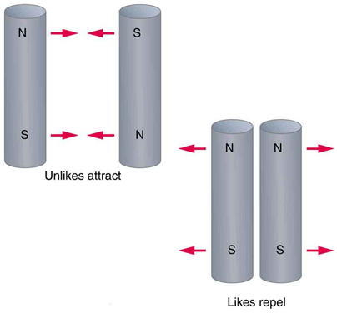
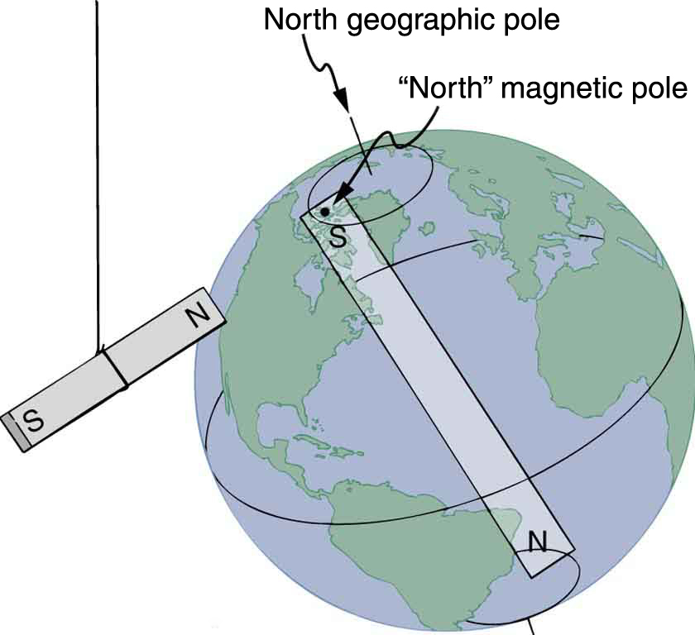
Magnet
Magnets have two distinct types of poles; we refer to them as north and south.
Like magnetic poles repel, and unlike poles attract.

Slide 4
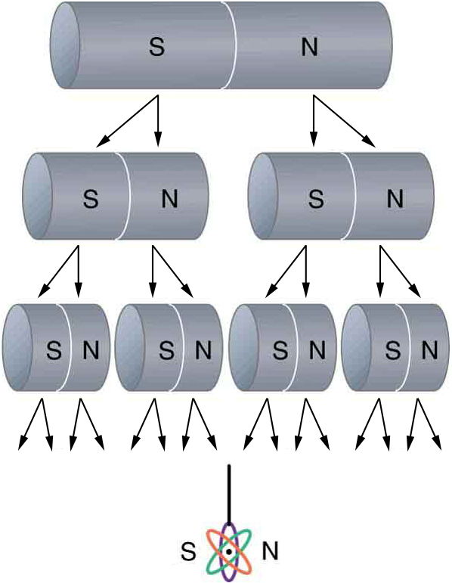
Magnet
Positive and negative charges can be separated but north and south poles of a magnet can not be separated.
If we continue to split the magnet, we will eventually get down to an iron atom with a north pole and a south pole—these, too, cannot be separated.

Slide 5
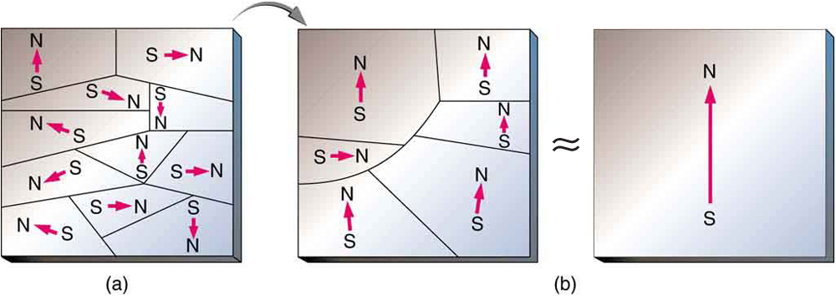
Ferromagnets and Electromagnets
Ferromagnets: certain materials, such as iron, nickel, exhibit strong magnetic field.

Slide 6
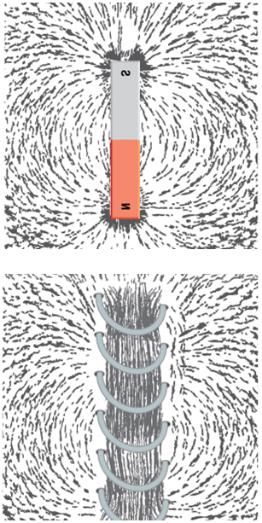
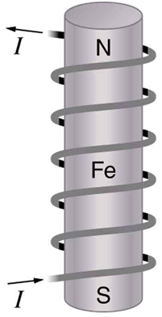
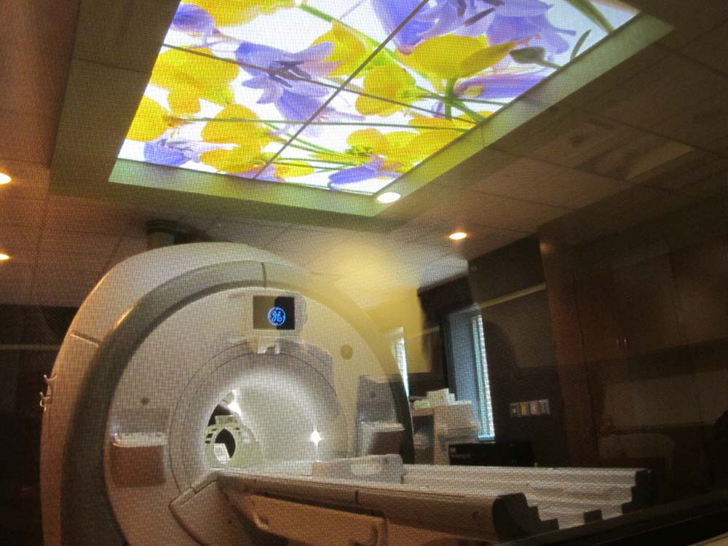
Ferromagnets and Electromagnets
Electromagnets: Electric current (moving charge) cause magnetic field.

Slide 7
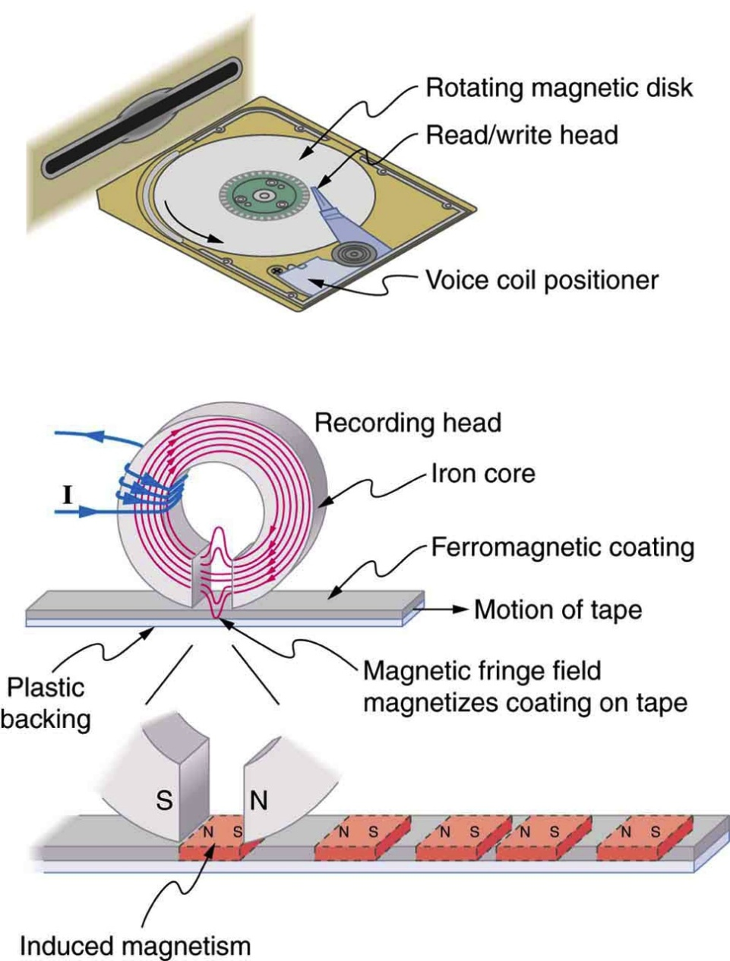
Application of Electromagnetism
An electromagnet induces regions of permanent magnetism on a floppy disk coated with a ferromagnetic material. The information stored here is digital (a region is either magnetic or not); in other applications, it can be analog (with a varying strength), such as on audiotapes.

Slide 8
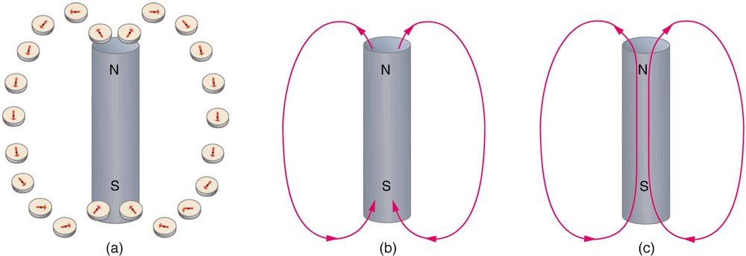
Magnetic Fields and Magnetic Field Lines
A field is a way of mapping forces surrounding any object that can act on another object at a distance without apparent physical connection (Gravitational, electric, magnetic fields).

Slide 9
Magnetic Fields and Magnetic Field Lines
A field is a way of mapping forces surrounding any object that can act on another object at a distance without apparent physical connection (Gravitational, electric, magnetic fields).

Slide 10
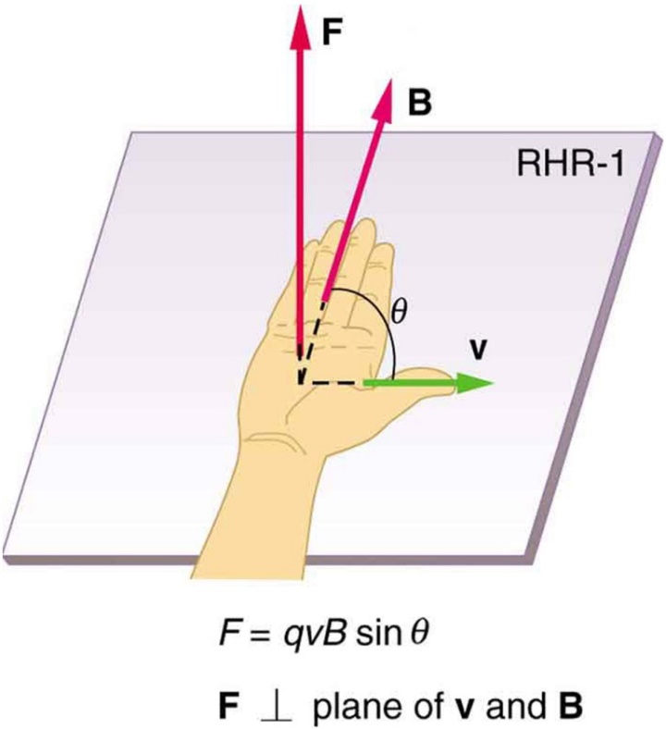
Magnetic Field Strength & Force on a Charge
A magnetic Field B exert a force on a moving charge in the field.
$$F =qvB\sin{θ}$$
$$B =\frac{F}{qv \text{sin} θ}$$
Unit tesla
$$1 T =\frac{1 N}{C m/s}=\frac{N}{A.m}$$
The direction of the magnetic force on a moving charge is perpendicular to the plane formed by $v$ and $B$ and follows right hand rule–1 (RHR-1).

Slide 11
Magnetic Forces on Charged Particles
A proton in a particle accelerator has a speed of 5.0x10⁶ m/s. The proton encounters a magnetic field whose magnitude is 0.40 T and whose direction makes and angle of 30.0 degrees with respect to the proton’s velocity. Find (a) the magnitude and direction of the force on the proton and (b) the acceleration of the proton. (c) What would be the force and acceleration of the particle if it was an electron?
m_{e} = 9.11 ᵡ10⁻³¹ kg
m_{p} = 1.67 ᵡ10⁻²⁷ kg

Slide 12
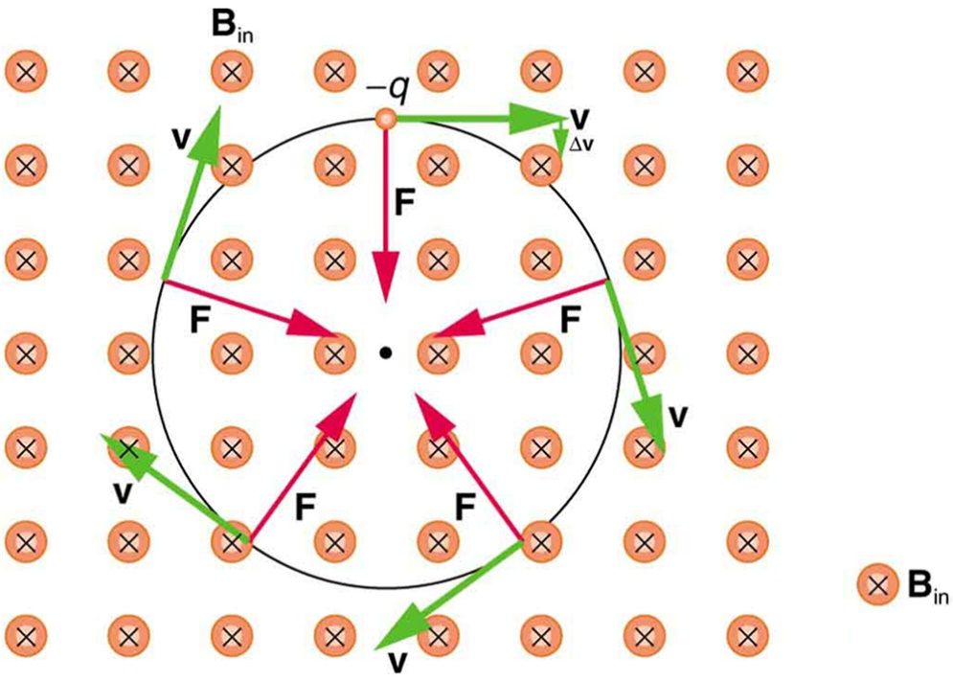
Force on a Moving Charge in a Magnetic Field
Ex 22.2:What happened when an electron enter a region with uniform magnetic field B (0.5 T) with specific velocity v 6ᵡ10⁷ m/s)?
- The magnetic force always remains perpendicular to the velocity and is directed toward the center of the
circular path.
- Magnetic Force = Centripetal Force
$$qvB =\frac{mv^{2}}{r}$$
$$r =\frac{mv}{qB}$$
m_{e} = 9.11 ᵡ10⁻³¹ kg
Ans: r = 6.83 ᵡ10⁻⁴ m

Slide 13
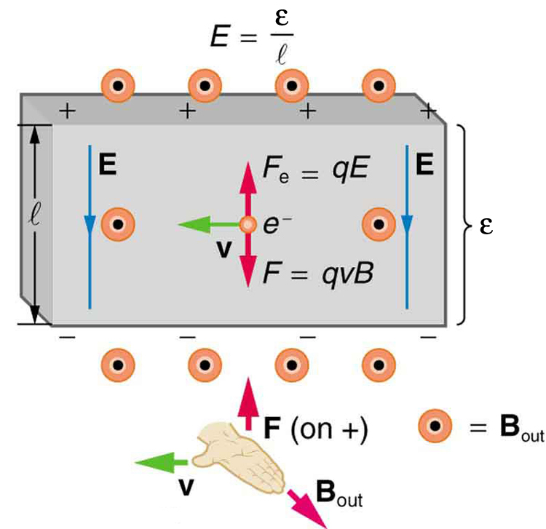
The Hall Effect
The Hall emf ε produces an electric force that balances the magnetic force on the moving charges. The magnetic force produces charge separation, which builds up until it is balanced by the electric force, an equilibrium that is quickly reached.
$$F_{e} =F_{m}$$
$$qE =qvB$$
$$\frac{ε}{l}=vB$$
$$ε=lvB$$

Slide 14
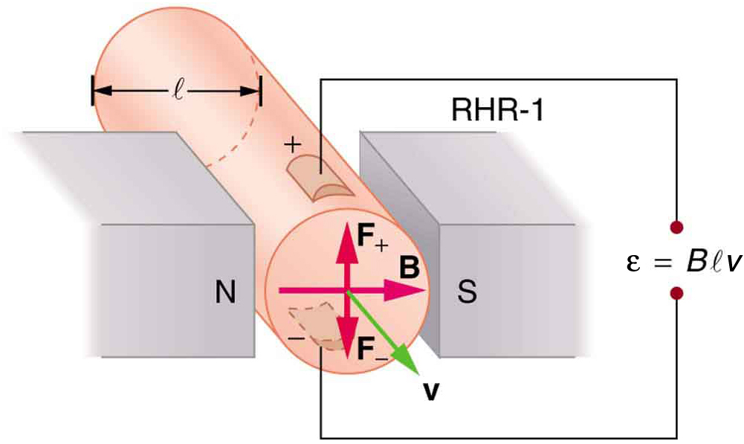
Application of the Hall Effect
Ex. A Hall effect flow probe is placed on an artery, applying a 0.1-T magnetic field across it. The probe measured 80.0 μV. The vessel’s inside diameter is 4.00 mm. Find the average blood velocity.
Ans: v = 2.0 ᵡ10⁻¹ m/s

Slide 15
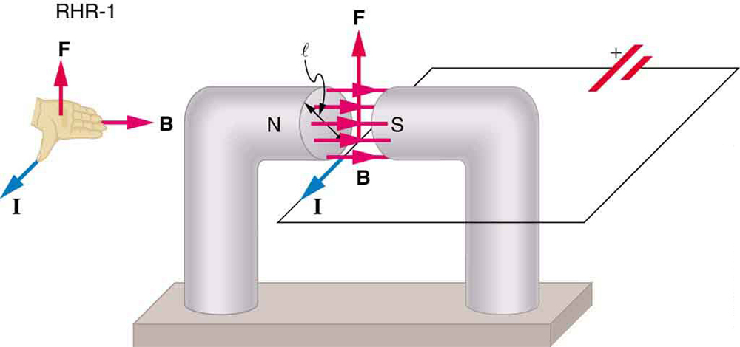
Magnetic Force on a Current-Carrying Conductor
The magnetic field exerts a force on a current-carrying wire in a direction given by the right hand rule 1 (the same direction as that on the individual moving charges). This force can easily be large enough to move the wire, since typical currents consist of very large numbers of moving charges.
$$F =qvB \text{sin} θ$$
$$F =qvB \text{sin}θ (nAl)$$
n: # of charge per unit volume
A: cross section of wire
$$F =\left(nqvA\right)lB \text{sin}θ$$
$$F =IlB \text{sin}θ$$

Slide 16
Magnetic Force on a Current-Carrying Conductor
EX 22.4: Calculate the force on the wire, given B =1.5 T, l =5.00 cm, and I =20.0 A.
Ans: F = 1.5 N

Slide 17
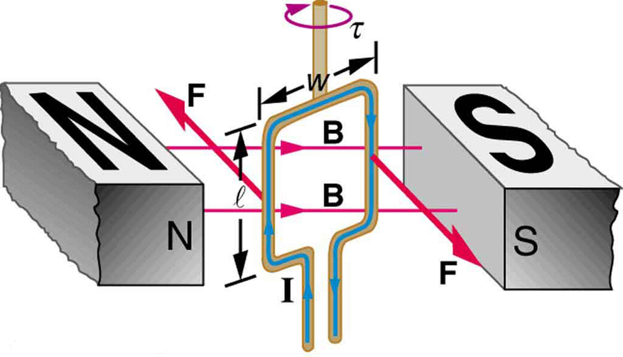
Torque on a Current Loop: Motors and Meters
Motors are the most application of magnetic force on current-carrying wires. A current-carrying loop of wire attached to a vertically rotating shaft feels magnetic forces that produce a clockwise torque as viewed from above.
F
r
θ
F
$$τ =r×F$$
$$τ =\frac{w}{2}F \text{sin} θ+\frac{w}{2}F \text{sin} θ=wF\text{sin} θ$$

Slide 18
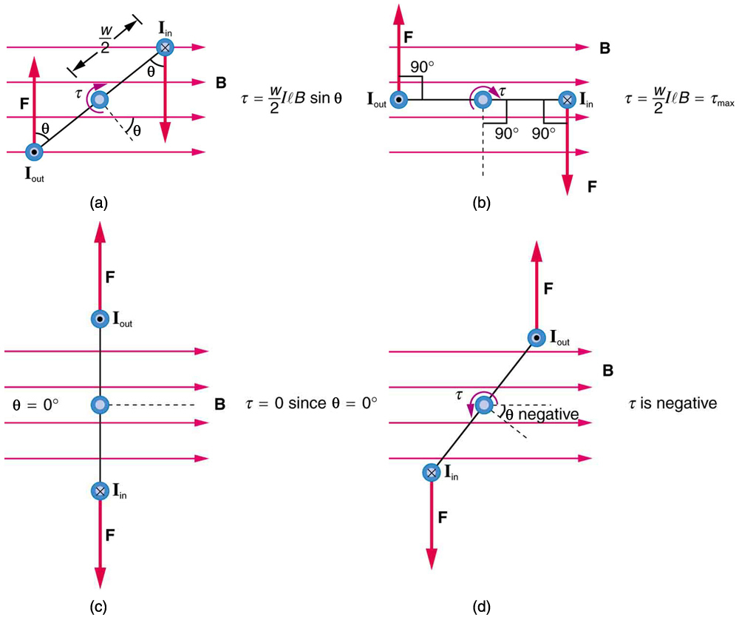
Torque on a Current Loop: Motors and Meters
$$F =IlB$$
$$τ =wIlB \text{sin} θ$$
For N loop
$$τ =NIAB \text{sin} θ$$

Slide 19
Torque on a Current Loop: Motors and Meters
Ex 22.5: Find the maximum torque on a 100-turn square loop of a wire of 10.0 cm on a side that carries 15.0 A of current in a 2.00-T field.
Ans: τ_{max} = 30.0 N.m

Slide 20
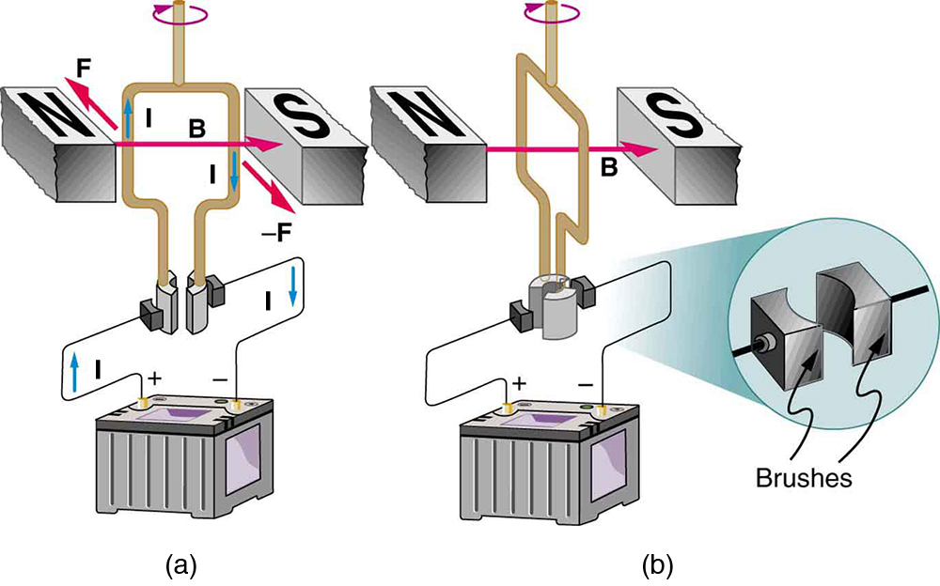
Torque on a Current Loop: Motors
As the angular momentum of the coil carries it through θ = 0 , the brushes reverse the current to keep the torque clockwise.
The coil will rotate continuously in the clockwise direction, with the current reversing each half revolution to maintain the clockwise torque.

Slide 21
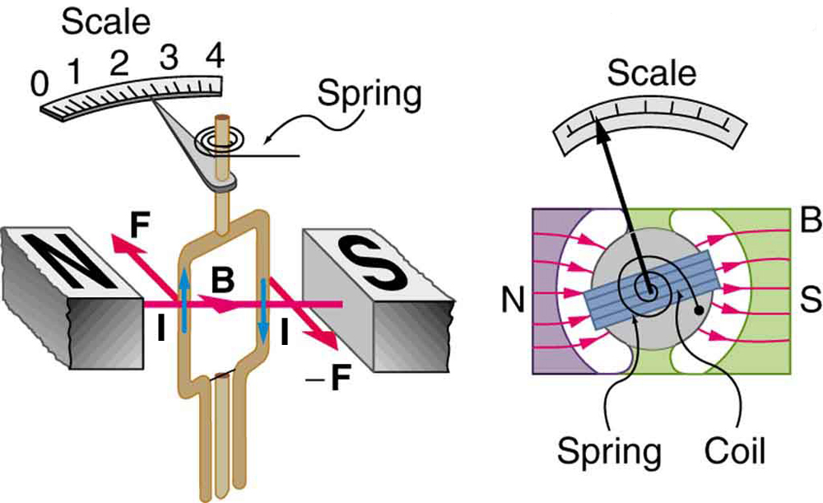
Torque on a Current Loop: Meters
Meters are very similar to motors but only rotate through a part of a revolution. The magnetic poles of this meter are shaped to keep the component of$B$perpendicular to the loop constant, so that the torque does not depend on $θ$ and the deflection against the return spring is proportional only to the current $I$ .

Slide 22
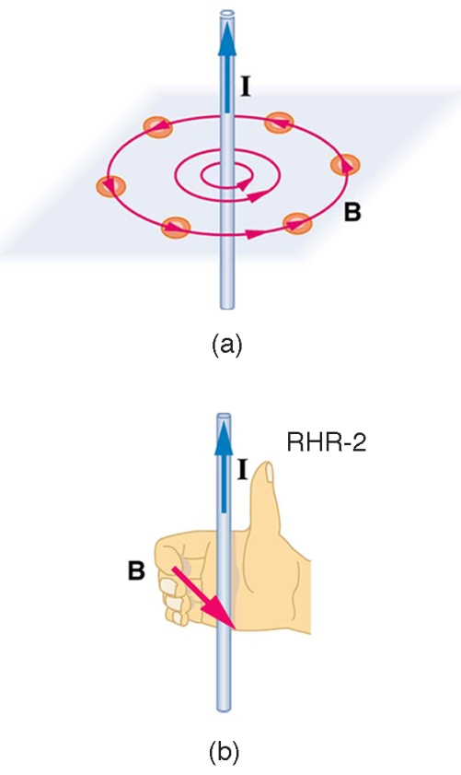
Ampere’s Law: Magnetic Fields Produced by Current
Right hand rule 2 states that, if the right hand thumb points in the direction of the current, the fingers curl in the direction of the field. This rule is consistent with the field mapped for the long straight wire and is valid for any current segment.
$$B=\frac{μ_{0}I}{2πr}$$
$μ_{0}=4π×{10}^{−7}$ T.m/A
Permeability of free space
Ex 22.6: Find the current in a long straight wire that would produce a magnetic field twice the strength of the earth’s (50 μT) at a distance of 5.0 cm from the wire.
Ans: I = 25 A

Slide 23
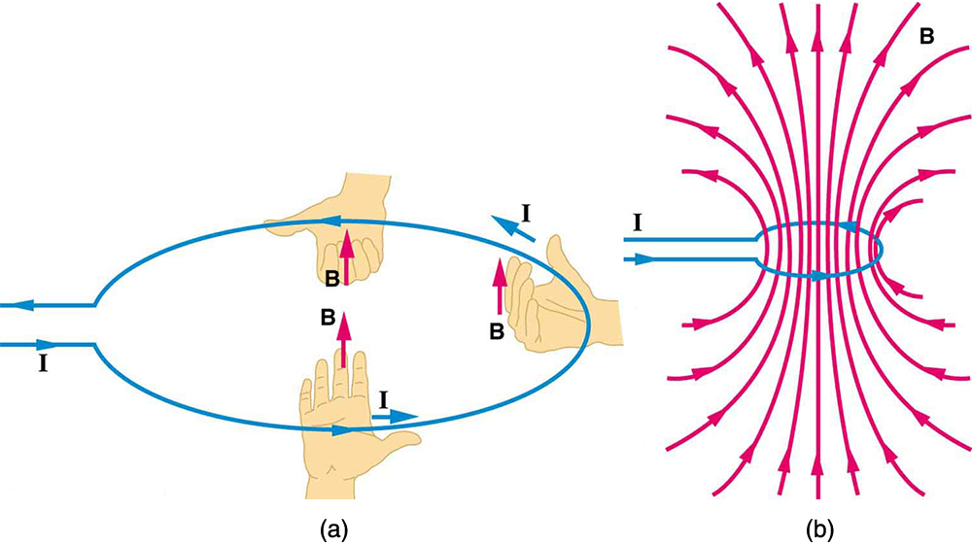
Magnetic Fields Produced by Current: Loop
Right hand rule 2 states that, if the right hand thumb points in the direction of the current, the fingers curl in the direction of the field. This rule is consistent with the field mapped for the long straight wire and is valid for any current segment.
$$B=\frac{μ_{0}I}{2R}$$
(at center of loop)

Slide 24
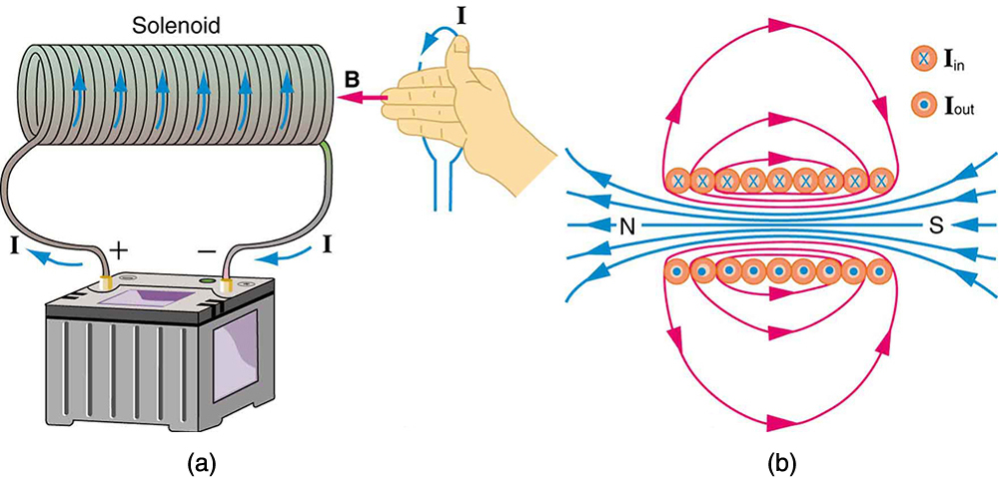
Magnetic Fields Produced by Current: Solenoid
Because of its shape, the field inside a solenoid of length l and n turns is remarkably uniform in magnitude and direction, as indicated by the straight and uniformly spaced field lines. The field outside the coils is nearly zero.
$$B=μ_{0}nI$$
(inside a solenoid)
$n$: number of loops per unit length
Ex 22.7: What is the field inside a 2.00 m-long solenoid that has 2000 loops and carries a 1600-A current?
Ans: B = 2.01 T

Slide 25
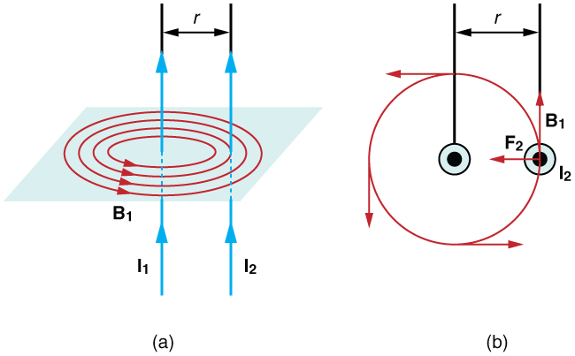
Magnetic Force between Two Parallel Conductors
Force between two long straight and parallel conductors:
$$B_{1}=\frac{μ_{0}I_{1}}{2πr}$$
$$F_{2}=I_{2}lB_{1}$$
$$F_{2}=\frac{μ_{0}lI_{2}I_{1}}{2πr}$$
$$\frac{F}{l}=\frac{μ_{0}I_{2}I_{1}}{2πr}$$
(Force per unit length)

Slide 26
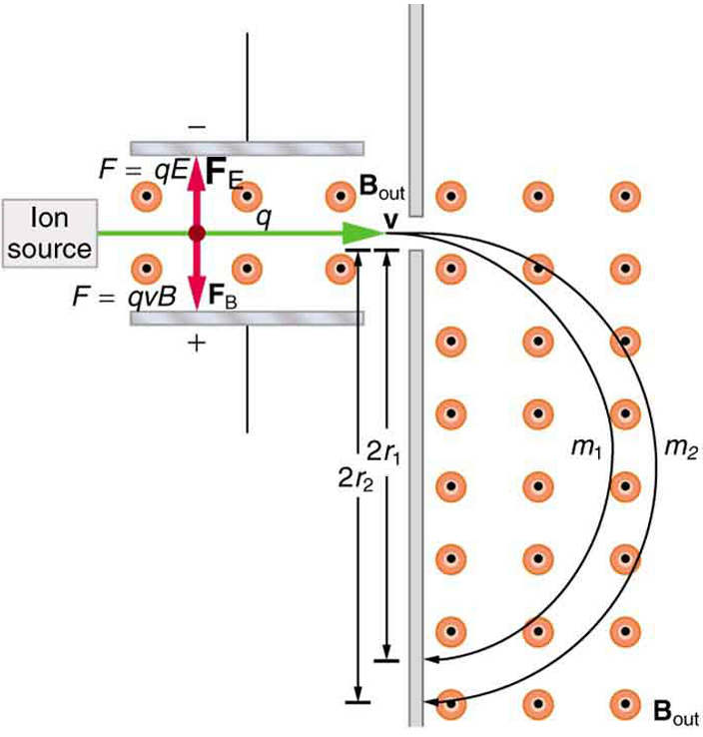
More Application of Magnetism
Mass Spectrometry: This mass spectrometer uses a velocity selector to fix $v$ so that the radius of the path is proportional to mass.
$$v=\frac{E}{B}$$
$$r=\frac{mv}{qB}$$

