Slide 1
PHY 1214
General Physics 2
Chapter 23
Electromagnetic Induction
Engineering and Physics
University of Central Oklahoma
Dr. Mohamed Bingabr

Slide 2
Chapter Outline
Induced Emf and Magnetic Flux
Faraday’s Law of Induction: Lenz’s Law
Motional Emf
Eddy Currents and Magnetic Damping
Electric Generators
Transformers
Inductance
RL and RLC Circuits

Slide 3
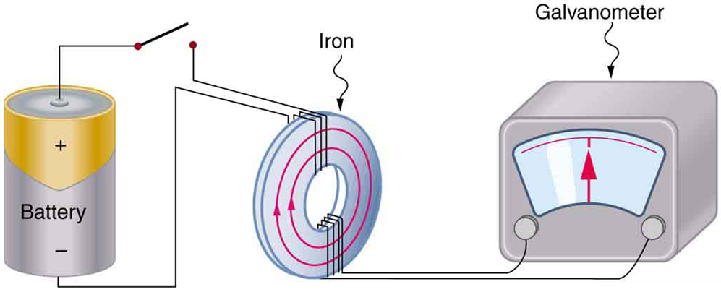
Electromagnetic Induction
Induction is the process of generating voltage and current from magnetic field.
Faraday’s apparatus for demonstrating that a magnetic field can produce a current. A change in the field produced by the top coil induces an emf and, hence, a current in the bottom coil. When the switch is opened and closed, the galvanometer registers currents in opposite directions. No current flows through the galvanometer when the switch remains closed or open.

Slide 4
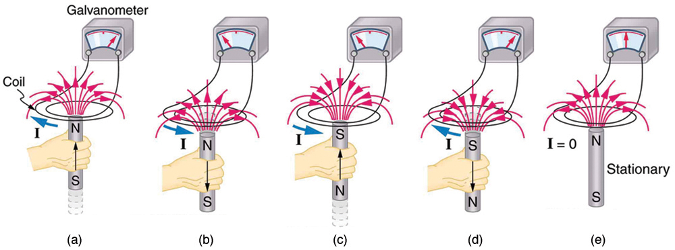
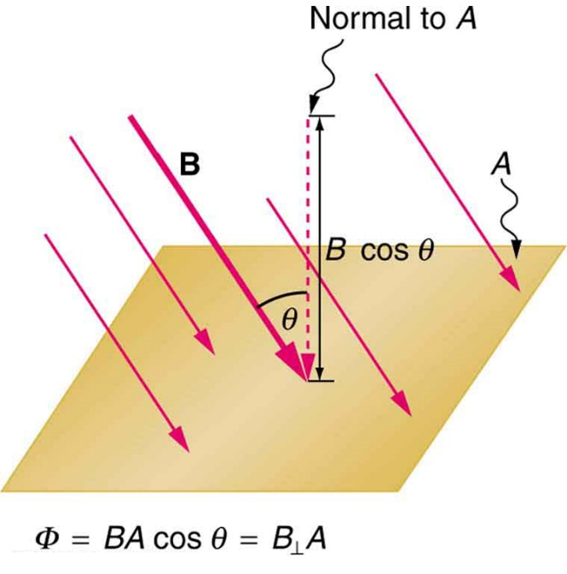
Magnetic Flux ϕ
Any change in magnetic flux ($∅$) through closed loop induces an emf. The induced emf causes current.
$$∅ =BA\cos{θ}$$

Slide 5
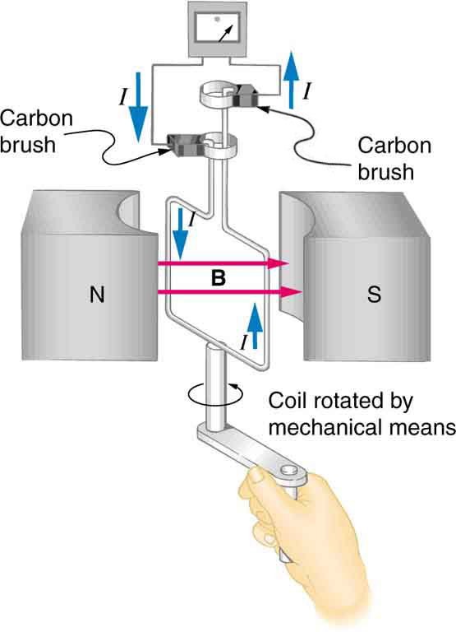
Generator
Generator is a device that generate electricity from mechanical motion.
Rotation of a coil in a magnetic field produces an emf. This is the basic construction of a generator, where work done to turn the coil is converted to electric energy. Note the generator is very similar in construction to a motor.

Slide 6
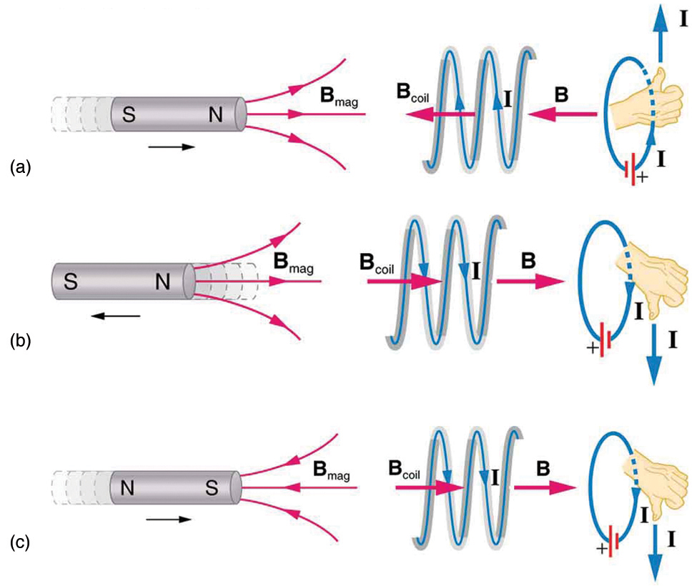
Faraday’s Law of Induction: Lenz’s Law
$$emf=−N\frac{Δ∅}{Δt}$$
Unit of emf is volt
Lenz’s Law: The minus sign means that the emf creates a current and magnetic field B that oppose the change in flux $Δ∅$.

Slide 7
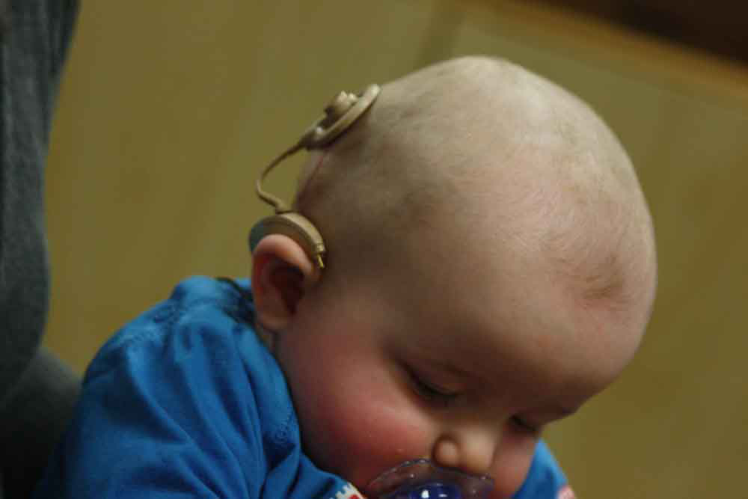
Application of Faraday’s Law
Cochlear Implant: Helping the deaf to hear again.

Slide 8
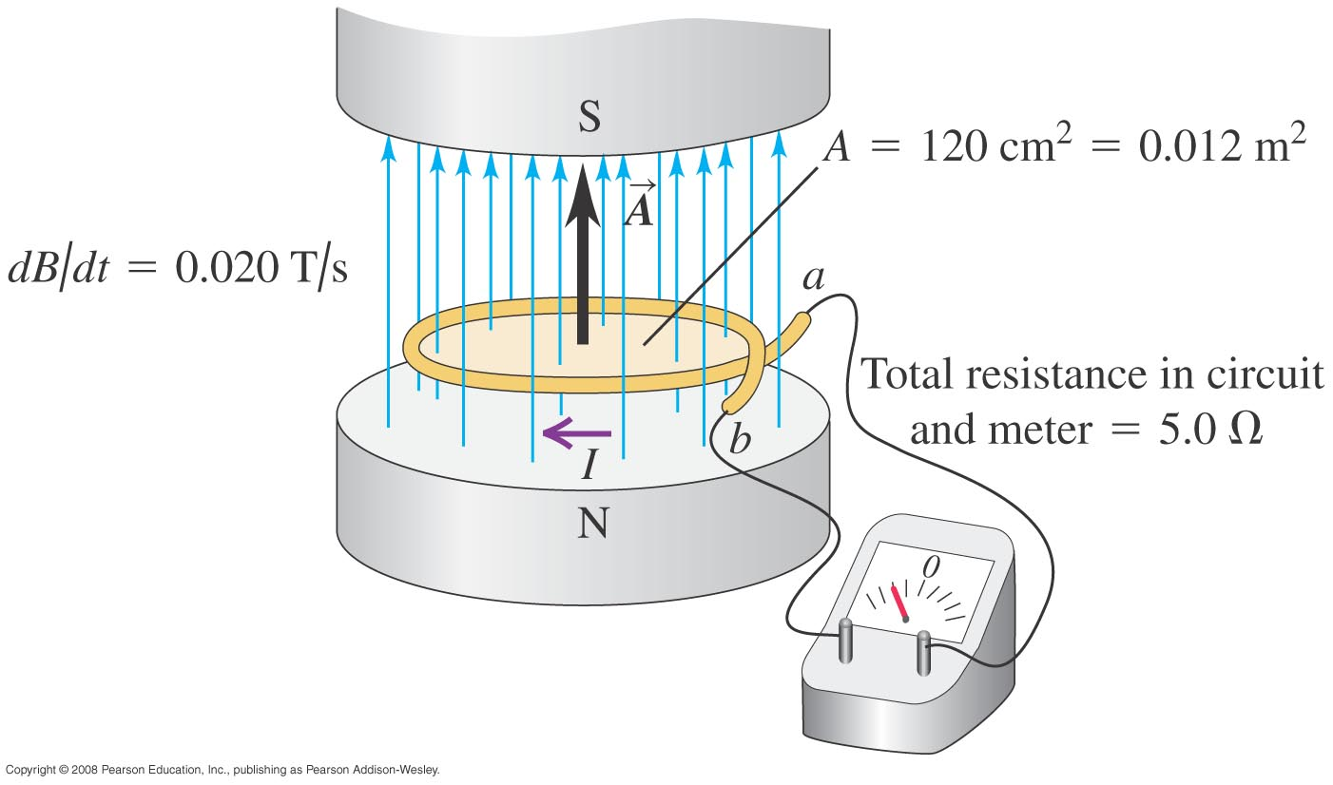
Calculating Emf
Ex.: The magnetic field between the poles of the electromagnet is uniform at any time, but its magnitude is increasing at the rate of 0.02 T/s. The area of the conducting loop in the field is 120 cm², and the total circuit resistance, including the meter, is 5 Ω. Find the induced emf and the induced current in the circuit.
Answer
$ε$ = 0.24 mV
I = 0.048 mA

Slide 9
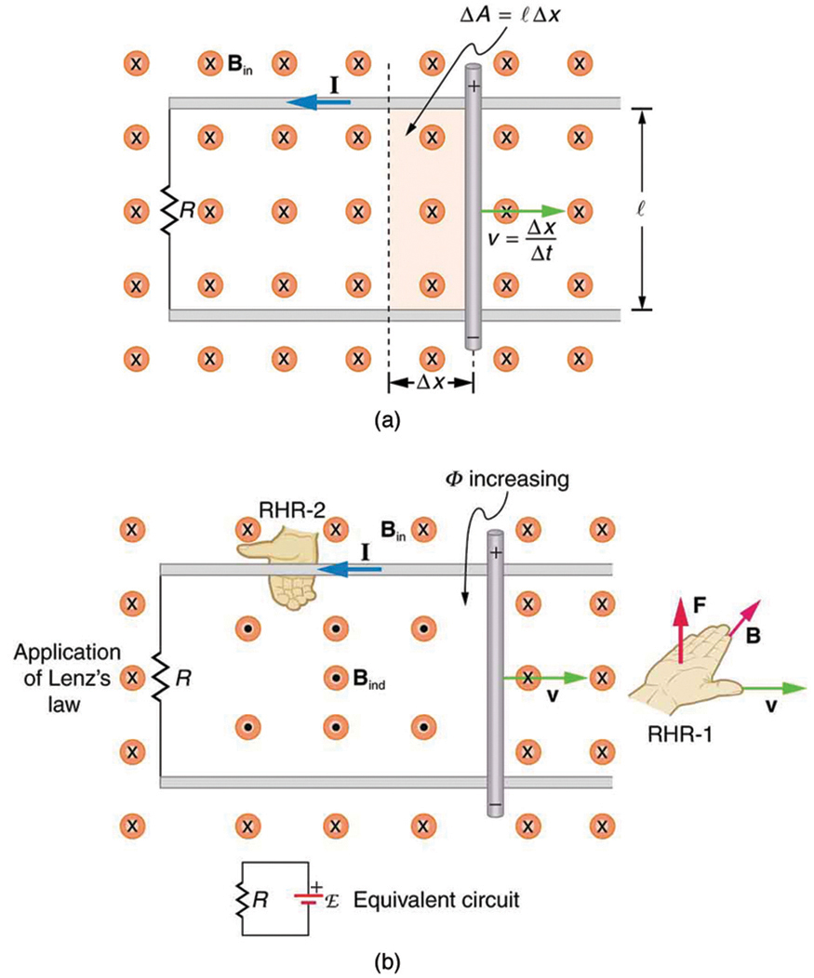
Motional Emf
Motion in a stationary uniform magnetic field produces motional emf.
$$F =qvB\sin{θ}$$
$$emf =N\frac{ΔΦ}{Δt}=\frac{BΔA}{Δt}$$
$$emf =\frac{BlΔx}{Δt}$$
$$emf =Blv$$

Slide 10
Magnetic Field Strength & Force in a Charge
Ex. : The length of the moving rod is 0.1 m, the velocity v is 2.5 m/s, the total resistance of the loop is 0.03 Ω, and B is 0.6 T. Find the motional emf, the induced current, and the force acting on the rod.
Answer
$ε$ = 0.15 V
I = 5 A
F = 0.3 N

Slide 11
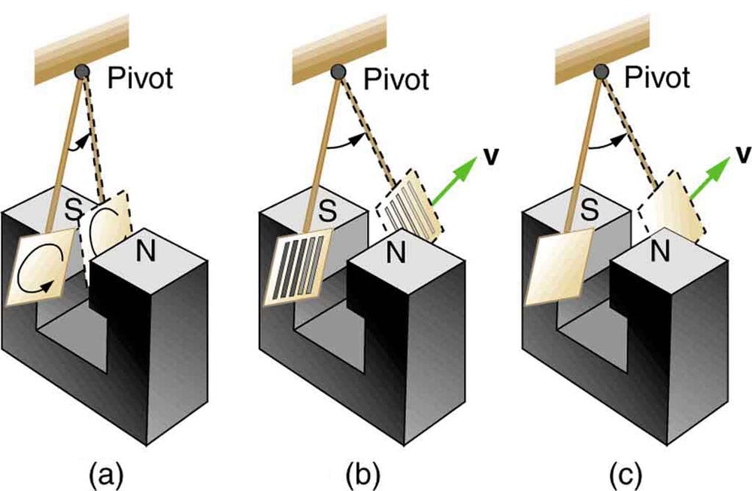
Eddy Currents and Magnetic Damping
The motion of a metal pendulum bob swinging between the poles of a magnet is quickly damped by the action of eddy currents.
There is little effect on the motion of a slotted metal bob, implying that eddy currents are made less effective.
There is also no magnetic damping on a nonconducting bob, since the eddy currents are extremely small.

Slide 12
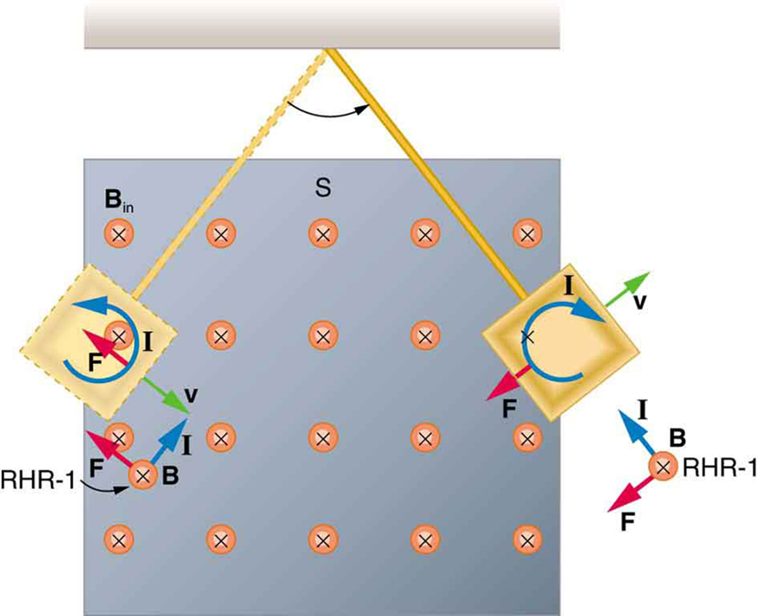
Eddy Currents and Magnetic Damping
A more detailed look at the conducting plate passing between the poles of a magnet. As it enters and leaves the field, the change in flux produces an eddy current. Magnetic force on the current loop opposes the motion. There is no current and no magnetic drag when the plate is completely inside the uniform field.

Slide 13
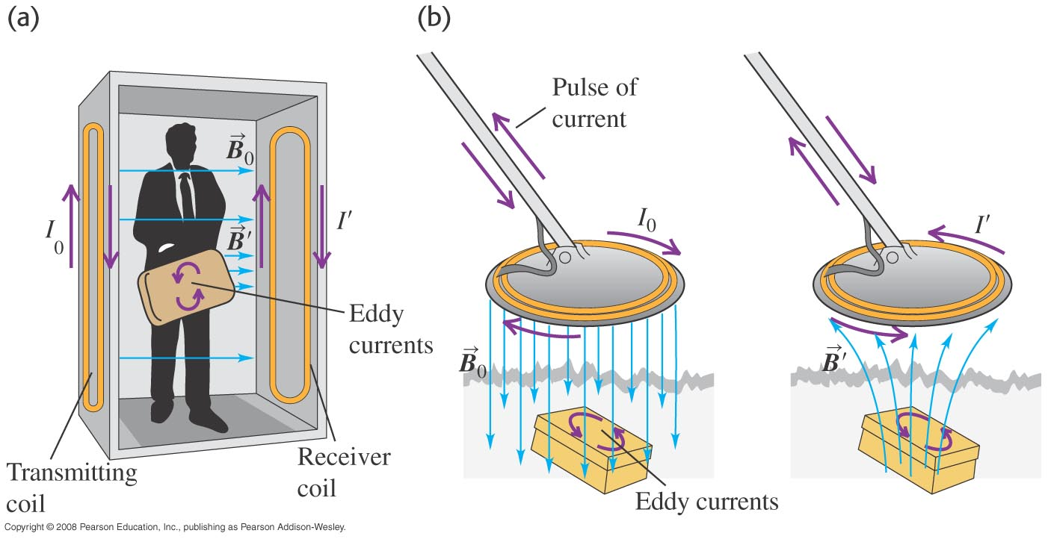
Application of Eddy Currents
An airport metal detector and a portable metal detector, both of which use eddy currents in their design.

Slide 14
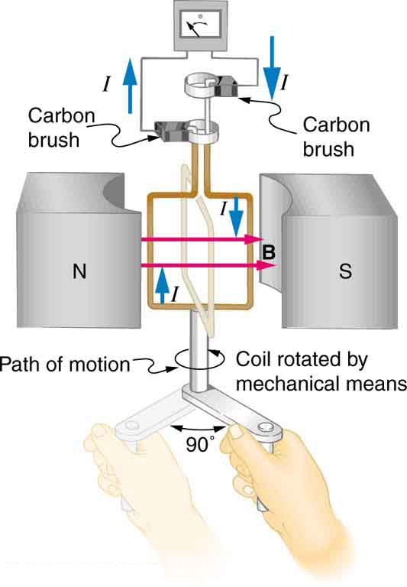
Electric Generators
The generator coil shown below is rotated through one-fourth of a revolution (from θ = 0 to θ = 90) in 15.0 ms. The 200-turn square coil has a side length 5.00 cm and is in a uniform 1.2 T magnetic field. What is the average emf induced?
$$emf=−N\frac{Δ∅}{Δt}=−N\frac{Δ(BA\text{cos} θ)}{Δt}$$
$$emf=−N\frac{BAΔ(\text{cos} θ)}{Δt}$$
$$Δ(\text{cos} θ)=\text{cos}\text{ 90 −}\text{cos}\text{ 0=−1}$$
$Ans: emf=40$ V

Slide 15
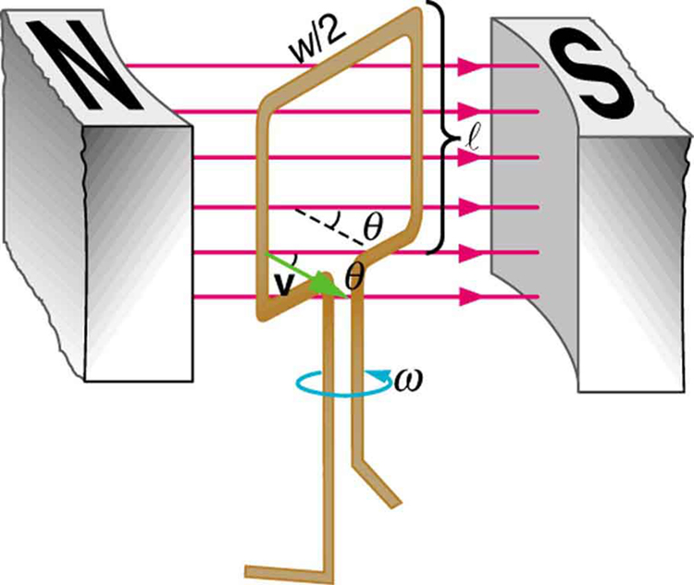
Electric Generators
A generator with a single rectangular coil rotated at constant angular velocity in a uniform magnetic field produces an emf that varies sinusoidally in time.
$$emf =2Blv \text{sin} θ$$
-
$$emf =2Blv \text{sin} ωt$$
+
>
$$emf =2Blrω \text{sin} ωt$$
$$emf =2Bl\frac{w}{2}ω \text{sin} ωt$$
+
>
$$emf =BAω \text{sin} ωt$$
-
Coil with N turn
$$emf =NBAω \text{sin} ωt$$

Slide 16
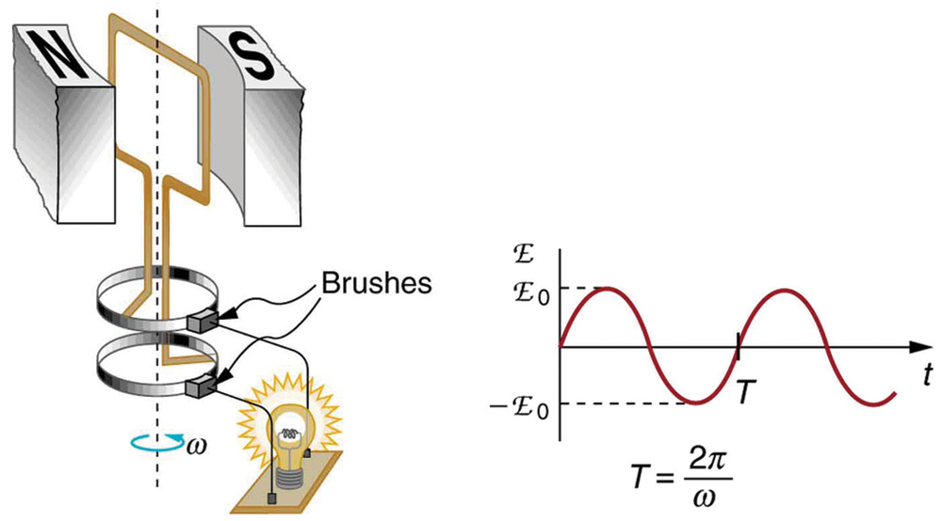
Electric Generators
$$emf =NBAω \text{sin} ωt$$
The emf of a generator is sent to a light bulb with the system of rings and brushes shown. The graph gives the emf of the generator as a function of time. E₀ is the peak emf. The period is $T = 1 / f = 2π / ω$, where$f$is the frequency. Note that the script E stands for emf.

Slide 17
Electric Generators
Ex: Consider a motor with a square, 500 turn coil 10 cm on a side. If the magnetic field has magnitude 0.2 T, at what rotation speed is the maximum emf of the motor equal to 112 V?
Answer
$ω$ = 112 rad/sec
f = 17.8 cycle /sec

Slide 18
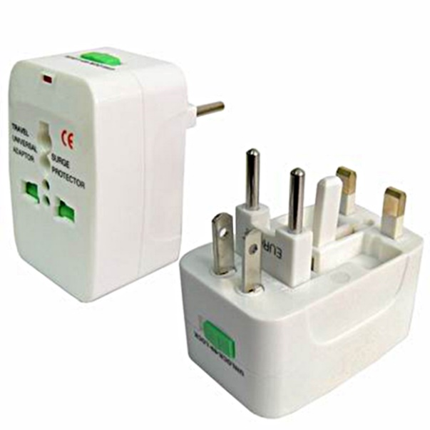
Transformers
Transformers: transform voltages from one value to another.

Slide 19
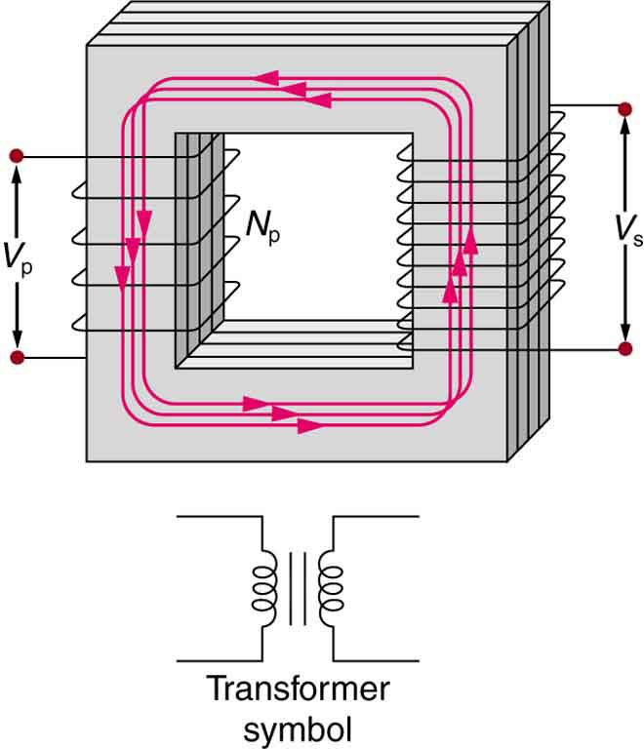
Transformers
A typical construction of a simple transformer has two coils wound on a ferromagnetic core. The magnetic field created by the primary is mostly confined to and increased by the core, which transmits it to the secondary coil. Any change in current in the primary induces a current in the secondary.
$$V_{s} =V_{p}\frac{N_{s}}{N_{p}}$$
$$I_{s} =I_{p}\frac{N_{p}}{N_{s}}$$
$$P_{s} =P_{p}$$

Slide 20
Transformers
Ex 23.5: A portable x-ray unit has a step-up transformer, the 120 V input of which is transformed to the 100 kV output needed by the x-ray tube. The primary has 50 loops and draws a current of 10.00 A when in use . (a) What is the number of loops in the secondary?(b) Find the current output of the secondary.
Answer
$Ns$ = 4.17×10⁴ turn
$Is$ = 12 mA

Slide 21
Transformers
Ex 23.6: A battery meant for a series connection of ten nickel-cadmium batteries (total of 12.5 V DC) needs to have a 15.0 V output to charge the batteries. It uses a step-down transformer with a 200-loop primary and a 120 V input. (a) How many loops should there be in the secondary coil? (b) If the charging current is 16.0 A, what is the input current?
Answer
$Ns$ = 25 turn
$Ip$ = 2.0 A

Slide 22
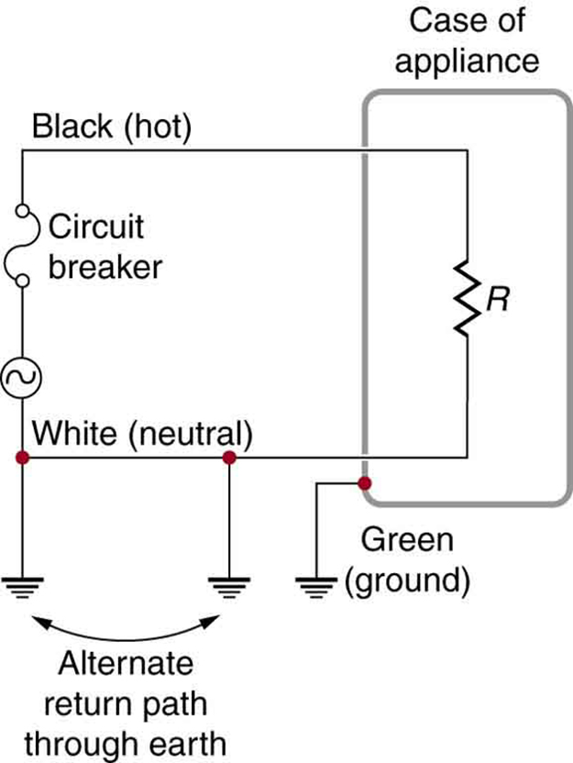
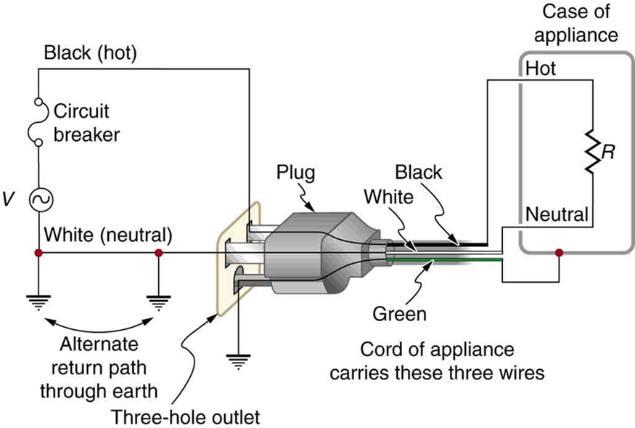
Electrical Safety: Systems and Devices
Electrical Safety:
- Thermal Hazard
- Shock Hazard

Slide 23
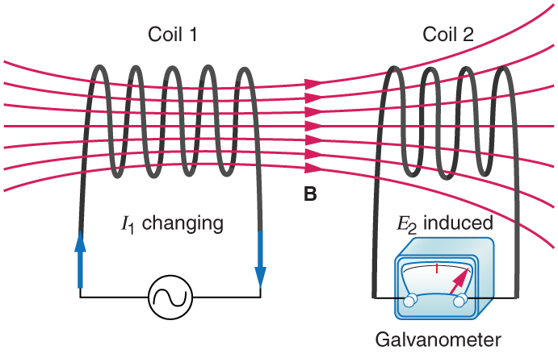
Inductance
Induction is the process in which an emf is induced by changing magnetic flux.
Mutual Inductance is the effect of Faraday’s law of induction for one device upon another, such as the primary coil in transmitting energy to the secondary in a transformer.
$${emf}_{2} =−M\frac{∆I_{1}}{∆t}$$
$${emf}_{1} =−M\frac{∆I_{2}}{∆t}$$
M: Mutual Inductance (unit H, henry)

Slide 24
Inductor
Self Inductance (L): When the current through a coil is increased, the magnetic field and flux also increase, inducing a counter emf, as required by Lenz’s law.
$$emf=−L\frac{∆I}{∆t}$$
$$L=\frac{μ_{0}N^{2}A}{l}\text{ (}\text{solenoid}\text{)}$$
$$E_{ind}=\frac{1}{2}LI^{2}$$
Energy stored
Ex. 23.7: Calculate the self-inductance of a 10.0 cm long, 4.00 cm diameter solenoid that has 200 coils. How much energy is stored in the inductor when 30.0 A current flows through it?
Ans: L = 0.632 mH E_{ind} = 0.284 J

Slide 25
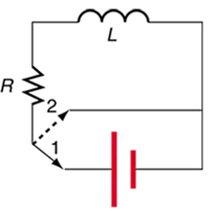
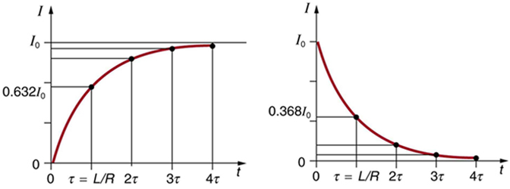
RL Circuits
Charging Mode (Position 1)
Discharging Mode
(Position 2)
Characteristic
time constant
$τ=L/R$
$$I=I_{0}\left(1−e^{−t/τ}\right)$$
$$I=I_{0}e^{−t/τ}$$
An RL circuit with a switch to turn current on and off. When in position 1, the battery, resistor, and inductor are in series and a current is established. In position 2, the battery is removed and the current eventually stops because of energy loss in the resistor.
A graph of current growth versus time when the switch is moved to position 1.
A graph of current decay when the switch is moved to position 2.

Slide 26
RL Circuits
Ex. 23.9: (a) What is the characteristic time constant for a 7.5 mH inductor in series with a 3.00 Ω resistor? (b) Find the current 5.00 ms after the switch is moved to position 2 to disconnect the battery, if it is initially 10.0 A.

