Slide 1
PHY 1214
General Physics 2
Chapter 25
Geometric Optics
Engineering and Physics
University of Central Oklahoma
Dr. Mohamed Bingabr

Slide 2
The Ray Aspect of Light
Light is modeled as traveling in straight lines called rays.

Slide 3
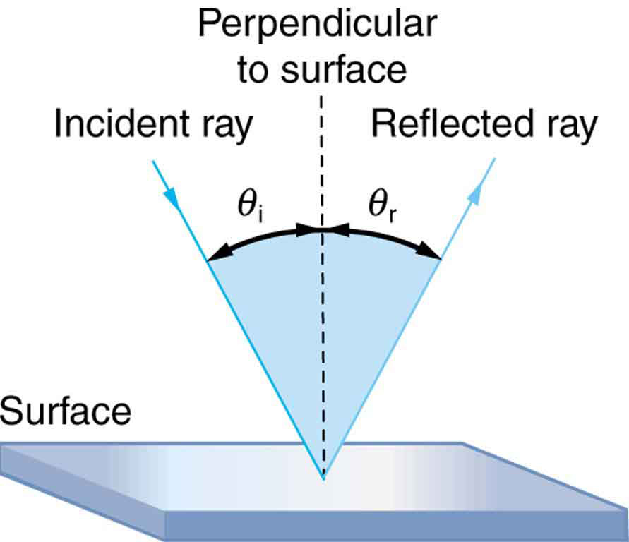
The Law of Reflection
The law of reflection states that the angle of reflection equals the angle of incidence— θ_{r} = θ_{i} . The angles are measured relative to the perpendicular to the surface at the point where the ray strikes the surface.

Slide 4
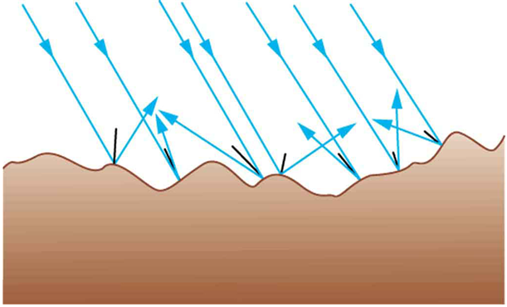
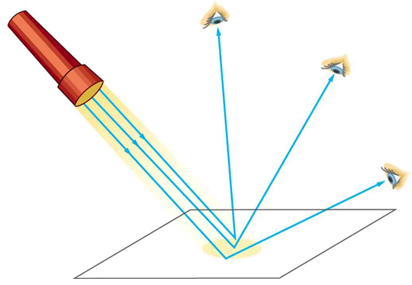
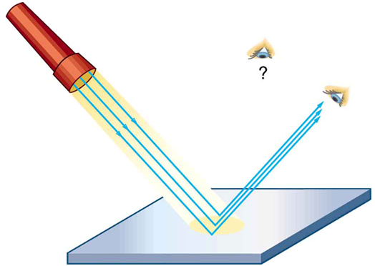
The Law of Reflection

Slide 5
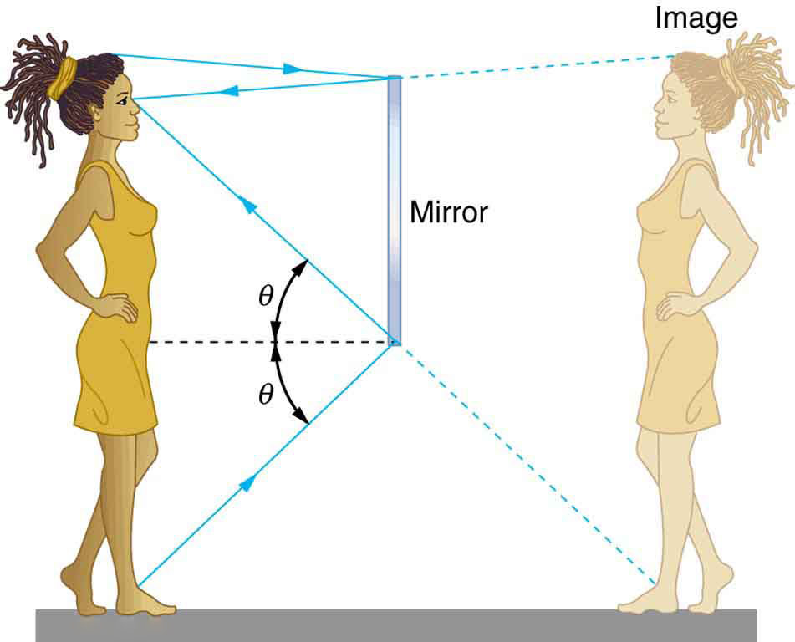
The Law of Reflection
Our image in a mirror is behind the mirror. The two rays shown are those that strike the mirror at just the correct angles to be reflected into the eyes of the person. The image appears to be in the direction the rays are coming from when they enter the eyes.

Slide 6
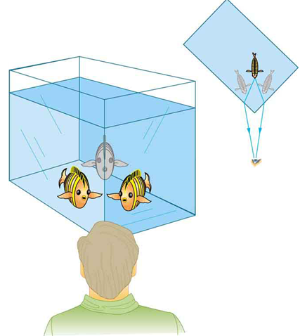
The Law of Refraction
The changing of a light ray’s direction (loosely called bending) when it passes through variations in matter is called refraction.
Looking at the fish tank as shown, we can see the same fish in two different locations, because light changes directions when it passes from water to air. In this case, the light can reach the observer by two different paths, and so the fish seems to be in two different places. This bending of light is called refraction and is responsible for many optical phenomena.

Slide 7
The Law of Refraction
When light travel from on medium (air) to another medium (water) its speed change and that causes refraction.
Speed of light in vacuum is $3×{10}^{8} m/s$
$$v=\frac{c}{n}$$
n is the refraction index of the medium
Ex. 25.1: Calculate the speed of light in zircon, a Material used in jewelry to imitate diamond.

Slide 8
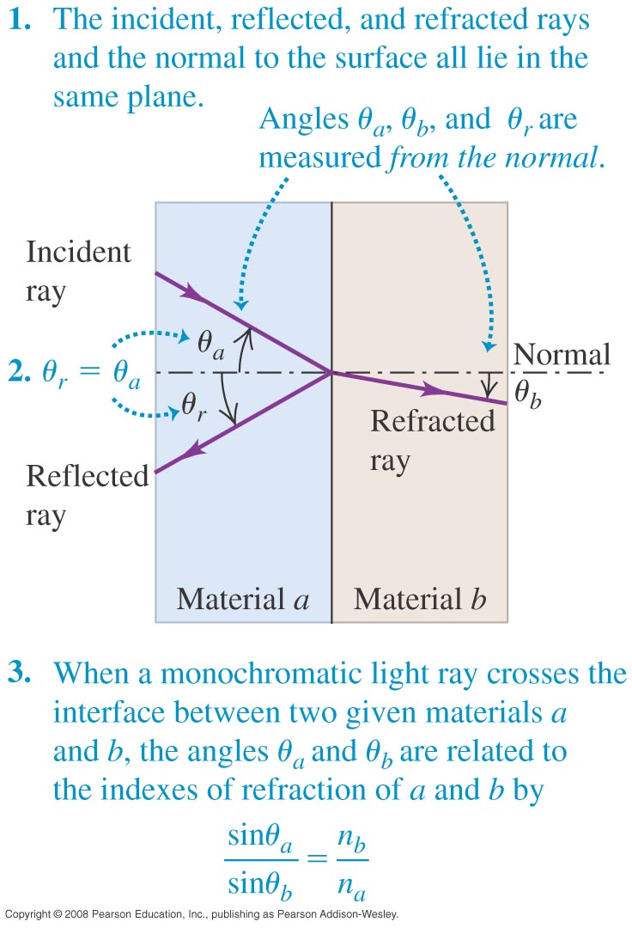
The Law of Refraction
The index of refraction is n = c/v >1.
Angles are measured with respect to the normal.
Law of Reflection: The angle of reflection is equal to the angle of incidence.
$θ_{r}=θ_{a}$
Law of Refraction: Snell’s law
$n_{a}\text{sin}θ_{a}=n_{b}\text{sin}θ_{b}$
In a material λ = λ₀/n.

Slide 9
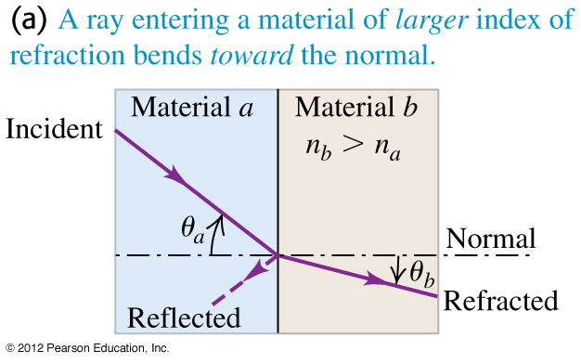
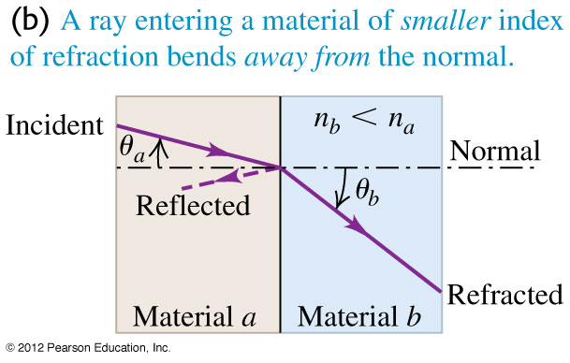
Reflection and Refraction in Three Cases
If n_{b} > n_{a}, the refracted ray is bent toward the normal.
If n_{b} < n_{a}, the refracted ray is bent away from the normal.
A ray oriented along the normal never bends.

Slide 10
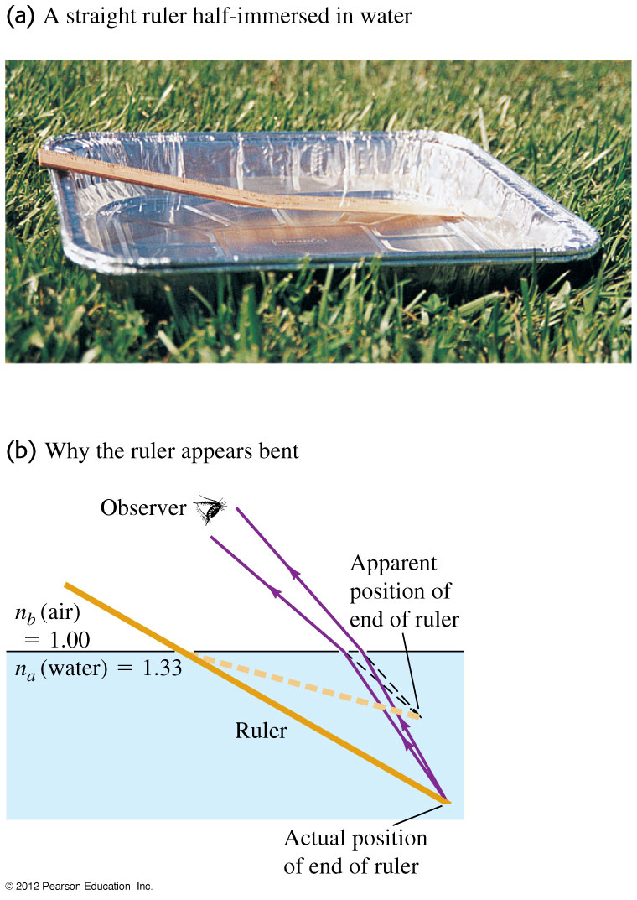
Why does the ruler appear to be bent?
The straight ruler appears to bend at the surface of the water.

Slide 11
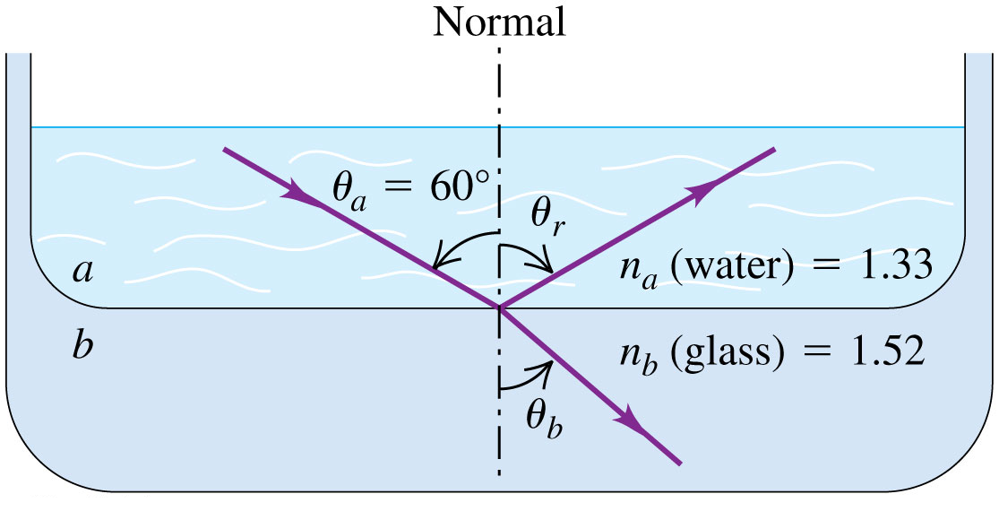
Examples
Example: Material a is water and material b is glass with index of refraction 1.52. The incident ray makes an angle of 60.0º with the normal; find the directions of the reflected and refracted rays.
Answer
$$θ_{b}={49.3}^{\text{°}}$$
Example: The wavelength of the red light from a helium-neon laser is 633 nm in air but 474 nm in the aqueous humor inside your eyeball. Calculate the index of refraction of the aqueous humor and the speed and frequency of the light in it.

Slide 12
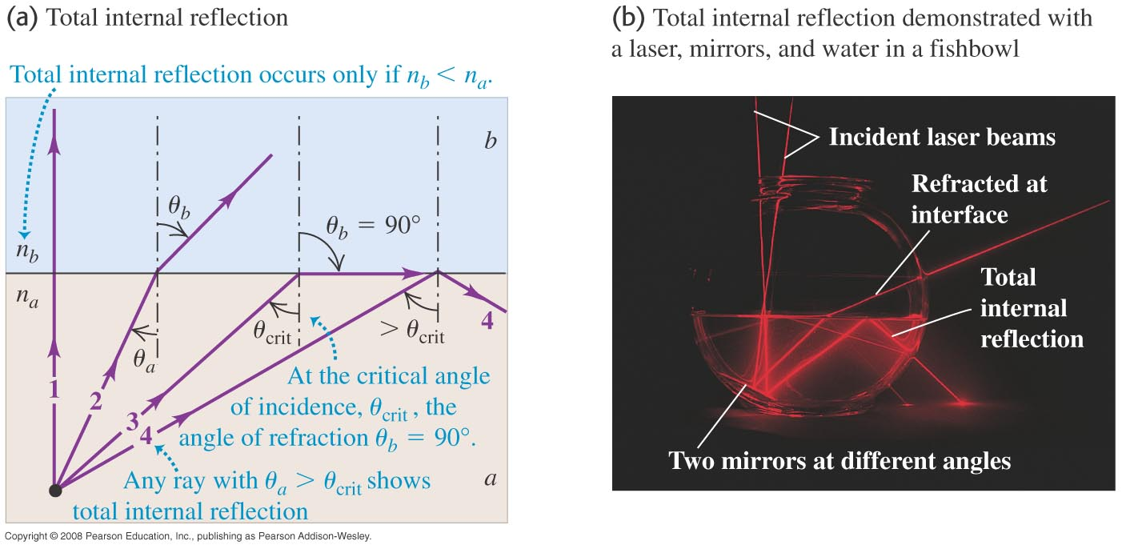
Total Internal Reflection
Light striking at the critical angle emerges tangent to the surface.
If θ_{a} > θ_{crit}, the light undergoes total internal reflection.
$n_{a}\text{sin}{ θ}_{\text{crit}}=n_{b}\text{sin}\text{ 90}$ ${ θ}_{\text{crit}}={\text{sin}}^{−1}\left(\frac{n_{b}}{n_{a}}\right)$

Slide 13
Total Internal Reflection
Ex 25.4: What is the critical angle for light traveling in a polystyrene (a type of plastic, n = 1.49) pipe surrounded by air?
Ans: 42.16º

Slide 14
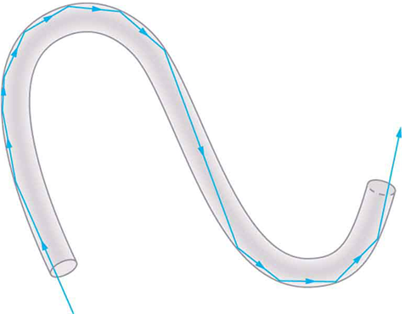
Application of Internal Reflection
Light entering a thin fiber may strike the inside surface at large or grazing angles and is completely reflected if these angles exceed the critical angle. Such rays continue down the fiber, even following it around corners, since the angles of reflection and incidence remain large.

Slide 15
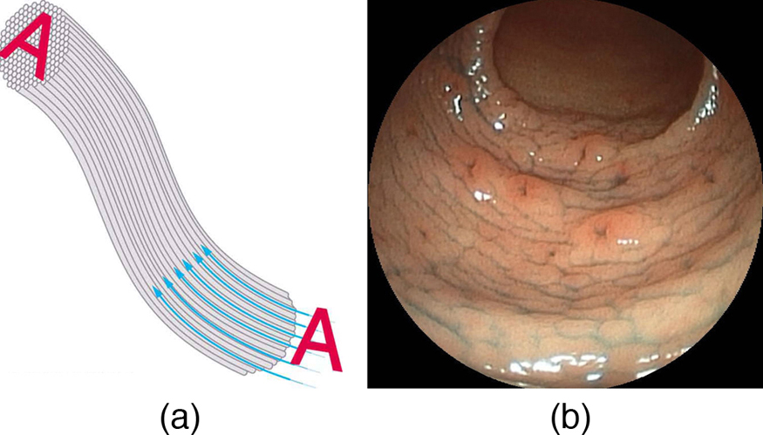
Application of Internal Reflection
An image is transmitted by a bundle of fibers that have fixed neighbors.
An endoscope is used to probe the body, both transmitting light to the interior and returning an image such as the one shown. (credit: Med_Chaos, Wikimedia Commons)

Slide 16
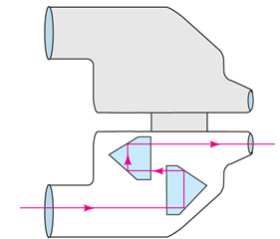
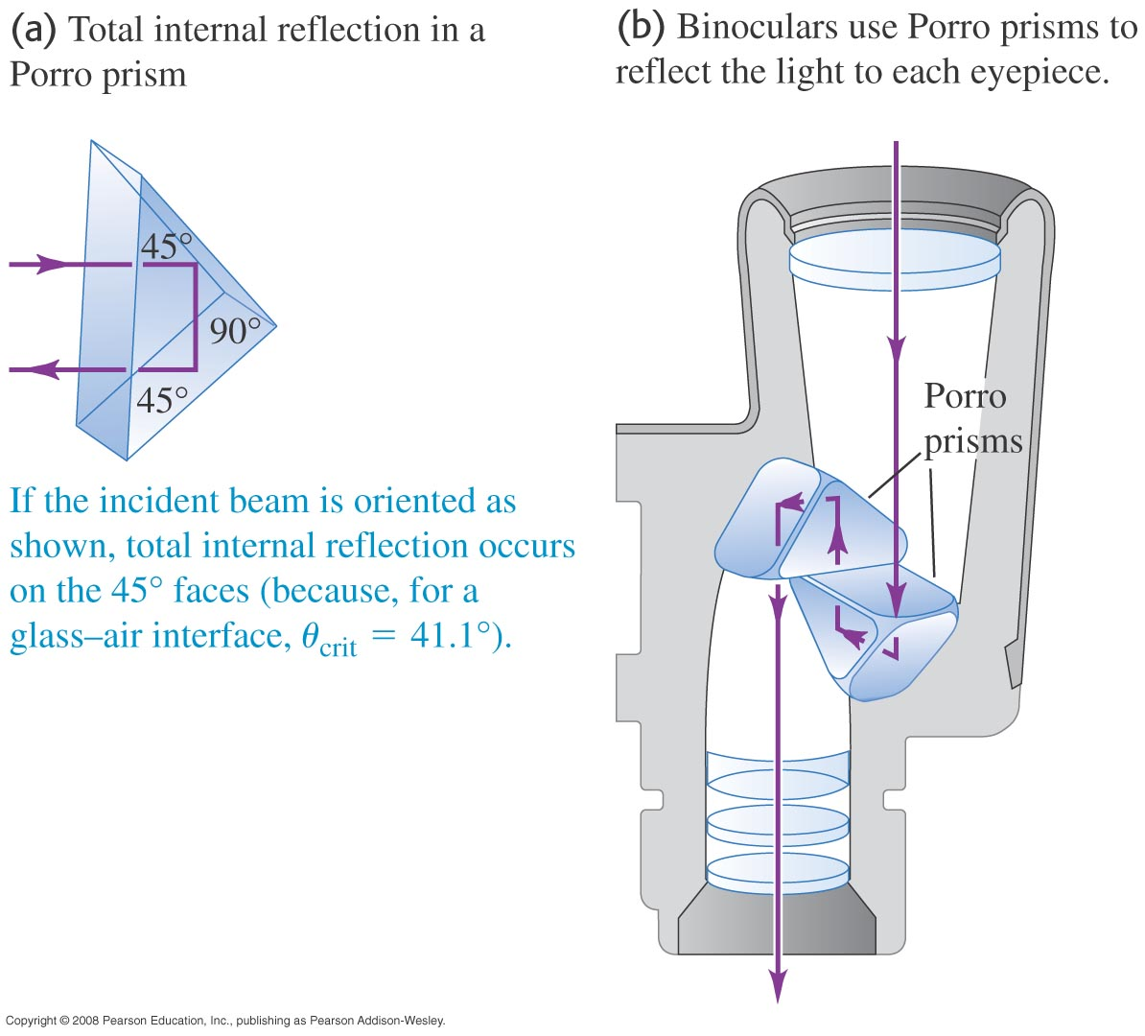
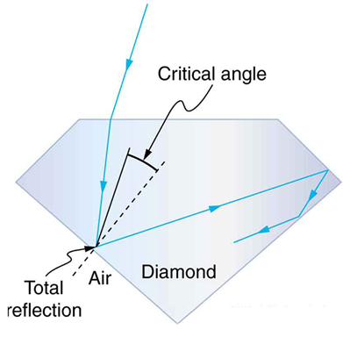
Application of Internal Reflection

Slide 17
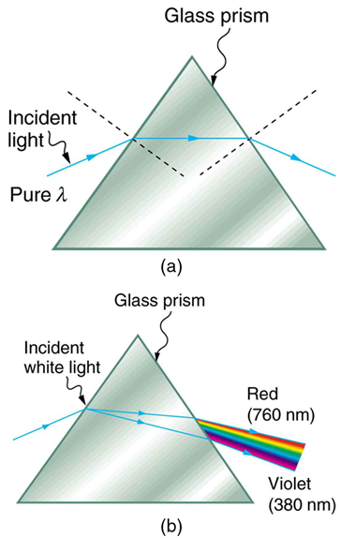
Prism and Rainbow
A pure wavelength of light falls onto a prism and is refracted at both surfaces.
White light is dispersed by the prism (shown exaggerated). Since the index of refraction varies with wavelength, the angles of refraction vary with wavelength. A sequence of red to violet is produced, because the index of refraction increases steadily with decreasing wavelength.

Slide 18
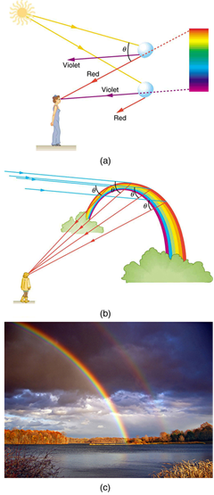
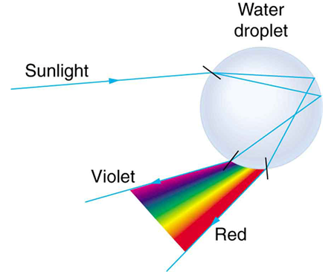
Prism and Rainbow
Part of the light falling on this water drop enters and is reflected from the back of the drop. This light is refracted and dispersed both as it enters and as it leaves the drop.

Slide 19
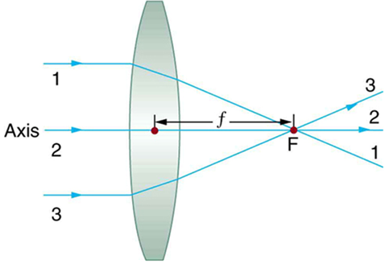
Image Formation by Convex Lenses
Convergence Lens: The lens in which light rays that enter it parallel to its axis cross one another at a single point on the opposite side with a converging effect.
Focal Point F: The point at which the light rays across is called the focal point F of the lens.
Focal Length f: The distance from the center of the lens to its focal point is called focal length f.
The power P of a lens is defined to be the inverse of its focal length.

Slide 20
Image Formation by Lenses
Ex. 25.5: Suppose you take a magnifying glass out on a sunny day and you find that it concentrates sunlight to a small spot 8.00 cm away from the lens. What are the focal length and power of the lens?

Slide 21
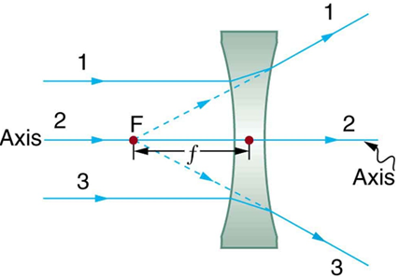
Image Formation by Concave Lenses
Divergence Lens: A lens that causes the light rays to bend away from its axis.
Rays of light entering a diverging lens parallel to its axis are diverged, and all appear to originate at its focal point F . The dashed lines are not rays—they indicate the directions from which the rays appear to come. The focal length $f$of a diverging lens is negative. An expanded view of the path taken by ray 1 shows the perpendiculars and the angles of incidence and refraction at both surfaces.

Slide 22
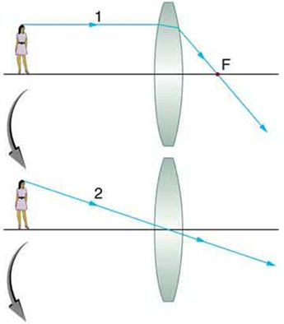
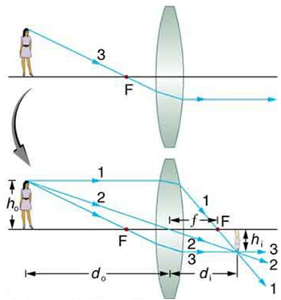
Image Formation by Lenses
$$\frac{1}{d_{o}}+\frac{1}{d_{i}}=\frac{1}{f}$$
$$\frac{h_{i}}{h_{o}}=−\frac{d_{i}}{d_{o}}=m$$

Slide 23
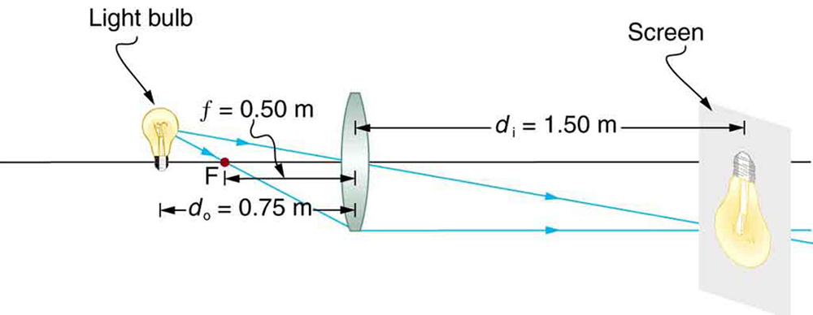
Real Image Formation
Ex. 25.6: A light bulb placed 0.750 m from a lens having a 0.500 m focal length produces a real image on a poster board as discussed in the example above. Ray tracing predicts the image location and size.

Slide 24
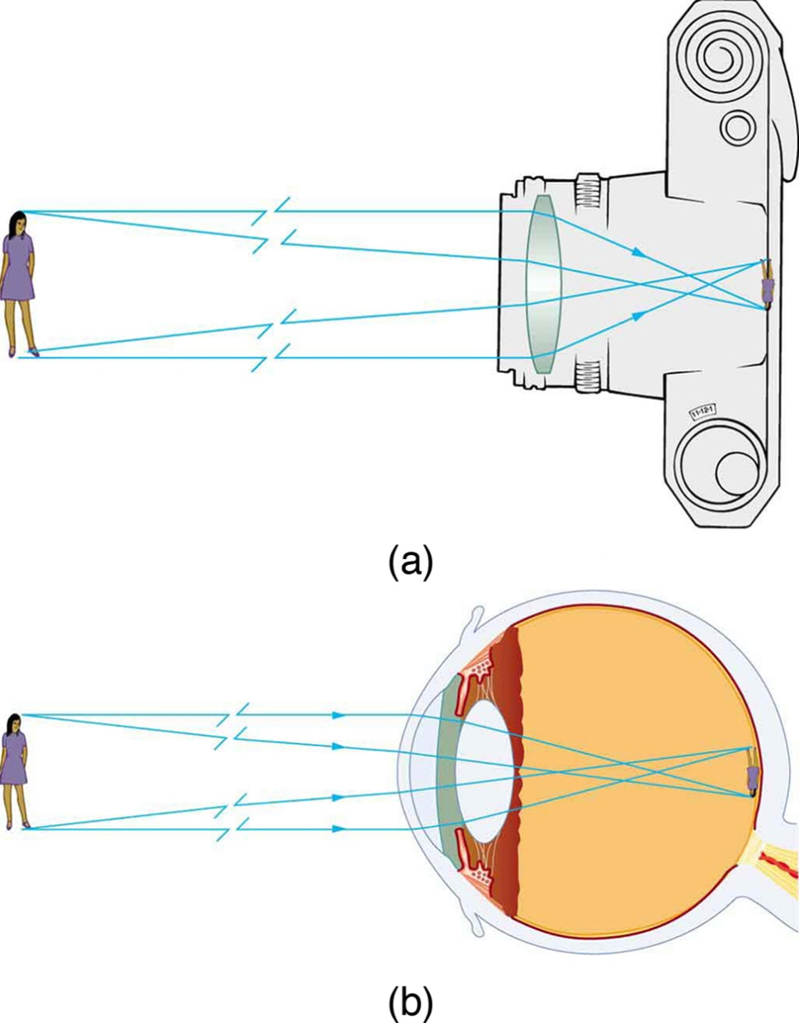
Real Image Formation
Real images can be projected.
A real image of the person is projected onto film.
The converging nature of the multiple surfaces that make up the eye result in the projection of a real image on the retina.

Slide 25
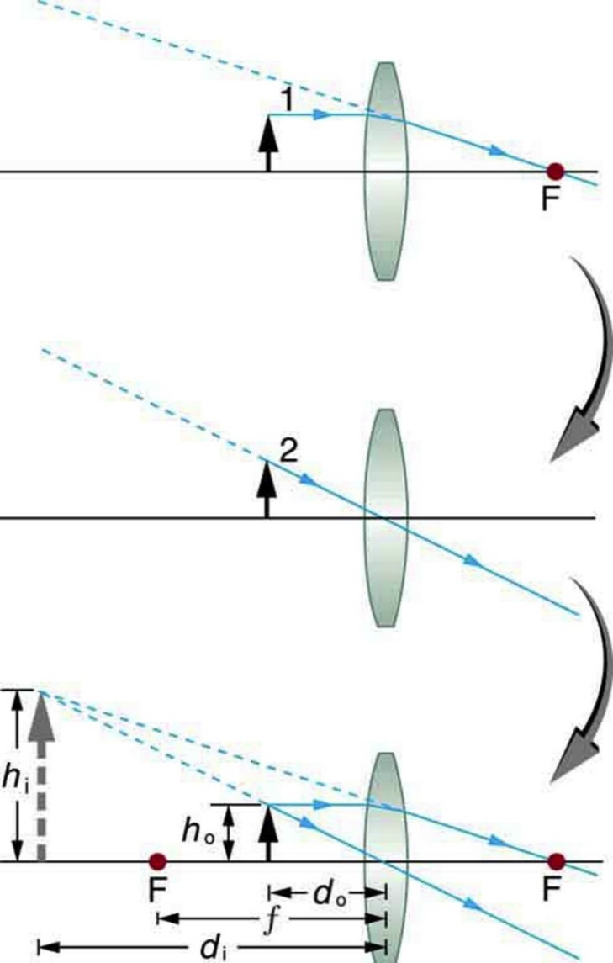
Virtual Image Formation
Virtual image is an image that is on the same side of the lens as the object and cannot be projected on a screen.
Ray 1 enters parallel to the axis and exits through the focal point on the opposite side, while ray 2 passes through the center of the lens without changing path. The two rays continue to diverge on the other side of the lens, but both appear to come from a common point, locating the upright, magnified, virtual image. This is a case 2 image.

Slide 26
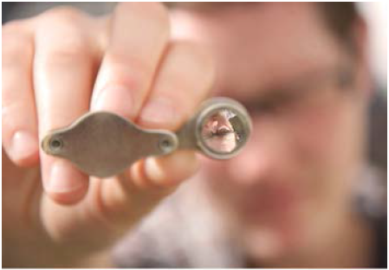
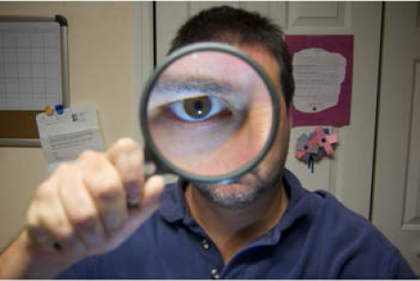
Virtual Image
Ex. 25.7: Suppose an object is held 7.5 cm from a convex lens of focal length 10.0 cm, such as a typical magnifying glass might have. What magnification is produced?

Slide 27
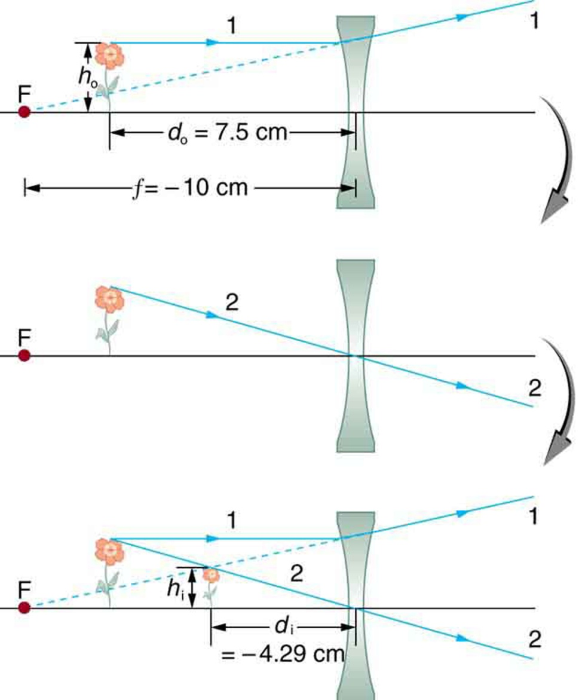
Image Produced by a Concave Lens
Ray tracing predicts the image location and size for a concave or diverging lens. Ray 1 enters parallel to the axis and is bent so that it appears to originate from the focal point. Ray 2 passes through the center of the lens without changing path. The two rays appear to come from a common point, locating the upright image. This is a case 3 image, which is closer to the lens than the object and smaller in height.

Slide 28
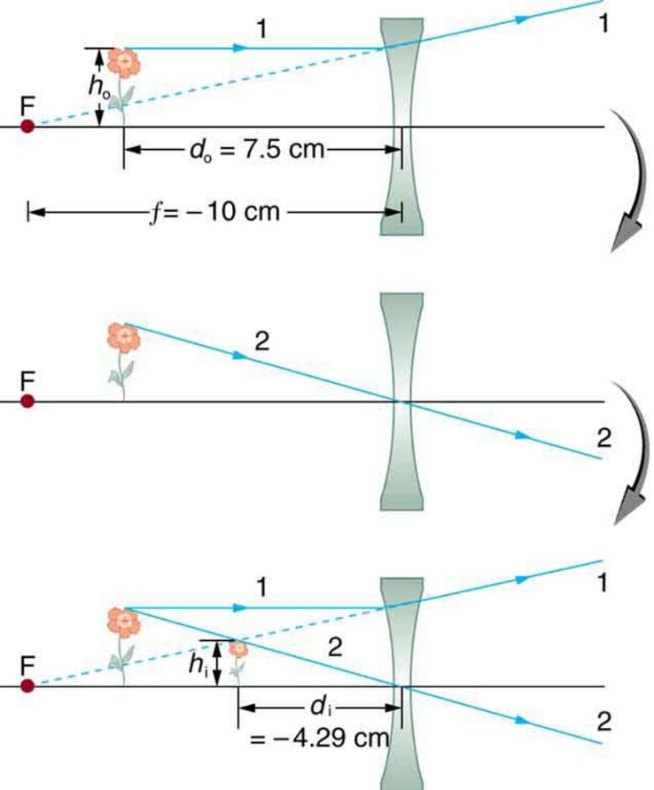
Image Produced by a Concave Lens
Ex. 25.8: Suppose an object is held 7.5 cm from a concave lens of focal length 10.0 cm. Such a lens could be used in eyeglasses to correct pronounced nearsightedness. What magnification is produced?

Slide 29
Three Types of Image Formed By Thin Lenses
$$\frac{1}{d_{o}}+\frac{1}{d_{i}}=\frac{1}{f}$$
$$m=\frac{h_{i}}{h_{o}}=−\frac{d_{i}}{d_{o}}$$

Slide 30
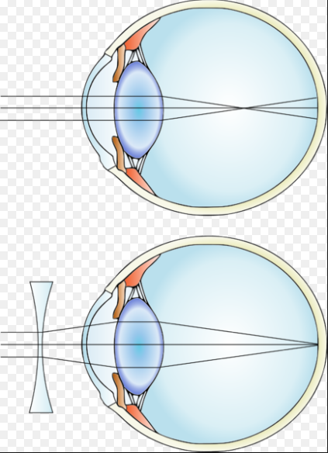
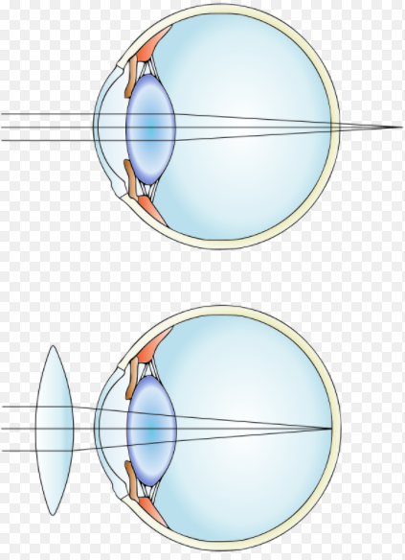
Nearsighted and Farsighted
Nearsighted: Unable to see things clearly especially if they are far to the eyes, owing to the focusing of rays of light by the eye at a point in front of the retina.
Farsighted: Unable to see things clearly, especially if they are relatively close to the eyes, owing to the focusing of rays of light by the eye at a point behind the retina.

Slide 31
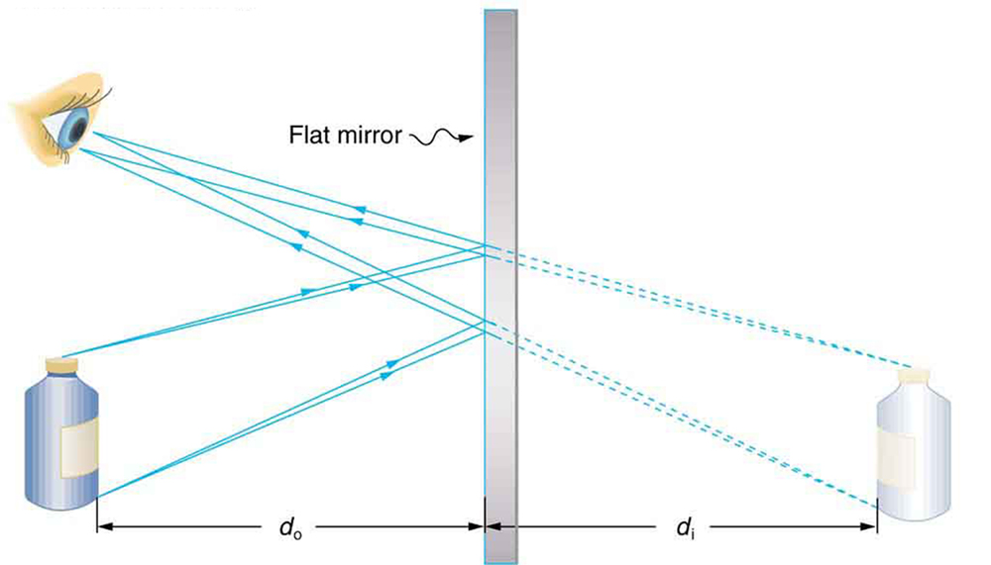
Image Formation by a Plane Mirror
Two sets of rays from common points on an object are reflected by a flat mirror into the eye of an observer. The reflected rays seem to originate from behind the mirror, locating the virtual image.

Slide 32
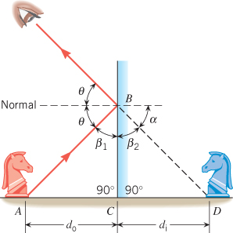
Image Formation by a Plane Mirror
The geometry used to show that the image distance is equal to the object distance d_{i} = d_{o}.

Slide 33
Spherical Mirror
If the inside surface of the spherical mirror is polished, it is a concave mirror. If the outside surface is polished, is it a convex mirror.
The law of reflection applies, just as it does for a plane mirror.
The principal axis of the mirror is a straight line drawn through the center and the midpoint of the mirror.

Slide 34
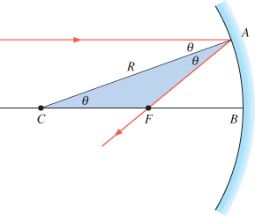
Concave Mirror
$$f=\frac{R}{2}$$
R: radius of curvature
The focal point of a concave mirror is halfway between
the center of curvature of the mirror C and the mirror at B.

Slide 35
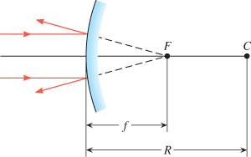
Convex Mirror
When paraxial light rays that are parallel to the principal axis strike a convex mirror, the rays appear to originate from the focal point.

Slide 36
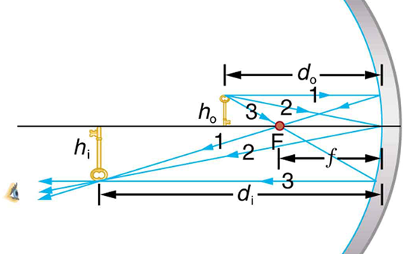
Image Formation by Concave Mirrors
Case 1: An object is farther from the converging mirror than its focal length. Rays from a common point on the object are traced using the rules below:
$$\frac{1}{d_{o}}+\frac{1}{d_{i}}=\frac{1}{f}$$
Ray 1 approaches parallel to the axis, ray 2 strikes the center of the mirror, and ray 3 goes through the focal point on the way toward the mirror. All three rays cross at the same point after being reflected, locating the inverted real image. Although three rays are shown, only two of the three are needed to locate the image and determine its height.

Slide 37
Image Formation by Concave Mirrors
Ex. 25.9: Electric room heaters use a concave mirror to reflect infrared (IP) radiation from hot coils. Note that IP follows the same law of reflection as visible light. Given the mirror has a radius of curvature of 50.0 cm and produces an image of the coils 3.00 m away from the mirror, where are the coils?
Ans: d_{o} = 27.3 cm

Slide 38
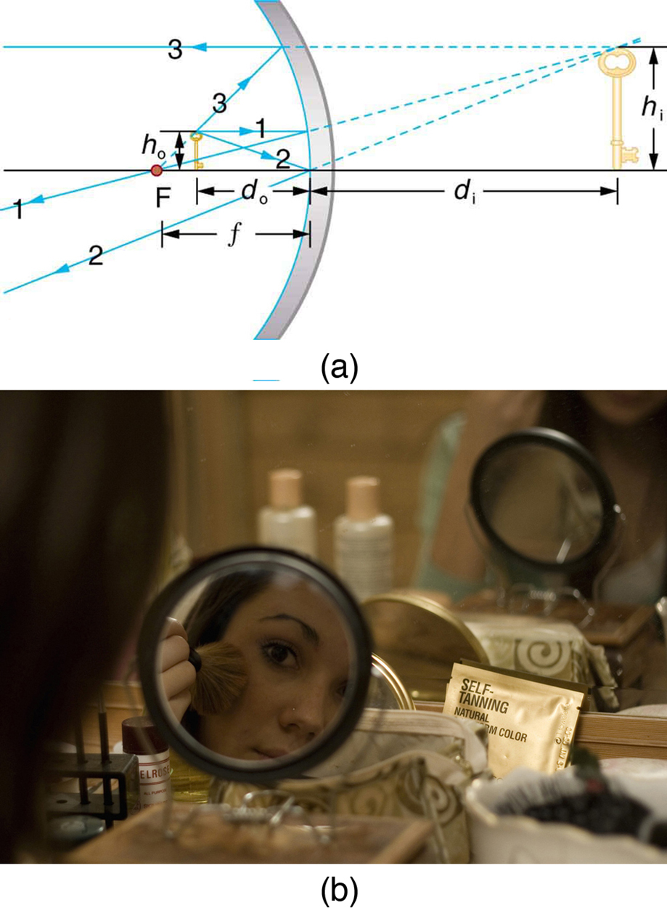
Image Formation by Concave Mirrors
Case 2: An object is closer to the converging mirror than its focal length. Ray 1 approaches parallel to the axis, ray 2 strikes the center of the mirror, and ray 3 approaches the mirror as if it came from the focal point.
A magnifying mirror showing the reflection. (credit: Mike Melrose, Flickr)

Slide 39
Image Formation by Concave Mirrors
Ex: A face is 10 cm a way from a concave mirror with focal length equals 15 cm. Where will the image of the face be formed? What is the magnification.
Ans: d_{i} = -30 cm m = 3

Slide 40
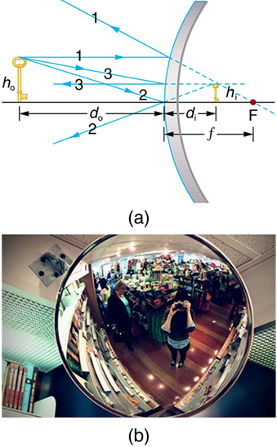
Image Formation by Convex Mirrors
Case 3 images for mirrors are formed by any convex mirror. Ray 1 approaches parallel to the axis, ray 2 strikes the center of the mirror, and ray 3 approaches toward the focal point. All three rays appear to originate from the same point after being reflected, locating the upright virtual image behind the mirror and showing it to be smaller than the object. (b) Security mirrors are convex, producing a smaller, upright image. Because the image is smaller, a larger area is imaged compared to what would be observed for a flat mirror (and hence security is improved).

Slide 41
Virtual Image Formation by Convex Mirrors
Ex.: A convex mirror is used to reflect light from an object placed 66 cm in front of the mirror. The focal length of the mirror is -46 cm. Find the location of the image and the magnification.
Ans: d_{i} = -27.11 cm m = 0.411

Slide 42
Image Formation by Convex Mirrors
Ex. 25.11: A keratometer is a device used to measure the curvature of the cornea, particularly for fitting contact lenses. Light is reflected from the cornea, which acts like a convex mirror, and the keratometer measure the magnification of the image. The smaller the magnification, the smaller the radius of curvature of the cornea. If the light source is 12.0 cm from the cornea and the image’s magnification is 0.0320, what is the cornea’s radius of curvature?
Ans: R = 0.8 cm

