Slide 1
Chapter 21
Electric Charge and Electric Field

Slide 2
Goals for Chapter 21
To study electric charge and charge conservation
To see how objects become charged
To calculate the electric force between objects using Coulomb’s law
To learn the distinction between electric force and electric field
To calculate the electric field due to many charges
To visualize and interpret electric fields
To calculate the properties of electric dipoles

Slide 3
Introduction
Water makes life possible as a solvent for biological molecules. What electrical properties allow it to do this?
We now begin our study of electromagnetism, one of the four fundamental forces.
We start with electric charge and look at electric fields.

Slide 4
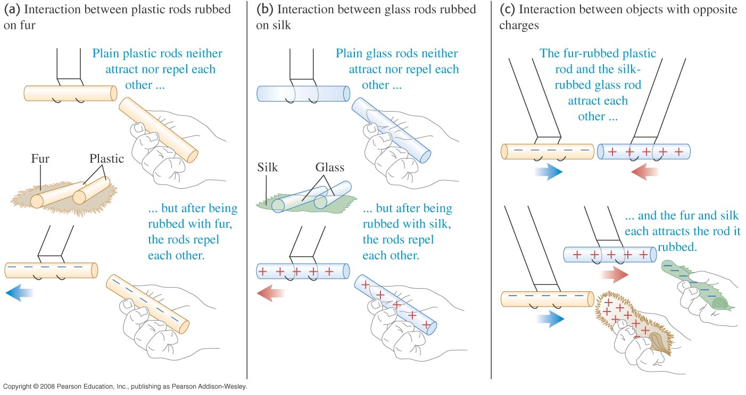
Electric charge
Two positive or two negative charges repel each other. A positive charge and a negative charge attract each other.
Figure 21.1 below shows some experiments in electrostatics.

Slide 5
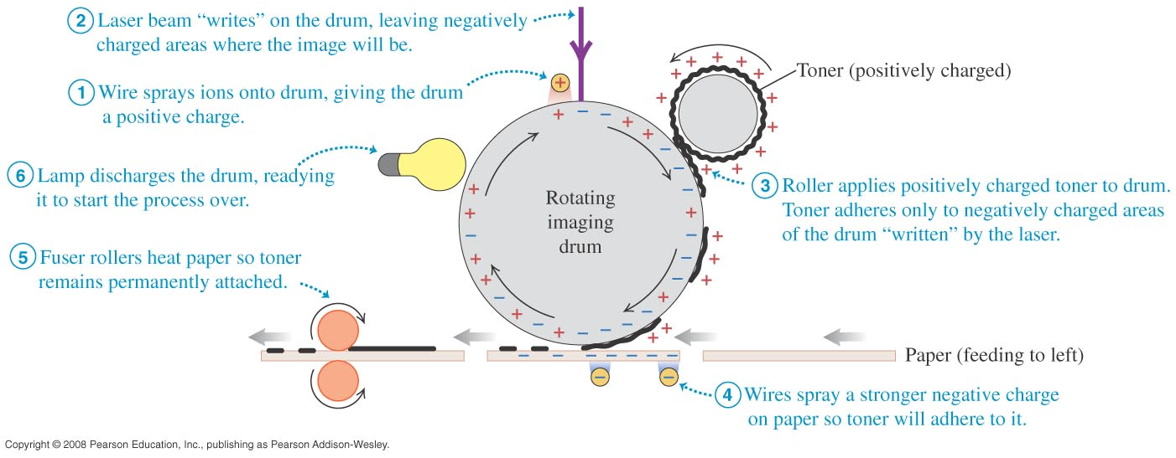
Laser printer
A laser printer makes use of forces between charged bodies.

Slide 6
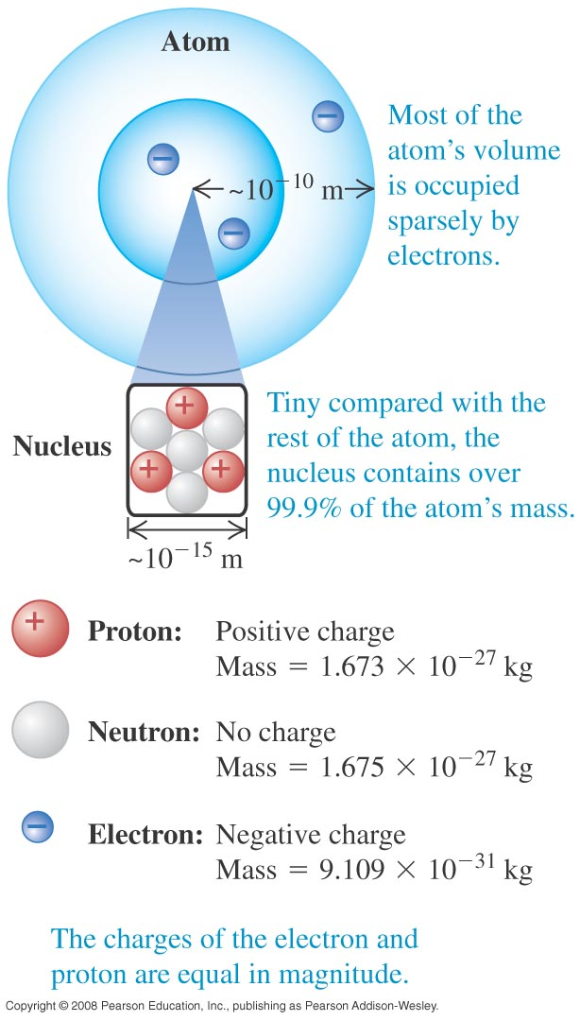
Electric charge and the structure of matter
The particles of the atom are the negative electron, the positive proton, and the uncharged neutron.
Protons and neutrons make up the tiny dense nucleus which is surrounded by electrons (see Figure 21.3 at the right).
The electric attraction between protons and electrons holds the atom together.

Slide 7
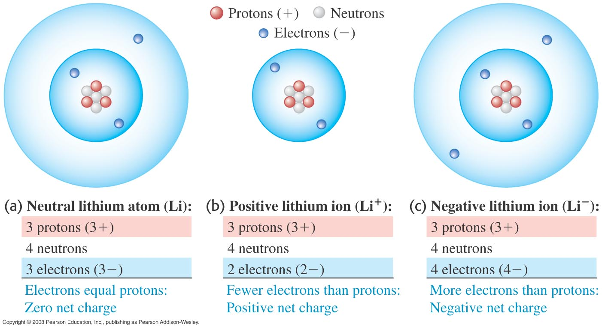
Atoms and ions
A neutral atom has the same number of protons as electrons.
A positive ion is an atom with one or more electrons removed. A negative ion has gained one or more electrons.

Slide 8
Conservation of charge
The proton and electron have the same magnitude charge.
The magnitude of charge of the electron or proton is a natural unit of charge. All observable charge is quantized in this unit.
The universal principle of charge conservation states that the algebraic sum of all the electric charges in any closed system is constant.

Slide 9
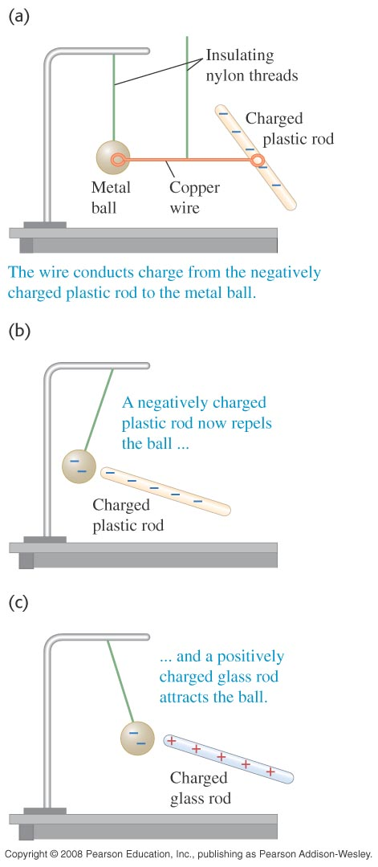
Conductors and insulators
A conductor permits the easy movement of charge through it. An insulator does not.
Most metals are good conductors, while most nonmetals are insulators. (See Figure 21.6 at the right.)
Semiconductors are intermediate in their properties between good conductors and good insulators.

Slide 10
Charging by induction
In Figure 21.7 below, the negative rod is able to charge the metal ball without losing any of its own charge. This process is called charging by induction.

Slide 11
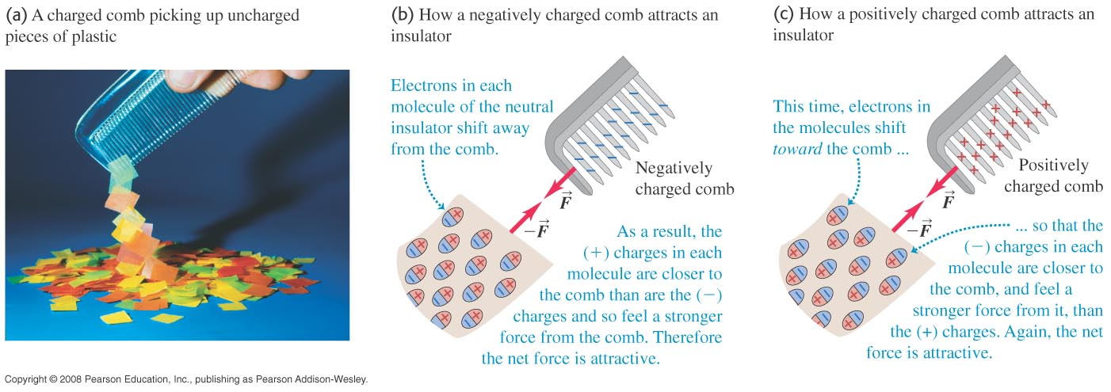
Electric forces on uncharged objects
The charge within an insulator can shift slightly. As a result, two neutral objects can exert electric forces on each other, as shown in Figure 21.8 below.

Slide 12
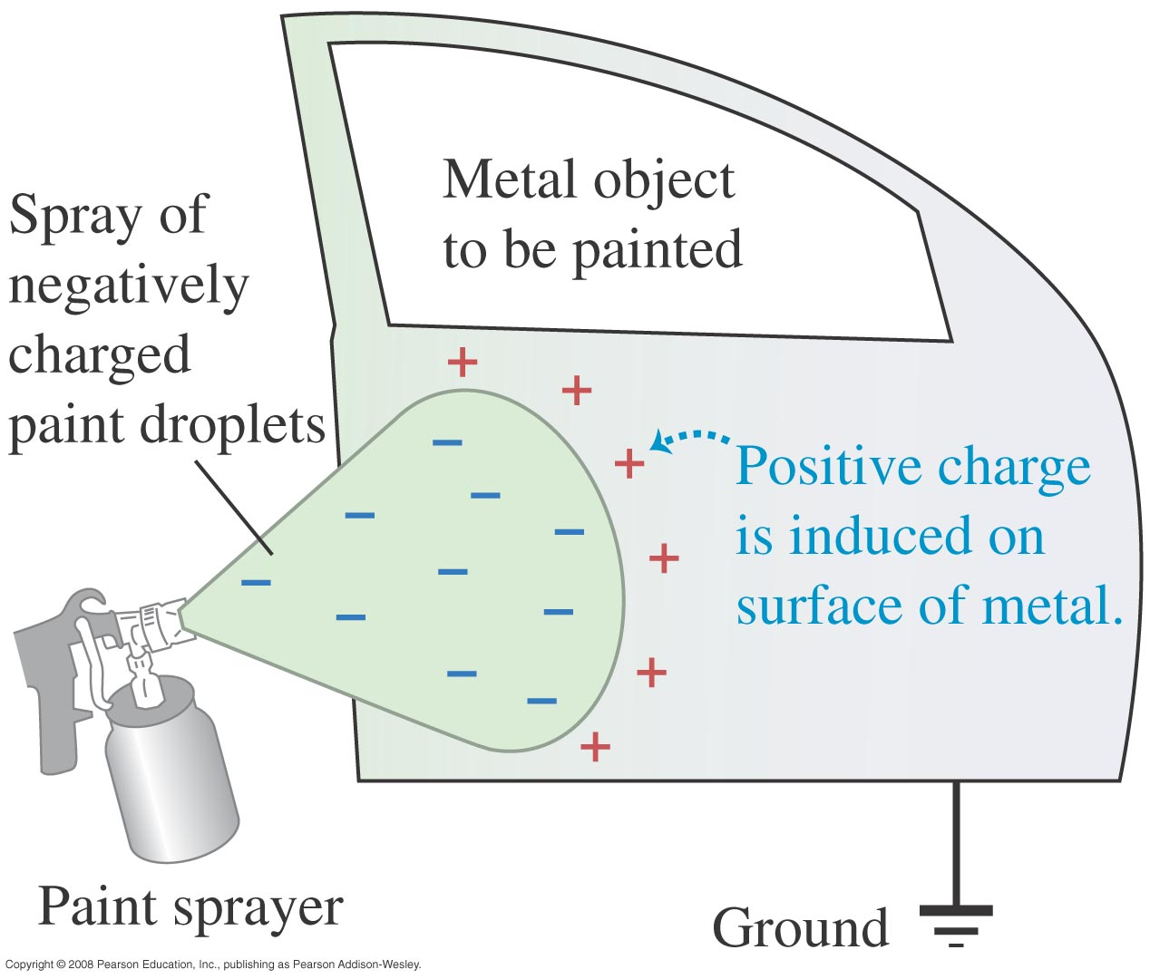
Electrostatic painting
Induced positive charge on the metal object attracts the negatively charged paint droplets.

Slide 13
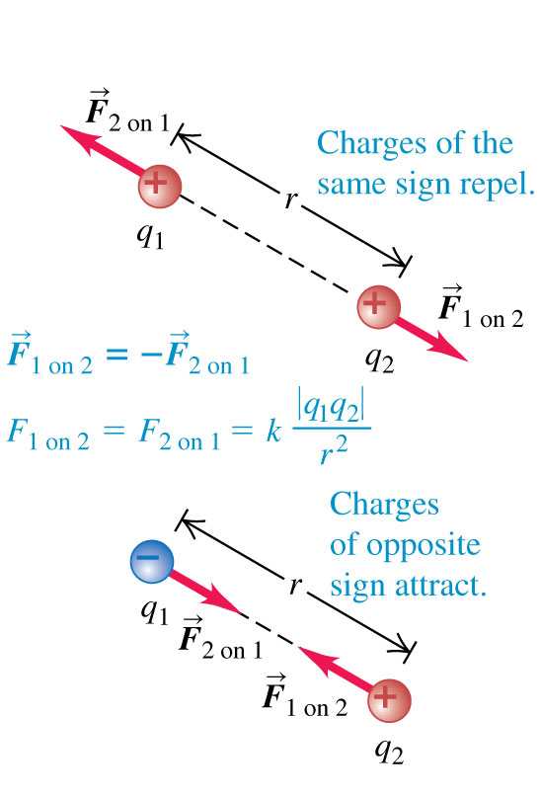
Coulomb’s law
Coulomb’s Law: The magnitude of the electric force between two point charges is directly proportional to the product of their charges and inversely proportional to the square of the distance between them. (See the figure at the right.)
Mathematically: F = k|q₁q₂|/r² = (1/4πε₀)|q₁q₂|/r²

Slide 14
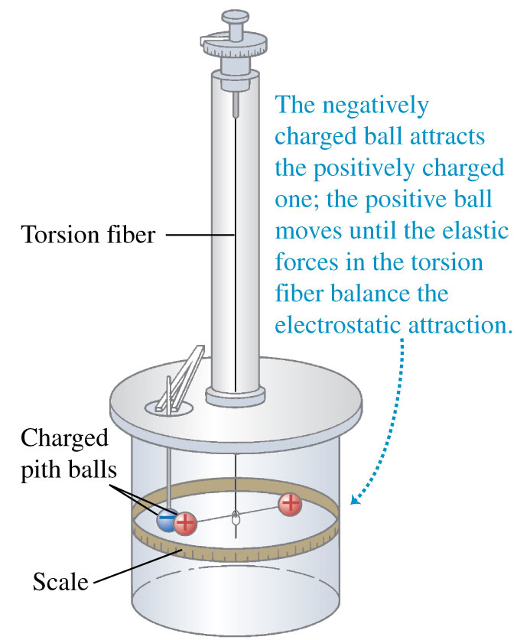
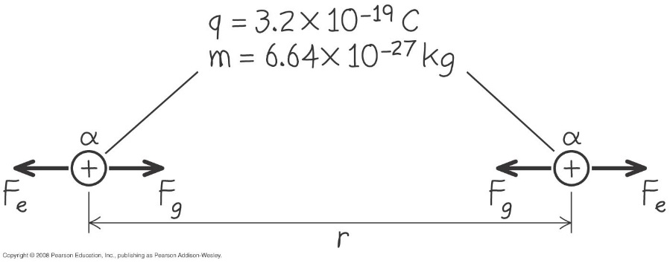
Measuring the electric force between point charges
The figure at the upper right illustrates how Coulomb used a torsion balance to measure the electric force between point charges.
Example 21.1 compares the electric and gravitational forces. Follow it using Figure 21.11 at the lower right.

Slide 15
Force between charges along a line
Read Problem-Solving Strategy 21.1.
Follow Example 21.2 for two charges, using Figure 21.12 at the right.
Follow Example 21.3 for three charges, using Figure 21.13 below.

Slide 16
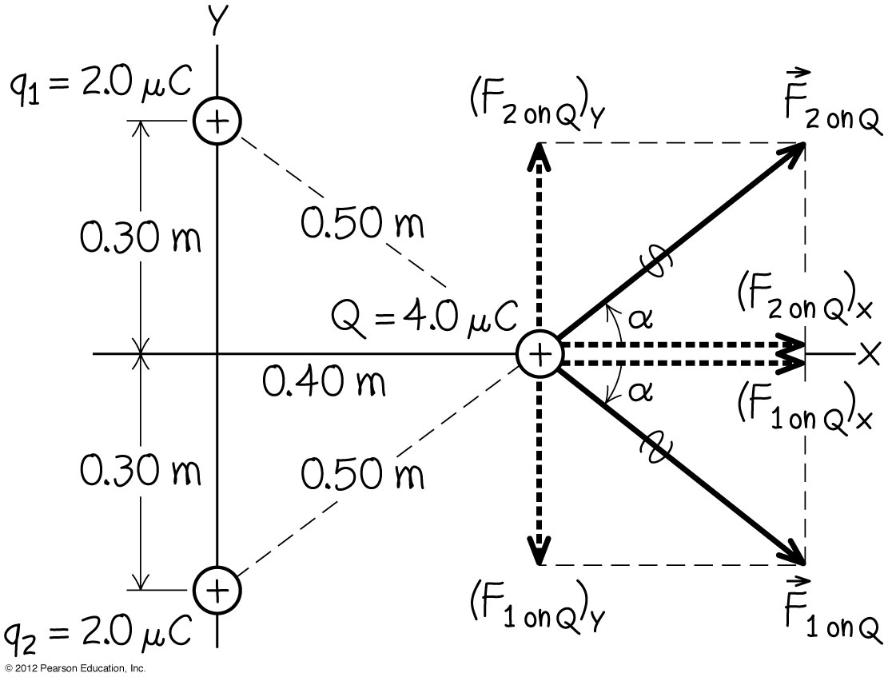
Vector addition of electric forces
Example 21.4 shows that we must use vector addition when adding electric forces. Follow this example using Figure 21.14 below.

Slide 17
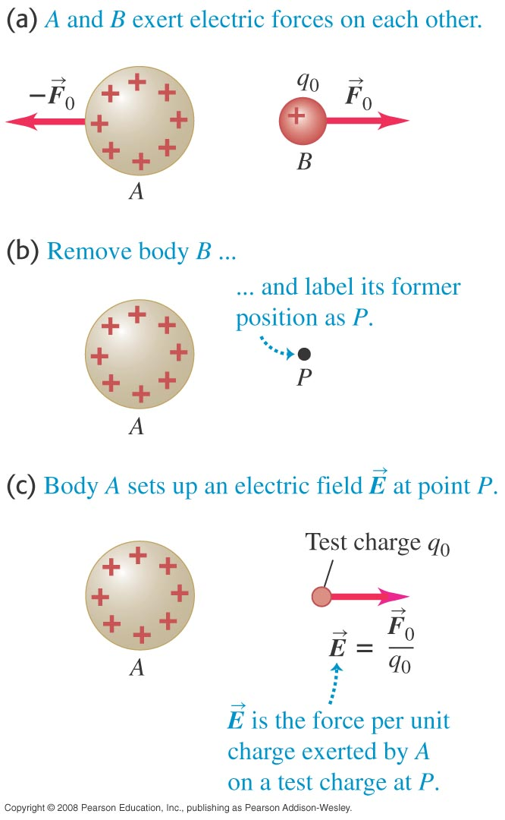
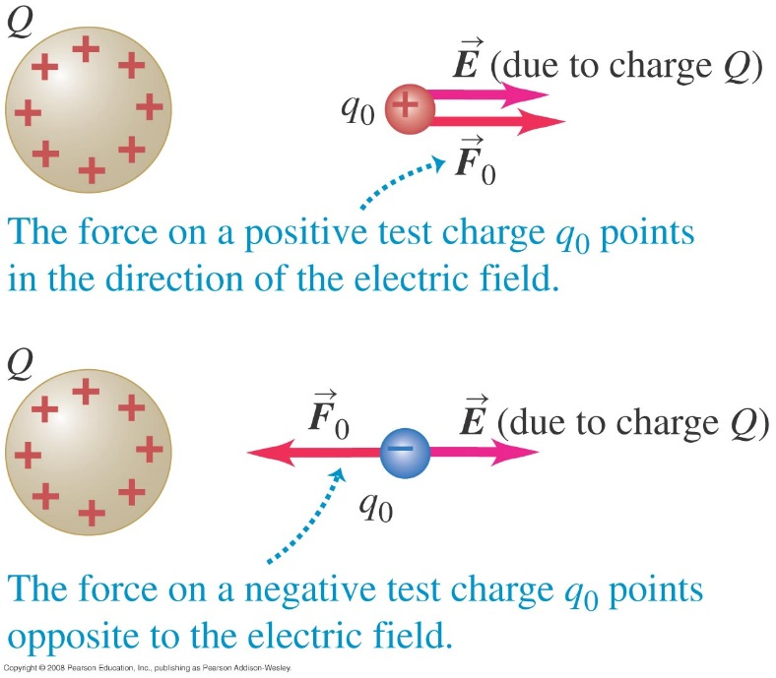
Electric field
A charged body produces an electric field in the space around it (see Figure 21.15 at the lower left).
We use a small test charge q₀ to find out if an electric field is present (see Figure 21.16 at the lower right).

Slide 18
Definition of the electric field
Follow the definition in the text of the electric field using Figure 21.17 below.

Slide 19
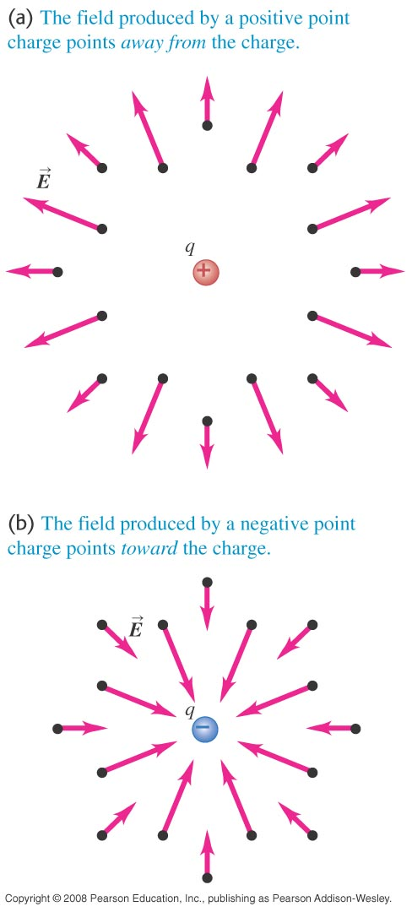
Electric field of a point charge
Follow the discussion in the text of the electric field of a point charge, using Figure 21.18 at the right.
Follow Example 21.5 to calculate the magnitude of the electric field of a single point charge.

Slide 20
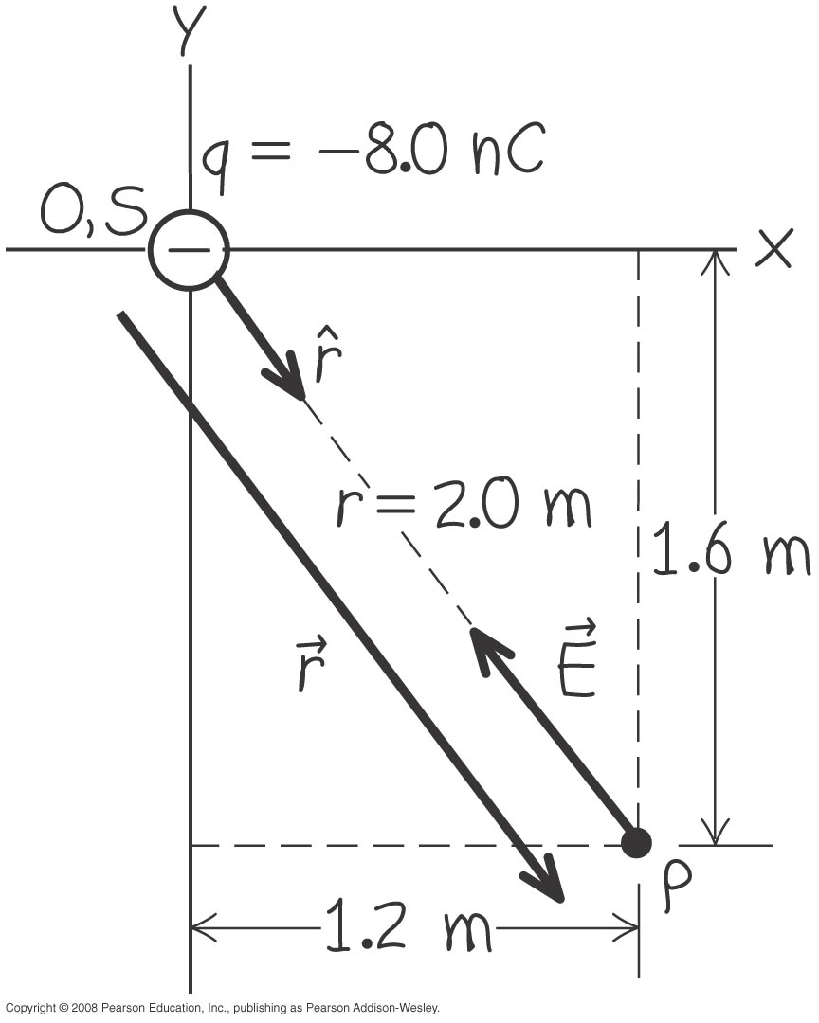
Electric-field vector of a point charge
Follow Example 21.6 to see the vector nature of the electric field. Use Figure 21.19 at the right.

Slide 21
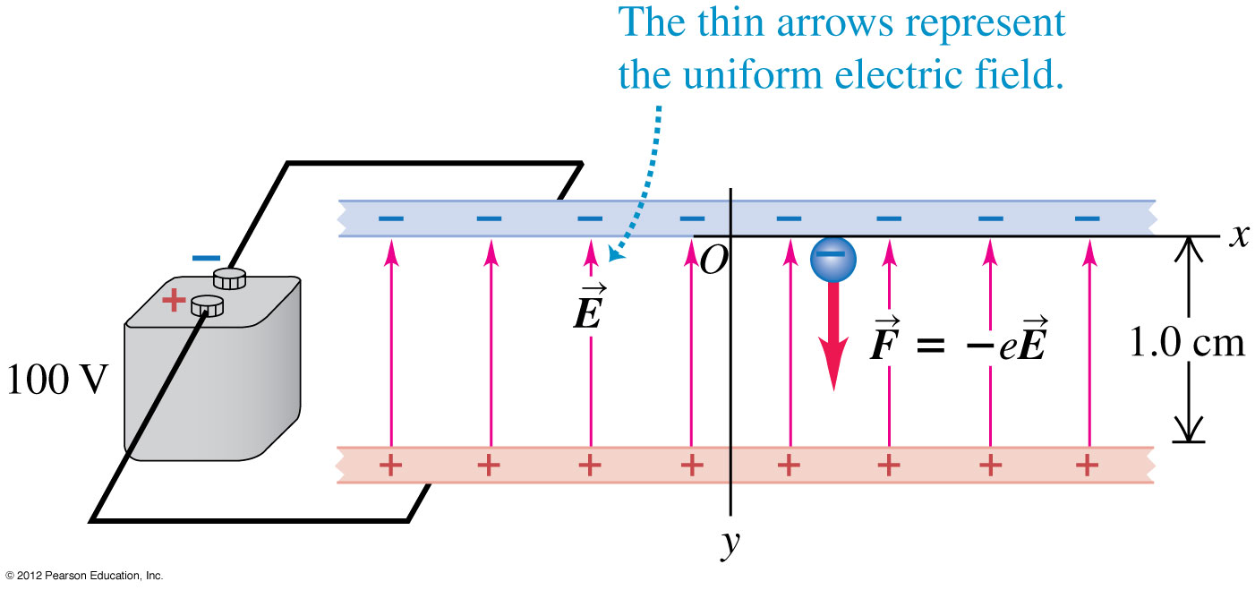
Electron in a uniform field
Example 21.7 requires us to find the force on a charge that is in a known electric field. Follow this example using Figure 21.20 below.

Slide 22
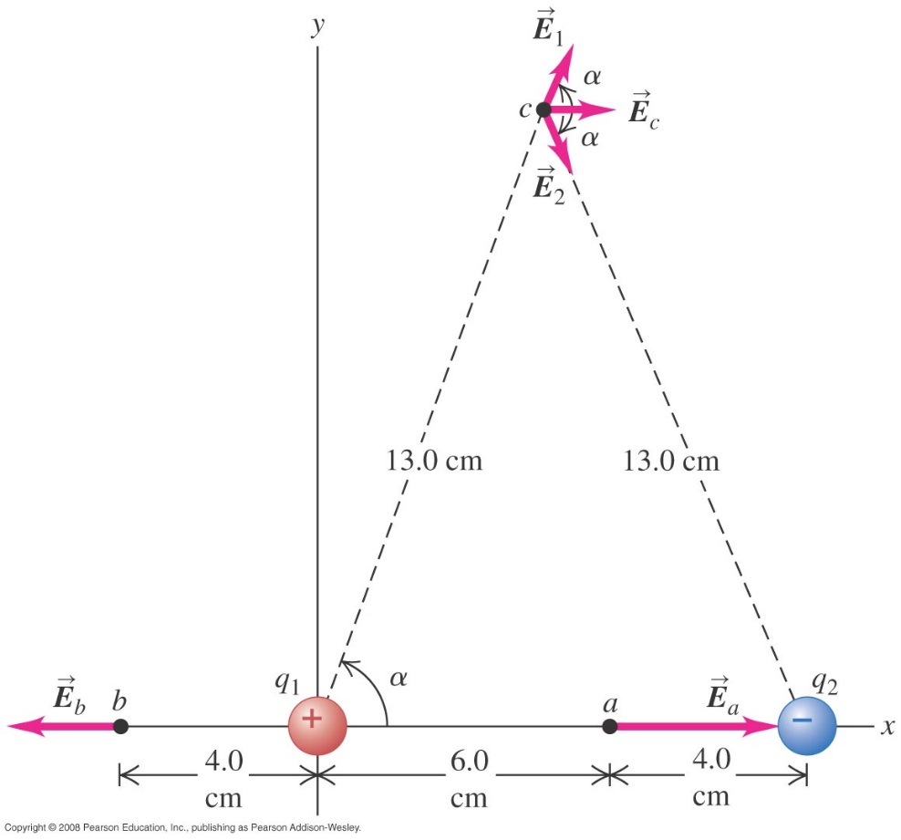
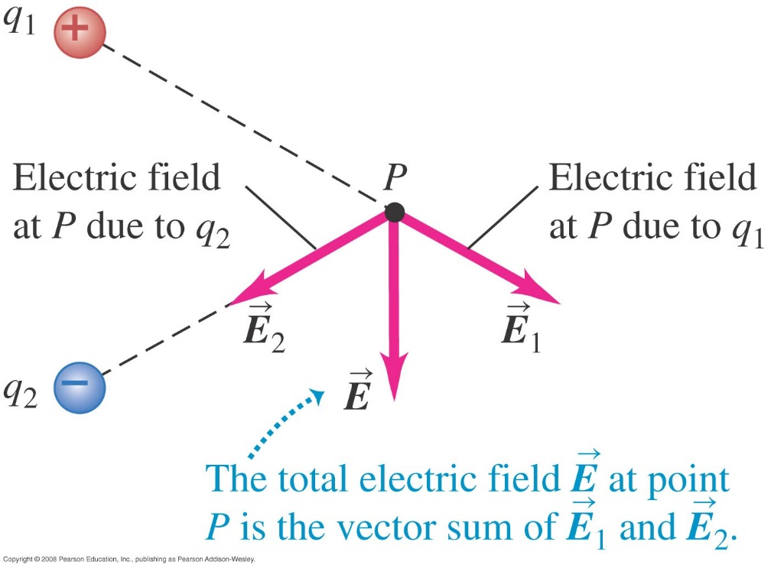
Superposition of electric fields
The total electric field at a point is the vector sum of the fields due to all the charges present. (See Figure 21.21 below right.)
Review Problem-Solving Strategy 21.2.
Follow Example 21.8 for an electric dipole. Use Figure 21.22 below.

Slide 23
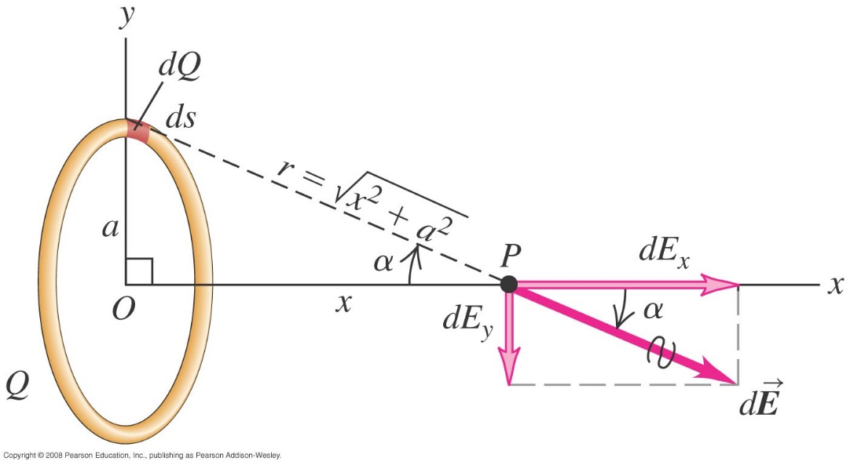
Field of a ring of charge
Example 21.9
$$dQ=λds$$

Slide 24
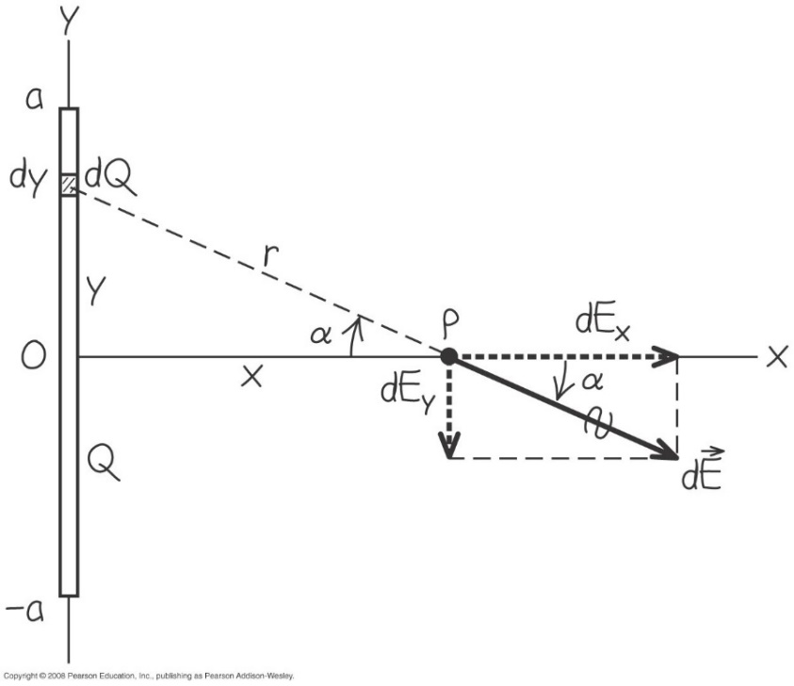
Field of a charged line segment
Example 21.10
$$dQ=λdy$$

Slide 25
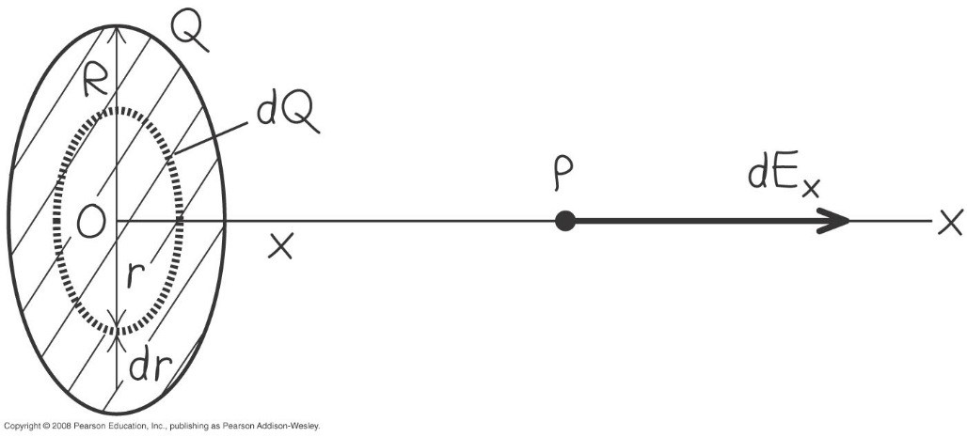
Field of a uniformly charged disk
Example 21.11
$$dQ=σdA$$
$$dQ=σ2πrdr$$

Slide 26
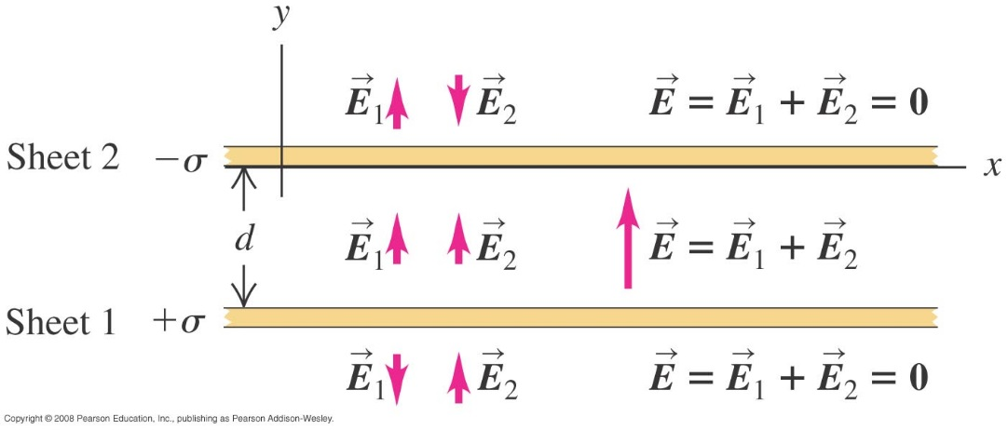
Field of two oppositely charged infinite sheets
Example 21.12
above the upper sheet
between the sheets
below the lower sheet

Slide 27
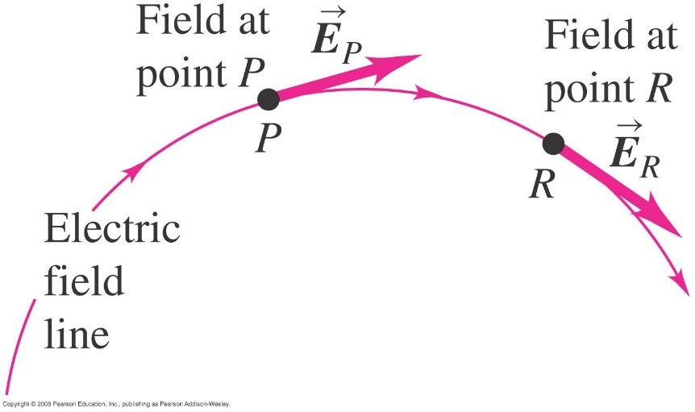
Electric field lines
An electric field line is an imaginary line or curve whose tangent at any point is the direction of the electric field vector at that point. (See Figure 21.27 below.)

Slide 28
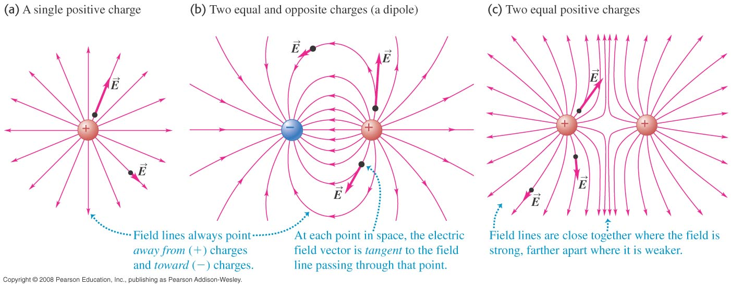
Electric field lines of point charges
Figure 21.28 below shows the electric field lines of a single point charge and for two charges of opposite sign and of equal sign.

Slide 29
Electric dipoles
An electric dipole is a pair of point charges having equal but opposite sign and separated by a distance.
Figure 21.30 at the right illustrates the water molecule, which forms an electric dipole.

Slide 30
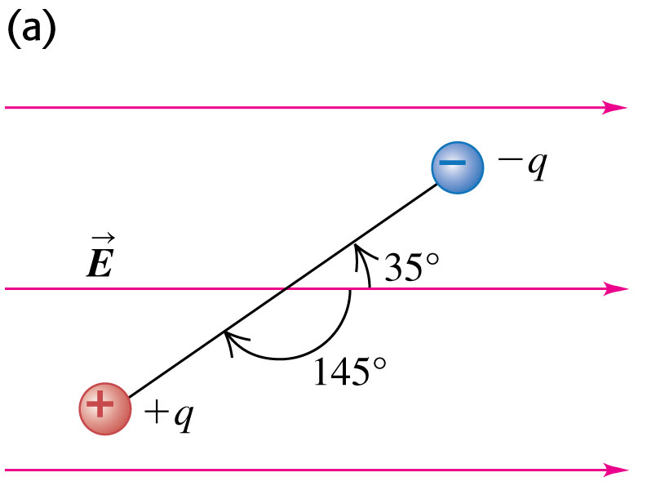
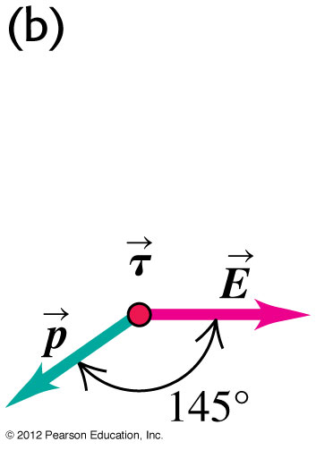
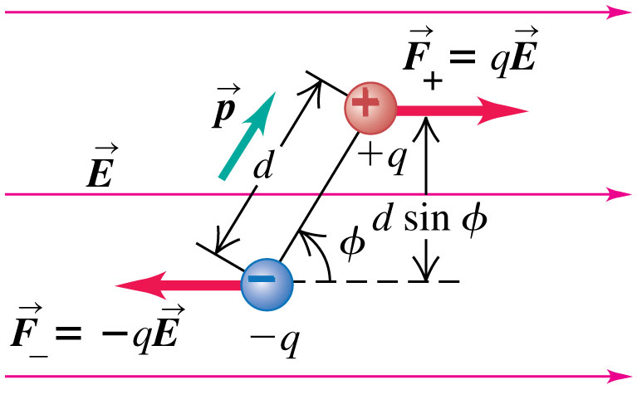
Force and torque on a dipole
Electric dipole moment $\vec{p}=q\vec{d}$
Torque $\vec{τ}=\vec{p}×\vec{E}$.
Torque magnitude $τ=pEsinφ$.
Potential Energy of a dipole $U=−\vec{p}.\vec{E}$

Slide 31
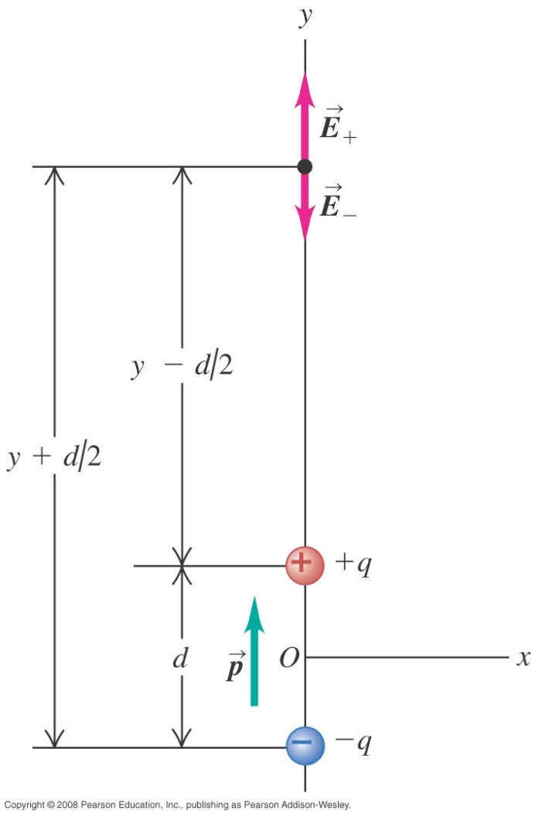
Electric field of a dipole
Follow Example 21.14 using Figure 21.33.

