Slide 1
Chapter 23
Electric Potential

Slide 2
Goals for Chapter 23
To calculate the electric potential energy of a group of charges
To know the significance of electric potential
To calculate the electric potential due to a collection of charges
To use equipotential surfaces to understand electric potential
To calculate the electric field using the electric potential

Slide 3
Introduction
How is electric potential related to welding?
Electric potential energy is an integral part of our technological society.
What is the difference between electric potential and electric potential energy?
How is electric potential energy related to charge and the electric field?

Slide 4
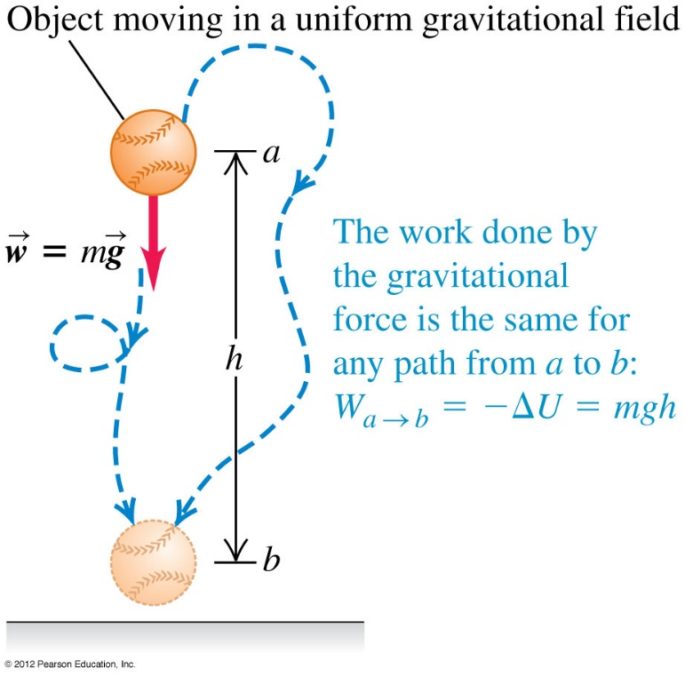
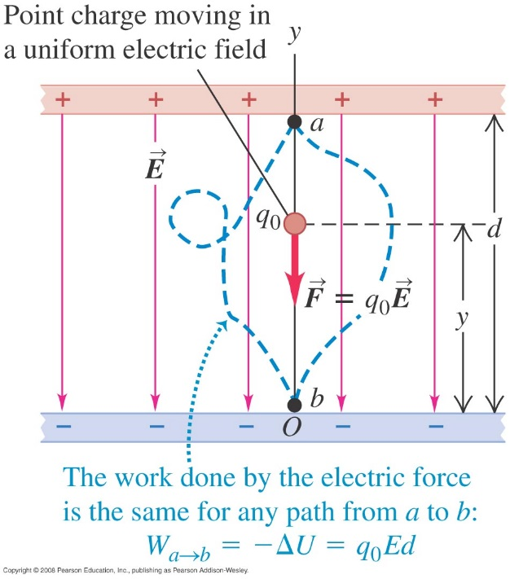
Electric potential energy in a uniform field
The behavior of a point charge in a uniform electric field is analogous to the motion of a baseball in a uniform gravitational field.

Slide 5
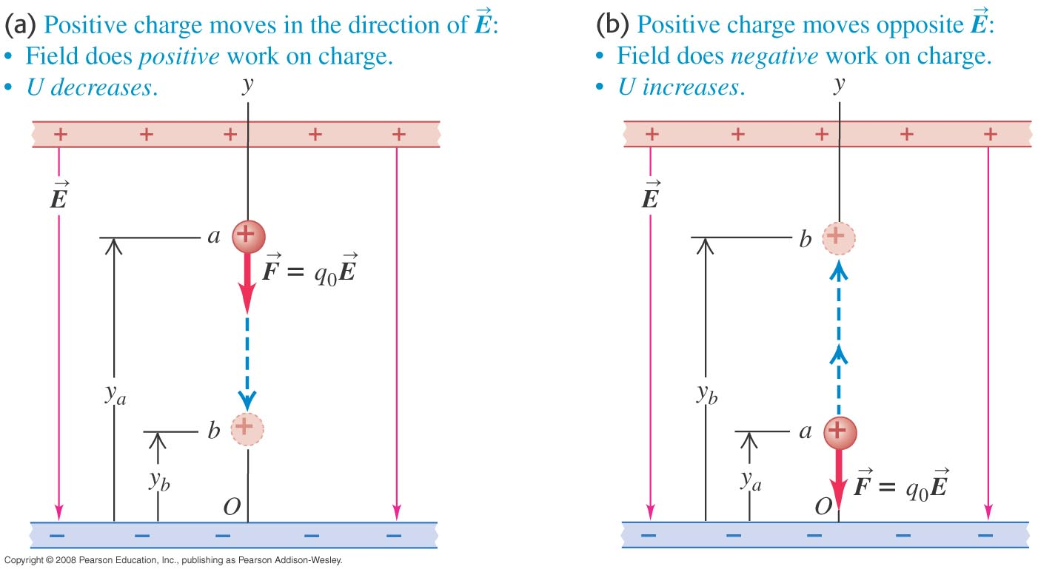
A positive charge moving in a uniform field
If the positive charge moves in the direction of the field, the potential energy decreases, but if the charge moves opposite the field, the potential energy increases.

Slide 6
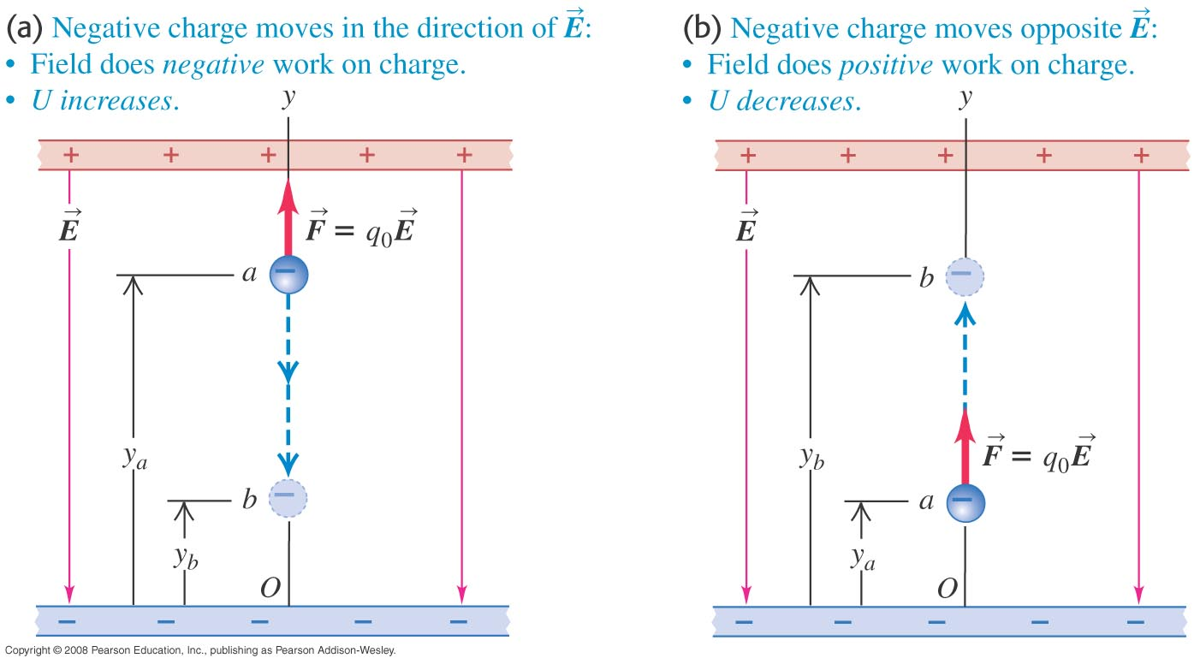
A negative charge moving in a uniform field
If the negative charge moves in the direction of the field, the potential energy increases, but if the charge moves opposite the field, the potential energy decreases.

Slide 7
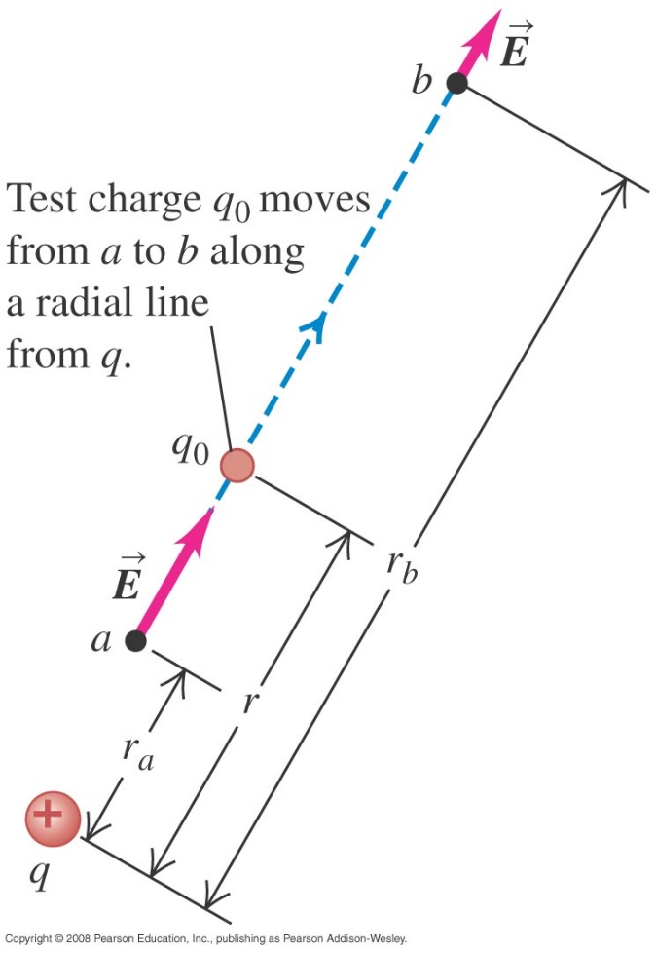
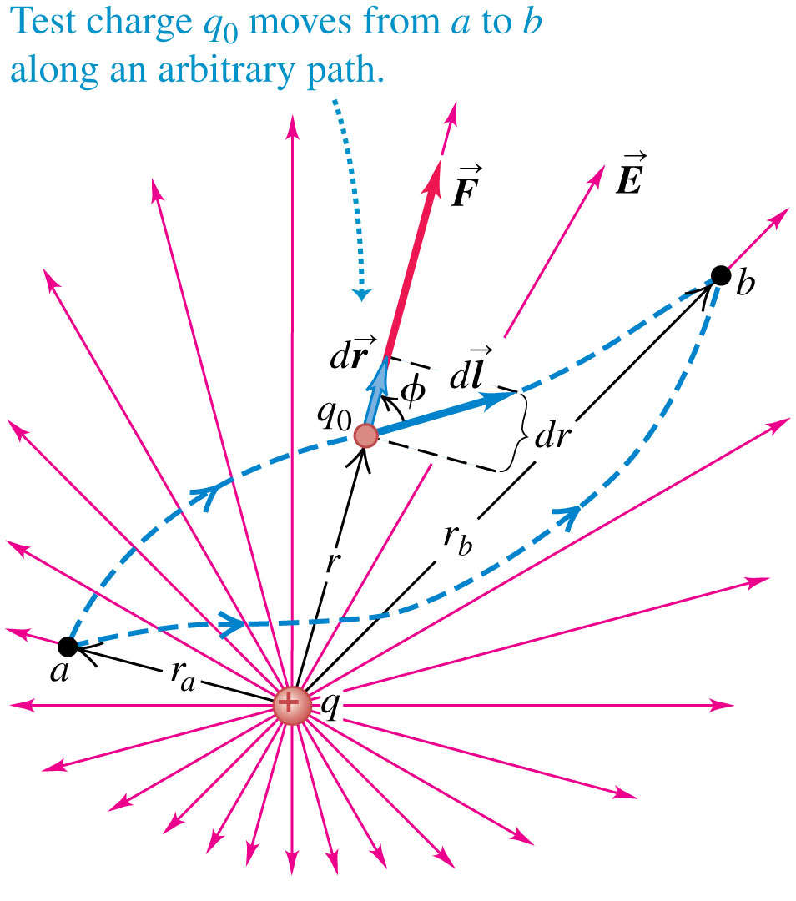
Electric potential energy of two point charges
Follow the discussion of the motion of a test charge q₀ in the text.
The electric potential is the same whether q₀ moves in a radial line (left figure) or along an arbitrary path (right figure).
$$W_{a→b}=\int_{a}^{b}{\vec{F}}.\vec{dl}$$
$$W_{a→b}=\int_{r_{a}}^{r_{b}}{F_{r}dr}$$
$$W_{a→b}=\int_{r_{a}}^{r_{b}}{\frac{qq_{0}}{4πε_{0}r^{2}}dr}$$
$$W_{a→b}=\frac{qq_{0}}{4πε_{0}}\left(\frac{1}{r_{a}}−\frac{1}{r_{b}}\right)$$

Slide 8
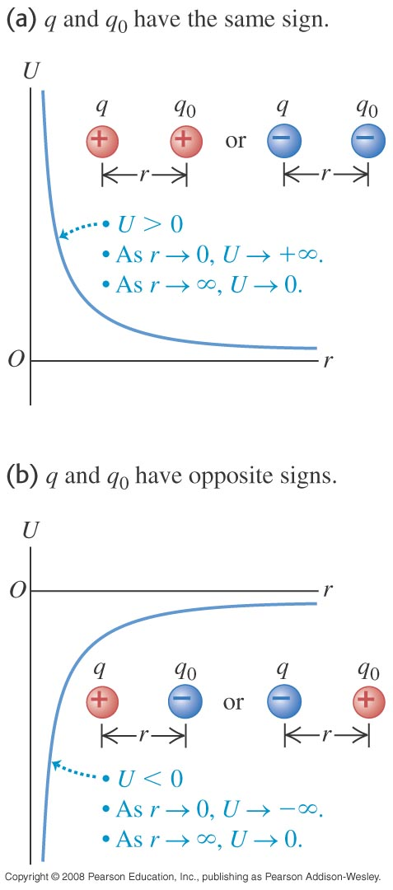
Graphs of the potential energy
The electric potential energy of two charges
$$U=\frac{1}{4πε_{0}}\frac{qq_{0}}{r}$$
The sign of the potential energy depends on the signs of the two charges.

Slide 9
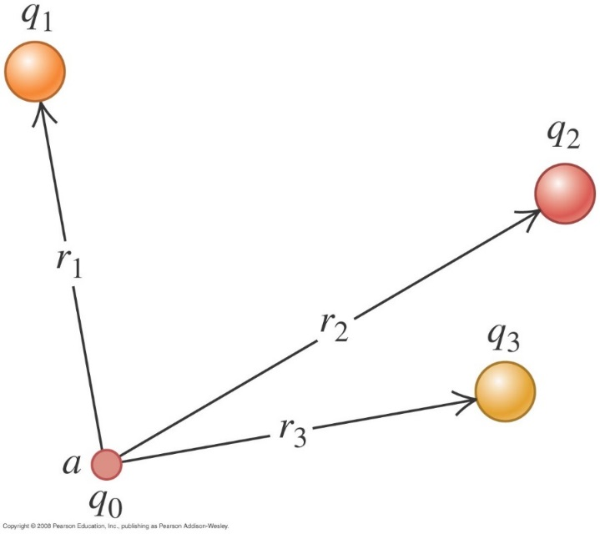
Electrical potential with several point charges
The potential energy associated with q₀ depends on the other charges and their distances from q₀.
$$U=\frac{q_{0}}{4πε_{0}}\left(\frac{q_{1}}{r_{1}}+\frac{q_{2}}{r_{2}}+…\right)=\frac{q_{0}}{4πε_{0}}\sum_{i}{\frac{q_{i}}{r_{i}}}$$
The total potential energy associated with a system of multiple charges is
$$U=\frac{1}{4πε_{0}}\sum_{i<j}{\frac{q_{i}q_{j}}{r_{ij}}}$$
Ex 23.2: Two point charges are located on the x-axis, q₁ = -e at x = 0 and q₂ = +e at x = a. (a) Find the work that must be done by an external force to bring a third point charge q₃ = +e from infinity to x = 2a. (b) Find the total potential energy of the system of the three charges.

Slide 10
Electric potential
Potential is potential energy per unit charge.
$V=\frac{U}{q_{0}}$ 1volt = 1 joule/coulomb
We can think of the potential difference between points a and b in either of two ways. The potential of a with respect to b (V_{ab} = V_{a} – V_{b}) equals:
the work done by the electric force when a unit charge moves from a to b.
the work that must be done to move a unit charge slowly from b to a against the electric force.

Slide 11
Electric potential
Potential due to a point charge
$$V=\frac{1}{4πε_{0}}\frac{q}{r}$$
Potential due to a collection of point charge
$$V=\frac{1}{4πε_{0}}\sum_{i}{\frac{q_{i}}{r_{i}}}$$
Potential due to a continuous distribution of charge
$$V=\frac{1}{4πε_{0}}\int{\frac{dq}{r}}$$

Slide 12
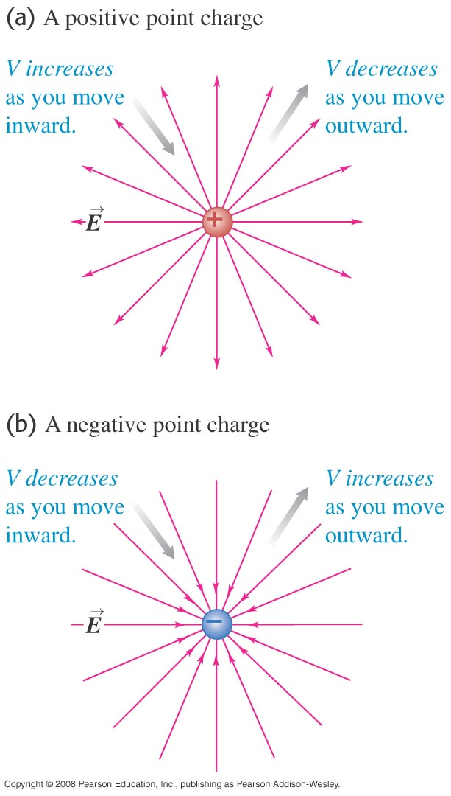
Finding electric potential from the electric field
If you move in the direction of the electric field, the electric potential decreases, but if you move opposite the field, the potential increases.
$$W_{a→b}=\int_{a}^{b}{\vec{F}.\vec{dl}}=\int_{a}^{b}{q_{0}\vec{E}.\vec{dl}}$$
$$V_{a}−V_{b}=\int_{a}^{b}{\vec{E}.\vec{dl}}$$

Slide 13
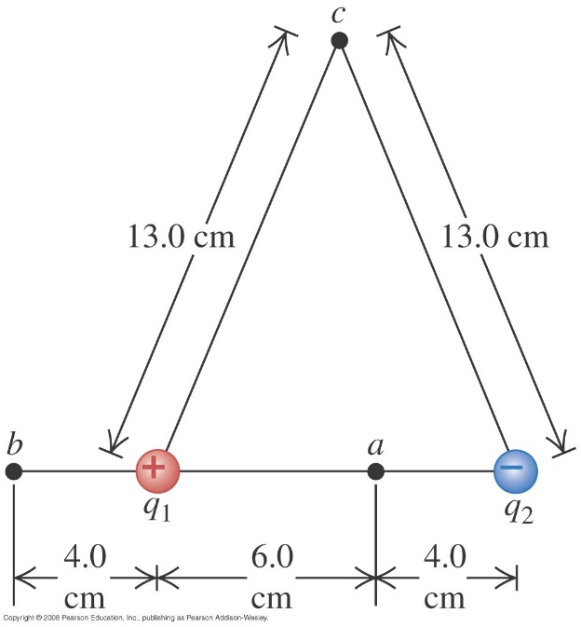
Potential due to two point charges
Ex 23.4 – 23.5: An electric dipole consists of point charges q₁ = +12 nC and q₂ = -12 nC placed 10.0 cm apart. Compute the electric potentials at point a, b, and c. Compute the potential energy associated with a +4 nC point charge if it is placed in a, b, and c.

Slide 14
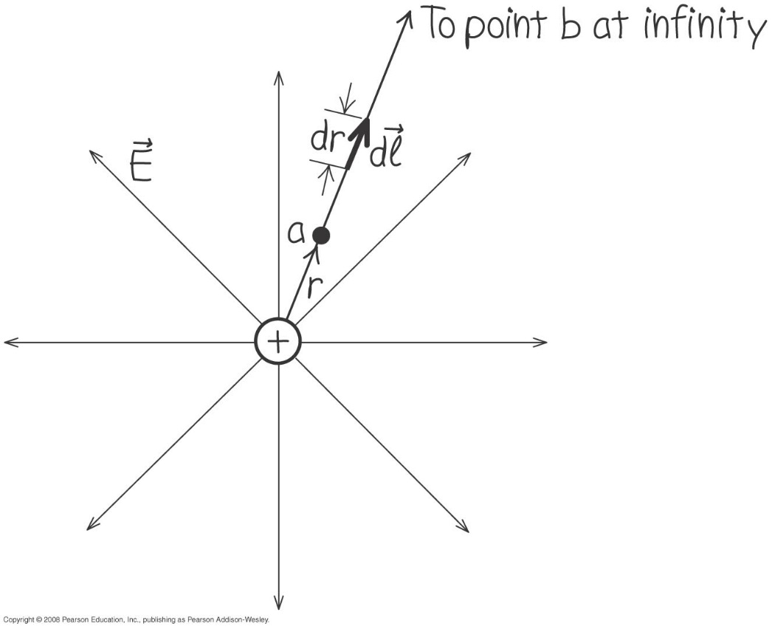
Finding potential by integration
Example 23.6: Find the potential by integration.

Slide 15
Moving through a potential difference
Example 23.7 A dust particle with mass m = 5 μg and charge q₀ = 2 nC starts from rest and moves in a straight line from point a to point b. What is its speed v at point b?

Slide 16
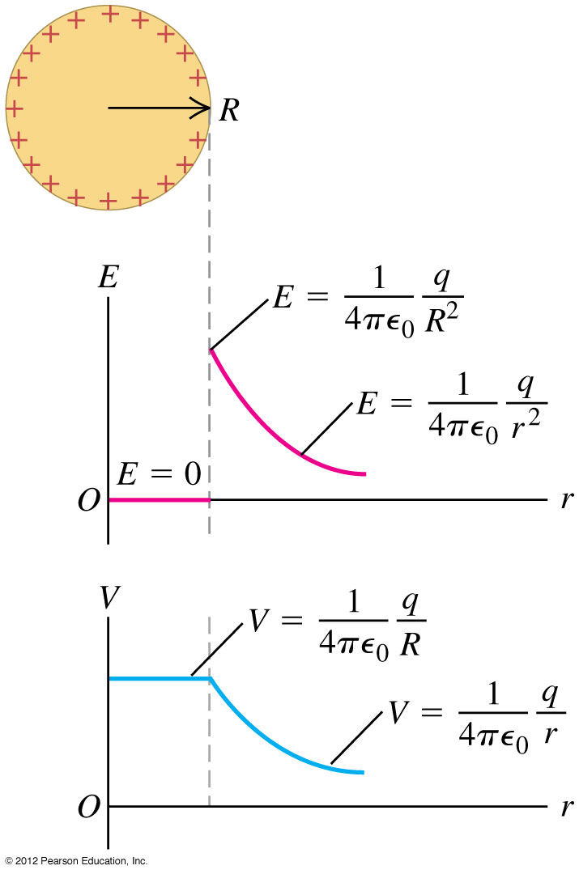
Calculating electric potential
Read Problem-Solving Strategy 23.1.
Follow Example 23.8 (a charged conducting sphere) using Figure 23.16 at the right.

Slide 17
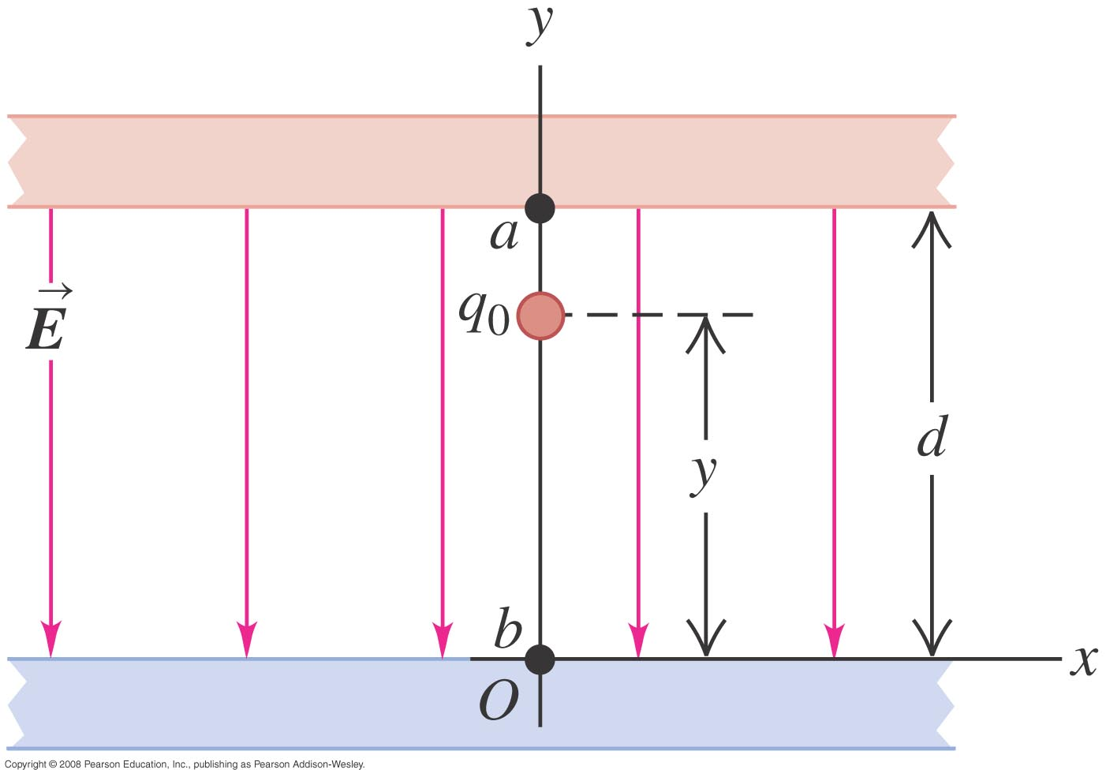
Oppositely charged parallel plates
Example 23.9: Find the potential at any height y between the two oppositely charged parallel plates.
$$V\left(y\right)=\frac{U\left(y\right)}{q_{o}}$$
$$V\left(y\right)=\frac{q_{o}Ey}{q_{o}}$$
$$V\left(y\right)=Ey$$
$$V_{a}−V_{b}=Ed−E0=Ed$$
$$V_{ab}=Ed$$
$$E=\frac{V_{ab}}{d}$$

Slide 18
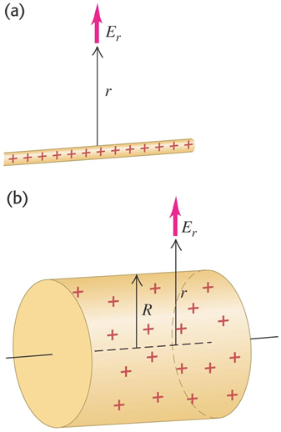
An infinite line charge or conducting cylinder
Example 23.10: Find the potential at a distance r from a very long line of charge with linear charge density λ.
$$V_{a}−V_{b}=\int_{a}^{b}{\vec{E}.\vec{dl}}$$
$$V_{a}−V_{b}=\frac{λ}{2πε_{0}}\int_{r_{a}}^{r_{b}}{\frac{dr}{r}}$$
$$V_{a}−V_{b}=\frac{λ}{2πε_{0}}\text{ln}\frac{r_{b}}{r_{a}}$$
Set V_{b} at r = R be zero
$$V=\frac{λ}{2πε_{0}}\text{ln}\frac{R}{r}$$

Slide 19
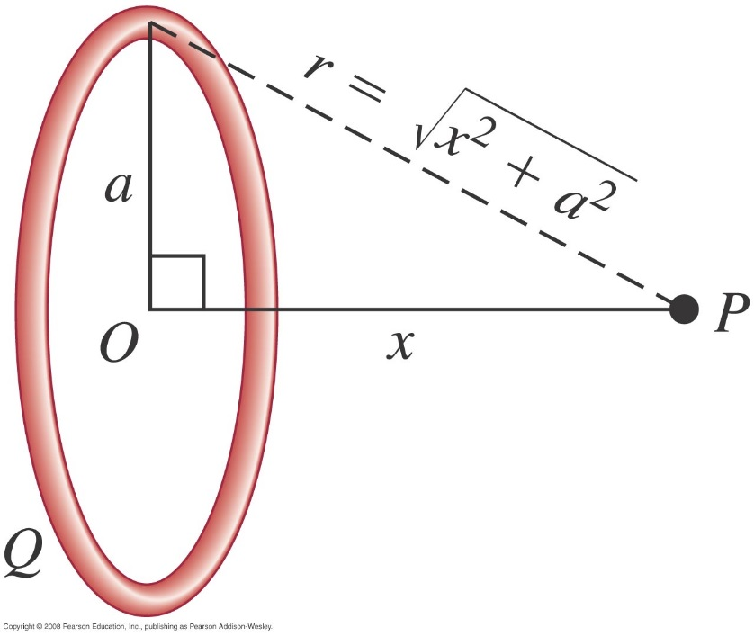
A ring of charge
Example 23.11: Electric charge Q is distributed uniformly around a thin ring of radius a. Find the potential at a point P on the ring axis at a distance x from the center.
$$V=\frac{1}{4πε_{0}}\frac{q}{r}$$
$$V=\frac{1}{4πε_{0}}\int{\frac{dq}{r}}$$
$$V=\frac{1}{4πε_{0}}\frac{1}{\sqrt{x^{2}+a^{2}}}\int{dq}$$
$$V=\frac{1}{4πε_{0}}\frac{Q}{\sqrt{x^{2}+a^{2}}}$$

Slide 20
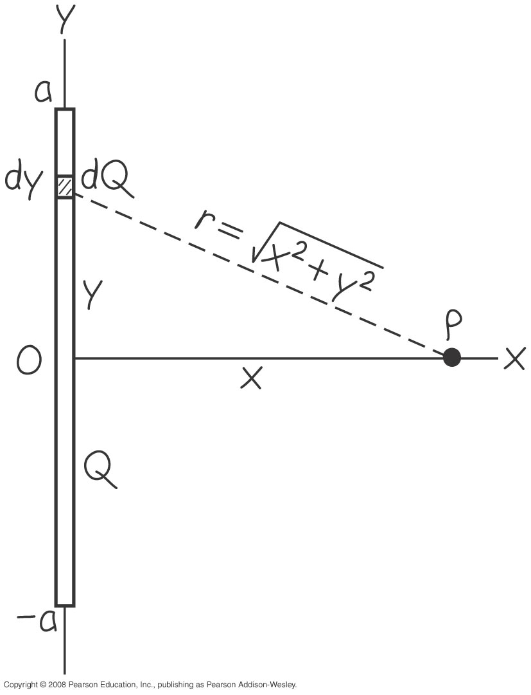
A finite line of charge
Read Example 23.12.

Slide 21
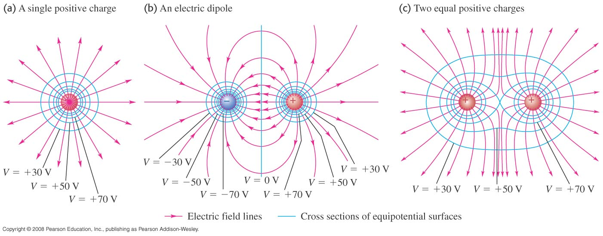
Equipotential surfaces and field lines
An equipotential surface is a surface on which the electric potential is the same at every point.
Figure 23.23 below shows the equipotential surfaces and electric field lines for assemblies of point charges.
Field lines and equipotential surfaces are always mutually perpendicular.

Slide 22
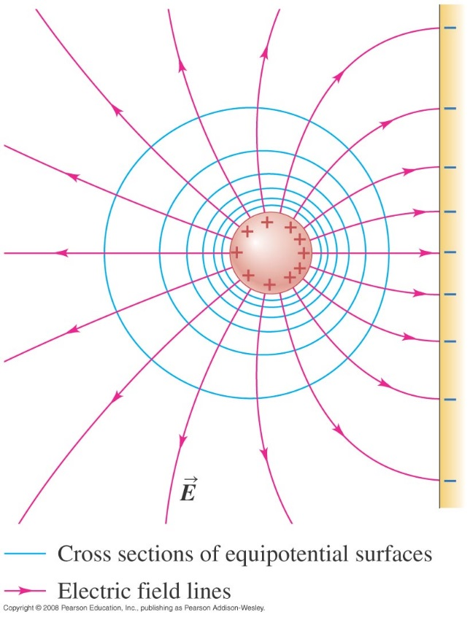
Equipotentials and conductors
When all charges are at rest:
the surface of a conductor is always an equipotential surface.
the electric field just outside a conductor is always perpendicular to the surface (see figures below).
the entire solid volume of a conductor is at the same potential.

Slide 23
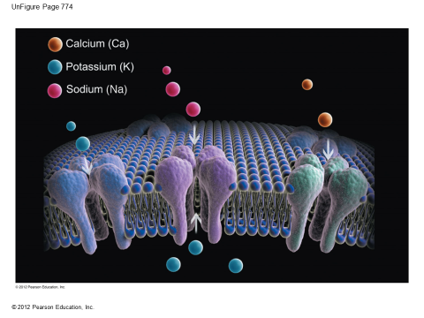
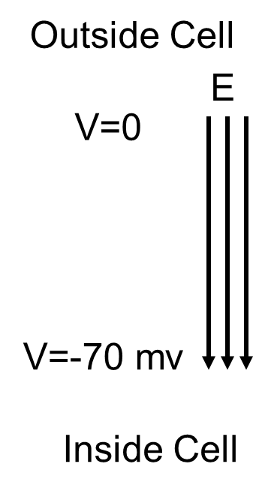
Potential gradient
During Action Potential
Na⁺
V=80 mv
Ca⁺

