Slide 1
Chapter 24
Capacitance and Dielectrics

Slide 2
Goals for Chapter 24
To understand capacitors and calculate capacitance
To analyze networks of capacitors
To calculate the energy stored in a capacitor
To examine dielectrics and how they affect capacitance

Slide 3
Introduction
How does a camera’s flash unit store energy?
Capacitors are devices that store electric potential energy.
The energy of a capacitor is actually stored in the electric field.

Slide 4
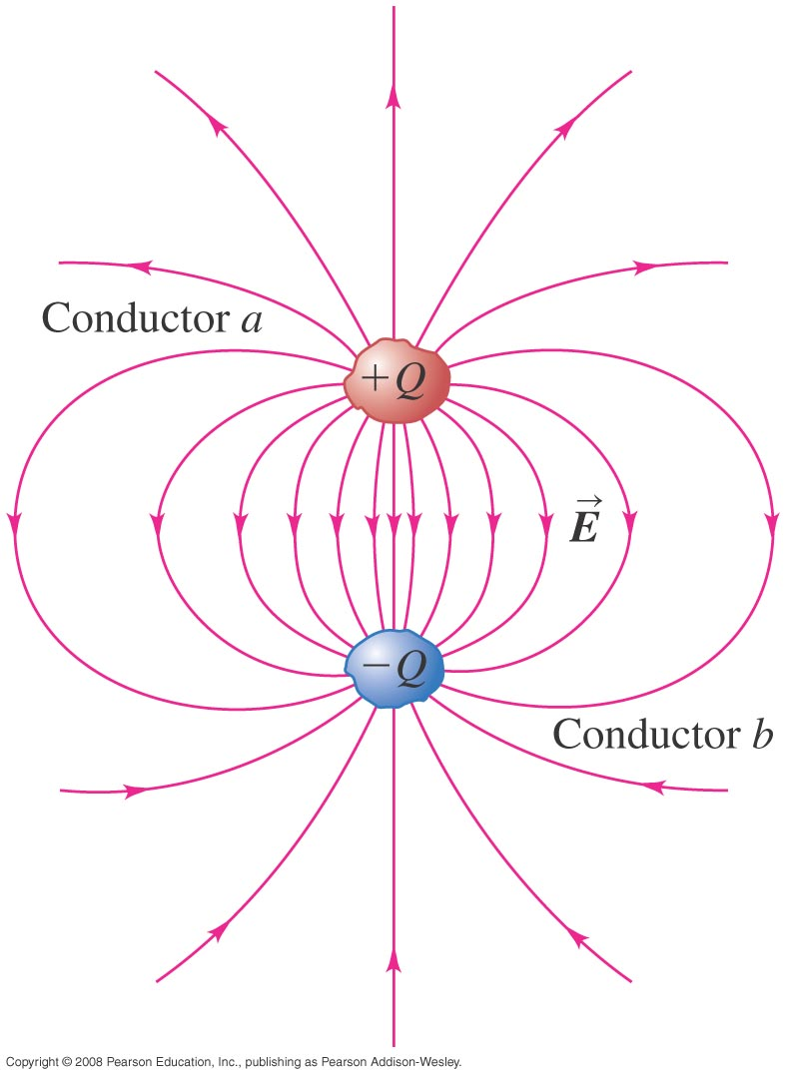
Capacitors and capacitance
Any two conductors separated by an insulator form a capacitor, as illustrated below.
The definition of capacitance is C = Q/V_{ab}.
Unit of capacitance is Farad

Slide 5
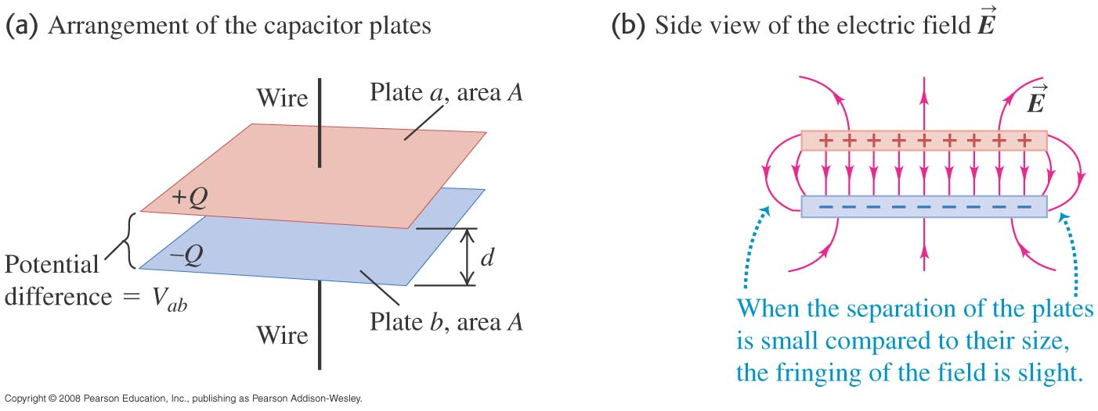
Parallel-plate capacitor
A parallel-plate capacitor consists of two parallel conducting plates separated by a distance that is small compared to their dimensions.
The capacitance of a parallel-plate capacitor is C = ε₀A/d.
$$E=\frac{σ}{ε_{0}}$$
$$V_{ab}=Ed$$
C = Q/V_{ab}

Slide 6
Parallel-plate capacitor
Examples 24.2: The plates of a parallel-plate capacitor in vacuum are 5.00 mm apart and 2.00 m² in area. A 10.0-kV potential difference is applied across the capacitor. Compute (a) the capacitance; (b) the charge on each plate: and © the magnitude of the electric field between the plates.

Slide 7
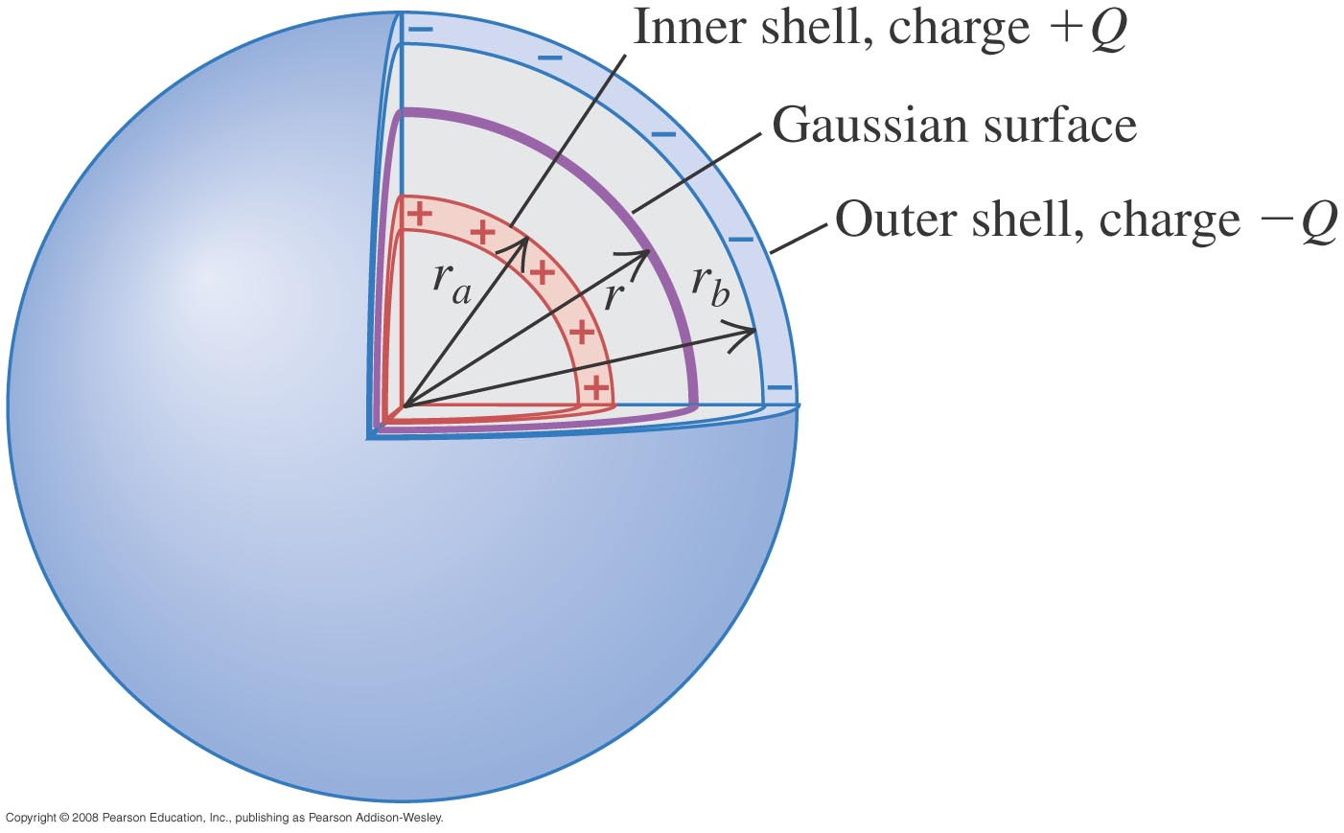
A spherical capacitor
Example 24.3: Two concentric spherical conducting shells are separated by vacuum. The inner shell has total charge +Q and outer radius r_{a}, and the outer shell has charge –Q and inner radius r_{b}. Find the capacitance of this spherical capacitor.
$$C=4πε_{0}\frac{r_{a}r_{b}}{r_{b}{−r}_{a}}$$

Slide 8
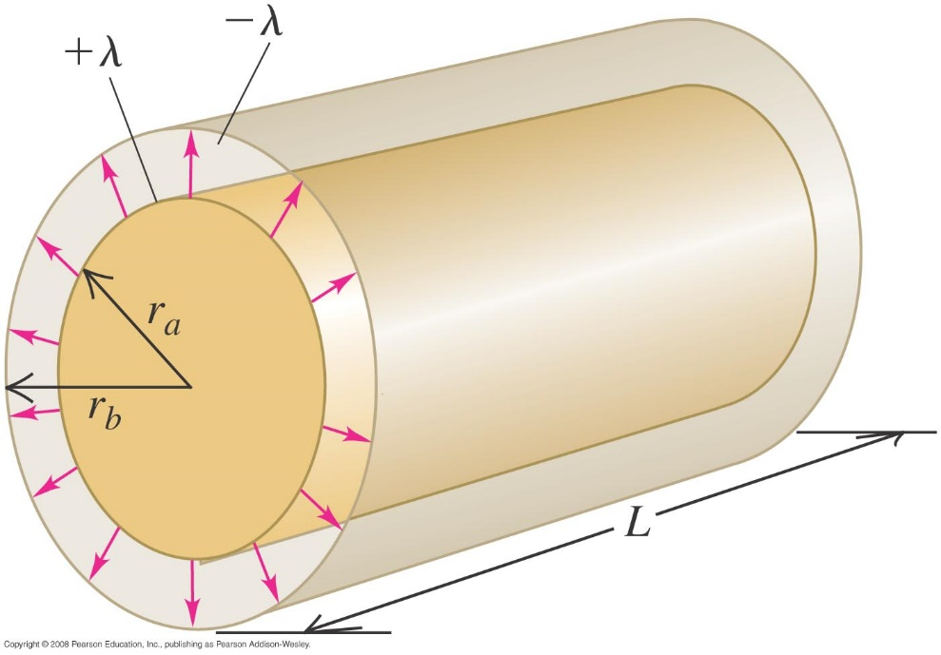
A cylindrical capacitor
Example 24.4: Two long coaxial cylindrical conductors are separated by vacuum. The inner cylinder has radius r_{a} and linear charge density +λ. The outer cylinder has inner radius r_{b} and linear charge –λ. Find the capacitance per unit length for this capacitor.
$$C=\frac{2πε_{0}L}{\text{ln}\left(r_{b}/r_{a}\right)}$$

Slide 9
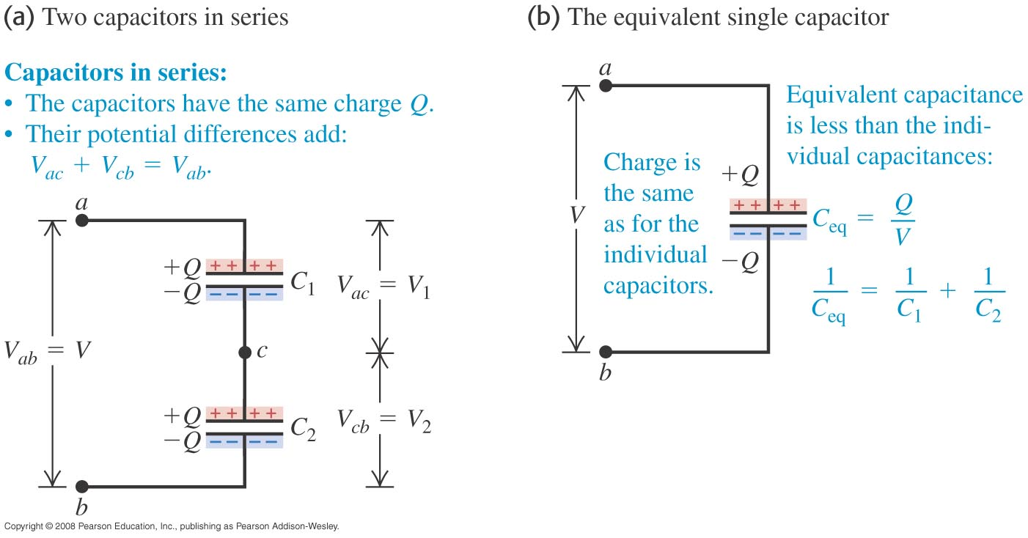
Capacitors in series
Capacitors are in series if they are connected one after the other, as illustrated in Figure below.
The equivalent capacitance of a series combination is given by 1/C_{eq} = 1/C₁ + 1/C₂ + 1/C₃ + …
V_{ab} = V₁ + V₂

Slide 10
Capacitors in parallel
Capacitors are connected in parallel between a and b if the potential difference V_{ab} is the same for all the capacitors. (See Figure below.)
The equivalent capacitance of a parallel combination is the sum of the individual capacitances: C_{eq} = C₁ + C₂ + C₃ + … .

Slide 11
Calculations of capacitance
Example 24.5: Two capacitors the first has capacitance C₁ = 6.0 µF, C₂ = 3.0 μF, and V_{ab} = 18 V. Find the equivalent capacitance and the charge and potential difference for each capacitor when the capacitors are connected (a) in series and (b) in parallel.

Slide 12
Calculations of capacitance
Example 24.6: Find the equivalent capacitor of the capacitor network below.

Slide 13
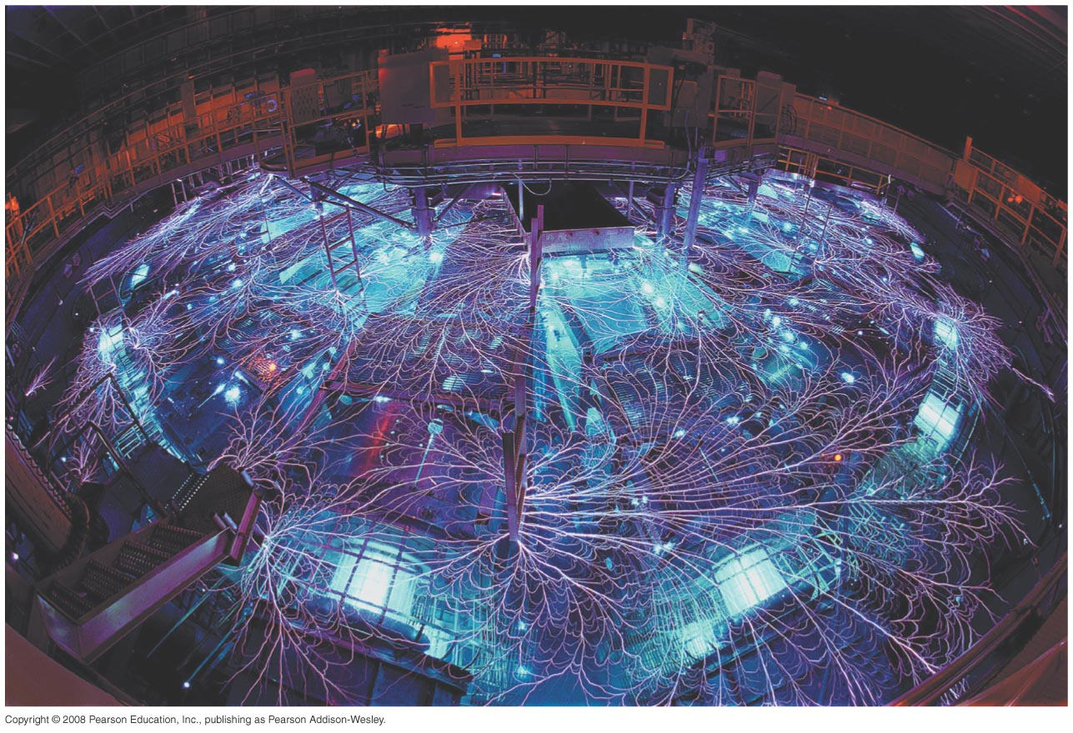
Energy stored in a capacitor
The potential energy stored in a capacitor is
U = Q²/2C = 1/2 CV² = 1/2 QV.
The capacitor energy is stored in the electric field between the plates. The energy density is u = 1/2 ε₀E².
The Z machine shown below can produce up to 2.9 × 10¹⁴ W using capacitors in parallel!

Slide 14
Some examples of capacitor energy
Example 24.7: We connect a capacitor C₁ = 8 μF to a power supply, charge it to a potential difference V₀ = 120 V, and disconnect the power supply. Switch S is open. (a) what is the charge Q₀ on C₁? (b) What is the energy stored in C₁? (c) Capacitor C₂ = 4 μF is initially uncharged. We close switch S. After charge no longer flows, what is the potential difference across each capacitor, and what is the charge on each capacitor? (d) What is the final energy of the system?
Answer: a) Q₀ = 960 μC b)E_{C1} = 58 mJ c) V=80V, Q_{C1} = 640 μC, Q_{C2} = 320 μC
d) E_{f} = 38 mJ.

Slide 15
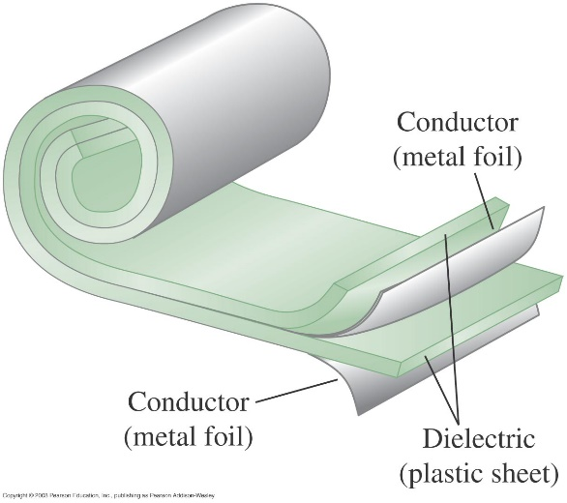
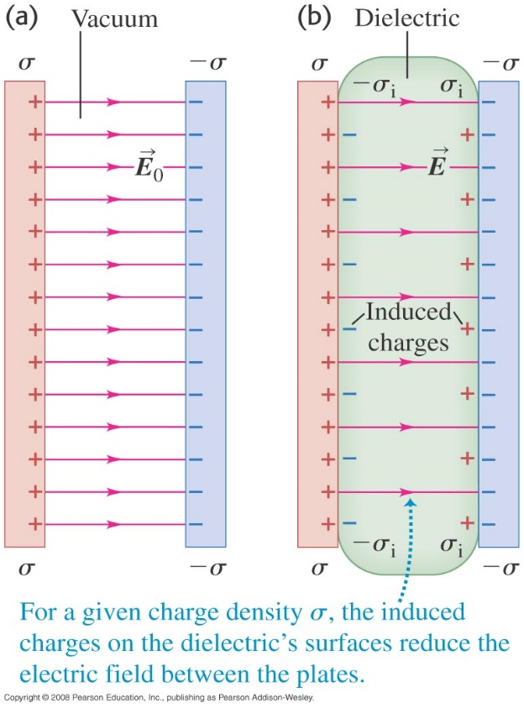
Dielectrics
A dielectric is a nonconducting material. Most capacitors have dielectric between their plates.
The dielectric constant of the material is K = C/C₀ > 1.
Dielectric increases the capacitance and the energy density by a factor K.
C = KC₀ = Kϵ₀A/d
Figure (lower right) shows how the dielectric affects the electric field between the plates. E = E₀/K
σ_{i} = σ (1 - 1/K)
Table 24.1 on the next slide shows some values of the dielectric constant.

Slide 16
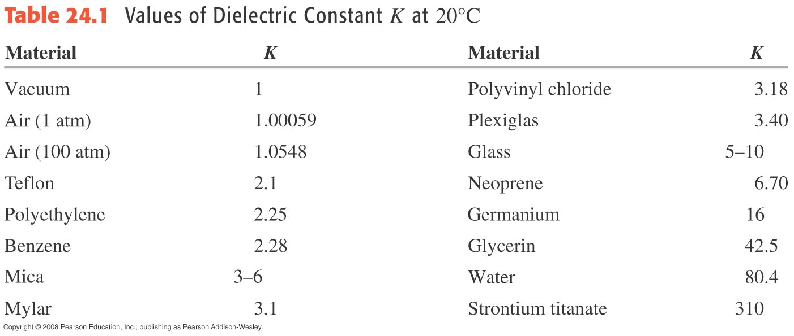
Table 24.1—Some dielectric constants

Slide 17
Examples with and without a dielectric
Example 24.10: A parallel plates capacitor with each plate have an area of 0.2 m² and are 0.01 m apart. We connect the capacitor to a power supply, charge it to a potential difference V₀ = 3 kV, and disconnect the power supply. We then insert a sheet of insulating plastic material between the plates, completely filling the space between them. We find that the potential difference decreases to 1 kV while the charge on each capacitor plate remains constant. Find (a) the original capacitance C₀; (b) the magnitude of charge Q on each plate; (c) the capacitance C after the dielectric is inserted; (d) the dielectric constant K of the dielectric; (e) the permittivity ϵ of the dielectric; (f) the magnitude of the induced charge Q_{i} on each face of the dielectric; (g) the original electric field E₀ between the plates; and (h) the electric field E after the dielectric is inserted.
a) 177 pF; b) 0.531 μC; c) 531 pF; d) 3; e) 26.6 p; f) 0.354 μC; g) 300 kV/m; h) 100 kV/m

Slide 18
Dielectric breakdown
If the electric field is strong enough, dielectric breakdown occurs and the dielectric becomes a conductor.
The dielectric strength is the maximum electric field the material can withstand before breakdown occurs.
Table 24.2 shows the dielectric strength of some insulators.

Slide 19
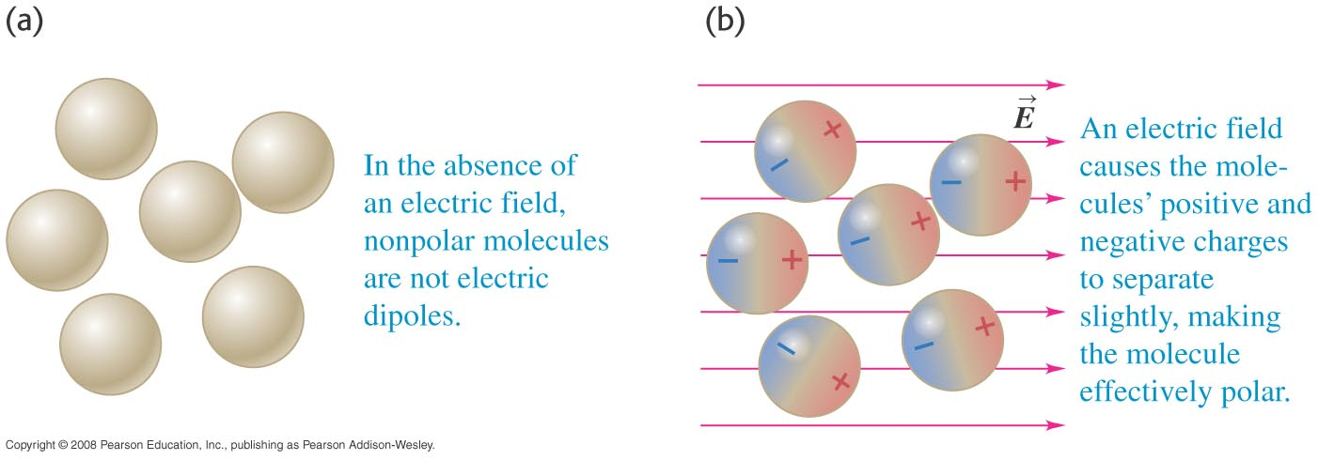
Molecular model of induced charge - I
Figures 24.17 (right) and 24.18 (below) show the effect of an applied electric field on polar and nonpolar molecules.

Slide 20
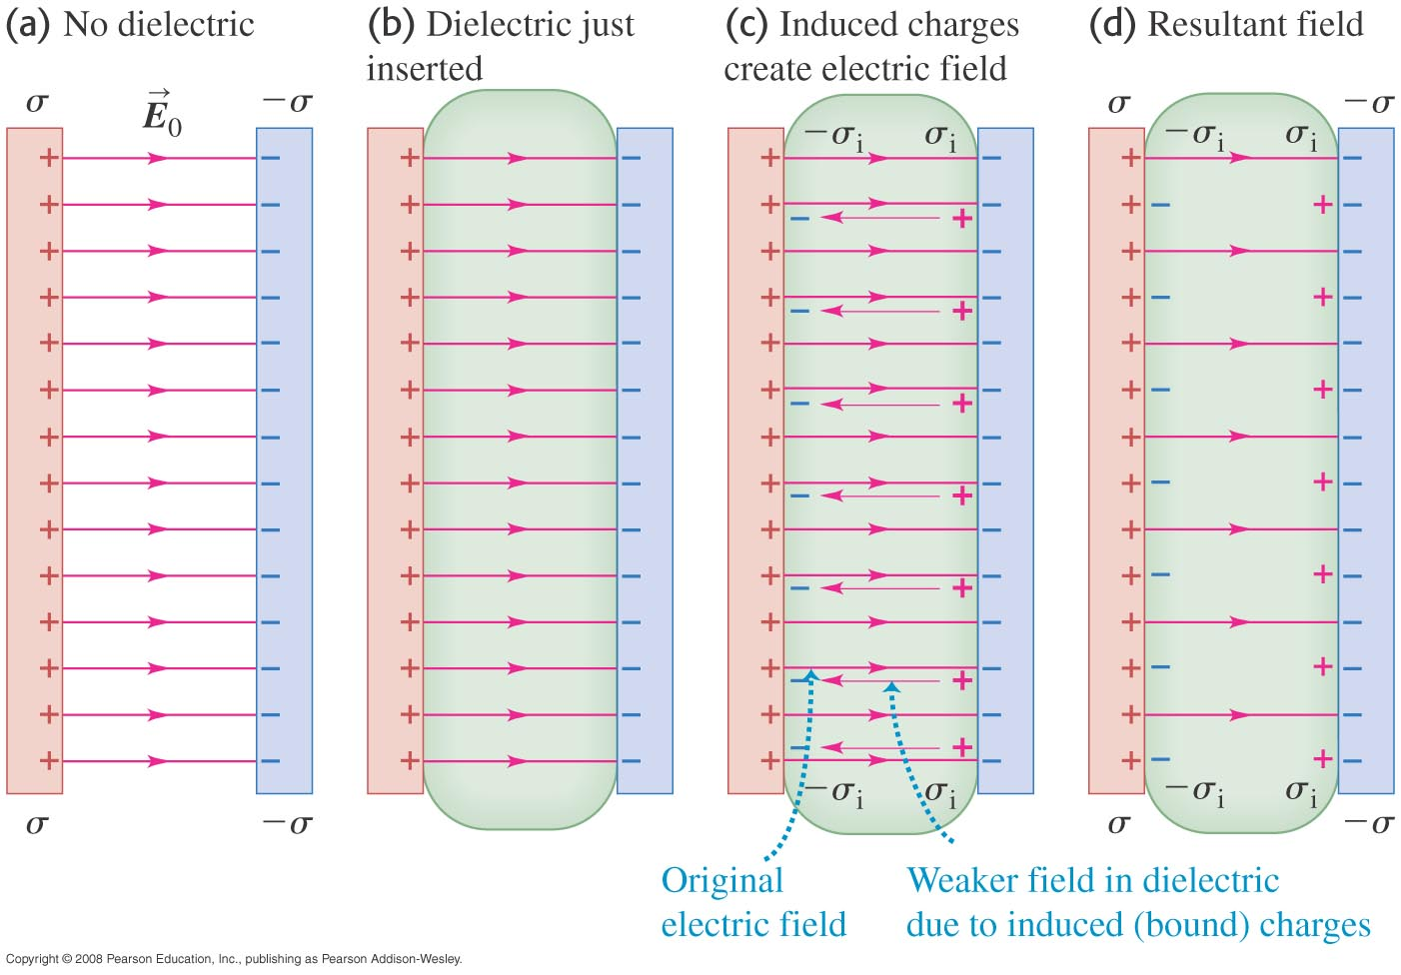
Molecular model of induced charge - II
Figure 24.20 below shows polarization of the dielectric and how the induced charges reduce the magnitude of the resultant electric field.

