Slide 1
Chapter 25
Current, Resistance, and Electromotive Force

Slide 2
Goals for Chapter 25
To understand current and how charges move in a conductor
To understand resistivity and conductivity
To calculate the resistance of a conductor
To learn how an emf causes current in a circuit
To calculate energy and power in circuits

Slide 3
Introduction
Electric currents flow through light bulbs.
Electric circuits contain charges in motion.
Circuits are at the heart of modern devices such as computers, televisions, and industrial power systems.

Slide 4
Current
A current is any motion of charge from one region to another. Current is the net charge flowing through a cross-sectional area A per unit time.
$$I=\frac{dQ}{dt}$$
An electric field in a conductor causes charges to flow.

Slide 5
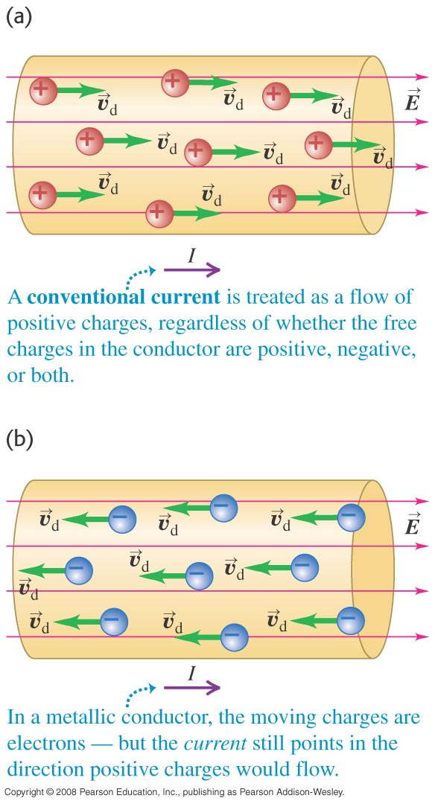
Direction of current flow
A current can be produced by positive or negative charge flow.
Conventional current is treated as a flow of positive charges.
The moving charges in metals are electrons (see figure below).

Slide 6
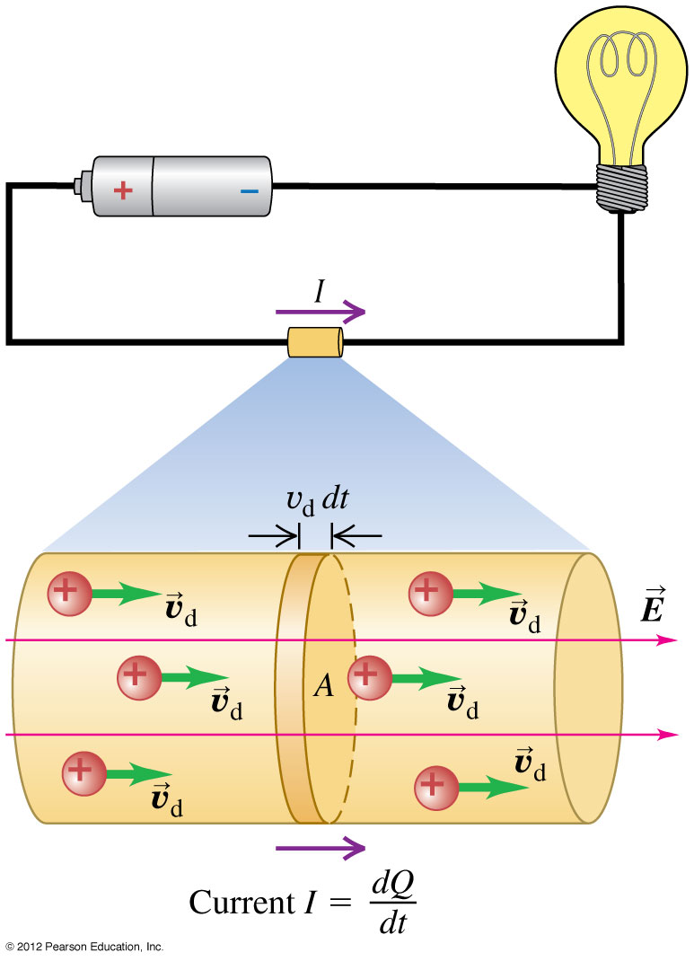
Current, drift velocity, and current density
$$I=\frac{dQ}{dt}=n|q|v_{d}A$$
Current Density
$$J=\frac{I}{A}=n|q|v_{d}$$

Slide 7
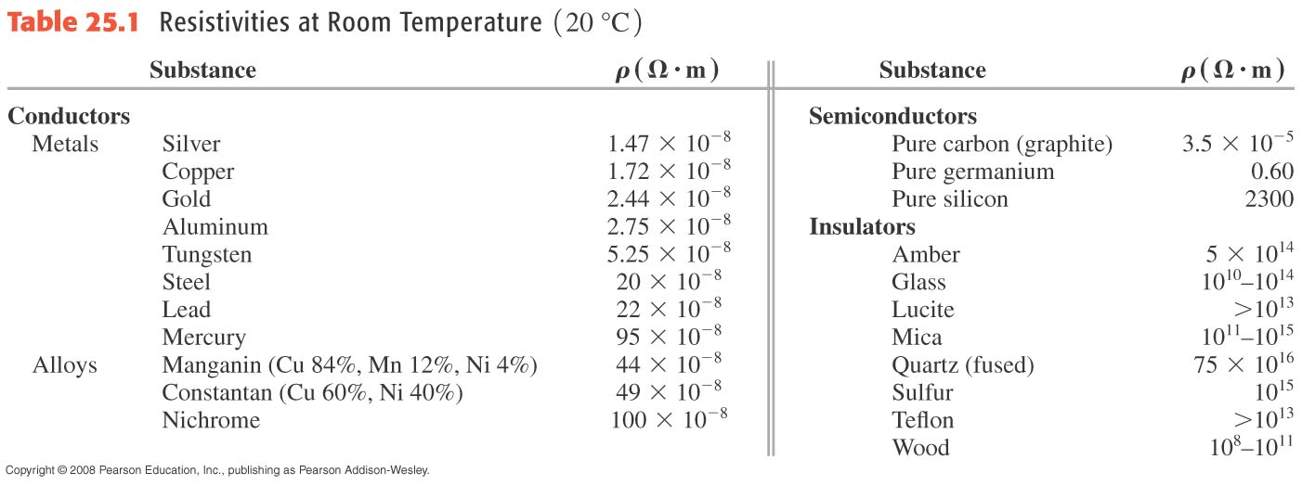
Resistivity
The resistivity of a material is the ratio of the electric field in the material to the current density it causes: ρ = E/J.
The conductivity is the reciprocal of the resistivity.
Table 25.1 shows the resistivity of various types of materials.

Slide 8
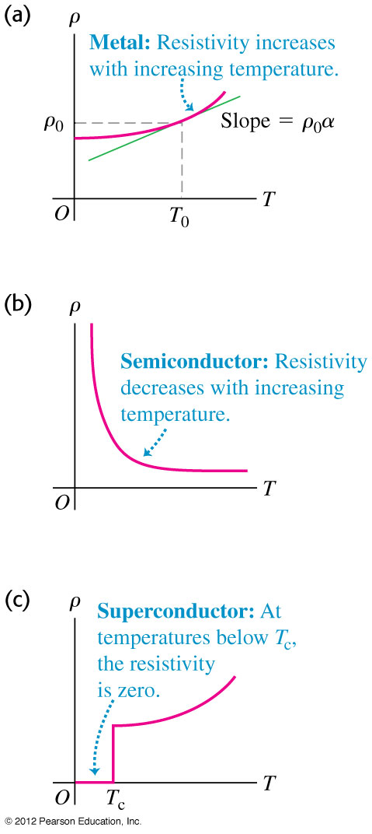
Resistivity and temperature
Resistivity depends on temperature. See Figure 25.6 at the left.
$$ρ(T)=ρ_{0}\left[1+α\left(T−T_{0}\right)\right]$$
$α$: Temperature Coefficients of Resistivity

Slide 9
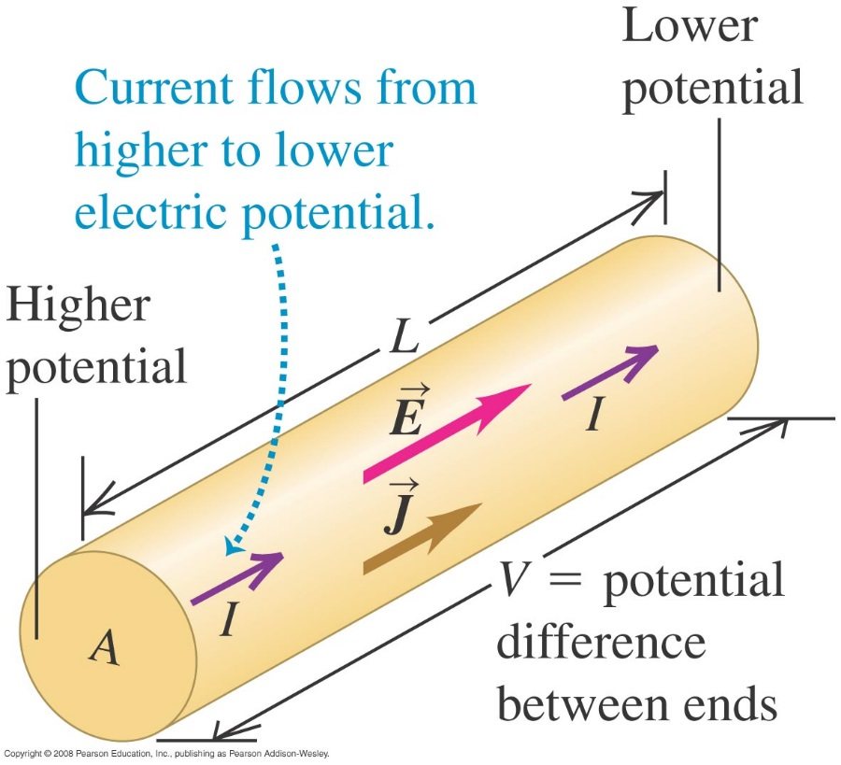
Resistance
The resistance of a conductor is R = ρL/A .
The potential across a conductor is V = IR.
If V is directly proportional to I (that is, if R is constant), the equation V = IR is called Ohm’s law.

Slide 10
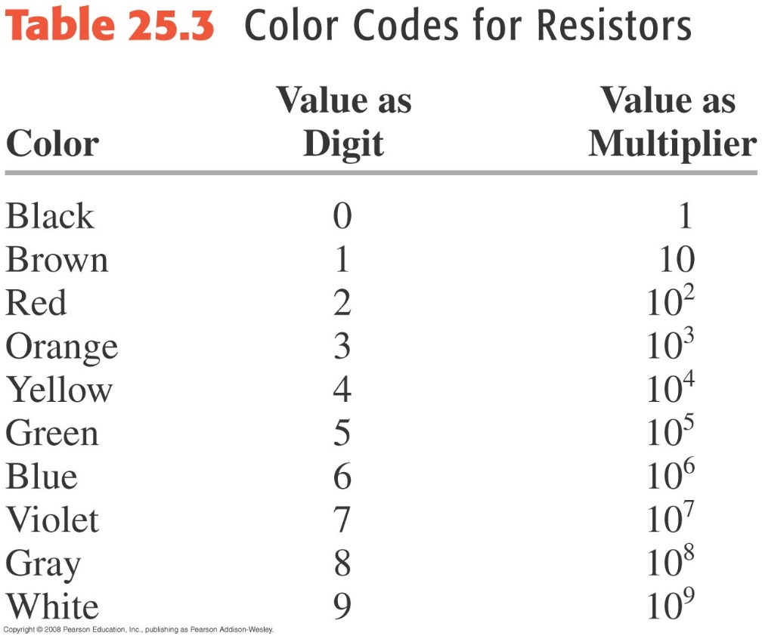
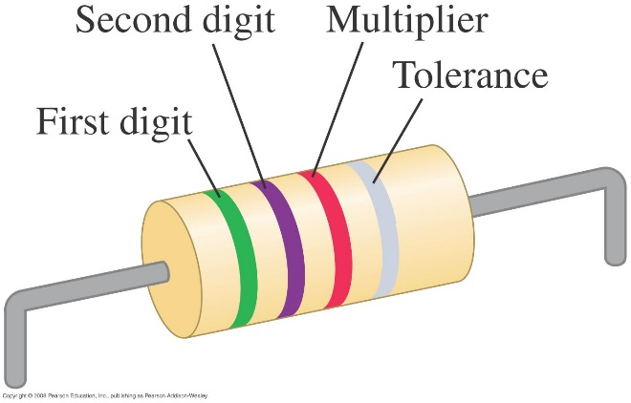
Resistors are color-coded for easy identification
This resistor has a resistance of 5.7 kΩ with a tolerance of ±10%.

Slide 11
Ohmic and nonohmic resistors
Only the resistor in Figure 25.10(a) below obeys Ohm’s law.
Follow Example 25.2.
Follow Example 25.3.

Slide 12
Ohmic and nonohmic resistors
Example 25.2 and 25.3.
18-gauge copper wire has a cross-sectional area of 8.2x10⁻⁷ m². It carries a current of 1.67 A. Find (a) the electric-field magnitude in the wire; (b) the potential difference between two points in the wire 50 m apart; (c) the resistance of a 50 m length of this wire.
Suppose the resistance of a copper wire is 1.05 Ω at 20º C. Find the resistance at 0ºC and 100ºC.

Slide 13
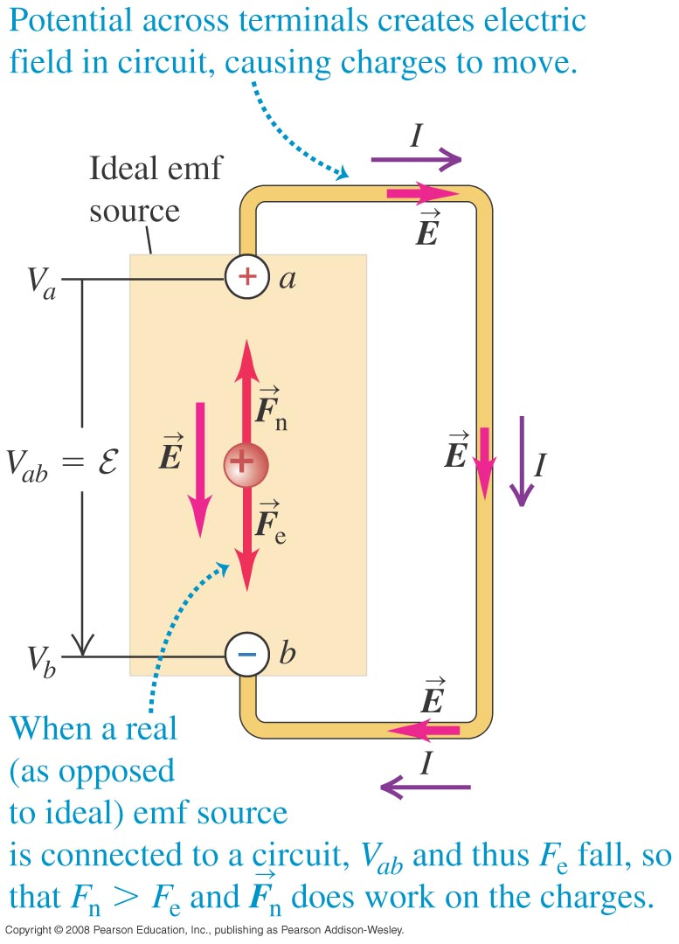
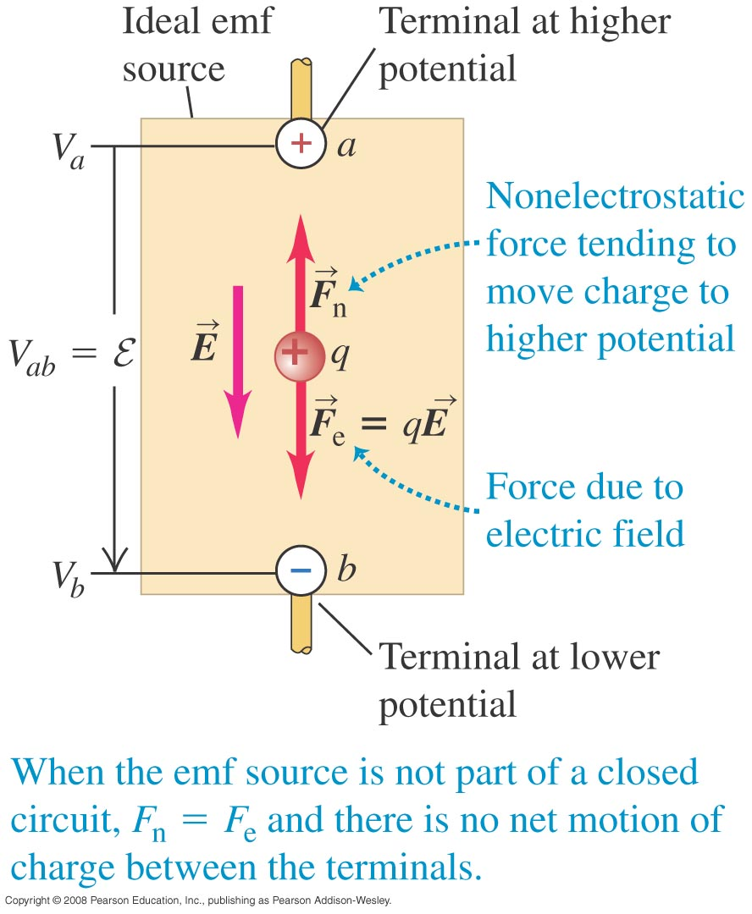
Electromotive force and circuits
An electromotive force (emf) makes current flow. In spite of the name, an emf is not a force.
The figures below show a source of emf in an open circuit (left) and in a complete circuit (right).

Slide 14
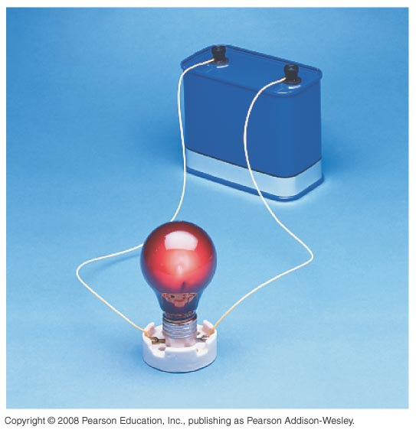
Internal resistance
Real sources of emf actually contain some internal resistance r.
The terminal voltage of an emf source is V_{ab} = ε – Ir.
The terminal voltage of the 12-V battery shown at the right is less than 12 V when it is connected to the light bulb.

Slide 15
Symbols for circuit diagrams
Table 25.4 shows the usual symbols used in circuit diagrams.

Slide 16
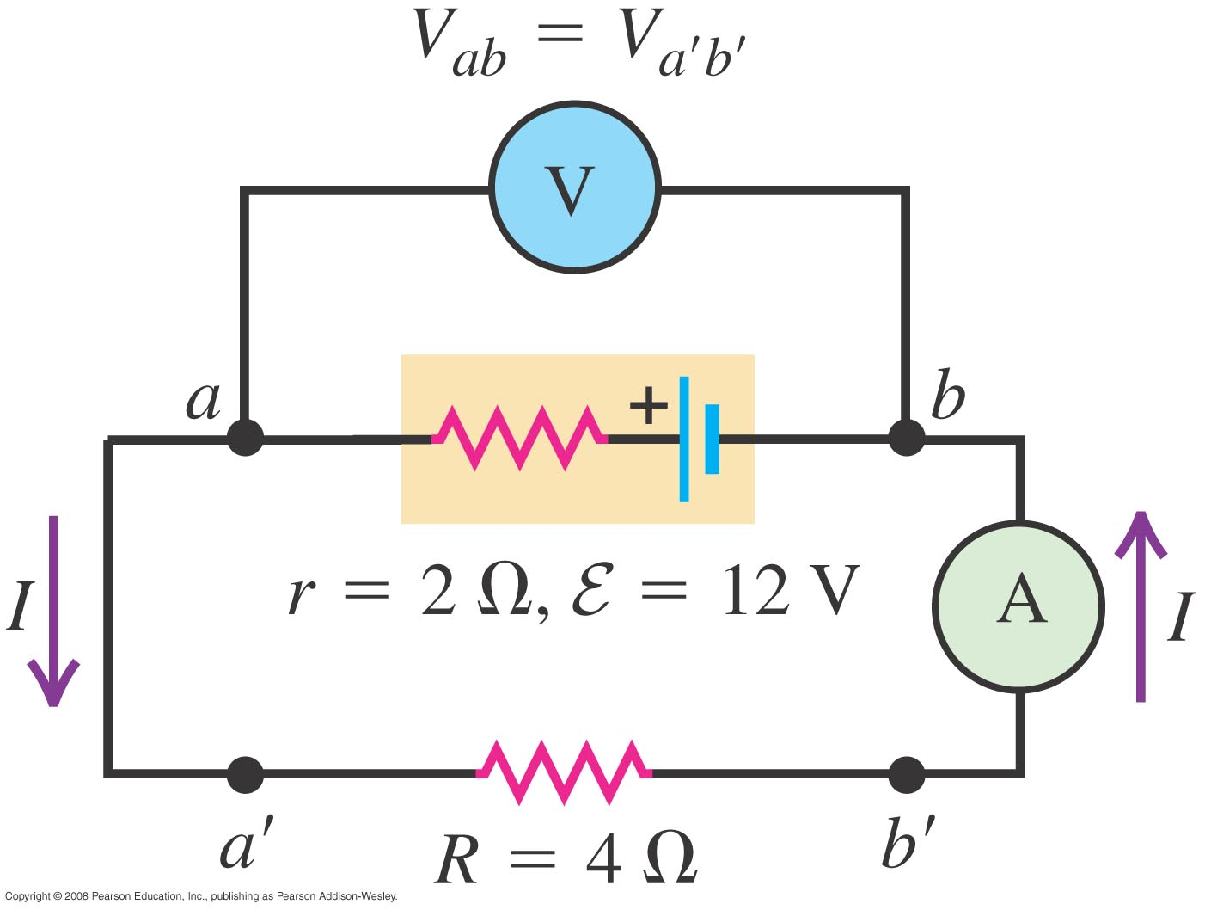
Source in a complete circuit
What are the voltmeter and ammeter readings V_{ab} and I?

Slide 17
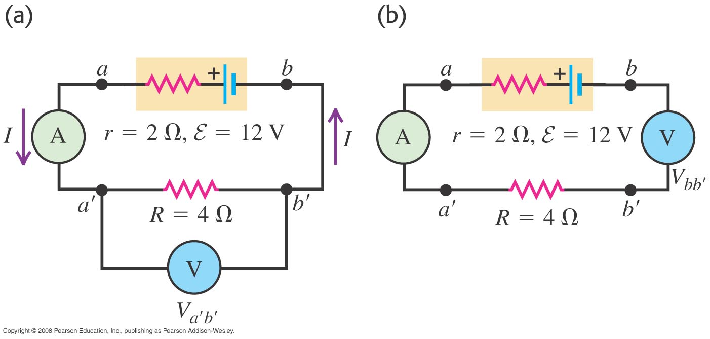
Using voltmeters and ammeters
What are the voltmeter and ammeter readings in circuits a and b?

Slide 18
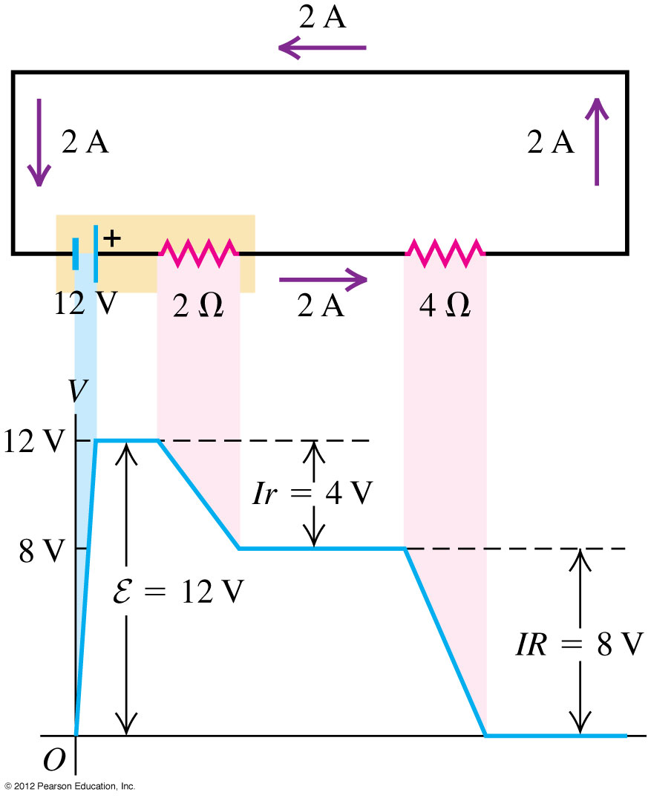
Potential changes around a circuit
The net change in potential must be zero for a round trip in a circuit.
Follow Figure 25.20 at the right.

Slide 19
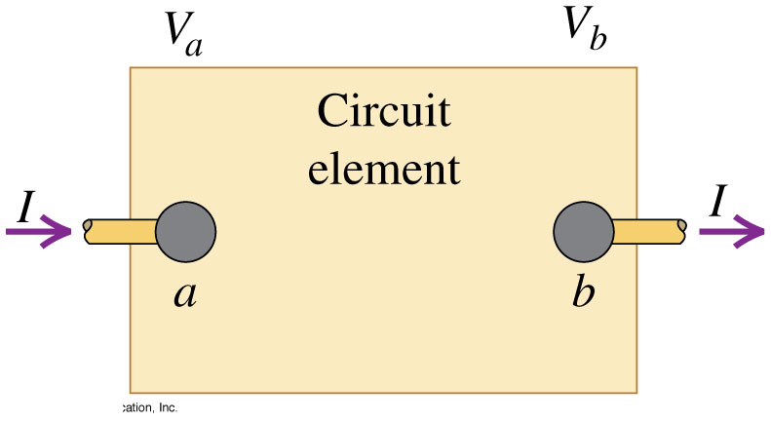
Energy and power in electric circuits
If V_{ab} > 0 then the circuit is gaining potential energy qV_{ab}.
If V_{ab} < 0 then the circuit is losing potential energy qV_{ab} (source).

Slide 20
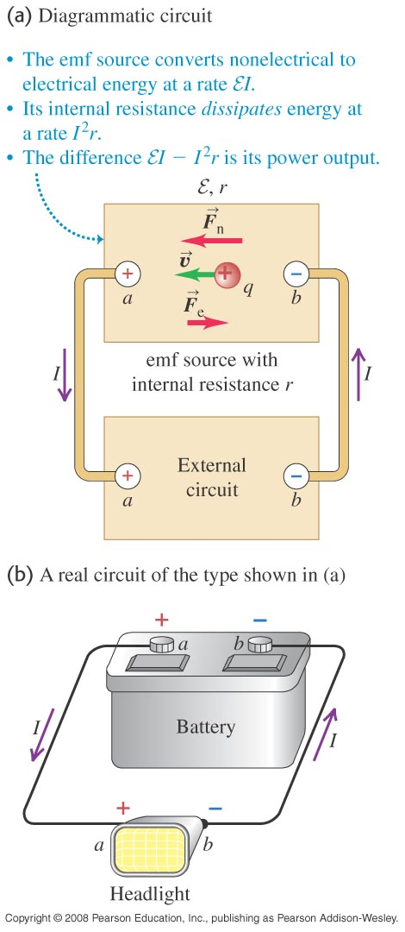
Energy and power in electric circuits
The rate at which energy is delivered to (or extracted from) a circuit element is P = V_{ab}I.
Unit of power: 1 Joule /second = 1 Watt
The power delivered to a pure resistor is P = I²R = V_{ab}²/R.

Slide 21
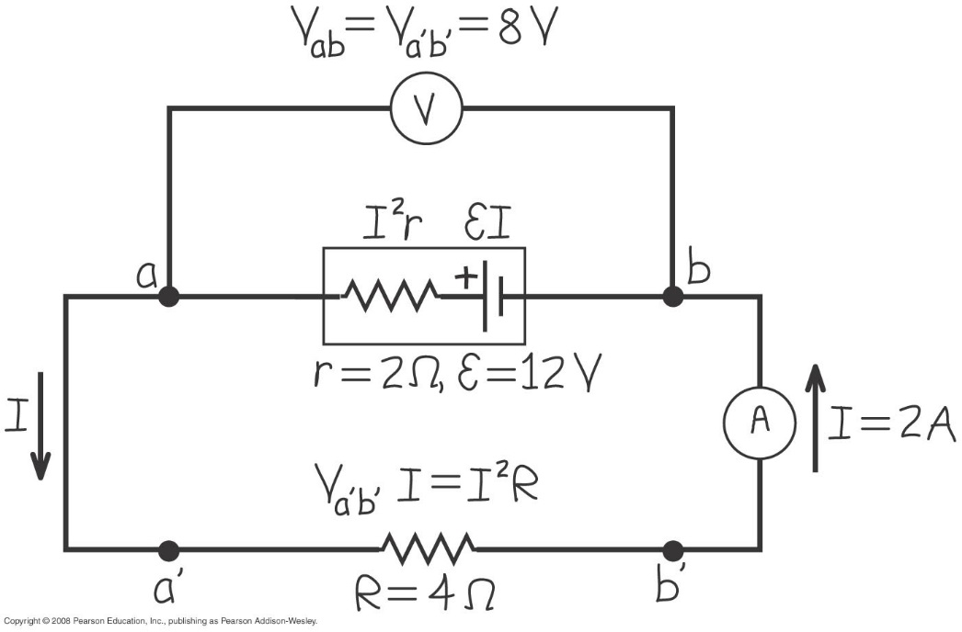
Power input and output
Find the rates of energy conversion (chemical to electric) and energy dissipation in the battery, the rate of energy dissipation in the 4-Ω resistor, and the battery’s net power output.
Repeat the above if the resistor value change to 8 Ω .

Slide 22
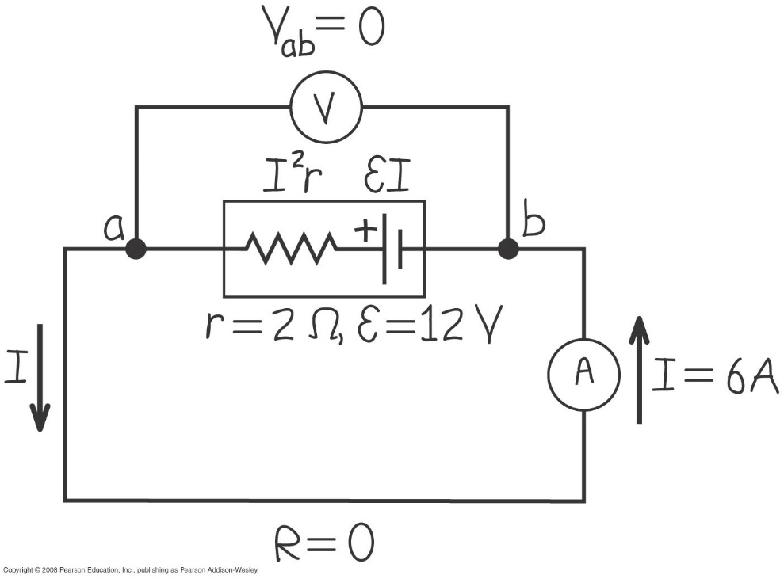
Power in a short circuit
Follow Example 25.10, using Figure 25.25 below.

Slide 23
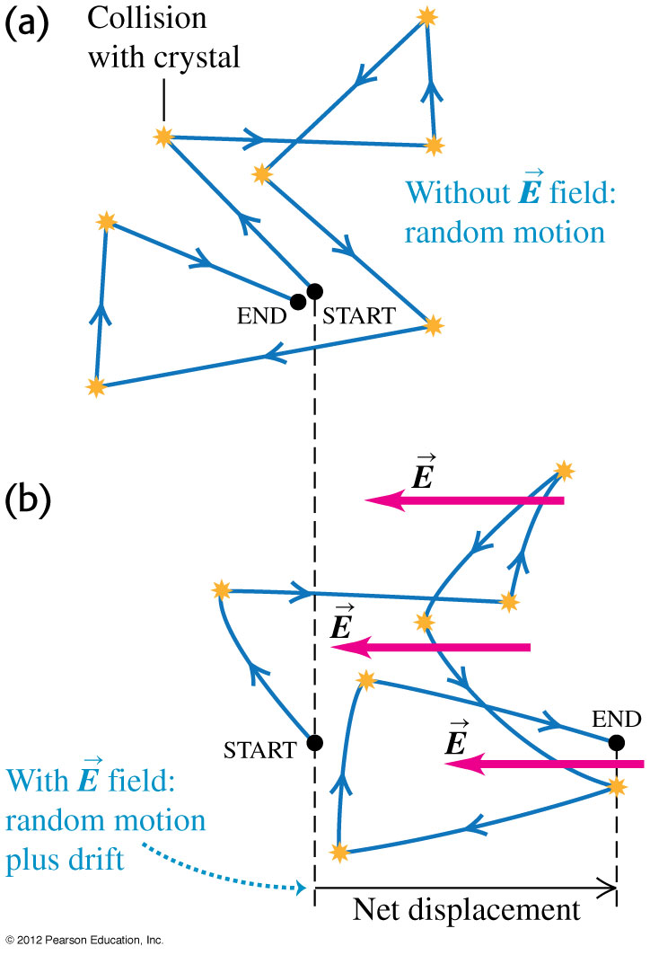
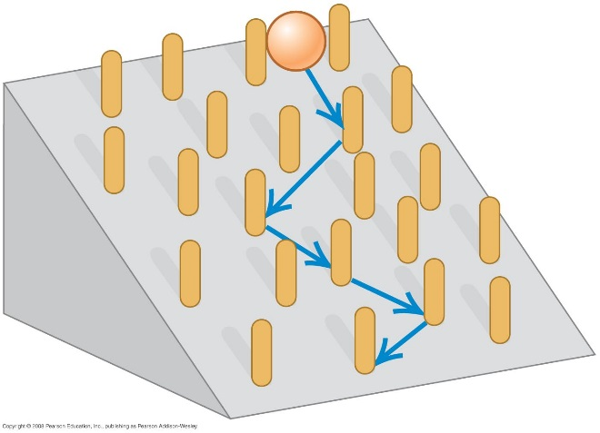
Theory of metallic conduction
Follow the discussion in the text using Figures 25.26 (right) and 25.27 (below). Both illustrate the random motion of electrons in a conductor.
Follow Example 25.11.

Slide 24
Nerve cells transmit electric signals through their long tubular axons. These signals propagate due to a sudden rush of Na⁺ ions, each with charge +e, into the axon. Measurements have revealed that typically about 5.6x10¹¹ Na⁺ ions enter each meter of the axon during a time of 10 ms. What is the current during this inflow of charge in a meter of axon?

Slide 25
A typical cost for electric power is $0.12 per kilowatt-hour. (a) some people leave their porch light on all the time. What is the yearly cost to keep a 75-W bulb burning day and night?

Slide 26
Problem 25.68
What is the potential difference V_{ad} in the circuit?
What is the terminal voltage of the 4 V battery?
A battery with emf 10.3 V and internal resistance 0.5 Ω is inserted in the circuit at d, with its negative terminal connected to the negative terminal of the 8 V battery. What is the difference of potential V_{bc} between the terminals of the 4 V battery now?

