Slide 1
Chapter 26
Direct-Current Circuits

Slide 2
Goals for Chapter 26
To analyze circuits having resistors in series and parallel
To apply Kirchhoff’s rules to multiloop circuits
To learn how to use various types of meters in a circuit
To analyze circuits containing capacitors and resistors
To study power distribution in the home

Slide 3
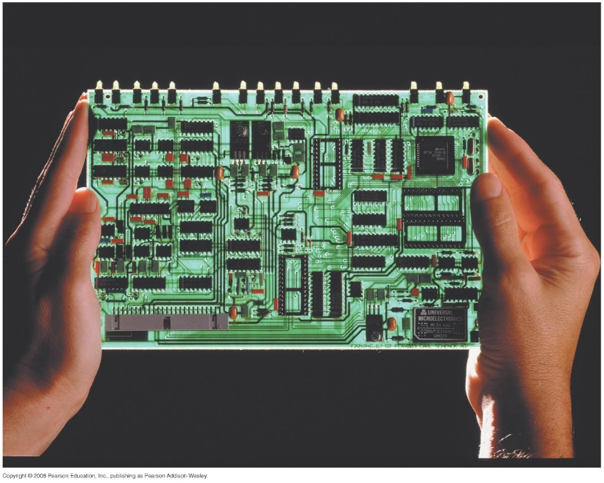
Introduction
How can we apply series/parallel combinations of resistors to a complex circuit board?
In this chapter, we will learn general methods for analyzing more complex networks.
We shall look at various instruments for measuring electrical quantities in circuits.

Slide 4
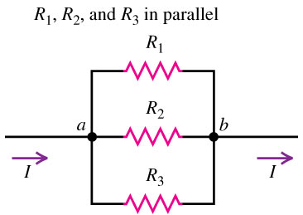
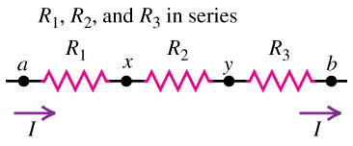
Resistors in series and parallel
Resistors are in series if they are connected one after the other so the current is the same in all of them (see left figure below).
The equivalent resistance of a series combination is the sum of the individual resistances: R_{eq} = R₁ + R₂ + R₃ + …
Resistors are in parallel if they are connected so that the potential difference must be the same across all of them (see right figure below).
The equivalent resistance of a parallel combinaton is given by 1/R_{eq} = 1/R₁ + 1/R₂ + 1/R₃ + …

Slide 5
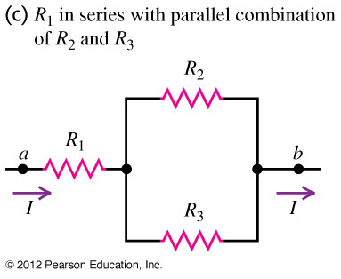
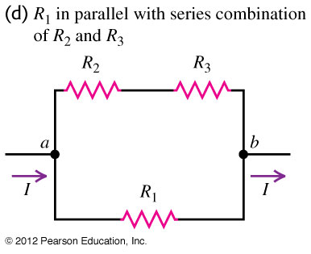
Series and parallel combinations
Resistors can also be connected in combinations of series and parallel, as shown in Figure 26.1(c) and (d) at the right.

Slide 6
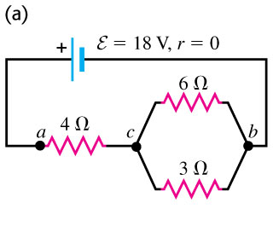
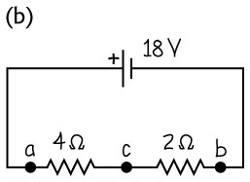
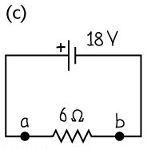
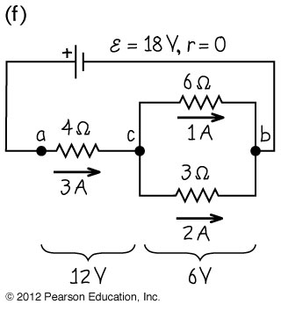
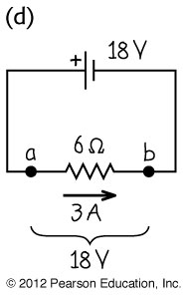
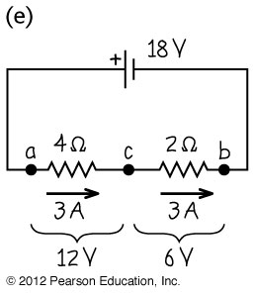
Equivalent resistance
Find the equivalent resistance of the network and the current in each resistor.

Slide 7
Series versus parallel combinations
Two identical light bulbs, each with resistance R = 2Ω, are connected to a source with ε = 8 V and negligible internal resistance. Find the current through each bulb, the potential difference across each bulb, and the power delivered to each bulb and to the entire network if the bulbs are connected (a) in series and (b) in parallel. (c) Suppose one of the bulbs burn out; that is, its filament breaks and current can no longer flow through it. What happens to the other bulb in the series case? In the Parallel case?

Slide 8
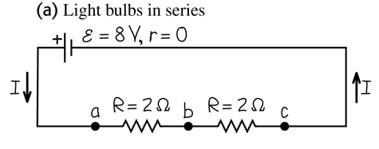
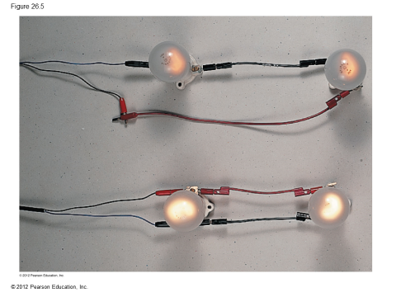
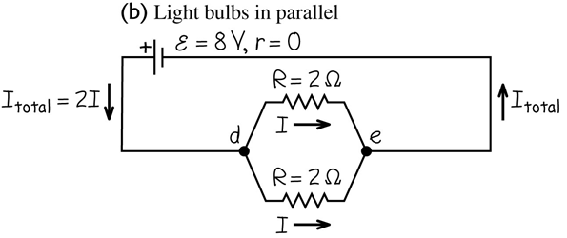
Series versus parallel combinations

Slide 9
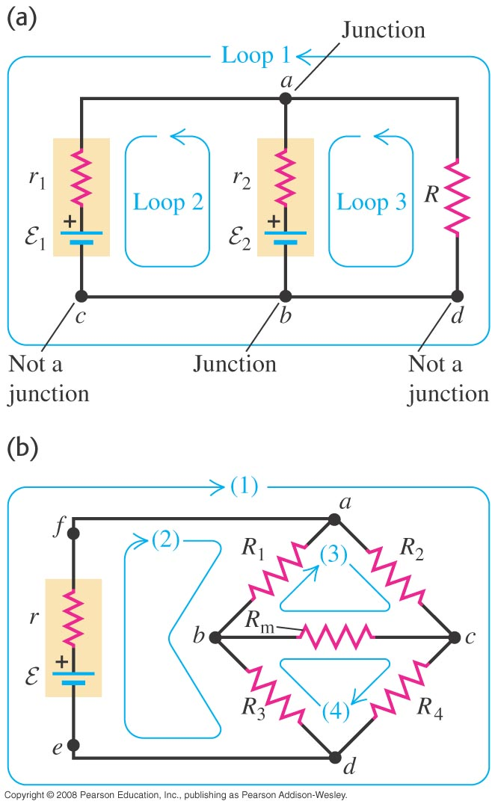
Kirchhoff’s Rules I
A junction is a point where three or more conductors meet.
A loop is any closed conducting path.

Slide 10
Kirchoff’s Rules II
Kirchhoff’s junction rule: The algebraic sum of the currents into any junction is zero: ΣI = 0. (Kirchhoff’s Current Law KCL)
Kirchhoff’s loop rule: The algebraic sum of the potential differences in any loop must equal zero: ΣV = 0. (Kirchhoff’s Voltage Law KVL)

Slide 11
Sign convention for the loop rule
Figure 26.8 below shows the sign convention for emfs and resistors.
Engineering Convention is the opposite. Either method will give you the right answer.

Slide 12
Reducing the number of unknown currents
Write KVL and KCL for the circuit below

Slide 13
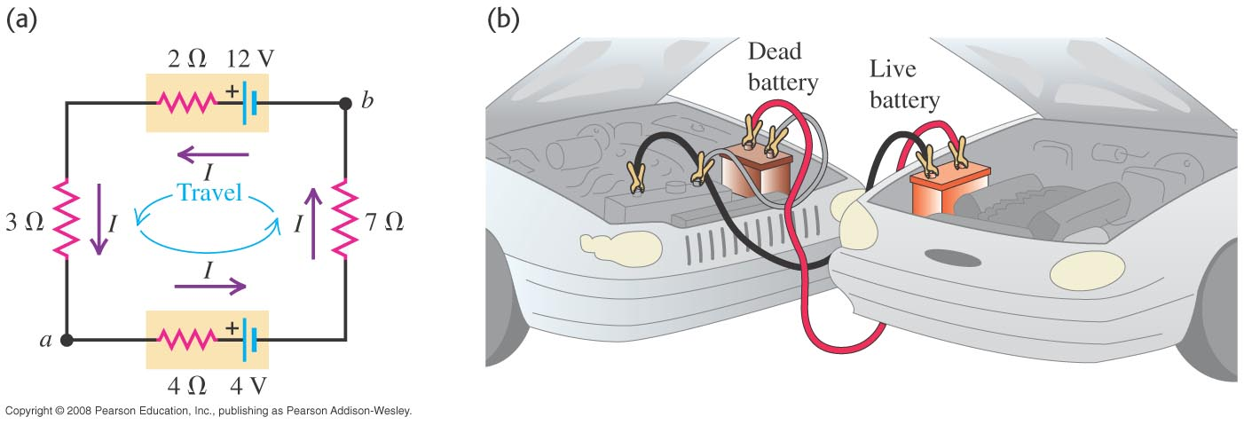
A single-loop circuit
Find (a) the current in the circuit, (b) the potential difference V_{ab}, and (c) the power output of the emf of each battery.

Slide 14
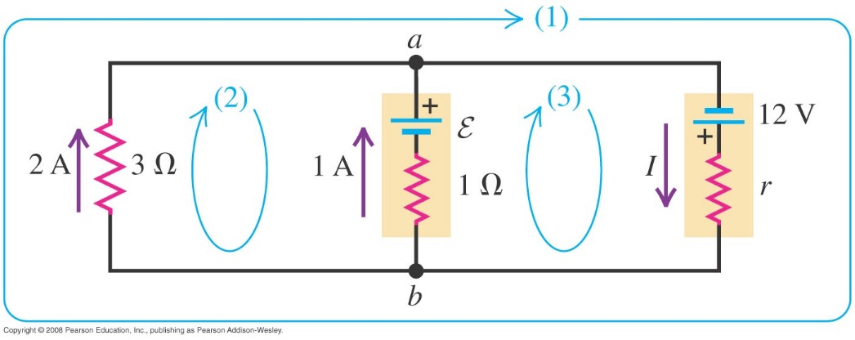
Charging a battery
A 12-V power supply with unknown internal resistance r is connected to a run-down rechargeable battery with unknown emf ε and internal resistance 1 Ω and to an indicator light bulb of resistance 3 Ω carrying a current of 2 A. The current through the run-down battery is 1 A in the direction shown. Find r, ε, and the current I through the power supply.

Slide 15
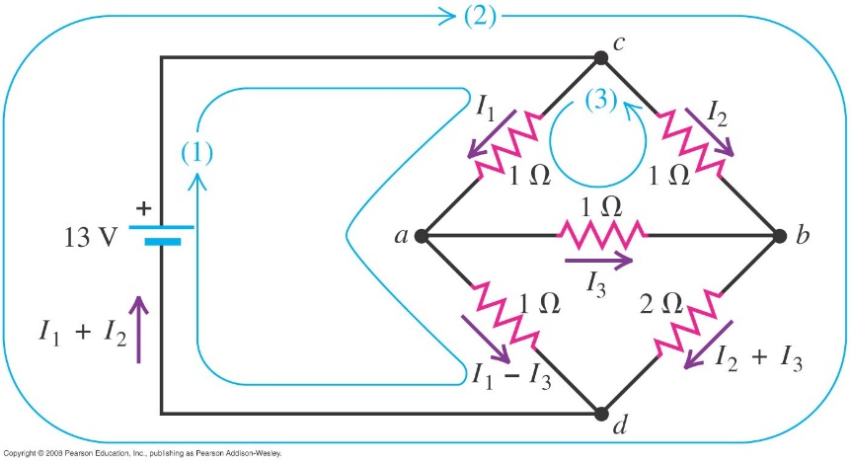
A complex network
For the bridge circuit below find (a) the current in each resistor (b) the equivalent resistance of the network of five resistors (c) the potential difference V_{ab}.

Slide 16
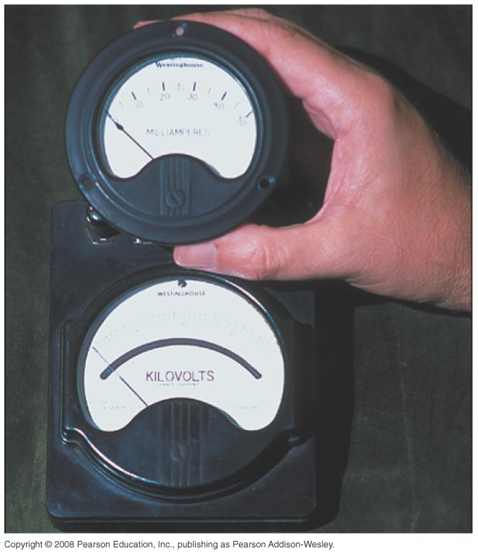
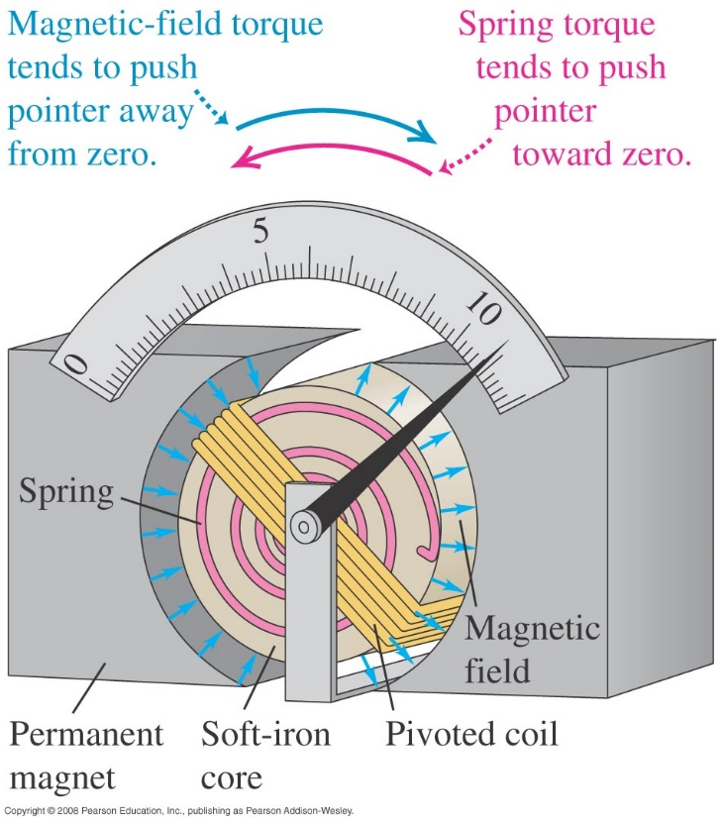
D’Arsonval galvanometer
A d’Arsonval galvanometer measures the current through it (see Figures 26.13 and 26.14 below).
Many electrical instruments, such as ammeters and voltmeters, use a galvanometer in their design.

Slide 17
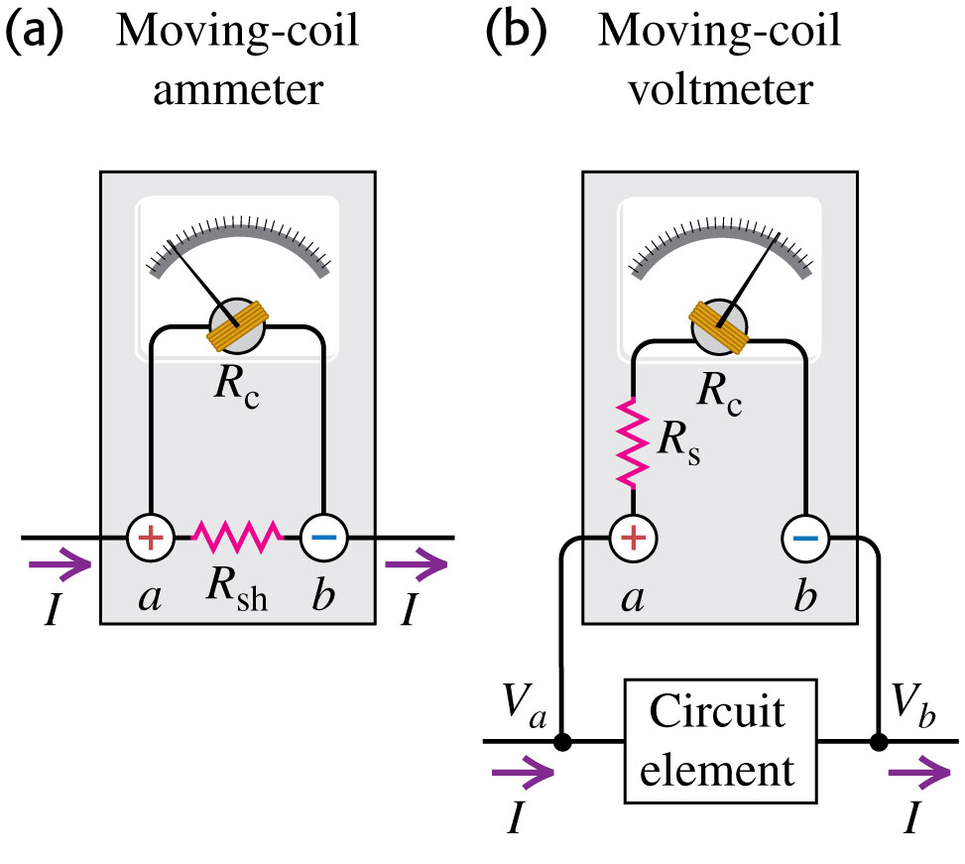
Ammeters and voltmeters
An ammeter measures the current passing through it.
A voltmeter measures the potential difference between two points.
Figure 26.15 at the right shows how to use a galvanometer to make an ammeter and a voltmeter.
Follow Examples 26.8 (ammeter) and 26.9 (ammeter).

Slide 18
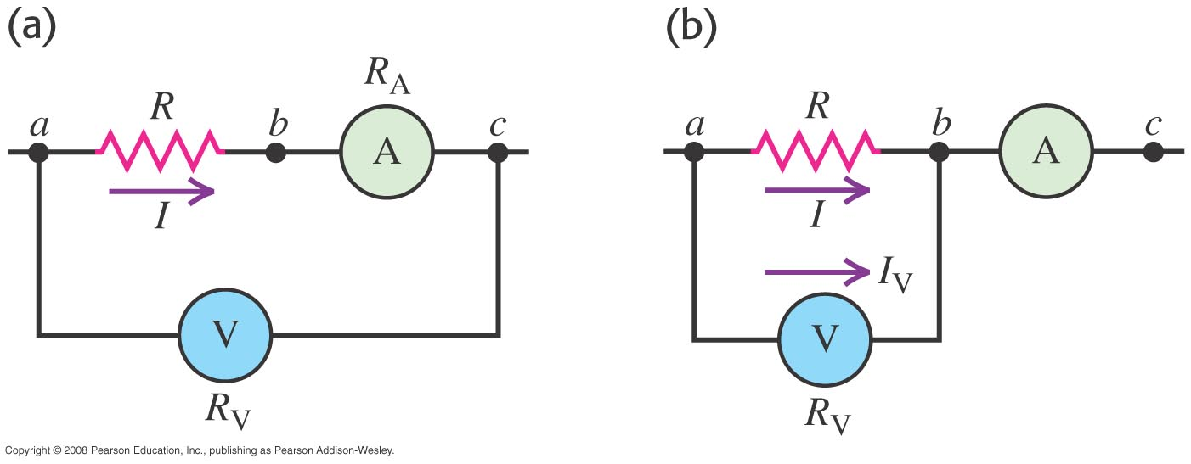
Ammeters and voltmeters in combination
An ammeter and a voltmeter may be used together to measure resistance and power. Figure 26.16 below illustrates how this can be done.
Follow Example 26.10 using Figure 26.16(a).
Follow Example 26.11 using Figure 26.16(b).

Slide 19
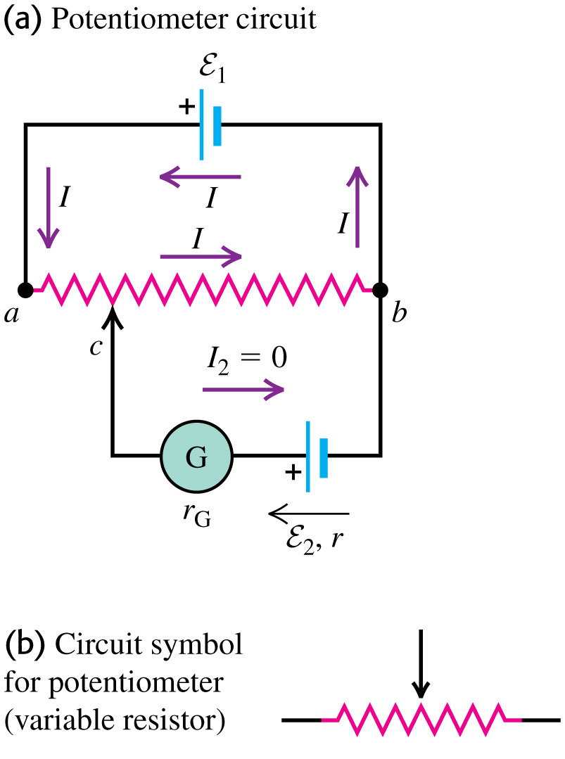
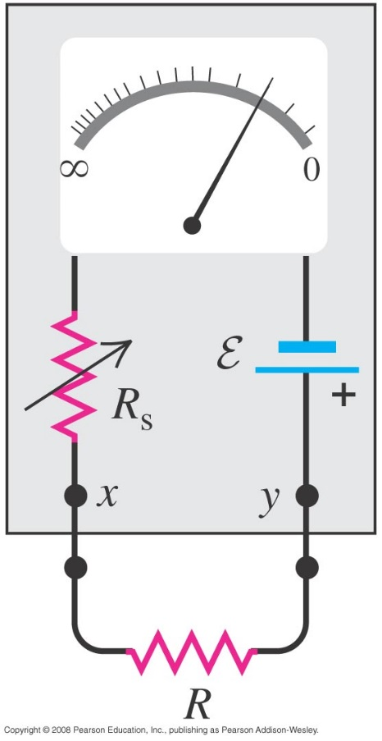
Ohmmeters and potentiometers
An ohmmeter is designed to measure resistance. (See Figure 26.17 below left.)
A potentiometer measures the emf of a source without drawing any current from the source. (See Figure 26.19 below right.)

Slide 20
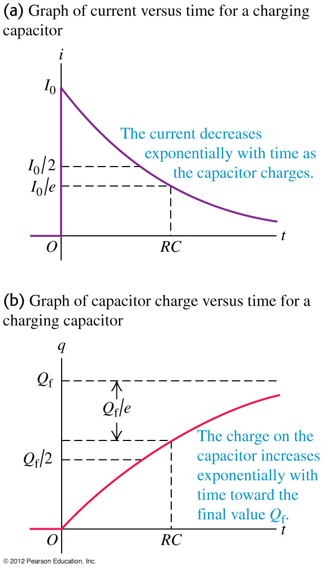
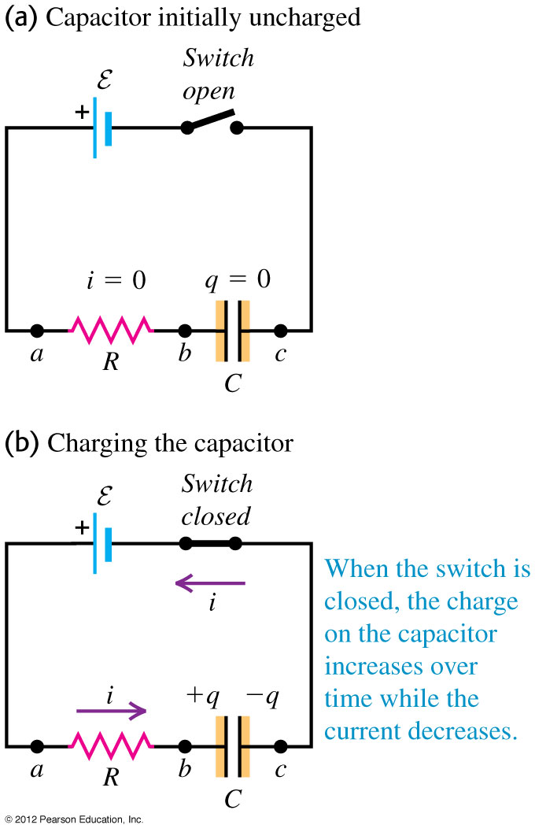
Charging a capacitor
The time constant is τ = RC. It is the time it takes to charge the capacitor to 63% of its maximum value. It is also the time it takes the capacitor to discharge 63% of its value.
$$q=Cε\left(1−e^{−t/RC}\right)$$
$$V_{c}=q/C=ε\left(1−e^{−t/RC}\right)$$
$$I=\frac{dq}{dt}=\frac{ε}{R}e^{−t/RC}$$

Slide 21
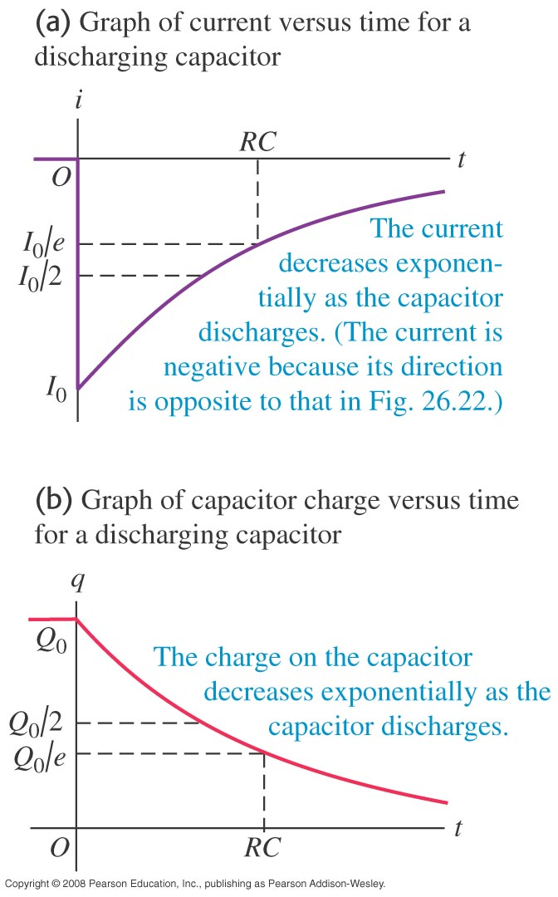
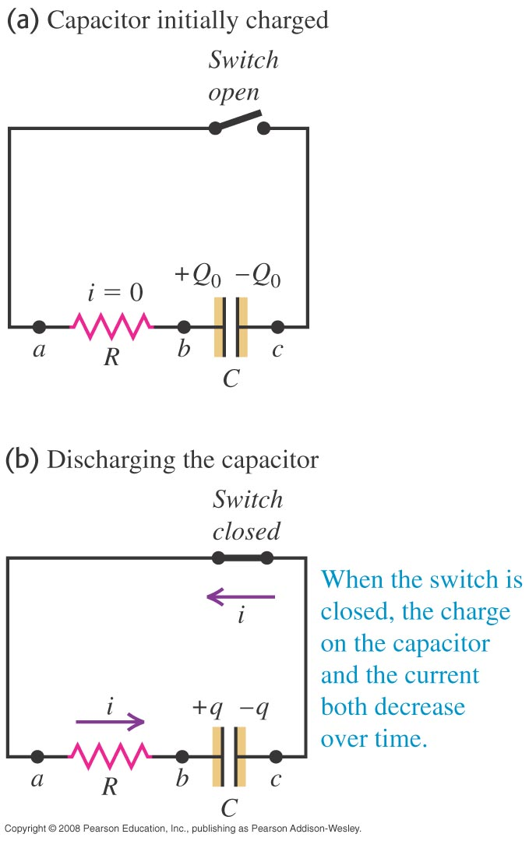
Discharging a capacitor
The capacitor has initial charge Q₀ before closing the switch. What is the voltage, current, and charge across the capacitor after closing the switch?
$$q=Q_{0}e^{−t/RC}$$
$$I=\frac{dq}{dt}=I_{0}e^{−t/RC}$$
$$V_{c}=\frac{q}{C}=\frac{Q_{0}}{C}e^{−t/RC}$$
$$V_{c}=V_{0}e^{−t/RC}$$

Slide 22
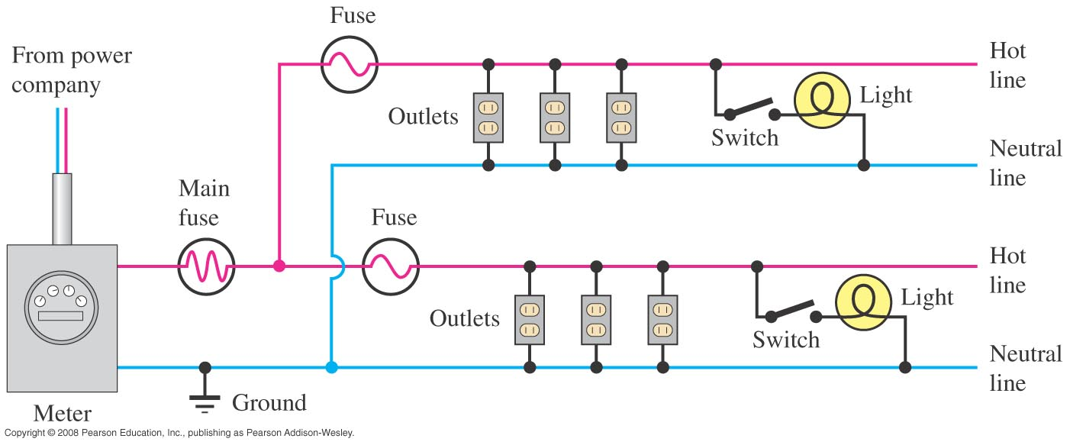
Power distribution systems
Follow the text discussion using Figure 26.24 below.

Slide 23
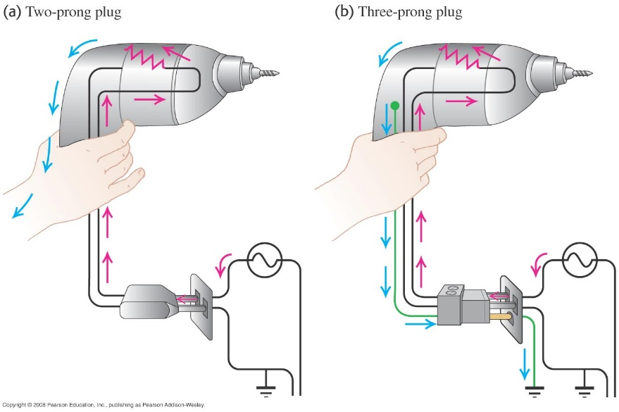
Household wiring
Figure 26.26 at the right shows why it is safer to use a three-prong plug for electrical appliances.
Follow Example 26.14.

