Slide 1
Chapter 27
Magnetic Field and Magnetic Forces

Slide 2
Goals for Chapter 27
To study magnets and the forces they exert on each other
To calculate the force that a magnetic field exerts on a moving charge
To contrast magnetic field lines with electric field lines
To analyze the motion of a charged particle in a magnetic field
To see applications of magnetism in physics and chemistry
To analyze magnetic forces on current-carrying conductors
To study the behavior of current loops in a magnetic field

Slide 3
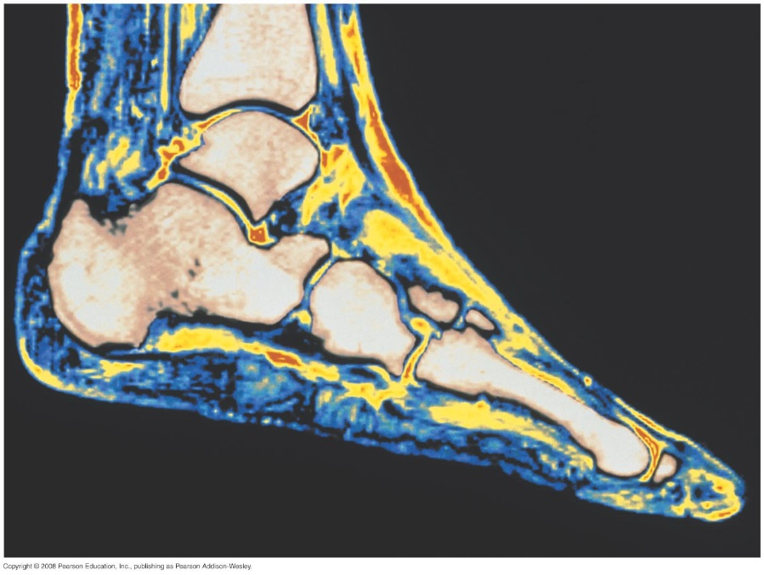
Introduction
How does magnetic resonance imaging (MRI) allow us to see details in soft nonmagnetic tissue?
How can magnetic forces, which act only on moving charges, explain the behavior of a compass needle?
In this chapter, we will look at how magnetic fields affect charges.

Slide 4
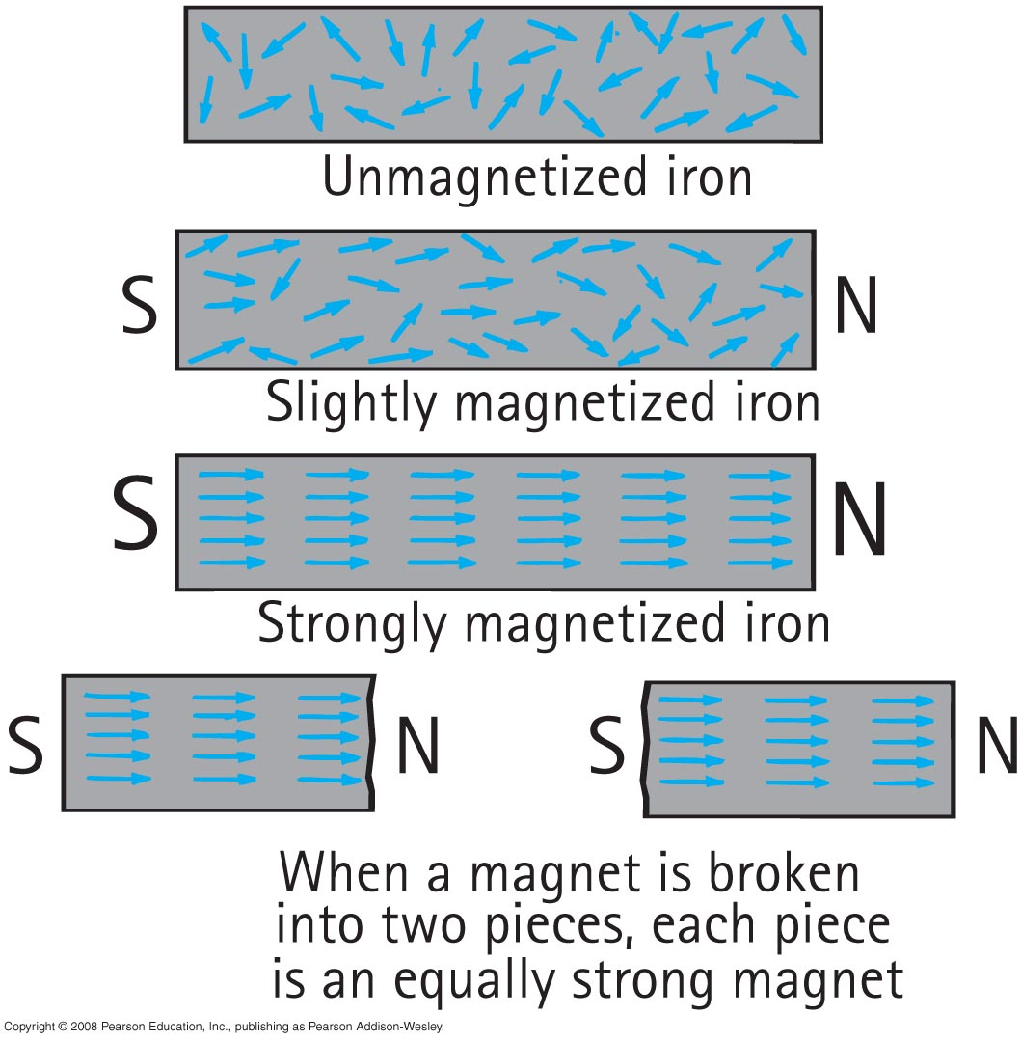
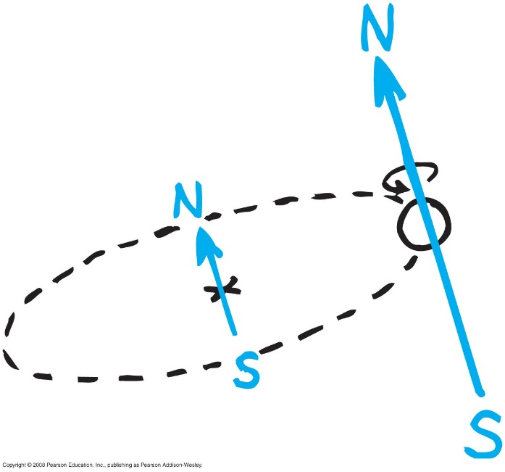
Magnetization
Electron Spin and Rotation

Slide 5
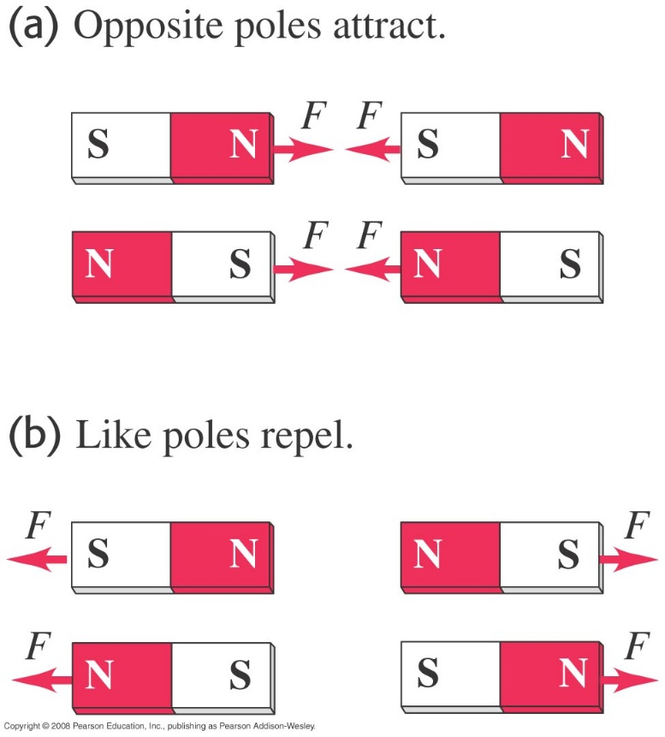
Magnetic poles
Forces between magnetic poles.

Slide 6
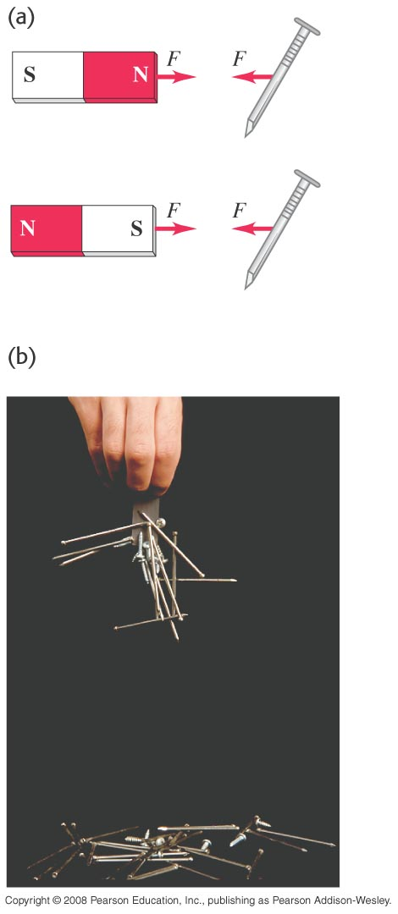
Magnetism and certain metals
Either pole of a permanent magnet will attract a metal like iron.

Slide 7
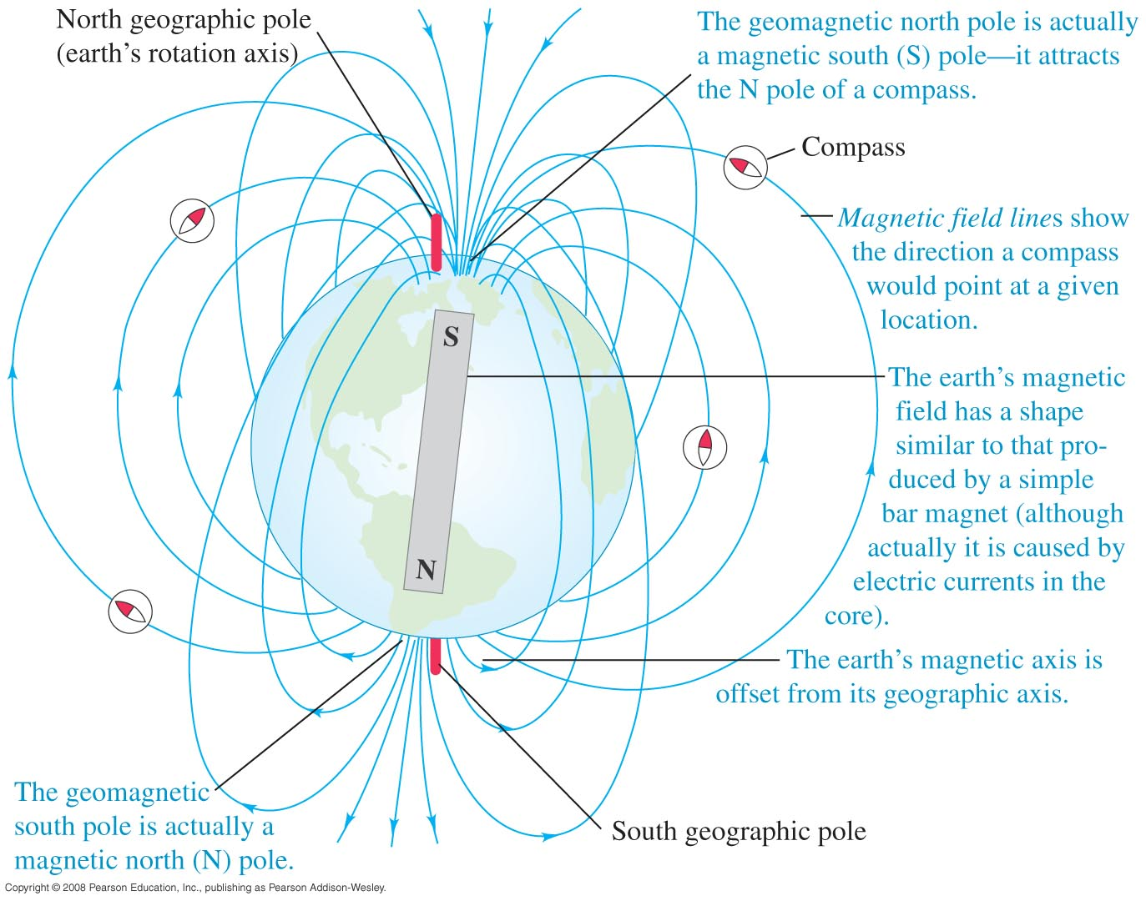
Magnetic field of the earth
The earth itself is a magnet. Figure 27.3 shows its magnetic field.

Slide 8
Magnetic monopoles
Breaking a bar magnet does not separate its poles.
There is no experimental evidence for magnetic monopoles.

Slide 9
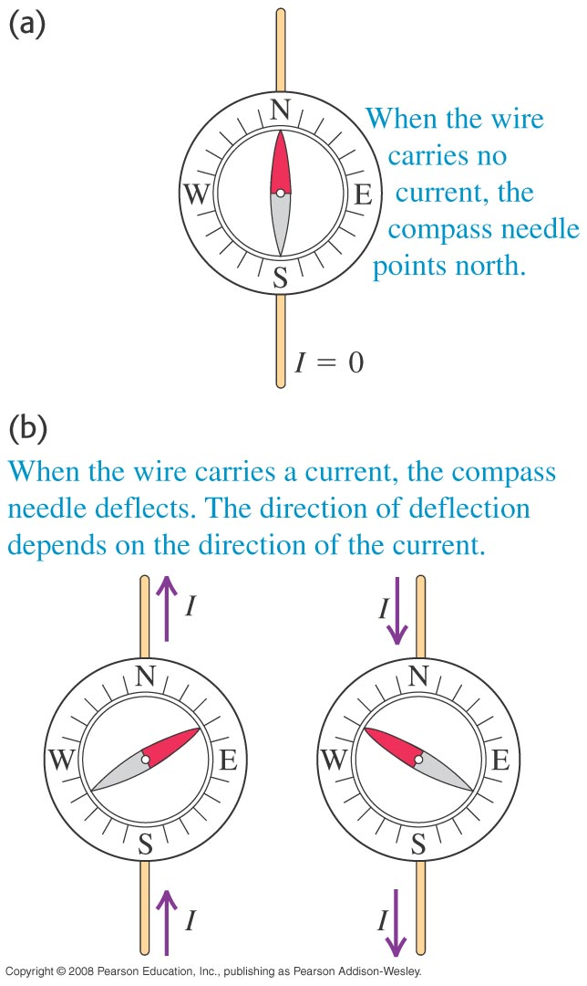
Electric current and magnets
In 1820, Hans Oersted discovered that a current-carrying wire causes a compass to deflect.
This discovery revealed a connection between moving charge and magnetism.

Slide 10
The magnetic field
A moving charge (or current) creates a magnetic field in the surrounding space.
The magnetic field exerts a force on any other moving charge (or current) that is present in the field.

Slide 11
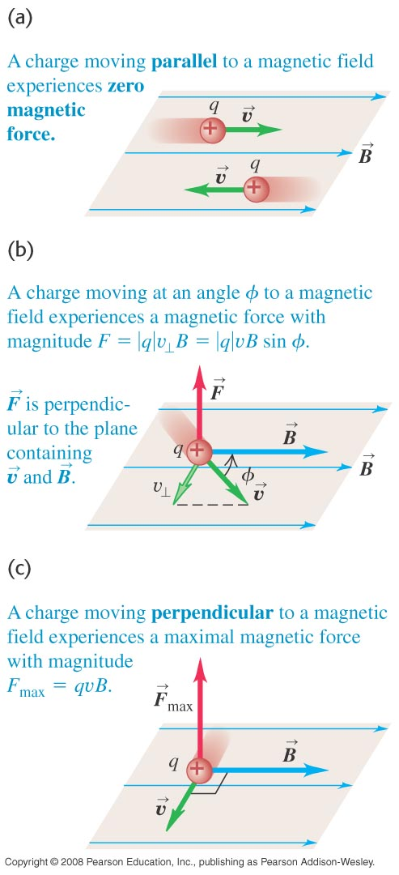
The magnetic force on a moving charge
The magnetic force on q is perpendicular to both the velocity of q and the magnetic field.
The magnitude of the magnetic force is
F = |q|vB sinφ.

Slide 12
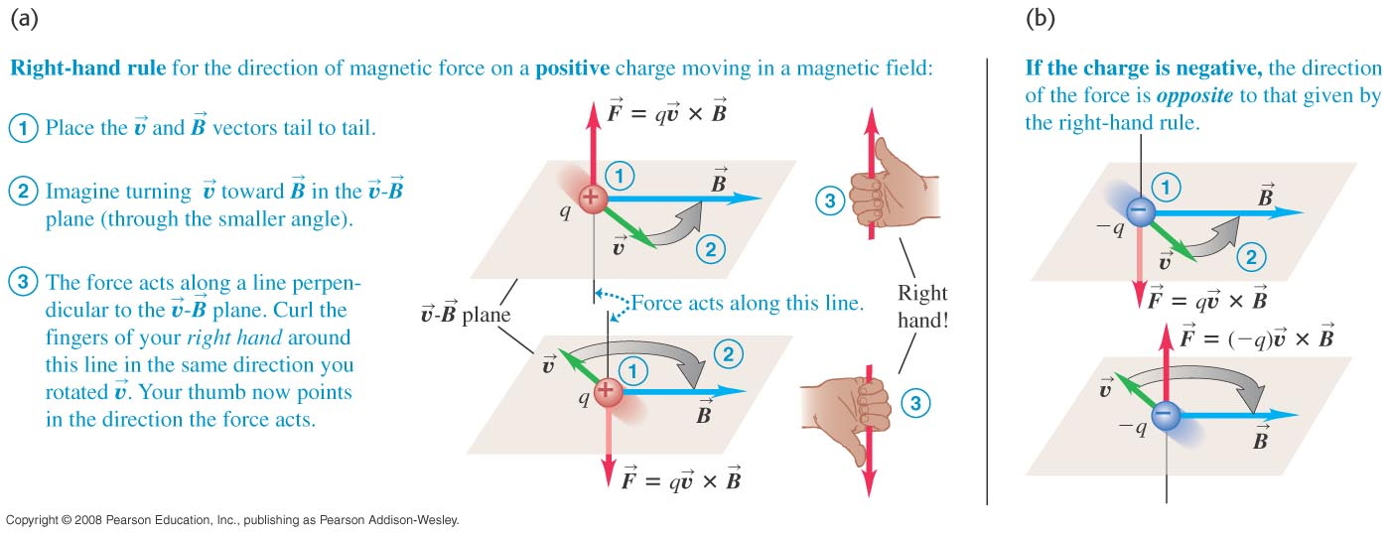
Magnetic force as a vector product
We can write the magnetic force as a vector product.
$\vec{F}=q\vec{v}×\vec{B}$
The right-hand rule gives the direction of the force on a positive charge.

Slide 13
Equal velocities but opposite signs
Two charges of equal magnitude but opposite signs moving in the same direction in the same field will experience magnetic forces in opposite directions.

Slide 14
Determining the direction of a magnetic field
A cathode-ray tube can be used to determine the direction of a magnetic field.

Slide 15
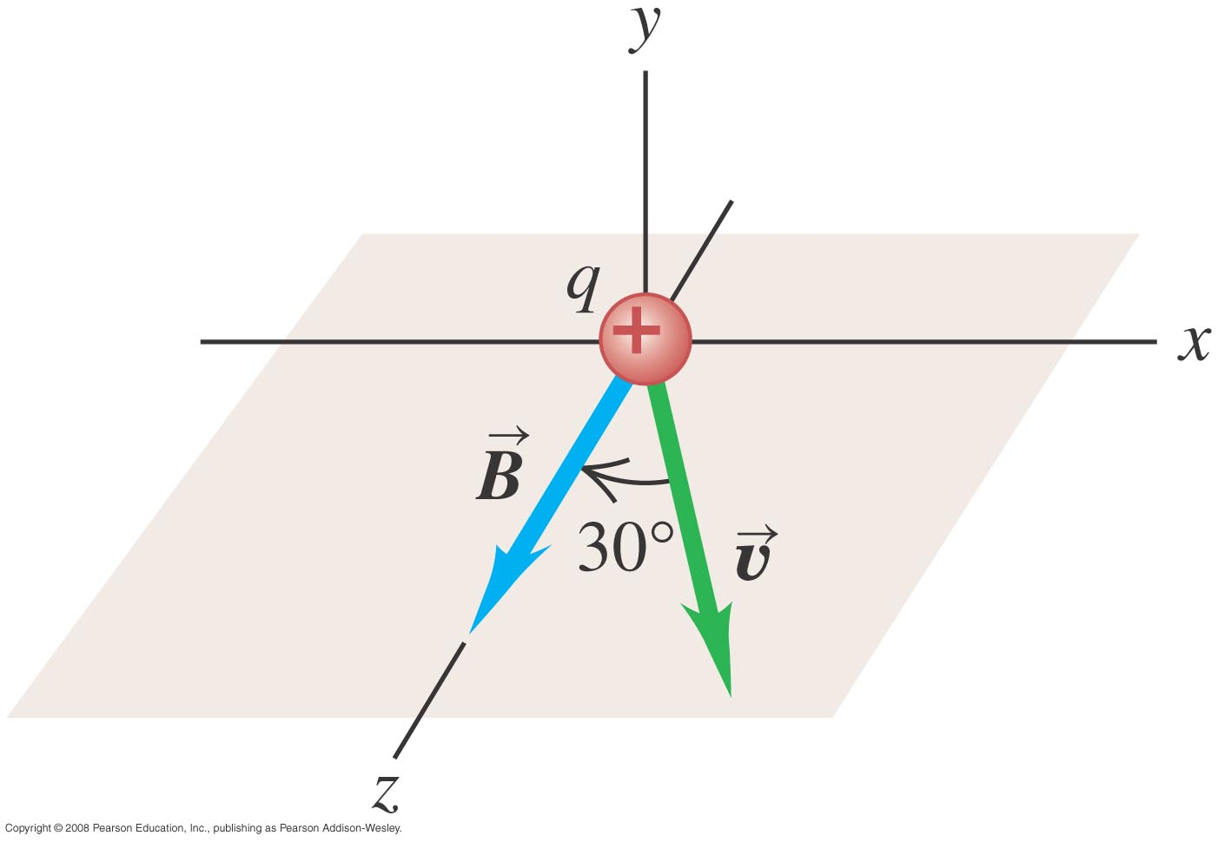
Magnetic force on a proton
A beam of protons moves at 300 km/s through a uniform 2.0-T magnetic field directed along the positive z-axis. The velocity of each proton lies in the xz-plane and is directed at 30o to the +z-axis. Find the force on a proton.

Slide 16
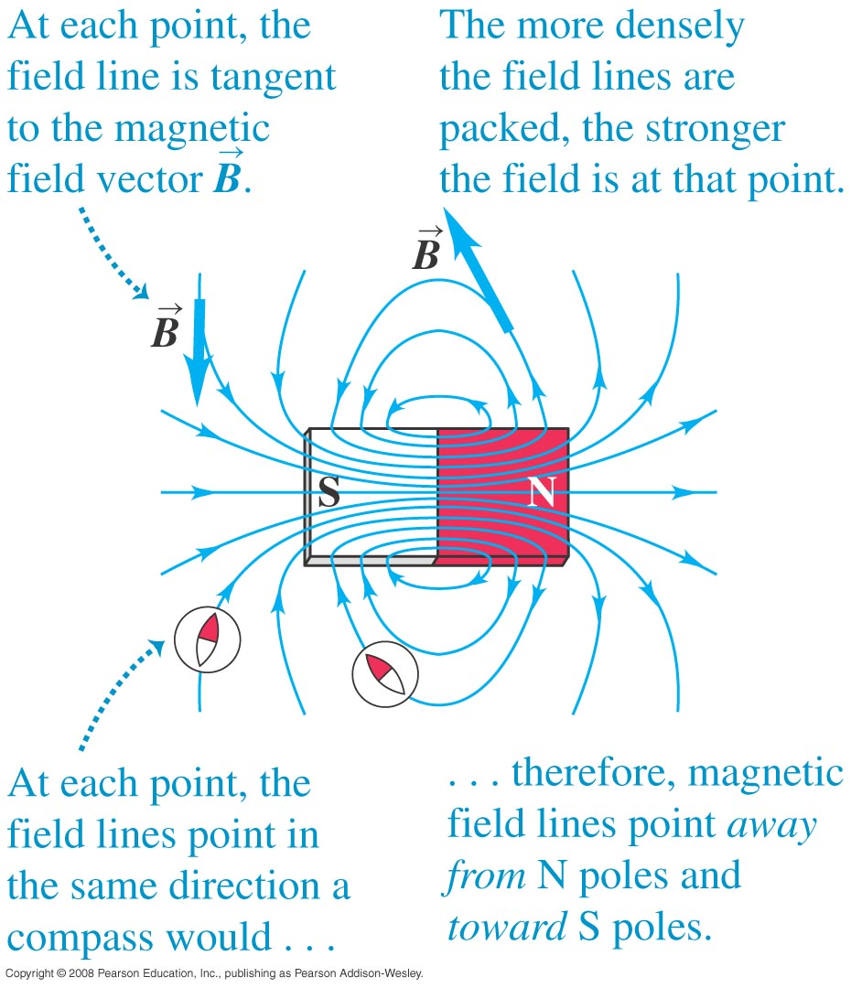
Magnetic field lines
Figure 27.11 below shows the magnetic field lines of a permanent magnet.

Slide 17
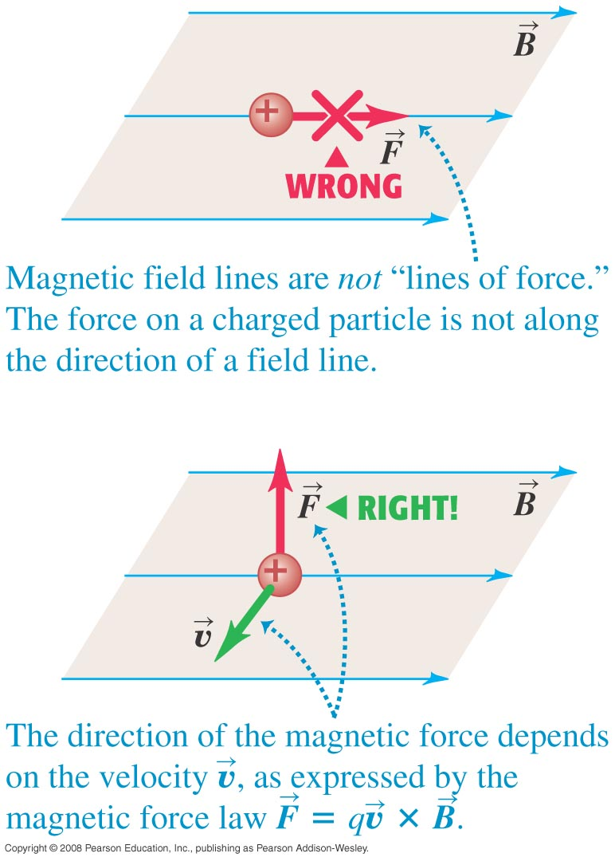
Magnetic field lines are not lines of force
It is important to remember that magnetic field lines are not lines of magnetic force. (See Figure 27.12 below.)

Slide 18
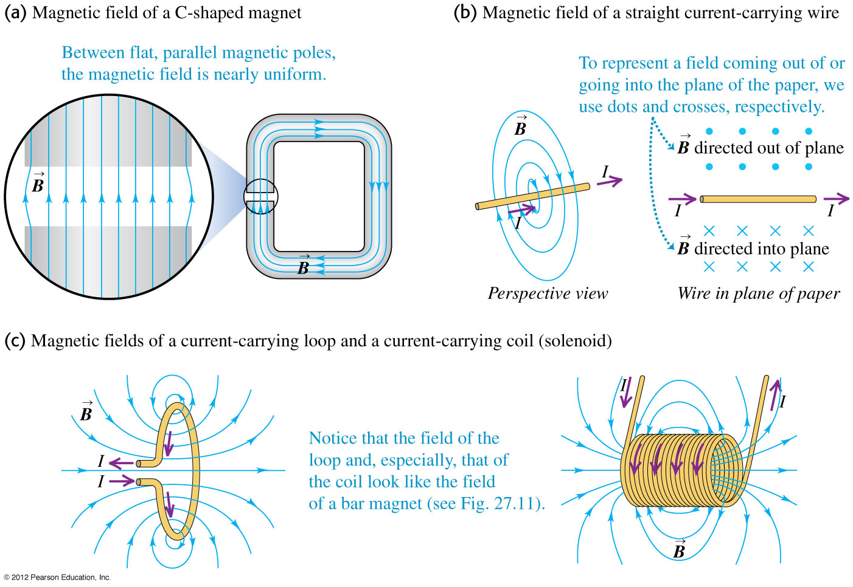

Slide 19
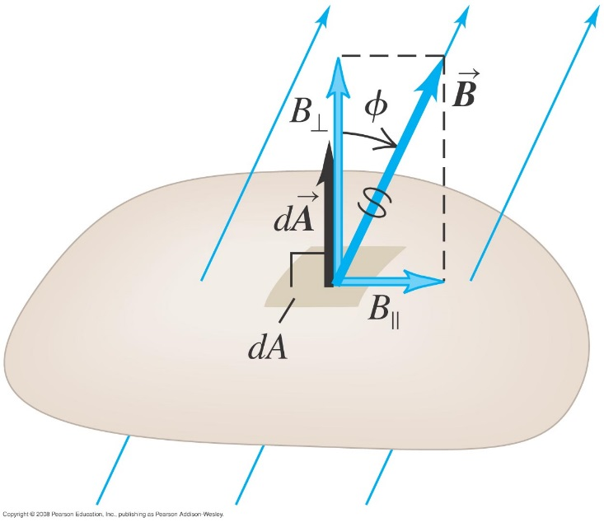
Magnetic flux
We define the magnetic flux through a surface
$$Φ_{B}=\int{B_{⊥}dA=\int{BcosφdA}=\int{\vec{B}⋅d\vec{A}}}$$
For a uniform magnetic field
$Φ_{B}=BAcosφ$
The total magnetic flux through a closed surface is always zero.
$$\oint{\vec{B}∙d\vec{A}=0}$$
The unit for magnetic flux is weber. 1 Wb = 1 T.m²

Slide 20
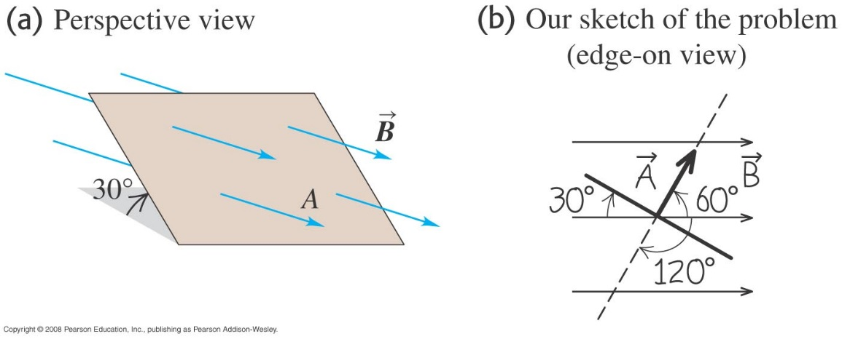
Magnetic flux calculations
A flat surface with area 3.0 cm² in a uniform magnetic field B. The magnetic flux through this surface is +0.9 mWb. Find the magnitude of the magnetic field and the direction of the area vector A.

Slide 21
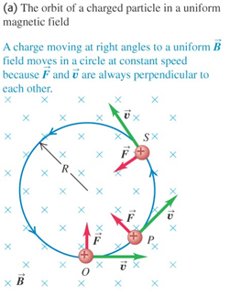
Motion of charged particles in a magnetic field
A charged particle in a magnetic field always moves with constant speed.
Figure 27.17 at the right illustrates the forces and motion.
If the velocity of the particle is perpendicular to the magnetic field, the particle moves in a circle of radius
$$R=\frac{mv}{|q|B}$$
The number of revolutions of the particle per unit time is the cyclotron frequency.
$$ω=\frac{v}{R}=\frac{|q|B}{m}$$
$$v=Rω$$

Slide 22
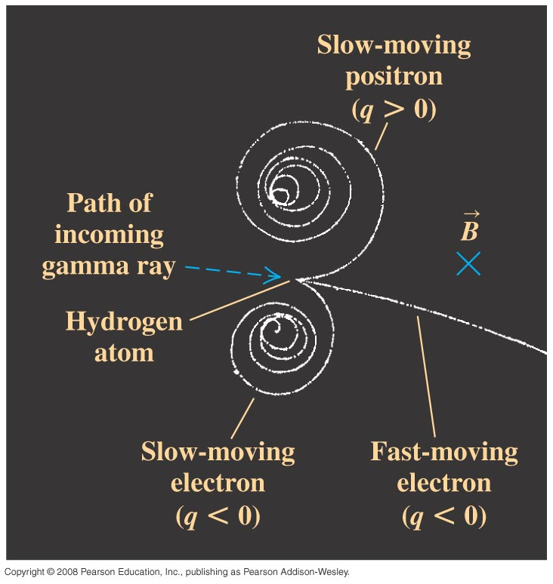
Helical motion
If the particle has velocity components parallel to and perpendicular to the field, its path is a helix.
The speed and kinetic energy of the particle remain constant.
Figure 27.21 at the right shows the tracks of charged particles in a bubble chamber experiment.

Slide 23
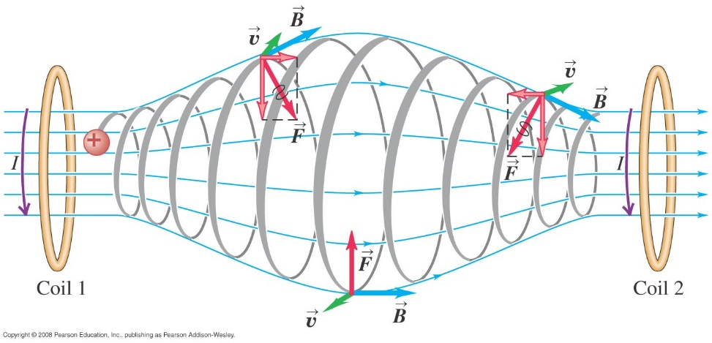
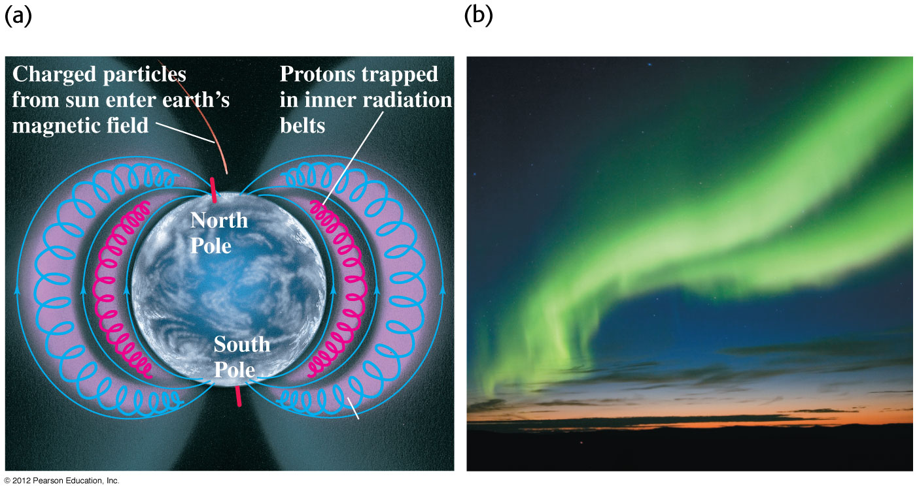
A nonuniform magnetic field
Figure 27.19 at the right shows charges trapped in a magnetic bottle, which results from a nonuniform magnetic field.
Figure 27.20 below shows the Van Allen radiation belts and the resulting aurora. These belts are due to the earth’s nonuniform field.

Slide 24
Example 27.3-4
A magnetron in a microwave oven emits electromagnetic waves with frequency f = 2450 MHz. What magnetic field strength is required for electrons to move in circular paths with this frequency? (B = 0.0877 T)
Example 27.4:
A proton traveling in a uniform magnetic field, 0.5 T directed along the x-axis. At t = 0 the proton has velocity components v_{x}=150 km/s, v_{y} = 0, and v_{z} = 200 km/s. Only the magnetic force acts on the proton. (a) at t = 0, find the force on the proton and its acceleration. (b) Find the radius of the resulting helical path. The angular speed of the proton, and the pitch of the helix (the distance traveled along the helix axis per revolution).

Slide 25
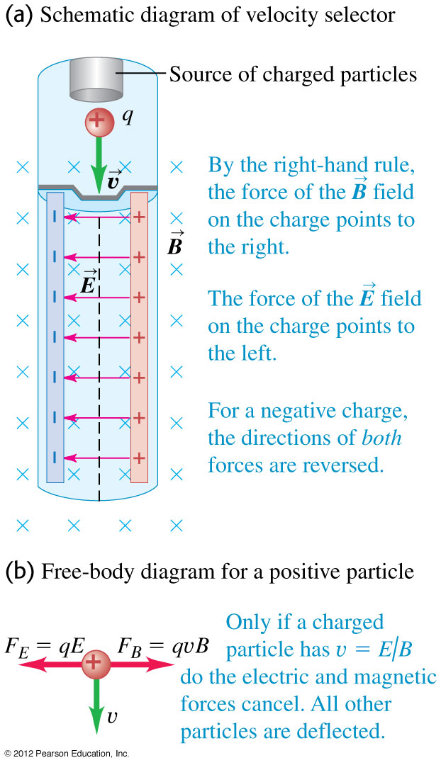
Velocity selector
A velocity selector uses perpendicular electric and magnetic fields to select particles of a specific speed from a beam. (See Figure 27.22 at the right.)
Only particles having speed v = E/B pass through undeflected.

Slide 26
Thomson’s e/m experiment
Thomson’s experiment measured the ratio e/m for the electron. His apparatus is shown in Figure 27.23 below.
$$\frac{1}{2}mv^{2}=eV$$
$$\frac{e}{m}=\frac{E^{2}}{2VB^{2}}$$

Slide 27
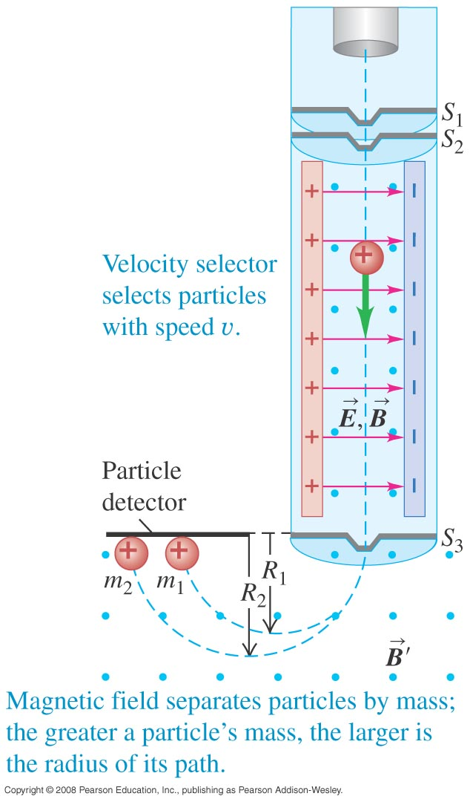
Mass spectrometer
A mass spectrometer measures the masses of ions.
The Bainbridge mass spectrometer (see Figure 27.24 at the right) first uses a velocity selector. Then the magnetic field separates the particles by mass.

Slide 28
Example 27.6
There is almost no helium in ordinary air, so helium sprayed near a leak in a vacuum system will quickly show up in the output of a vacuum pump connected to such a system. You are designing a leak detector that uses a mass spectrometer to detect He⁺ ions (charge +e = +1.6 x 10⁻¹⁹ C, mass 6.65 x 10⁻²⁷ kg). The ions emerge from the velocity selector with a speed of 1 x 10⁵ m/s. They are curved in a semicircular path by a magnetic field B’ and are detected at a distance of 10.16 cm from the slit S₃. Calculate the magnitude of the magnetic field B’.

Slide 29
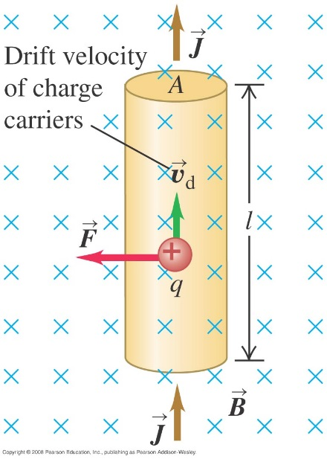
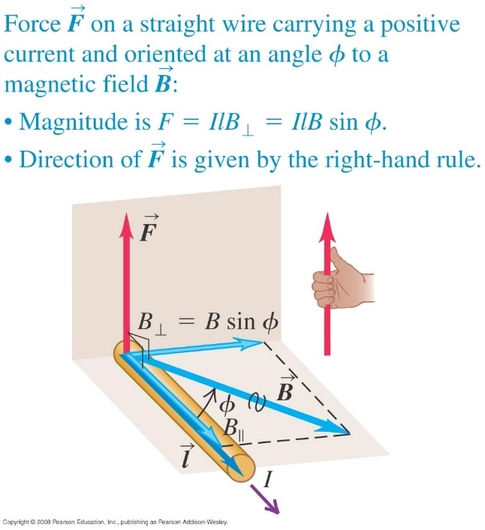
The magnetic force on a current-carrying conductor
Top Figure shows the magnetic force on a moving positive charge in a conductor.
$$\vec{F}=q\vec{v}×\vec{B}$$
Magnetic force on a straight wire segment with current I.
$\vec{F}=\left(nAl\right) q\vec{v}×\vec{B}$
$\vec{F}=\left(Al\right) \vec{J}×\vec{B}$
$\vec{F}=I\vec{l}×\vec{B}$
Magnetic force on an infinitesimal wire section
$$|F|=IlBsinφ$$
$$d\vec{F}=Id\vec{l}×\vec{B}$$

Slide 30
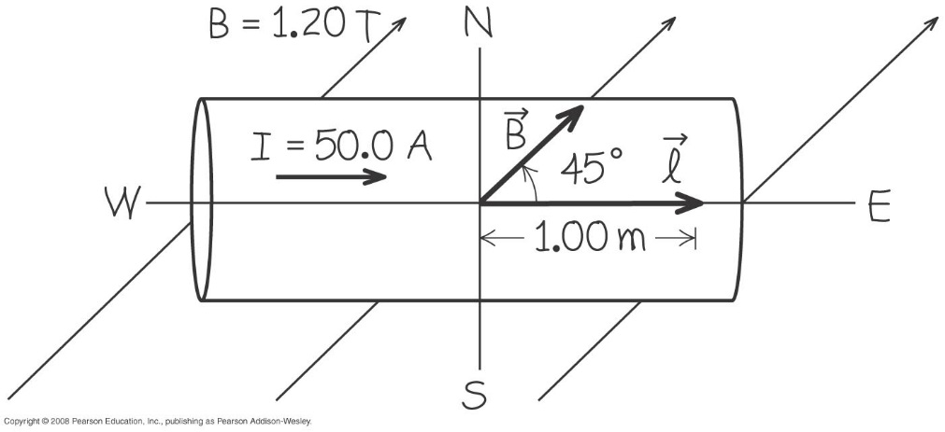
Magnetic force on a straight conductor
Example 27.7: A straight horizontal copper rod carries a current of 50 A from west to east in a region between the poles of a large electromagnet. In this region there is a horizontal magnetic field toward the northeast with magnitude 1.2 T. (a) Find the magnitude and direction of the force on a 1 m section of rod. (b) While keeping the rod horizontal, how should it be oriented to maximize the magnitude of the force? What is the force magnitude in this case?
42.4 T
60 T

Slide 31
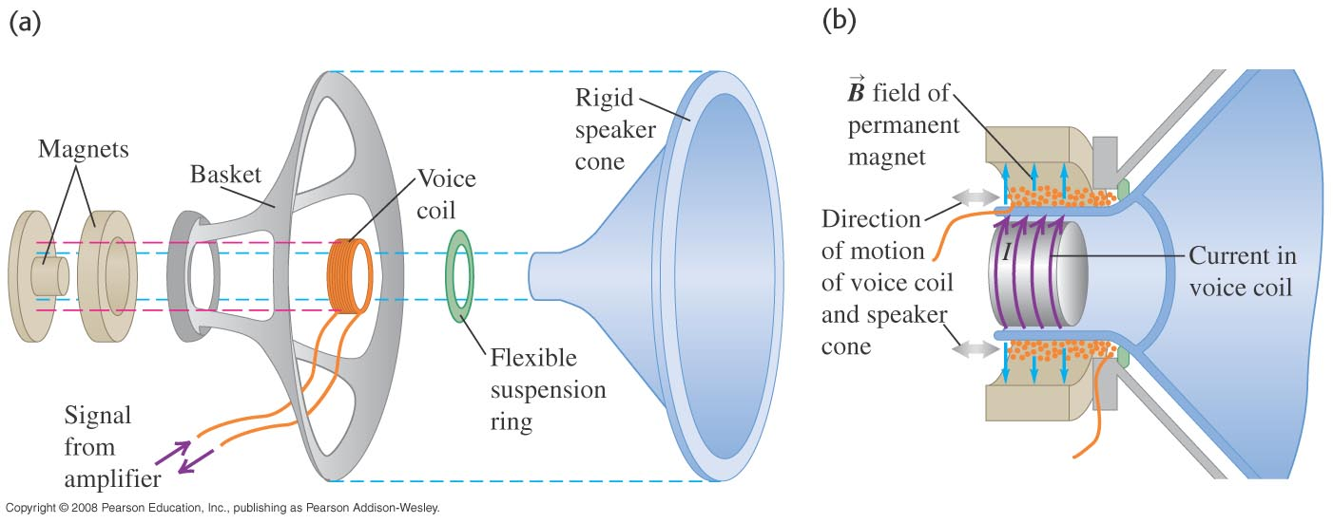
Loudspeaker
A loudspeaker design. If the current in the voice coil oscillates, the speaker cone oscillates at the same frequency.

Slide 32
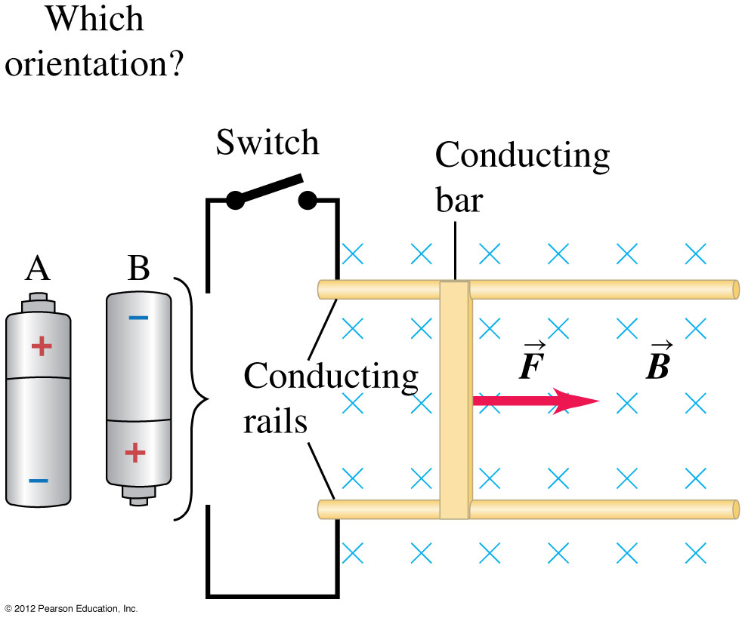
Magnetic force on a curved conductor
In which orientation, A or B, should the battery be placed in the circuit to move the bar to the right?

Slide 33
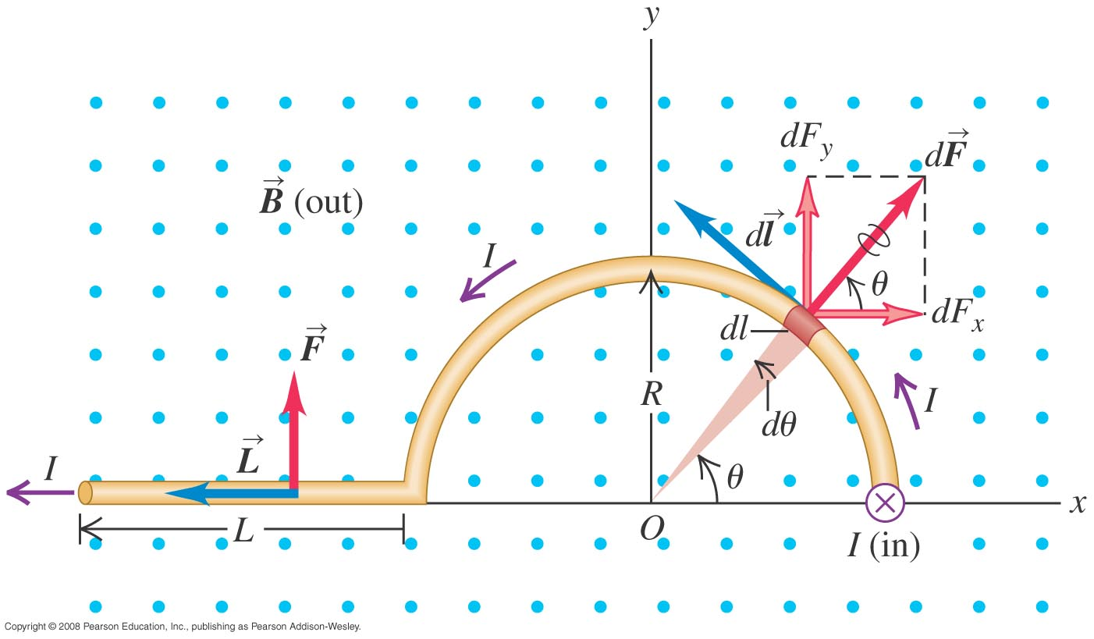
Magnetic force on a curved conductor
Example 27.8: The magnetic field B is uniform and perpendicular to the plane of the figure, pointing out of the page. The conductor carrying current I to the left, has three segments: (1) a straight segment with length L perpendicular to the plane of the figure, (2) a segment with radius R, and (3) another straight segment with length L parallel to the x-axis. Find the total magnetic force on this conductor.

Slide 34
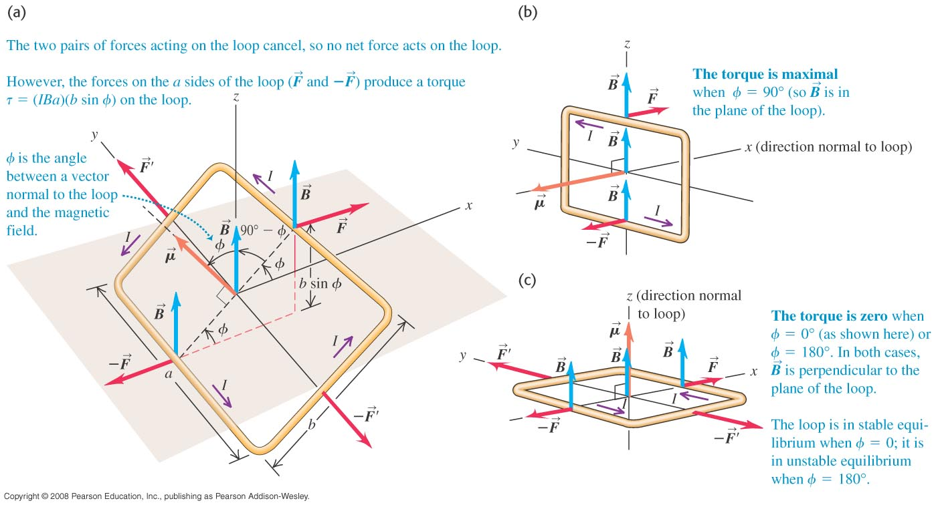
Force and torque on a current loop
The net force on a current loop in a uniform magnetic field is zero. But the net torque is not, in general, equal to zero.
Magnetic torque in a current loop: $\overline{τ}=\overline{r}×\overline{F}=\overline{r}×\left[I\overline{l}×\overline{B}\right]$
$$τ=IBA sin φ$$

Slide 35
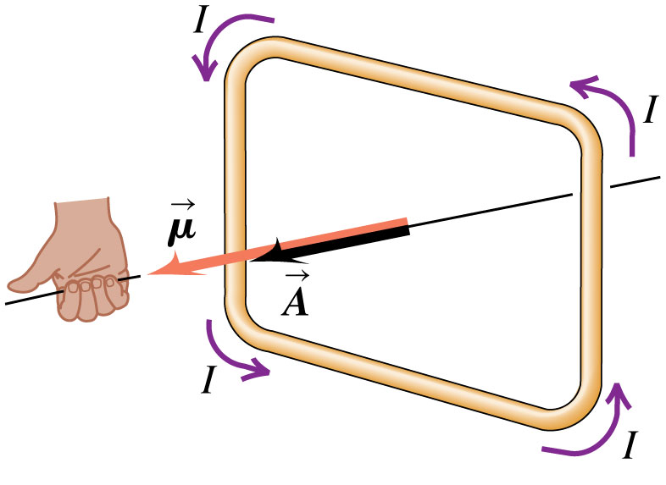
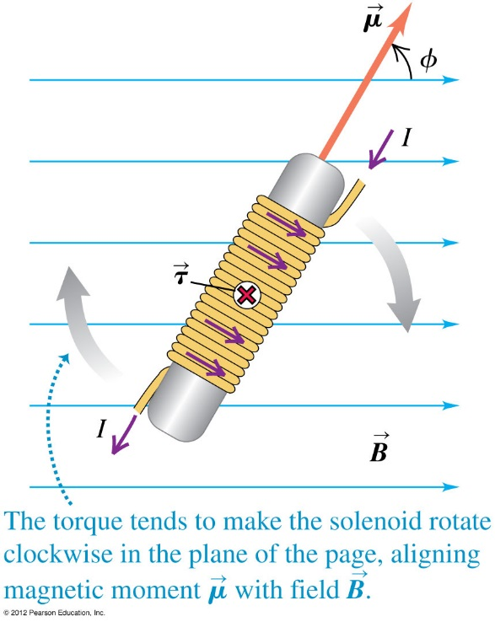
Magnetic moment
Magnetic dipole moment or magnetic moment.
$μ=IA$
Magnetic torque vector
$\vec{τ}=\vec{μ}×\vec{B}$
Potential Energy for a magnetic dipole
$$U=−\vec{μ}⋅\vec{B}=−μB cos φ$$

Slide 36
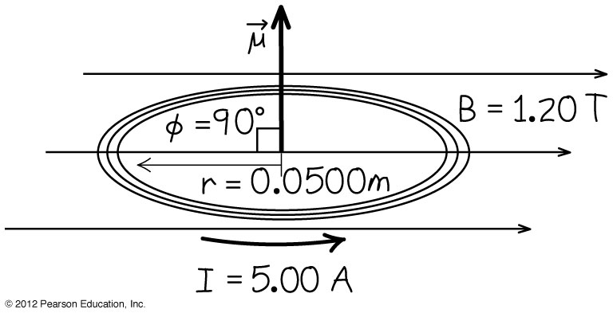
Magnetic torque and potential energy of a coil
Example 27.9-10: A circular coil 0.05 m in radius, with 30 turns of wire, lies in a horizontal plane. It carries a counterclockwise current of 5 A. The coil is in a uniform 1.2 T magnetic field directed toward the right. Find the magnitude of the magnetic moment and the torque on the coil. If the coil rotates from its initial orientation to one in which its magnetic moment μ is parallel to B, what is the change in potential energy?

Slide 37
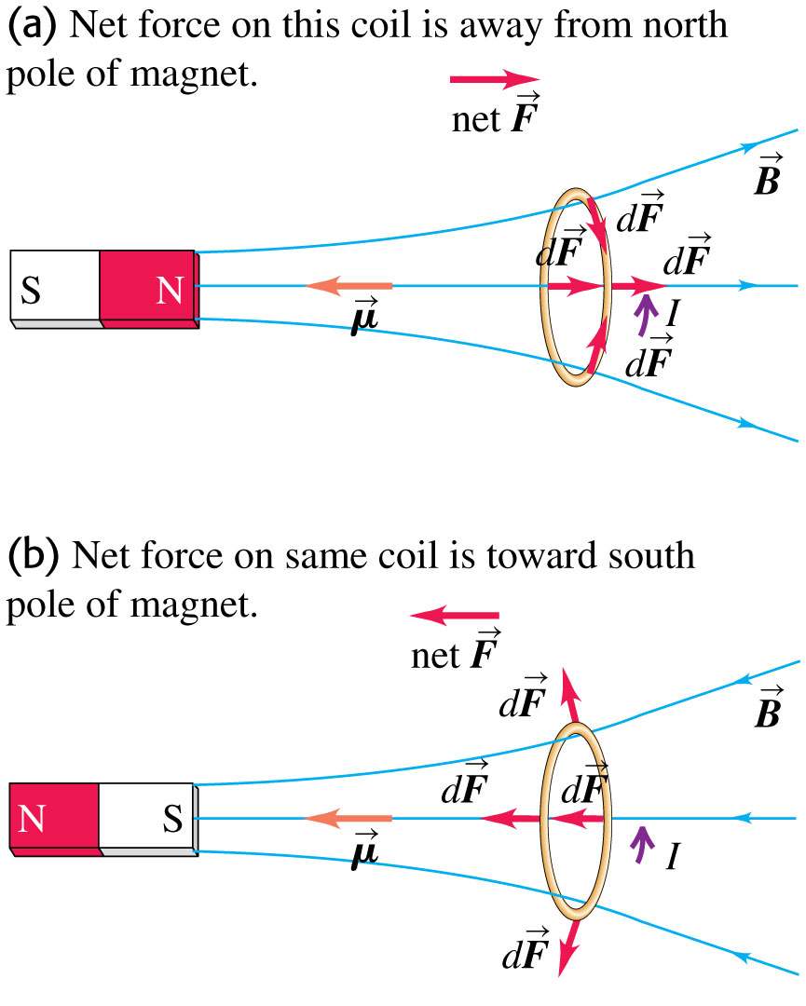
How magnets work
Follow the discussion in the text of magnetic dipoles and how magnets work. Use Figures 27.36 (below) and 27.37 (right).

Slide 38
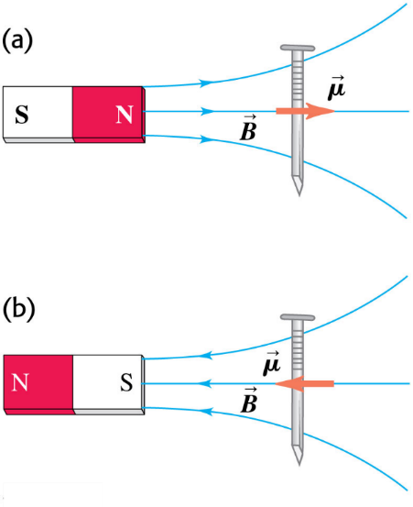
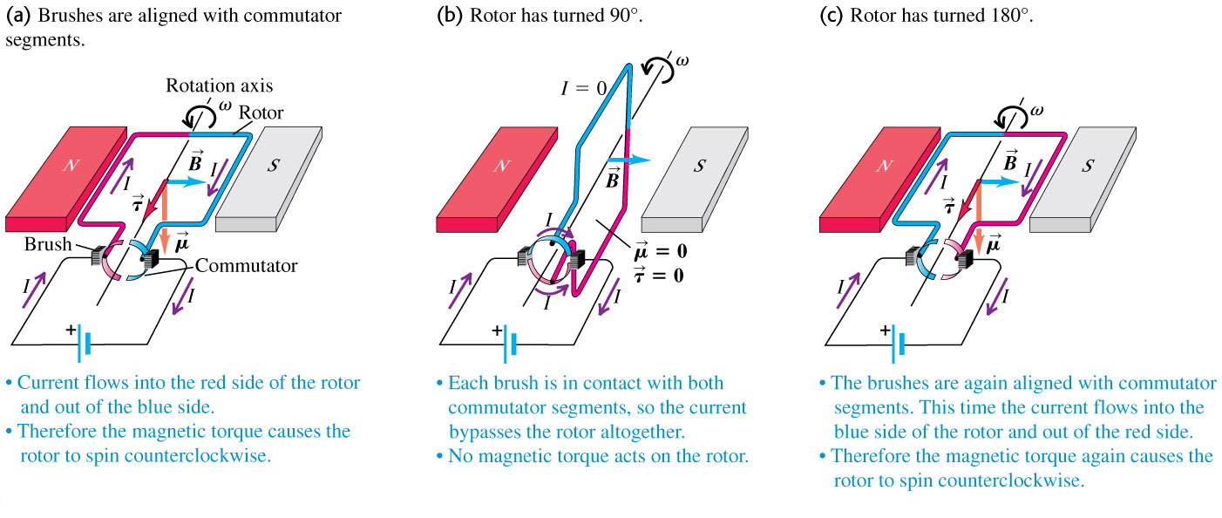
The direct-current motor
Follow the discussion in the text of the direct-current motor. Use Figures 27.38 (right) and 27.39 (below).
Follow Example 27.11.

Slide 39
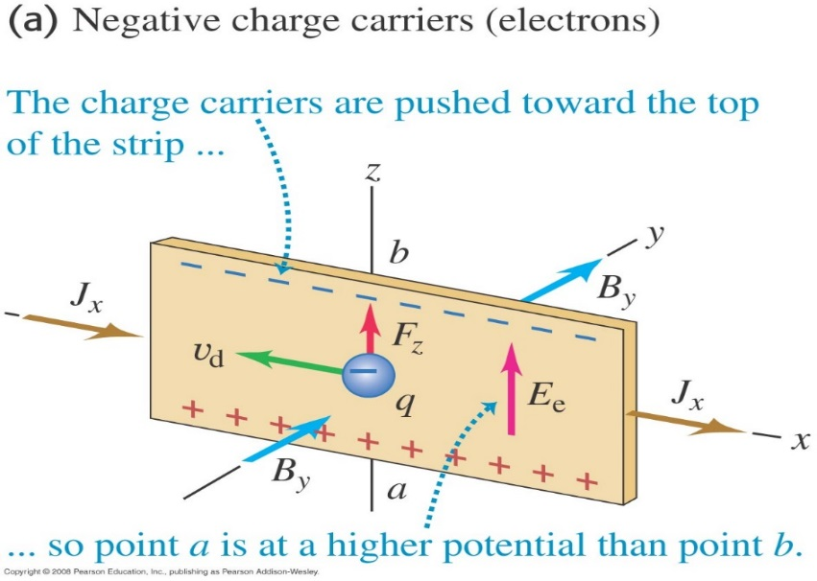
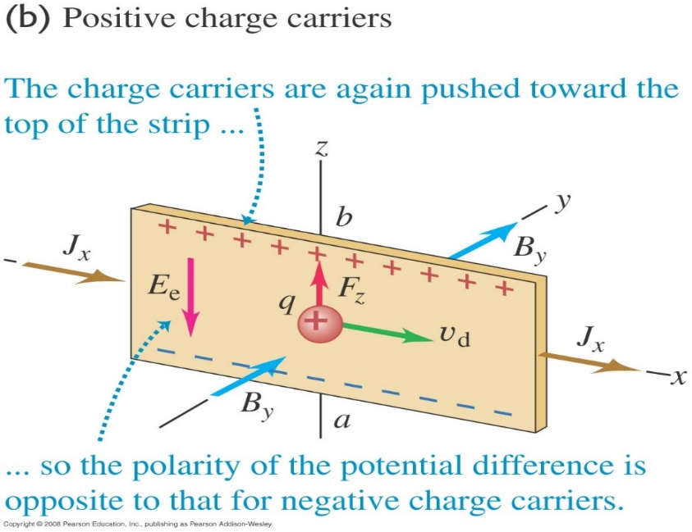
The Hall Effect
$$nq=\frac{−J_{x}B_{y}}{E_{z}}$$
$$qE_{z}+qv_{d}B_{y}=0$$
Example 27.12: You place a strip of copper, 2 mm thick and 1.5 cm wide, in a uniform 0.4 T magnetic field as shown in figure (a). When you run a 75-A current in the +x-direction, you find that the potential at the bottom of the slab is 0.81 μV higher than at the top. From this measurement, determine the concentration of mobile electrons in copper.

