Slide 1
Chapter 28
Sources of Magnetic Field

Slide 2
Goals for Chapter 28
To determine the magnetic field produced by a moving charge
To study the magnetic field of an element of a current-carrying conductor
To calculate the magnetic field of a long, straight, current-carrying conductor
To study the magnetic force between current-carrying wires
To determine the magnetic field of a circular loop
To use Ampere’s Law to calculate magnetic fields

Slide 3
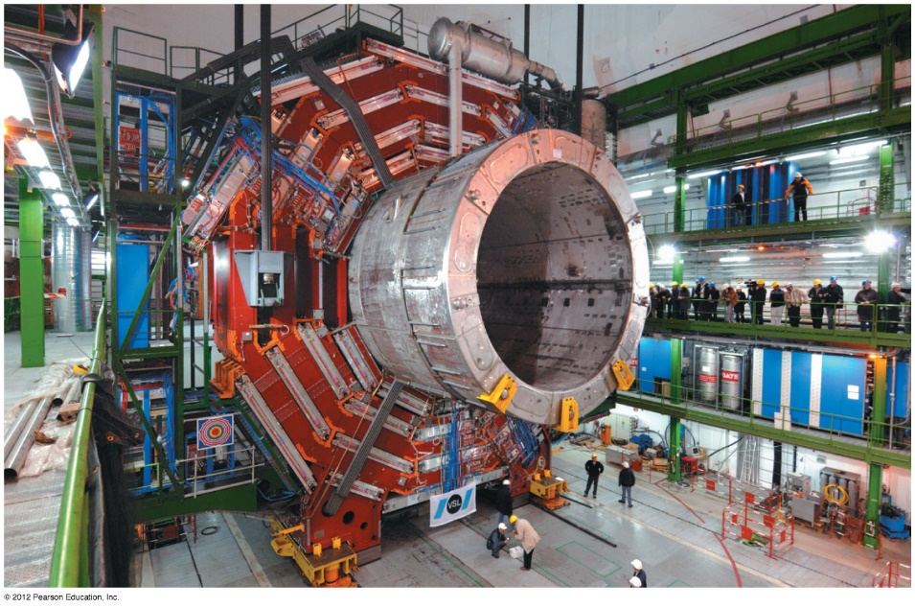
Introduction
What can we say about the magnetic field due to a solenoid?
What actually creates magnetic fields?
We will introduce Ampere’s law to calculate magnetic fields.

Slide 4
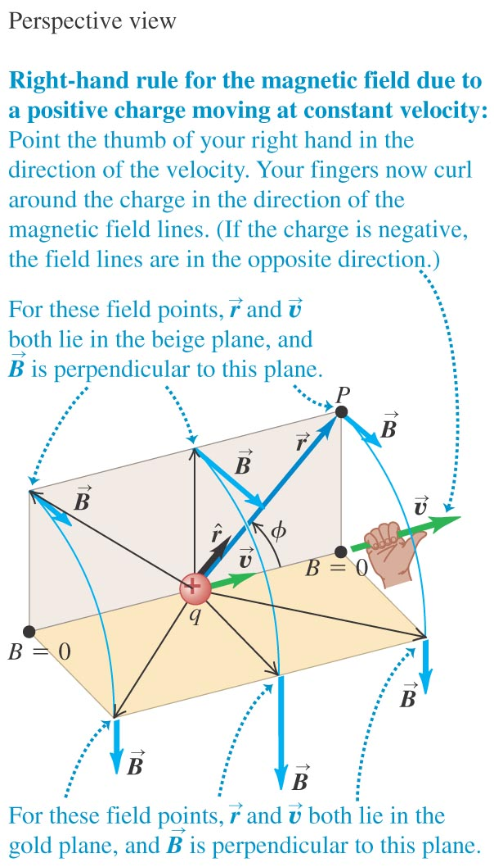
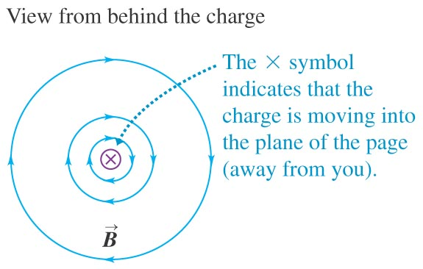
The magnetic field of a moving charge
A moving charge generates a magnetic field that depends on the velocity of the charge.
$$\vec{B}=\frac{μ_{0}}{4π}\frac{q\vec{v}×\hat{r}}{r^{2}}$$
$$B=\frac{μ_{0}}{4π}\frac{|q|v \text{sin} φ}{r^{2}}$$
Magnitude of
µ₀ = 4π x 10⁻⁷ T.m/A

Slide 5
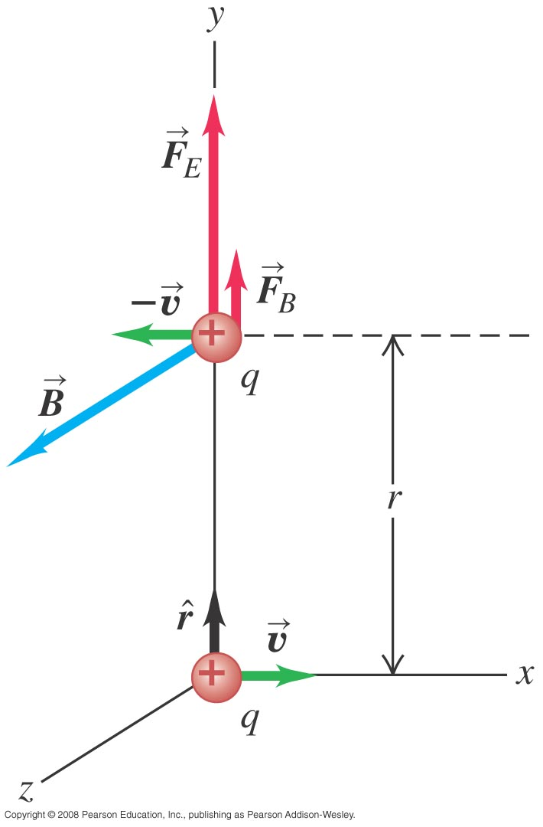
Magnetic force between moving protons
Example 28.1: Two protons move parallel to the x-axis in opposite directions at the same speed v. At the instant shown, find the electric and magnetic forces on the upper proton and compared their magnitude.

Slide 6
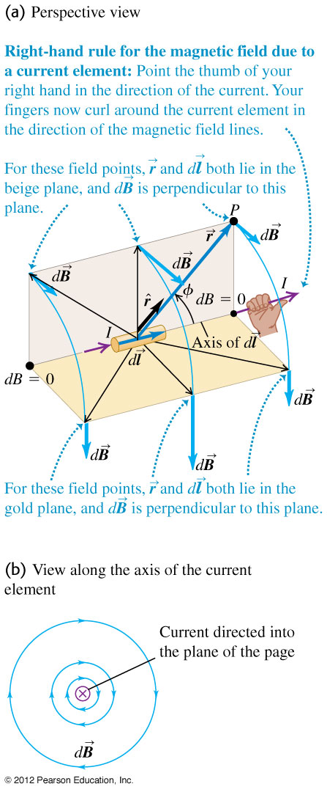
Magnetic field of a current element
The total magnetic field of several moving charges is the vector sum of each field.
The law of Biot and Savart.
$$d\vec{B}=\frac{μ_{0}}{4π}\frac{Id\vec{l}×\hat{r}}{r^{2}}$$
$$\vec{B}=\frac{μ_{0}}{4π}\int{\frac{Id\vec{l}×\hat{r}}{r^{2}}}$$

Slide 7
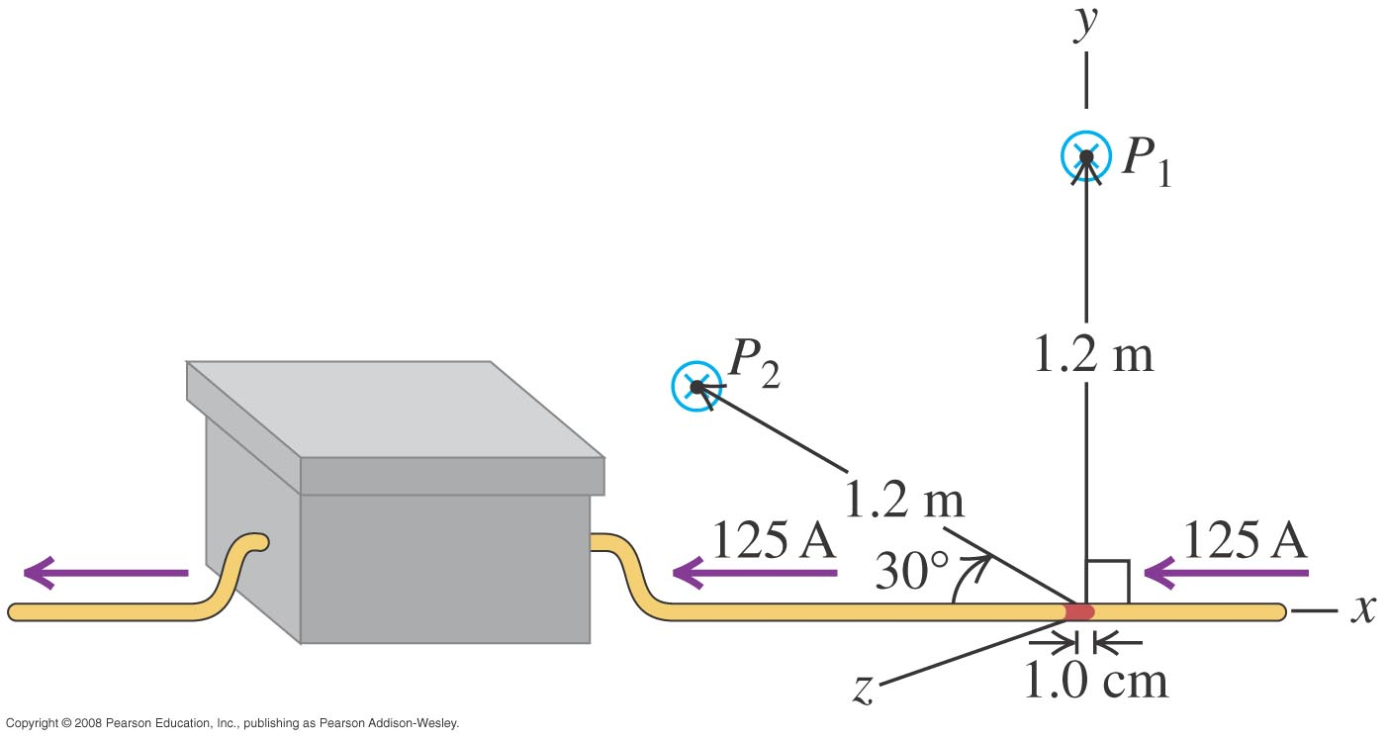
Magnetic field of a current segment
Example 28.2: A copper wire carries a steady 125-A current to an electroplating tank. Find the magnetic field due to a 1 cm segment of this wire at a point 1.2 m away from it, if the point is (a) point P₁, straight out to the side of the segment, and (b) point P₂, in the xy-plane and on a line at 30º to the segment.

Slide 8
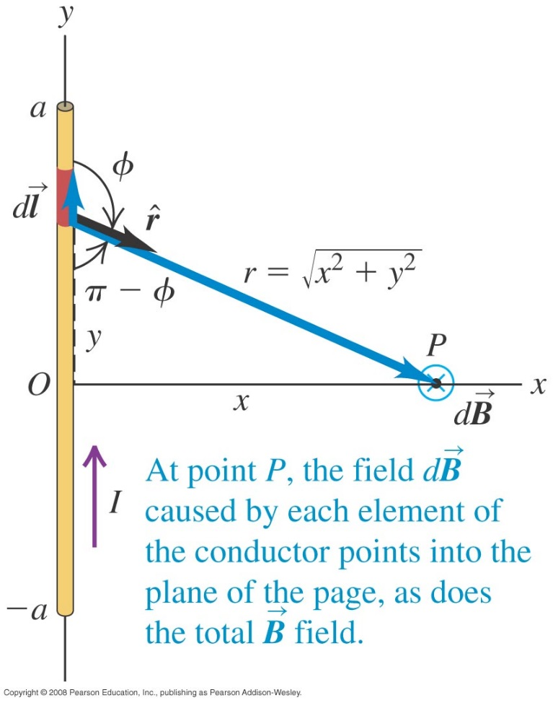
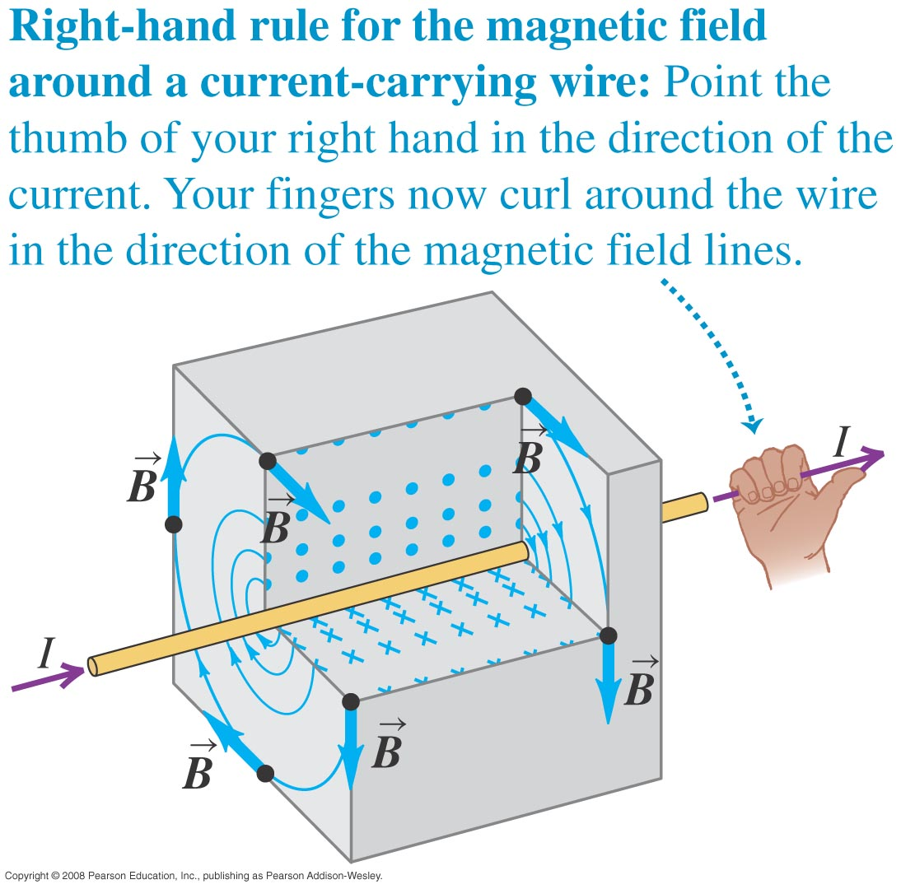
Magnetic field of a straight current-carrying conductor
Biot and Savart Law for a long straight conductor:
$$\vec{B}=\frac{μ_{0}}{4π}\int{\frac{Id\vec{l}×\hat{r}}{r^{2}}}$$
$$B=\frac{μ_{0}I}{2πr}$$
Direction of B is determined by the right-hand rule.

Slide 9
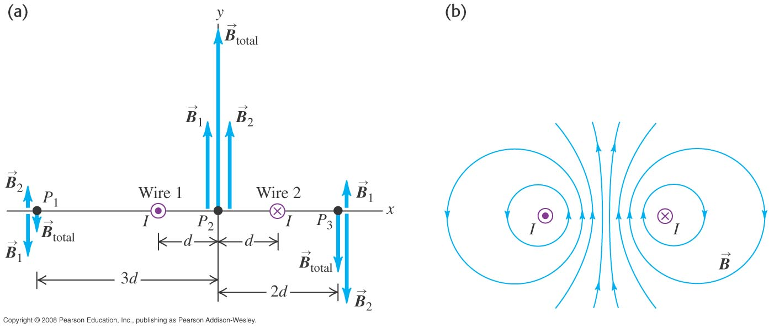
Magnetic fields of long wires
Example 28.4: Two straight wires perpendicular to the xy-plane, each carrying a current I but in opposite directions. (a) Find B at points P₁, P₂, and P₃. (b) Find an expression for B at any point on the x-axis to the right of wire 2.

Slide 10
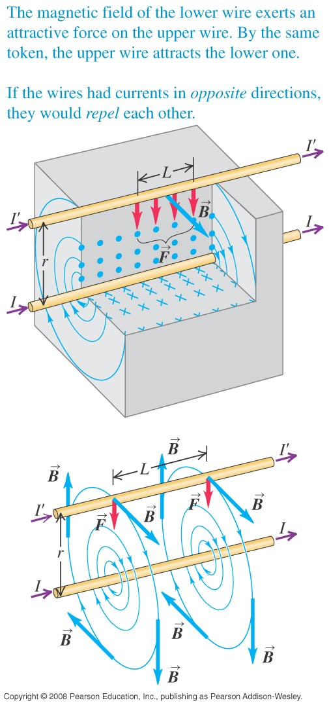
Force between parallel conductors
The force per unit length on each conductor is
$$B=\frac{μ_{0}I}{2πr}$$
$$\vec{F}=I^{′}\vec{L}×\vec{B}$$
$$F=I^{′}LB$$
$$\frac{F}{L}=\frac{μ_{0}II^{′}}{2πr}$$
The conductors attract each other if the currents are in the same direction and repel if they are in opposite directions.

Slide 11
Forces between parallel wires
Example 28.5: Two straight, parallel, superconducting wires 4.5 mm apart carry equal current of 15,000 A in opposite directions. What force, per unit length, does each wire exert on the other?
Answer: 10,000 N/m

Slide 12
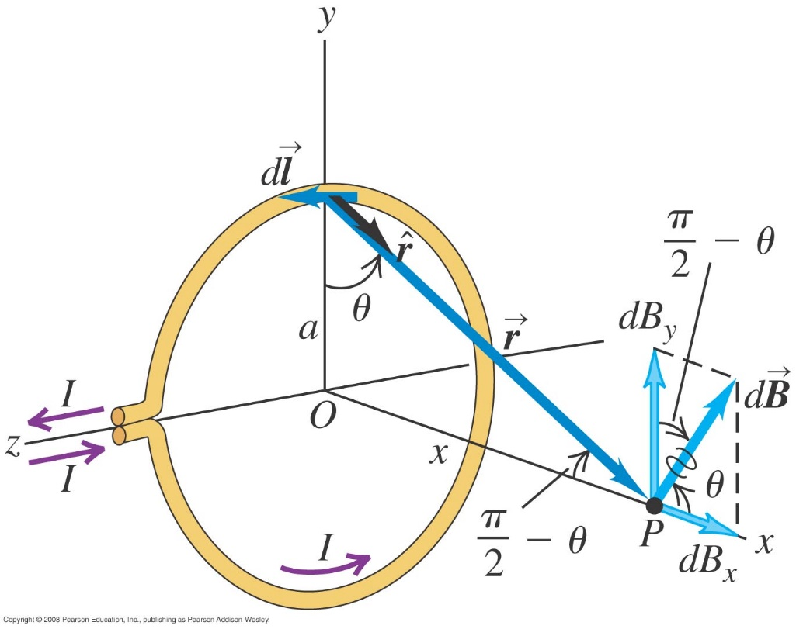
Magnetic field of a circular current loop
The Biot Savart law gives the magnetic field on the axis of the loop.
$$\vec{B}=\frac{μ_{0}}{4π}\int{\frac{Id\vec{l}×\hat{r}}{r^{2}}}$$
$$B_{x}=\frac{μ_{0}Ia^{2}}{2{\left(x^{2}+a^{2}\right)}^{3/2}}$$
At the center of N loops, the field on the axis is
$$B_{x}=\frac{μ_{0}NI}{2a}$$

Slide 13
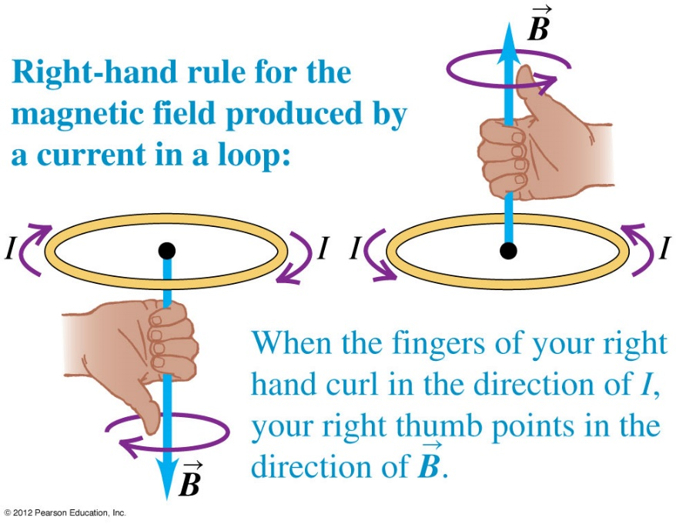
Magnetic field of a coil
Figure 28.13 (top) shows the direction of the field using the right-hand rule.

Slide 14
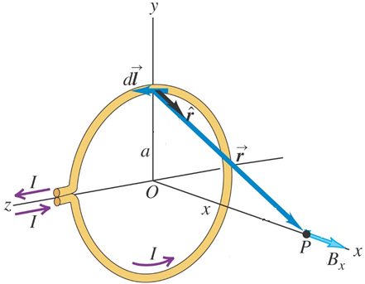
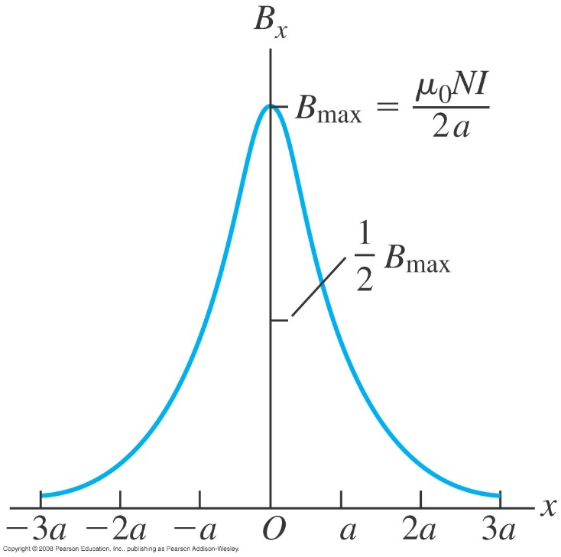
Magnetic field of a coil
Example 28.6: A coil consisting of 100 circular loops with radius 0.6 m carries a 5 A current. (a) Find the magnetic field at a point along the axis of the coil, 0.8 m from the enter. (b) Along the axis, at what distance from the center of the coil is the field magnitude 1/8 as great as it is at the center?

Slide 15
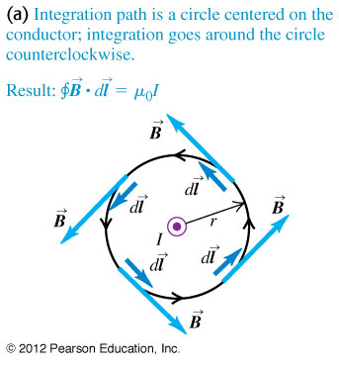
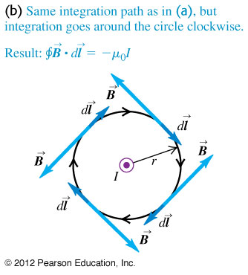
Ampere’s law (special case)
Ampere’s law for a circular path around a long straight conductor.
$$\oint{\vec{B}⋅d\vec{l}=μ_{0}I}$$

Slide 16
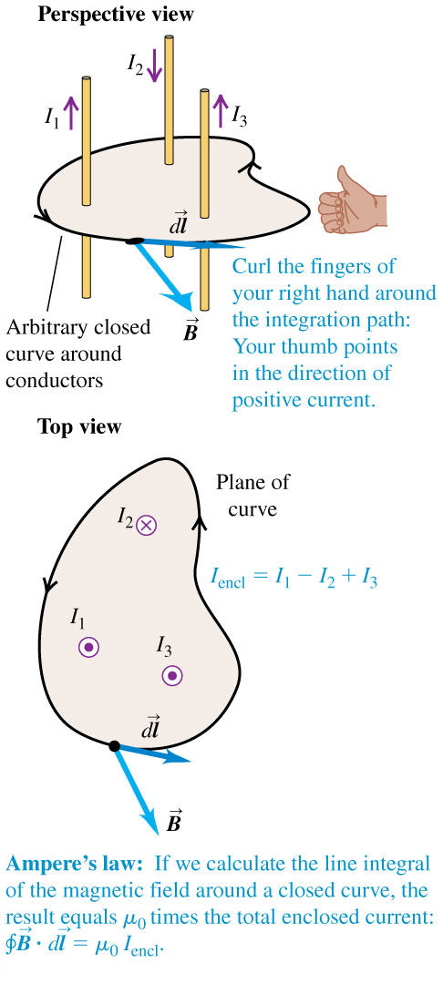
Ampere’s law (general statement)
General statement of Ampere’s law.
$$\oint{\vec{B}⋅d\vec{l}=μ_{0}I_{\text{encl}}}$$

Slide 17
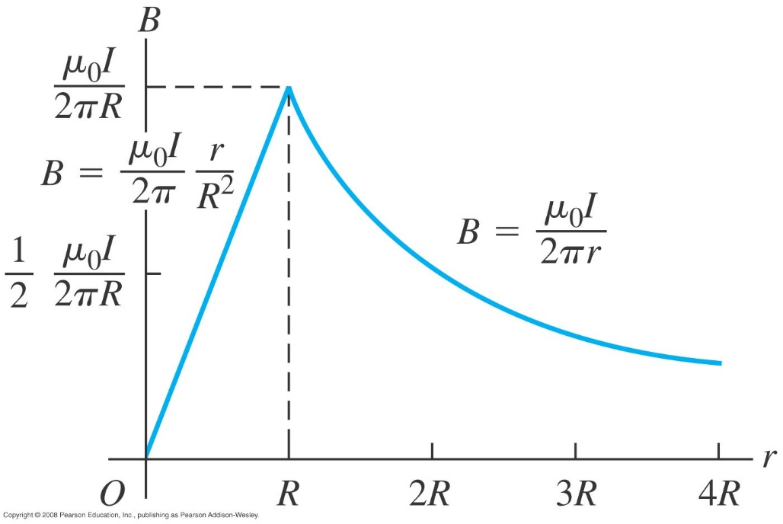
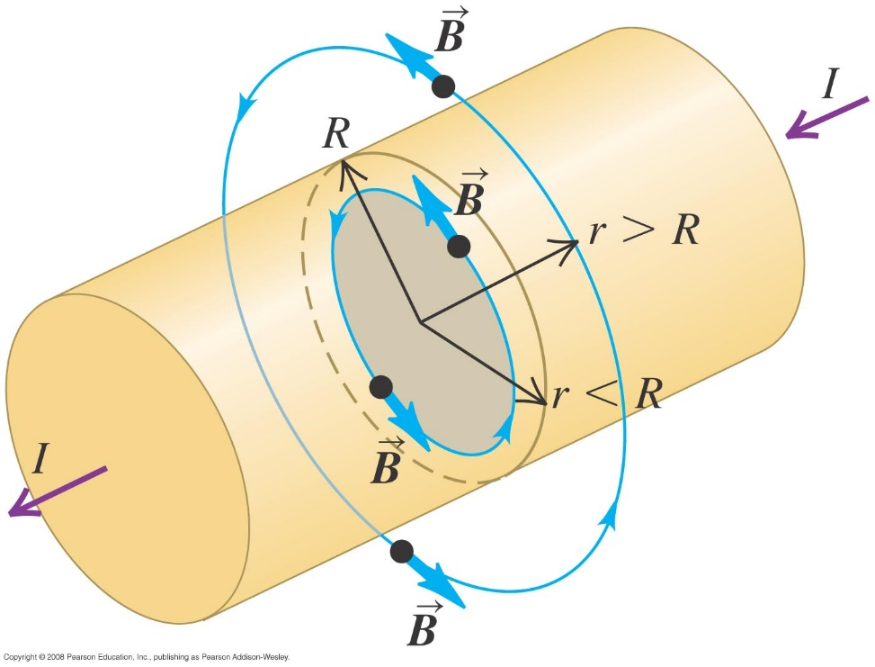
Magnetic fields of long conductors
Example 28.8: A cylindrical conductor with radius R carries a current I. The current is uniformly distributed over the cross-sectional area of the conductor. Find the magnetic field as a function of the distance r from the conductor axis for point both inside (r < R) and outside (r > R) the conductor.

Slide 18
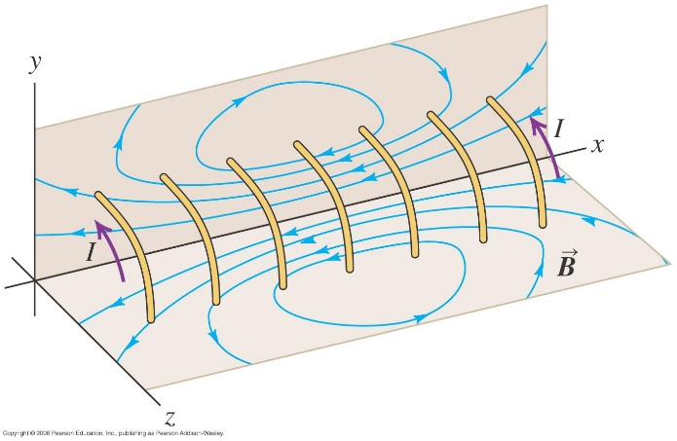
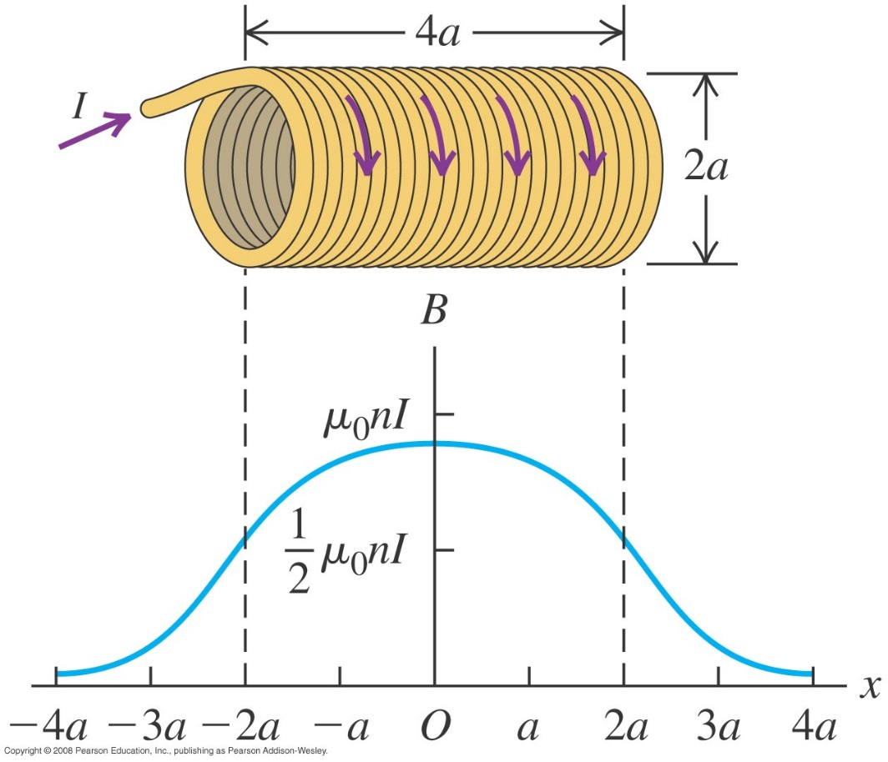
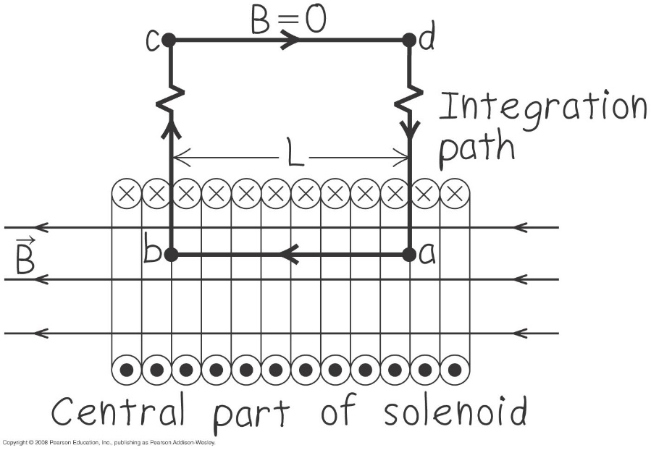
Field of a solenoid
A solenoid consists of a helical winding of wire on a cylinder.
Example 28.9: Find the magnetic field at or near the center of a
solenoid if it has n turns per unit length and carries current I.
$$B=μ_{0}nI$$

Slide 19
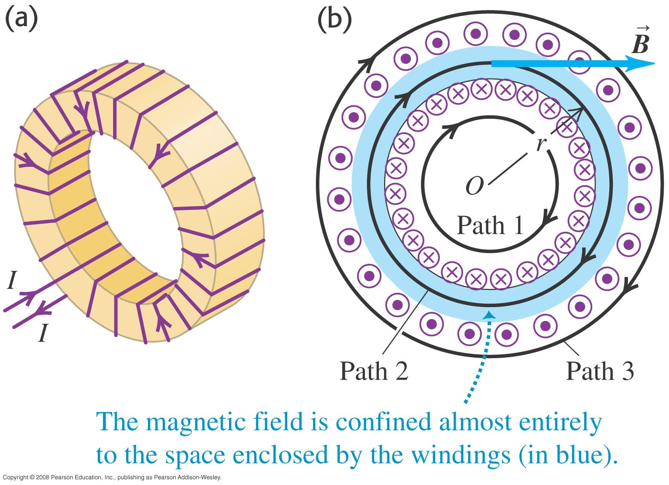
Field of a toroidal solenoid
A toroidal solenoid is a doughnut-shaped solenoid.
Example 28.10: Toroidal with N turns of wire carrying a current I, Find the magnetic field at all points.
$$B=\frac{μ_{0}NI}{2πr}$$

Slide 20
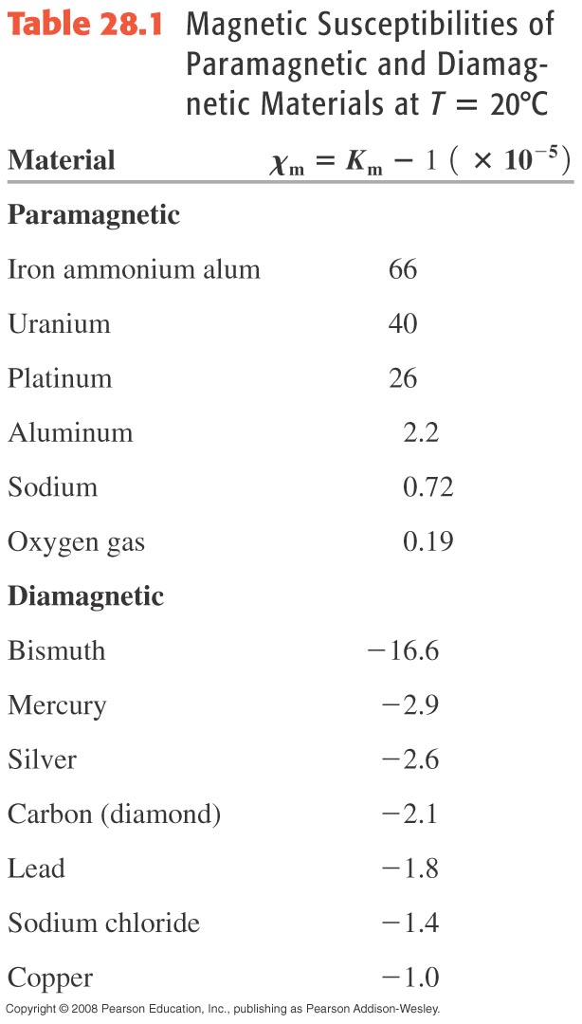
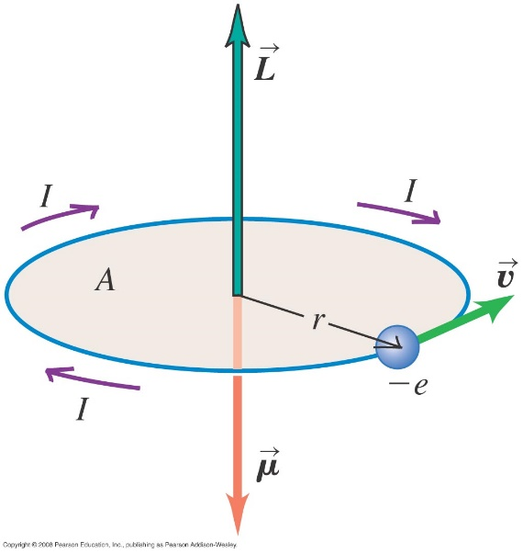
The Bohr magneton
Bohr magneton μ_{B} is a magnetic moment of a revolving electron.
$$μ=\frac{e}{2m}L=\frac{e}{2m}\left(\frac{h}{2π}\right)=\frac{eh}{4πm}$$
$$μ_{B}=9.274×{10}^{−24} J/T$$
$$μ=K_{m}μ_{0}$$
$$\vec{B}={\vec{B}}_{0}+μ\vec{M}$$

Slide 21
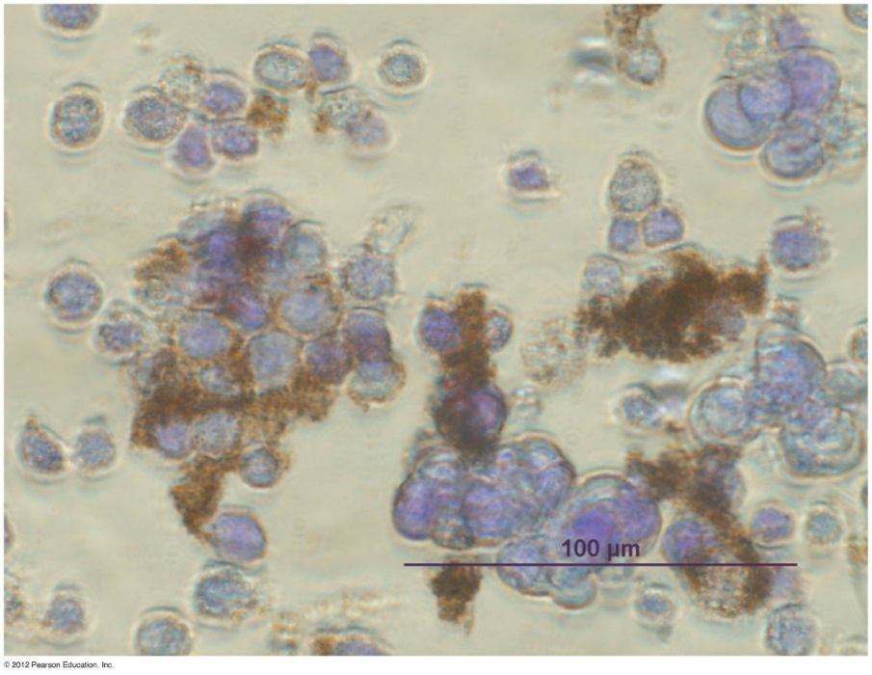
Magnetic Behavior in Materials
Paramagnetism: Materials which become magnetized in a magnetic field but their magnetism disappears when the field is removed
Diamagnetism: Materials that create an induced magnetic field in a direction opposite to an externally applied magnetic field and are therefore repelled by the applied magnetic field
Ferromagnetism: Materials (such as iron and nickel) that can retain their magnetic properties when the magnetic field is removed

Slide 22
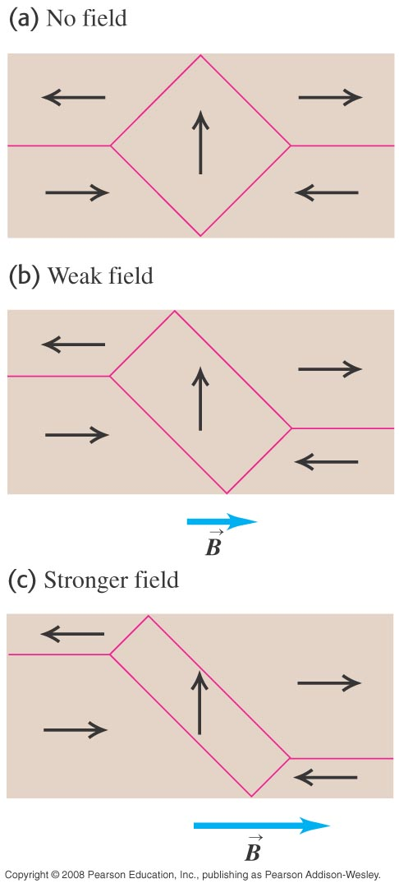
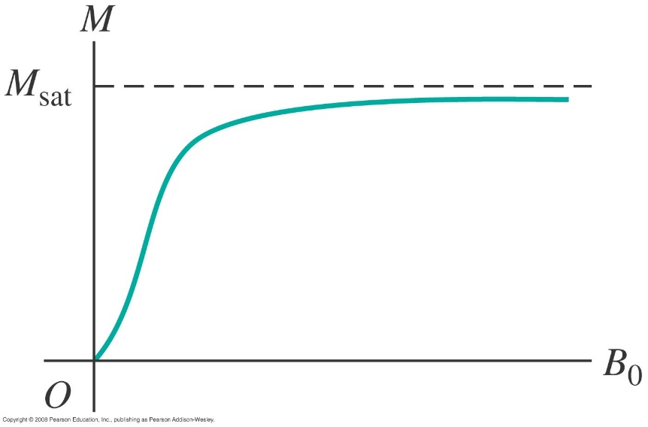
Diamagnetism and ferromagnetism
Follow the text discussion of diamagnetism and ferromagnetism.
Figure 28.27 at the right shows how magnetic domains react to an applied magnetic field.
Figure 28.28 below shows a magnetization curve for a ferromagnetic material.

