Slide 1
Chapter 29
Electromagnetic Induction

Slide 2
Goals for Chapter 29
To examine experimental evidence that a changing magnetic field induces an emf
To learn how Faraday’s law relates the induced emf to the change in flux
To determine the direction of an induced emf
To calculate the emf induced by a moving conductor
To learn how a changing magnetic flux generates an electric field
To study the four fundamental equations that describe electricity and magnetism

Slide 3
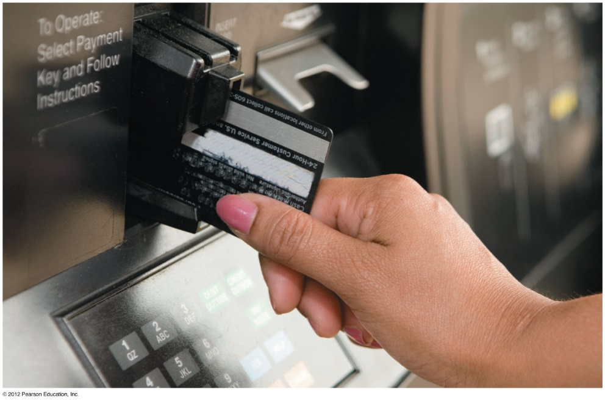
Introduction
How is a credit card reader related to magnetism?
Energy conversion makes use of electromagnetic induction.
Faraday’s law and Lenz’s law tell us about induced currents.
Maxwell’s equations describe the behavior of electric and magnetic fields in any situation.

Slide 4
Induced current
A changing magnetic flux causes an induced current.
The induced emf is the corresponding emf causing the current.

Slide 5
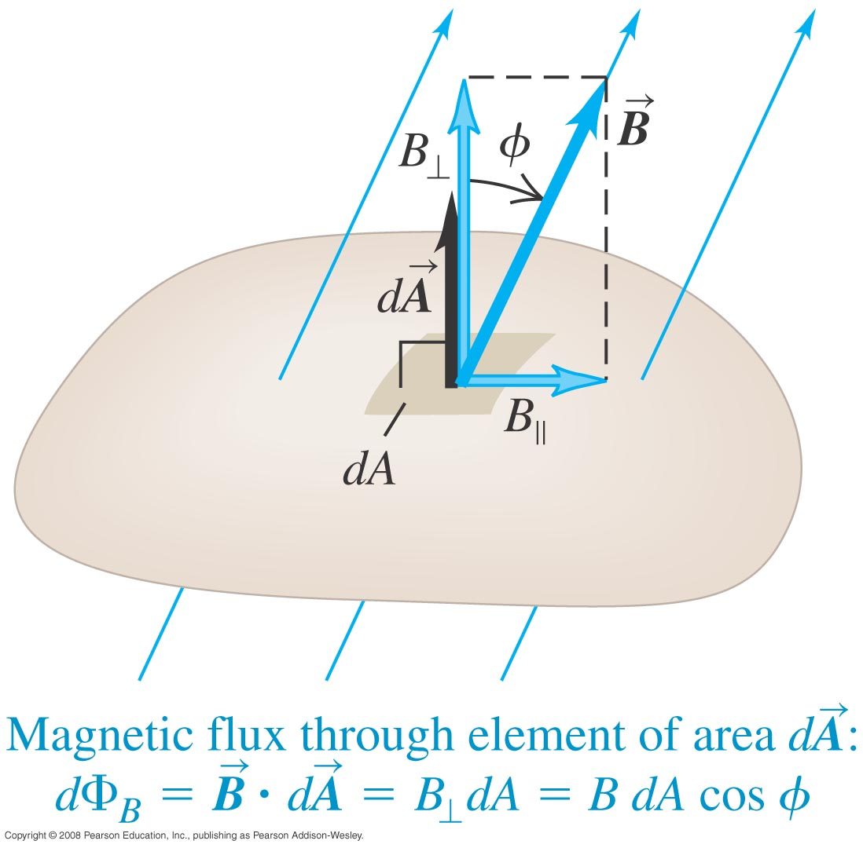
Magnetic flux through an area element
Magnetic flux through an element of area.
$$dΦ_{B}=\vec{B}∙d\vec{A}=B_{⊥}dA=BdA \text{cos} φ$$
$$Φ_{B}=\int{\vec{B}∙d\vec{A}}$$
$$Φ_{B}=\int{B \text{cos} φ dA}$$

Slide 6
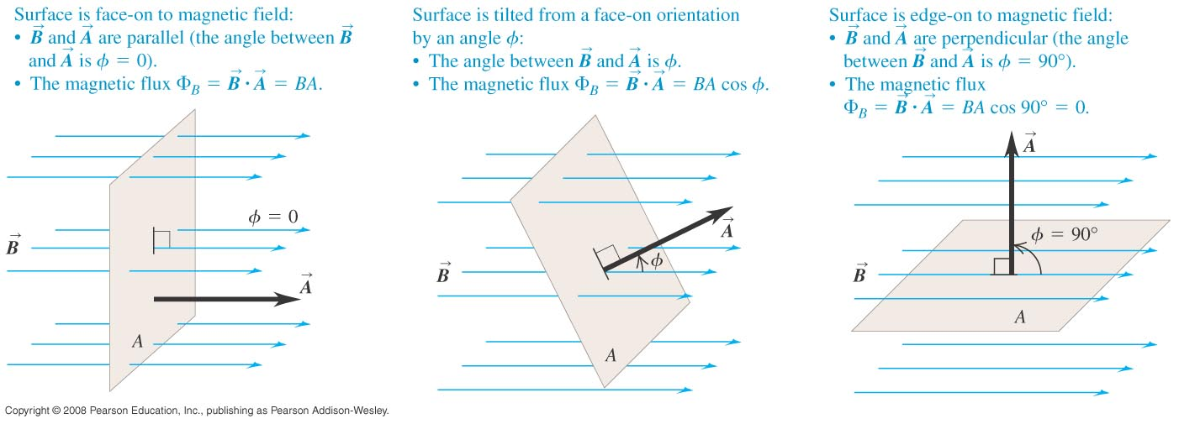
Faraday’s law
The flux depends on the orientation of the surface with respect to the magnetic field.
Faraday’s law: The induced emf in a closed loop equals the negative of the time rate of change of magnetic flux through the loop,
$$ε=−\frac{dΦ_{B}}{dt}$$

Slide 7
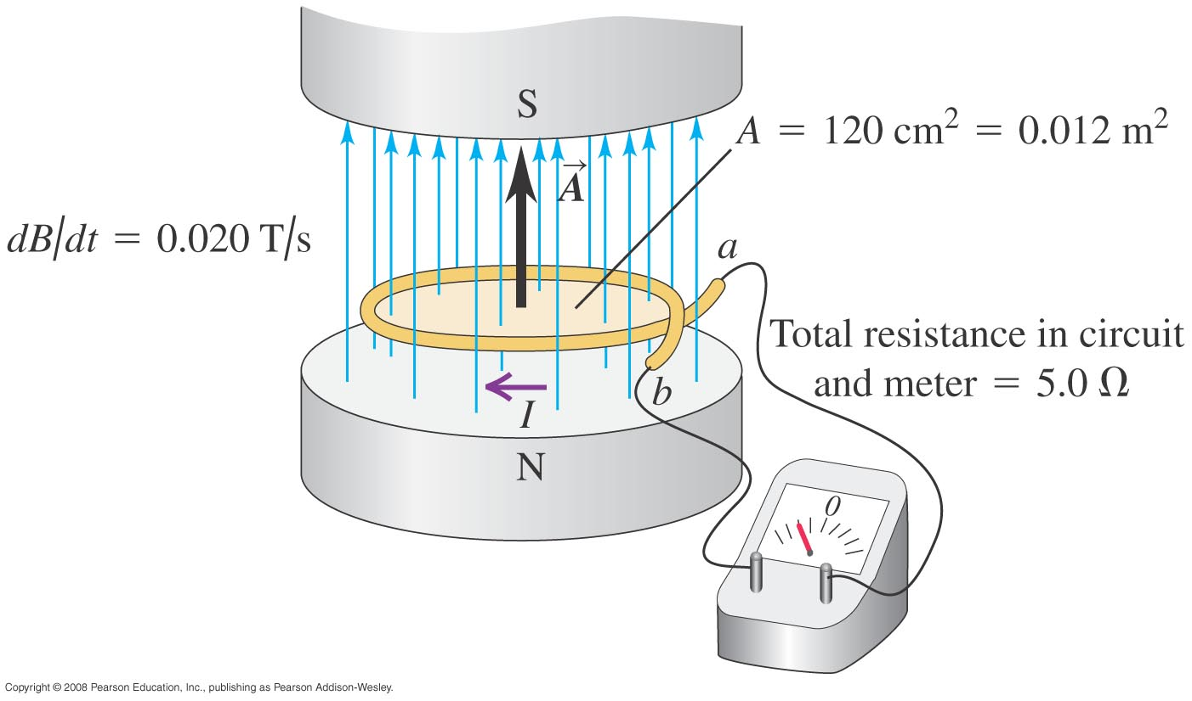
Emf and the current induced in a loop
Example 29.1: The magnetic field between the poles of the electromagnet is uniform at any time, but its magnitude is increasing at the rate of 0.02 T/s. The area of the conducting loop in the field is 120 cm², and the total circuit resistance, including the meter, is 5 Ω. Find the induced emf and the induced current in the circuit.
Answer
$ε$ = 0.24 mV
I = 0.048 mA

Slide 8
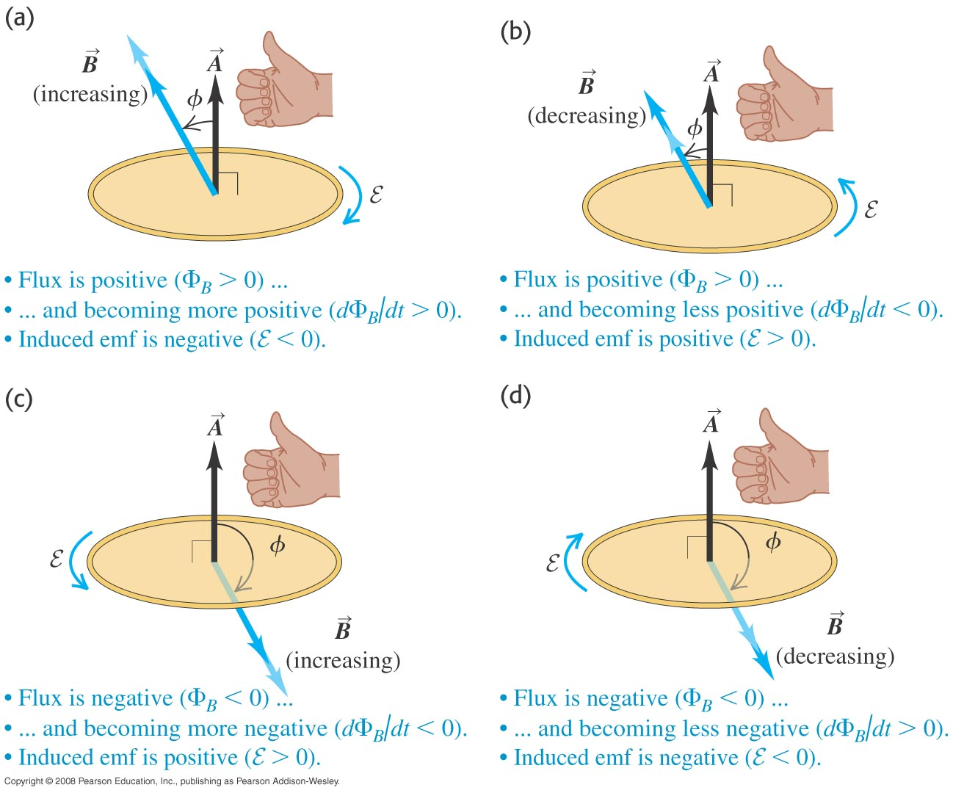
Direction of the induced emf
Point the right hand thumb along vector A, if the emf is positive then the emf and current are in the direction of the curled fingers.
$$Φ_{B}=\int{B \text{cos} φ dA}$$
$$ε=−\frac{dΦ_{B}}{dt}$$

Slide 9
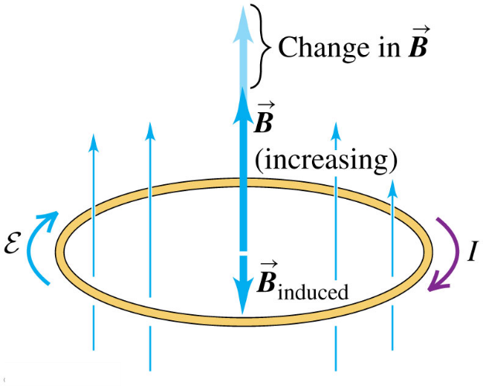
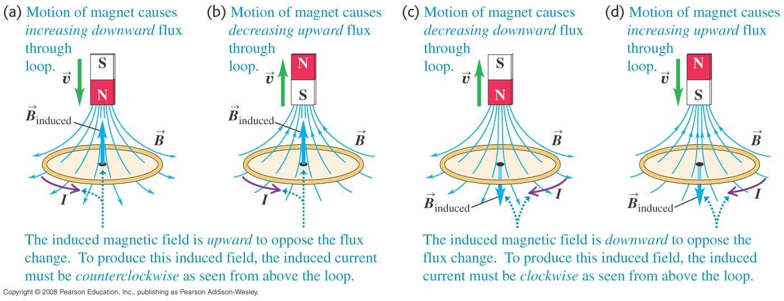
Lenz’s law and the direction of induced current
Lenz’s law: The direction of any magnetic induction effect is such as to oppose the cause of the effect.
Example 29.8: use Lenz’s law to determine the direction of the resulting induced current.

Slide 10
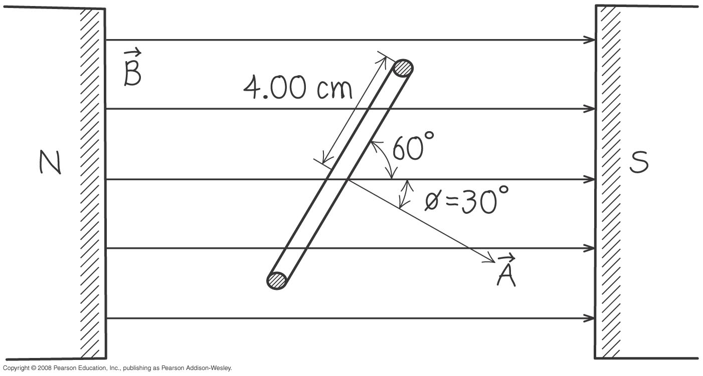
Magnitude and direction of an induced emf
Example 29.2: A 500-loop circular wire coil with radius 4 cm is placed between the poles of a large electromagnet. The magnetic field is uniform and makes an angle of 60º with the plane of coil; it decrease at 0.2 T/s. What are the magnitude and direction of the induced emf?
Answer
$ε$ = 0.435 V

Slide 11
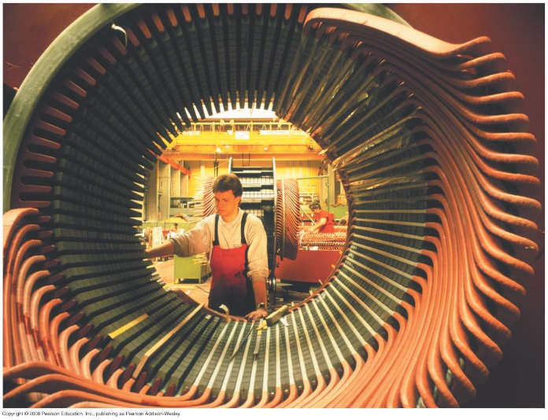
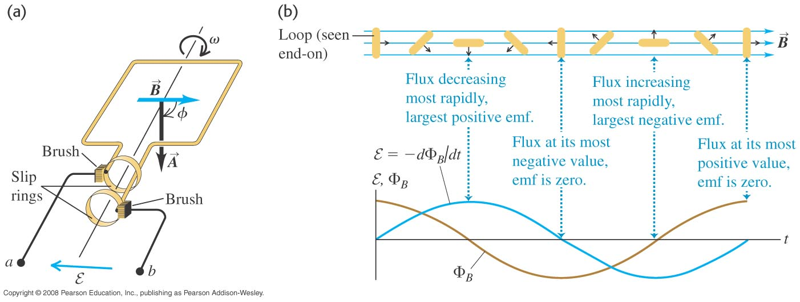
A simple alternator
Example 29.3: A rectangular loop is rotated with constant angular speed ω about the axis shown. The magnitude field B is uniform and constant. At time t = 0, ϕ = 0. Determine the induced emf.

Slide 12
DC generator and back emf in a motor
Example 29.4: Consider a motor with a square, 500 turn coil 10 cm on a side. If the magnetic field has magnitude 0.2 T, at what rotation speed is the average back emf of the motor equal to 112 V?

Slide 13
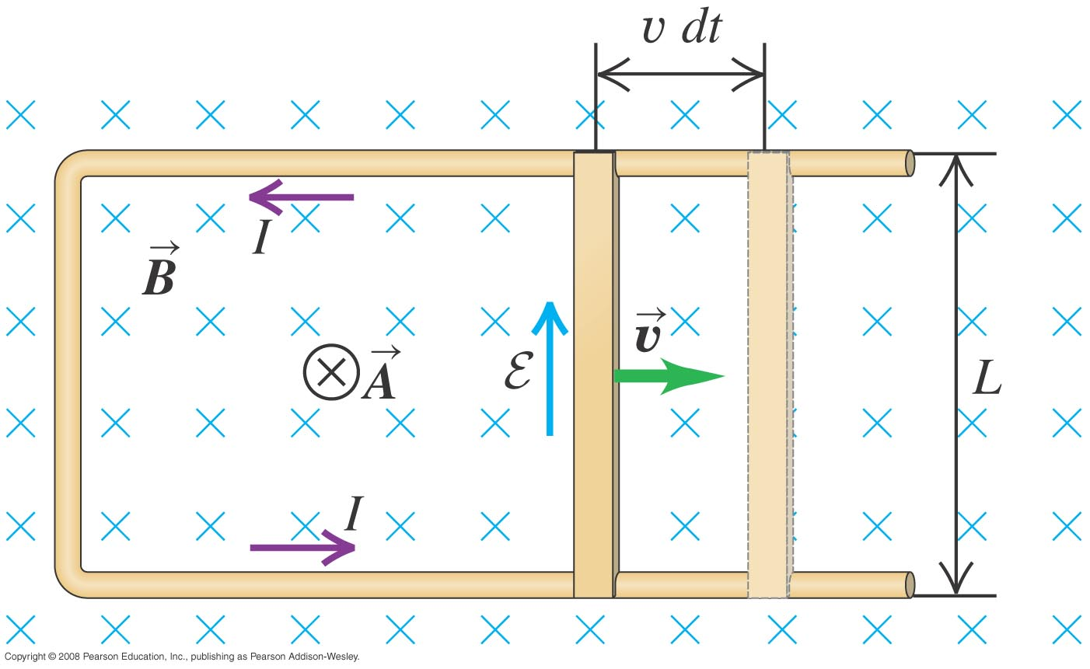
Slidewire generator
Example 29.5: A U-shaped conductor in a uniform magnetic field B perpendicular to the plane of the figure and directed into the page. We lay a metal rod (the slidewire) with length L across the two arms of the conductor, forming a circuit, and move it to the right with constant velocity v. Find the magnitude and direction of the resulting induced emf.
Answer:
ε = vBL.

Slide 14
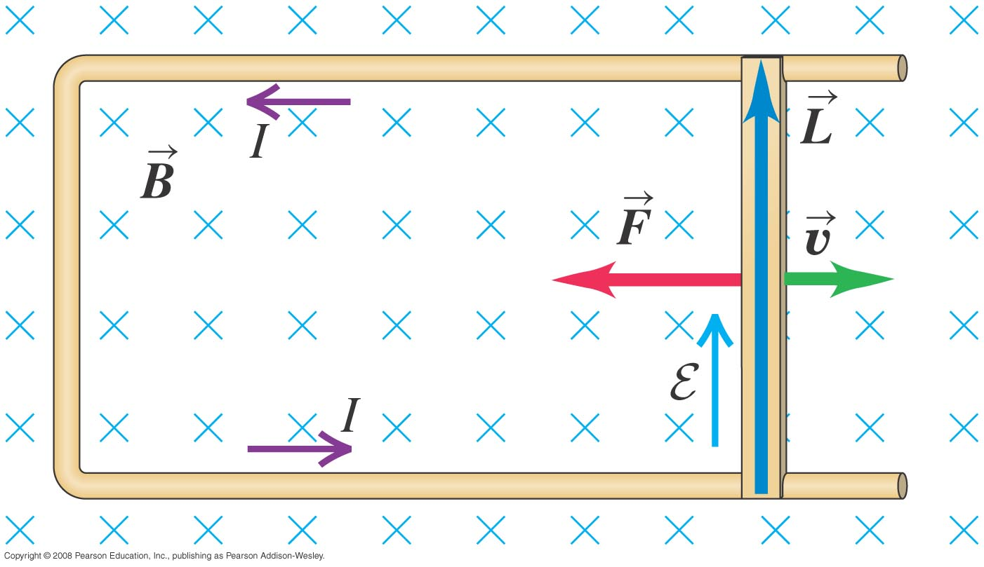
Work and power in the slidewire generator
Read Example 29.6

Slide 15
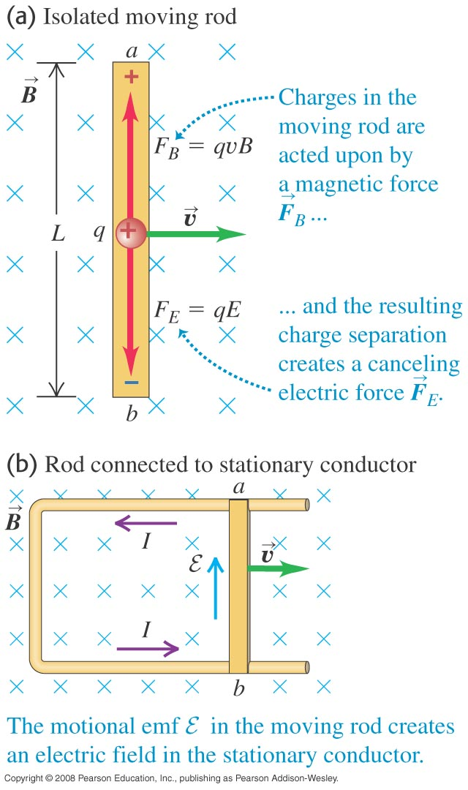
Motional electromotive force
The motional electromotive force across the ends of a rod moving perpendicular to a magnetic field is
ε = vBL.
$$ε=\oint{\left(\vec{v}×\vec{B}\right)∙d\vec{l}}$$

Slide 16
Motional electromotive force of the slidewire generator
Example 29.9: The length of the moving rod is 0.1 m, the velocity v is 2.5 m/s, the total resistance of the loop is 0.03 Ω, and B is 0.6 T. Find the motional emf, the induced current, and the force acting on the rod.

Slide 17
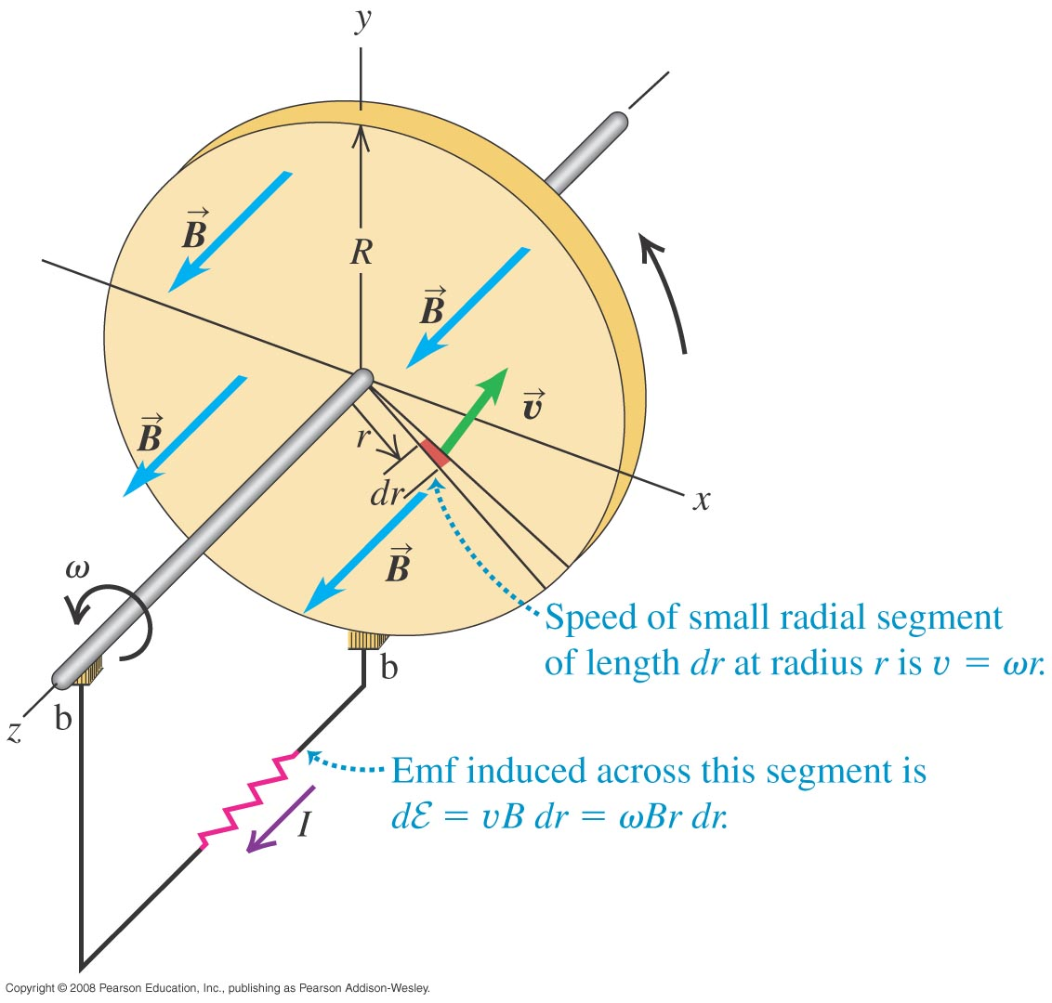
The Faraday disk dynamo
Example 29.10: A conducting disk with radius R that lies in the xy-plane and rotates with constant angular velocity ω about the z-axis. The disk is in a uniform, constant B field in the z-direction. Find the induced emf between the center and rim of the disk.
Answer
ε = 0.5 ω B R²

Slide 18
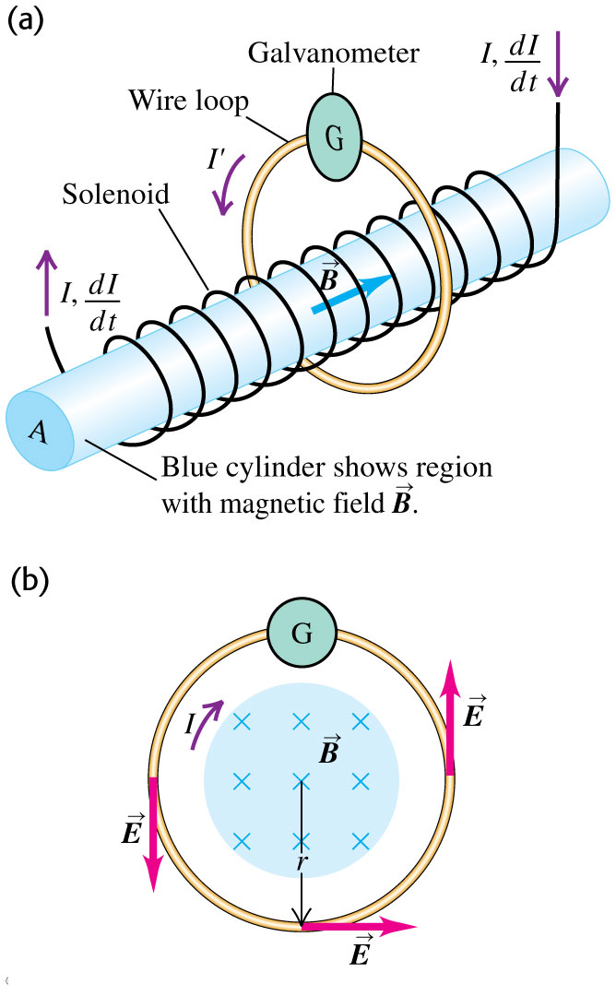
Induced electric fields
Changing magnetic flux causes an induced electric field.
$$ε=\oint{\vec{E}∙d\vec{l}}$$
$$ε=−\frac{dΦ_{B}}{dt}$$
$$\oint{\vec{E}∙d\vec{l}}=−\frac{dΦ_{B}}{dt}$$
$$E=\frac{1}{2πr}\left|\frac{dΦ_{B}}{dt}\right|$$

Slide 19
Induced electric fields
Example 29.11: A long solenoid has 500 turns per meter and cross-sectional area 4 cm². The current in its windings is increasing at 100A/s. (a) Find the magnitude of the induced emf in the wire loop outside the solenoid. (b) Find the magnitude of the induced electric field within the loop if its radius is 2 cm.

Slide 20
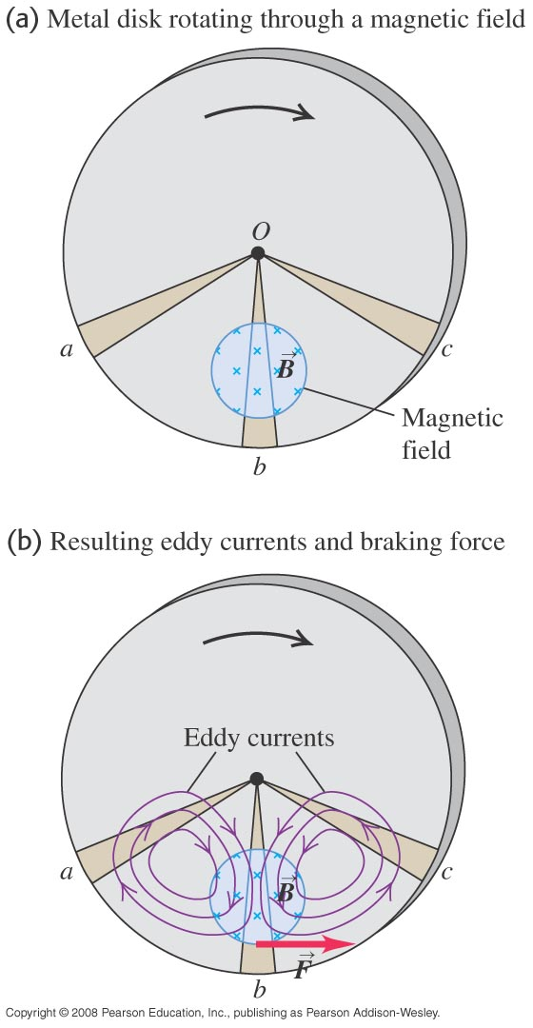
Eddy currents
Follow the text discussion of eddy currents, using Figure 29.19 at the right.

Slide 21
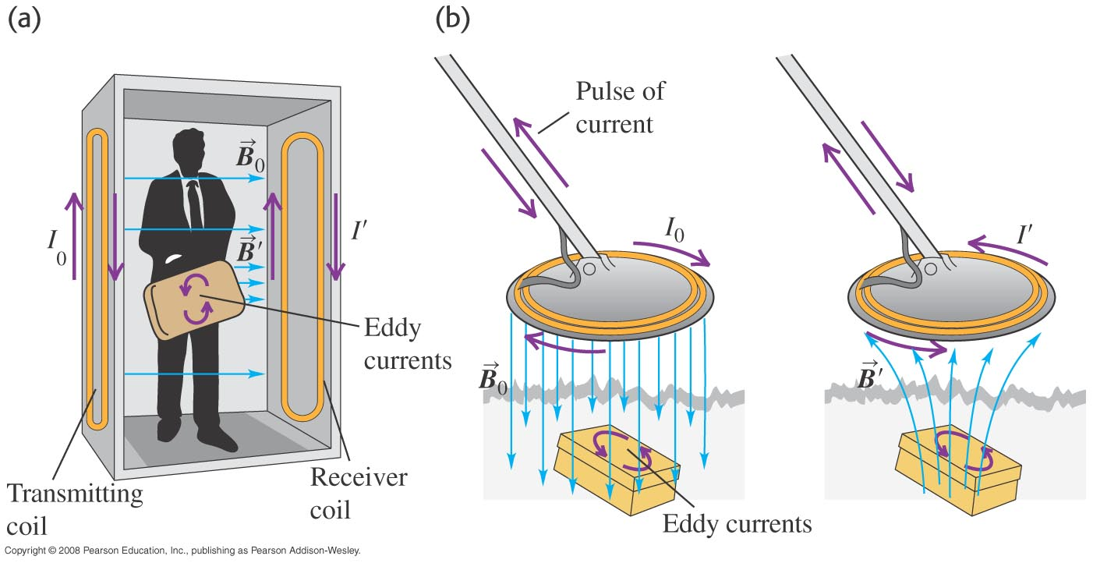
Using eddy currents
Figure 29.20 below illustrates an airport metal detector and a portable metal detector, both of which use eddy currents in their design.

Slide 22
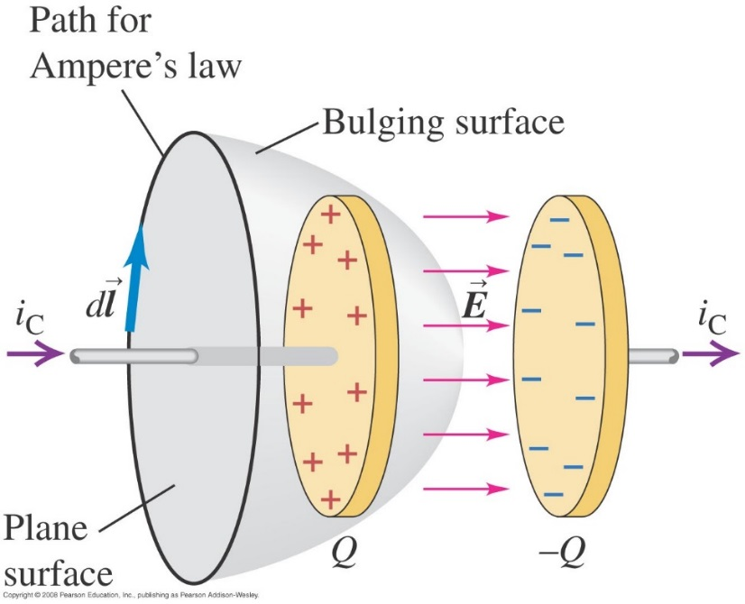
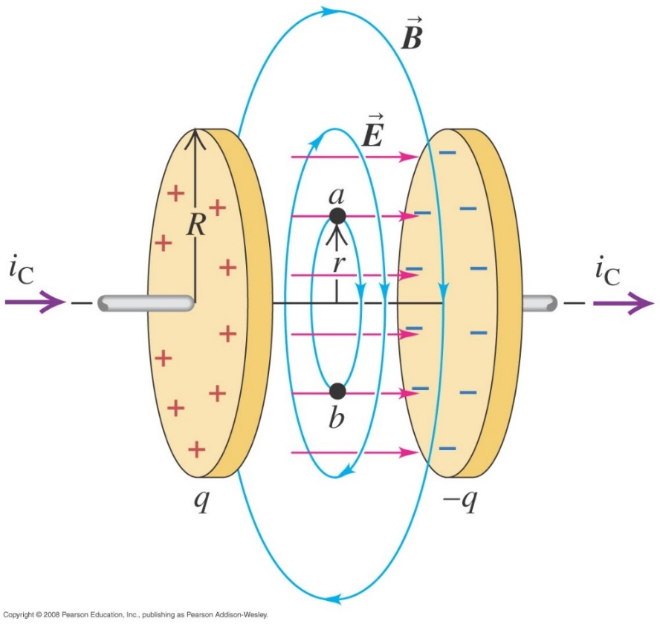
Displacement current
Follow the text discussion displacement current using Figures 29.21 and 29.22 below.
$$\oint{\vec{B}∙d\vec{l}=μ_{0}I_{encl}}$$
$$q=Cv=\frac{εA}{d}\left(Ed\right)=εEA=εΦ_{E}$$
$$i_{D}=\frac{dq}{dt}=ε\frac{dΦ_{d}}{dt}$$
$$\oint{\vec{B}∙d\vec{l}=μ_{0}{\left(i_{c}+i_{D}\right)}_{\text{encl}}}$$

Slide 23
Maxwell’s equations
Maxwell’s equations consist of
Gauss’s law for the electric field
Gauss’s law for the magnetic field
Ampere’s law
Faraday’s law.
Follow the text discussion for the mathematical form of these four fundamental laws.

