Slide 1
Chapter 30
Inductance

Slide 2
Goals for Chapter 30
To learn how current in one coil can induce an emf in another unconnected coil
To relate the induced emf to the rate of change of the current
To calculate the energy in a magnetic field
To analyze circuits containing resistors and inductors
To describe electrical oscillations in circuits and why the oscillations decay

Slide 3
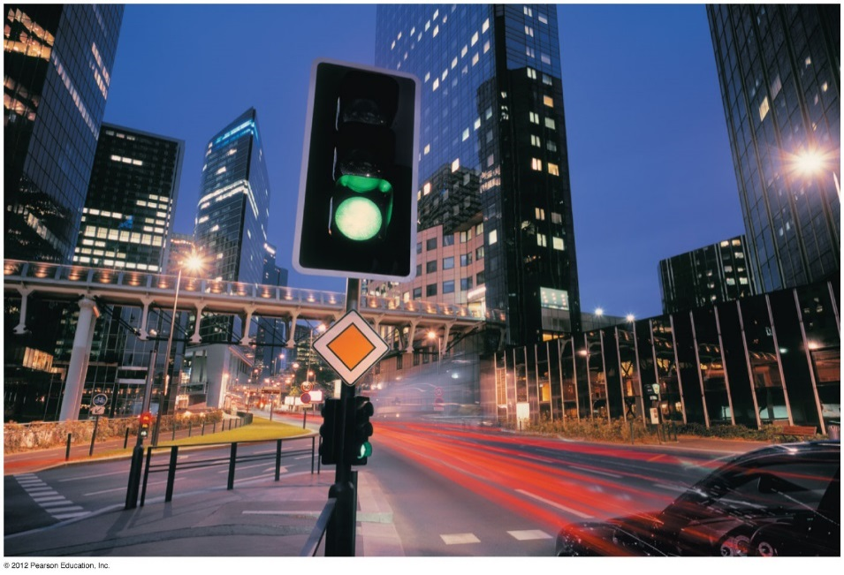
Introduction
How does a coil induce a current in a neighboring coil.
A sensor triggers the traffic light to change when a car arrives at an intersection. How does it do this?
Why does a coil of metal behave very differently from a straight wire of the same metal?
We’ll learn how circuits can be coupled without being connected together.

Slide 4
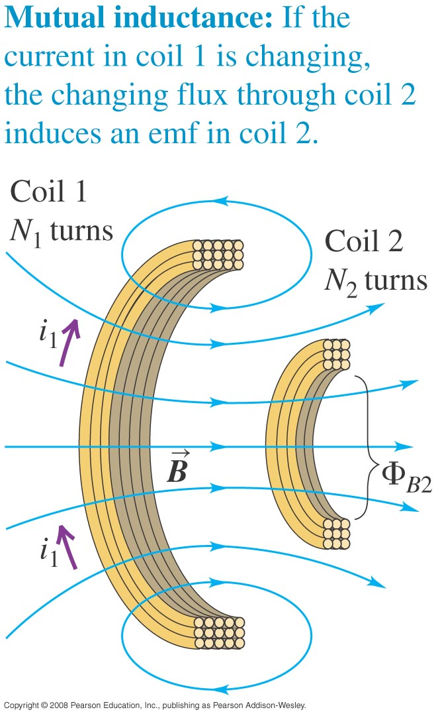
Mutual inductance
Mutual inductance: A changing current in one coil induces a current in a neighboring coil.
$$ε_{2}=−M\frac{di_{1}}{dt}$$
$$ε_{1}=−M\frac{di_{2}}{dt}$$
$$M=\frac{N_{2}Φ_{B2}}{i_{1}}=\frac{N_{1}Φ_{B1}}{i_{2}}$$
Mutual inductance M depends on the geometry of coils. Its unit is Henry.

Slide 5
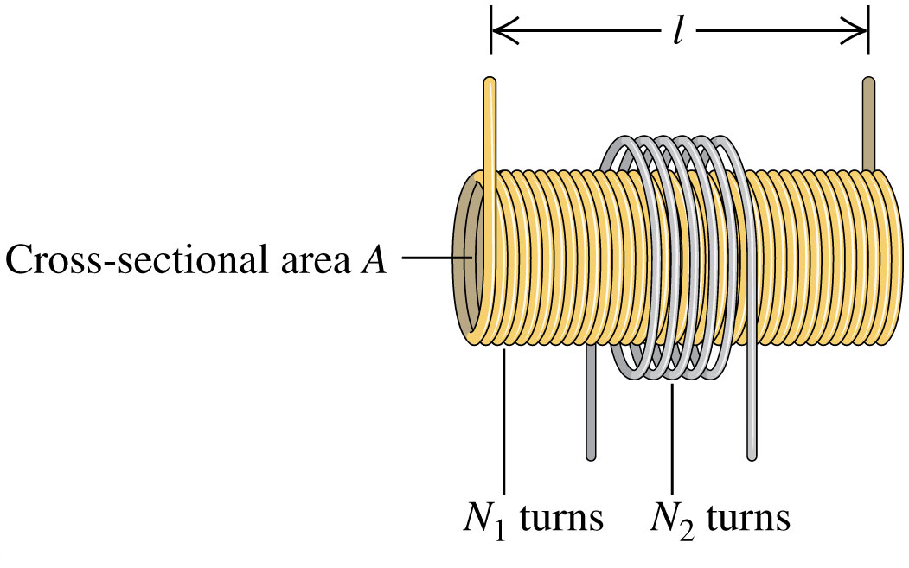
Mutual inductance examples
Example 30.1: A long solenoid with length l and cross-sectional area A is closely wound with N₁ turns of wire. A coil with N₂ turns surrounds it at its center. Find the mutual inductance M.
Answer:
$$M=\frac{μ_{0}AN_{1}N_{2}}{l}$$
Find M if l = 0.5 m, A =10 cm², N₁=1000 turns, and N₂ = 10 turns.
Answer: M = 25 μH

Slide 6
Mutual inductance examples
Example 30.2: Suppose the current i₂ in the outer coil is given by
i₂ = 2t million A/s. (a) at t = 3 μs, what is the average magnetic flux through each turn of the solenoid (coil 1) due to the current in the outer coil? (b) What is the induced emf in the solenoid?
Answer:
$$Φ_{B1}=1.5×{10}^{−7} \text{Wb}$$
$$ε=−50 \text{V}$$

Slide 7
Self-inductance
Self-inductance: A varying current in a circuit induces an emf in that same circuit. See Figure 30.4 below.
$$L=\frac{NΦ_{B}}{i}$$
Self-induced emf
$$ε=−L\frac{di}{dt}$$

Slide 8
Calculating self-inductance and self-induced emf
Example 30.3: Determine the self-inductance of a toroidal solenoid with cross sectional area A and mean radius r closely wound with N turn of wire on a nonmagnetic core. Assume that B is uniform across a cross section.
N = 200 turns, A = 5 cm², r = 0.1 m
Example 30.4: If the current in the toroidal solenoid in example 30.3 increases uniformly from 0 to 6 A in 3 μs find the magnitude and direction of the self-induced emf.

Slide 9
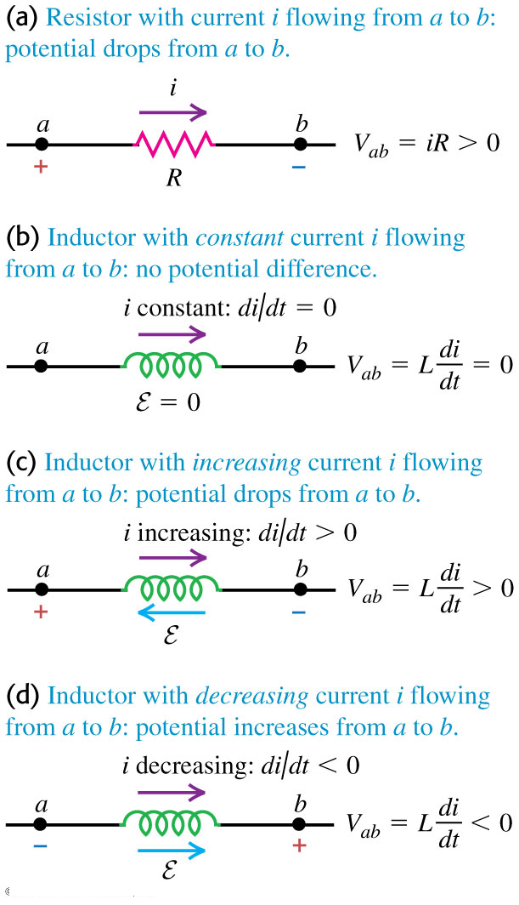
Potential across an inductor and Kirchhoff’s rule
The potential across an inductor depends on the rate of change of the current through it.
Figure 30.6 at the right compares the behavior of the potential across a resistor and an inductor.
The self-induced emf does not oppose current, but opposes a change in the current.

Slide 10
Magnetic field energy
The energy stored in an inductor is
$$U=\frac{1}{2}Li^{2}$$
Magnetic energy density in vacuum
$u=\frac{B^{2}}{2μ_{0}}$ J/m³
Replace $μ_{0}$ by μ for material.

Slide 11
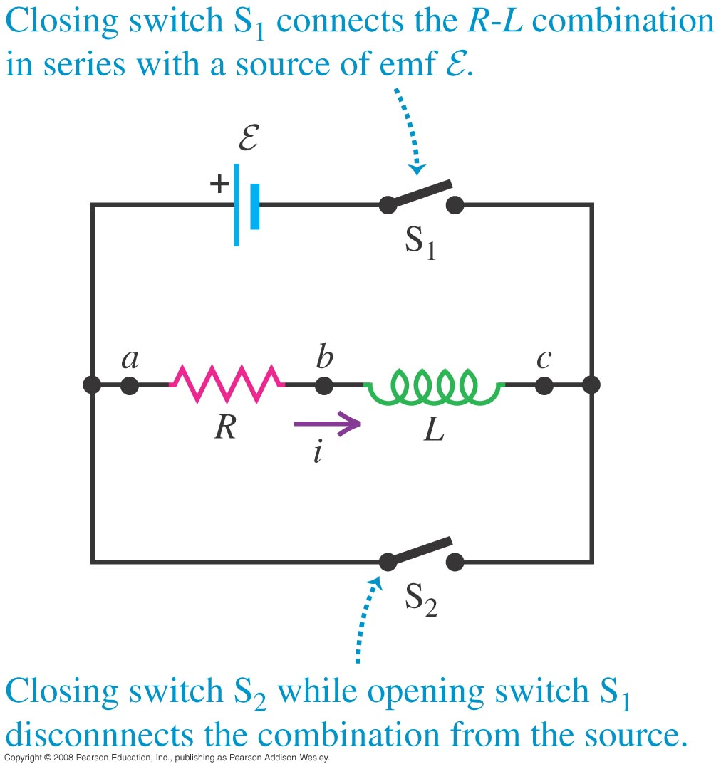
The R-L circuit
An R-L circuit contains a resistor and inductor and possibly an emf source.
Figure 30.11 at the right shows a typical R-L circuit.

Slide 12
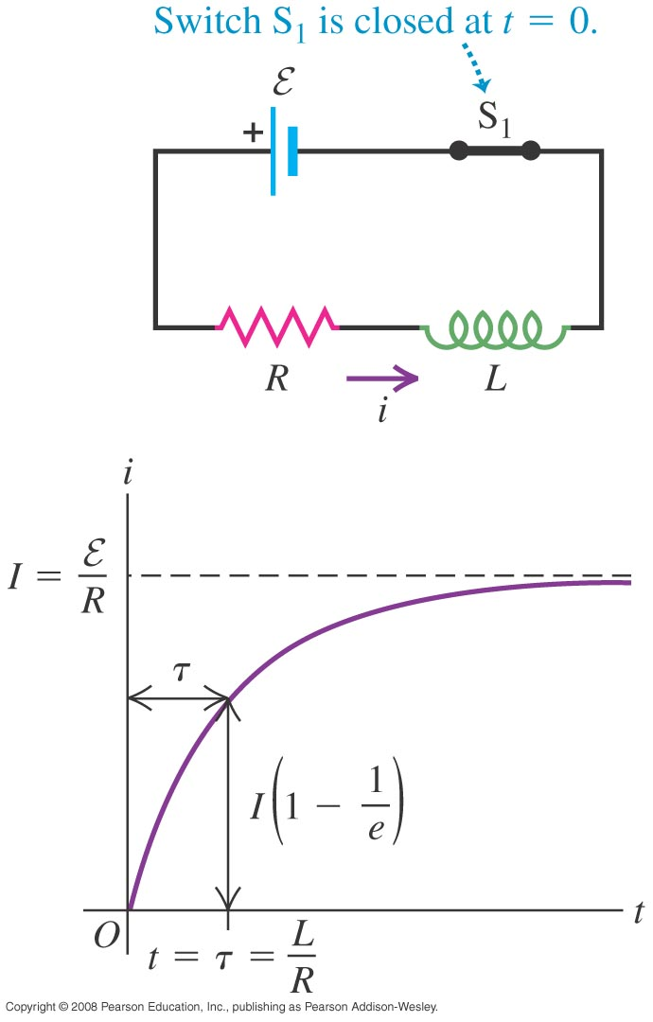
Current growth in an R-L circuit
Current across inductor when switch is closed and initial energy in inductor is zero.
$$i\left(t\right)=\frac{ε}{R}\left(1−e^{−\left(\frac{R}{L}\right)t}\right)$$
$$i\left(t\right)=\frac{ε}{R}\left(1−e^{−\frac{t}{τ}}\right)$$
The time constant for an R-L circuit is τ = L/R.
Figure 30.12 at the right shows a graph of the current as a function of time in an R-L circuit containing an emf source.

Slide 13
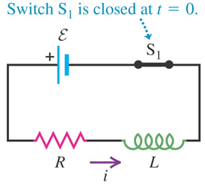
Current growth in an R-L circuit
Example 30.6: A sensitive electronic device of resistance R = 175 Ω is to be connected to a source of emf (of negligible internal resistance) by a switch S₁. The device is designed to operate with a 36-mA current, but to avoid damage to the device, the current can rise to no more than 4.9 mA in the first 58 μs after the switch is closed. An inductor is therefore connected in series with the device, as shown in figure. (a) What is the required source emf ε? (b) What is the required inductance L? (c) What is the R-L time constant τ?
Answer: ε = 6.3 V L = 69 mH τ = 390 μs

Slide 14
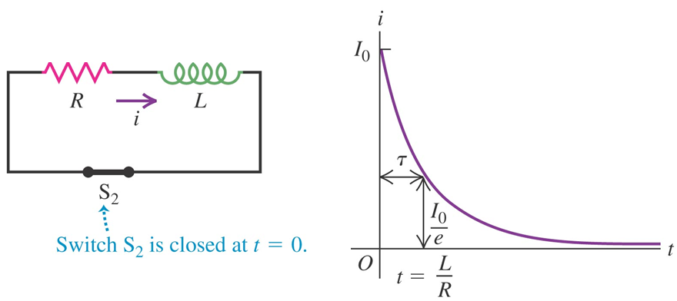
Current decay in an R-L circuit
Current across inductor when switch S₂ is closed and inductor start discharging:
$i\left(t\right)=I_{0}e^{−\left(R/L\right)t}$ $i\left(t\right)=I_{0}e^{−t/τ}$
τ = L/R
I₀ is the initial current in the inductor.

Slide 15
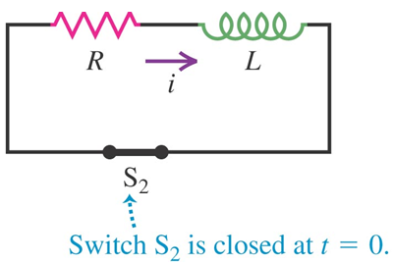
Current decay in an R-L circuit
Example 30.7: When the current in an R-L circuit is decaying, what fraction of the original energy stored in the inductor has been dissipated after 2.3 time constants?
Answer: U = 0.01U₀
The last two sections 3.5 and 3.6 will not be in the quiz or the final exam.

Slide 16
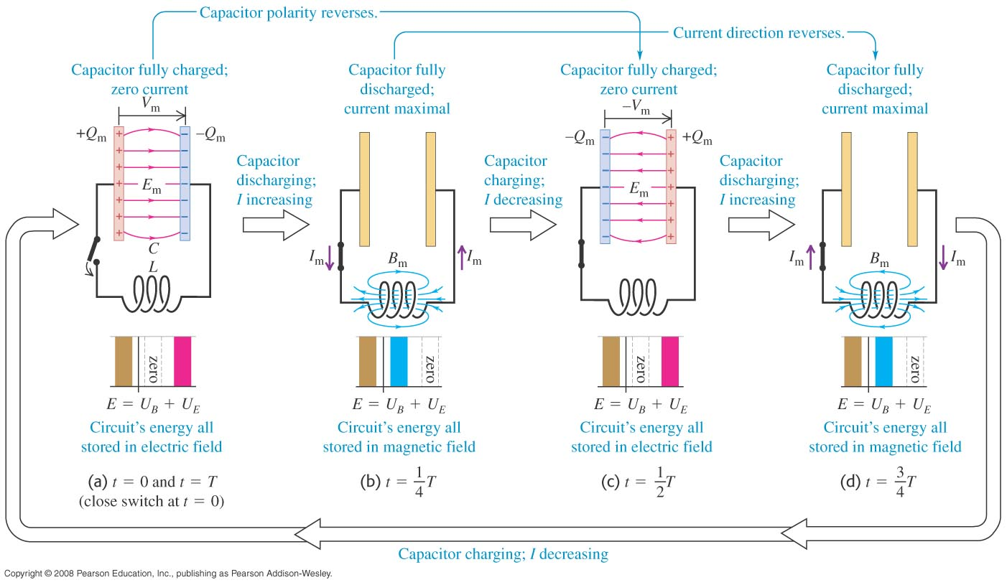
The L-C circuit
An L-C circuit contains an inductor and a capacitor and is an oscillating circuit. See Figure 30.14 below.

Slide 17
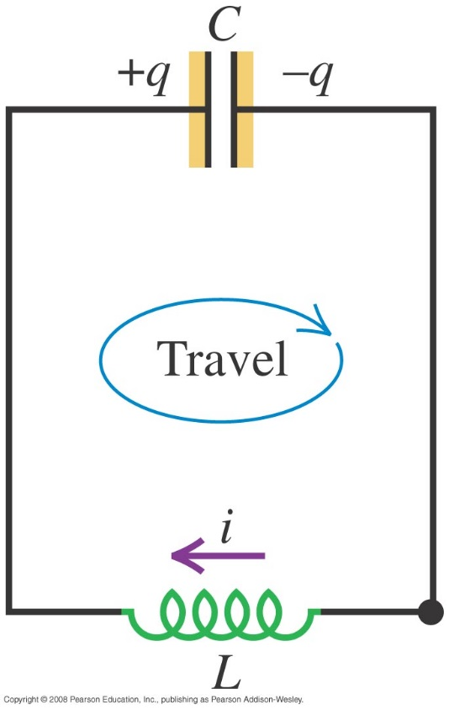
Electrical oscillations in an L-C circuit
Follow the text analysis of electrical oscillations and energy in an L-C circuit using Figure 30.15 at the right.

Slide 18
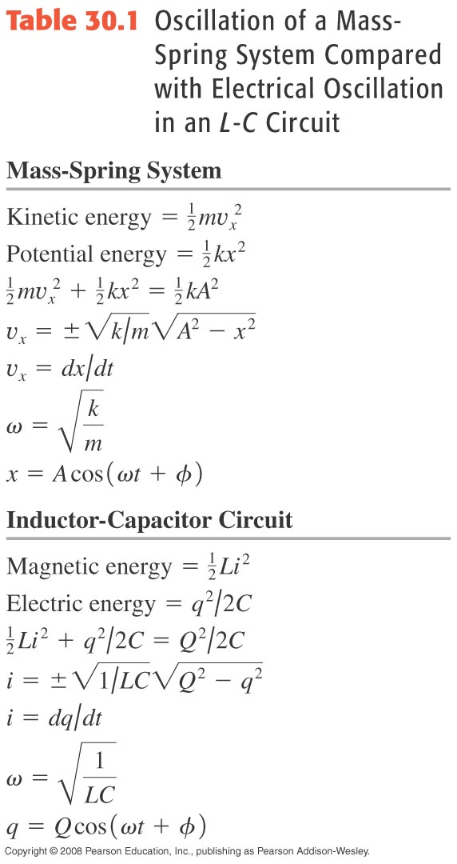
Electrical and mechanical oscillations
Table 30.1 summarizes the analogies between SHM and L-C circuit oscillations.
Follow Example 30.8.
Follow Example 30.9.

Slide 19
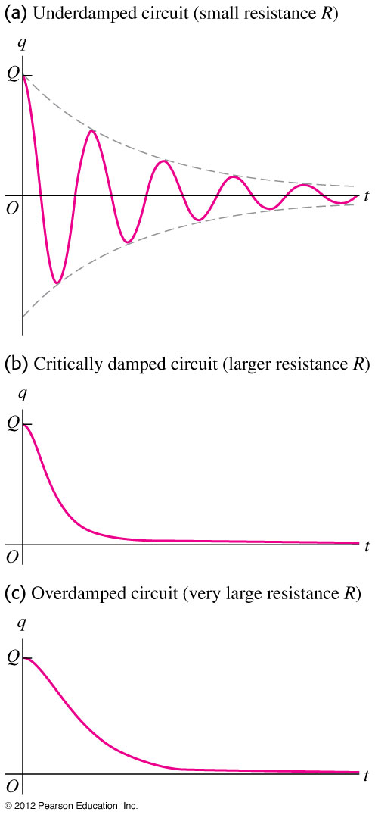
The L-R-C series circuit
Follow the text analysis of an L-R-C circuit.
An L-R-C circuit exhibits damped harmonic motion if the resistance is not too large. (See graphs in Figure 30.16 at the right.)

