Slide 1
Chapter 33
The Nature and Propagation of Light

Slide 2
Goals for Chapter 33
To understand light rays and wavefronts
To analyze reflection and refraction of light
To understand total internal reflection
To analyze the polarization of light
To use Huygens’s principle to analyze reflection and refraction

Slide 3
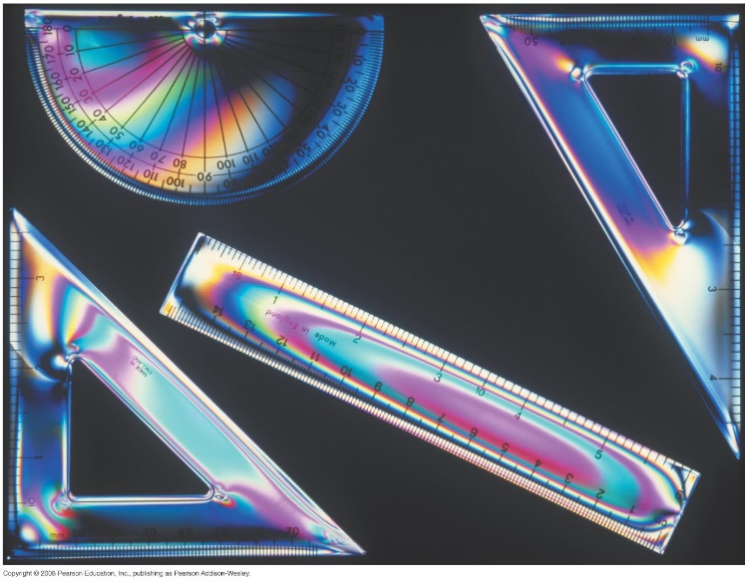
Introduction
Why does a rainbow of colors appear when these tools are placed between polarizing filters?
Our study of light will help us understand why the sky is blue and why we sometimes see a mirage in the desert.
Huygens’s principle will connect the ray and wave models of light.

Slide 4
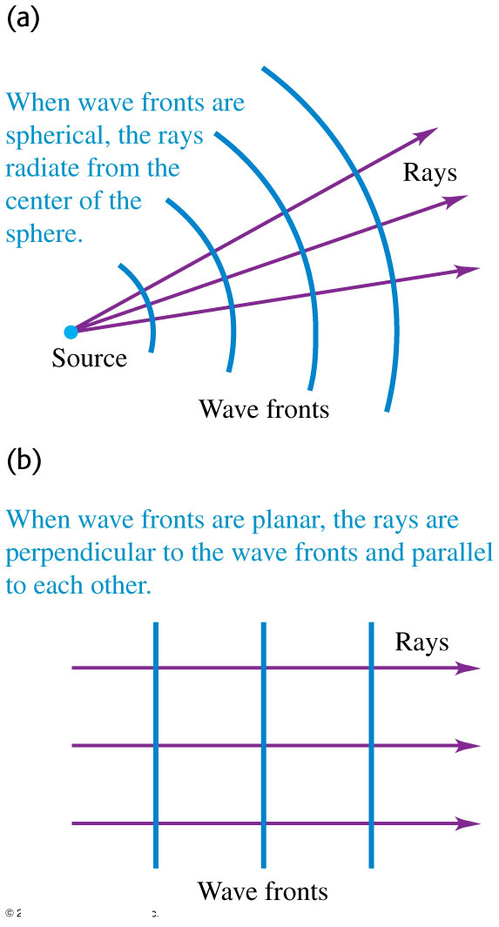
The nature of light
Light has properties of both waves and particles. The wave model is easier for explaining propagation, but some other behavior requires the particle model.
The rays are perpendicular to the wave fronts. See Figure at the right.

Slide 5
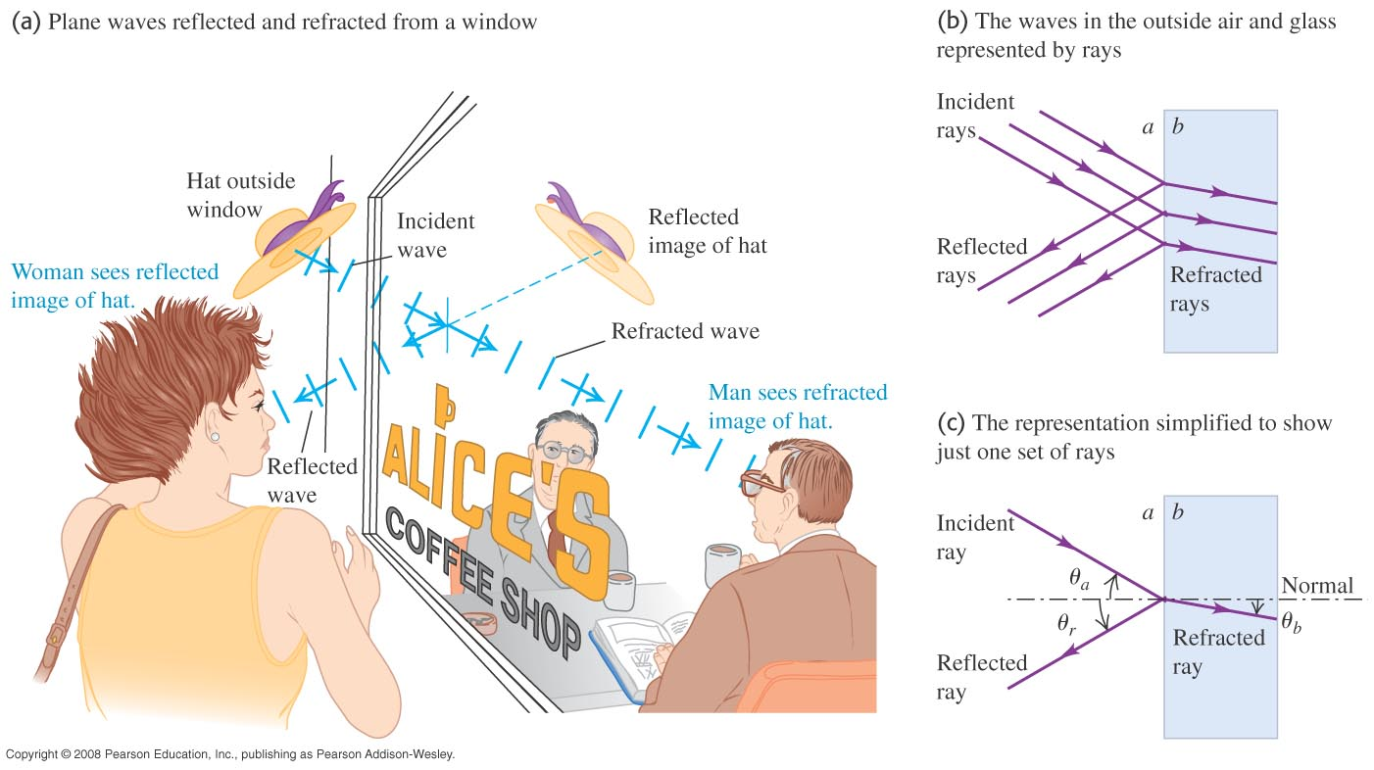
Reflection and refraction
In Figure 33.5 the light is both reflected and refracted by the window.

Slide 6
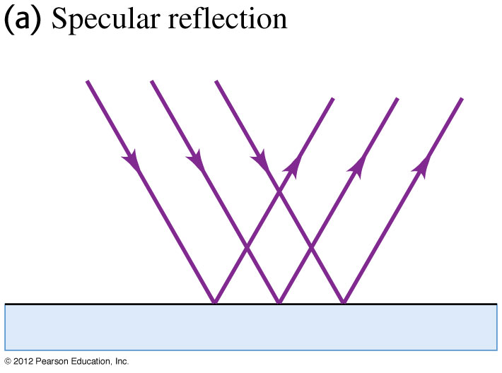
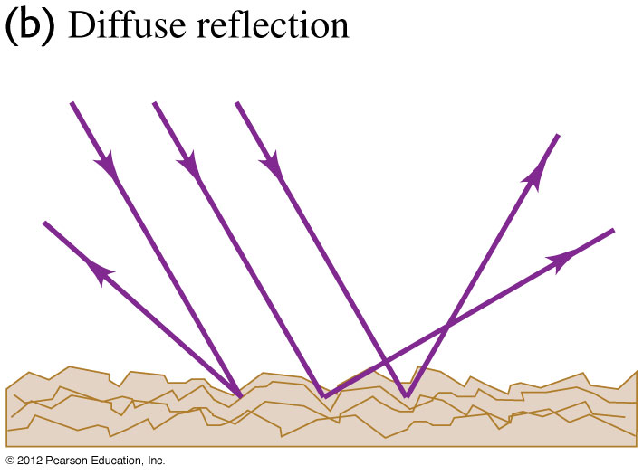
Specular and diffuse reflection
Specular reflection occurs at a very smooth surface (left figure).
Diffuse reflection occurs at a rough surface (right figure).
Our primary concern is with specular reflection.

Slide 7
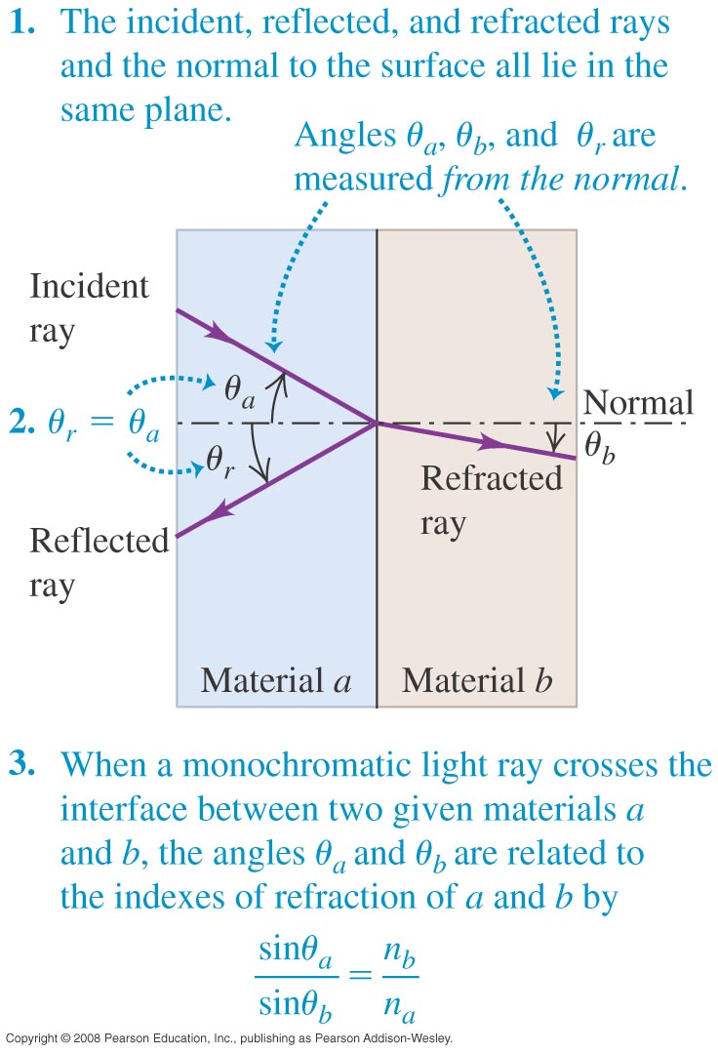
Laws of reflection and refraction
The index of refraction is n = c/v >1.
Angles are measured with respect to the normal.
Law of Reflection: The angle of reflection is equal to the angle of incidence.
$θ_{r}=θ_{a}$
Law of Refraction: Snell’s law
$n_{a}\text{sin}θ_{a}=n_{b}\text{sin}θ_{b}$
In a material λ = λ₀/n.

Slide 8
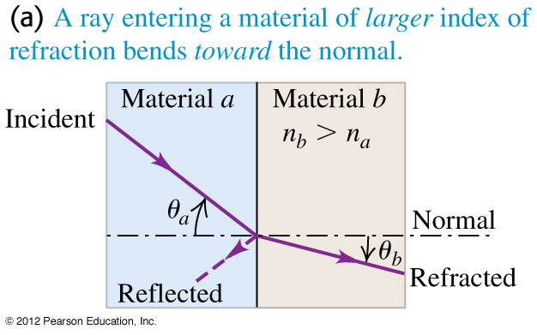
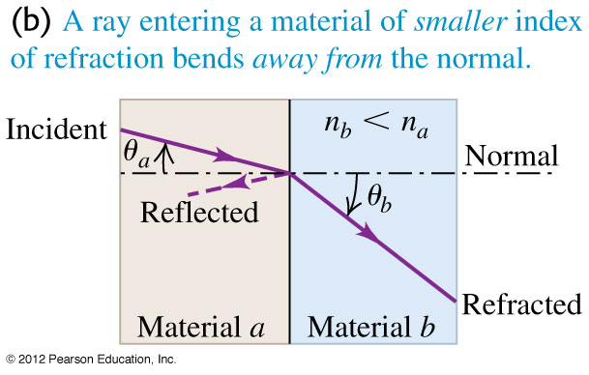
Reflection and refraction in three cases
Figure 33.8 below shows three important cases:
If n_{b} > n_{a}, the refracted ray is bent toward the normal.
If n_{b} < n_{a}, the refracted ray is bent away from the normal.
A ray oriented along the normal never bends.

Slide 9
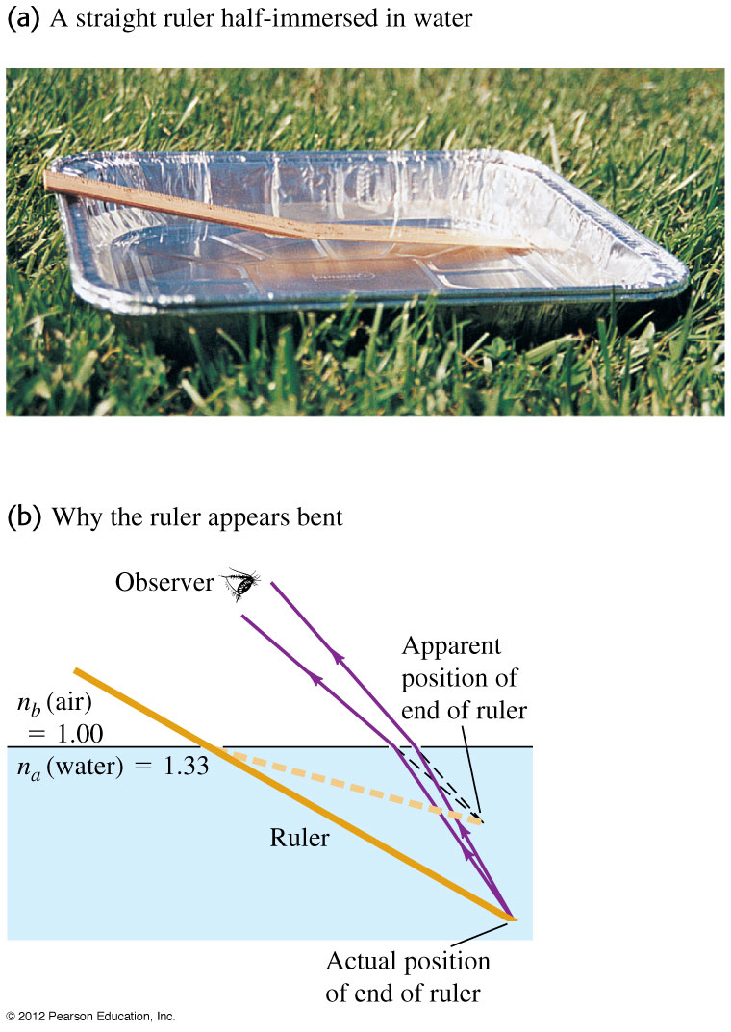
Why does the ruler appear to be bent?
The straight ruler appears to bend at the surface of the water.
Figure below shows why.

Slide 10
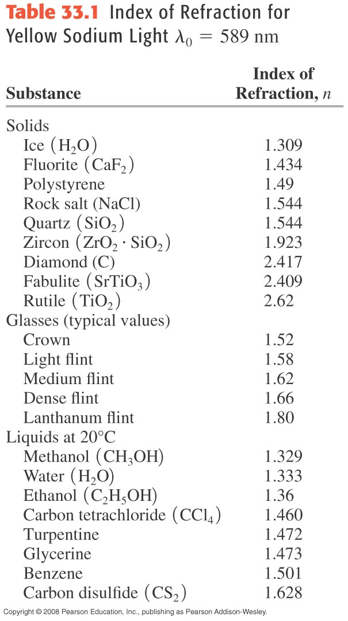
Some indexes of refraction

Slide 11
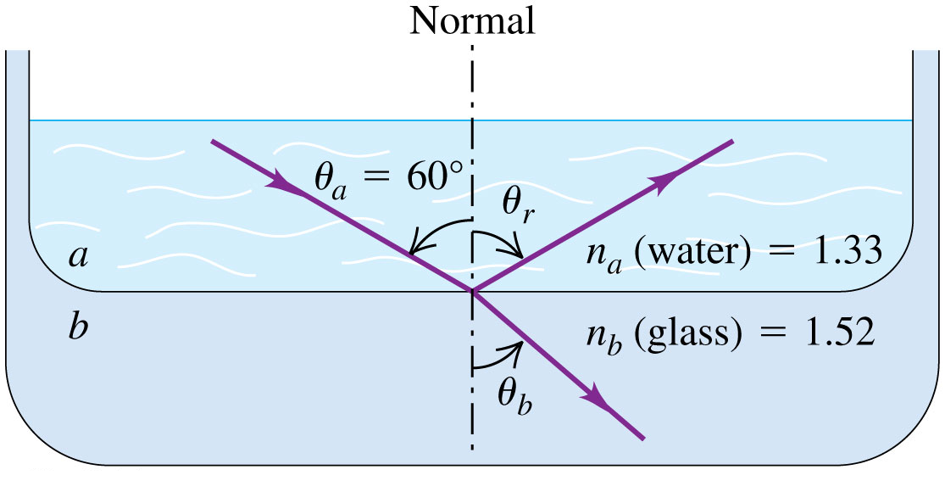
An example of reflection and refraction
Example 33.1: Material a is water and material b is glass with index of refraction 1.52. The incident ray makes an angle of 60.0º with the normal; find the directions of the reflected and refracted rays.
Answer
$$θ_{b}={49.3}^{\text{°}}$$
Example 33.2: The wavelength of the red light from a helium-neon laser is 633 nm in air but 474 nm in the aqueous humor inside your eyeball. Calculate the index of refraction of the aqueous humor and the speed and frequency of the light in it.

Slide 12
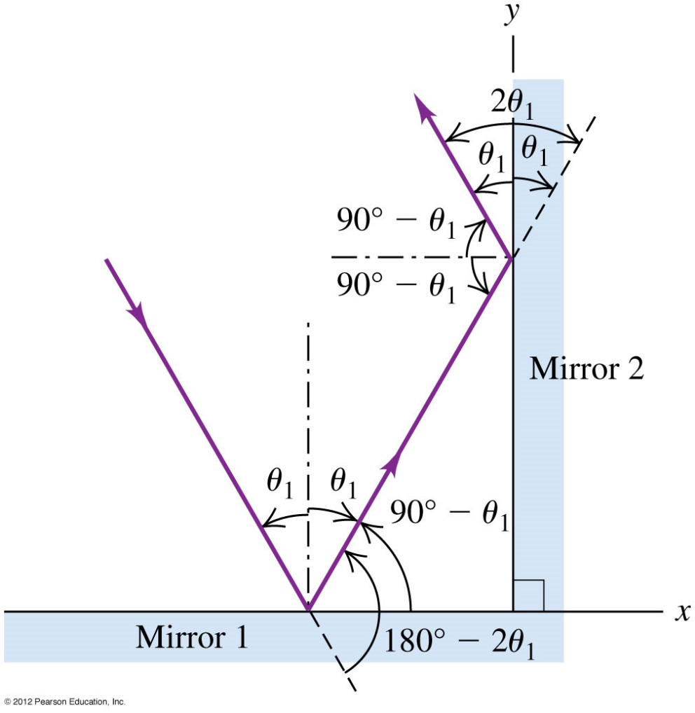
The eye and two mirrors
Example 33.3: Two mirrors are perpendicular to each other. A ray traveling in a plane perpendicular to both mirrors is reflected from one mirror, then the other, as shown in Figure below. What is the ray’s final direction relative to its original direction?

Slide 13
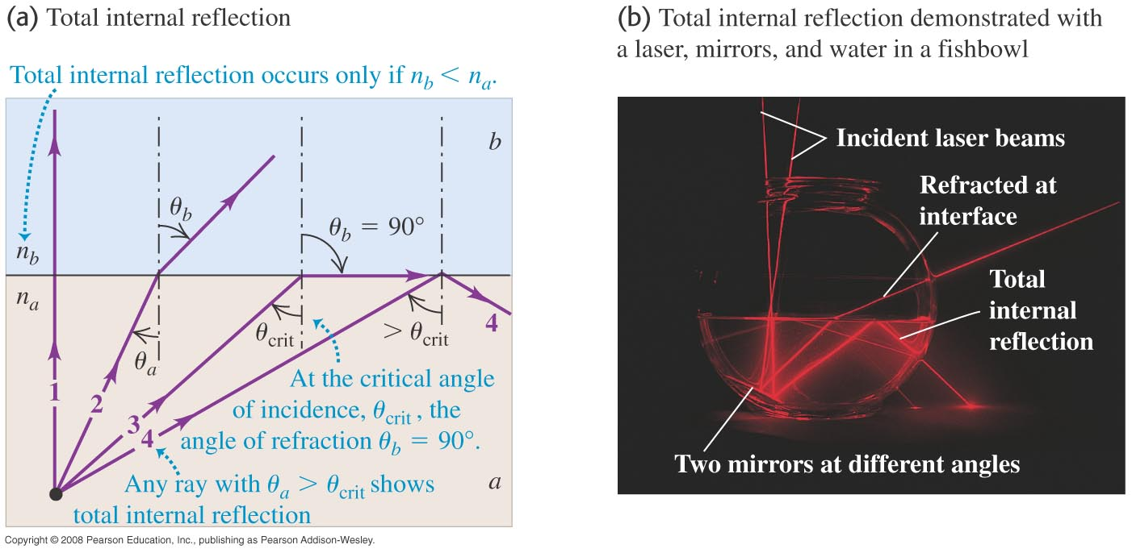
Total internal reflection
Light striking at the critical angle emerges tangent to the surface.
If θ_{a} > θ_{crit}, the light is undergoes total internal reflection.

Slide 14
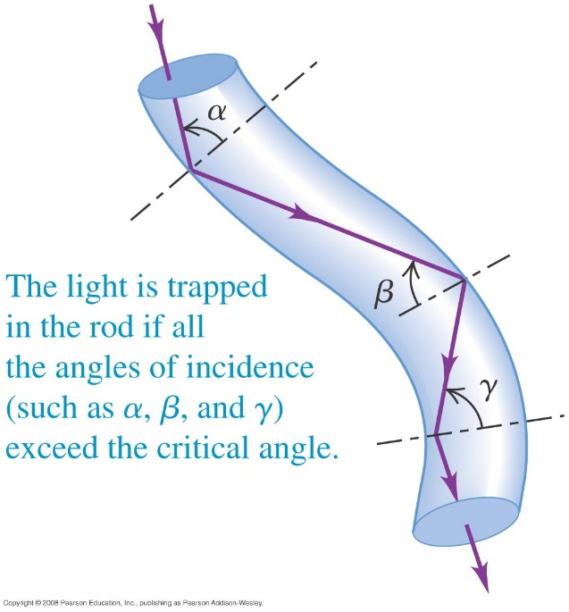
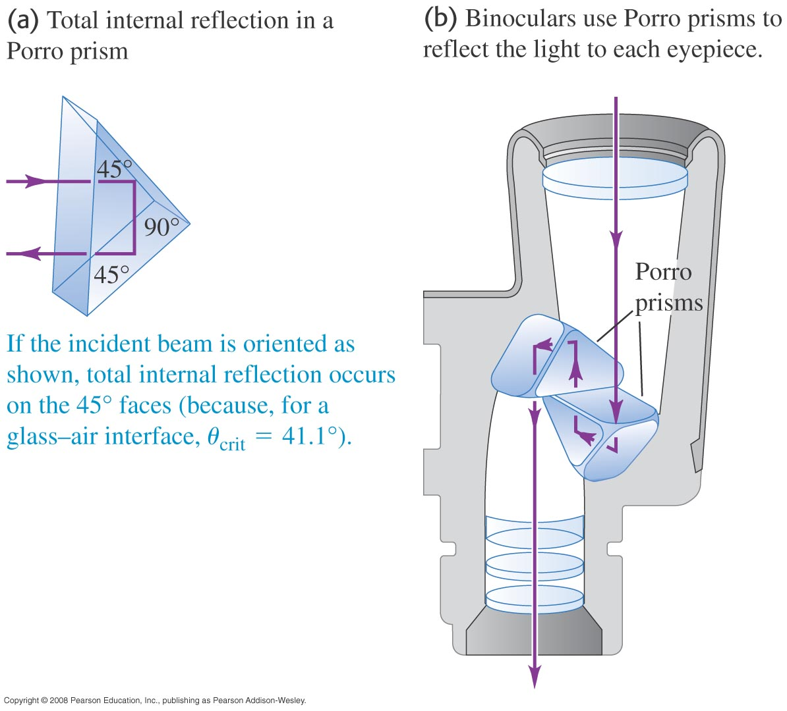
Some applications of total internal reflection
A binocular using Porro prisms (below) and a “light pipe” (right) make use of total internal reflection in their design.

Slide 15
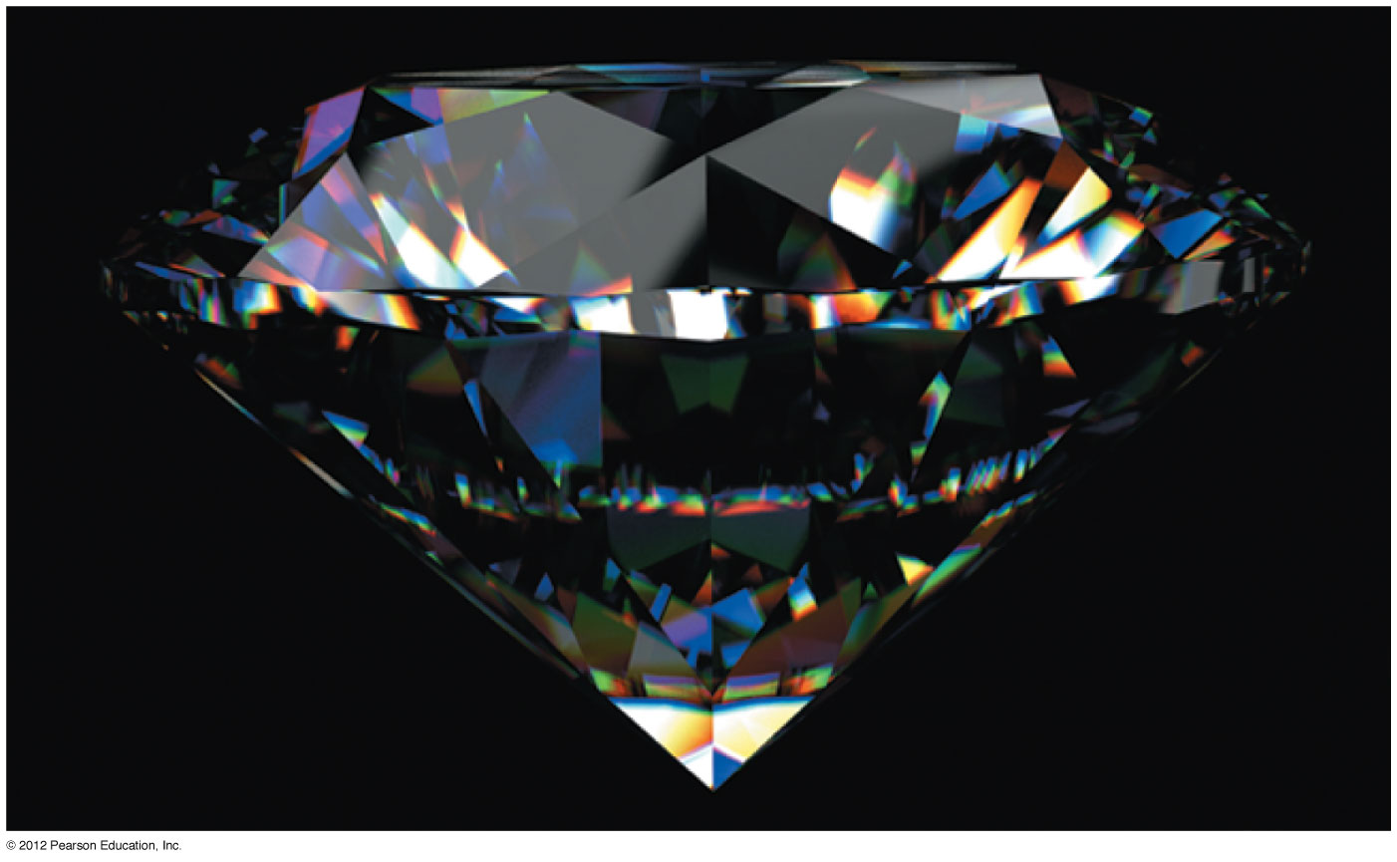
A diamond and a periscope
Diamonds sparkle because they are cut so that total internal reflection occurs on their back surfaces. See Figure 33.17 below.
Follow Conceptual Example 33.4.

Slide 16
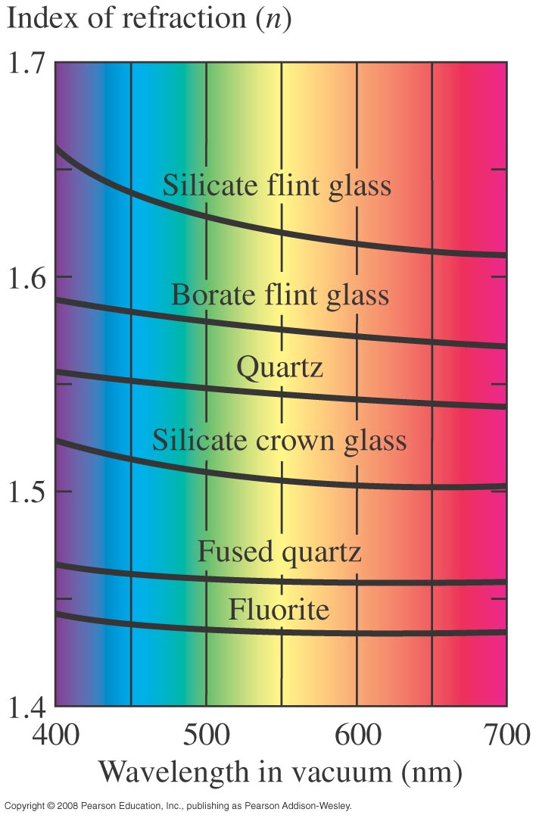
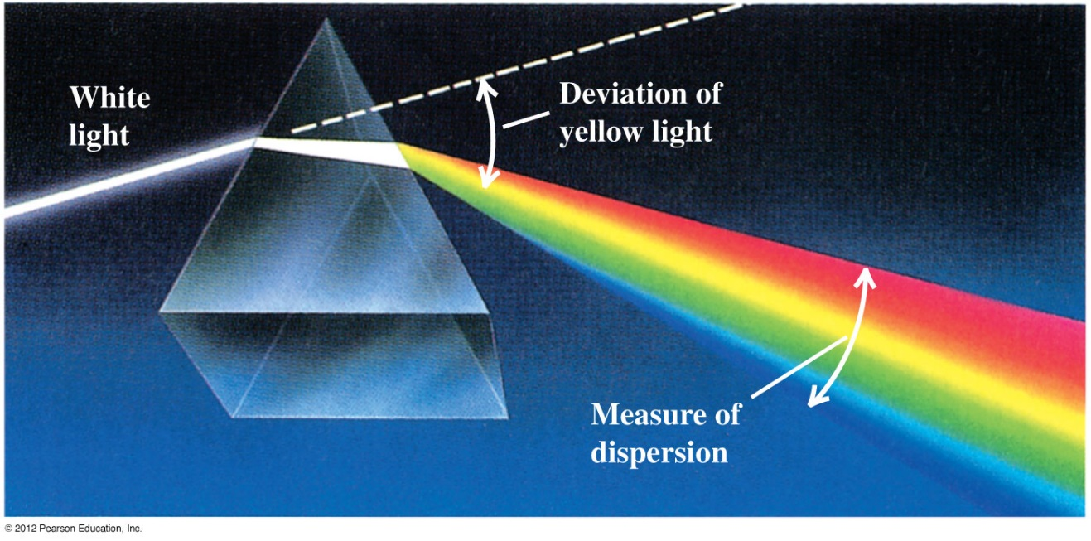
Dispersion
Dispersion: The index of refraction depends on the wavelength of the light. See Figure right.
Figure below shows dispersion by a prism.
a
b
$$n=\frac{λ_{0}}{λ}$$
$$\text{sin}θ_{b}=\frac{n_{a}}{n_{b}}\text{sin}θ_{a}$$
$$\text{sin}θ_{a}=\frac{n_{b}}{n_{a}}\text{sin}θ_{b}$$

Slide 17
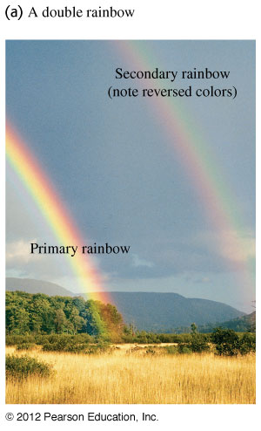
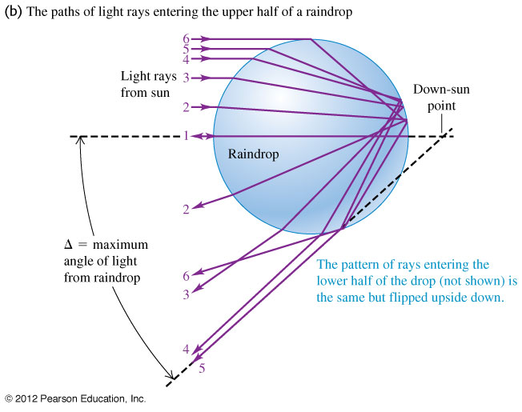
Rainbows—I
The formation of a rainbow is due to the combined effects of dispersion, refraction, and reflection.

Slide 18
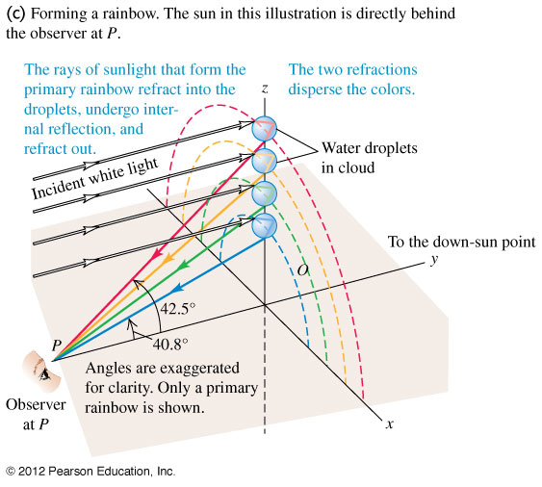
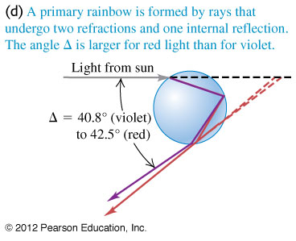
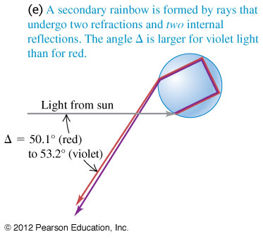
Rainbows—II

Slide 19
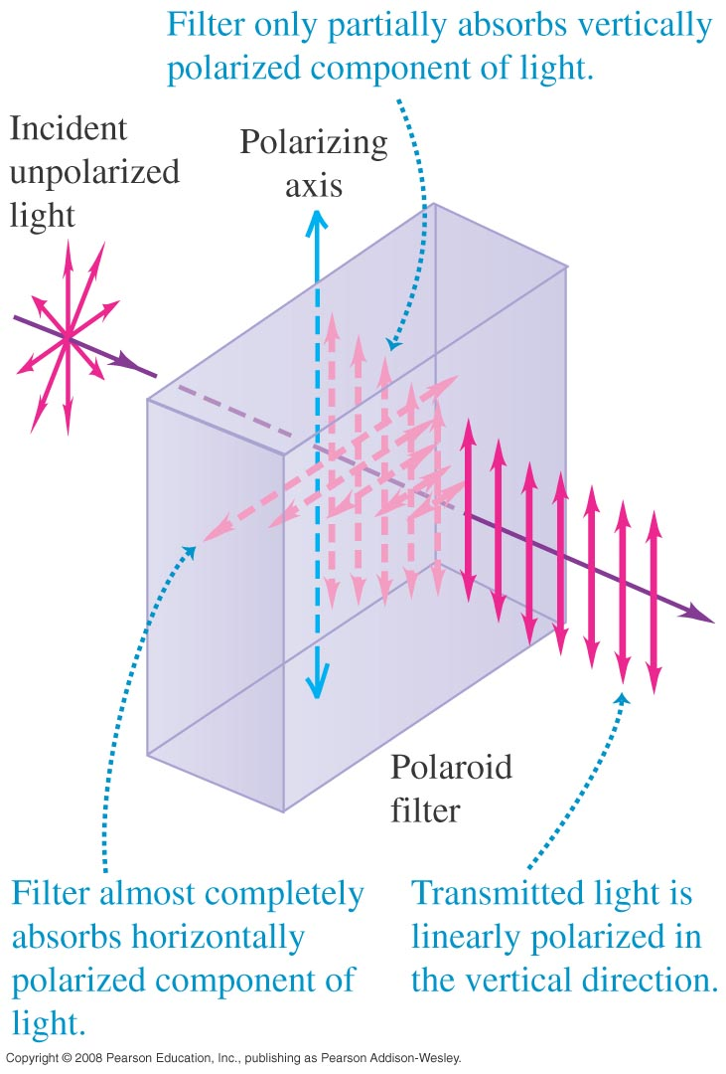
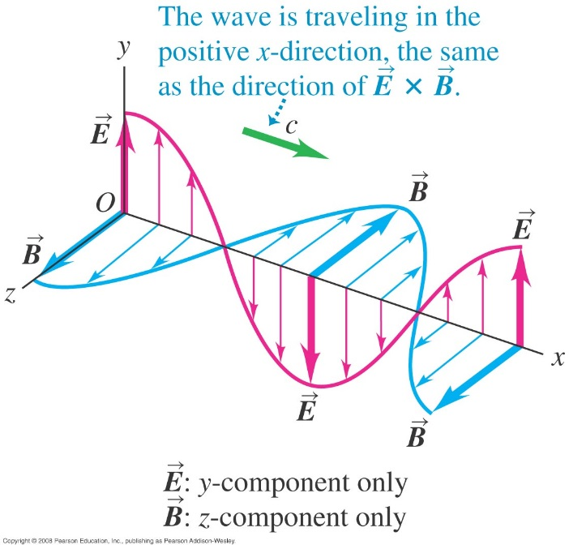
Polarization
An electromagnetic wave is linearly polarized if the electric field has only one component.
$$\vec{E}\left(x,t\right)=\hat{J}E_{max}cos⁡(kx−ωt)$$
$$\vec{B}\left(x,t\right)=\hat{k}B_{max}cos⁡(kx−ωt)$$
Figure at the right shows a Polaroid polarizing filter.

Slide 20
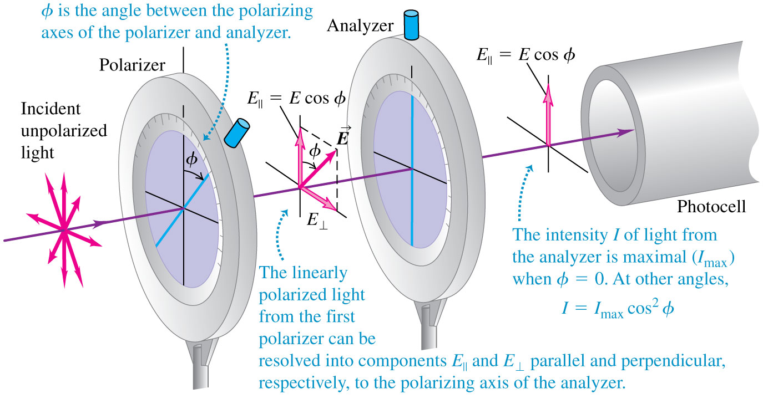
Malus’s law
Figure 33.25 below shows a polarizer and an analyzer.
Intensity of EM wave $I=\frac{{E_{max}B}_{max}}{2μ_{0}}=\frac{{E_{max}}^{2}}{2μ_{0}c}$
Malus’s law: I = I_{max}cos²φ. (polarized light passing through an analyzer)

Slide 21
Malus’s law
Example 33.5: The incident unpolarized light has intensity I_{o}. Find the intensities transmitted by the first and second polarizers if the angle between the axes of the two filters is 30º.

Slide 22
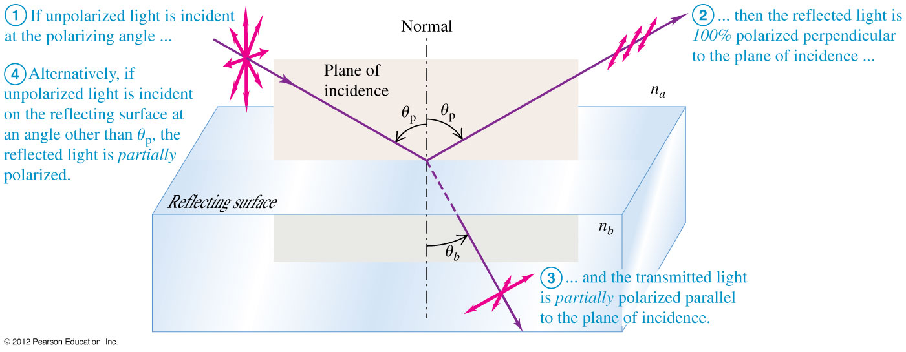
Polarization by reflection
When light is reflected at the polarizing angle θ_{p}, the reflected light is linearly polarized. See Figure below.

Slide 23
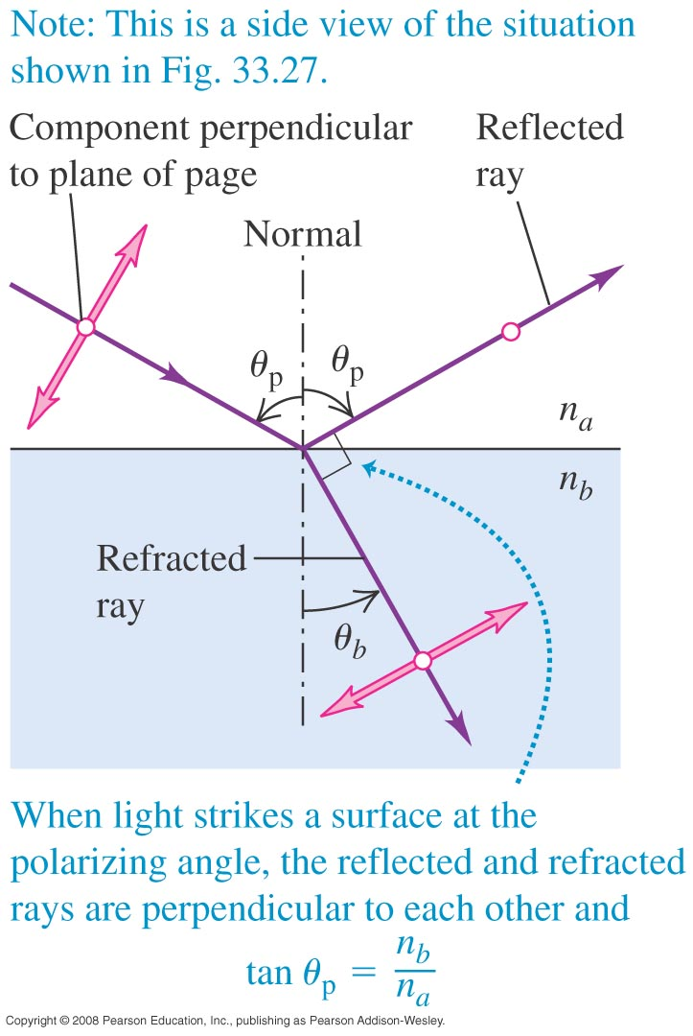
Brewster’s law
Brewster’s law: tan θ_{p} = n_{b}/n_{a}.
At the polarizing angle, the reflected and refracted rays are perpendicular to each other.

Slide 24
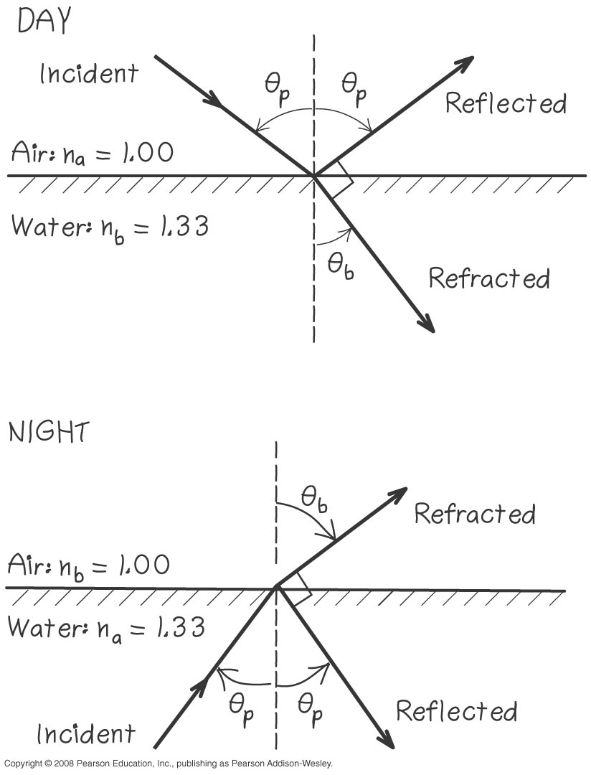
Reflection from a swimming pool
Example 33.6: Sunlight reflects off the smooth surface of a swimming pool. (a) for what angle of reflection is the reflected light completely polarized? (b) What is the corresponding angle of refraction? (c) At night, and underwater floodlight is turned on in the pool. Repeat parts (a) and (b) for rays from the floodlight that strike the surface from below.

Slide 25
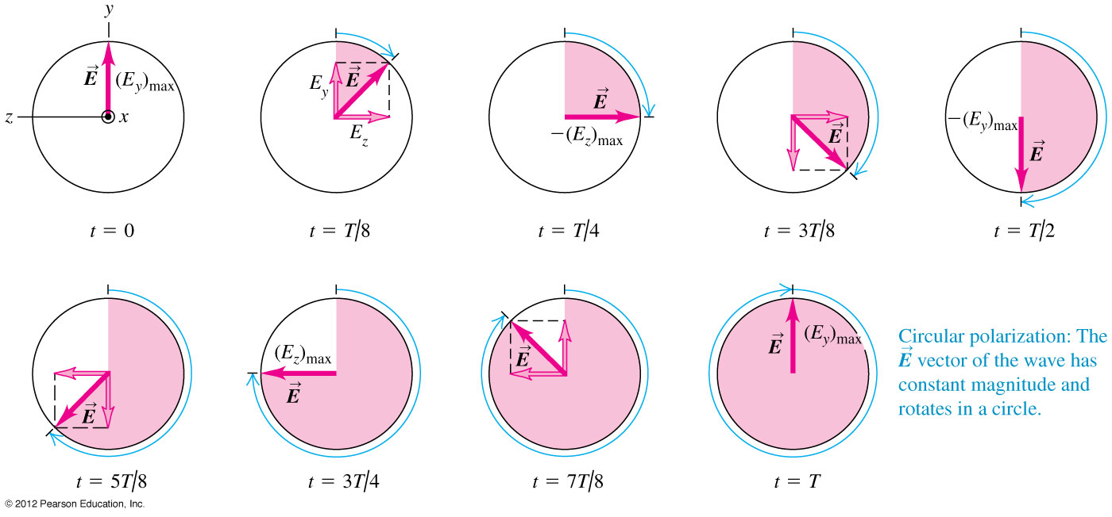
Circular polarization
Circular polarization results from the superposition of two perpendicularly polarized electromagnetic waves having equal amplitude but a quarter-cycle phase difference. The result is that the electric field vector has constant amplitude but rotates about the direction of propagation. (Figure 33.30 below.)

Slide 26
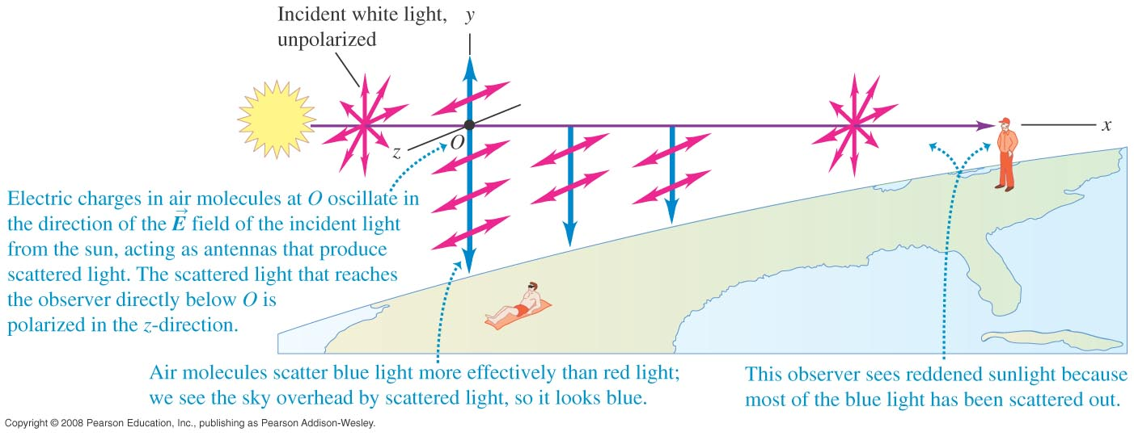
Scattering of light
Scattering occurs when light has been absorbed by molecules and reradiated.
Intensity of scattered light from air molecule ∝ f ⁴. Scattered light contains 15 times as much blue light as red.

Slide 27
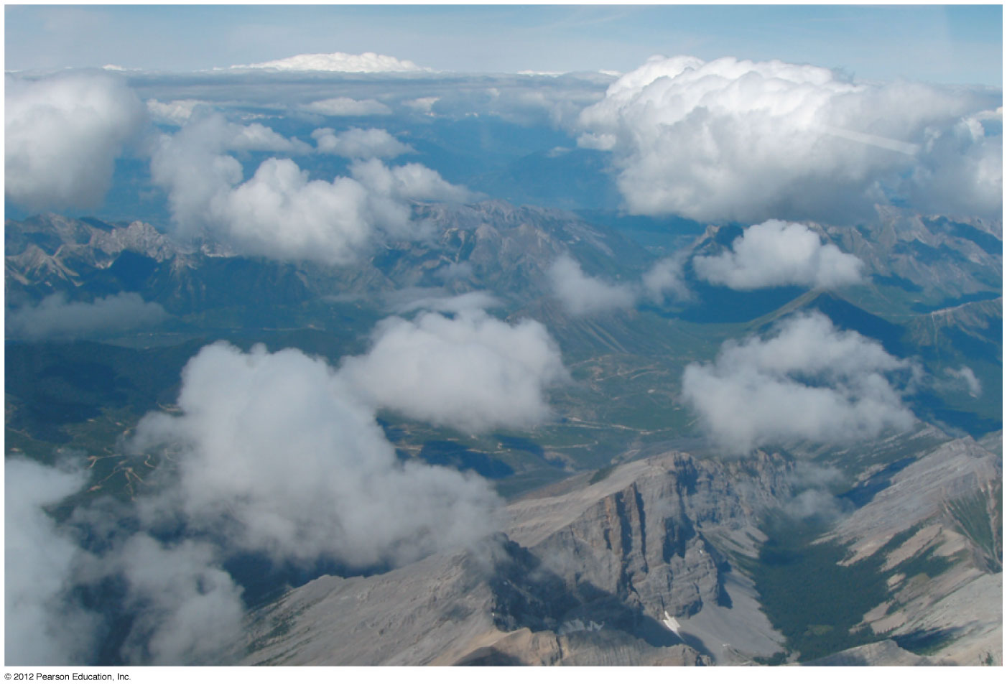
Why are clouds white?
Clouds are white because they scatter all wavelengths efficiently.

Slide 28
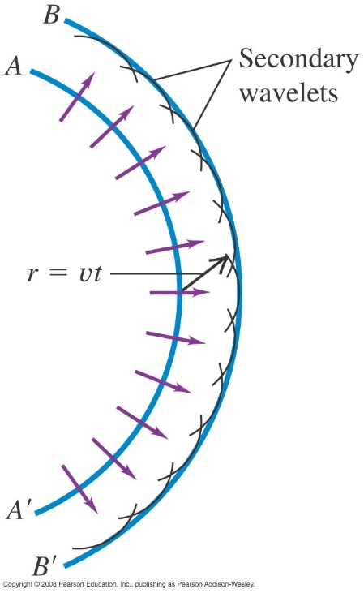
Huygens’s principle
Huygens’s principle: Every point of a wave front can be considered to be a source of secondary wavelets that spread out in all directions with a speed equal to the speed of propagation of the wave.

Slide 29
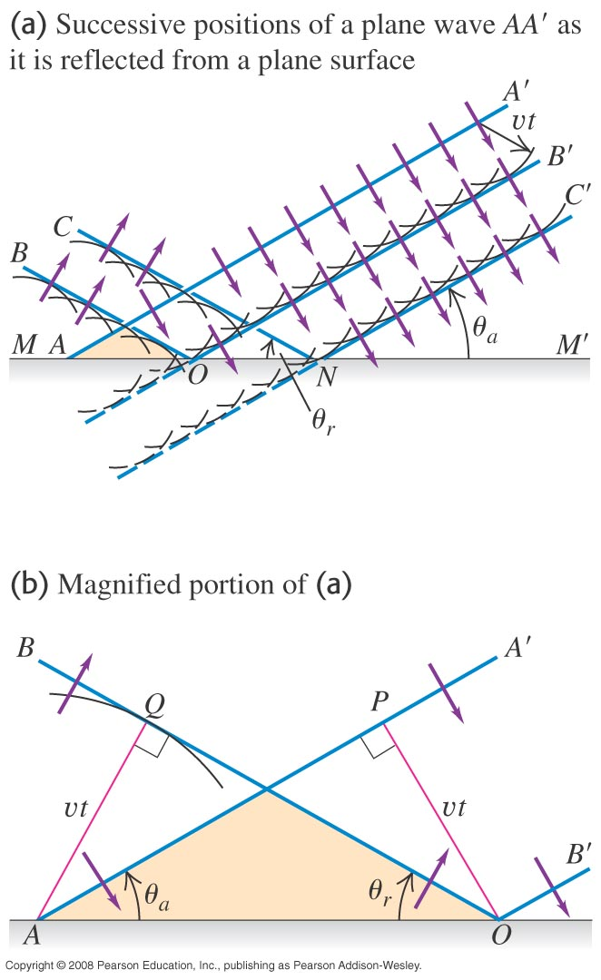
Reflection and Huygens’s principle
Figure 33.35 at the right shows how Huygens’s principle can be used to derive the law of reflection.

Slide 30
Refraction and Huygens’s principle
Huygens’s principle can be used to derive the law of reflection.
Follow the text analysis using Figure 33.36 below.

Slide 31
A mirage
Huygens’s principle can also explain the formation of a mirage. See Figure 33.37 below.

