Slide 1
Signals and Systems
Chapter 1
Dr. Mohamed Bingabr
University of Central Oklahoma

Slide 2
Signals and Systems Outline
Size of a Signal
Useful Signal Operations
Classification of Signals
Signal Models
Classification of Systems
System Model: Input-Output Description

Slide 3
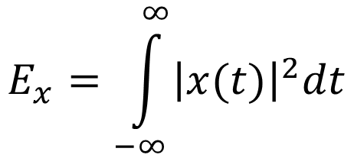
Size of Signal-Energy Signal
Signal: is a set of data or information collected over time.
If the signal goes to zero as time goes to infinity, then the signal is measured by its energy E_{x}:
$$E_{x}=\int_{−∞}^{∞}{{\left|x(t)\right|}^{2}dt}$$
Example: Find the energy of the signal x(t) = 2e^{-3t} t ≥ 0

Slide 4
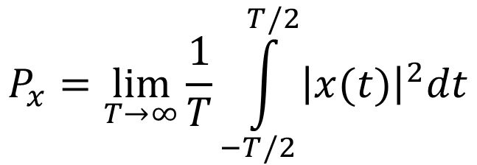
Size of Signal-Power Signal
If the signal is periodic or the amplitude of x(t) does not → 0 when t →∞ ", need to measure power P_{x} instead:
$$P_{x}=\lim_{T→∞}{\frac{1}{T}\int_{−T/2}^{T/2}{{\left|x(t)\right|}^{2}dt}}$$
Example: Find the power of the signal x(t) = Acos(10πt)

Slide 5
Useful Signal Operations
Time Delay
Times Scaling
Time Reversal

Slide 6
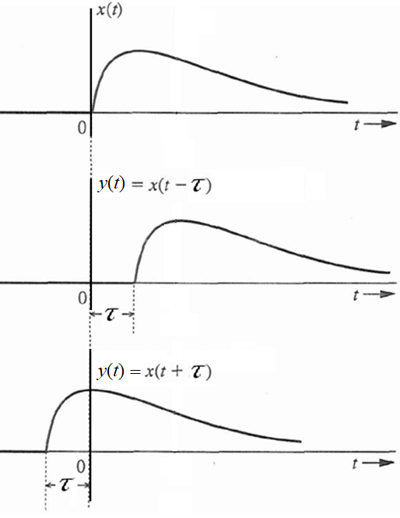
Time Delay
Signal x(t)
x(t) delayed by time τ
y(t) = x (t – τ)
x(t) advanced by time τ :
y(t) = x (t + τ)

Slide 7
Time Delay Example
Find x(t-2) and x(t+2) for the signal
x(t)
2
t
1
4

Slide 8
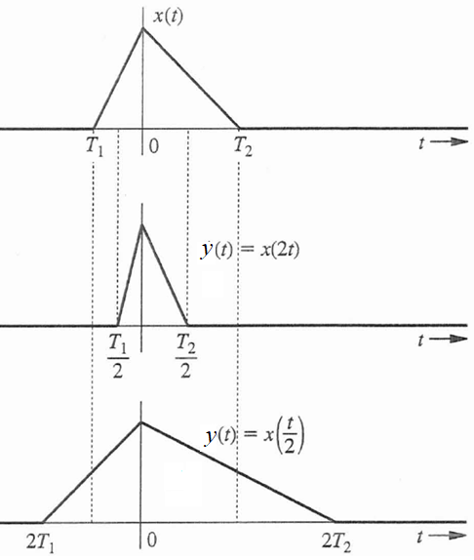
Time Scaling
x(t) compressed in time by a factor of 2:
y(t) = x (2t)
x(t) expanded in time
by a factor of 2:
y(t) = x (t/2)
Same as a recording played back at twice and half the speed respectively

Slide 9
Time Scaling Example
Find x(2t) and x(t/2) for the signal
x(t)
2
t
1
4

Slide 10
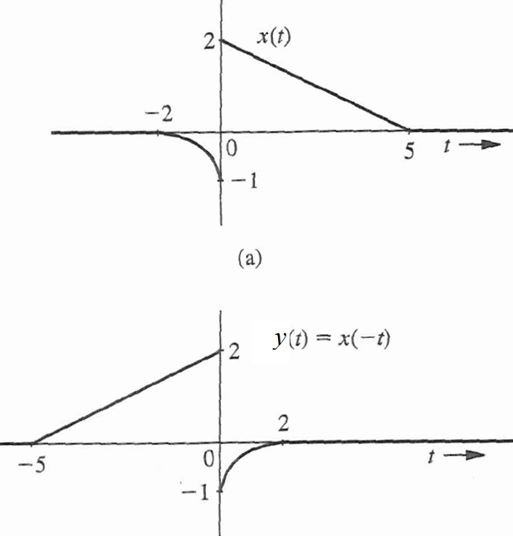
Time Reversal
Signal may be reflected about the vertical axis (i.e. time reversed):
y(t) = x (-t)

Slide 11
Example
x(t)
Find the signal x(2t - 6)
can be obtained in two ways;
• Delay x(t) by 6 to obtain x(t - 6), and then time-compress this
signal by factor 2 (replace t with 2t) to obtain x(2t - 6).
• Alternately, time-compress x(t) by factor 2 to obtain x(2t), then delay this signal by 3 (replace t with t – 3→ x(2(t-3)), to obtain x(2t - 6).
2
t
1
4
x(2t-6)
2
t
3.5
5

Slide 12
Signal Classification
Signals may be classified into:
1. Continuous-time and discrete-time signals
2. Analog and digital signals
3. Periodic and aperiodic signals
4. Energy and power signals
5. Deterministic and probabilistic signals
6. Causal and non-causal
7. Even and Odd signals

Slide 13
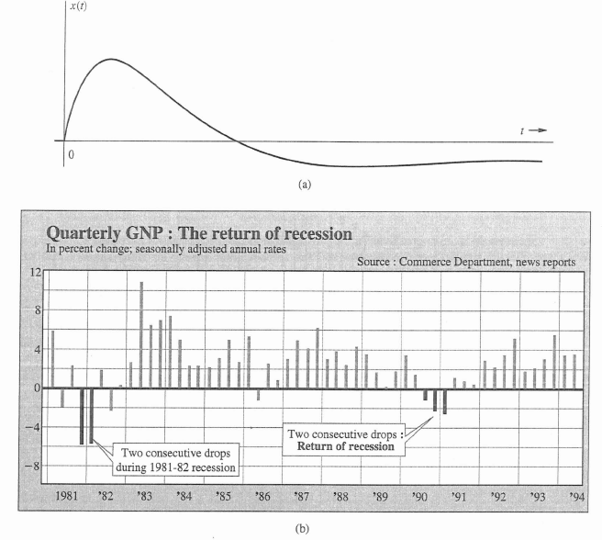
Continuous vs Discrete
Continuous-time
Discrete-time

Slide 14
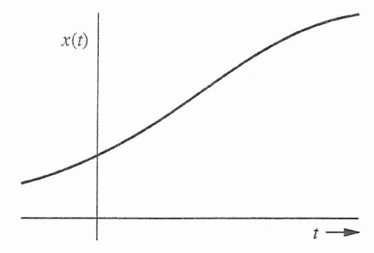
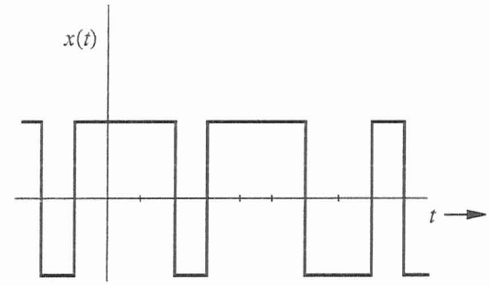
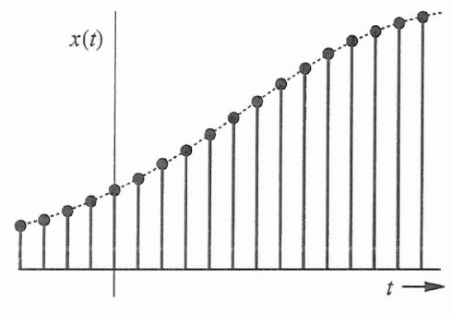
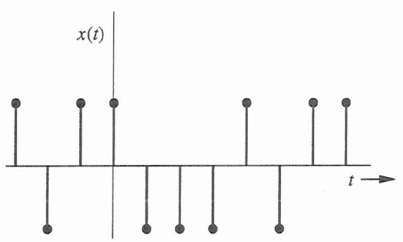
Analog vs Digital
Analog, continuous
Digital, continuous
Analog, discrete
Digital, discrete

Slide 15
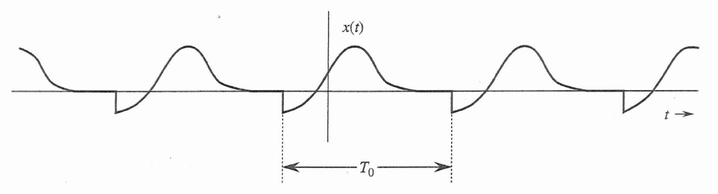
Periodic vs Aperiodic
A signal x(t) is said to be periodic if for some positive constant T_{o}
x(t) = x (t+T_{o}) for all t
The smallest value of T_{o} that satisfies the periodicity condition of this equation is the fundamental period of x(t).

Slide 16
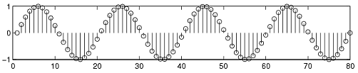

Deterministic vs Random
Deterministic
Random

Slide 17
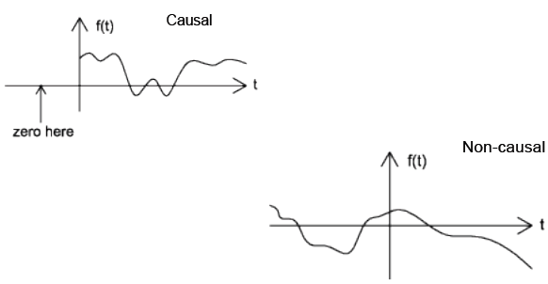
Causal vs Non-causal

Slide 18
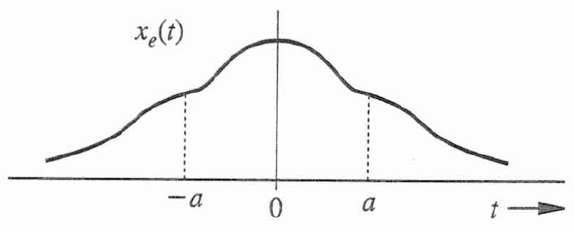
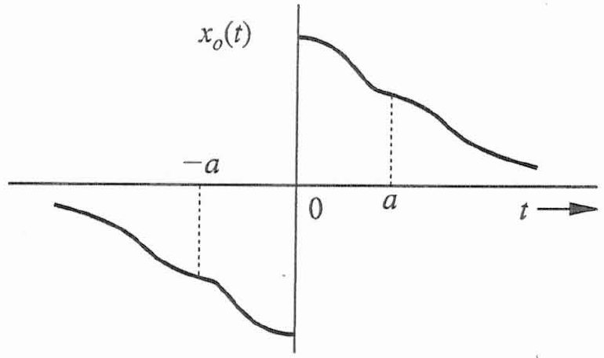
Even and Odd Functions
A real function x_{e}(t) is said to be an even function of t if
x_{e}(t) = x_{e}(-t)
A real function x_{o}(t) is said to be an odd function of t if
x_{o}(t) = -x_{o}(-t)

Slide 19
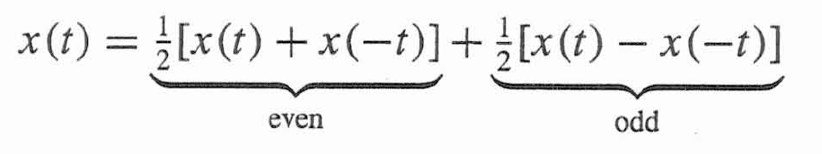
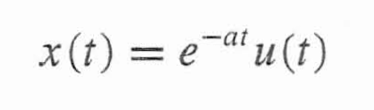
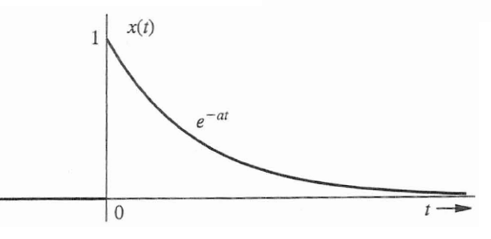
Even and Odd Function
Even and odd functions have the following properties:
• Even x Odd = Odd
• Odd x Odd = Even
• Even x Even = Even
Every signal x(t) can be expressed as a sum of even and
odd components because:
Example: Consider the causal exponential function

Slide 20
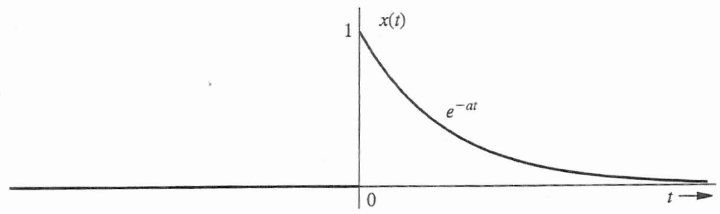


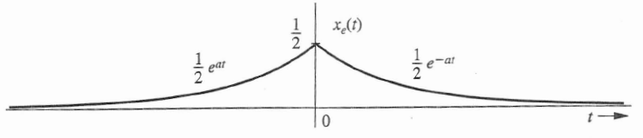
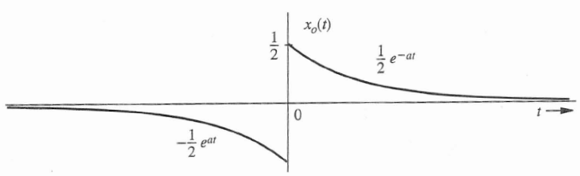

Even and Odd Function
Example: Consider the causal exponential function

Slide 21
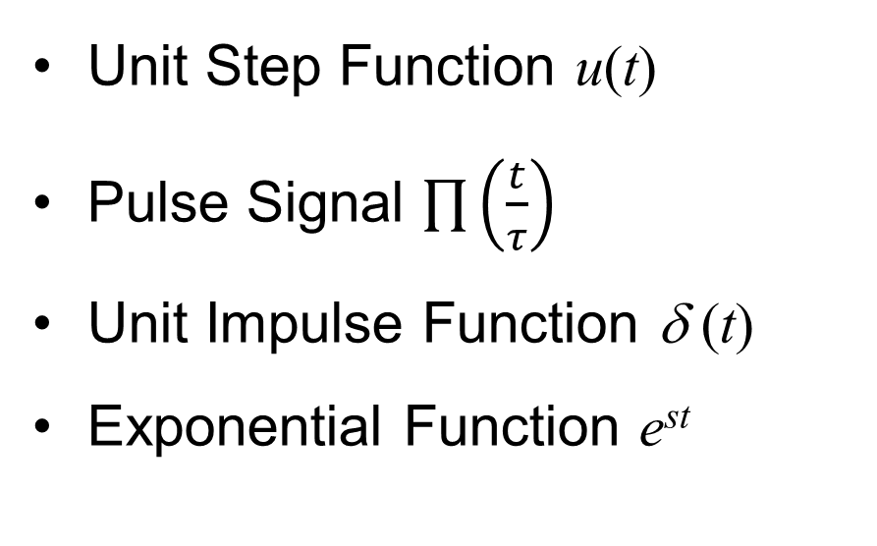
Signal Models
Unit Step Function u(t)
Pulse Signal $\prod{\left(\frac{t}{τ}\right)}$
Unit Impulse Function δ (t)
Exponential Function e^{st}

Slide 22
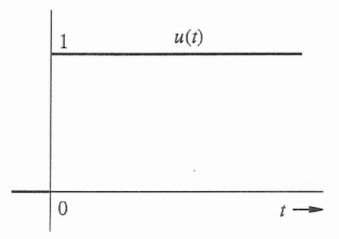
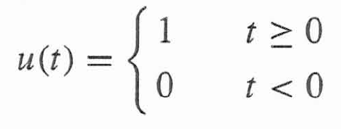
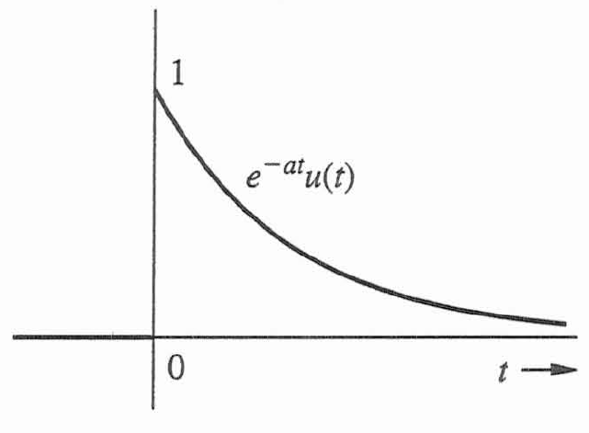
Unit Step Function u(t)
Step function defined by:
Useful to describe a signal that begins at t = 0 (i.e. causal signal).
For example, the signal e^{-at} represents an everlasting exponential that starts at t = -∞.
The causal for of this exponential e^{-at}u(t)

Slide 23
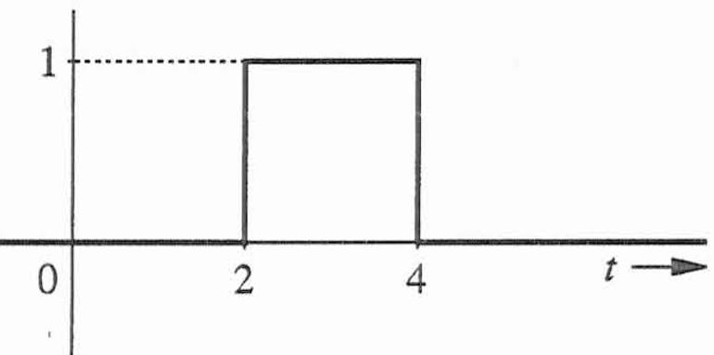
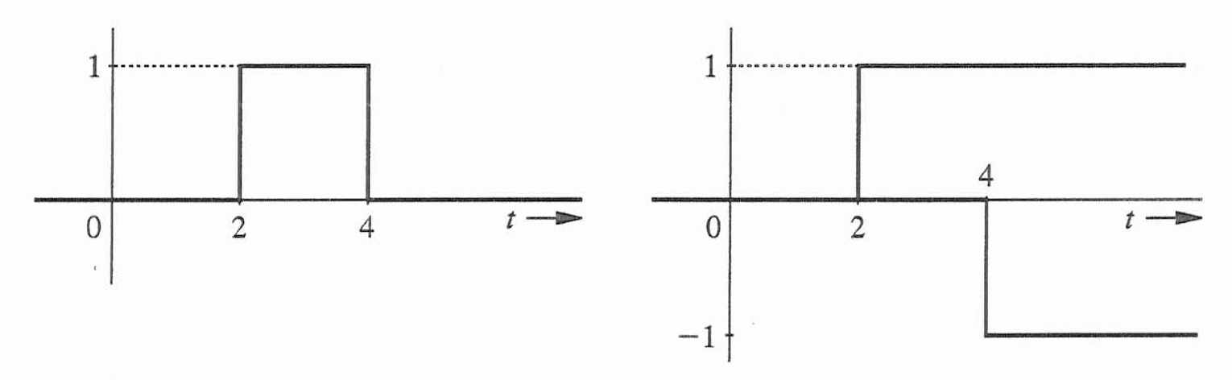
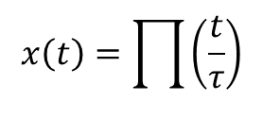
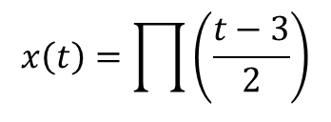


Pulse Signal
$$x\left(t\right)=\prod{\left(\frac{t}{τ}\right)}$$
$$x\left(t\right)=\prod{\left(\frac{t−3}{2}\right)}$$
$$−τ/2$$
$$τ/2$$
A pulse signal can be presented by two step functions:
x(t) = u(t-2) – u(t-4)
u(t-2)
– u(t-4)

Slide 24
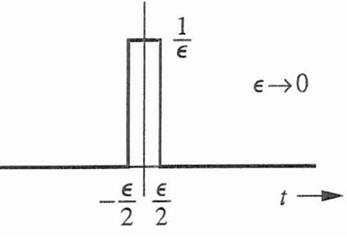
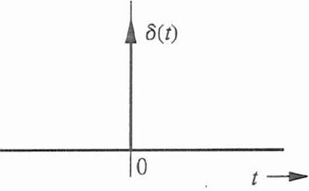
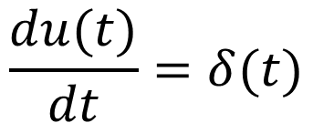
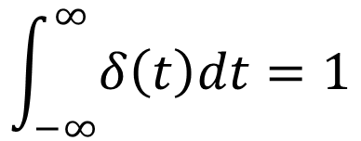

Unit Impulse Function δ(t)
First defined by Dirac as:
$$δ\left(t\right)=0 t≠0$$
$$\int_{−∞}^{∞}{δ\left(t\right)dt=1}$$
$$\frac{du(t)}{dt}=δ(t)$$

Slide 25
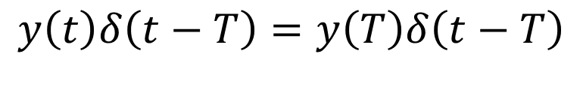
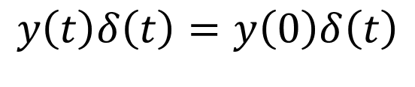
Multiplying Function φ (t) by an Impulse
Since impulse is non-zero only at t = 0, and y(t) at t = 0 is y(0), we get:
We can generalize this for t = T:
$$y\left(t\right)δ\left(t\right)=y\left(0\right)δ\left(t\right)$$
$$y\left(t\right)δ\left(t−T\right)=y\left(T\right)δ\left(t−T\right)$$

Slide 26
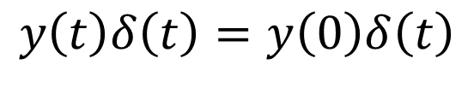
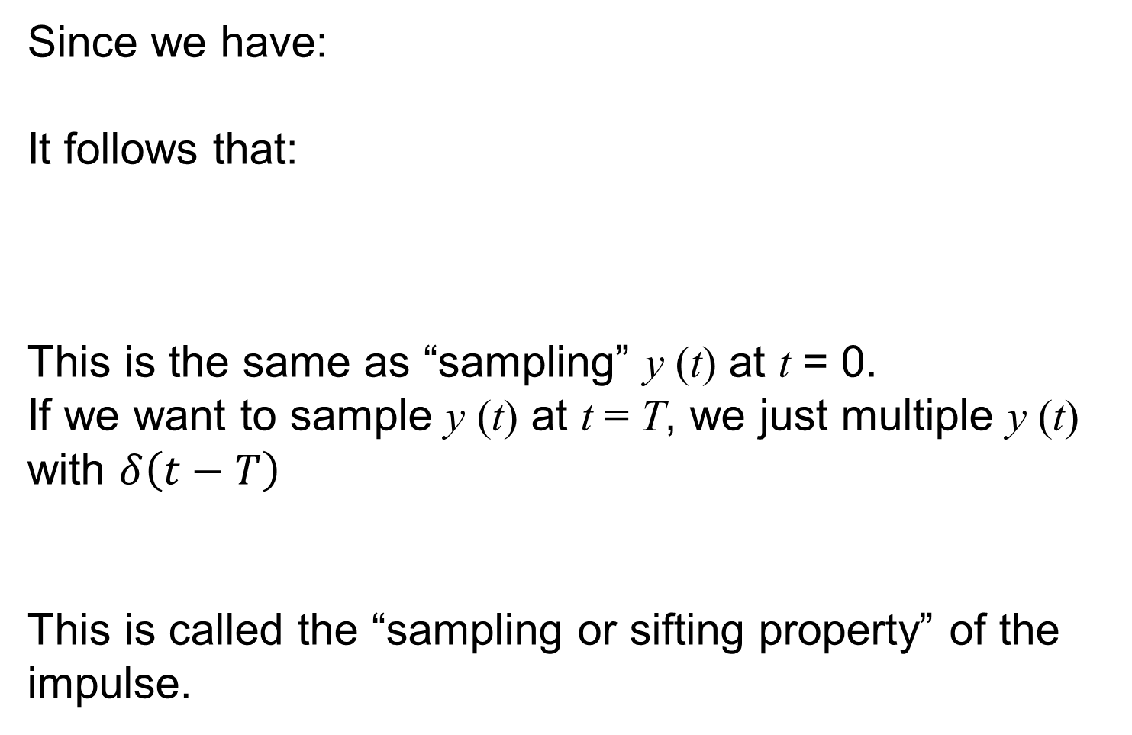
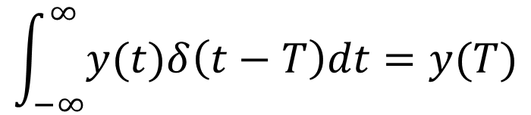
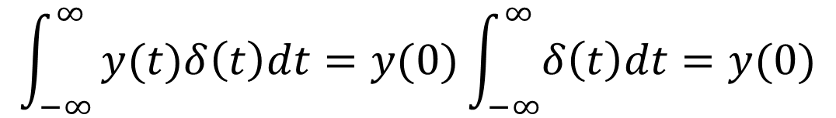
Sampling Property of Unit Impulse Function
Since we have:
It follows that:
This is the same as “sampling” y (t) at t = 0.
If we want to sample y (t) at t = T, we just multiple y (t) with $δ\left(t−T\right)$
This is called the “sampling or sifting property” of the impulse.
$$y\left(t\right)δ\left(t\right)=y\left(0\right)δ\left(t\right)$$
$$\int_{−∞}^{∞}{y(t)δ\left(t\right)dt=y(0)\int_{−∞}^{∞}{δ\left(t\right)dt}=y(0)}$$
$$\int_{−∞}^{∞}{y(t)δ\left(t−T\right)dt=y(T)}$$

Slide 27
Examples
Simplify the following expression
Evaluate the following
Find dx/dt for the following signal
x(t) = u(t-2) – 3u(t-4)

Slide 28
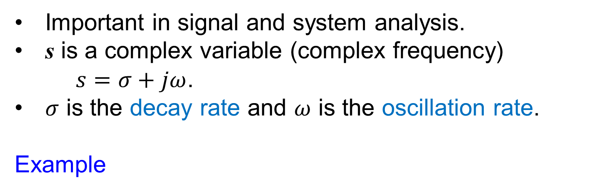
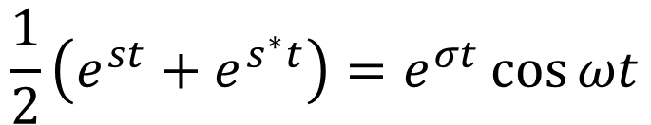
The Exponential Function e^{st}
Important in signal and system analysis.
s is a complex variable (complex frequency)
$s=σ+jω$.
$σ$ is the decay rate and $ω$ is the oscillation rate.
Example
$$e^{st}=e^{\left(σ+jω\right)t}=e^{σt}e^{jωt}=e^{σt}\left(\cos{ωt}+j sin ωt\right)$$
$$e^{s^{∗}t}=e^{\left(σ−jω\right)t}=e^{σt}e^{−jωt}=e^{σt}\left(\cos{ωt}−j sin ωt\right)$$
$$\frac{1}{2}\left(e^{st}+e^{s^{∗}t}\right)=e^{σt}\cos{ωt}$$

Slide 29
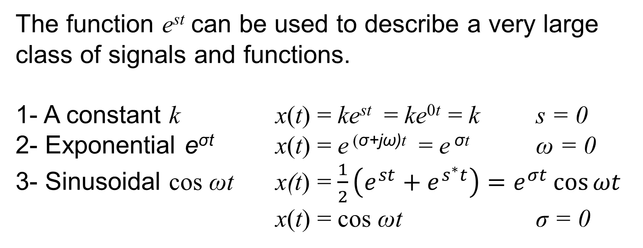
The Exponential Function e^{st}
The function e^{st} can be used to describe a very large class of signals and functions.
1- A constant k x(t) = ke^{st} = ke^{0t} = k s = 0
2- Exponential e^{σt} x(t) = e ^{(σ+jω)t} = e ^{σt} ω = 0
3- Sinusoidal cos ωt x(t) = $\frac{1}{2}\left(e^{st}+e^{s^{∗}t}\right)=e^{σt}\cos{ωt}$
x(t) = cos ωt σ = 0

Slide 30
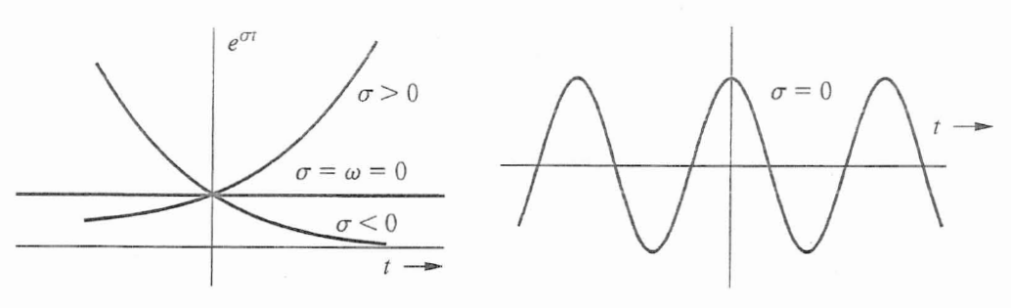
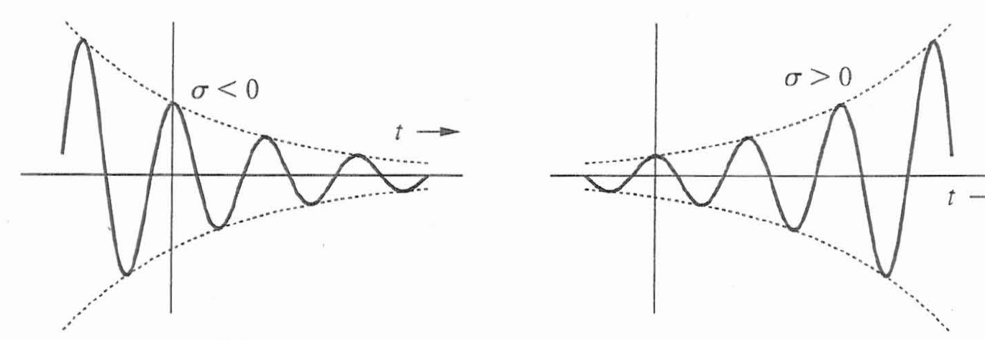
The Exponential Function e^{st}
HW1_Ch1

Slide 31
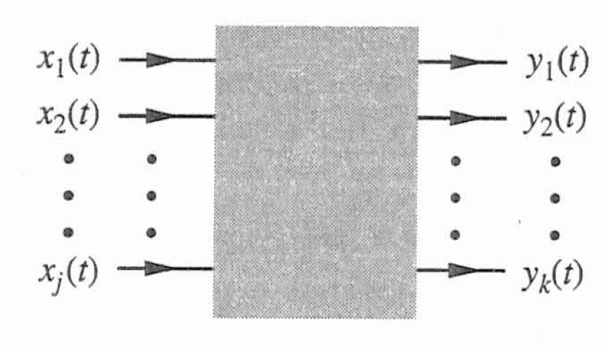
What are Systems?
Systems are used to process signals to modify or extract information
Physical system – characterized by their input-output relationships
E.g. Electrical systems are characterized by voltage-current relationships
E.g. Mechanical systems are characterized by force-displacement relationships
From this, we derive a mathematical model of the system
“Black box” model of a system:

Slide 32
Classification of Systems
Systems may be classified into:
Linear and non-linear systems
Constant parameter and time-varying-parameter systems
Instantaneous (memoryless) and dynamic (with memory) systems
Causal and non-causal systems
Continuous-time and discrete-time systems
Analog and digital systems
Invertible and noninvertible systems
Stable and unstable systems

Slide 33
Linear Systems
A linear system exhibits the additivity property:
if x₁ ---> y₁ and x₂ ----> y₂ then x₁ + x₂ ---> y₁ + y₂
It also must satisfy the homogeneity or scaling property:
if x ---> y then kx ---> ky
These can be combined into the property of superposition:
if x₁ ---> y₁ and x₂ ----> y₂ then k₁ x₁ + k₂x₂ ---> k₁ y₁ + k₂ y₂
A non-linear system is one that is NOT linear (i.e. does not obey the principle of superposition)

Slide 34
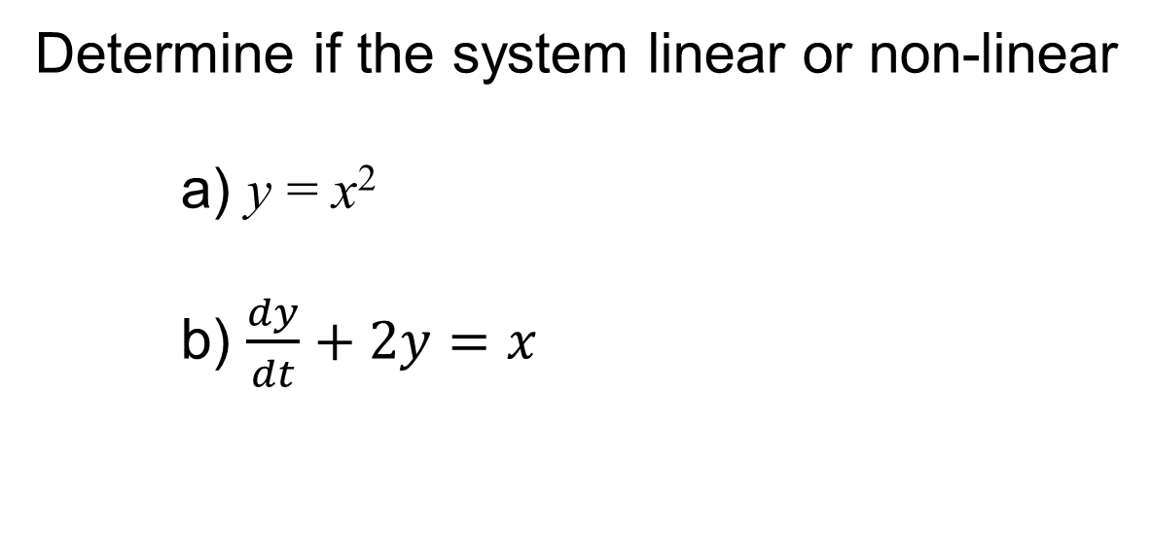
Examples
Determine if the system linear or non-linear
a) y = x²
b) $\frac{dy}{dt}+2y=x$

Slide 35
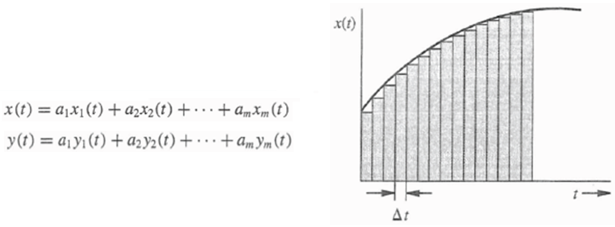
Advantage of Linear Systems
A complex input can be represented as a sum of simpler inputs (pulse, step, sinusoidal), and then use linearity to find the response to this simple inputs to find the system output to the complex input.

Slide 36
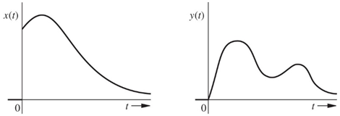
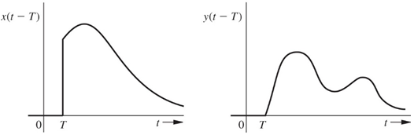

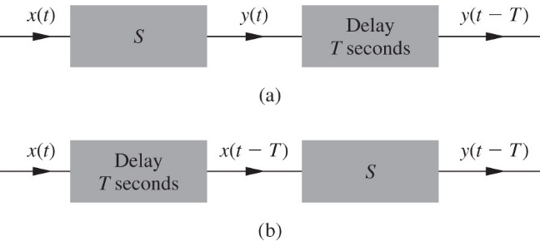
Time-Invariant System
Time-Invariant system is a system whose parameters and response do not change with time.
Method to test time-invariant

Slide 37
Example
Determine if the system is time-invariant?
(a) y(t) = 3x(t) (b) y(t) = t x(t)

Slide 38
Instantaneous and Dynamic Systems
Dynamic System: system’s output at time t depends on the current input and past input (system with memory).
Instantaneous System: system’s output at time t depends only on the current input. (memoryless system)
Which of the two systems is instantaneous?
a) y(t) = 3 x(t)
b) y(t) = 3 x(t) + x(t-1)

Slide 39
Causal and Noncausal Systems
Causal System: the output at any time instant t₀ depends only on the input x(t) for t ≤ t₀ .
Present output depends on the past and present inputs, not on future inputs.
All practical real time system must be causal system since it cannot predict future input and produce an output based on future input.
Which of the two systems is causal?
a) y(t) = 3 x(t-2)
b) y(t) = 3 x(t+2)

Slide 40


Analog and Digital Systems
Analog System: Input is continuous and the output is continuous
Digital System: Input is discrete, and the output is discrete

Slide 41

Invertible and Noninvertible
Let S₁ be a system whose output is y(t) for input x(t).
S₁ is invertible if it is possible to design a system S₂ that takes the signal y(t) as an input and produces an output that is x(t). S₂ is the inverse of S₁.
System S₁ is invertible if it produces a unique output for every unique input, one to one mapping of the inputs to the outputs.
Which of the two systems is invertible?
a) y(t) = x²
b) y = 2x

Slide 42
System External Stability (BIBO)
System is externally stable if for bounded input it gives bounded output.

Slide 43



System Model
Many biological, electrical, and mechanical system can be modeled by a differential equation that relates the input x(t) to the output y(t).
The next task in coming chapters is to solve the differential equation to find the output y(t) for specific input x(t).

Slide 44

Electrical System
i(t)
+ v(t) -
R
+
v(t)
-
i(t)
i(t)
+ v(t) -
$$v\left(t\right)= \frac{1}{C}\int_{−∞}^{t}{i\left(t\right)dt}$$
v : Voltage
i : Current
R : Resistor
C : Capacitor
L : Inductor

Slide 45






Example
Find the input-output relationship for the electrical system shown below. The input is the voltage x(t), and the output is the current y(t).
$$\frac{d}{dt}=D$$
$$\frac{d^{2}}{{dt}^{2}}=D^{2}$$
$$D^{2}y+\frac{R}{L}Dy+\frac{1}{LC}y=\frac{1}{L}Dx$$
$$V_{L}+V_{R}+V_{C}=x(t)$$
D²y + 3Dy + 2y = Dx
$$L\frac{dy(t)}{dt}+Ry\left(t\right)+\frac{1}{C}\int{y(t)dt}=x(t)$$
(D² + 3D + 2) y = (D) x
$$\frac{d^{2}y}{{dt}^{2}}+\frac{R}{L}\frac{dy}{dt}+\frac{1}{LC}y=\frac{1}{L}\frac{dx}{dt}$$
Characteristic Polynomial

Slide 46




Mechanical System
$$x(t)=M\dot{\dot{y}}(t)=M\frac{d^{2}y}{dt^{2}}$$
M : Mass
x : Force
y : Displacement
k : stiffness constant of the spring
B : Damping coefficient of the dashpot

Slide 47



Example 2
Find the input-output relationship for the transitional mechanical system shown below. The input is the force x(t), and the output is the mass position y(t).
$$x\left(t\right)−F_{s}−F_{DP}=Ma$$
$$x\left(t\right)−ky\left(t\right)−B\dot{y}\left(t\right)=M\ddot{y}(t)$$
$$\ddot{y}\left(t\right)+\frac{B}{M}\dot{y}\left(t\right)+\frac{k}{M}y\left(t\right)=\frac{1}{M}x\left(t\right)$$
HW2_Ch1

