Slide 1
Continuous-Time System Analysis Using The Laplace Transform
Dr. Mohamed Bingabr
University of Central Oklahoma

Slide 2
Outline
Laplace Transform
Properties of Laplace Transform
Solution of Differential Equations
Analysis of Electrical Networks
Block Diagrams and System Realization
Frequency Response of an LTIC System
Filter Design by Placement of Poles and Zeros of H(s)

Slide 3
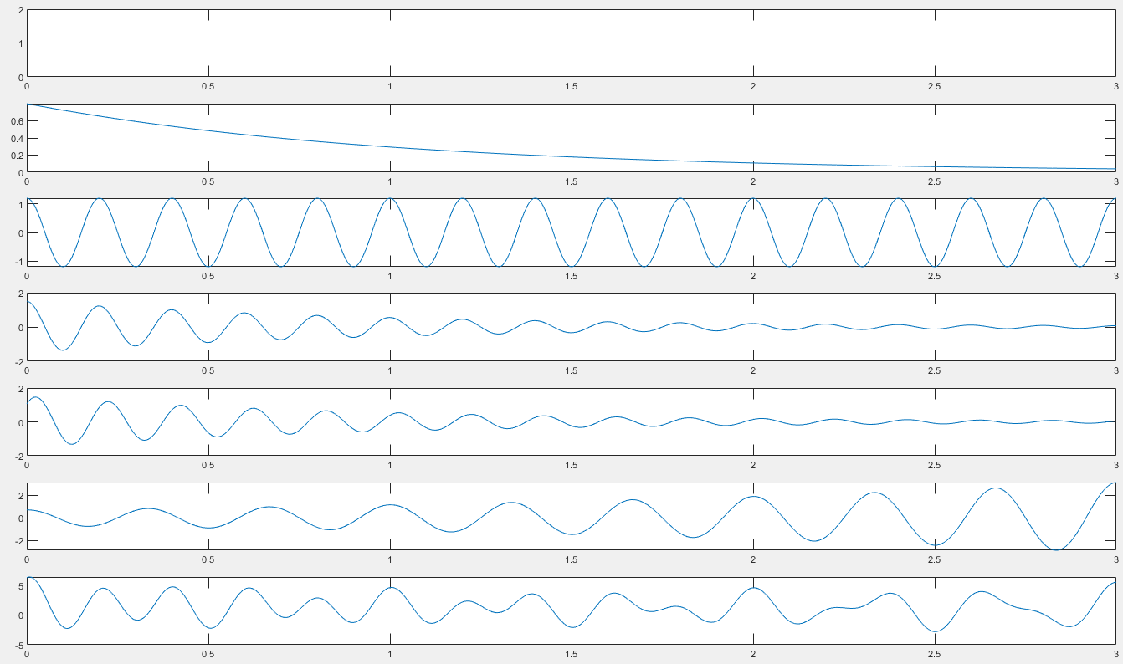









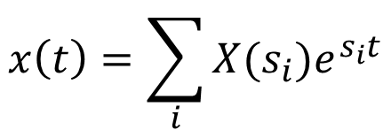
LT
$$x\left(t\right)=\sum_{i}{X(s_{i})e^{s_{i}t}}$$
s_{i} : complex frequency = σ_{i} + jω_{i}
$$x\left(t\right)$$
$$X(s)$$
σ_{i} : rate of decay
ω_{i} : rate of oscillation
$$x_{1}=e^{−0t}cos⁡(2π0t)$$
$$x_{2}=0.8 e^{−1t}cos⁡(2π0t)$$
$$x_{3}=1.2 e^{−0t}cos⁡(2π5t)$$
$$x_{4}=1.5 e^{−1t}cos⁡(2π5t)$$
$$x_{5}=1.5 e^{−1t}cos⁡(2π5t−π/4)$$
$$x_{6}=0.7 e^{0.5t}cos⁡(2π3t)$$
$${x(t)=x}_{1}+x_{2}+x_{3}+…+x_{6}$$

Slide 4
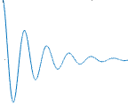
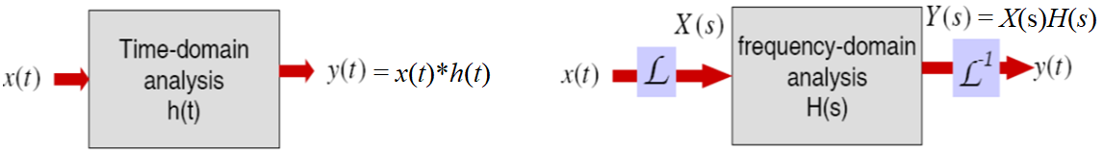
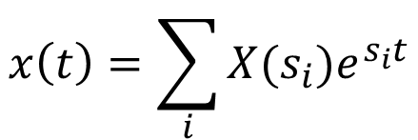
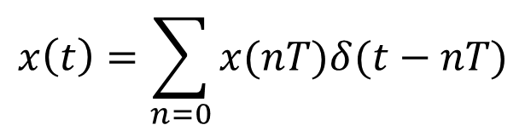
Why Laplace Transform?
Laplace transform is a mathematical tool to map signals and system behavior from the time-domain into the frequency domain.
Time Domain
Laplace Domain (frequency)
$$x\left(t\right)=\sum_{n=0}{x(nT)δ(t−nT)}$$
$$x\left(t\right)=\sum_{i}{X(s_{i})e^{s_{i}t}}$$
s_{i} : complex frequency = σ_{i} + jω_{i}
σ_{i} : rate of decay ω_{i} : rate of oscillation

Slide 5
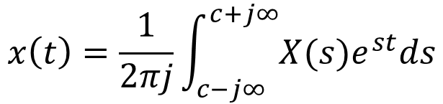
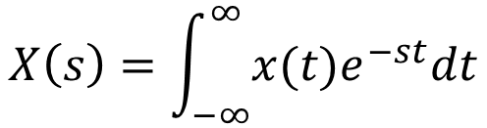
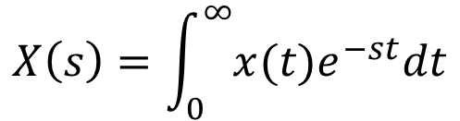
Definition of Laplace Transform
Two-sided Laplace transform of x(t)
$$X\left(s\right)=\int_{−∞}^{∞}{x(t)e^{−st}dt}$$
One-sided (unilateral) Laplace transform of causal signal x(t)
$$X\left(s\right)=\int_{0}^{∞}{x(t)e^{−st}dt}$$
Two-sided (bilateral) inverse Laplace transform of X(s)
$$x\left(t\right)=\frac{1}{2πj}\int_{c−j∞}^{c+j∞}{X(s)e^{st}ds}$$

Slide 6
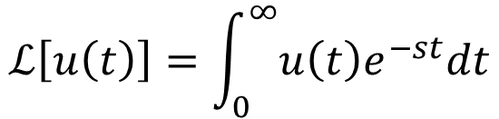
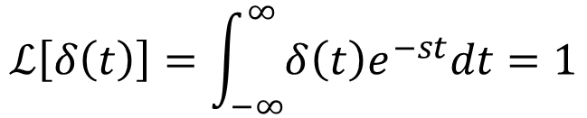
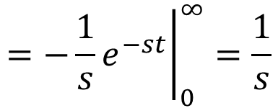
Examples of Popular Functions
Find the Laplace transform of the impulse δ(t).
$$ℒ\left[δ\left(t\right)\right]=\int_{−∞}^{∞}{δ\left(t\right)e^{−st}dt}=1$$
For all s
Find the Laplace transform of the unit step u(t).
$$ℒ\left[u\left(t\right)\right]=\int_{0}^{∞}{u\left(t\right)e^{−st}dt}$$
$$={\left.−\frac{1}{s}e^{−st}\right|}_{0}^{∞}=\frac{1}{s}$$
For Re[s]
σ > 0

Slide 7
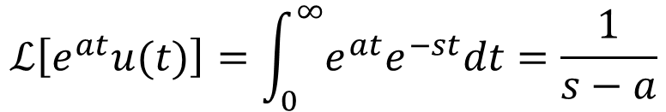
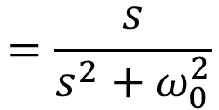
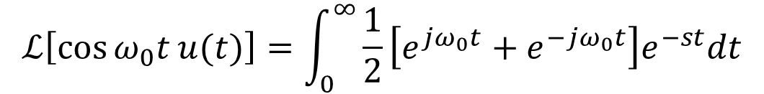
Examples of Popular Functions
Find the Laplace transform of $e^{at}u(t)$.
$$ℒ\left[e^{at}u(t)\right]=\int_{0}^{∞}{e^{at}e^{−st}dt}=\frac{1}{s−a}$$
For Re[s] > a
σ > a
Find the Laplace transform of $\cos{ω_{0}t}u(t)$.
$$ℒ\left[\cos{ω_{0}t}u(t)\right]=\int_{0}^{∞}{\frac{1}{2}\left[e^{jω_{0}t}+e^{−jω_{0}t}\right]e^{−st}dt}$$
$$=\frac{s}{s^{2}+ω_{0}^{2}}$$
For Re[s] > 0
σ > 0

Slide 8
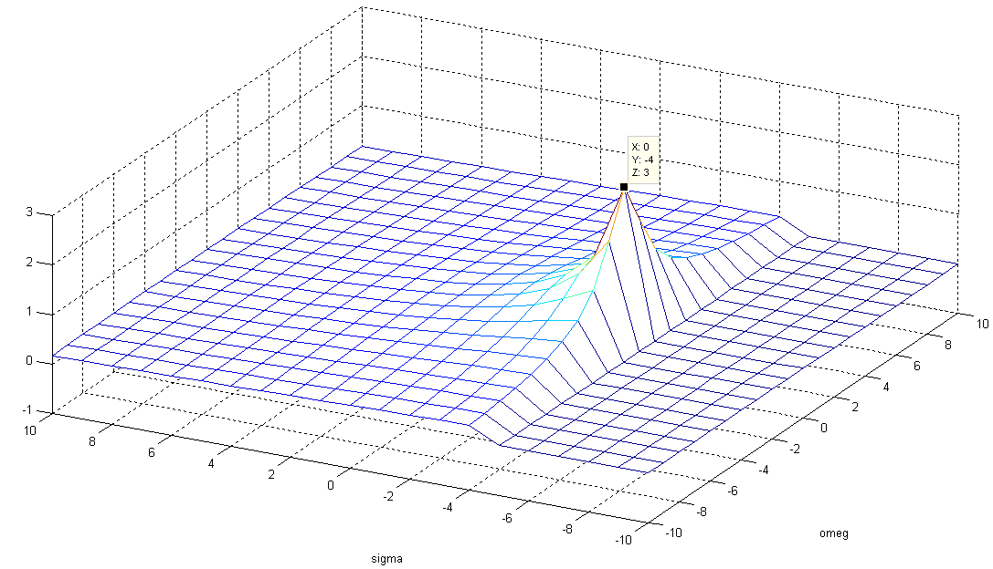
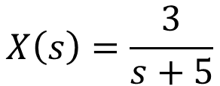
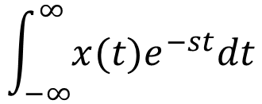
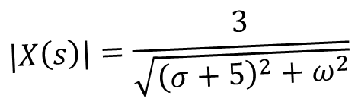
Laplace Transform
$$\int_{−∞}^{∞}{x(t)e^{−st}dt}$$
$$X\left(s\right)=\frac{3}{s+5}$$
x(t) = 3e^{-5t} u(t)
$$|X\left(s\right)|=\frac{3}{\sqrt{{\left(σ+5\right)}^{2}+ω^{2}}}$$
ω = 0
σ = -4
z =3
ω
σ
Omega
Sigma

Slide 9
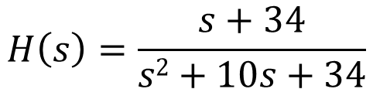

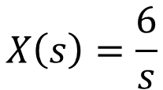



$$X\left(s\right)=\frac{6}{s}$$
$$H\left(s\right)=\frac{s+34}{s2+10s+34}$$
$$Y\left(s\right)$$
Inverse Laplace Transform
By Partial Fraction Expansion & the Table
$$x\left(t\right)=6u(t)$$
$$h\left(t\right)=10e^{−5t}cos⁡(3t+{127}^{o})u(t)$$
$$y\left(t\right)$$

Slide 10
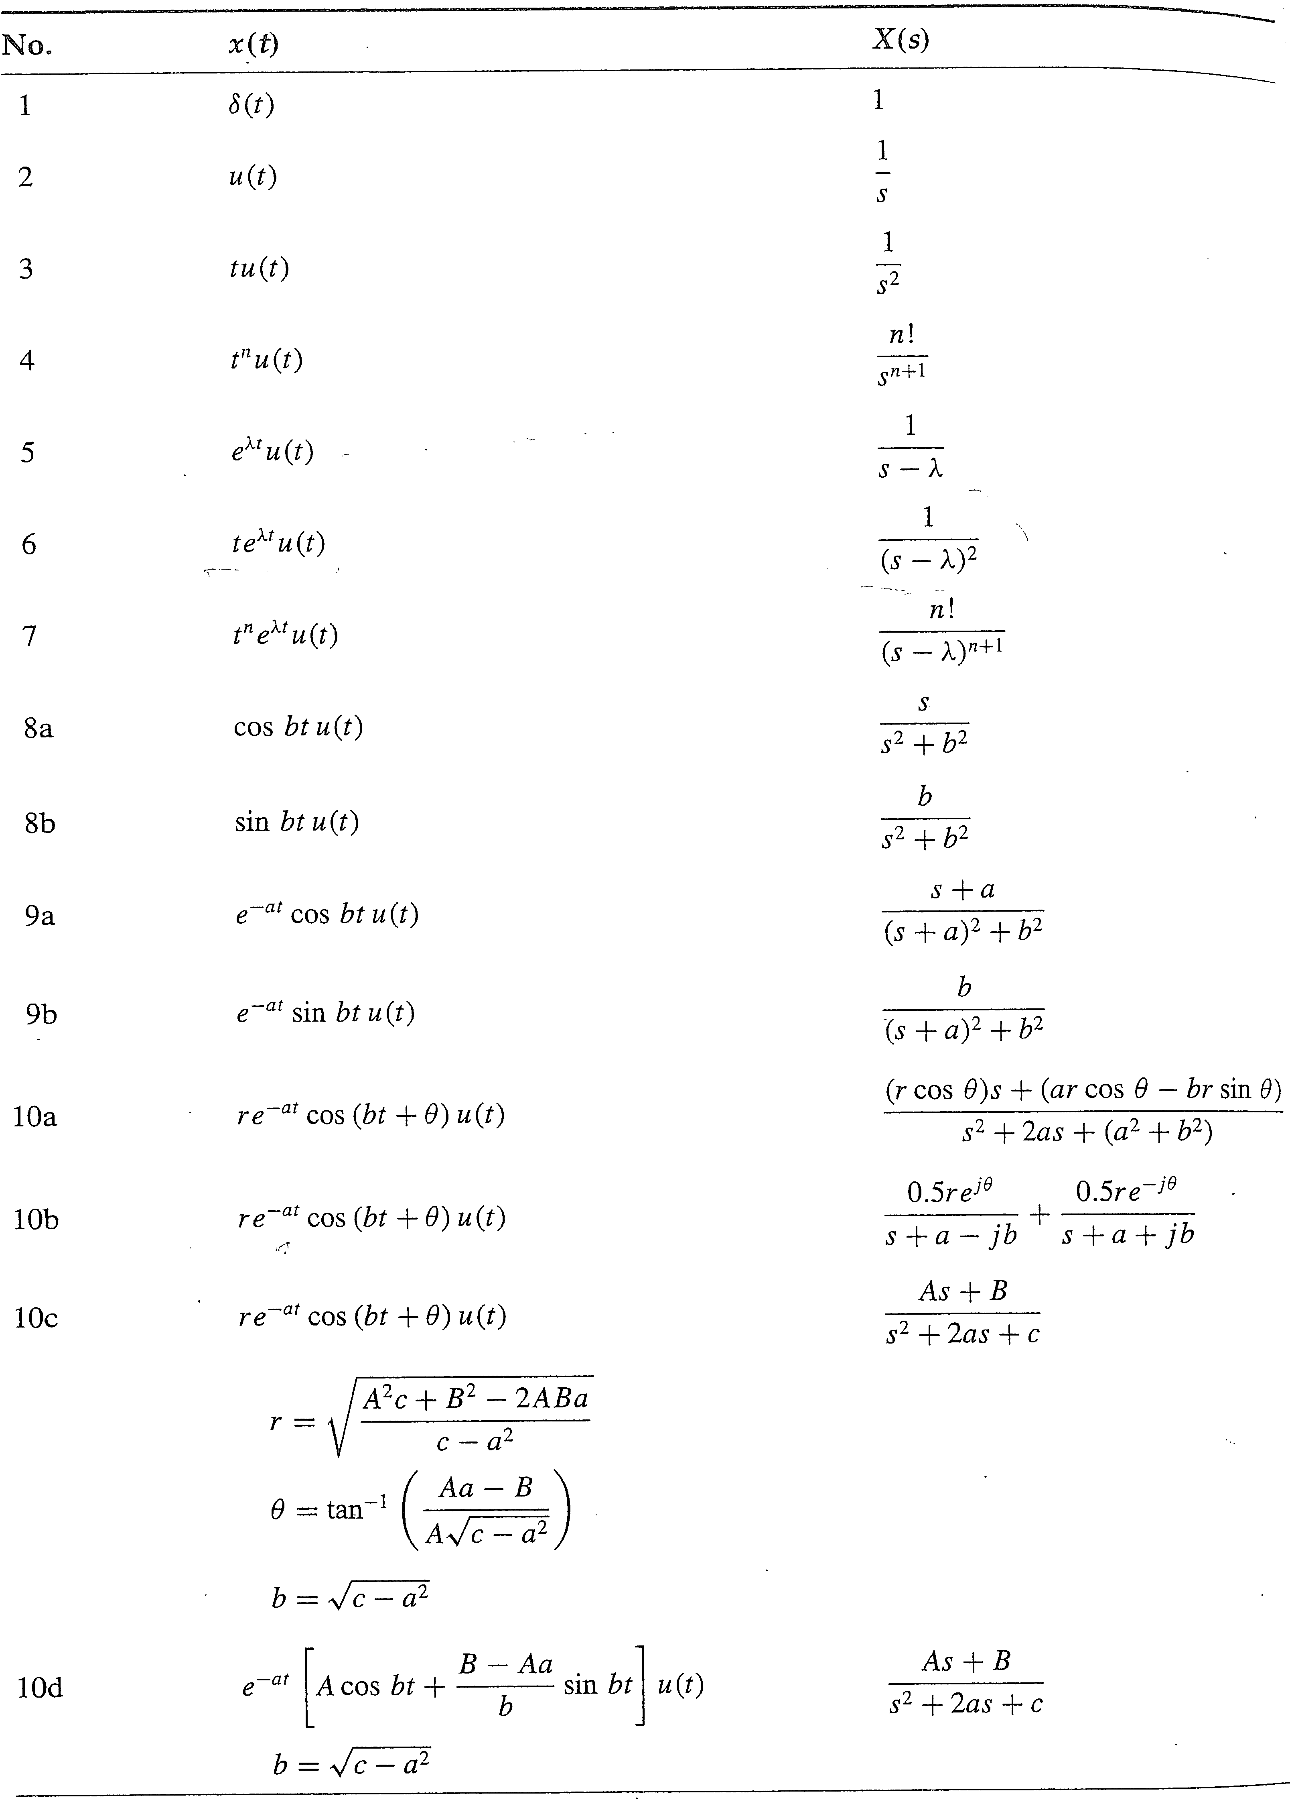
Inverse Laplace Transform
The inverse Laplace transform, finding x(t) from X(s), involves integration in the complex plane that is not covered in this class.
Partial fractions expansion, Laplace properties, and the table will be used to find the inverse Laplace transform.

Slide 11

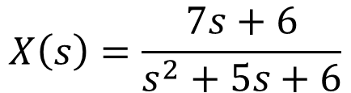
Example 1 of Inverse Laplace Transform
Use partial fraction expansion to find the inverse Laplace transform of
$$X\left(s\right)=\frac{7s+6}{s^{2}+5s+6}$$
Answer:
$$x\left(t\right)=\left[−8e^{−2t}+15e^{−3t}\right]u(t)$$

Slide 12

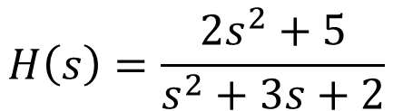
Example 2 of Inverse Laplace Transform
Use partial fraction expansion to find the inverse Laplace transform of
$$H\left(s\right)=\frac{2s^{2}+5}{s^{2}+3s+2}$$
Answer:
$$h\left(t\right)=2δ\left(t\right)+\left[7e^{−t}−13e^{−2t}\right]u(t)$$

Slide 13
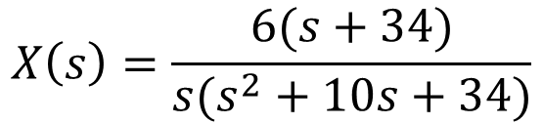
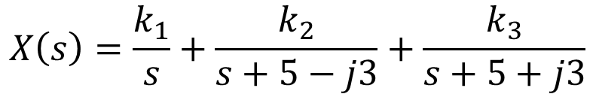
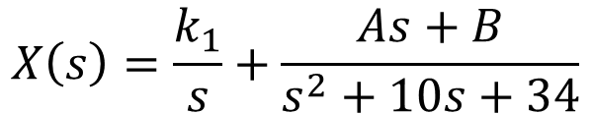
Example 3 of Inverse Laplace Transform
Use partial fraction expansion to find the inverse Laplace transform of
$$X\left(s\right)=\frac{6(s+34)}{s(s^{2}+10s+34)}$$
$$X\left(s\right)=\frac{k_{1}}{s}+\frac{k_{2}}{s+5−j3}+\frac{k_{3}}{s+5+j3}$$
$$X\left(s\right)=\frac{k_{1}}{s}+\frac{As+B}{s^{2}+10s+34}$$
Answer:
$$x\left(t\right)=\left[6+10e^{−5t}cos⁡(3t+{126.9}^{o})\right]u(t)$$

Slide 14

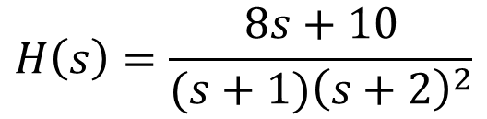
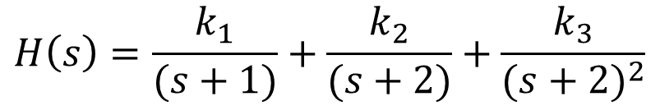
Example 4 of Inverse Laplace Transform
Use partial fraction expansion to find the inverse Laplace transform of
$$H\left(s\right)=\frac{8s+10}{(s+1){\left(s+2\right)}^{2}}$$
$$H\left(s\right)=\frac{k_{1}}{(s+1)}+\frac{k_{2}}{(s+2)}+\frac{k_{3}}{{(s+2)}^{2}}$$
Answer:
$$h\left(t\right)=\left[2e^{−t}−2e^{−2t}+6te^{−2t}\right]u(t)$$

Slide 15
Properties of The Laplace Transform

Slide 16













Linearity Property
Laplace Transform
$$\int_{−∞}^{∞}{x(t)e^{−st}dt}$$
$$x\left(t\right)$$
$$X\left(s\right)$$
$$x\left(t\right)$$
$$X\left(s\right)$$
If
$$x1\left(t\right)$$
$$X1\left(s\right)$$
and
$$x2\left(t\right)$$
$$X2\left(s\right)$$
then
$$a x1\left(t\right)$$
$$a X1\left(s\right)$$
$$a x1\left(t\right)+b x2\left(t\right)$$
$$a X1\left(s\right)+b X2\left(s\right)$$

Slide 17


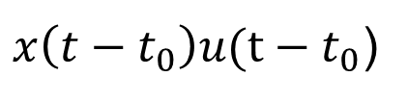

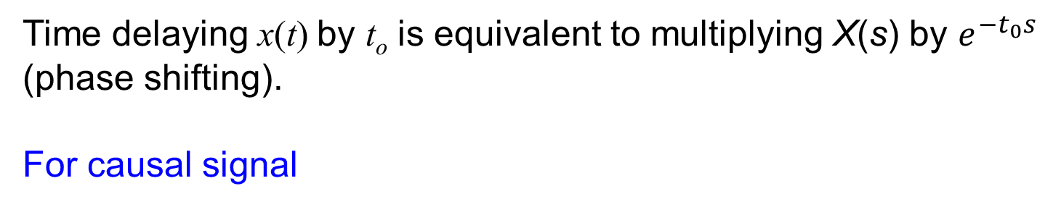




Time Shifting Property
$$x\left(t\right)$$
$$X\left(s\right)$$
$$x\left(t−t_{0}\right)$$
$$X\left(s\right)e^{−t_{0}s}$$
Time delaying x(t) by t_{o} is equivalent to multiplying X(s) by $e^{−t_{0}s}$ (phase shifting).
For causal signal
$$x\left(t\right)u(t)$$
$$X\left(s\right)$$
$x\left(t−t_{0}\right)u(t−t_{0}$)
$$X\left(s\right)e^{−t_{0}s}$$

Slide 18
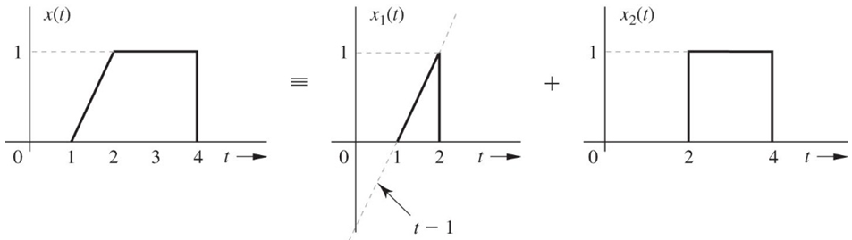

Example: Time Shifting Property
Find the Laplace transform of the signal x(t)
Answer:
$$X\left(s\right)=\frac{1}{s^{2}}e^{−s}−\frac{1}{s^{2}}e^{−2s}\frac{1}{s}e^{−4s}$$

Slide 19
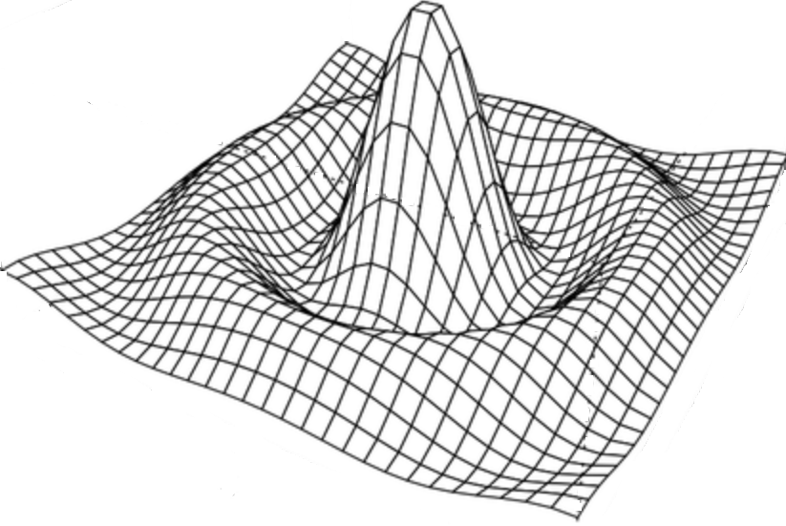

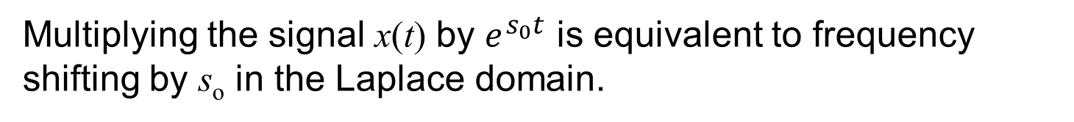











Frequency Shifting Property
$$x\left(t\right)$$
$$X\left(s\right)$$
$$x\left(t\right)e^{s_{o}t}$$
$$X\left(s−s_{o}\right)$$
Multiplying the signal x(t) by $e^{s_{0}t}$ is equivalent to frequency shifting by s_{o} in the Laplace domain.
$$x\left(t\right)$$
$$σ_{0}$$
$$s_{o}$$
$$t$$
$$jω$$
$$ω_{0}$$
$$jω$$
$$σ$$
$$σ$$

Slide 20

Example: Frequency Shifting Property
Find the Laplace transform of $e^{−at}cos(bt) u(t)$
Answer:
$$X\left(s\right)=\frac{s+a}{{(s+a)}^{2}+b^{2}}$$

Slide 21

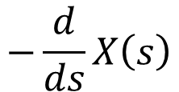





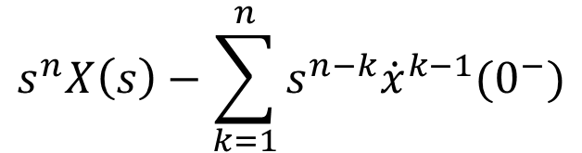

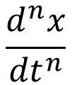


Time-Differentiation Property
$$x\left(t\right)$$
$$X\left(s\right)$$
$$\frac{dx}{dt}$$
$$sX\left(s\right)−x(0^{−})$$
$$\frac{d^{2}x}{{dt}^{2}}$$
$$s^{2}X\left(s\right)−sx\left(0^{−}\right)−\dot{x}(0^{−})$$
$$\frac{d^{3}x}{{dt}^{3}}$$
$$s^{3}X\left(s\right)−s^{2}x\left(0^{−}\right)−s\dot{x}\left(0^{−}\right)−\ddot{x} (0^{−})$$
$$\frac{d^{n}x}{{dt}^{n}}$$
$$s^{n}X\left(s\right)−\sum_{k=1}^{n}{s^{n−k}{\dot{x}}^{k−1}(0^{−})}$$
$$−\frac{d}{ds}X\left(s\right)$$
Frequency-differentiation property
$$tx\left(t\right)$$

Slide 22
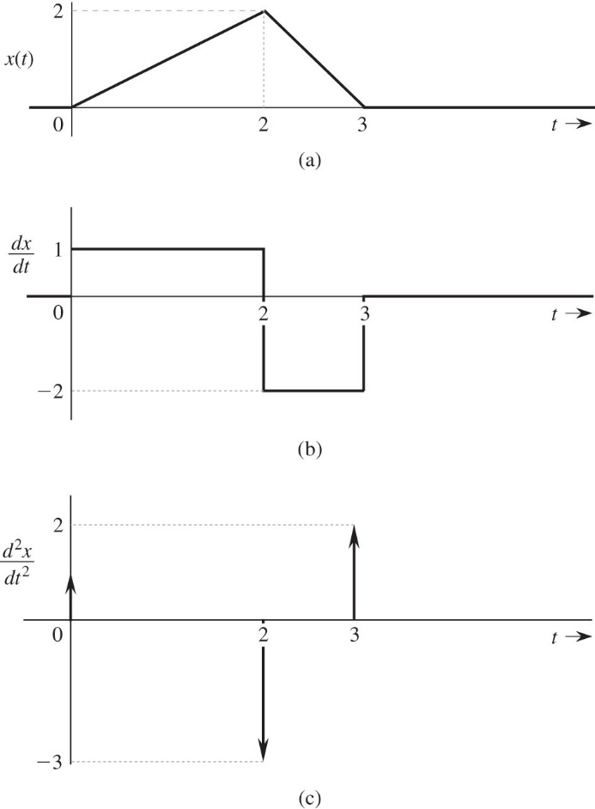
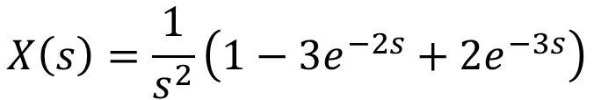
Example: Time Differentiation Property
Find the Laplace transform of the signal x(t)
Answer:
$$X\left(s\right)=\frac{1}{s^{2}}\left(1−3e^{−2s}+2e^{−3s}\right)$$

Slide 23


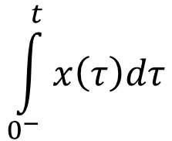
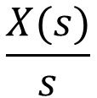
Time-Integration Property
$$x\left(t\right)$$
$$X\left(s\right)$$
$$\int_{0^{−}}^{t}{x\left(τ\right)dτ}$$
$$\frac{X(s)}{s}$$

Slide 24







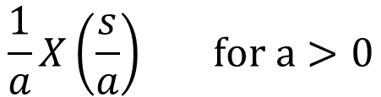


Scaling Property
$$x\left(t\right)$$
$$X\left(s\right)$$
$$\frac{1}{a}X\left(\frac{s}{a}\right) for a>0$$
$$x\left(at\right)$$
Expansion in time domain result in compression in the s (frequency) domain, and the inverse is true.
$$x\left(t\right)$$
$$x\left(0.5t\right)$$
-2
2
$$t$$
-1
1
$$t$$
$$jω$$
$$jω$$
$$σ$$
$$σ$$

Slide 25
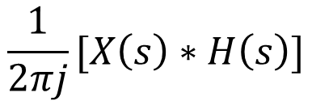







Convolution Property
Convolution in the time domain is equivalent to multiplication in the Laplace (frequency) domain.
$$x\left(t\right)$$
$$X\left(s\right)$$
$$h\left(t\right)$$
$$H\left(s\right)$$
$$x\left(t\right)∗h(t)$$
$$X\left(s\right)H(s)$$
Multiplication in the time domain is equivalent to multiplication in the Laplace (frequency) domain.
$$\frac{1}{2πj}[X\left(s\right)∗H\left(s\right)]$$
$$x\left(t\right)h(t)$$

Slide 26


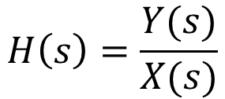
Laplace and Time Domains analysis of Systems
The convolution property is very useful in simplifying the system analysis in the Laplace domain.
Impulse Response
h(t)
x(t)
y(t)
$$y\left(t\right)=x\left(t\right)∗h(t)$$
Zero-state response. All initial conditions are zeros
Transfer Function
H(s)
X(s)
Y(s)
$$H\left(s\right)=\frac{Y(s)}{X(s)}$$
$$Y\left(s\right)=X\left(s\right)H\left(s\right)$$

Slide 27
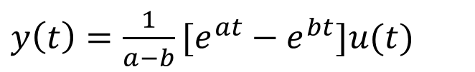
Example: Convolution Property
Find y(t) where $y\left(t\right)=e^{at}u(t)∗e^{bt}u(t)$
Answer:
$y\left(t\right)={\frac{1}{a−b}[e}^{at}−e^{bt}]u(t)$

Slide 28
Summary of Laplace Transform Properties

Slide 29
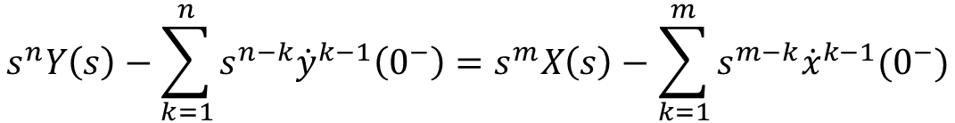



Using Laplace to Solve Differential Equations and System Analysis
Solving differential equation of third order and higher in the time domain to find the output of the system y(t) is challenging.
Solving differentials of any order in the Laplace domain is very easy since Laplace transform transfers differential equation into algebraic equation that can be easily solved to find Y(s).
If you set all initial conditions to zero then you will obtain only the zero-state response of the output y(t).
$$\frac{d^{n}y}{{dt}^{n}}=\frac{d^{m}x}{{dt}^{m}}$$
$$s^{n}Y\left(s\right)−\sum_{k=1}^{n}{s^{n−k}{\dot{y}}^{k−1}\left(0^{−}\right)}=s^{m}X\left(s\right)−\sum_{k=1}^{m}{s^{m−k}{\dot{x}}^{k−1}(0^{−})}$$
$$s^{n}Y\left(s\right)=s^{m}X\left(s\right)$$
$$Y\left(s\right)=\frac{s^{m}}{s^{n}}X\left(s\right)$$
Initial Conditions

Slide 30
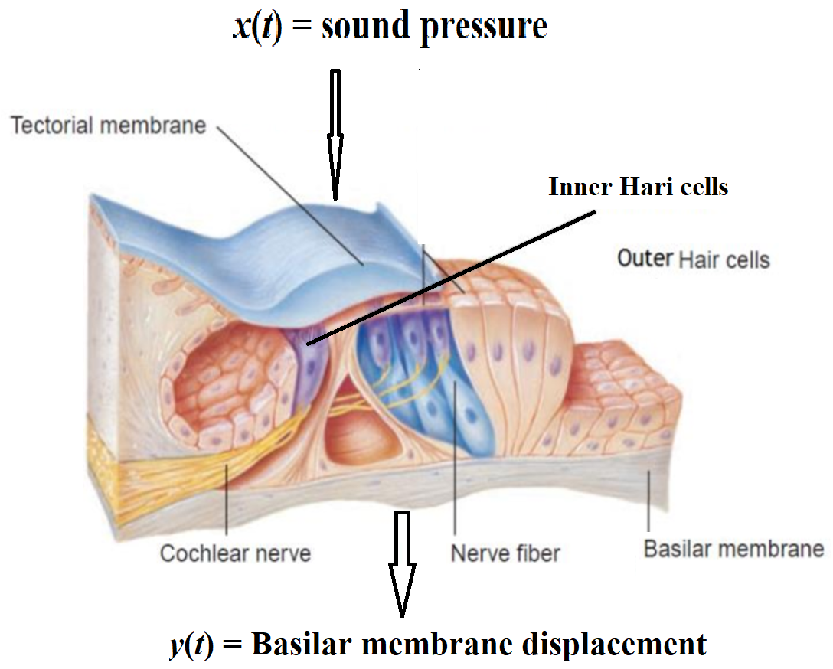
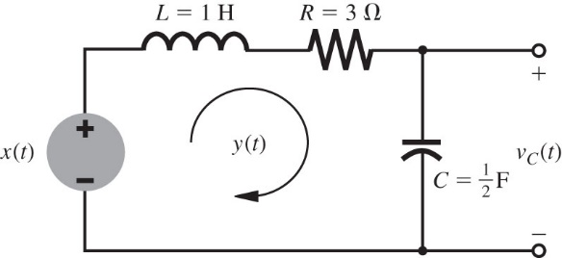
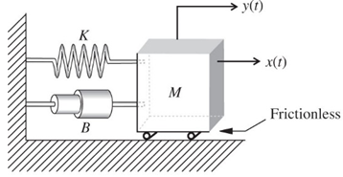


System Modeling
$$\frac{d^{2}y(t)}{{dt}^{2}}+5\frac{dy(t)}{dt}+6y\left(t\right)=\frac{dx(t)}{dt}+x(t)$$
Using Laplace to Solve Differential Equations and System Analysis
$$Y\left(s\right)=\frac{s+1}{s^{2}+5s+6}X\left(s\right) + \frac{\left(s+5\right)y\left(0\right)+\dot{y}(0)}{s^{2}+5s+6}$$
Zero State Response
Zero Input Response

Slide 31
Example
Find the transfer function H(s) of an LTIC system described by the equation
and the system response y(t) if the input x(t) = 3e^{-5t}u(t) and all the initial conditions are zero; that is the system is in the zero state (relaxed).
Answer :

Slide 32


Example: System Analysis in Laplace Domain
Solve the differential equation to find y(t)
Given that $y\left(0^{−}\right)=2$ and $\dot{y}\left(0^{−}\right)=1$ and the input $x\left(t\right)=e^{−4t}u(t)$
Make sure to show the zero-input response, the zero-state response, and the transfer function of the system H(s).
$$\frac{d^{2}y}{{dt}^{2}}+5\frac{dy}{dt}+6y\left(t\right)=\frac{dx}{dt}+x(t)$$
Answer:
$$y\left(t\right)=\left(7e^{−2t}−5e^{−3t}\right)u\left(t\right)+\left(−0.5e^{−2t}+2e^{−3t}−1.5e^{−4t}\right)u\left(t\right)$$
zero-input response
zero-state response

Slide 33


Example
In the circuit, the switch is in the closed position for a long time before t = 0, when it is opened instantaneously. Find the inductor current y(t) for t ≥ 0.
1 H
2 Ω
y(t)
$$L\frac{dy}{dt}+Ry(t)+\frac{1}{C}\int_{−∞}^{t}{y(τ)dτ=x(t)}$$
x(t)
10 V
5 Ω
0.2 F
t=0
Note: i(t) = dq/dt
Q = CV

Slide 34







Frequency Response of LTI System
H(s)
X(s)
$$\frac{s+0.1}{s+5}$$
Y(s) = H(s)X(s)
$$x\left(t\right)=\cos\left(2t\right)u(t)$$
$$s=σ+jω$$
$$y\left(t\right)=0.84e^{−5t}u\left(t\right)+0.37cos\left(2t+65.3\right)u(t)$$
H( jω)
X( jω )
$$\frac{jω+0.1}{jω+5}$$
Y( jω) =H( jω)X( jω)

Slide 35







Frequency Response of a LTI System
Transfer Function
$$s=σ+jω$$
Frequency Response
If σ = 0
$$H\left(jω\right)=\frac{2jω}{{−ω}^{2}+2jω+5}$$
$$\left|H\left(s\right)\right|=\frac{2\sqrt{σ^{2}+ω^{2}}}{\sqrt{{\left(σ^{2}−ω^{2}+2σ+5\right)}^{2}+{\left(2σω+2ω\right)}^{2}}}$$
$$\left|H\left(ω\right)\right|=\frac{2ω}{\sqrt{{\left(5−ω^{2}\right)}^{2}+{4ω}^{2}}}$$
|H(s)|
$$σ$$
$$ω$$
2.24

Slide 36









Laplace and Frequency Response of a LTI System
$$x\left(t\right)=\sum_{i}{X(s_{i})e^{s_{i}t}}$$
$$y\left(t\right)=\sum_{i}{H(s_{i})X(s_{i})e^{s_{i}t}}$$
H(s)
X(s)
$$\frac{1}{s+1}$$
Y(s)
$$Y(s_{i})$$
$$s=σ+jω$$
If σ = 0 in the complex frequency s, so s = jω then system analysis is simplified further, and it becomes frequency response.
$$y\left(t\right)=\sum_{i}{H({jω}_{i})X({jω}_{i})e^{{jω}_{i}t}}$$
$$x\left(t\right)=\sum_{i}{X({jω}_{i})e^{{jω}_{i}t}}$$
H( jω)
X( jω )
$$\frac{1}{jω+1}$$
Y( jω)
$$x\left(t\right)=Acos⁡(ω_{o}t+45o)$$
$$y\left(t\right)=\left|H(jω_{o})\right|\operatorname{Acos}\left[ω_{o}t+45o+∠H(jω_{o}\text{)}\right]$$
Amplitude Response
Phase Response

Slide 37


Example: Frequency Response
For the system described by the transfer function
$H\left(s\right)=\frac{s + 0.1}{s + 5}$
Find the frequency response H(jω), and the system response y(t) for input x(t) = cos2t and x(t) = cos(10t - 50° )
Solution
$$H(jω)=\frac{jω+0.1}{jω+5}$$
Replace s by jω
Find the Magnitude
Find the Phase

Slide 38

Magnitude and Phase of the Frequency Response
$$H(jω)=\frac{jω+0.1}{jω+5}$$
x(t) = cos2t & x(t) = cos(10t - 50° )

Slide 39
Example: Frequency Response
For input x(t)=cos2t, we have:
Therefore

Slide 40
Example: Frequency Response
For input x(t)= cos(10t - 50°), we will use the amplitude and phase response curves directly:
Therefore
$$y(t)=0.894\cos{(}10t−50^{∘}+26^{∘})=0.894\cos{(}10t−24^{∘})$$

Slide 41


Frequency Response of Ideal Delay
x(t)
Delay
T
y(t)=x(t-T)
X(s)
Y(s)= X(s) e^{-sT}
H(s) of an ideal T sec delay is:
$$H\left(s\right)=e^{−sT} H\left(jω\right)=e^{−jωT}$$
The magnitude $\left|H\left(jω\right)\right|=1$
The phase $θ\left(jω\right)=−ωT$
An ideal delay system does not effect the amplitude of the input but phase shift the input with –T gradient.
The group delay is the time delay of all frequencies $\frac{dθ}{dω}=−T$

Slide 42




Frequency Response of an Ideal Differentiator
x(t)
$$\frac{d}{dt}$$
$$y\left(t\right)=\frac{dx}{dt}$$
Y(s)= sX(s)
X(s)
H(s) of an ideal differentiator is:
$$H\left(s\right)=s H\left(jω\right)=jω=ωe^{jπ/2}$$
The magnitude $\left|H\left(jω\right)\right|=ω$
The phase is π/2
If x(t) = cosωt what is the output
Differentiators amplify inputs with high frequencies such as noise and for that it is avoided in system design.

Slide 43





Frequency Response of an ideal Integrator
x(t)
$$\int{x\left(t\right)dt}$$
$$y\left(t\right)=\int{x\left(t\right)dt}$$
$Y\left(s\right)=\frac{1}{s}$X(s)
X(s)
H(s) of an ideal integrator is:
$$H\left(s\right)=\frac{1}{s} H\left(jω\right)=\frac{1}{jω}=\frac{1}{ω}e^{−jπ/2}$$
The magnitude $\left|H\left(jω\right)\right|=1/ω$
The phase is -π/2
If x(t) = cosωt what is the output
Integrator supress inputs with high frequencies such as noise and for that it is used in system design.

Slide 44
Internal Stability
Internal Stability (Asymptotic)
  Stable if all the poles are in the LHP
  Unstable if one or both of the following conditions exist:
    At least one pole is in the RHP
    There are repeated poles on the imaginary axis
  Marginally stable if there are no poles in the RHP, and there are some unrepeated poles on the imaginary axis.

Slide 45
External Stability BIBO
The transfer function H(s) can only indicate the external stability of the system BIBO.
BIBO stable if M ≤ N and all poles are in the LHP
Example
Is the system below BIBO and asymptotically (internally) stable?
x(t)
y(t)

